Slide 1
DBSCAN, t-SNE
and UMAP
4
BDATA 412: Advanced Data Visualization
University of Washington

Slide 2

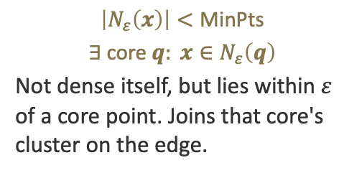
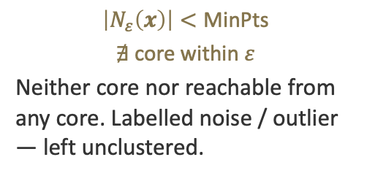
Density: Core, Border & Noise
$N_{ε}\left(x\right)=\left\{x′∈X:\left\|x−x′\right\|≤ε\right\}$ $x \text{is} \text{core} ⇔ \left|N_{ε}\left(x\right)\right|≥\text{MinPts}$
Core point
Border point
Noise point
$$\left|N_{ε}\left(x\right)\right|≥\text{MinPts}$$
Has at least MinPts points (including itself) within distance $ε$. Cores seed and grow clusters.
$$\left|N_{ε}\left(x\right)\right|<\text{MinPts}$$
$$∃ \text{core} q: x∈N_{ε}\left(q\right)$$
Not dense itself, but lies within $ε$ of a core point. Joins that core's cluster on the edge.
$$\left|N_{ε}\left(x\right)\right|<\text{MinPts}$$
$$∄ \text{core} \text{within} ε$$
Neither core nor reachable from any core. Labelled noise / outlier — left unclustered.

Slide 3
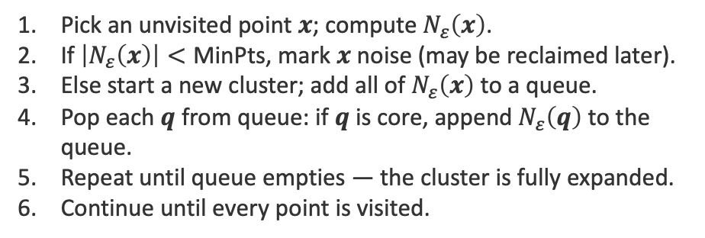
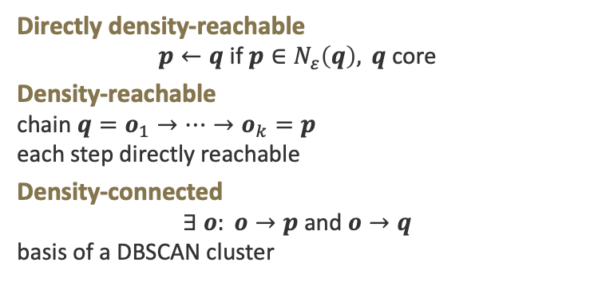
DBSCAN Algorithm
Pick an unvisited point $x$; compute $N_{ε}\left(x\right)$.
If $\left|N_{ε}\left(x\right)\right|<\text{MinPts}$, mark $x$ noise (may be reclaimed later).
Else start a new cluster; add all of $N_{ε}\left(x\right)$ to a queue.
Pop each $q$ from queue: if $q$ is core, append $N_{ε}\left(q\right)$ to the queue.
Repeat until queue empties — the cluster is fully expanded.
Continue until every point is visited.
Reachability
Directly density-reachable
$$p←q \text{if} p∈N_{ε}\left(q\right), q \text{core}$$
Density-reachable
chain $q=o_{1}→…→o_{k}=p$
each step directly reachable
Density-connected
$$∃ o: o→p \text{and} o→q$$
basis of a DBSCAN cluster

Slide 4
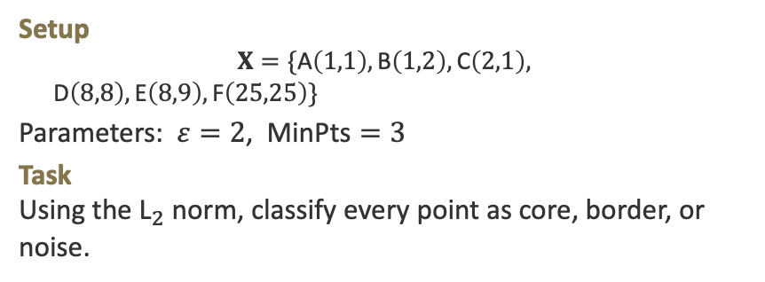

Example 1: Point Classification
EXAMPLE
Setup
$$X=\{\text{A}\left(1,1\right),\text{B}\left(1,2\right),\text{C}\left(2,1\right),$$
$\text{D}\left(8,8\right),\text{E}\left(8,9\right),\text{F}\left(25,25\right)\}$
Parameters: $ε=2$, $\text{MinPts}=3$
Task
Using the ${\text{L}}_{2}$ norm, classify every point as core, border, or noise.
Solution
$$\text{A}: N_{ε}=\{\text{A},\text{B},\text{C}\}→\left|3\right|≥3 \text{CORE}$$
$$\text{B}: N_{ε}=\{\text{A},\text{B},\text{C}\}→\left|3\right|≥3 \text{CORE}$$
$$\text{C}: N_{ε}=\{\text{A},\text{B},\text{C}\}→\left|3\right|≥3 \text{CORE}$$
$$\text{D}: N_{ε}=\{\text{D},\text{E}\}→\left|2\right|<3$$
$$\text{E}: N_{ε}=\{\text{D},\text{E}\}→\left|2\right|<3$$
$$\text{D},\text{E} \text{both} <3, \text{no} \text{core} → \text{NOISE}$$
$$\text{F}: N_{ε}=\{\text{F}\}→\left|1\right|<3 \text{NOISE}$$
Cluster 1 = $\left\{\text{A},\text{B},\text{C}\right\}$; D, E, F are noise (too sparse at $ε=2$).

Slide 5
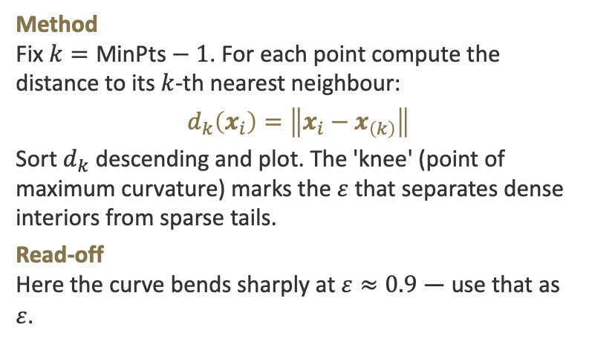
Example 2: Choosing ε (k-distance)
EXAMPLE
Method
Fix $k=\text{MinPts}−1$. For each point compute the distance to its $k$-th nearest neighbour:
$$d_{k}\left(x_{i}\right)=\left\|x_{i}−x_{\left(k\right)}\right\|$$
Sort $d_{k}$ descending and plot. The 'knee' (point of maximum curvature) marks the $ε$ that separates dense interiors from sparse tails.
Read-off
Here the curve bends sharply at $ε≈0.9$ — use that as $ε$.

Slide 6
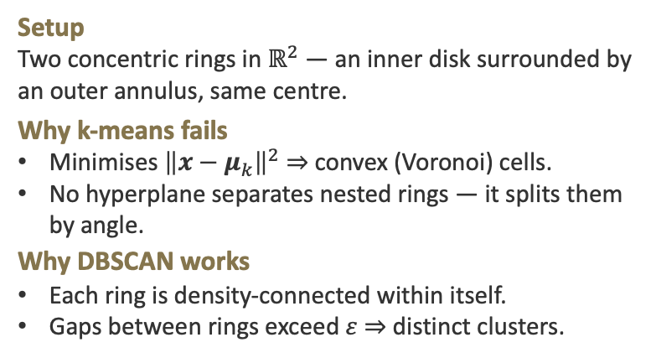

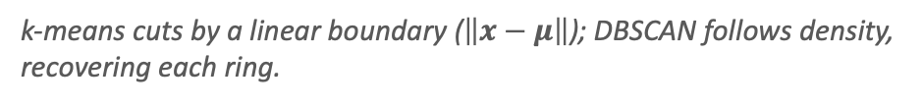
Example 3: Non-Convex Shapes
EXAMPLE
Setup
Two concentric rings in $ℝ^{2}$ — an inner disk surrounded by an outer annulus, same centre.
Why k-means fails
Minimises ${\left\|x−μ_{k}\right\|}^{2}$ ⇒ convex (Voronoi) cells.
No hyperplane separates nested rings — it splits them by angle.
Why DBSCAN works
Each ring is density-connected within itself.
Gaps between rings exceed $ε$ ⇒ distinct clusters.
k-means ($k=2$)
DBSCAN
k-means cuts by a linear boundary ($\left\|x−μ\right\|$); DBSCAN follows density, recovering each ring.

Slide 7
DBSCAN — Exercises
E1
E1 Given $X=\{\left(0,0\right),\left(0,1\right),\left(1,0\right),\left(1,1\right),\left(5,5\right)\}$ with $ε=1.5$, $\text{MinPts}=3$, label each point core / border / noise using the ${\text{L}}_{2}$ norm.
E2
E2 A point $p$ has $\left|N_{ε}\left(p\right)\right|=2<\text{MinPts}$ but lies within $ε$ of a core $q$. Prove $p$ is a border point and assign its cluster. State the reachability definition you use.
E3
E3 Explain, using ${\left\|x−μ_{k}\right\|}^{2}$ vs density-connectivity, why DBSCAN finds two clusters on concentric rings while k-means ($k=2$) cannot. When would DBSCAN itself fail?

Slide 8
04
t-SNE
t-Distributed Stochastic Neighbor Embedding

Slide 9
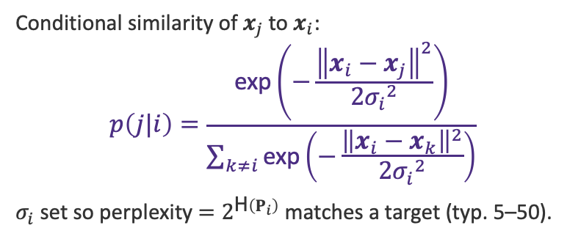
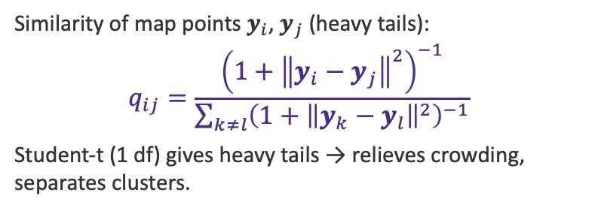
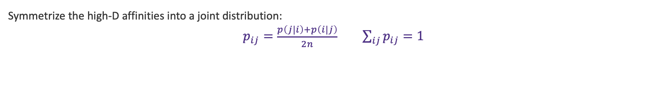
t-SNE: High-D vs Low-D Affinities
High-dimensional (Gaussian)
Low-dimensional (Student-t)
Conditional similarity of $x_{j}$ to $x_{i}$:
$$p\left(j|i\right)=\frac{\text{exp}\left(−\frac{{\left\|x_{i}−x_{j}\right\|}^{2}}{2{σ_{i}}^{2}}\right)}{\sum_{k≠i}{\text{exp}\left(−\frac{{\left\|x_{i}−x_{k}\right\|}^{2}}{2{σ_{i}}^{2}}\right)}}$$
$σ_{i}$ set so perplexity $=2^{\text{H}\left(P_{i}\right)}$ matches a target (typ. 5–50).
Similarity of map points $y_{i}$, $y_{j}$ (heavy tails):
$$q_{ij}=\frac{{\left(1+{\left\|y_{i}−y_{j}\right\|}^{2}\right)}^{−1}}{\sum_{k≠l}{{\left(1+{\left\|y_{k}−y_{l}\right\|}^{2}\right)}^{−1}}}$$
Student-t (1 df) gives heavy tails → relieves crowding, separates clusters.
Symmetrize the high-D affinities into a joint distribution:
$p_{ij}=\frac{p\left(j|i\right)+p\left(i|j\right)}{2n}$ $\sum_{ij}{p_{ij}}=1$

Slide 10


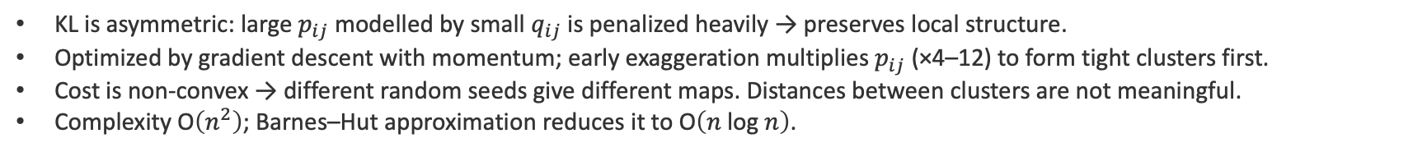
t-SNE: Cost & Gradient
Minimize the Kullback–Leibler divergence between the joint distributions $P$ and $Q$:
$$C=\text{KL}\left(P‖Q\right)=\sum_{i}{\sum_{j}{p_{ij} \text{log}\left(\frac{p_{ij}}{q_{ij}}\right)}}$$
$$\frac{∂C}{∂y_{i}}=4\sum_{j}{\left(p_{ij}−q_{ij}\right)\left(y_{i}−y_{j}\right){\left(1+{\left\|y_{i}−y_{j}\right\|}^{2}\right)}^{−1}}$$
KL is asymmetric: large $p_{ij}$ modelled by small $q_{ij}$ is penalized heavily → preserves local structure.
Optimized by gradient descent with momentum; early exaggeration multiplies $p_{ij}$ (×4–12) to form tight clusters first.
Cost is non-convex → different random seeds give different maps. Distances between clusters are not meaningful.
Complexity $\text{O}\left(n^{2}\right)$; Barnes–Hut approximation reduces it to $\text{O}\left(n \text{log} n\right)$.

Slide 11
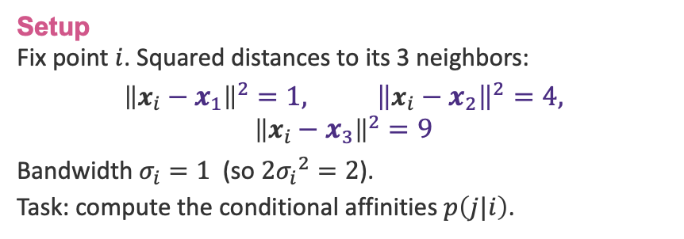

Example 1: Computing an Affinity
EXAMPLE
Setup
Fix point $i$. Squared distances to its 3 neighbors:
$${\left\|x_{i}−x_{1}\right\|}^{2}=1, {\left\|x_{i}−x_{2}\right\|}^{2}=4,$$
$${\left\|x_{i}−x_{3}\right\|}^{2}=9$$
Bandwidth $σ_{i}=1$ (so $2{σ_{i}}^{2}=2$).
Task: compute the conditional affinities $p\left(j|i\right)$.
Solution
Unnormalized weights $\text{exp}\left(−\frac{d^{2}}{2}\right)$:
$$w_{1}=e^{−0.5}=0.607$$
$$w_{2}=e^{−2}=0.135, w_{3}=e^{−4.5}=0.011$$
Sum $Z=0.753$.
$$p\left(1|i\right)=\frac{0.607}{0.753}=0.806$$
$$p\left(2|i\right)=\frac{0.135}{0.753}=0.179$$
$$p\left(3|i\right)=\frac{0.011}{0.753}=0.015$$
Nearest neighbor dominates the distribution.

Slide 12

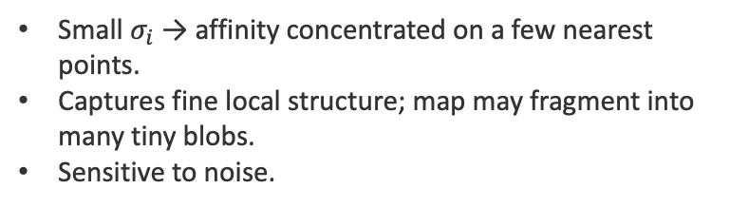
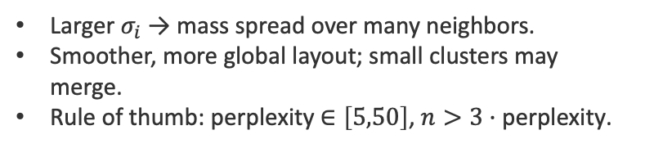
Example 2: Perplexity & Bandwidth
EXAMPLE
Perplexity sets the effective number of neighbors; $σ_{i}$ is solved so:
$$\text{Perp}\left(P_{i}\right)=2^{\text{H}\left(P_{i}\right)}, \text{H}\left(P_{i}\right)=−\sum_{j}{p\left(j|i\right) {\text{log}}_{2} p\left(j|i\right)}$$
Low perplexity ($≈5$)
High perplexity ($≈50$)
Small $σ_{i}$ → affinity concentrated on a few nearest points.
Captures fine local structure; map may fragment into many tiny blobs.
Sensitive to noise.
Larger $σ_{i}$ → mass spread over many neighbors.
Smoother, more global layout; small clusters may merge.
Rule of thumb: perplexity $∈\left[5,50\right]$, $n>3·\text{perplexity}$.

Slide 13
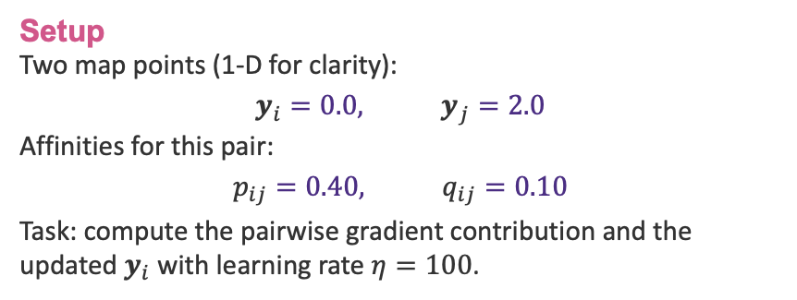

Example 3: One Gradient Step
EXAMPLE
Setup
Two map points (1-D for clarity):
$$y_{i}=0.0, y_{j}=2.0$$
Affinities for this pair:
$$p_{ij}=0.40, q_{ij}=0.10$$
Task: compute the pairwise gradient contribution and the updated $y_{i}$ with learning rate $η=100$.
Solution
Student-t factor:
$${\left(1+{\left\|y_{i}−y_{j}\right\|}^{2}\right)}^{−1}={\left(1+4\right)}^{−1}=0.2$$
Pairwise gradient term:
$$4\left(p_{ij}−q_{ij}\right)\left(y_{i}−y_{j}\right)·0.2$$
$$=4\left(0.30\right)\left(−2.0\right)\left(0.2\right)=−0.48$$
Gradient descent step:
$$y_{i}←0.0−100\left(−0.48\right)·{10}^{−3}=0.048$$
$p>q$ → attractive force pulls $y_{i}$ toward $y_{j}$.

Slide 14
t-SNE — Exercises
E1
Given squared distances $\left\{0.5,2.0,6.0\right\}$ from point $i$ with ${σ_{i}}^{2}=1$, compute the three conditional affinities $p\left(j|i\right)$ and verify they sum to 1.
E2
A point distribution has entropy $\text{H}\left(P_{i}\right)=3.0$ bits. Find its perplexity. If the target perplexity is 30, should $σ_{i}$ increase or decrease? Explain.
E3
For map points $y_{i}=\left(0,0\right)$, $y_{j}=\left(3,0\right)$ with $p_{ij}=0.05$, $q_{ij}=0.20$, compute the Student-t factor and the pairwise gradient. Is the force attractive or repulsive?

Slide 15
05
UMAP
Uniform Manifold Approximation and Projection

Slide 16

UMAP: High-Dimensional Graph
UMAP builds a weighted k-NN graph in high-D, then finds a low-D layout with a matching graph. For each point $x_{i}$ with $k$ neighbors:
$ρ_{i}={\text{min}}_{j}d\left(x_{i},x_{j}\right)$ ; $\sum_{j}{\text{exp}\left(−\frac{{\left(d\left(x_{i},x_{j}\right)−ρ_{i}\right)}_{+}}{σ_{i}}\right)}={\text{log}}_{2} k$
$$w\left(x_{i},x_{j}\right)=\text{exp}\left(−\frac{\text{max}\left(0,d\left(x_{i},x_{j}\right)−ρ_{i}\right)}{σ_{i}}\right)$$
$$v_{ij}=w_{ij}+w_{ji}−w_{ij}·w_{ji}$$
$ρ_{i}$ (local connectivity): distance to the nearest neighbor — guarantees each point connects to at least one other.
$σ_{i}$ (bandwidth): solved per point so the row of weights sums to ${\text{log}}_{2} k$ — adapts to local density.
Symmetrization combines the two directed edges via the probabilistic t-conorm (fuzzy union).

Slide 17

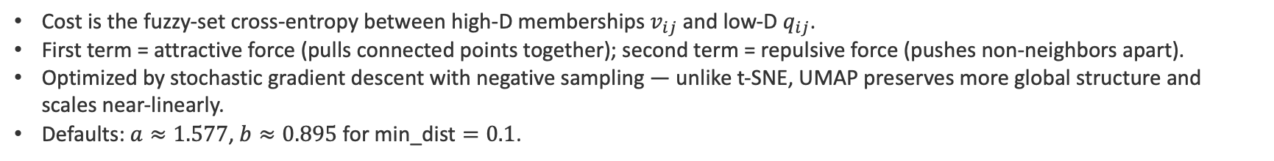
UMAP: Low-D Layout & Cost
In the low-D embedding $Y={\left[y_{1} … y_{n}\right]}^{\text{T}}$, edge weights use a smooth differentiable curve with parameters $a$, $b$ fit to the min-dist hyperparameter:
$$q_{ij}={\left(1+a{\left\|y_{i}−y_{j}\right\|}^{2b}\right)}^{−1}$$
$$C=\sum_{ij}{\left[v_{ij} \text{log}\left(\frac{v_{ij}}{q_{ij}}\right)+\left(1−v_{ij}\right) \text{log}\left(\frac{1−v_{ij}}{1−q_{ij}}\right)\right]}$$
Cost is the fuzzy-set cross-entropy between high-D memberships $v_{ij}$ and low-D $q_{ij}$.
First term = attractive force (pulls connected points together); second term = repulsive force (pushes non-neighbors apart).
Optimized by stochastic gradient descent with negative sampling — unlike t-SNE, UMAP preserves more global structure and scales near-linearly.
Defaults: $a≈1.577$, $b≈0.895$ for $\text{min}\text{_}\text{dist}=0.1$.

Slide 18
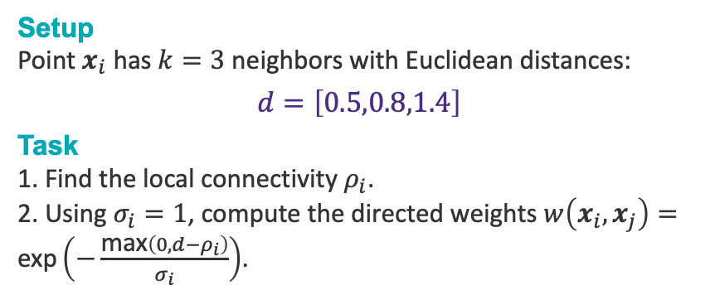

Example 1: Local Connectivity ρᵢ
EXAMPLE
Setup
Point $x_{i}$ has $k=3$ neighbors with Euclidean distances:
$$d=\left[0.5,0.8,1.4\right]$$
Task
1. Find the local connectivity $ρ_{i}$.
2. Using $σ_{i}=1$, compute the directed weights $w\left(x_{i},x_{j}\right)=\text{exp}\left(−\frac{\text{max}\left(0,d−ρ_{i}\right)}{σ_{i}}\right)$.
Solution
$ρ_{i}$ = nearest-neighbor distance = $\text{min}\left(d\right)$:
$$ρ_{i}=0.5$$
Shifted distances $\text{max}\left(0,d−ρ_{i}\right)$:
$$\left[0.0,0.3,0.9\right]$$
Weights $w=\text{exp}\left(−\frac{\text{shift}}{1}\right)$:
$$w_{1}=e^{0}=1.000$$
$$w_{2}=e^{−0.3}=0.741$$
$$w_{3}=e^{−0.9}=0.407$$
The nearest neighbor always gets weight 1 — this is what local connectivity guarantees.

Slide 19
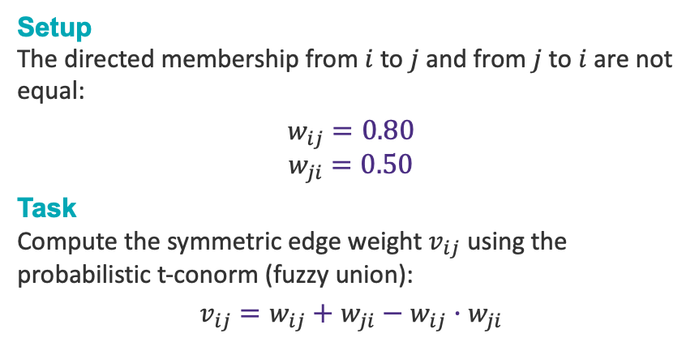

Example 2: Fuzzy Union
EXAMPLE
Setup
The directed membership from $i$ to $j$ and from $j$ to $i$ are not equal:
$$w_{ij}=0.80$$
$$w_{ji}=0.50$$
Task
Compute the symmetric edge weight $v_{ij}$ using the probabilistic t-conorm (fuzzy union):
$$v_{ij}=w_{ij}+w_{ji}−w_{ij}·w_{ji}$$
Solution
Substitute the two directed weights:
$$v_{ij}=0.80+0.50−\left(0.80\right)\left(0.50\right)$$
$$=1.30−0.40$$
$$=0.90$$
Interpretation: the fuzzy union is larger than either directed weight ($0.90>0.80$), but stays bounded in $\left[0,1\right]$. An edge is strong if either endpoint considers the other a neighbor.

Slide 20
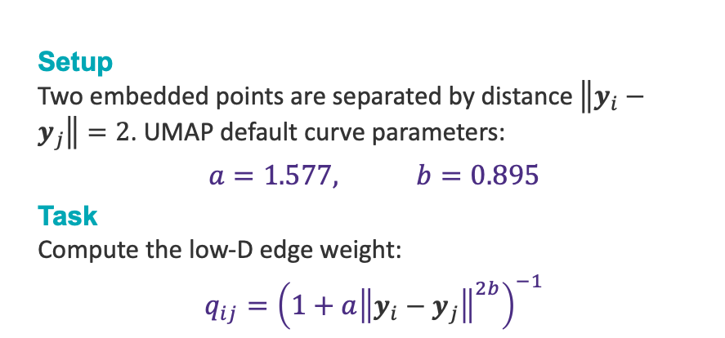

Example 3: Low-D Weight qᵢⱼ
EXAMPLE
Setup
Two embedded points are separated by distance $\left\|y_{i}−y_{j}\right\|=2$. UMAP default curve parameters:
$$a=1.577, b=0.895$$
Task
Compute the low-D edge weight:
$$q_{ij}={\left(1+a{\left\|y_{i}−y_{j}\right\|}^{2b}\right)}^{−1}$$
Solution
Squared distance term ${\left\|y_{i}−y_{j}\right\|}^{2}=4$. Raise to power $b$:
$$4^{0.895}=3.43$$
Scale by $a$ and add 1:
$$1+1.577·3.43=6.41$$
Invert:
$$q_{ij}=\frac{1}{6.41}=0.156$$
Distant points get a small low-D weight; if their high-D membership $v_{ij}$ is large, the attractive term pulls them closer next step.

Slide 21
UMAP — Exercises
E1
E1. A point has neighbor distances $d=\left[0.3,0.6,0.6,1.0\right]$ ($k=4$). With $σ_{i}=0.5$, find $ρ_{i}$ and the four directed weights $w\left(x_{i},x_{j}\right)=\text{exp}\left(−\frac{\text{max}\left(0,d−ρ_{i}\right)}{σ_{i}}\right)$.
E2
E2. Two directed memberships are $w_{ij}=0.6$ and $w_{ji}=0.9$. Compute the symmetric weight $v_{ij}=w_{ij}+w_{ji}−w_{ij}w_{ji}$, then verify $0≤v_{ij}≤1$.
E3
E3. With $a=1.577$, $b=0.895$, compute the low-D weight $q_{ij}={\left(1+a{\left\|y_{i}−y_{j}\right\|}^{2b}\right)}^{−1}$ for $\left\|y_{i}−y_{j}\right\|=1$ and for $\left\|y_{i}−y_{j}\right\|=3$. Which pair is pulled together more strongly?

Slide 22
06
Clustering Profiling
Characterizing & Validating Clusters with Matrix Statistics

Slide 23

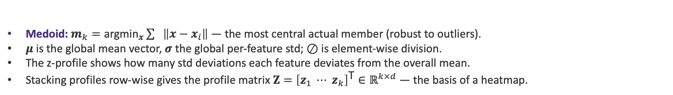
Centroids, Medoids & Profiles
A cluster profile summarizes each cluster $C_{k}$ by a vector of feature statistics over its members.
$$\text{Centroid}\text{: }μ_{k}=\frac{1}{\left|C_{k}\right|}\sum{x_{i}}, i∈C_{k} ∈ℝ^{d}$$
$$\text{Profile}\text{ (}\text{z}\text{−}\text{score}\text{): }z_{k}=\left(μ_{k}−μ\right)⊘σ ∈ℝ^{d}$$
Medoid: $m_{k}={\text{argmin}}_{x}\sum{\left\|x−x_{i}\right\|}$ — the most central actual member (robust to outliers).
$μ$ is the global mean vector, $σ$ the global per-feature std; $⊘$ is element-wise division.
The z-profile shows how many std deviations each feature deviates from the overall mean.
Stacking profiles row-wise gives the profile matrix $Z={\left[z_{1} ⋯ z_{k}\right]}^{\text{T}}∈ℝ^{k×d}$ — the basis of a heatmap.

Slide 24
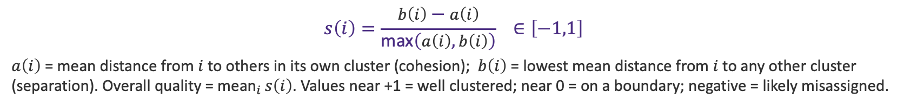
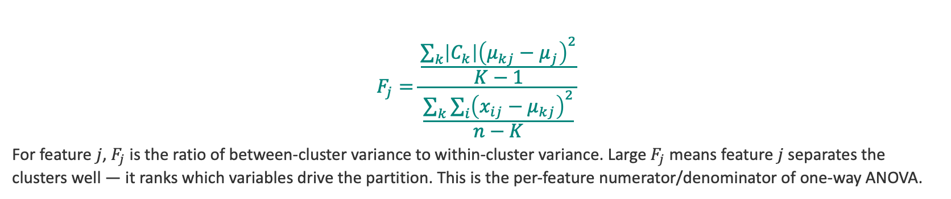
Validation: Silhouette & F-Statistic
Silhouette — cohesion vs separation
$$s\left(i\right)=\frac{b\left(i\right)−a\left(i\right)}{\text{max}\left(a\left(i\right),b\left(i\right)\right)} ∈\left[−1,1\right]$$
$a\left(i\right)$ = mean distance from $i$ to others in its own cluster (cohesion); $b\left(i\right)$ = lowest mean distance from $i$ to any other cluster (separation). Overall quality = ${\text{mean}}_{i} s\left(i\right)$. Values near +1 = well clustered; near 0 = on a boundary; negative = likely misassigned.
ANOVA F-statistic — per-feature discriminative power
$$F_{j}=\frac{\frac{\sum_{k}{\left|C_{k}\right|{\left(μ_{kj}−μ_{j}\right)}^{2}}}{K−1}}{\frac{\sum_{k}{\sum_{i}{{\left(x_{ij}−μ_{kj}\right)}^{2}}}}{n−K}}$$
For feature $j$, $F_{j}$ is the ratio of between-cluster variance to within-cluster variance. Large $F_{j}$ means feature $j$ separates the clusters well — it ranks which variables drive the partition. This is the per-feature numerator/denominator of one-way ANOVA.

Slide 25
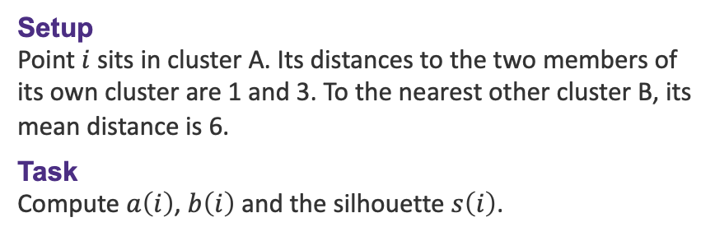

Example 1: Silhouette of a Point
EXAMPLE
Setup
Point $i$ sits in cluster $\text{A}$. Its distances to the two members of its own cluster are 1 and 3. To the nearest other cluster $\text{B}$, its mean distance is 6.
Task
Compute $a\left(i\right)$, $b\left(i\right)$ and the silhouette $s\left(i\right)$.
Solution
$$a\left(i\right)=\frac{\left(1+3\right)}{2}=2$$
$$b\left(i\right)=6$$
$$s\left(i\right)=\frac{b−a}{\text{max}\left(a,b\right)}$$
$$=\frac{\left(6−2\right)}{\text{max}\left(2,6\right)}$$
$$=\frac{4}{6}=0.667$$
$s\left(i\right)≈0.67$ → the point is well matched to cluster $\text{A}$ and clearly separated from $\text{B}$.

Slide 26
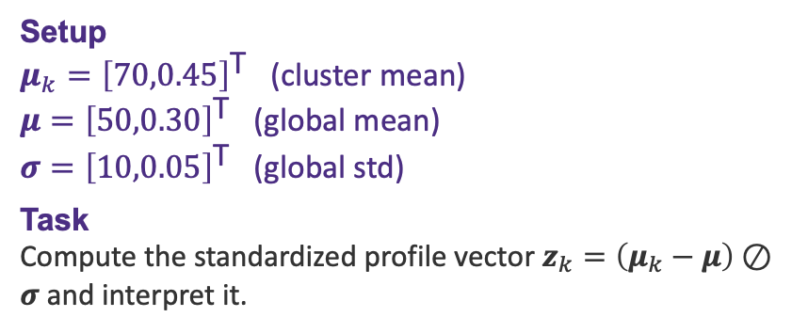

Example 2: Centroid z-Profile
EXAMPLE
Setup
$μ_{k}={\left[70,0.45\right]}^{\text{T}}$ (cluster mean)
$μ={\left[50,0.30\right]}^{\text{T}}$ (global mean)
$σ={\left[10,0.05\right]}^{\text{T}}$ (global std)
Task
Compute the standardized profile vector $z_{k}=\left(μ_{k}−μ\right)⊘σ$ and interpret it.
Solution
$$μ_{k}−μ={\left[20,0.15\right]}^{\text{T}}$$
$$z_{k}={\left[\frac{20}{10},\frac{0.15}{0.05}\right]}^{\text{T}}$$
$$={\left[2.0,3.0\right]}^{\text{T}}$$
Feature 1 sits $2σ$ above the overall mean; feature 2 sits $3σ$ above. Both features are strongly elevated — this cluster is the 'high on both' segment, with feature 2 the more distinctive.

Slide 27
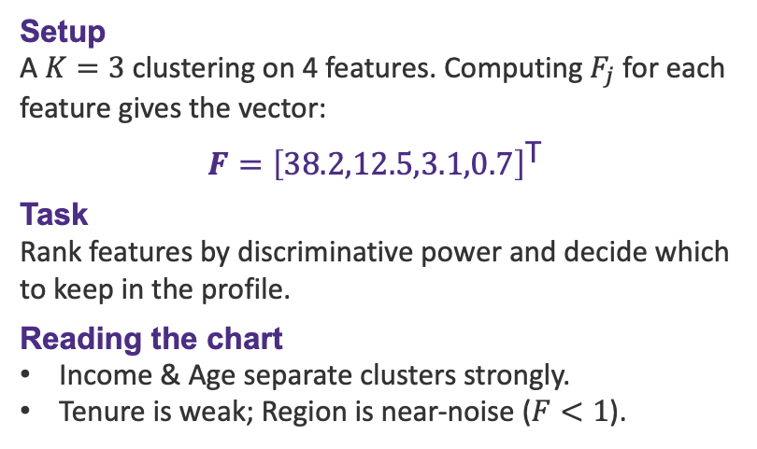
Example 3: F-Statistic Feature Ranking
EXAMPLE
Setup
A $K=3$ clustering on 4 features. Computing $F_{j}$ for each feature gives the vector:
$$F={\left[38.2,12.5,3.1,0.7\right]}^{\text{T}}$$
Task
Rank features by discriminative power and decide which to keep in the profile.
Reading the chart
Income & Age separate clusters strongly.
Tenure is weak; Region is near-noise ($F<1$).

Slide 28
Clustering Profiling — Exercises
E1
Silhouette. A point has own-cluster distances $\left\{2,4\right\}$ and nearest other-cluster mean distance 4.5.
Compute $a\left(i\right)$, $b\left(i\right)$, and $s\left(i\right)$.
E2
z-Profile. Cluster mean $μ_{k}={\left[120,8\right]}^{\text{T}}$, global $μ={\left[100,5\right]}^{\text{T}}$, std $σ={\left[40,1.5\right]}^{\text{T}}$.
Find $z_{k}=\left(μ_{k}−μ\right)⊘σ$ and say which feature is most distinctive.
F-Statistic. Between-cluster var of feature $j$ = 24.0 (df $K−1=2$); within-cluster var = 4.0 (df $n−K=27$).
Compute $F_{j}=\frac{\frac{24.0}{2}}{\frac{4.0}{27}}$ and judge if feature $j$ separates clusters.
E3

Slide 29
Choosing a Method
Method | Best for | Core object
K-means | Spherical, balanced clusters | Centroids μₖ, minimize Σ‖x−μₖ‖²
Hierarchical | Nested structure, dendrograms | Linkage on distance matrix D
DBSCAN | Arbitrary shapes, noise | ε-neighborhoods, density reachability
t-SNE | 2-D visualization, local structure | KL(P∥Q) on affinity matrices
UMAP | Fast embedding, local+global | Cross-entropy on fuzzy graph
Profiling | Interpreting clusters | z-profiles, silhouette, F-stat

Slide 30
DBSCAN, t-SNE
and UMAP
4
BDATA 412: Advanced Data Visualization
University of Washington

