Slide 1
Principal Component
Analysis (PCA)
5
BDATA 412: Advanced Data Visualization
University of Washington

Slide 3
Course Roadmap
Four classical-to-modern techniques, one unifying goal: represent complex data as low-dimensional vectors that preserve the structure that matters.
1
Principal Component Analysis
2
Correspondence Analysis
Linear projection maximizing variance
PCA for categorical / contingency data
3
Multidimensional Scaling
4
Autoencoders
Embedding from distances alone
Nonlinear neural compression & embeddings

Slide 5
Principal Component Analysis
Linear projection that maximizes variance
INTUITION
HOW TO USE
Find new axes — the principal components — that point in the directions of greatest variance in the data. The first captures the most spread; each next captures the most that remains while staying perpendicular to the others. Keeping the top few axes preserves the dominant structure and discards noise.
• Center and standardize the features • Compute the covariance matrix, then its eigenvectors (or use SVD) • Rank components by explained variance (scree plot) • Keep the top-k and project the data onto them • Use for: visualization, denoising, preprocessing

Slide 7
Correspondence Analysis
PCA's cousin for categorical / contingency data
INTUITION
HOW TO USE
Take a contingency table — counts of how categories co-occur — and measure how far it strays from independence (chi-square distances). CA places both the rows and the columns in one shared low-dimensional space, so categories that tend to occur together land near each other and associations become visible at a glance.
• Start from a contingency table of category counts • Convert counts to row and column profiles (relative frequencies) • Decompose the standardized residuals via SVD • Plot rows and columns together on the first 2 axes (biplot) • Read nearby points as associated; check inertia per axis

Slide 9
Multidimensional Scaling
Build an embedding from distances alone
INTUITION
HOW TO USE
Suppose you only know the pairwise distances between objects, not their coordinates. MDS searches for positions in a low-dimensional space so that the distances between the placed points match the given dissimilarities as closely as possible — in effect turning a distance matrix back into a map you can plot.
• Assemble a pairwise distance / dissimilarity matrix • Choose classical (metric) or non-metric MDS • Metric: eigendecompose the double-centered matrix • Non-metric: preserve rank order, minimize stress • Embed in 2–3D; judge fit with stress / Shepard plot

Slide 11
Autoencoders
Nonlinear neural compression & embeddings
INTUITION
HOW TO USE
A neural network trained to reproduce its own input through a narrow bottleneck. The encoder squeezes the input into a small latent code; the decoder rebuilds the input from it. To reconstruct well through so few numbers, the network is forced to learn a compact, nonlinear representation of the structure that matters.
• Define encoder → bottleneck → decoder layers • Train to minimize reconstruction loss (e.g. MSE) on unlabeled data • Use the bottleneck activations as learned embeddings • Variants: denoising, sparse, variational (VAE) • Use for nonlinear reduction, anomaly detection, generation

Slide 13
Turning Anything into Meaningful Vectors
Text, images, users, products, documents, genes — almost any object can be encoded as a point in a vector space. Once data lives in ℝᵈ, geometry does the work: similarity becomes distance, structure becomes shape, and learning becomes optimization.
Raw object
Encoding
Vector x ∈ ℝᵈ
Embedding z ∈ ℝᵏ
Text, image, table row, graph node
Counts, pixels, features, similarities
Coordinates in a space
Compressed, meaningful (k ≪ d)
This deck: four ways to learn the map x ↦ z — linear (PCA, CA, MDS) and nonlinear (autoencoders).

Slide 15
Why This Toolkit Enables Advanced Visualization
Once objects become vectors, dimensionality reduction and clustering reveal structure that is invisible in raw high-dimensional data.
1
Data Reduction
2
Nonlinearity
PCA, CA and MDS collapse dozens or thousands of dimensions into 2–3, so an entire dataset fits on one screen while keeping its dominant structure.
Autoencoders and distance-based methods unfold curved manifolds that flat linear projections distort — exposing structure PCA alone would miss.
3
Clustering = Segments
4
Patterns & Outliers
Cluster in the reduced space, then color the embedding by cluster: geometry becomes named groups you can interpret, compare and label.
In the embedding, similarity becomes proximity — neighborhoods, gradients and anomalies become visible to the eye, guiding analysis and QA.
Reduce → embed → cluster → visualize: the pipeline behind modern exploratory data analysis.

Slide 17



The Common Thread
All four methods solve one problem: find a low-dimensional representation Z ∈ ℝⁿˣᵏ of data X ∈ ℝⁿˣᵖ that preserves a chosen notion of structure.
Method
Preserves
Map
Core operation
PCA
Variance / covariance
Linear
Eigen-decomposition of $X^{T}X$
Correspondence Analysis
χ² association in tables
Linear
SVD of standardized residuals
MDS
Pairwise distances
Linear (classical)
Eigen-decomp of $−\frac{1}{2}JD^{(2)}J$
Autoencoders
Reconstruction error
Nonlinear
Gradient descent on $‖X−\hat{X}‖^{2}$

Slide 19
01
Principal Component Analysis
Linear projection that maximizes retained variance

Slide 21
PCA — The Core Idea
PCA finds a new orthogonal coordinate system for the data in which the first axis captures the most variance, the second captures the most of what remains, and so on.
Three equivalent views
Why we do it
• Variance view: directions of maximum spread in the cloud of points. • Reconstruction view: the k-dim subspace minimizing squared projection error (best-fitting hyperplane). • Decorrelation view: a rotation that makes the new coordinates mutually uncorrelated. All three give the same answer: the eigenvectors of the covariance matrix, ordered by eigenvalue.
Compression
Keep $k≪p$ coordinates
De-noising
Drop low-variance directions
Visualization
Plot on PC1–PC2
Decorrelation
Inputs for downstream models

Slide 23





Eigenvectors & Eigenvalues — The Intuition
Applying a matrix usually rotates a vector. A few special vectors keep their direction — they only get scaled. Those are the eigenvectors.
$$A v = λ v$$
$$λv$$
• v — the eigenvector: its direction is preserved • λ — the eigenvalue: the factor v is stretched by • Most vectors change direction; eigenvectors do not
$$Aw$$
$$v$$
$$w$$
same line → eigenvector

Slide 25




What the Eigenvalue Tells You
λ is the signed scale factor along an eigenvector — it stretches, shrinks, flips, or leaves the vector unchanged. (Grey = original v, purple = Av.)
$$λ > 1$$
$$0 < λ < 1$$
$$λ < 0$$
$$λ = 1$$
Stretch
Shrink
Flip & scale
Unchanged

Slide 27




Example 1 (2×2) — Step 1: The Setup
Step 1 / 5
Goal: find the vectors that A only scales — solve A v = λ v.
$$\left[\begin{matrix}2 & 1 \\ 1 & 2\end{matrix}\right]$$
$$A v = λ v$$
$$A =$$
$$(A − λI) v = 0$$
A nonzero v can exist only when det( A − λI ) = 0 — the characteristic equation.

Slide 29






Example 1 (2×2) — Step 2: Form A − λI
Step 2 / 5
Subtract λ from the diagonal. A nonzero v exists only if this matrix is singular.
$$\left[\begin{matrix}2 & 1 \\ 1 & 2\end{matrix}\right]$$
$$\left[\begin{matrix}1 & 0 \\ 0 & 1\end{matrix}\right]$$
$$\left[\begin{matrix}2−λ & 1 \\ 1 & 2−λ\end{matrix}\right]$$
$$A − λI =$$
$$− λ$$
$$=$$
Set det( A − λI ) = 0 to find the λ that make it singular.

Slide 31

Example 1 (2×2) — Step 3: Solve det = 0
Step 3 / 5
Expand the 2×2 determinant into a quadratic in λ and factor it.
$$det(A − λI) = (2 − λ)(2 − λ) − (1)(1)$$
$$= {(2 − λ)}^{2} − 1 = λ^{2} − 4λ + 3$$
$$= (λ − 1)(λ − 3) = 0$$
$$λ_{1} = 3 λ_{2} = 1$$

Slide 33


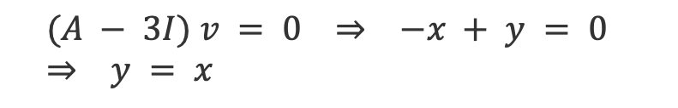
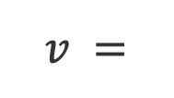


Example 1 (2×2) — Step 4: Eigenvector for λ = 3
Step 4 / 5
Plug λ = 3 into (A − λI)v = 0 and solve the resulting system.
$$\left[\begin{matrix}−1 & 1 \\ 1 & −1\end{matrix}\right]$$
$$A − 3I =$$
$$(A − 3I) v = 0 ⇒ −x + y = 0 ⇒ y = x$$
$$\left[\begin{matrix}1 \\ 1\end{matrix}\right]$$
$$v =$$
$$(λ = 3)$$

Slide 35


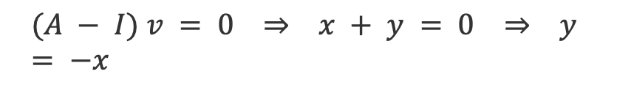
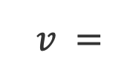

Example 1 (2×2) — Step 5: Eigenvector for λ = 1
Step 5 / 5
Repeat with λ = 1, then collect both eigenpairs.
$$\left[\begin{matrix}1 & 1 \\ 1 & 1\end{matrix}\right]$$
$$A − I =$$
$$(A − I) v = 0 ⇒ x + y = 0 ⇒ y = −x$$
$$\left[\begin{matrix}1 \\ −1\end{matrix}\right]$$
$$v =$$
$$Eigenpairs: λ = 3 → \left[\begin{matrix}1 & 1\end{matrix}\right] λ = 1 → \left[\begin{matrix}1 & −1\end{matrix}\right]$$

Slide 37




Example 2 (3×3) — Step 1: The Setup
Step 1 / 7
Same recipe in 3-D: solve A v = λ v through det(A − λI) = 0. (A is a companion matrix.)
$$\left[\begin{matrix}0 & 1 & 0 \\ 0 & 0 & 1 \\ 6 & −11 & 6\end{matrix}\right]$$
$$A v = λ v$$
$$A =$$
$$(A − λI) v = 0$$
det( A − λI ) = 0 now expands into a cubic — it will have three eigenvalues.

Slide 39


Example 2 (3×3) — Step 2: Form A − λI
Step 2 / 7
Subtract λ from each diagonal entry.
$$\left[\begin{matrix}−λ & 1 & 0 \\ 0 & −λ & 1 \\ 6 & −11 & 6−λ\end{matrix}\right]$$
$$A − λI =$$
Next: expand this determinant by cofactors down the first column.

Slide 41
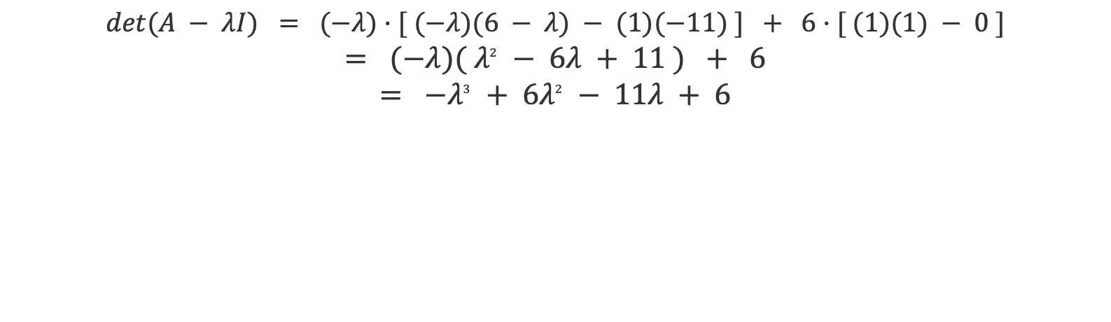
Example 2 (3×3) — Step 3: Expand the Determinant
Step 3 / 7
Cofactor expansion down column 1; the middle entry is 0, so it drops out.
$$det(A − λI) = (−λ)·[ (−λ)(6 − λ) − (1)(−11) ] + 6·[ (1)(1) − 0 ]$$
$$= (−λ)( λ^{2} − 6λ + 11 ) + 6$$
$$= −λ^{3} + 6λ^{2} − 11λ + 6$$

Slide 43
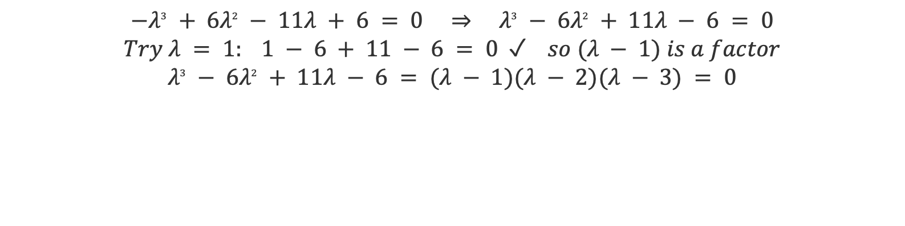
Example 2 (3×3) — Step 4: Solve the Cubic
Step 4 / 7
Find one integer root, then factor the cubic completely.
$$−λ^{3} + 6λ^{2} − 11λ + 6 = 0 ⇒ λ^{3} − 6λ^{2} + 11λ − 6 = 0$$
$$Try λ = 1: 1 − 6 + 11 − 6 = 0 ✓ so (λ − 1) is a factor$$
$$λ^{3} − 6λ^{2} + 11λ − 6 = (λ − 1)(λ − 2)(λ − 3) = 0$$
$$λ_{1} = 1 λ_{2} = 2 λ_{3} = 3$$

Slide 45



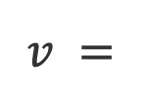


Example 2 (3×3) — Step 5: Eigenvector for λ = 1
Step 5 / 7
Solve (A − I)v = 0; the first two rows give a chain of substitutions.
$$\left[\begin{matrix}−1 & 1 & 0 \\ 0 & −1 & 1 \\ 6 & −11 & 5\end{matrix}\right]$$
$$−x + y = 0 ⇒ y = x$$
$$−y + z = 0 ⇒ z = x$$
$$A − I =$$
$$\left[\begin{matrix}1 \\ 1 \\ 1\end{matrix}\right]$$
$$v =$$
$$(λ = 1)$$

Slide 47



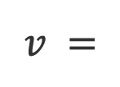


Example 2 (3×3) — Step 6: Eigenvector for λ = 2
Step 6 / 7
Same substitution chain with λ = 2.
$$\left[\begin{matrix}−2 & 1 & 0 \\ 0 & −2 & 1 \\ 6 & −11 & 4\end{matrix}\right]$$
$$−2x + y = 0 ⇒ y = 2x$$
$$−2y + z = 0 ⇒ z = 4x$$
$$A − 2I =$$
$$\left[\begin{matrix}1 \\ 2 \\ 4\end{matrix}\right]$$
$$v =$$
$$(λ = 2)$$

Slide 49


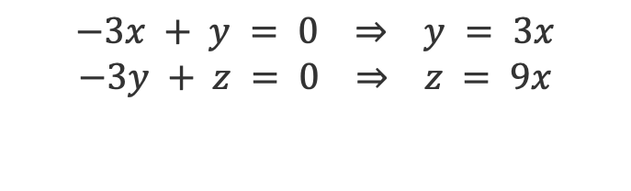

Example 2 (3×3) — Step 7: Eigenvector for λ = 3
Step 7 / 7
Last one, then collect all three eigenpairs.
$$\left[\begin{matrix}−3 & 1 & 0 \\ 0 & −3 & 1 \\ 6 & −11 & 3\end{matrix}\right]$$
$$−3x + y = 0 ⇒ y = 3x$$
$$−3y + z = 0 ⇒ z = 9x$$
$$A − 3I =$$
$$\left[\begin{matrix}1 \\ 3 \\ 9\end{matrix}\right]$$
$$v =$$
$$Eigenpairs: λ = 1 → \left[\begin{matrix}1 & 1 & 1\end{matrix}\right] λ = 2 → \left[\begin{matrix}1 & 2 & 4\end{matrix}\right] λ = 3 → \left[\begin{matrix}1 & 3 & 9\end{matrix}\right]$$

Slide 51


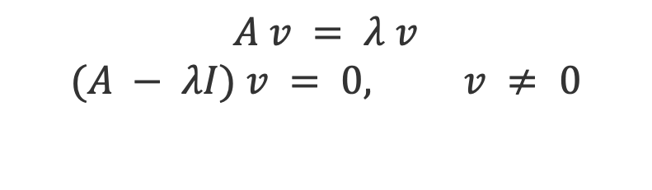
Example 3 (3×3, triangular) — Step 1: The Setup
Step 1 / 7
A third example with an upper-triangular matrix — watch how that shortcuts the determinant.
$$\left[\begin{matrix}3 & 2 & 0 \\ 0 & 1 & 0 \\ 0 & 0 & 2\end{matrix}\right]$$
$$A v = λ v$$
$$(A − λI) v = 0, v ≠ 0$$
$$A =$$
All entries below the diagonal are 0 → the eigenvalues will read straight off the diagonal.

Slide 53

Example 3 (3×3, triangular) — Step 2: Form A − λI
Step 2 / 7
Subtract λ from each diagonal entry — the zeros below the diagonal stay put.
$$\left[\begin{matrix}3−λ & 2 & 0 \\ 0 & 1−λ & 0 \\ 0 & 0 & 2−λ\end{matrix}\right]$$
$$A − λI =$$
Still upper-triangular → det = product of the diagonal entries.

Slide 55
Example 3 (3×3, triangular) — Step 3: The Determinant
Step 3 / 7
No cofactor expansion needed — the triangular shortcut does the work.
For a triangular matrix, the determinant is just the product of the diagonal entries:
$$det(A − λI) = (3 − λ)(1 − λ)(2 − λ)$$
$$Set it to zero: (3 − λ)(1 − λ)(2 − λ) = 0$$
It is already factored — each factor gives one eigenvalue.

Slide 57

Example 3 (3×3, triangular) — Step 4: The Eigenvalues
Step 4 / 7
Each factor set to zero gives one eigenvalue.
$$3 − λ = 0 ⇒ λ = 3$$
$$1 − λ = 0 ⇒ λ = 1$$
$$2 − λ = 0 ⇒ λ = 2$$
$$λ_{1} = 3 λ_{2} = 1 λ_{3} = 2 ( = the diagonal! )$$

Slide 59





Example 3 (3×3) — Step 5: Eigenvector for λ = 3
Step 5 / 7
Solve (A − 3I)v = 0.
$$\left[\begin{matrix}0 & 2 & 0 \\ 0 & −2 & 0 \\ 0 & 0 & −1\end{matrix}\right]$$
$$2y = 0 ⇒ y = 0$$
$$−z = 0 ⇒ z = 0$$
$$x is free$$
$$A − 3I =$$
$$\left[\begin{matrix}1 \\ 0 \\ 0\end{matrix}\right]$$
$$v =$$
$$(λ = 3)$$

Slide 61




Example 3 (3×3) — Step 6: Eigenvector for λ = 1
Step 6 / 7
Solve (A − I)v = 0.
$$\left[\begin{matrix}2 & 2 & 0 \\ 0 & 0 & 0 \\ 0 & 0 & 1\end{matrix}\right]$$
$$z = 0 (row 3)$$
$$2x + 2y = 0 ⇒ x = −y$$
$$A − I =$$
$$\left[\begin{matrix}1 \\ −1 \\ 0\end{matrix}\right]$$
$$v =$$
$$(λ = 1)$$

Slide 63


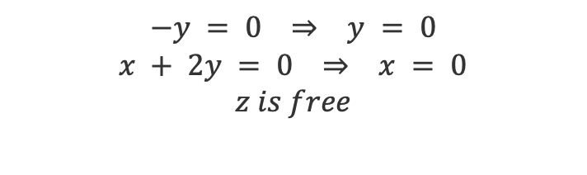


Example 3 (3×3) — Step 7: Eigenvector for λ = 2
Step 7 / 7
Solve (A − 2I)v = 0, then collect all three eigenpairs.
$$\left[\begin{matrix}1 & 2 & 0 \\ 0 & −1 & 0 \\ 0 & 0 & 0\end{matrix}\right]$$
$$−y = 0 ⇒ y = 0$$
$$x + 2y = 0 ⇒ x = 0$$
$$z is free$$
$$A − 2I =$$
$$\left[\begin{matrix}0 \\ 0 \\ 1\end{matrix}\right]$$
$$v =$$
$$Eigenpairs: λ = 3 → \left[\begin{matrix}1 & 0 & 0\end{matrix}\right] λ = 1 → \left[\begin{matrix}1 & −1 & 0\end{matrix}\right] λ = 2 → \left[\begin{matrix}0 & 0 & 1\end{matrix}\right]$$

Slide 65
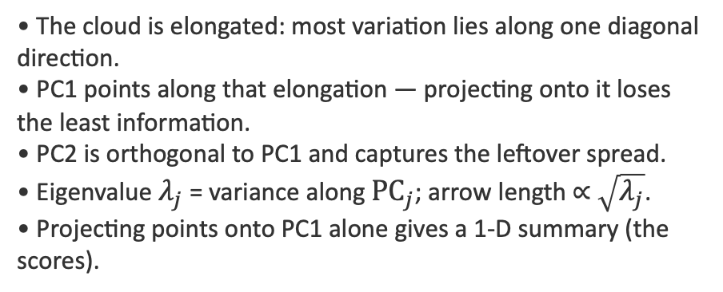
PCA — Geometric Intuition
Reading the picture
• The cloud is elongated: most variation lies along one diagonal direction.
• PC1 points along that elongation — projecting onto it loses the least information.
• PC2 is orthogonal to PC1 and captures the leftover spread.
• Eigenvalue $λ_{j}$ = variance along ${PC}_{j}$; arrow length ∝ $\sqrt{λ_{j}}$.
• Projecting points onto PC1 alone gives a 1-D summary (the scores).
PC1 (max variance)
PC2

Slide 67


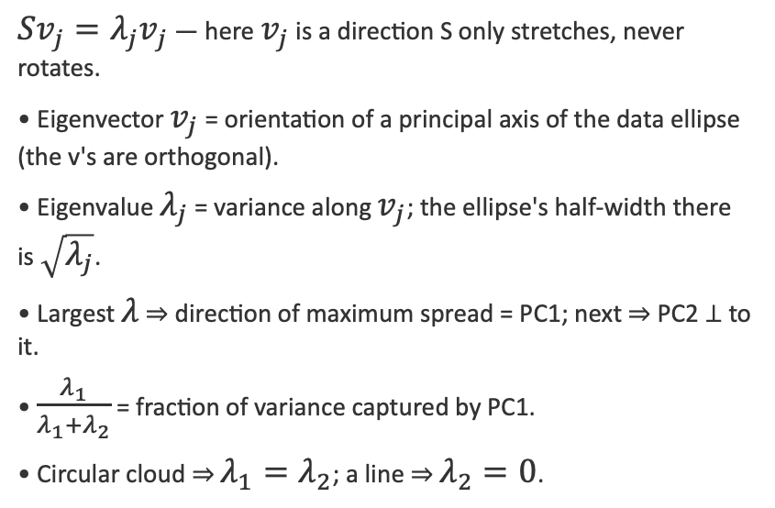
PCA — Eigenvectors & Eigenvalues in 2D
The covariance matrix S describes the shape of the data cloud. Its eigenvectors give the directions of the cloud's principal axes; its eigenvalues give the variance (spread²) along each.
What they mean geometrically
$Sv_{j}=λ_{j}v_{j}$ — here $v_{j}$ is a direction S only stretches, never rotates.
• Eigenvector $v_{j}$ = orientation of a principal axis of the data ellipse (the v's are orthogonal).
• Eigenvalue $λ_{j}$ = variance along $v_{j}$; the ellipse's half-width there is $\sqrt{λ_{j}}$.
• Largest $λ$ ⇒ direction of maximum spread = PC1; next ⇒ PC2 ⊥ to it.
• $\frac{λ_{1}}{λ_{1}+λ_{2}}$ = fraction of variance captured by PC1.
• Circular cloud ⇒ $λ_{1}=λ_{2}$; a line ⇒ $λ_{2}=0$.
$$v_{2} (\sqrt{λ_{2}})$$
$$v_{1} (\sqrt{λ_{1}})$$
Eigenvectors = axes of the data ellipse • eigenvalues = squared half-lengths

Slide 69
PCA — Graphical Representations
Three standard plots summarize a PCA. Each answers a different question.
Score plot
Loading plot
Biplot
Where do observations sit on PC1–PC2? Reveals clusters, gradients, outliers.
How does each original variable contribute to each PC? Arrows = variable directions.
Scores + loadings overlaid. Points near an arrow score high on that variable.
Interpretation checklist
• Axes carry % variance explained — always label them (e.g., "PC1 (62%)"). • Angle between two loading arrows ≈ correlation between those variables (small angle ⇒ positively correlated). • Length of a loading arrow ⇒ how well that variable is represented in the plotted plane. • Sign of a PC is arbitrary — only relative positions and directions are meaningful.

Slide 71
PCA — Reading a Biplot
How to read it
PC2 (23%)
• Three colored clusters → three sub-populations separated mainly along PC1. • "Income" and "Age" arrows point right → high-PC1 observations are older, higher-income. • "Income" and "Education" arrows are ~90° apart → roughly uncorrelated in this sample. • A point far along an arrow's direction scores high on that variable. • Axes show 54% + 23% = 77% of total variance captured in 2-D.
Education
Income
PC1 (54%)
Age

Slide 73


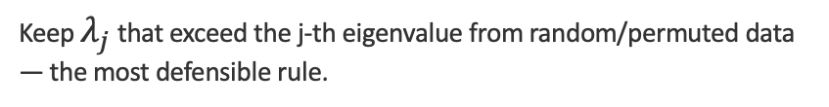
PCA — How Many Components to Keep
No single rule is definitive — use several and look for agreement.
Kaiser criterion
Keep components with eigenvalue $λ_{j}>1$ (on standardized data): they explain more than one original variable's worth of variance.
Scree / elbow
Plot $λ_{j} vs j$; keep components before the curve flattens into the 'rubble'.
Cumulative variance
Keep enough PCs to reach a target $Σλ$ share (e.g., 80–90%).
Parallel analysis
Keep $λ_{j}$ that exceed the j-th eigenvalue from random/permuted data — the most defensible rule.

Slide 75


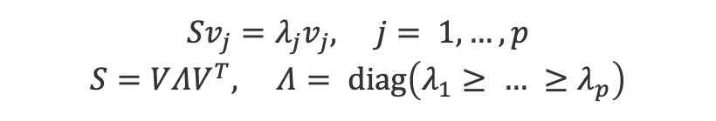

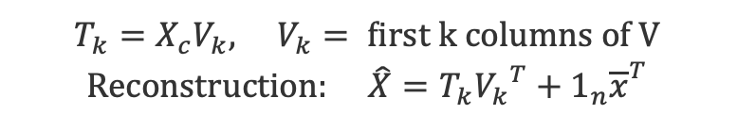
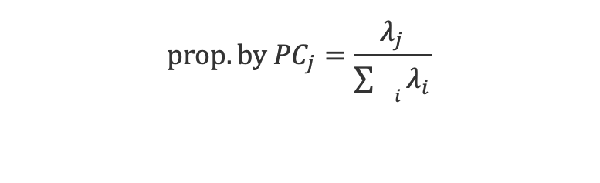
PCA — Matrix Formulation
Data matrix X ∈ ℝⁿˣᵖ : n observations (rows), p variables (columns). Center each column to mean 0; standardize if scales differ.
1 · Centering
4 · Loadings & scores
$$X_{c}=X−1_{n}{\overline{x}}^{T}, \overline{x}=\frac{1}{n}X^{T}1_{n}$$
Loadings: columns of V (eigenvectors)
$$Scores: T=X_{c}V (n×p)$$
2 · Covariance matrix (p×p)
$$S=\frac{1}{n−1}{X_{c}}^{T}X_{c}$$
5 · k-dim projection
$$T_{k}=X_{c}V_{k}, V_{k}= first k columns of V$$
$$Reconstruction: \hat{X}=T_{k}{V_{k}}^{T}+1_{n}{\overline{x}}^{T}$$
3 · Eigen-decomposition
$$Sv_{j}=λ_{j}v_{j}, j= 1,…,p$$
$$S=VΛV^{T}, Λ= diag\left(λ_{1}≥ … ≥λ_{p}\right)$$
6 · Variance explained
$$prop. by {PC}_{j}=\frac{λ_{j}}{\sum_{{}_{i}}{λ_{i}}}$$

Slide 77

Worked Example: A 5×2 Data Matrix
n = 5 observations (rows), p = 2 variables (columns). We will run the full PCA by hand, then plot the result.
Data matrix X (5 × 2)
$$X=\left[\begin{matrix}3 & 4 \\ 4 & 3 \\ 5 & 5 \\ 6 & 7 \\ 7 & 6\end{matrix}\right]$$
Each row = one observation; columns = variables x₁, x₂.

Slide 79


Step 1 · Centering
Subtract each column's mean so every variable is mean-zero — the operation is Xc = X − 1ₙ x̄ᵀ.
1 · Column means → mean vector x̄
$$\bar{x}=\left[\begin{matrix}5 & 5\end{matrix}\right]$$
x̄₁ = (3+4+5+6+7)/5 = 5 x̄₂ = (4+3+5+7+6)/5 = 5
2 · Subtract the mean from every observation → centered matrix Xc
$$X_{c}=\left[\begin{matrix}3 & 4 \\ 4 & 3 \\ 5 & 5 \\ 6 & 7 \\ 7 & 6\end{matrix}\right]−\left[\begin{matrix}5 & 5 \\ 5 & 5 \\ 5 & 5 \\ 5 & 5 \\ 5 & 5\end{matrix}\right]=\left[\begin{matrix}−2 & −1 \\ −1 & −2 \\ 0 & 0 \\ 1 & 2 \\ 2 & 1\end{matrix}\right]$$
Each column of Xc now sums to 0 — the data is centred on the origin.

Slide 81
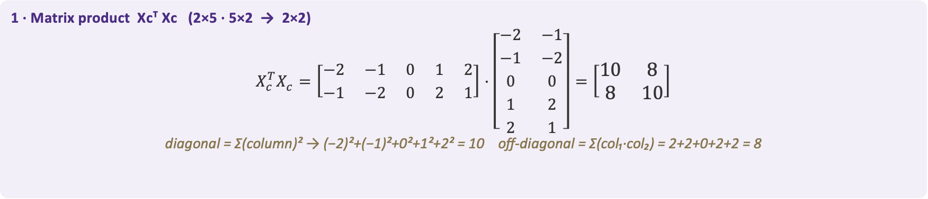

Step 2 · Covariance Matrix
Multiply the centered matrix by its transpose and scale — S = 1/(n−1) · Xcᵀ Xc (a 2×2 matrix).
1 · Matrix product Xcᵀ Xc (2×5 · 5×2 → 2×2)
$$X_{c}^{T}X_{c}=\left[\begin{matrix}−2 & −1 & 0 & 1 & 2 \\ −1 & −2 & 0 & 2 & 1\end{matrix}\right]·\left[\begin{matrix}−2 & −1 \\ −1 & −2 \\ 0 & 0 \\ 1 & 2 \\ 2 & 1\end{matrix}\right]=\left[\begin{matrix}10 & 8 \\ 8 & 10\end{matrix}\right]$$
diagonal = Σ(column)² → (−2)²+(−1)²+0²+1²+2² = 10 off-diagonal = Σ(col₁·col₂) = 2+2+0+2+2 = 8
2 · Scale by 1/(n−1) = 1/4 → covariance matrix S
$$S=\frac{1}{n−1}X_{c}^{T}X_{c}=\frac{1}{4}\left[\begin{matrix}10 & 8 \\ 8 & 10\end{matrix}\right]=\left[\begin{matrix}2.5 & 2.0 \\ 2.0 & 2.5\end{matrix}\right]$$

Slide 83



Step 3 · Eigenvalues
Part 1 of 3 — solve the characteristic equation det(S − λI) = 0 for the two eigenvalues.
1 · Subtract λ from the diagonal of S
$$S − λI = \left[\begin{matrix}2.5 & 2 \\ 2 & 2.5\end{matrix}\right] − λ\left[\begin{matrix}1 & 0 \\ 0 & 1\end{matrix}\right] = \left[\begin{matrix}2.5 − λ & 2 \\ 2 & 2.5 − λ\end{matrix}\right]$$
2 · Set the determinant to zero
$$det\left|\begin{matrix}2.5 − λ & 2 \\ 2 & 2.5 − λ\end{matrix}\right| = {\left(2.5 − λ\right)}^{2} − 4 = 0$$
expand: (2.5 − λ)(2.5 − λ) − (2)(2) = (2.5 − λ)² − 4
3 · Solve for λ
$${\left(2.5 − λ\right)}^{2} = 4 ⇒ 2.5 − λ = ± 2 ⇒ λ = 2.5 ∓ 2$$
⇒ λ₁ = 4.5 λ₂ = 0.5

Slide 85



Step 3 · Eigenvector for λ₁ = 4.5
Part 2 of 3 — solve (S − λ₁I)v₁ = 0, then normalize to unit length.
1 · Form (S − λ₁I) with λ₁ = 4.5
$$S − 4.5 I = \left[\begin{matrix}2.5 − 4.5 & 2 \\ 2 & 2.5 − 4.5\end{matrix}\right] = \left[\begin{matrix}−2 & 2 \\ 2 & −2\end{matrix}\right]$$
2 · Solve the homogeneous system (S − λ₁I)v₁ = 0 (let v₁ = [a, b]ᵀ)
$$\left[\begin{matrix}−2 & 2 \\ 2 & −2\end{matrix}\right]\left[\begin{matrix}a \\ b\end{matrix}\right] = \left[\begin{matrix}0 \\ 0\end{matrix}\right] ⇒ −2a + 2b = 0 ⇒ a = b$$
$$so v₁ ∝ \left[\begin{matrix}1 \\ 1\end{matrix}\right] (choose a = b = 1)$$
3 · Normalize to unit length
$$‖\left[\begin{matrix}1 \\ 1\end{matrix}\right]‖ = √(1² + 1²) = √2 ⇒ v₁ = 1/√2 \left[\begin{matrix}1 \\ 1\end{matrix}\right] = \left[\begin{matrix}0.707 \\ 0.707\end{matrix}\right]$$

Slide 87



Step 3 · Eigenvector for λ₂ = 0.5
Part 2 of 3 (continued) — solve (S − λ₂I)v₂ = 0, then normalize to unit length.
1 · Form (S − λ₂I) with λ₂ = 0.5
$$S − 0.5 I = \left[\begin{matrix}2.5 − 0.5 & 2 \\ 2 & 2.5 − 0.5\end{matrix}\right] = \left[\begin{matrix}2 & 2 \\ 2 & 2\end{matrix}\right]$$
2 · Solve the homogeneous system (S − λ₂I)v₂ = 0 (let v₂ = [a, b]ᵀ)
$$\left[\begin{matrix}2 & 2 \\ 2 & 2\end{matrix}\right]\left[\begin{matrix}a \\ b\end{matrix}\right] = \left[\begin{matrix}0 \\ 0\end{matrix}\right] ⇒ 2a + 2b = 0 ⇒ a = −b$$
$$so v₂ ∝ \left[\begin{matrix}1 \\ −1\end{matrix}\right] (choose a = 1, b = −1)$$
3 · Normalize to unit length
$$‖\left[\begin{matrix}1 \\ −1\end{matrix}\right]‖ = √(1² + (−1)²) = √2 ⇒ v₂ = 1/√2 \left[\begin{matrix}1 \\ −1\end{matrix}\right] = \left[\begin{matrix}0.707 \\ −0.707\end{matrix}\right]$$

Slide 89



Step 3 · Assemble S = VΛVᵀ
Part 3 of 3 — collect the eigenvectors into V (columns) and eigenvalues into Λ (diagonal).
1 · Eigenvectors → columns of V
$$V = [ v₁ v₂ ] = \left[\begin{matrix}0.707 & 0.707 \\ 0.707 & −0.707\end{matrix}\right]$$
2 · Eigenvalues → diagonal of Λ (largest first)
$$Λ = diag(λ₁, λ₂) = \left[\begin{matrix}4.5 & 0 \\ 0 & 0.5\end{matrix}\right]$$
3 · Spectral decomposition
$$S = VΛV^{T} = \left[\begin{matrix}2.5 & 2 \\ 2 & 2.5\end{matrix}\right] ✓$$
V is orthogonal (VᵀV = I), so Vᵀ = V⁻¹ — multiplying back reproduces S exactly.

Slide 91

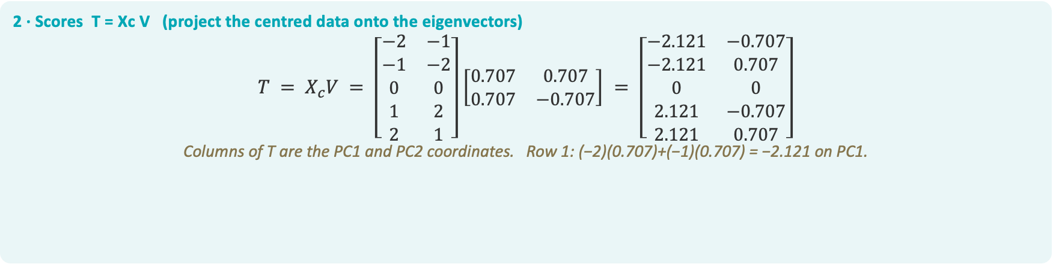
Step 4 · Loadings & Scores
Loadings are the columns of V; scores are the centred data projected onto them — T = Xc V.
1 · Loadings = columns of V (the weight of each variable on each PC)
$$p₁ = \left[\begin{matrix}0.707 \\ 0.707\end{matrix}\right] (PC1) p₂ = \left[\begin{matrix}0.707 \\ −0.707\end{matrix}\right] (PC2)$$
2 · Scores T = Xc V (project the centred data onto the eigenvectors)
$$T = X_{c}V = \left[\begin{matrix}−2 & −1 \\ −1 & −2 \\ 0 & 0 \\ 1 & 2 \\ 2 & 1\end{matrix}\right]\left[\begin{matrix}0.707 & 0.707 \\ 0.707 & −0.707\end{matrix}\right] = \left[\begin{matrix}−2.121 & −0.707 \\ −2.121 & 0.707 \\ 0 & 0 \\ 2.121 & −0.707 \\ 2.121 & 0.707\end{matrix}\right]$$
Columns of T are the PC1 and PC2 coordinates. Row 1: (−2)(0.707)+(−1)(0.707) = −2.121 on PC1.

Slide 93
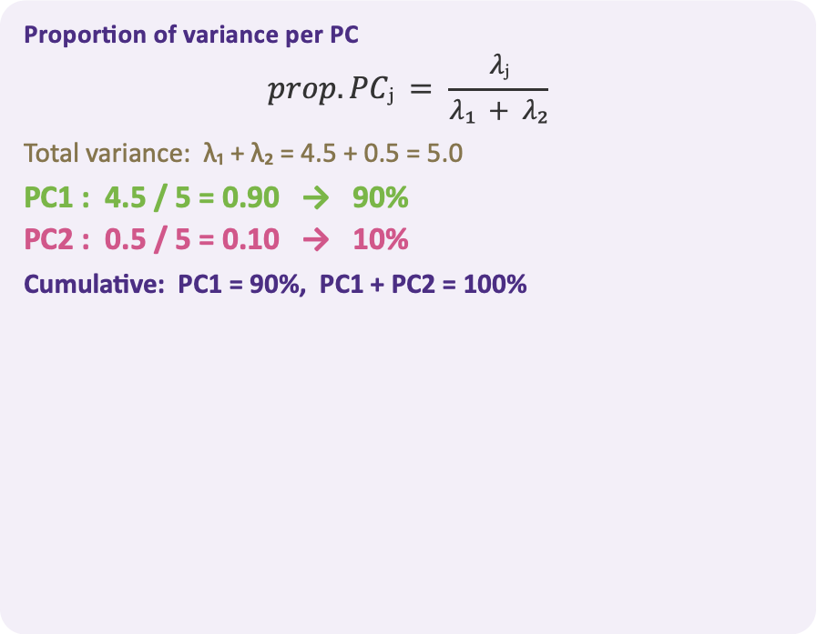
Step 5 · Variance Explained
Each eigenvalue is the variance along its PC; divide by the total to get the share — λⱼ / Σλ.
Proportion of variance per PC
$$prop. PCⱼ = \frac{λⱼ}{λ₁ + λ₂}$$
Total variance: λ₁ + λ₂ = 4.5 + 0.5 = 5.0
PC1 : 4.5 / 5 = 0.90 → 90%
PC2 : 0.5 / 5 = 0.10 → 10%
Cumulative: PC1 = 90%, PC1 + PC2 = 100%

Slide 95
Step 6 · Plotting the Biplot
Plot the scores in PC space and overlay each original variable as a vector from the origin.
Plotting PC1, PC2 & the variable vectors
1 · Axes = the PCs. PC1 on the x-axis, PC2 on the y-axis; the origin is the data mean.
2 · Plot the scores. Place each row of T at its (PC1, PC2) — e.g. obs 1 → (−2.12, −0.71).
3 · Draw variable arrows. From the origin along each variable's loadings (a row of V): x₁ → (0.707, 0.707), x₂ → (0.707, −0.707).
4 · Interpret. Arrow direction = how a variable aligns with the PCs; points spread mostly along PC1 (90% of variance).
PC2 (10%)
x₁
2
5
3
PC1 (90%)
1
4
x₂

Slide 97

PCA via Singular Value Decomposition
In practice PCA is computed from the SVD of the centered data — more numerically stable than forming S = X꜀ᵀX꜀ explicitly.
$$X_{c}=UΣV^{T}$$
U (n×n)
Σ (n×p)
V (p×p)
Left singular vectors — orthonormal
Diagonal singular values σ₁ ≥ σ₂ ≥ …
Right singular vectors = PCA loadings
$$Eigen−route: S=\frac{1}{n−1}X_{c}^{T}X_{c}=V\frac{Σ^{T}Σ}{n−1}V^{T} ⇒ λ_{j}=\frac{σ_{j}^{2}}{n−1}$$
$$Scores: T=X_{c}V=UΣ$$
$$Rank−k (Eckart–Young): X_{c}≈U_{k}Σ_{k}V_{k}^{T} minimizes {\left\|X_{c}−X̂\right\|}_{F}$$
Cost: full SVD is O(n p · min(n,p)); truncated / randomized SVD gives the top k components far faster.

Slide 99
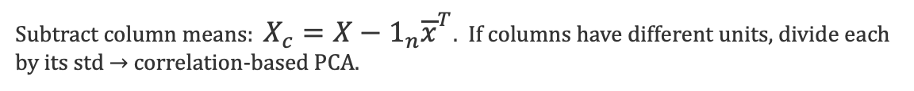
PCA — Computation Algorithm
1
Center (and scale)
Subtract column means: $X_{c}=X−1_{n}{\overline{x}}^{T}$. If columns have different units, divide each by its std → correlation-based PCA.
2
Form covariance
$S=\frac{1}{n−1}{X_{c}}^{T}X_{c}$ ( p×p symmetric, positive semi-definite ).
3
Eigen-decompose
Solve $Sv_{j}=λ_{j}v_{j}$. Sort $λ_{1}≥ … ≥λ_{p}≥ 0$; eigenvectors form the columns of V.
4
Choose k
Apply Kaiser / scree / cumulative-variance / parallel-analysis rules.
5
Project
Scores $T_{k}=X_{c}V_{k}$. Each row is an observation's coordinates in k-D.
6
Interpret / reconstruct
Read loadings $V_{k}$; reconstruct $\hat{X}=T_{k}{V_{k}}^{T}+1_{n}{\overline{x}}^{T}$ if needed.

Slide 101



Worked Example 1 — Step 1: Data & Centering
Example 1 · 1 / 6
1 · Data matrix X
$$X = \left[\begin{matrix}4 & 5 \\ 8 & 9 \\ 6 & 5 \\ 10 & 11 \\ 2 & 0\end{matrix}\right]$$
n = 5 students, p = 2 scores
2 · Column means → x̄
$$\bar{x} = \left[\begin{matrix}6 \\ 6\end{matrix}\right]$$
x̄₁ = (4+8+6+10+2)/5 = 6
x̄₂ = (5+9+5+11+0)/5 = 6
3 · Center: Xc = X − 1ₙx̄ᵀ
$$\left[\begin{matrix}−2 & −1 \\ 2 & 3 \\ 0 & −1 \\ 4 & 5 \\ −4 & −6\end{matrix}\right]$$
subtract x̄ = (6, 6) from every row

Slide 103



Worked Example 1 — Step 2: Covariance Matrix
Example 1 · 2 / 6
1 · Cross-product matrix XcᵀXc (2×5 · 5×2 → 2×2)
$$X_{c}^{T}X_{c} = \left[\begin{matrix}40 & 50 \\ 50 & 72\end{matrix}\right]$$
Σxᵢ² = 4+4+0+16+16 = 40, Σyᵢ² = 1+9+1+25+36 = 72, Σxᵢyᵢ = 2+6+0+20+24 = 50
2 · Scale by 1/(n−1) = 1/4 → covariance matrix S
$$S = \frac{1}{4}\left[\begin{matrix}40 & 50 \\ 50 & 72\end{matrix}\right] = \left[\begin{matrix}10.0 & 12.5 \\ 12.5 & 18.0\end{matrix}\right]$$
3 · Useful summaries
$$tr(S) = 10 + 18 = 28 det(S) = (10)(18) − 12.5² = 23.75$$

Slide 105



Worked Example 1 — Step 3: Eigenvalues
Example 1 · 3 / 6
1 · Characteristic equation det(S − λI) = 0
$$det\left|\begin{matrix}10 − λ & 12.5 \\ 12.5 & 18 − λ\end{matrix}\right| = \left(10 − λ\right)\left(18 − λ\right) − {12.5}^{2} = 0$$
2 · Expand to a quadratic in λ
$$λ^{2} − 28λ + (180 − 156.25) = 0 ⇒ λ^{2} − 28λ + 23.75 = 0$$
3 · Solve with the quadratic formula
$$λ = \frac{28 ± √(784 − 95)}{2} = \frac{28 ± √689}{2}$$
⇒ λ₁ ≈ 27.12 λ₂ ≈ 0.88

Slide 107



Worked Example 1 — Step 4: Eigenvectors
Example 1 · 4 / 6
1 · Solve (S − λ₁I)v = 0 with λ₁ = 27.12
$$(10 − 27.12)v₁ + 12.5 v₂ = 0 ⇒ −17.12 v₁ + 12.5 v₂ = 0 ⇒ v₂ = 1.370 v₁$$
2 · Choose a free value, then normalize to unit length
$$v = (1, 1.370) ‖v‖ = √(1² + 1.370²) = √2.876 = 1.696$$
$$v₁ = (1/1.696)(1, 1.370) = (0.590, 0.808)$$
3 · Second eigenvector (perpendicular to v₁)
$$v₂ = (−0.808, 0.590)$$
v₂ ⊥ v₁ (v₁ · v₂ = 0) and is also unit length

Slide 109

Worked Example 1 — Step 5: Variance Explained
Example 1 · 5 / 6
1 · Total variance = trace of S
$$tr(S) = λ₁ + λ₂ = 27.12 + 0.88 = 28$$
2 · Share of total variance
PC1 : 27.12 / 28 = 96.9%
PC2 : 0.88 / 28 = 3.1%
3 · Takeaway
PC1 alone captures ≈ 97% of the variance — the data is essentially one-dimensional.

Slide 111

Worked Example 1 — Step 6: Scores
Example 1 · 6 / 6
1 · Project the centred data onto PC1: T₁ = Xc · v₁
$$T₁ = X_{c}v₁ = \left[\begin{matrix}−2 & −1 \\ 2 & 3 \\ 0 & −1 \\ 4 & 5 \\ −4 & −6\end{matrix}\right]\left[\begin{matrix}0.590 \\ 0.808\end{matrix}\right] = \left[\begin{matrix}−1.99 \\ 3.60 \\ −0.81 \\ 6.40 \\ −7.21\end{matrix}\right]$$
2 · Read the result
Row 1: (−2)(0.590) + (−1)(0.808) = −1.99 Row 4: 4(0.590) + 5(0.808) = 6.40
PC1 ranks the 5 students on one “overall-ability” axis — Student 4 is highest (6.40), Student 5 lowest (−7.21).

Slide 113


Worked Example 2 — Step 1: Standardize → R
Example 2 · 1 / 5
1 · Standardize each variable to a z-score
$$zⱼ = \frac{xⱼ − x̄ⱼ}{sⱼ} (mean 0, variance 1)$$
2 · Correlation matrix R = (1/(n−1)) ZᵀZ (3 variables)
$$R = \left[\begin{matrix}1.0 & 0.8 & 0.4 \\ 0.8 & 1.0 & 0.5 \\ 0.4 & 0.5 & 1.0\end{matrix}\right]$$
3 · Note
$$tr(R) = 1 + 1 + 1 = 3$$
every standardized variable has variance 1, so R has 1s on the diagonal

Slide 115

Worked Example 2 — Step 2: Eigenvalues of R
Example 2 · 2 / 5
1 · Characteristic equation det(R − λI) = 0 (3×3 → cubic)
$$det\left|\begin{matrix}1 − λ & 0.8 & 0.4 \\ 0.8 & 1 − λ & 0.5 \\ 0.4 & 0.5 & 1 − λ\end{matrix}\right| = 0$$
expands to: λ³ − 3λ² + 1.95λ − 0.27 = 0 (solve numerically)
2 · Three eigenvalues, sorted largest first
λ₁ = 2.18 λ₂ = 0.62 λ₃ = 0.20
3 · Sanity check — eigenvalues sum to the trace
$$λ₁ + λ₂ + λ₃ = 2.18 + 0.62 + 0.20 = 3.00 = tr(R) ✓$$

Slide 117


Worked Example 2 — Step 3: Variance & Retention
Example 2 · 3 / 5
1 · Proportion of variance = λⱼ / tr(R), tr(R) = 3
$$PC1: 2.18/3 = 72.7\% PC2: 0.62/3 = 20.7\% PC3: 0.20/3 = 6.7\%$$
2 · Cumulative variance
$$72.7\% → 93.3\% → 100\%$$
3 · How many components to keep? — Kaiser rule (λ > 1)
only λ₁ = 2.18 > 1 ⇒ retain PC1
on a correlation matrix the average eigenvalue is 1, so keep components above the average

Slide 119


Worked Example 2 — Step 4: First Eigenvector
Example 2 · 4 / 5
1 · Solve (R − λ₁I)v₁ = 0 for λ₁ = 2.18
$$R − 2.18 I = \left[\begin{matrix}−1.18 & 0.8 & 0.4 \\ 0.8 & −1.18 & 0.5 \\ 0.4 & 0.5 & −1.18\end{matrix}\right]$$
find the null-space direction of this matrix, then scale to unit length
2 · Normalized first eigenvector
$$v₁ = \left[\begin{matrix}0.60 \\ 0.63 \\ 0.49\end{matrix}\right] ( ‖v₁‖ = 1 )$$
3 · Interpretation
all three entries are positive and similar in size ⇒ PC1 is a 'general / overall level' factor
PC1 is essentially a weighted average of the three standardized variables

Slide 121

Worked Example 2 — Step 5: Correlation Loadings
Example 2 · 5 / 5
1 · A loading is the correlation of a variable with the PC
$$corr(zⱼ, PC1) = vⱼ · √λ₁$$
2 · Compute (√λ₁ = √2.18 = 1.476)
corr(z₁, PC1) = 0.60 · 1.476 = 0.89
corr(z₂, PC1) = 0.63 · 1.476 = 0.93
corr(z₃, PC1) = 0.49 · 1.476 = 0.72
3 · Key takeaway
PCA on R ≠ PCA on S unless all variables share the same scale
standardize first whenever the variables are measured in different units

Slide 123


Worked Example 3 — Step 1: The SVD Factorization
Example 3 · 1 / 5
1 · Factorize the centred data directly — no covariance needed
$$X_{c} = UΣV^{T}$$
2 · The three factors
U (5×2): left singular vectors (orthonormal columns)
Σ (2×2): diagonal of singular values σ₁ ≥ σ₂ ≥ 0
Vᵀ (2×2): right singular vectors = PCA loadings
3 · Same Xc as Example 1
$$X_{c} = \left[\begin{matrix}−2 & −1 \\ 2 & 3 \\ 0 & −1 \\ 4 & 5 \\ −4 & −6\end{matrix}\right]$$

Slide 125


Worked Example 3 — Step 2: Singular Values
Example 3 · 2 / 5
1 · Singular values are linked to XcᵀXc
$$X_{c}^{T}X_{c} = VΣ^{2}V^{T} ⇒ σ^{2}ⱼ = (n − 1) λⱼ$$
2 · Compute (n − 1 = 4, λ from Example 1)
σ₁ = √(4 · 27.12) = √108.6 = 10.42
σ₂ = √(4 · 0.88) = √3.52 = 1.88
3 · The Σ matrix
$$Σ = \left[\begin{matrix}10.42 & 0 \\ 0 & 1.88\end{matrix}\right]$$

Slide 127

Worked Example 3 — Step 3: Connect to Eigenvalues
Example 3 · 3 / 5
1 · Eigenvalue ↔ singular value
$$λⱼ = \frac{σ^{2}ⱼ}{n − 1}$$
2 · Check against Example 1
λ₁ = 10.42² / 4 = 108.6 / 4 = 27.12 ✓
λ₂ = 1.88² / 4 = 3.52 / 4 = 0.88 ✓
3 · Same answer, two routes
Eigen-decomposition of S and SVD of Xc give identical principal components
SVD reaches the same PCA without ever forming the covariance matrix

Slide 129


Worked Example 3 — Step 4: Loadings & Scores
Example 3 · 4 / 5
1 · Loadings = columns of V (right singular vectors)
$$V = \left[\begin{matrix}0.590 & −0.808 \\ 0.808 & 0.590\end{matrix}\right]$$
identical to Example 1's eigenvectors v₁, v₂
2 · Scores come for free
$$T = X_{c}V = (U Σ V^{T}) V = U Σ$$
because VᵀV = I — no separate projection needed
3 · Read the scores
column j of the score matrix = σⱼ × (column j of U)

Slide 131
Worked Example 3 — Step 5: Why Use SVD?
Example 3 · 5 / 5
1 · Numerical stability
Forming XcᵀXc squares the condition number and can lose precision. SVD factorizes Xc directly, staying accurate even when columns are nearly collinear.
2 · Truncated SVD → top-k components
Keep only the first k columns — (Uₖ, Σₖ, Vₖ) — to obtain the top k PCs. Efficient when p is very large: text, images, genomics.
3 · Best low-rank approximation — Eckart–Young
Xc ≈ Uₖ Σₖ Vₖᵀ is the optimal rank-k approximation of Xc, minimizing both the Frobenius and spectral-norm error — the foundation of PCA-based compression.

Slide 133

Exercise 1 — The Problem
Exercise 1 · 1 / 4
Given — covariance matrix S
$$S = \left[\begin{matrix}5 & 2 \\ 2 & 2\end{matrix}\right]$$
Find
(a) the eigenvalues of S
(b) the unit eigenvector for the larger eigenvalue
(c) the fraction of total variance explained by PC1

Slide 135


Exercise 1 — Solution (a): Eigenvalues
Exercise 1 · 2 / 4
1 · Characteristic equation det(S − λI) = 0
$$det\left|\begin{matrix}5 − λ & 2 \\ 2 & 2 − λ\end{matrix}\right| = \left(5 − λ\right)\left(2 − λ\right) − 4 = 0$$
2 · Expand and factor
$$λ^{2} − 7λ + 6 = 0 ⇒ (λ − 6)(λ − 1) = 0$$
3 · Eigenvalues
λ₁ = 6 λ₂ = 1

Slide 137


Exercise 1 — Solution (b): Unit Eigenvector
Exercise 1 · 3 / 4
1 · Solve (S − λ₁I)v = 0 for λ₁ = 6
$$(5 − 6)v₁ + 2v₂ = 0 ⇒ −v₁ + 2v₂ = 0 ⇒ v₁ = 2v₂$$
2 · Pick a vector, then normalize to unit length
$$v = (2, 1), ‖v‖ = √(2² + 1²) = √5$$
$$v₁ = (1/√5)(2, 1) = (0.894, 0.447)$$
3 · Second eigenvector (orthogonal)
$$v₂ = (−0.447, 0.894)$$
perpendicular to v₁ and also unit length

Slide 139


Exercise 1 — Solution (c): Variance Explained
Exercise 1 · 4 / 4
1 · Total variance = trace of S
$$tr(S) = 5 + 2 = 7 = λ₁ + λ₂ ✓$$
2 · Fraction of variance carried by PC1
$$PC1 share = \frac{λ₁}{λ₁ + λ₂} = \frac{6}{7} = 0.857$$
3 · Answer
PC1 explains ≈ 85.7% of the total variance

Slide 141

Exercise 2 — The Problem
Exercise 2 · 1 / 4
Given — eigenvalues from 6 standardized variables
$$λ = (3.1, 1.4, 0.7, 0.4, 0.25, 0.15)$$
standardized data → total variance Σλ = 6
Find
(a) how many components the Kaiser rule (λ > 1) keeps
(b) how many components are needed to reach ≥ 80% cumulative variance
(c) where the elbow of the scree plot lies

Slide 143

Exercise 2 — Solution (a): Kaiser Rule
Exercise 2 · 2 / 4
1 · The Kaiser rule
Keep every component with λⱼ > 1. For standardized data the average eigenvalue is exactly 1, so this retains the above-average components.
2 · Compare each eigenvalue with 1
$$3.1 > 1 ✓ 1.4 > 1 ✓ 0.7$$
3 · Answer
Kaiser keeps 2 components — PC1 and PC2

Slide 145
Exercise 2 — Solution (b): Cumulative Variance
Exercise 2 · 3 / 4
1 · Variance share (λⱼ / 6)
PC1: 3.1 / 6 = 51.7%
PC2: 1.4 / 6 = 23.3%
PC3: 0.7 / 6 = 11.7%
2 · Cumulative
PC1 = 51.7%
PC1+PC2 = 75.0%
PC1+PC2+PC3 = 86.7% ← first ≥ 80%
3 · Answer
3 components are needed to exceed 80%

Slide 147
Exercise 2 — Solution (c): Scree Elbow
Exercise 2 · 4 / 4
1 · Drops between successive eigenvalues
3.1 → 1.4 (big drop, −1.7)
1.4 → 0.7 (−0.7)
0.7 → 0.4 → 0.25 → 0.15 (small, flat tail)
2 · Where is the elbow?
the curve flattens after PC2 → elbow at 2 components
3 · Takeaway
Kaiser and the scree elbow agree on 2; the 80% rule wants 3. Rules can disagree — state your choice and the variance retained.

Slide 149
Exercise 3 — The Problem
Exercise 3 · 1 / 4
Answer these conceptual questions about PCA
(a) Why must the data be centred before running PCA?
(b) When should you use the correlation matrix R instead of the covariance matrix S?
(c) A colleague keeps the PCs with the largest loading magnitudes — not the largest eigenvalues. What is wrong with that?

Slide 151
Exercise 3 — Solution (a): Why Centre the Data?
Exercise 3 · 2 / 4
The principle
PCA looks for the directions of maximum variance about the mean — spread is always measured relative to the data's centroid.
Without centring
The first component is pulled toward the mean vector (the origin → centroid direction). It then measures squared distance from the origin, not spread — so the decomposition no longer describes variance at all.
Takeaway
Always subtract each column's mean first: Xc = X − 1ₙ x̄ᵀ.

Slide 153
Exercise 3 — Solution (b): Correlation R vs Covariance S
Exercise 3 · 3 / 4
Use the correlation matrix R
When variables are on different units or scales. Standardizing makes every variable have variance 1, so a high-variance unit (e.g. income in dollars) can't dominate PC1 just because of its scale.
Use the covariance matrix S
When all variables share comparable units and their differing variances are meaningful and worth preserving.
Rule of thumb
Different units → R. Same units → S.

Slide 155
Principal Component
Analysis (PCA)
5
BDATA 412: Advanced Data Visualization
University of Washington

