Slide 1
Correspondence Analysis
and MCA
6
BDATA 412: Advanced Data Visualization
University of Washington

Slide 3
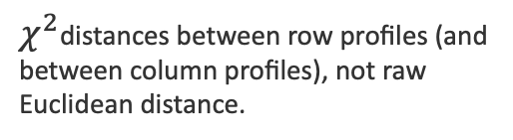
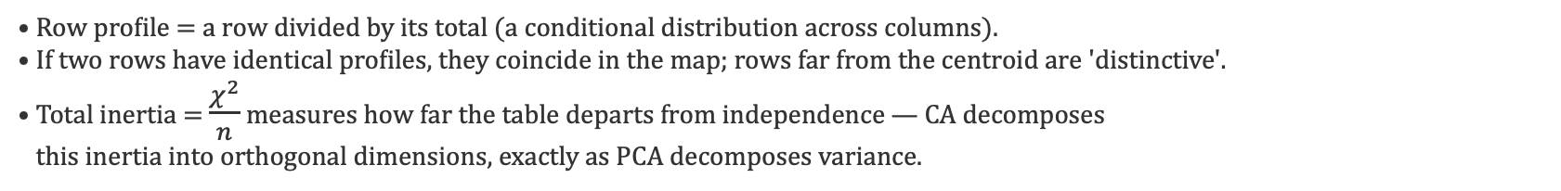
Correspondence Analysis — The Core Idea
CA is "PCA for categorical data": it turns a contingency table of counts into a low-dimensional map where row and column categories with similar profiles sit close together.
Input
What it preserves
Output
A two-way contingency table N (counts) — e.g., brands × attributes, regions × responses.
$χ^{2}$distances between row profiles (and between column profiles), not raw Euclidean distance.
A biplot: rows and columns as points in the same space; proximity ⇒ association.
Central concept — profiles & inertia
• Row profile = a row divided by its total (a conditional distribution across columns).
• If two rows have identical profiles, they coincide in the map; rows far from the centroid are 'distinctive'.
• Total inertia = $\frac{χ^{2}}{n}$ measures how far the table departs from independence — CA decomposes
this inertia into orthogonal dimensions, exactly as PCA decomposes variance.

Slide 5
Correspondence Analysis — The Intuition
CA is PCA for categorical contingency tables — it turns a cross-tab into a map.
The data: a contingency table
What CA asks
Which rows have similar distributions across the columns?
Which columns tend to be associated with which rows?
 | Cat A | Cat B | Cat C
Group 1 | 20 | 10 | 5
Group 2 | 5 | 25 | 10
Group 3 | 10 | 8 | 22
What you get
A low-dimensional map — usually 2-D — where rows with similar profiles sit close together, and so do similar columns. A row near a column suggests they are associated.

Slide 7
The χ² Test for Contingency Tables
Testing whether two categorical variables are independent.
H₀ — Null hypothesis
The row and column variables are independent: the observed counts match what independence would predict.
H₁ — Alternative hypothesis
The two variables are associated: the observed counts depart from the independence pattern.
The idea
Compare each observed count O with the count E expected under independence. Large gaps are evidence of association.

Slide 9
The Test Statistic
Total squared departure from independence, scaled by the expected counts.
1 · Expected counts under H₀
Eᵢⱼ = (rowᵢ × colⱼ) ⁄ n
2 · The χ² statistic
χ² = ∑ᵢ ∑ⱼ (Oᵢⱼ − Eᵢⱼ)² ⁄ Eᵢⱼ
sums the standardized squared gaps over every cell
3 · Distribution and decision
Under H₀, χ² follows a χ² distribution with df = (I−1)(J−1). Reject H₀ when χ² exceeds the critical value (p

Slide 11
Example — Step 1: The Data
Is hair color associated with eye color? (n = 100)
Observed counts (O)
 | Blue | Brown | Total
Fair | 30 | 10 | 40
Dark | 10 | 50 | 60
Total | 40 | 60 | 100
The hypotheses
H₀ (independence)
Hair color and eye color are independent — no association.
H₁ (association)
Hair color and eye color are associated.

Slide 13
Example — Step 2: Expected Counts
Under H₀, each cell's expected count is row × column ÷ n.
The rule
Eᵢⱼ = (rowᵢ × colⱼ) / n
Expected counts (E)
 | Blue | Brown
Fair | 16 | 24
Dark | 24 | 36
Cell by cell
E(Fair, Blue) = 40 × 40 / 100 = 16 E(Fair, Brown) = 40 × 60 / 100 = 24 E(Dark, Blue) = 60 × 40 / 100 = 24 E(Dark, Brown) = 60 × 60 / 100 = 36
Expected counts are what we'd see if hair and eye color were perfectly independent. The χ² statistic measures how far the observed counts stray from these.

Slide 15
Example — Step 3: The χ² Statistic
Add up (O − E)² / E across all four cells.
Cell contributions (O − E)² / E
(30 − 16)² / 16 = 12.25 (10 − 24)² / 24 = 8.17 (10 − 24)² / 24 = 8.17 (50 − 36)² / 36 = 5.44
Total
χ² = 12.25 + 8.17 + 8.17 + 5.44 = 34.03

Slide 17
Example — Step 4: Degrees of Freedom & Decision
Compare the statistic with the critical value.
Degrees of freedom
Critical value (α = 0.05)
df = (I − 1)(J − 1) = (2 − 1)(2 − 1) = 1
χ²(0.05, df = 1) = 3.84
Decision
χ² = 34.03 > 3.84 ⇒ reject H₀ (p < 0.001)
The data show a strong association between hair color and eye color.

Slide 19
Connecting the χ² Test and CA
Correspondence Analysis decomposes the very same χ².
Same quantity, two views
χ² = n × total inertia ⇒ total inertia = χ² / n = 34.03 / 100 = 0.3403
What CA adds
CA splits the total inertia into orthogonal dimensions — the principal inertias σ²ₖ that sum to the total. Each dimension captures part of the association.
The big picture
The χ² test tells you IF an association exists; CA shows you WHERE it comes from — which rows and columns drive it, and on which dimensions.

Slide 21
Reading a CA Map
CA is "PCA for categorical data": it turns a contingency table of counts into a low-dimensional map where row and column categories with similar profiles sit close together.
Proximity = similarity
Rows close together have similar column profiles.
Columns close together have similar row profiles.
A row point near a column point suggests the two categories are associated.
Distance from the origin
Points near the origin match the average, the independence pattern.
Points far from the origin contribute more to the association structure.
CA turns a cross-tab into a picture of which row and column categories go together.

Slide 23



CA Decomposes the Pearson χ²
CA does not maximize counts; it studies deviations from independence.
1 · Proportions and masses
$$P = \frac{N}{n} r = P1 c = P^{T}1$$
2 · Standardized residuals (departure from independence rcᵀ)
$$S = D_{r}^{−1/2}\left(P − rc^{T}\right)D_{c}^{−1/2}$$
3 · SVD gives the principal inertias
$$S = UΣV^{T} total inertia = Σσ^{2}ₖ = \frac{χ²}{n} ⇒ χ² = n · inertia$$

Slide 25
CA Decomposes the Pearson χ²
CA does not maximize counts; it studies deviations from independence.
The objective
CA finds the dimensions that capture the largest share of χ² inertia. The first axis explains the largest departure from independence; each later axis is orthogonal and explains the largest remaining part.
PCA
CA
• Maximizes variance • Uses Euclidean distance • For continuous variables
• Maximizes χ² inertia • Uses chi-square distance • For categorical profiles
CA shows which row and column categories are responsible for the association in a contingency table.

Slide 27
Correspondence Analysis — Reading the Map
How to read it
Dim 2 (27%)
• Near the origin = average profile (close to independence); far out = distinctive. • Row–row / col–col proximity ⇒ similar profiles. • Row near a column point ⇒ that combination occurs more than independence predicts (positive association). • Axis % = share of total inertia explained by that dimension; report them like PCA variance. • Caution (symmetric map): row–column distances are only suggestive — strictly, interpret each cloud's geometry separately.
C: Sport
R: Young
R: Mid
C: Sedan
Dim 1 (58%)
R: Senior
C: Luxury
● rows (e.g. age groups) ▲ columns (e.g. car type)

Slide 29


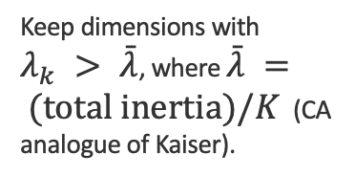
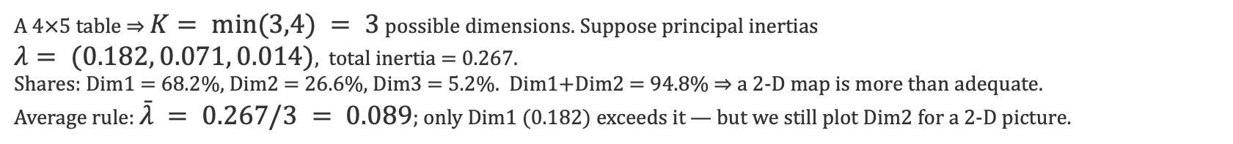
CA — How Many Dimensions to Keep
The map has at most K = min(I−1, J−1) dimensions for an I×J table. Choose how many to display.
Inertia explained
Scree of inertia
Average rule
Interpretability
Each dimension k explains $\frac{λ_{k}}{Σλ}$ of total inertia. Keep enough to reach ~70–80%.
Plot $λ_{k} vs k$; keep dimensions before the elbow — same logic as PCA's scree plot.
Keep dimensions with $λ_{k} > \bar{λ}$, where $\bar{λ} = (total inertia)/K$ (CA analogue of Kaiser).
Two dimensions are usually plotted for a readable biplot; a 3rd only if clearly meaningful.
Worked illustration
A 4×5 table ⇒ $K= min(3,4) = 3$ possible dimensions. Suppose principal inertias
$λ= (0.182, 0.071, 0.014)$, total inertia = 0.267.
Shares: Dim1 = 68.2%, Dim2 = 26.6%, Dim3 = 5.2%. Dim1+Dim2 = 94.8% ⇒ a 2-D map is more than adequate.
Average rule: $\bar{λ} = 0.267/3 = 0.089$; only Dim1 (0.182) exceeds it — but we still plot Dim2 for a 2-D picture.

Slide 31
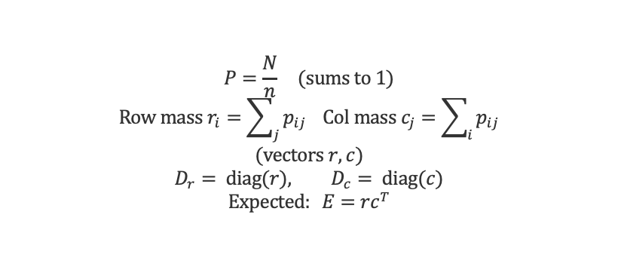
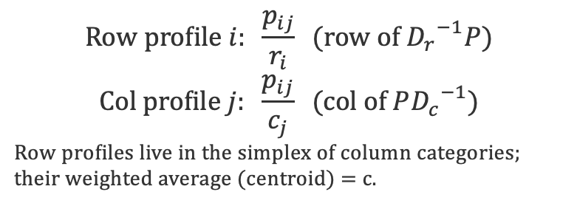
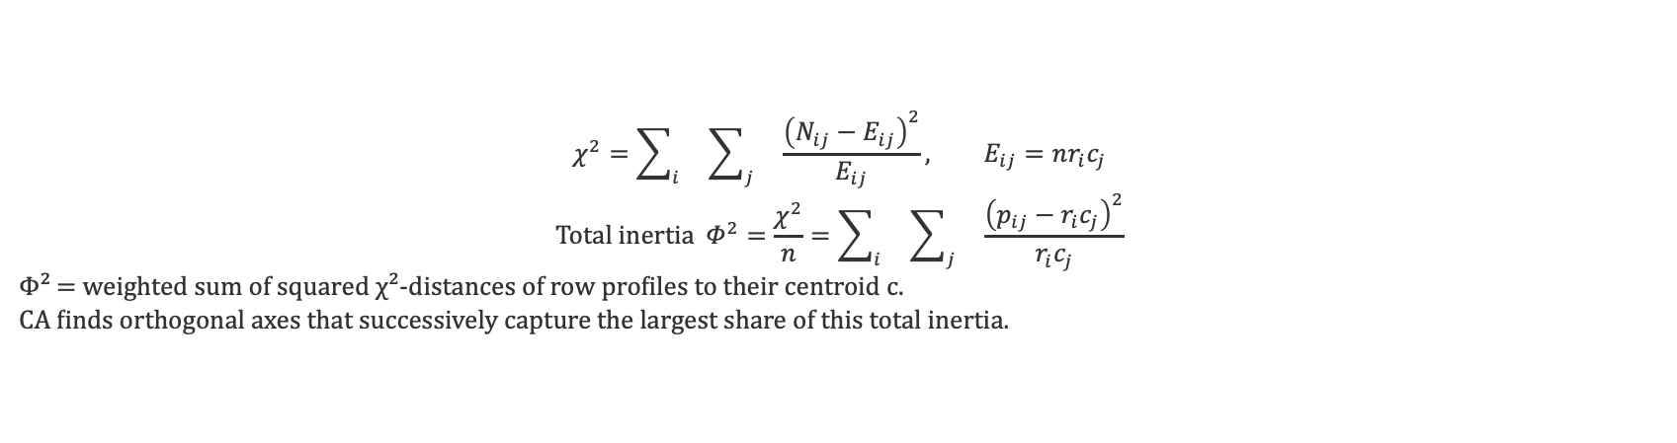
CA — Matrix Formulation (1): Profiles & Inertia
Start from the I×J count table N with grand total n. Work with proportions, masses, and expected values.
Correspondence matrix & masses
Profiles
$$P=\frac{N}{n} (sums to 1)$$
$$Row mass r_{i}=\sum_{j}{p_{ij}} Col mass c_{j}=\sum_{i}{p_{ij}}$$
$$(vectors r, c)$$
$$D_{r}= diag(r), D_{c}= diag(c)$$
$$Expected: E=rc^{T}$$
$$Row profile i: \frac{p_{ij}}{r_{i}} (row of {D_{r}}^{−1}P)$$
$$Col profile j: \frac{p_{ij}}{c_{j}} (col of P{D_{c}}^{−1})$$
Row profiles live in the simplex of column categories; their weighted average (centroid) = c.
Total inertia = χ²/n
$$χ^{2}=\sum_{i}{}\sum_{j}{}\frac{{\left(N_{ij}−E_{ij}\right)}^{2}}{E_{ij}}, E_{ij}=nr_{i}c_{j}$$
$$Total inertia Φ^{2}=\frac{χ^{2}}{n}=\sum_{i}{}\sum_{j}{}\frac{{\left(p_{ij}−r_{i}c_{j}\right)}^{2}}{r_{i}c_{j}}$$
Φ² = weighted sum of squared χ²-distances of row profiles to their centroid c.
CA finds orthogonal axes that successively capture the largest share of this total inertia.

Slide 33
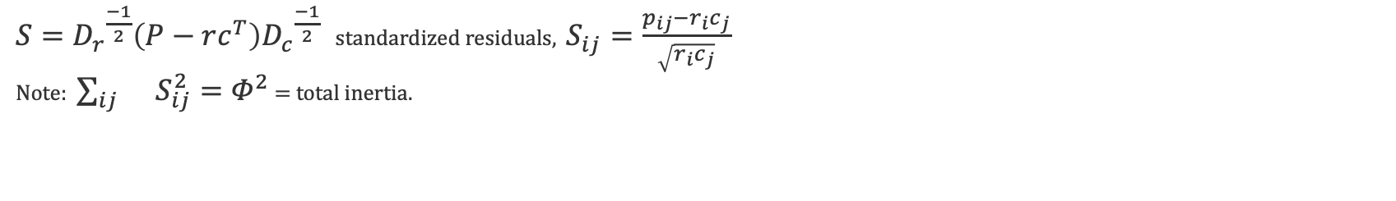
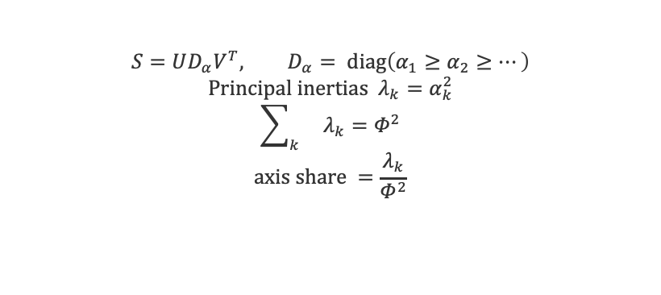
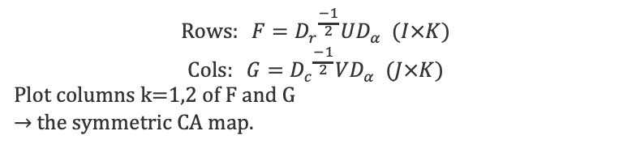
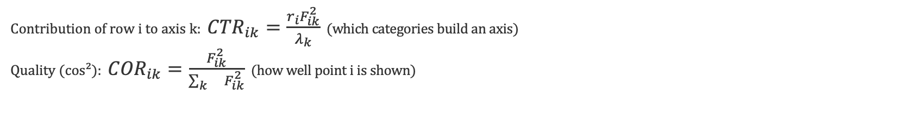
CA — Matrix Formulation (2): SVD & Coordinates
Step 1 — Standardized residual matrix
$S={D_{r}}^{\frac{−1}{2}}\left(P−rc^{T}\right){D_{c}}^{\frac{−1}{2}}$ standardized residuals, $S_{ij}=\frac{p_{ij}−r_{i}c_{j}}{\sqrt{r_{i}c_{j}}}$
Note: $\sum_{ij}{}S_{ij}^{2}=Φ^{2}$ = total inertia.
Step 2 — SVD of S
Step 3 — Principal coordinates
$$S=UD_{α}V^{T}, D_{α}= diag\left(α_{1}≥α_{2}≥…\right)$$
$$Principal inertias λ_{k}=α_{k}^{2}$$
$$\sum_{k}{}λ_{k}=Φ^{2}$$
$$axis share =\frac{λ_{k}}{Φ^{2}}$$
$$Rows: F={D_{r}}^{\frac{−1}{2}}UD_{α} (I×K)$$
$$Cols: G={D_{c}}^{\frac{−1}{2}}VD_{α} (J×K)$$
Plot columns k=1,2 of F and G
→ the symmetric CA map.
Diagnostics — contributions & quality
Contribution of row i to axis k: ${CTR}_{ik}=\frac{r_{i}F_{ik}^{2}}{λ_{k}}$ (which categories build an axis)
Quality (cos²): ${COR}_{ik}=\frac{F_{ik}^{2}}{\sum_{k}{}F_{ik}^{2}}$ (how well point i is shown)

Slide 35
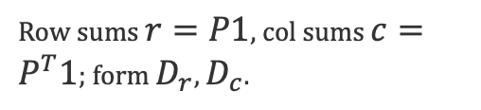

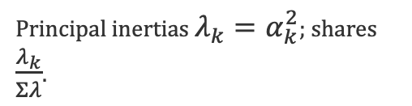

CA — Computation Algorithm
1
Build P = N/n
2
Masses r, c
3
Residual matrix S
Divide the contingency table by its grand total.
Row sums $r=P1$, col sums $c=P^{T}1$; form $D_{r}$, $D_{c}$.
$$S={D_{r}}^{\frac{−1}{2}}\left(P−rc^{T}\right){D_{c}}^{\frac{−1}{2}}$$
4
SVD S = U Dₐ Vᵀ
5
Coordinates F, G
6
Plot & diagnose
Principal inertias $λ_{k}=α_{k}^{2}$; shares $\frac{λ_{k}}{Σλ}$.
$F={D_{r}}^{\frac{−1}{2}}UD_{α}$, $G={D_{c}}^{\frac{−1}{2}}VD_{α}$.
Plot dims 1–2; report contributions & cos² quality.

Slide 37



CA Example 1 — Step 1: Table & Masses
CA Example 1 · 1 / 6
1 · Contingency table N (Hair × Eye)
$$N = \left[\begin{matrix}30 & 10 \\ 10 & 50\end{matrix}\right]$$
rows = Fair, Dark · columns = Blue, Brown · totals 40/60, grand total n = 100
2 · Correspondence matrix P = N / n
$$P = \left[\begin{matrix}0.30 & 0.10 \\ 0.10 & 0.50\end{matrix}\right]$$
3 · Masses (margins of P)
$$r = (0.40, 0.60)$$
$$c = (0.40, 0.60)$$

Slide 39

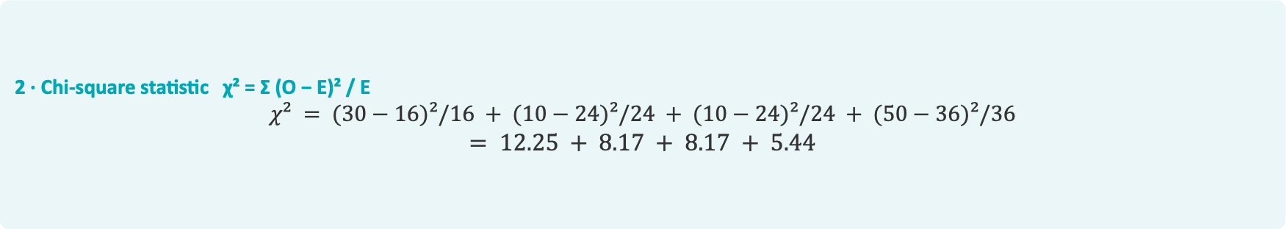
CA Example 1 — Step 2: Expected Counts & χ²
CA Example 1 · 2 / 6
1 · Expected counts under independence Eᵢⱼ = (rowᵢ · colⱼ) / n
$$E = \left[\begin{matrix}16 & 24 \\ 24 & 36\end{matrix}\right]$$
e.g. E₁₁ = 40·40 / 100 = 16, E₂₂ = 60·60 / 100 = 36
2 · Chi-square statistic χ² = Σ (O − E)² / E
$$χ² = (30−16)²/16 + (10−24)²/24 + (10−24)²/24 + (50−36)²/36$$
$$= 12.25 + 8.17 + 8.17 + 5.44$$
3 · Result
χ² = 34.03

Slide 41
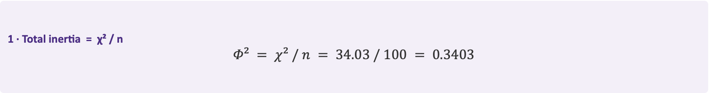

CA Example 1 — Step 3: Total Inertia
CA Example 1 · 3 / 6
1 · Total inertia = χ² / n
$$Φ² = χ² / n = 34.03 / 100 = 0.3403$$
2 · How many dimensions?
$$K = min(I − 1, J − 1) = min(1, 1) = 1$$
a 2×2 table needs only one axis — it captures 100% of the inertia

Slide 43


CA Example 1 — Step 4: Standardized Residuals
CA Example 1 · 4 / 6
1 · Standardized residual Sᵢⱼ = (pᵢⱼ − rᵢcⱼ) / √(rᵢcⱼ)
$$r cᵀ = \left[\begin{matrix}0.16 & 0.24 \\ 0.24 & 0.36\end{matrix}\right] (the independence model)$$
2 · Compute each entry
$$S = \left[\begin{matrix}0.350 & −0.286 \\ −0.286 & 0.233\end{matrix}\right]$$
e.g. S₁₁ = (0.30 − 0.16) / √0.16 = 0.14 / 0.40 = 0.350
3 · Check
Σ Sᵢⱼ² = 0.350² + 0.286² + 0.286² + 0.233² = 0.340 = Φ² ✓

Slide 45

CA Example 1 — Step 5: Coordinates
CA Example 1 · 5 / 6
1 · One axis from the SVD of S (S = α₁ u₁ v₁ᵀ)
$$α₁ = √0.340 = 0.583 → principal coord = α₁ × (standard coord)$$
S has rank 1, so a single axis reproduces it exactly
2 · Principal coordinates on dimension 1
Rows: Fair = +0.714 Dark = −0.476
Columns: Blue = +0.714 Brown = −0.476
3 · Sanity checks
weighted mean = 0.4(+0.714) + 0.6(−0.476) = 0 ✓ inertia = 0.4(0.714²) + 0.6(0.476²) = 0.340 = λ₁ ✓

Slide 47
CA Example 1 — Step 6: The Map
CA Example 1 · 6 / 6
Dimension 1 explains 100% of the inertia
rows = hair (purple) · columns = eye (pink)
Dark −0.48
Fair +0.71
0
Brown −0.48
Blue +0.71
Dimension 1 — 100% of inertia

Slide 49

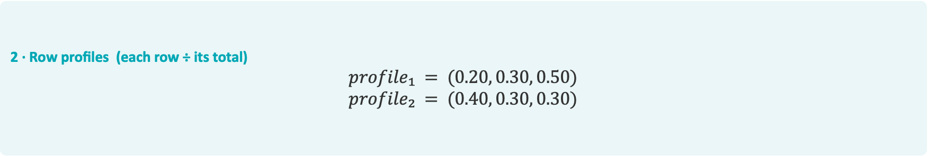

CA Example 2 — Step 1: Table & Row Profiles
CA Example 2 · 1 / 5
1 · Contingency table N (2 rows × 3 columns A, B, C)
$$N = \left[\begin{matrix}20 & 30 & 50 \\ 40 & 30 & 30\end{matrix}\right]$$
row totals 100, 100 · column totals 60, 60, 80 · grand total n = 200
2 · Row profiles (each row ÷ its total)
$$profile₁ = (0.20, 0.30, 0.50)$$
$$profile₂ = (0.40, 0.30, 0.30)$$
3 · Column masses (column total ÷ n)
$$c = (0.30, 0.30, 0.40)$$

Slide 51
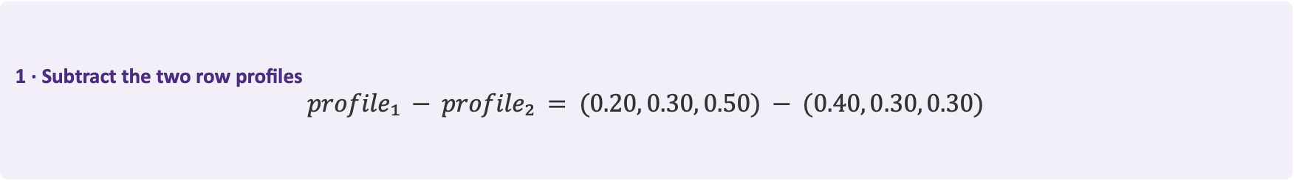
CA Example 2 — Step 2: Profile Difference
CA Example 2 · 2 / 5
1 · Subtract the two row profiles
$$profile₁ − profile₂ = (0.20, 0.30, 0.50) − (0.40, 0.30, 0.30)$$
2 · Difference vector
= ( −0.20, 0, +0.20 )
3 · Read it
The rows differ on categories A and C (by ∓0.20) and match exactly on B.
The χ² distance will weight each gap by 1 / cⱼ.

Slide 53
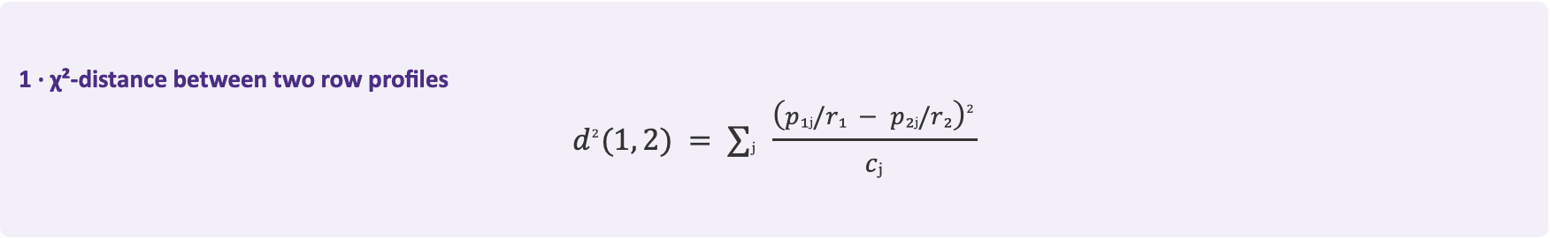
CA Example 2 — Step 3: The χ² Distance
CA Example 2 · 3 / 5
1 · χ²-distance between two row profiles
$$d^{2}(1, 2) = ∑ⱼ \frac{{\left(p₁ⱼ/r₁ − p₂ⱼ/r₂\right)}^{2}}{cⱼ}$$
2 · Why divide by cⱼ ?
Dividing each squared gap by the column mass up-weights rare columns and down-weights common ones.
This is exactly what makes the geometry χ² — not ordinary Euclidean.
3 · Note
Both rows have equal total, so pᵢⱼ / rᵢ is just the row profile from Step 1.

Slide 55


CA Example 2 — Step 4: Compute the Distance
CA Example 2 · 4 / 5
1 · Plug in the difference (−0.20, 0, +0.20) and masses (0.30, 0.30, 0.40)
$$d^{2}(1,2) = \frac{{\left(−0.20\right)}^{2}}{0.30} + \frac{0^{2}}{0.30} + \frac{{\left(0.20\right)}^{2}}{0.40}$$
2 · Evaluate each term
$$= 0.04 / 0.30 + 0 + 0.04 / 0.40 = 0.1333 + 0 + 0.1000$$
3 · Result
d²(1, 2) = 0.2333 → d(1, 2) = √0.2333 = 0.483

Slide 57
CA Example 2 — Step 5: Interpretation
CA Example 2 · 5 / 5
What the distance means
d = 0.483 measures how differently the two rows spread across categories A, B and C. The rows match on B but diverge on A and C, so their profiles are moderately far apart.
Why the χ² weighting matters
Because each squared gap is divided by the column mass cⱼ, a difference in a rare category contributes more than the same gap in a common one.
Connection to CA
These χ²-distances between profiles are exactly what a CA map reproduces as ordinary straight-line distances in a low-dimensional plot.

Slide 59
CA Example 3 — Step 1: The CA Output
CA Example 3 · 1 / 5
Inertia by dimension
Point diagnostics — Axis 1
Dim | λ (inertia) | % total | cumul.
1 | 0.210 | 61% | 61%
2 | 0.095 | 28% | 89%
3 | 0.038 | 11% | 100%
Total | 0.343 | 100% | —
Point | CTR | cos²
A | 0.05 | 0.22
B | 0.48 | 0.88
C | 0.41 | 0.83
D | 0.06 | —

Slide 61
CA Example 3 — Step 2: How Many Dimensions?
CA Example 3 · 2 / 5
Cumulative inertia
Dim 1: 61%
Dim 1 + Dim 2: 89%
Dim 1 + 2 + 3: 100%
Decision
Two dimensions capture 89% of the inertia → a 2-D map is enough.
Dim 3 (11%) adds little and can be safely ignored.

Slide 63
CA Example 3 — Step 3: Contributions (CTR)
CA Example 3 · 3 / 5
1 · CTR = how much each point builds the axis
Contributions to Axis 1: A = 0.05 B = 0.48 C = 0.41 D = 0.06 (they sum to 1)
2 · The big contributors
B (0.48) and C (0.41) together make up 89% of Axis 1 — so Axis 1 is essentially the contrast between Region B and Region C.
3 · The rest
A (0.05) and D (0.06) contribute almost nothing — they do not define this axis.

Slide 65
CA Example 3 — Step 4: Quality (cos²)
CA Example 3 · 4 / 5
1 · cos² = how well a point is shown on the axis
Quality on Axis 1: B = 0.88 C = 0.83 A = 0.22 (closer to 1 = better represented)
2 · Well represented
B and C have cos² ≈ 0.85 — their positions on Axis 1 are trustworthy and can be interpreted.
3 · Poorly represented
A has cos² = 0.22 — most of its profile lies off this plane, so don't over-interpret where A sits.

Slide 67
CA Example 3 — Step 5: CTR vs cos²
CA Example 3 · 5 / 5
CTR — what BUILDS an axis
Use contributions to NAME a dimension. A high CTR means the point drives that axis.
Here: B and C build Axis 1, so it is the “B vs C” axis.
cos² — which points to TRUST
Use quality to judge whether a point's position is reliable. A high cos² means it is well shown in this plane.
Here: B and C are reliable; A (cos²=0.22) is not.
Golden rule
CTR tells you what an axis MEANS; cos² tells you which points you may INTERPRET. Always check both before reading a CA map.

Slide 69
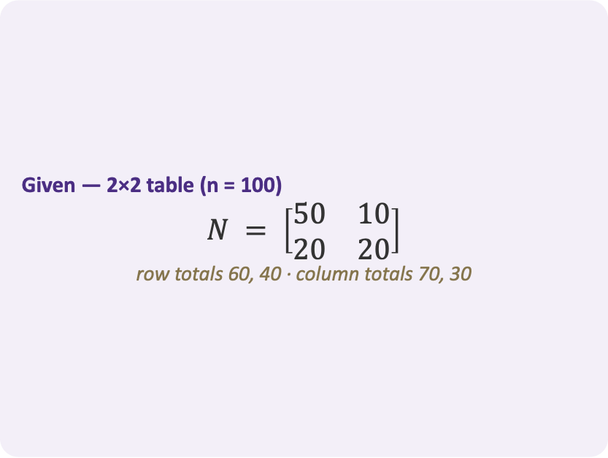
CA Exercise 1 — The Problem
CA Exercise 1 · 1 / 4
Given — 2×2 table (n = 100)
$$N = \left[\begin{matrix}50 & 10 \\ 20 & 20\end{matrix}\right]$$
row totals 60, 40 · column totals 70, 30
Find
(a) row & column masses
(b) the expected counts
(c) the χ² statistic
(d) the total inertia Φ²
(e) how many CA dimensions

Slide 71
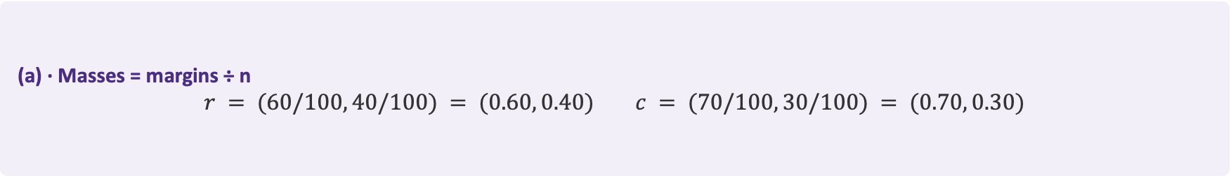

CA Exercise 1 — Masses & Expected Counts
CA Exercise 1 · 2 / 4
(a) · Masses = margins ÷ n
$$r = (60/100, 40/100) = (0.60, 0.40) c = (70/100, 30/100) = (0.70, 0.30)$$
(b) · Expected counts Eᵢⱼ = n · rᵢ · cⱼ
$$E = \left[\begin{matrix}42 & 18 \\ 28 & 12\end{matrix}\right]$$
e.g. E₁₁ = 100 · 0.60 · 0.70 = 42
Idea
The expected counts assume row and column are independent; CA measures how far N departs from E.

Slide 73


CA Exercise 1 — The χ² Statistic
CA Exercise 1 · 3 / 4
(c) · Chi-square statistic χ² = Σ (O − E)² / E
$$χ² = (50−42)²/42 + (10−18)²/18 + (20−28)²/28 + (20−12)²/12$$
Evaluate each term
$$= 1.524 + 3.556 + 2.286 + 5.333$$
Result
χ² = 12.70

Slide 75
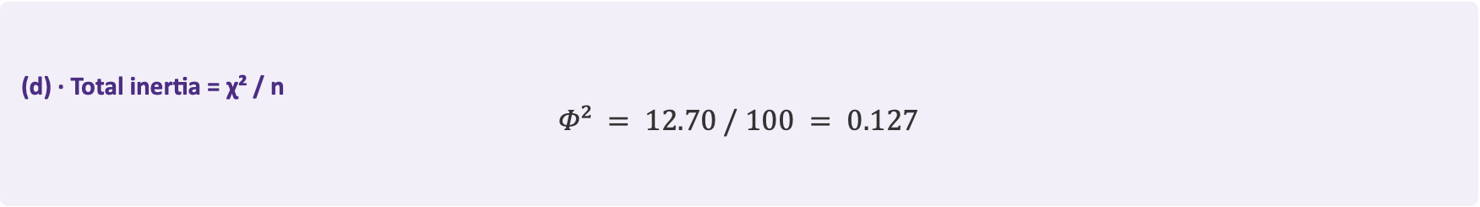
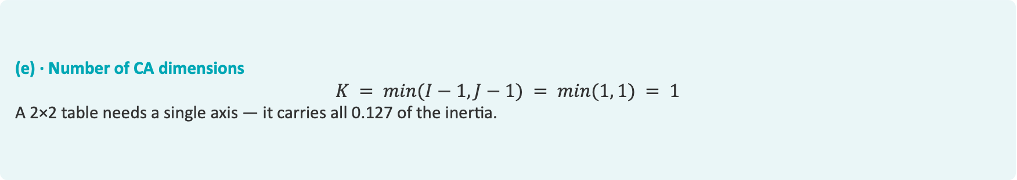
CA Exercise 1 — Total Inertia & Dimensions
CA Exercise 1 · 4 / 4
(d) · Total inertia = χ² / n
$$Φ² = 12.70 / 100 = 0.127$$
(e) · Number of CA dimensions
$$K = min(I−1, J−1) = min(1, 1) = 1$$
A 2×2 table needs a single axis — it carries all 0.127 of the inertia.
Answer
Φ² = 0.127, captured entirely on one CA dimension.

Slide 77
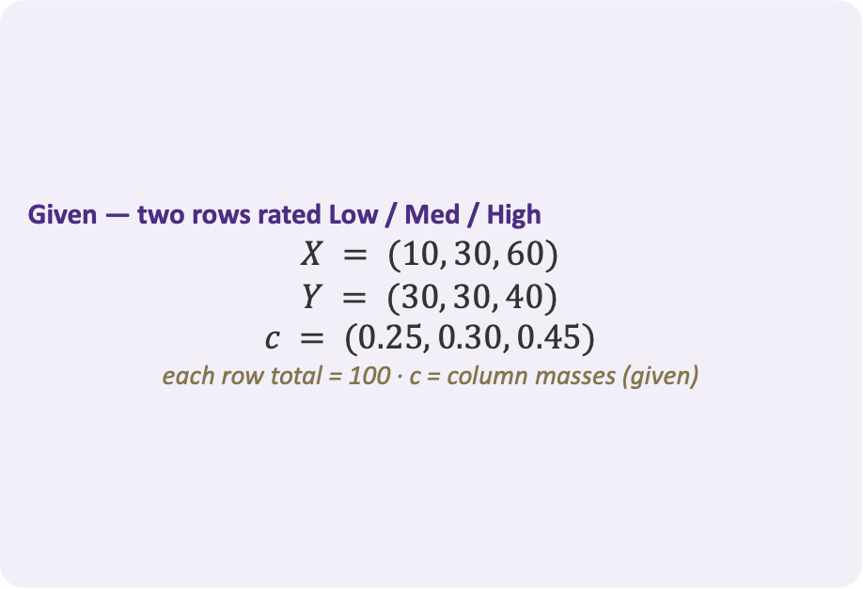
CA Exercise 2 — The Problem
CA Exercise 2 · 1 / 4
Given — two rows rated Low / Med / High
$$X = (10, 30, 60)$$
$$Y = (30, 30, 40)$$
$$c = (0.25, 0.30, 0.45)$$
each row total = 100 · c = column masses (given)
Find
(a) the row profile of each row
(b) the χ²-distance d(X, Y) between them

Slide 79
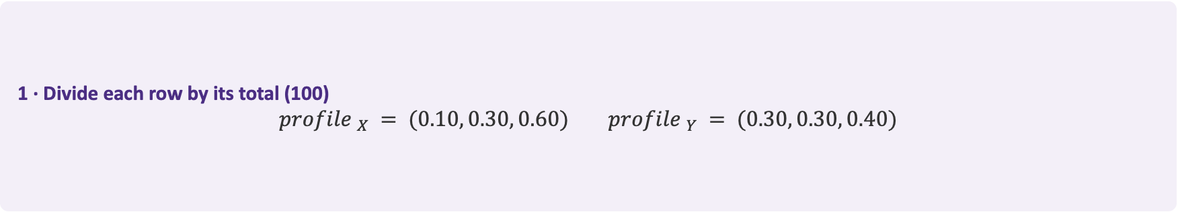
CA Exercise 2 — Solution (a): Row Profiles
CA Exercise 2 · 2 / 4
1 · Divide each row by its total (100)
$$profile _{X} = (0.10, 0.30, 0.60) profile _{Y} = (0.30, 0.30, 0.40)$$
2 · Profile difference
(0.10, 0.30, 0.60) − (0.30, 0.30, 0.40) = (−0.20, 0, +0.20)
3 · Read it
The two rows match on 'Med' but diverge on 'Low' (−0.20) and 'High' (+0.20).

Slide 81
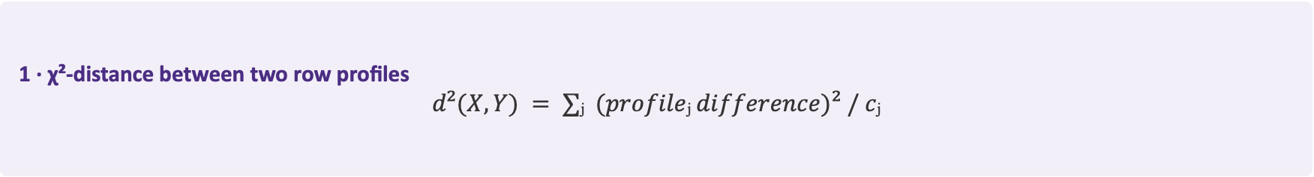

CA Exercise 2 — Solution (b): χ²-Distance
CA Exercise 2 · 3 / 4
1 · χ²-distance between two row profiles
$$d²(X, Y) = ∑ⱼ (profileⱼ difference)² / cⱼ$$
2 · Plug in the difference and the column masses
$$d²(X, Y) = (−0.20)²/0.25 + (0)²/0.30 + (0.20)²/0.45$$
3 · Evaluate each term
= 0.160 + 0 + 0.0889 = 0.2489

Slide 83
CA Exercise 2 — Result & Interpretation
CA Exercise 2 · 4 / 4
Take the square root
d(X, Y) = √0.2489 = 0.499
Which column matters most?
The 'Low' category (mass 0.25 — the rarest) contributes 0.160 of the 0.249. Dividing each squared gap by cⱼ up-weights the rarer columns.
Why it matters
This χ²-weighting is exactly the distance CA preserves when it places the row points on a map.

Slide 85
CA Exercise 3 — The Problem
CA Exercise 3 · 1 / 4
Given — CA output of a 5×4 table
Principal inertias:
λ = (0.240, 0.110, 0.030, 0.012), total = 0.392
Axis-1 contributions (CTR):
A = 0.55, B = 0.32, C = 0.08, D = 0.05
Axis-1 quality (cos²):
A = 0.91, C = 0.18
Find
(a) how many dimensions to report
(b) an interpretation of Axis 1
(c) Brand A vs Brand C

Slide 87
CA Exercise 3 — Solution (a): How Many Dimensions?
CA Exercise 3 · 2 / 4
1 · Variance share = λ / total inertia (0.392)
Dim 1: 0.240/0.392 = 61% Dim 2: 0.110/0.392 = 28% Dim 3: 8% Dim 4: 3%
2 · Cumulative
Dim 1 = 61% Dim 1 + Dim 2 = 89%
3 · Decision
Report a 2-D map — it captures 89% of the inertia. Dim 3 and Dim 4 (11% combined) are negligible.

Slide 89
CA Exercise 3 — Solution (b): Interpreting Axis 1
CA Exercise 3 · 3 / 4
1 · Which columns build Axis 1? (contributions)
CTR: A = 0.55 B = 0.32 C = 0.08 D = 0.05
2 · The dominant pair
A (0.55) + B (0.32) = 0.87 → 87% of Axis 1 comes from Brands A and B.
3 · Interpretation
Axis 1 is defined by Brands A and B — it captures how these two dominant brands stand apart from the rest. C and D barely shape it.

Slide 91
CA Exercise 3 — Solution (c): Brand A vs Brand C
CA Exercise 3 · 4 / 4
Brand A — cos² = 0.91
Excellently represented on Axis 1: A's position on the map is trustworthy and can be interpreted with confidence.
Brand C — cos² = 0.18
Poorly represented in this plane: most of C's variation lies on a higher, unshown dimension. Do not interpret where C sits on the 2-D map.
Golden rule recap
CTR tells you what builds an axis (here A and B); cos² tells you which points you can trust (A yes, C no).

Slide 93
02b
Multiple Correspondence Analysis
Correspondence Analysis for more than two categorical variables

Slide 95
Multiple Correspondence Analysis (MCA)
Correspondence Analysis extended to more than two categorical variables.
PCA
CA
MCA
For continuous numerical variables. Projects standardized measurements to maximize variance.
For one contingency table — two categorical variables, e.g. Gender × Preference.
For many categorical variables at once, e.g. a full set of survey responses.
In one sentence
MCA is basically Correspondence Analysis for more than two categorical variables. Each respondent answers several categorical questions; MCA finds a low-dimensional map where similar response patterns sit close together — just as CA does for a single two-way table, and PCA does for continuous data.

Slide 97
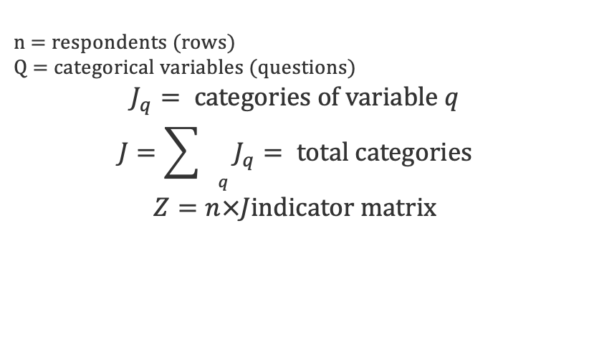
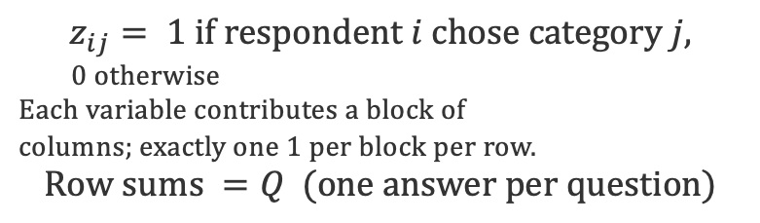
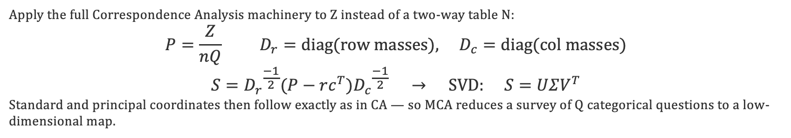
MCA — From CA to the Indicator Matrix
MCA is CA applied to the indicator (dummy-coded) matrix of the categorical variables.
Setup & notation
Indicator matrix Z
n = respondents (rows)
Q = categorical variables (questions)
$$J_{q}= categories of variable q$$
$$J=\sum_{{}_{q}}{J_{q}}= total categories$$
$$Z=n×Jindicator matrix$$
$$z_{ij}= 1 if respondent i chose category j,$$
0 otherwise
Each variable contributes a block of
columns; exactly one 1 per block per row.
$$Row sums =Q (one answer per question)$$
MCA = CA of Z
Apply the full Correspondence Analysis machinery to Z instead of a two-way table N:
$$P=\frac{Z}{nQ} D_{r}=diag(row masses), D_{c}=diag(col masses)$$
$$S={D_{r}}^{\frac{−1}{2}}(P−rc^{T}){D_{c}}^{\frac{−1}{2}} → SVD: S=UΣV^{T}$$
Standard and principal coordinates then follow exactly as in CA — so MCA reduces a survey of Q categorical questions to a low-dimensional map.

Slide 99
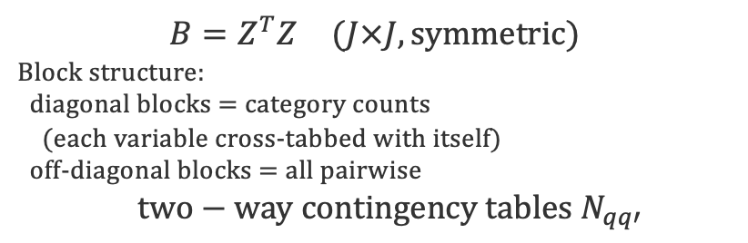
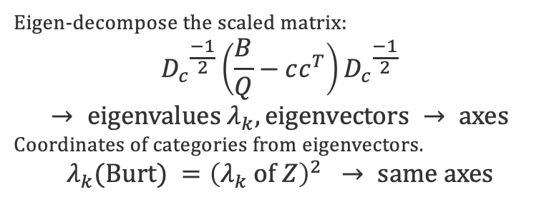
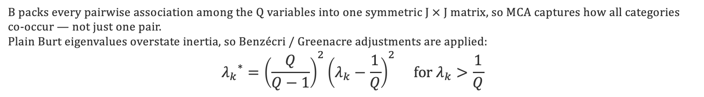
MCA — The Burt Matrix & Decomposition
Two equivalent routes: CA of the indicator matrix Z, or CA of the Burt matrix B = ZᵀZ.
Burt matrix B = ZᵀZ
Decomposition
$$B=Z^{T}Z (J×J, symmetric)$$
Block structure:
diagonal blocks = category counts
(each variable cross-tabbed with itself)
off-diagonal blocks = all pairwise
$$two−way contingency tables N_{qq′}$$
Eigen-decompose the scaled matrix:
$${D_{c}}^{\frac{−1}{2}}\left(\frac{B}{Q}−cc^{T}\right){D_{c}}^{\frac{−1}{2}}$$
$$→ eigenvalues λ_{k}, eigenvectors → axes$$
Coordinates of categories from eigenvectors.
$$λ_{k}(Burt) ={\left(λ_{k} of Z\right)}^{2} → same axes$$
Why it matters
B packs every pairwise association among the Q variables into one symmetric J × J matrix, so MCA captures how all categories co-occur — not just one pair.
Plain Burt eigenvalues overstate inertia, so Benzécri / Greenacre adjustments are applied:
$${λ_{k}}^{∗}={\left(\frac{Q}{Q−1}\right)}^{2}{\left(λ_{k}−\frac{1}{Q}\right)}^{2} for λ_{k}>\frac{1}{Q}$$

Slide 101

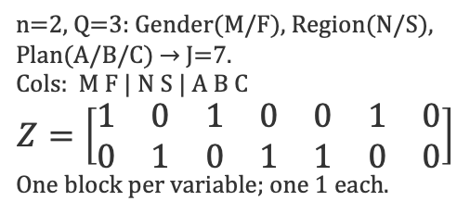

MCA — Three Worked Examples
The indicator matrix Z in matrix notation for three small surveys.
1 · Yes/No survey
2 · Three variables
3 · Burt matrix B = ZᵀZ
3 respondents, Q=2 (Buy?, Recommend?), each Yes/No → J=4 columns.
Columns: By Bn Ry Rn
$$Z=\left[\begin{matrix}1 & 0 & 1 & 0 \\ 0 & 1 & 0 & 1 \\ 1 & 0 & 0 & 1\end{matrix}\right]$$
Z is 3×4; row sums = Q = 2.
n=2, Q=3: Gender(M/F), Region(N/S), Plan(A/B/C) → J=7.
Cols: M F | N S | A B C
$$Z=\left[\begin{matrix}1 & 0 & 1 & 0 & 0 & 1 & 0 \\ 0 & 1 & 0 & 1 & 1 & 0 & 0\end{matrix}\right]$$
One block per variable; one 1 each.
From Example 1's Z (3×4), the Burt matrix:
$$B=Z^{T}Z=\left[\begin{matrix}2 & 0 & 1 & 1 \\ 0 & 1 & 0 & 1 \\ 1 & 0 & 1 & 0 \\ 1 & 1 & 0 & 2\end{matrix}\right]$$
Rows/cols: By Bn Ry Rn.
Takeaway
Code each categorical answer as dummy columns to build Z, then run CA on Z (or on the Burt matrix $B = Z^{T}Z$) to obtain the MCA map of categories and respondents.

Slide 103

Example A · Step 1 — Build the Indicator Matrix Z
Survey: 4 respondents, Q = 2 questions (Pet owner? · Garden?) → J = 4 dummy columns
Indicator matrix Z (4 × 4)
From answer to a 0/1 row
P+ P− G+ G−
$$Z=\left[\begin{matrix}1 & 0 & 1 & 0 \\ 1 & 0 & 1 & 0 \\ 0 & 1 & 0 & 1 \\ 0 & 1 & 1 & 0\end{matrix}\right]$$
Respondent 1 answers:
• Pet owner? → Yes ⇒ P+ = 1
• Garden? → Yes ⇒ G+ = 1
→ row 1 = [ 1 0 1 0 ]
Each row has exactly Q = 2 ones.
Z is n × J = 4 × 4.
Teal row 1 = Respondent 1's two answers · rows R1–R4 top→bottom
Takeaway The indicator matrix Z turns every categorical answer into a block of 0/1 dummy columns — the raw input for MCA.

Slide 105

Example A · Step 2 — Correspondence Matrix P
Divide every entry of Z by the grand total nQ = 4 × 2 = 8, so the table sums to 1.
Correspondence matrix P = Z / nQ
Why divide by nQ ?
$$P=\frac{1}{8}\left[\begin{matrix}1 & 0 & 1 & 0 \\ 1 & 0 & 1 & 0 \\ 0 & 1 & 0 & 1 \\ 0 & 1 & 1 & 0\end{matrix}\right]$$
Grand total = sum of all 1's in Z = n × Q.
• n = 4 respondents
• Q = 2 questions
⇒ nQ = 8
Each entry becomes a proportion.
P sums to 1 → a joint probability table.
Gold scalar 1/8 = 1/nQ · every 1 → 0.125, every 0 stays 0
Takeaway Rescaling to P puts every category on a common probability footing, so profiles become comparable.

Slide 107

Example A · Step 3 — Row & Column Masses
Row masses r = row sums of P (green); column masses c = column sums of P (pink).
Sum the rows and columns of P
Reading the masses
$$P=\frac{1}{8}\left[\begin{matrix}1 & 0 & 1 & 0 \\ 1 & 0 & 1 & 0 \\ 0 & 1 & 0 & 1 \\ 0 & 1 & 1 & 0\end{matrix}\right]$$
Row mass rᵢ = 1/n = ¼
(each row of P sums to Q/nQ = ¼).
Column mass cⱼ = total / nQ.
• G+ chosen 3× → c = 3/8
• G− chosen once → c = 1/8
Masses = weights of points in the map.
row sum → r = ( ¼, ¼, ¼, ¼ )
col sum → c = ( ¼, ¼, ⅜, ⅛ )
Takeaway Masses are the weights MCA assigns: frequent categories pull harder, rare ones (G−) sit lighter.

Slide 109

Example A · Step 4 — Burt Matrix B = ZᵀZ
Cross-tabulate every pair of categories: B = ZᵀZ (4 × 4, symmetric).
Burt matrix (order: P+ P− G+ G−)
What B stores
$$B=Z^{T}Z=\left[\begin{matrix}2 & 0 & 2 & 0 \\ 0 & 2 & 1 & 1 \\ 2 & 1 & 3 & 0 \\ 0 & 1 & 0 & 1\end{matrix}\right]$$
Zᵀ is J×n, Z is n×J → B is 4×4.
Diagonal: how often each category was chosen.
Off-diagonal: how often two categories co-occur.
B(P+, G+) = colP+ · colG+
= [1 1 0 0]·[1 1 0 1] = 2
Pet & garden owners appear together twice.
diagonal (gold) = category totals
off-diagonal (teal) = co-occurrences
Takeaway The Burt matrix packs every pairwise category co-occurrence into one symmetric table — the heart of MCA.

Slide 111
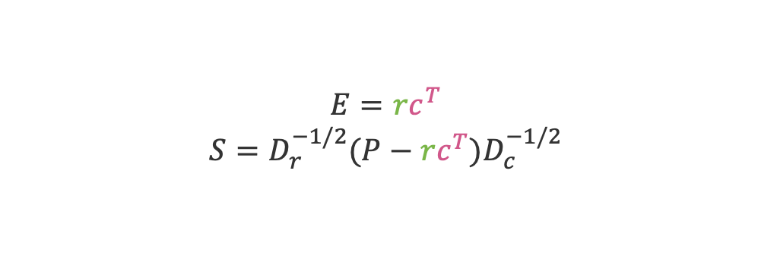
Example A · Step 5 — Standardized Residuals S
Compare observed P with expected E = r cᵀ, then standardize the residuals.
Residuals around independence
From counts to signal
$$E=rc^{T}$$
$$S=D_{r}^{−1/2}(P−rc^{T})D_{c}^{−1/2}$$
Expected Eᵢⱼ = rᵢ cⱼ
— what we'd see if answers were independent.
Residual = P − E (observed − expected).
Scale by 1/√(rᵢ cⱼ) → standardized S.
Dᵣ, D꜀ are diagonal mass matrices.
S is exactly what MCA decomposes next.
outer product r cᵀ → E(1,1) = ¼ × ¼ = 1/16
Takeaway S measures how far each cell departs from independence — the signal MCA will turn into a map.

Slide 113

Example A · Step 6 — SVD & the MCA Map
Decompose S = U Σ Vᵀ; coordinates G = D꜀^(−½) V Σ place each category on the map.
Decompose, then place the points
MCA category map
$$S=UΣV^{T}$$
$$G=D_{c}^{−1/2}VΣ$$
Axis 1: λ₁ = σ₁² = 0.79 (79%)
Axis 2: λ₂ = σ₂² = 0.21 (21%)
Total inertia (J−Q)/Q = 1.00
Takeaway Categories close together are chosen by the same respondents: P+ sits with G+, while rare G− is pushed far out.

Slide 115

Example B · Step 1 — Indicator Matrix Z
Survey: 6 commuters, Q = 2 questions (Transport · Commute) → J = 5 columns.
Indicator matrix Z (6 × 5)
From answer to 0/1 row
Car Bike Train Short Long
Commuter 1 travels by Car, Long trip.
→ row 1 = [ 1 0 0 0 1 ]
• One 1 per question block
(Transport: 3 cols · Commute: 2 cols).
• Row sum = Q = 2 for everyone.
• Z has n = 6 rows, J = 5 columns.
$$Z=\left[\begin{matrix}1 & 0 & 0 & 0 & 1 \\ 1 & 0 & 0 & 0 & 1 \\ 0 & 1 & 0 & 1 & 0 \\ 0 & 1 & 0 & 1 & 0 \\ 0 & 0 & 1 & 0 & 1 \\ 0 & 0 & 1 & 1 & 0\end{matrix}\right]$$
rows R1–R6 top→bottom · row 1 (teal) = commuter 1
Takeaway With a 3-category variable, that question contributes 3 dummy columns — still exactly one 1 per block.

Slide 117

Example B · Step 2 — Correspondence Matrix P
Divide every entry of Z by the grand total nQ = 6 × 2 = 12.
Correspondence matrix P = Z ⁄ nQ
Why divide by nQ?
$$P=\frac{1}{12}\left[\begin{matrix}1 & 0 & 0 & 0 & 1 \\ 1 & 0 & 0 & 0 & 1 \\ 0 & 1 & 0 & 1 & 0 \\ 0 & 1 & 0 & 1 & 0 \\ 0 & 0 & 1 & 0 & 1 \\ 0 & 0 & 1 & 1 & 0\end{matrix}\right]$$
Grand total = sum of all 1's in Z
= n × Q = 6 × 2 = 12.
Each entry becomes a proportion of the whole table.
P now sums to 1 → a joint probability table.
Same recipe, any survey size.
every 1 → 1/12 ≈ 0.083 · every 0 stays 0 · grand total = 12
Takeaway Rescaling to P makes surveys of different sizes directly comparable on a shared probability footing.

Slide 119

Example B · Step 3 — Row & Column Masses
Row masses r (green) = row sums of P; column masses c (pink) = column sums.
Sum the rows and columns of P
Reading the masses
$$P=\frac{1}{12}\left[\begin{matrix}1 & 0 & 0 & 0 & 1 \\ 1 & 0 & 0 & 0 & 1 \\ 0 & 1 & 0 & 1 & 0 \\ 0 & 1 & 0 & 1 & 0 \\ 0 & 0 & 1 & 0 & 1 \\ 0 & 0 & 1 & 1 & 0\end{matrix}\right]$$
Row mass rᵢ = 1/n = 1/6.
Column mass cⱼ = total / nQ.
• Car, Bike, Train each 2× → c = 2/12 = ⅙
• Short, Long each 3× → c = 3/12 = ¼
Bigger groups carry more weight in the map.
row sum → r = ( ⅙, ⅙, ⅙, ⅙, ⅙, ⅙ )
col sum → c = ( ⅙, ⅙, ⅙, ¼, ¼ )
Takeaway Commute categories (¼) outweigh the three transport categories (⅙) — mass follows frequency.

Slide 121

Example B · Step 4 — Burt Matrix B = ZᵀZ
Cross-tabulate every pair of categories: B = ZᵀZ (5 × 5, symmetric).
order: Car Bike Train Short Long
What B stores
$$B=Z^{T}Z=\left[\begin{matrix}2 & 0 & 0 & 0 & 2 \\ 0 & 2 & 0 & 2 & 0 \\ 0 & 0 & 2 & 1 & 1 \\ 0 & 2 & 1 & 3 & 0 \\ 2 & 0 & 1 & 0 & 3\end{matrix}\right]$$
Zᵀ is 5×6, Z is 6×5 → B is 5×5.
Diagonal: each category's total.
Off-diagonal: pairwise co-occurrence.
B(Car, Long) = colCar · colLong
= [110000]·[110010] = 2
Every Car commuter here travels Long.
diagonal (gold) = category totals
off-diagonal (teal) = co-occurrences
Takeaway The 5×5 Burt matrix captures all transport–commute associations in one symmetric table.

Slide 123

Example B · Step 5 — Standardized Residuals S
Compare observed P with expected E = r cᵀ, then standardize the residuals.
Residuals around independence
From counts to signal
$$E=rc^{T}$$
$$S=D_{r}^{−1/2}(P−rc^{T})D_{c}^{−1/2}$$
Expected Eᵢⱼ = rᵢ cⱼ — value under independence.
E(1,1) = ⅙ × ⅙ = 1/36.
Residual = P − E (observed − expected).
Divide by √(rᵢ cⱼ) → standardized S.
S is exactly what MCA decomposes next.
outer product: r (mass column) × cᵀ (mass row)
Takeaway S measures how far each cell departs from independence — the signal MCA turns into a map.

Slide 125
Correspondence Analysis
and MCA
6
BDATA 412: Advanced Data Visualization
University of Washington

