Slide 1


YERLEM 2023 - Wageningen University and research
RandomForestExample – data and code for feature selection
Pedro Beschoren da Costa
Postdoc at the MICROP consortia
Entomology Department – WUR – 15/06/2023
Random forest basics – Feature Selection with Boruta – Split, train and test with caret – Examples – Data/code availability

Slide 2
Random Forest at a glance
Unacceptable pest damage
Sufficient
Biocontrol
Sufficient
Biocontrol
Unacceptable pest damage
Random Forest is a type of machine learning algorithm. It can be useful to select variables that predict an outcome or another variable
It is based on decision trees
In a decision tree, variables are split at specific intervals. Depending on the value of one or more variables, an outcome is decided based on data labels
On fictional example: large plants will be OK even with few caterpillars, but small plants need some parasitoid diversity
≤1
>1
≤2
>2
Number of parasitoid species
Number of caterpillars
≤4g
>4g
Plant dry weight week 4 (g)

Slide 3
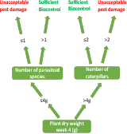
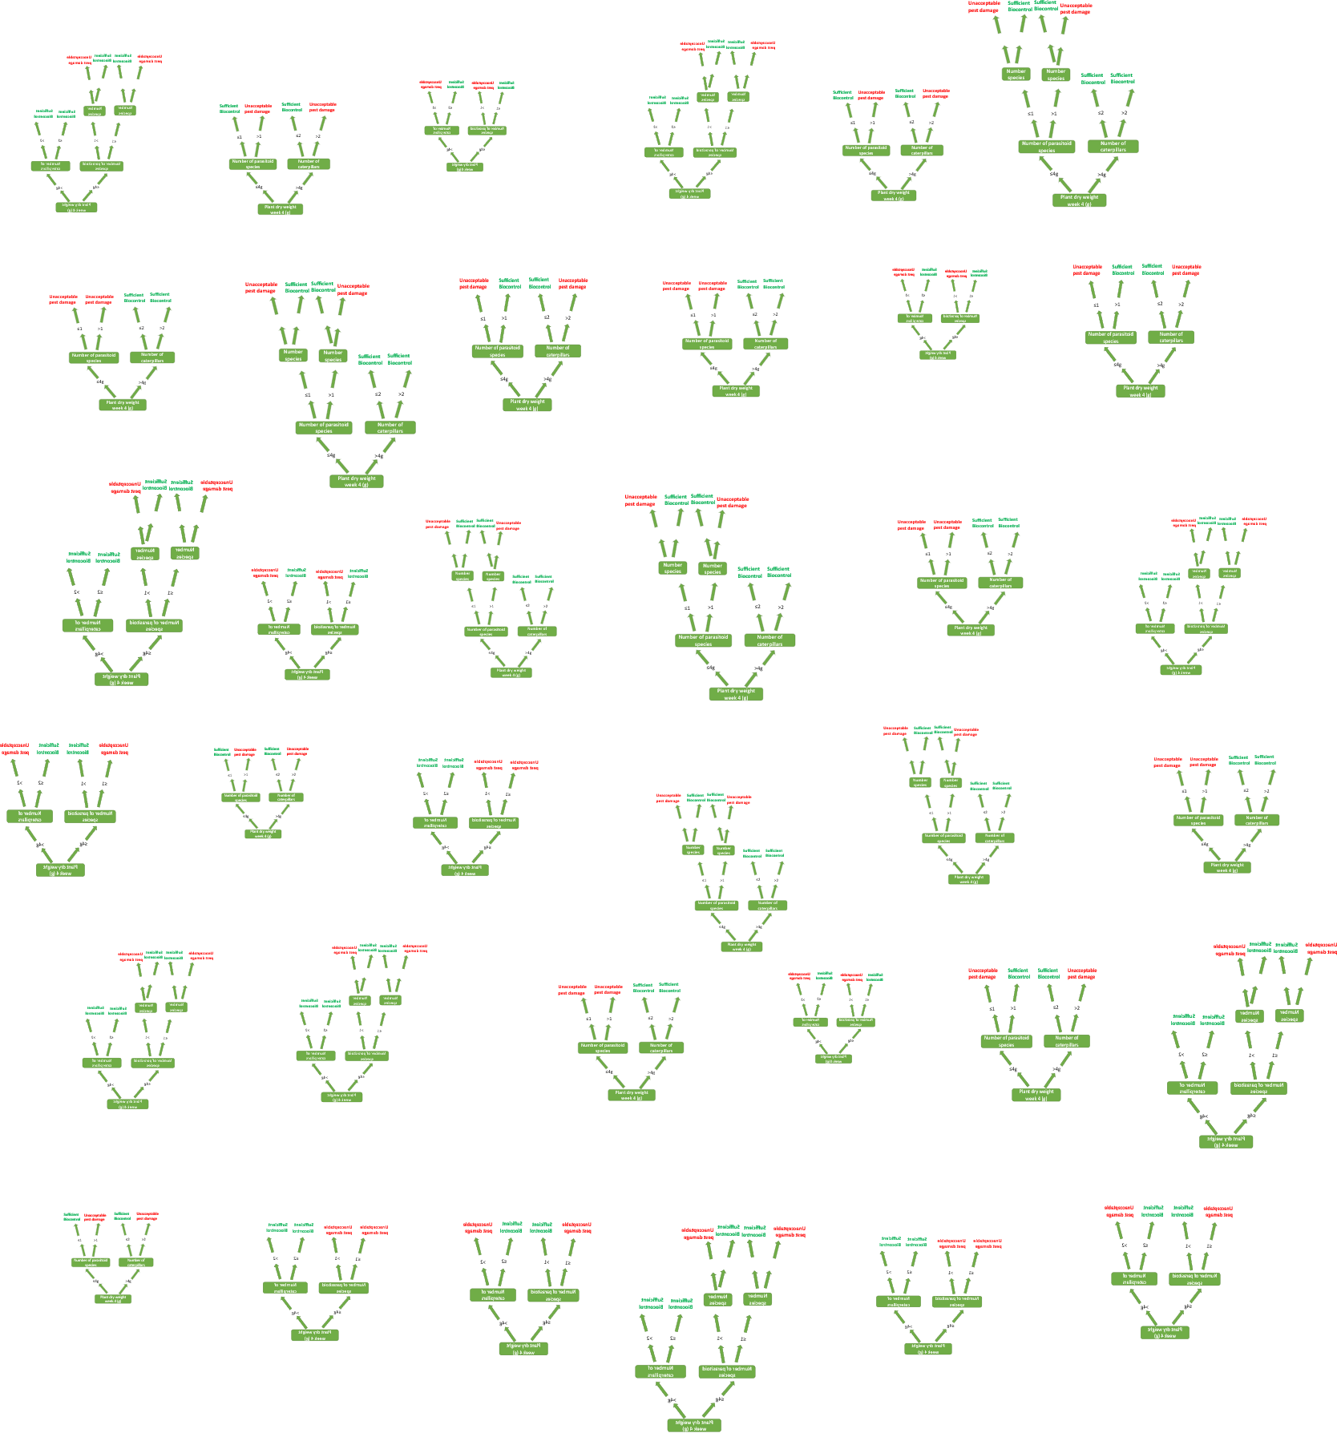
Random Forest at a glance
On random forest, a few variables from a few samples are picked randomly from your full dataset
This constructs a decision tree. The processes is performed several times
Many random trees = a random forest!
Each tree defines the outcome (pest damage) based on the limited training data available to it
Given new data, each tree has a guess at the outcome.
Sample S7 (2g dry weight, 3 parasitoid sp) would be classified as Sufficient biocontrol!
variable | s1 | s2 | s3 | s4 | s5 | s6 | s7
Plant dry weight week 2 | 3 | 4 | 1 | 5 | 2 | 4 | 5
Plant dry weight week 4 | 3 | 5 | 2 | 1 | 6 | 5 | 2
Plant dry weight week 8 | 6 | 5 | 4 | 5 | 8 | 8 | 7
Leaf damage | 0.2 | 0.5 | 0.7 | 0.2 | 0.9 | 0.1 | 0.2
Number of caterpilars | 2 | 3 | 3 | 5 | 3 | 1 | 2
Caterpillar weight | 0.3 | 0.2 | 0.1 | 0.2 | 0.2 | 0.2 | 0.1
Number of herbivore species | 1 | 3 | 2 | 4 | 1 | 2 | 3
Number of aphids | 23 | 15 | 23 | 10 | 3 | 5 | 12
Number of Parasitoid species | 1 | 0 | 4 | 2 | 2 | 3 | 3
Number of ladybugs | 7 | 12 | 2 | 3 | 5 | 0 | 1
Pest damage | Un | Un | Su | Su | Un | Su | Un
Soil addition | t1 | t1 | t1 | t2 | t2 | t2 | t3

Slide 4
Random Forest at a glance
Each tree “votes” if pest damage is acceptable or not
Individual trees have poor accuracy, but the majority vote from thousands of trees together has high accuracy
Accuracy is recoded, and the process reiterated with new random trees, subsets and splits
The algorithm learns that some variables and thresholds are better than others to predict the outcomes
This is useful for feature reduction – reducing the number of variables, and ranking their importance on both classification and regression tasks
Which variable can better predict the treatments used?
Which variable can better predict another key variable?
I vote that this new sample data (2g weight, 3 parasitoid sp) will lead to Sufficient biocontrol
Un
Su
Un
Su
Un
Su
Su
Su
Su
Su
Su
Un
Su
Su
Su
Su
Su
Un
Su
Un
Su
Un
Su
Su
Su
Su
Su
Su
Su
Un
Su
Un
Su
Un
Su
10 votes for Unacceptable pest damage
26 votes for Sufficient biocontrol
New sample data s7 is classified as Sufficient biocontrol!... Which is wrong!
Now check true label, next samples, check precision and iterate with new trees with new features and treholds…
This method is very robust against outliers, non-parametric data, different measurement units, and slight differences in sample sizes

Slide 5

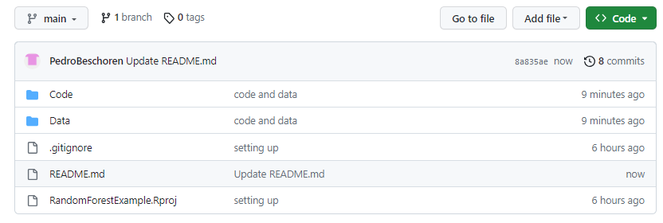
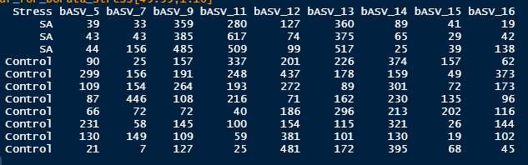
Random Forest: Basic application in R
We can use the Boruta R package to easily run feature selection with random forest
Boruta (name of a Slavic demon that lives in the forest) selects the features (variables) most important to predict a classification or another variable
It uses “shadow features”: reshuffled and randomized versions of the true features in your dataset
Boruta will test if the real feature is significantly better at predicting the outcome than the shadow features
If it is, the feature is tagged as “important”
Thresholds are determined automatically
Several simple functions can help you explore the output
500 features (bacterial Amplicon Sequencing Variants, counted per sample)
143 samples (16S amplicon sequencing from Illumina, from 3 different plant sp.)
This can be easily replaced by dozen plant or insect variables!
Let’s see a microbiome-based example: which bacteria can tell apart plants exposed to Methyl Jasmonate, Salycilic Acid or Controls?

Slide 6
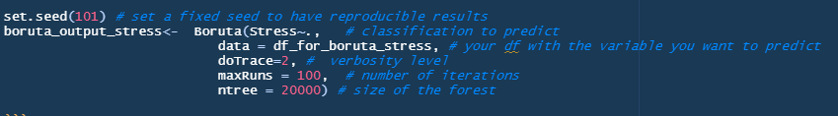
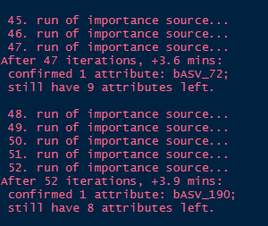
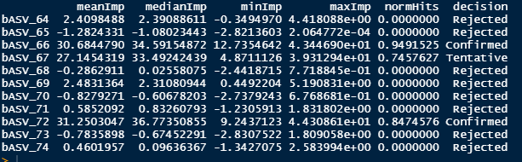
Random Forest: a dataframe given to a function with a few arguments

Slide 7
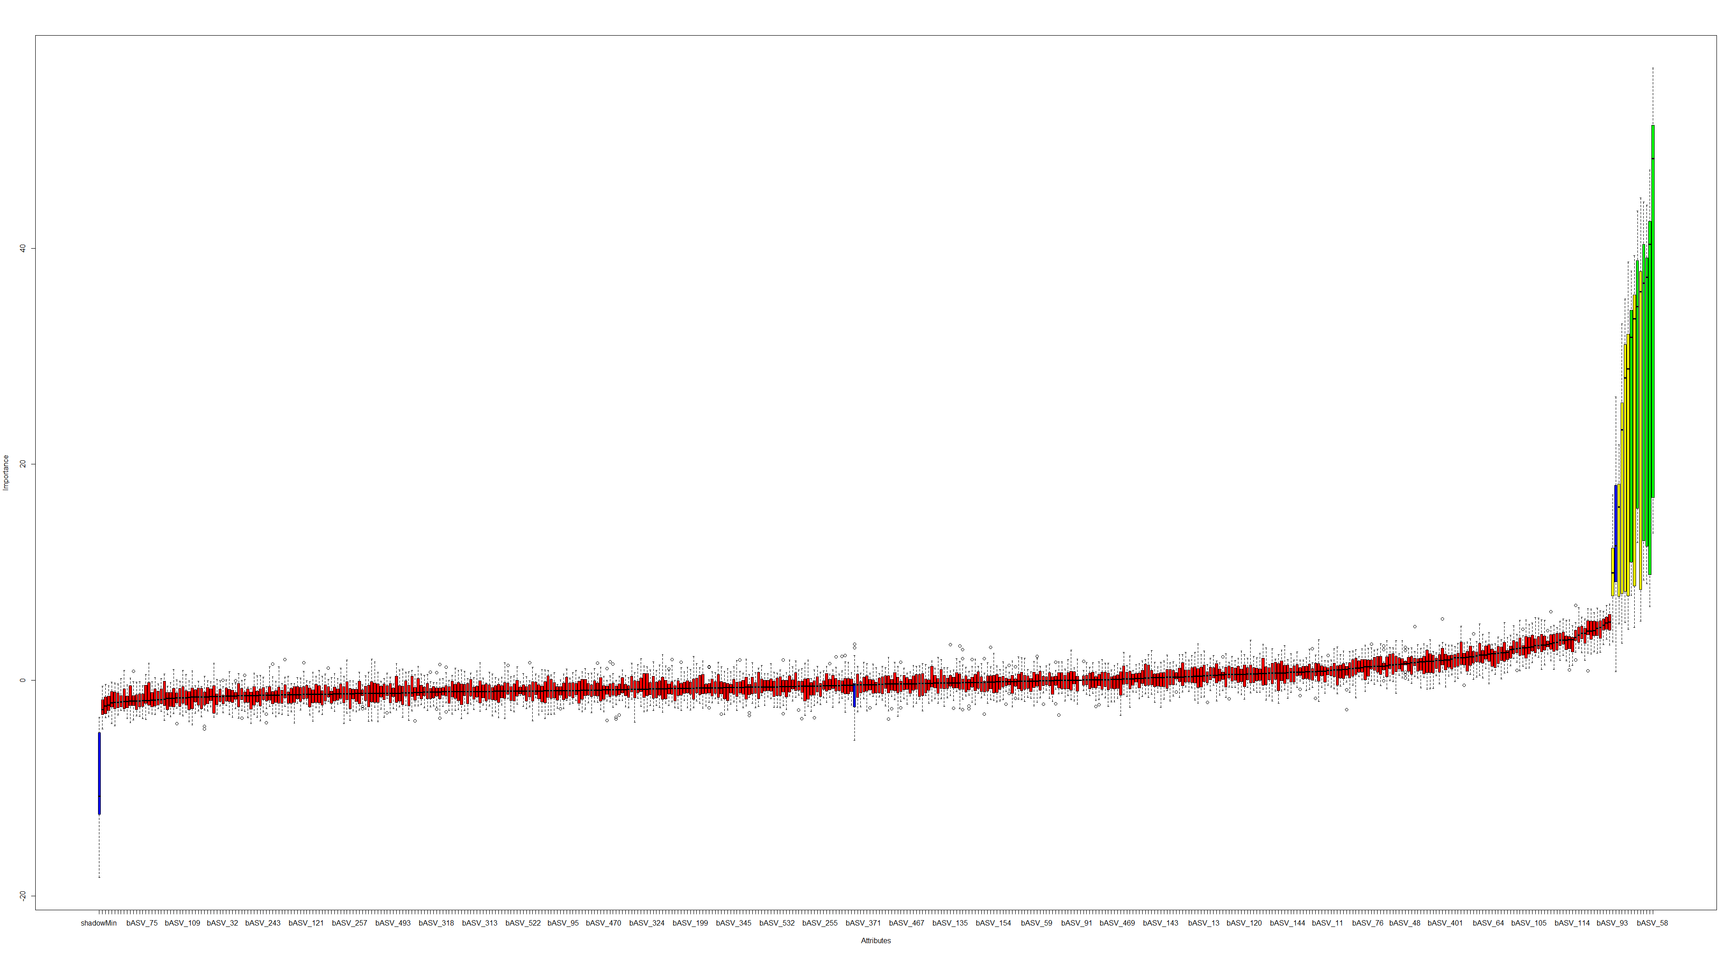
Random Forest: plot feature importance
Confirmed! These features can help telling the 3 stress conditions apart
Shadow feature minimum importance
Non-important features(bacteria): not better than random noise at telling apart the 3 stress conditions
Shadow feature maximum importance
Tentative: Boruta is not sure about these features, because they are too close to thresholds. It needs more iterations to solve this!
Shadow feature median importance

Slide 8

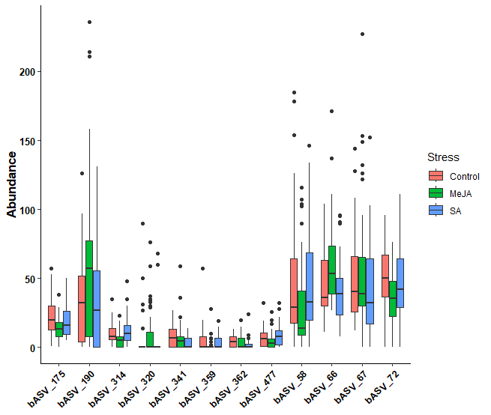
Random Forest: solve tentative features and put them into a formula!
Feature selection may be very important to you, and the output you get at this point may already be quite valid for your research questions
Abundance of important features
But are the selected features really telling the species apart?
For this we have to split training and testing datasets, train a new model, and then test it

Slide 9
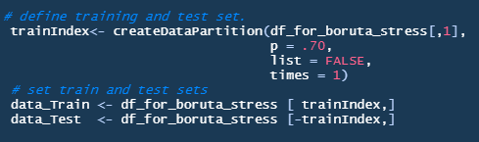
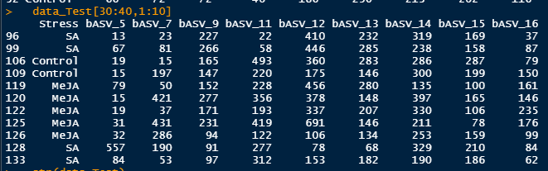
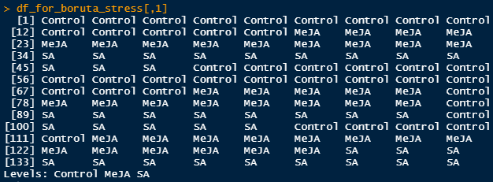
Random Forest: splitting training and testing datasets
There are dozens of methods and packages that will perform the data splitting and testing for you (I use caret)
Simple random splitting often suffices, while advanced designs (considering blocks or batches) need a bit of reading

Slide 10
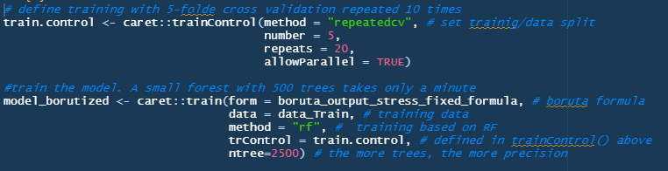
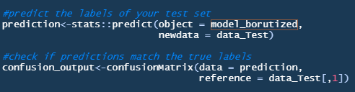
Random Forest: train and test
Train the model with the training dataset and a few parameter. It takes a few minutes
Test the model with the test set, it is processed immediately

Slide 11
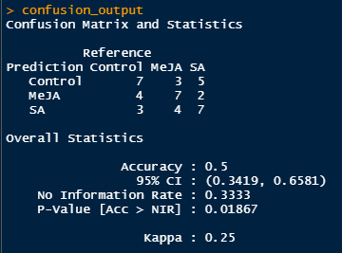
Random Forest: evaluate results
Accuracy was of ~ 50%
95% Confidence interval of classifications had a high range
No Informantion Rate (NIR): accuracy of a random guess
Yet, accuracy was significantly higher than the NIR
Kappa is another measure of accuracy, that accounts for unbalanced designs. It’s one of the many metrics for comparing models
Our ranges are high, and accuracy low, but still better than a random guess. For a proper prediction and more confidence, we need other model parameters or more/better data
On a far larger dataset (11k features, 1500 samples, 33 sp) accuracy was 0.504, 95% CI is 0.45-0.55, ~ 48h to run
7 of 14 Control sample were correctly classified
4 of 14 MeJA sample was misclassified as SA
Observed accuracy (1) was significantly higher than a random guess (0.33)

Slide 12
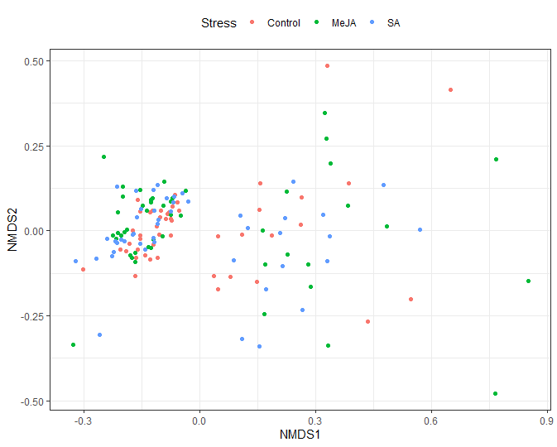
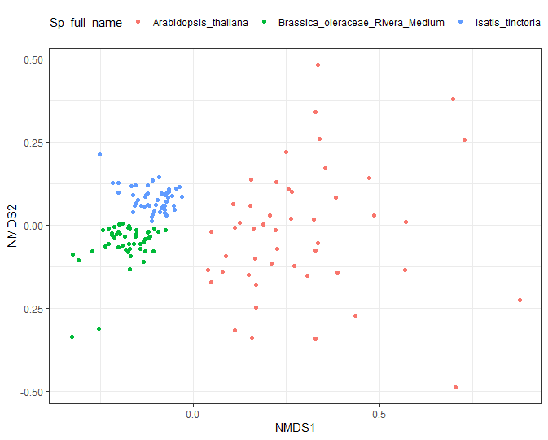
Random Forest: difficult and easy classification tasks
Predicting 3 stresses: accuracy of 50%!
Predicting 3 plant sp: accuracy of 100%!

Slide 13
Random Forest: key takeaways from these examples
On a challenging classification task, the algorithm was not impressive
This can still be useful for your research!
We found features that were better than random noise in separating the treatments
The accuracy of classification was better than random
More data (33 plant species instead of 3) did not increase the accuracy
Different model parameters, random forest/ML algorithms, train/test splitting, feature/sample engineering or more computational power could help increase accuracy
Comparing multiple different models is a common task to find the most accurate model!
However, you might not be interested in high-accuracy predictions but instead want to find the features that better explained what happened in your experiment. It depends on your goals!
This method can be used as an additional tool in your box, not a replacement for methods we know that work well (PCA, GLM…)
Let’s see two other examples from Ento!

Slide 14
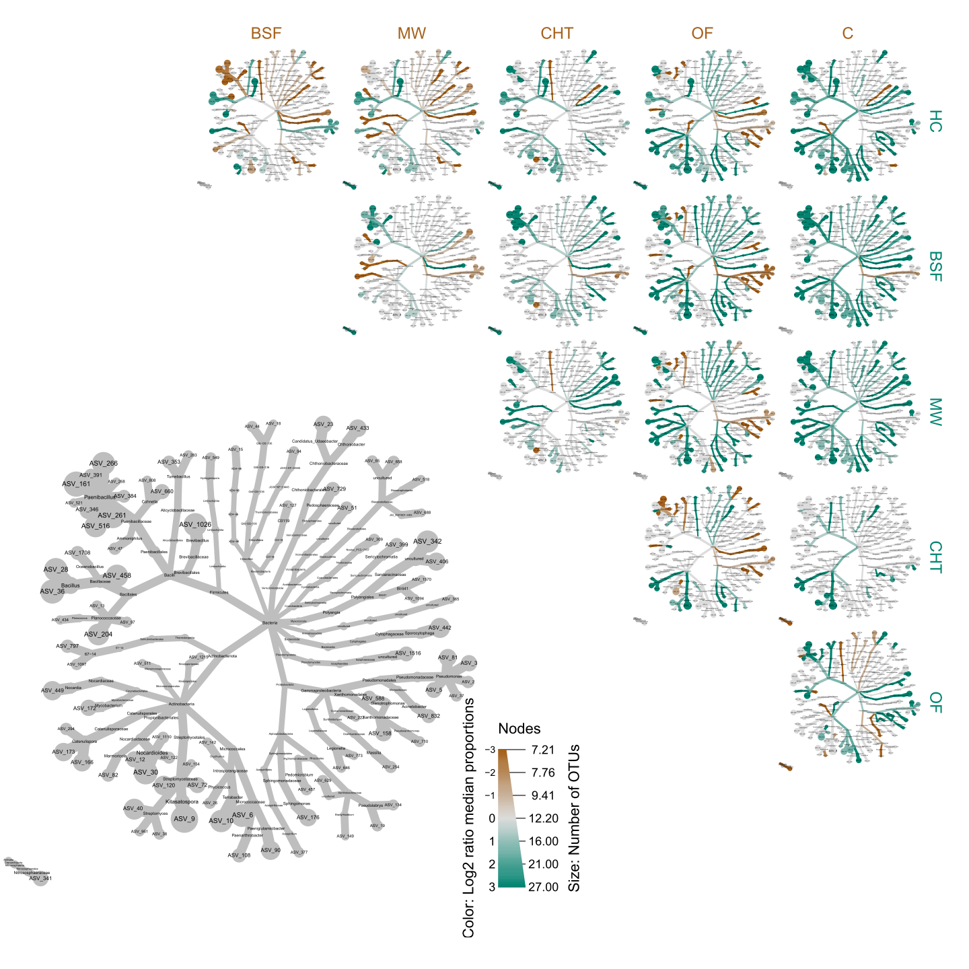
Random Forest: Classification
K.Fonseca et al (in prep): insect residues (BSF, crickets, mealworm) were mixed with soil in a greenhouse experiment and compared to different controls (Chitin, Organic fertilizer, Control)
About 44 samples from rhizosphere
Found 94 of 9700 ASV features as important predictors of applied treatments
Accuracy of 0.951 and Kappa of 0.940 in the training set
Full taxonomy of 94 bacteria can be easily plotted
Paenibacillus
Abundance of Paenibacillus and Baciliales and were clearly different between treatments
Code available upon publication!
Baciliales

Slide 15
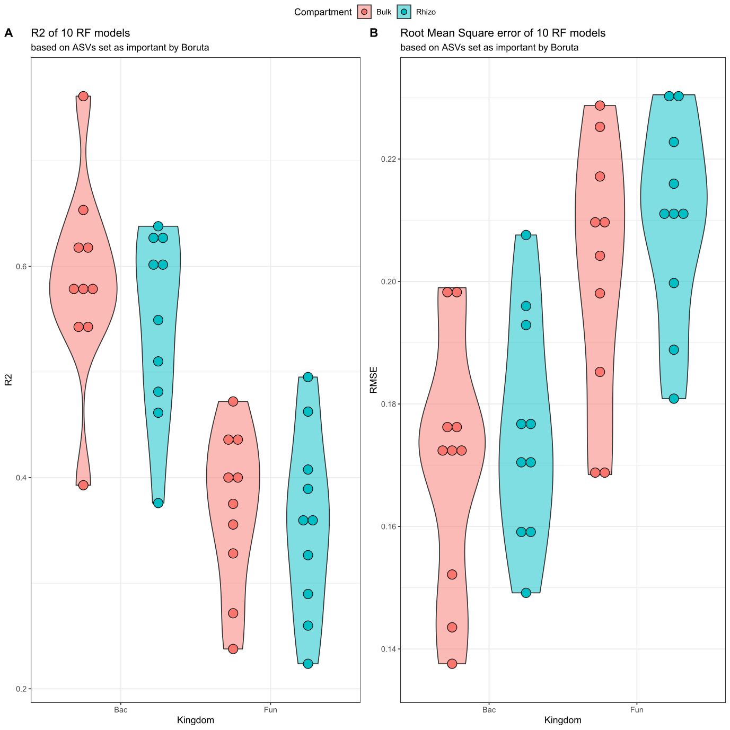
Random Forest: Regression
S. Chia et al (in prep): Insect frass from different sources and composting conditions were mixed with soil in a greenhouse experiment
About 800 samples, rhizospheric and bulk soil communities for bacteria and fungi
Regression to predict plant biomass according bacterial abundances in 4 different datasets, repeated 10 times
~340 bacteria and fungi, out of 30.000, were better than shadow features in predicting plant biomass
Bacteria were better than Fungi at predicting biomass
Bulk soil communities were slightly better than rhizosphere communities at predicting soil biomass
Bacilli were much better than other groups at predicting Biomass in bulk soil, but on rhizosphere they are similar to Verrubimicrobia
Code available upon publication!
Found 94 of 9700 ASV features as important predictors of treatment with accuracy of 0.951 and Kappa of 0.940 in the training set.

Slide 16
RandomForestExample: a random forest example
This presentation, along with data and code, are publicly available at https://github.com/PedroBeschoren/RandomForestExample
The Boruta R package is powerful, useful and simple to run
The Caret R package can help split, train and test your models
The repository contains one advanced example with lists, loops and custom functions. This immensely facilitates application of random forest to several datasets and conditions, and can be adapted to non-microbiome data without too much coding
Feature reduction helps you focus your attention into variables that are more strongly associated to your experimental conditions
Such tools are increasingly present in scientific publication & in industry, and ignoring them might not be a very good career choice
Thankfully, there are countless tutorials and examples to help effectively use these tools!
Thank you!
Special thanks to MICROP colleagues (Marcel, Karen, Marcela, Kris, Zulema, Roland, Melissa, Chrats), Katherine and Shaphan

Slide 17
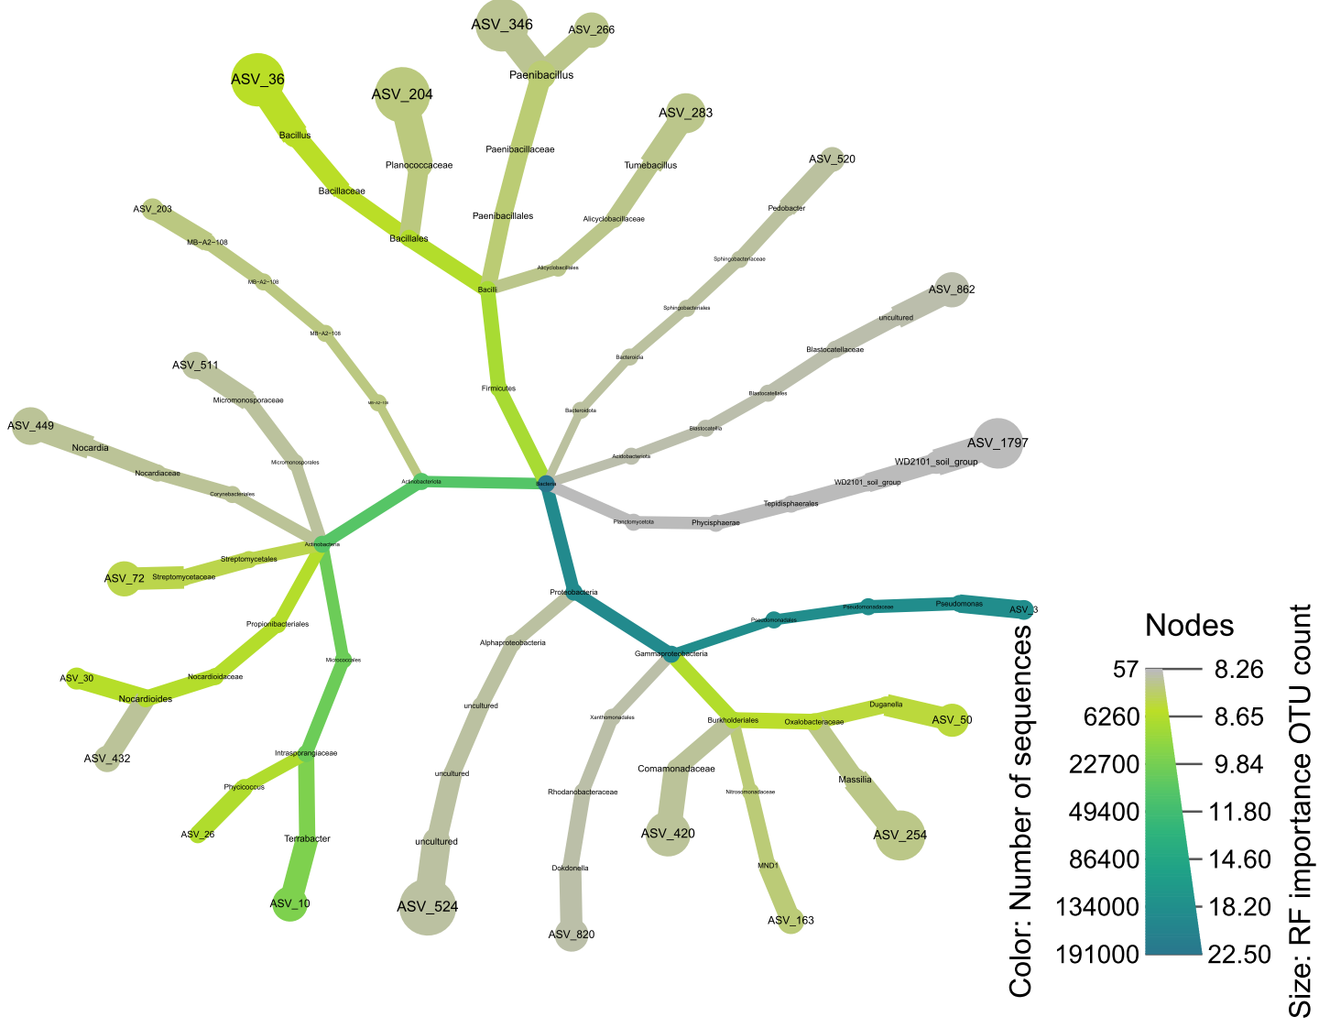
EXTRA: Random Forest: Regression
This is work from Katherine, where insect residues (BSF, crickets, mealworm) were mixed with soil in a greenhouse experiment and compared to different controls
Regression to predict number of flowers according bacterial abundances in frass soil amendments experiments
Found 25 of 9700 ASV features as important predictors of number of flowers
Root Mean Square Error (RMSE) is 8,97, used to compare models
R² = 0.59
Bacillus but also proteobacteria play a role in the number of flowers

Slide 18
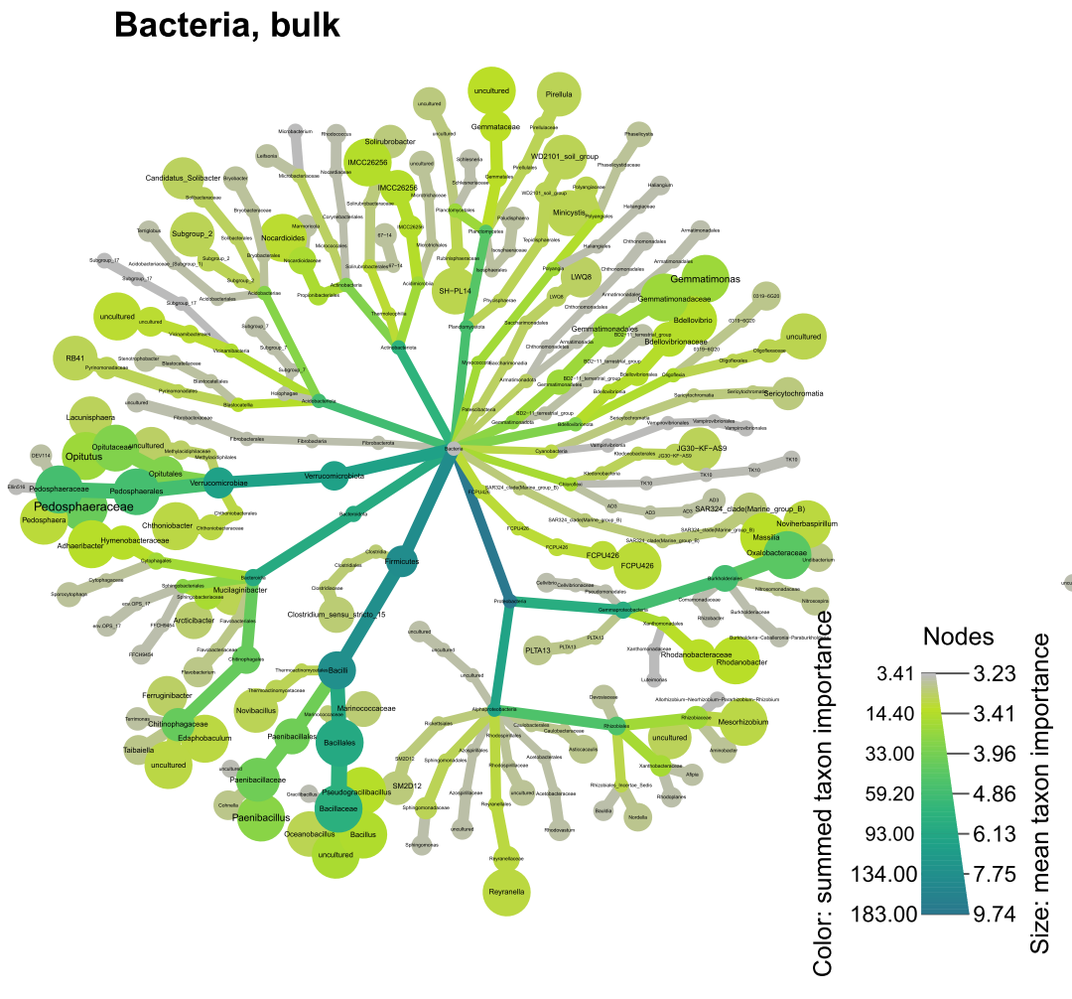
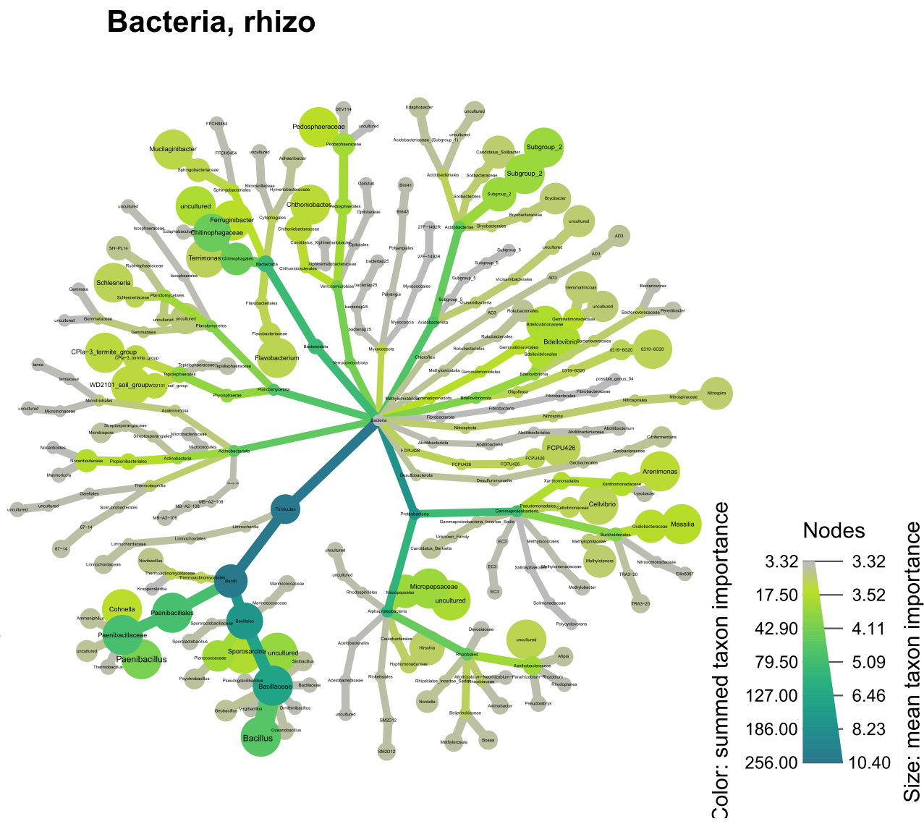
EXTRA: Random Forest: Regression
This is work from Shaphan, where insect frass from different sources and composting conditions were mixed with soil in a greenhouse experiment and compared to different controls
Taxonomy of ASVs important in predicting plant biomass
Found 94 of 9700 ASV features as important predictors of treatment with accuracy of 0.951 and Kappa of 0.940 in the training set.

