Slide 1
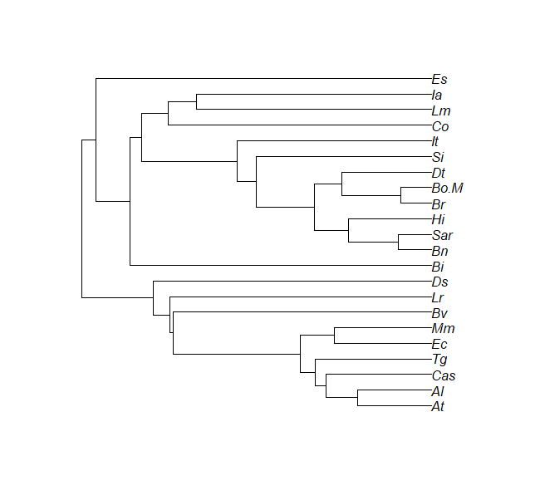
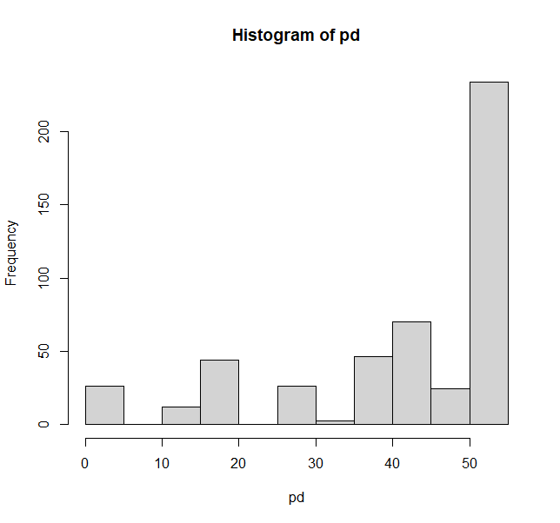
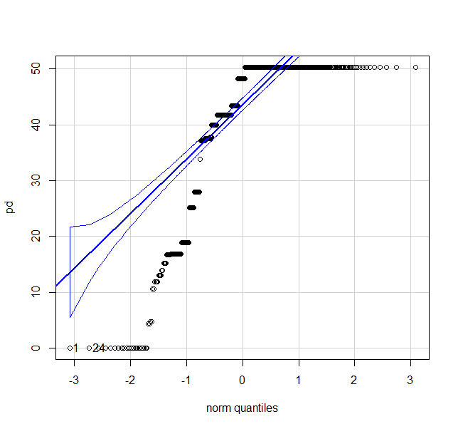
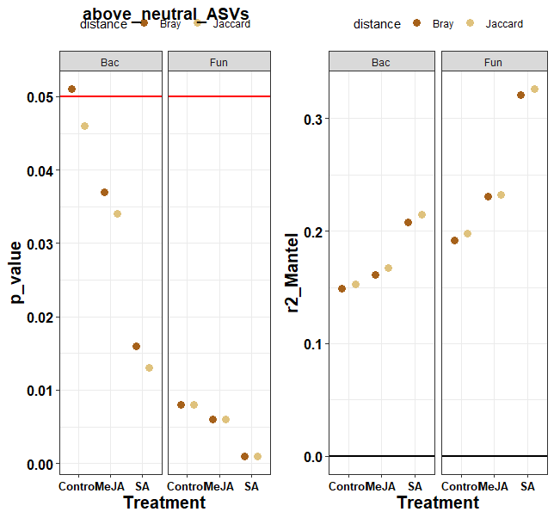
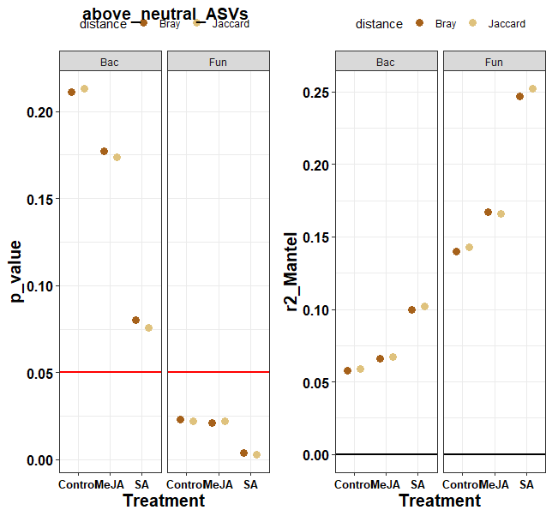
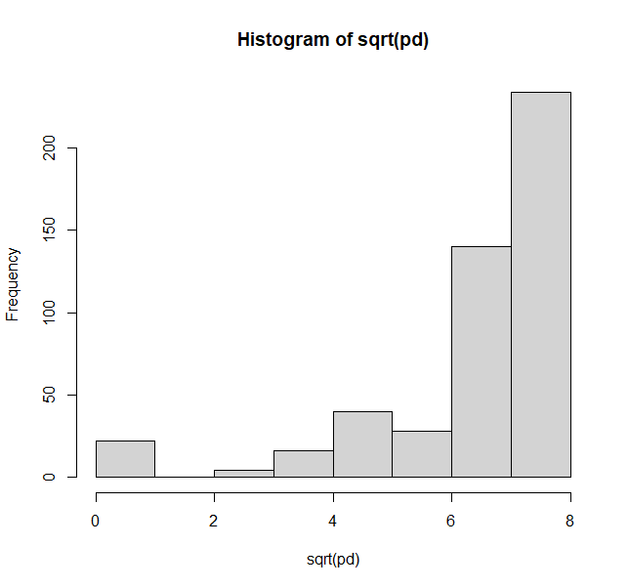
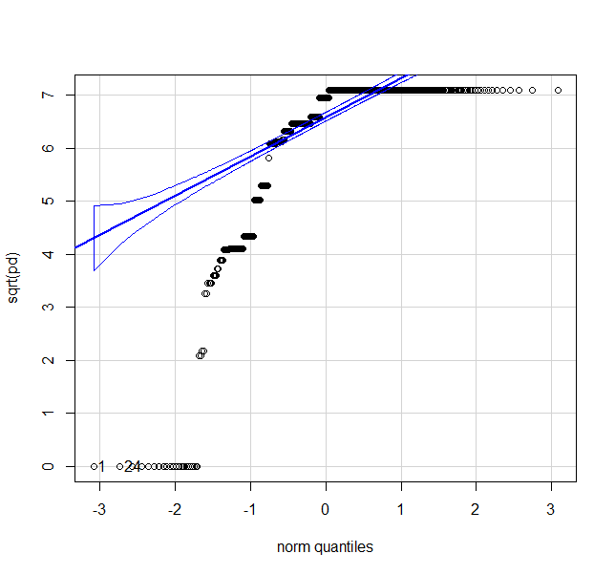
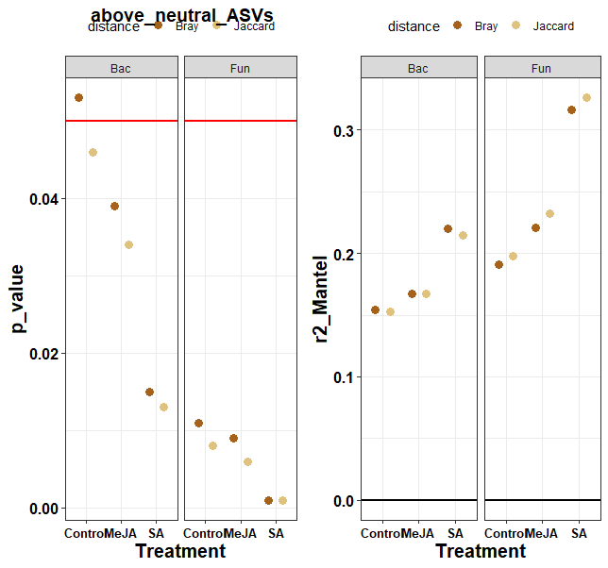

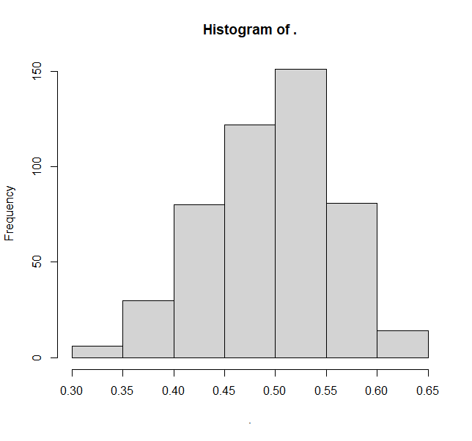
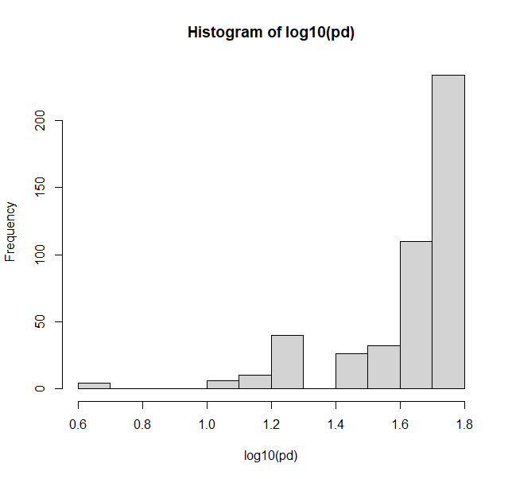
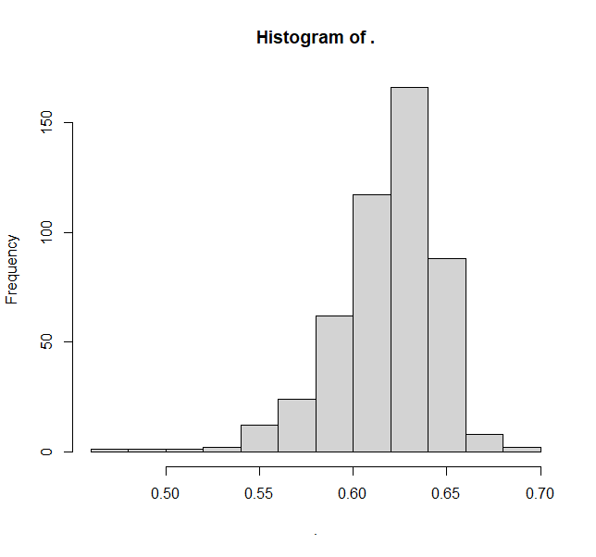
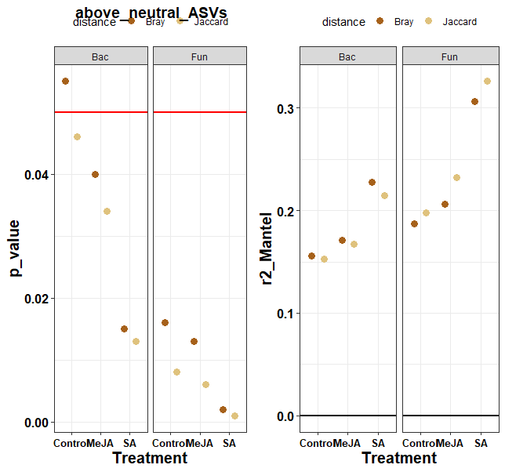
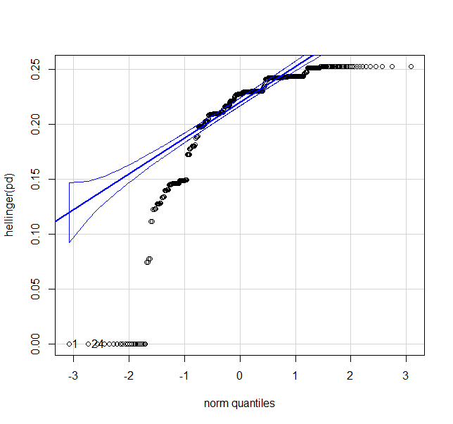
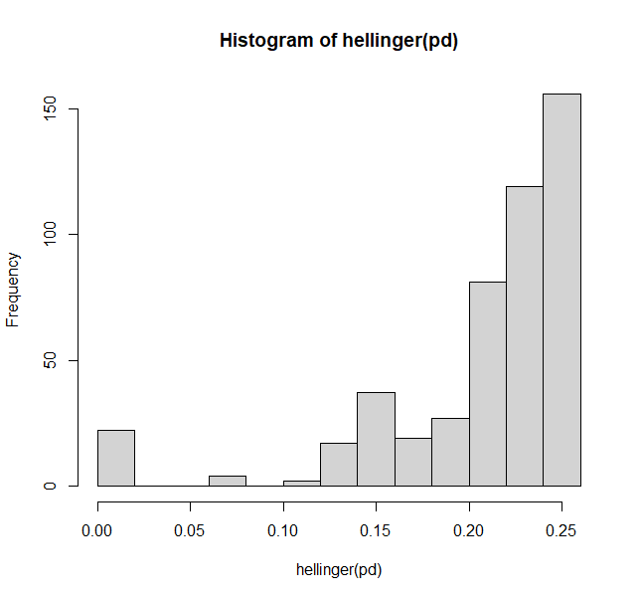
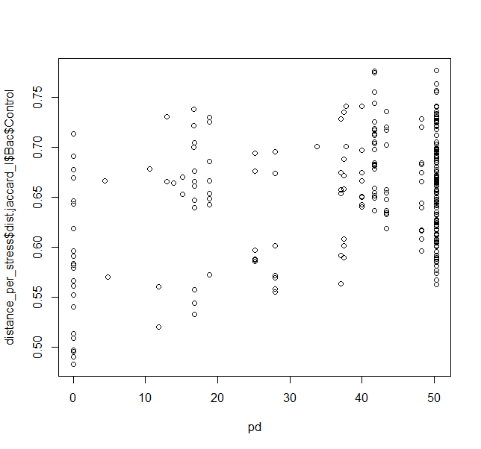
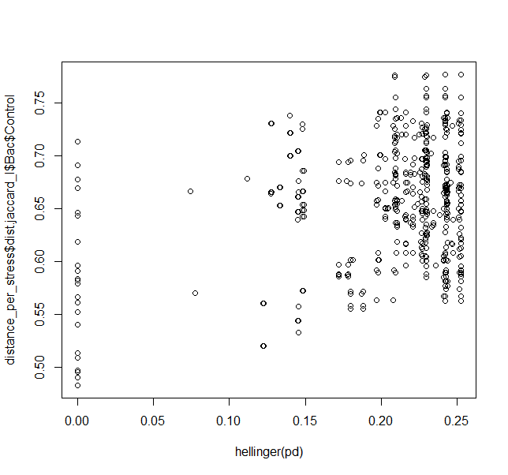
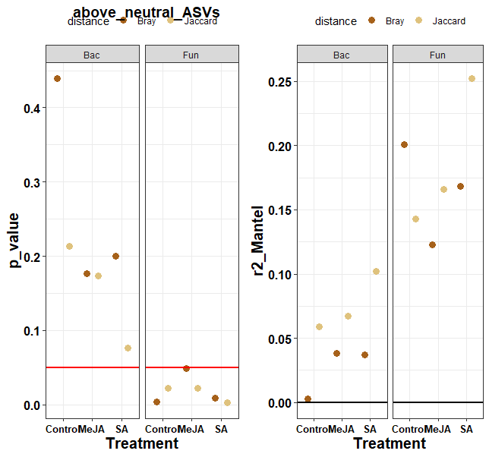
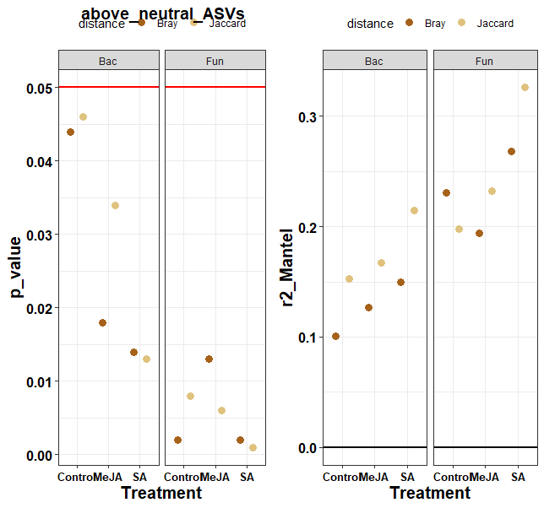
MY tree
Pearson
Spearman
raw
Bac
sqrt
log
Fun
hellinger

Slide 2
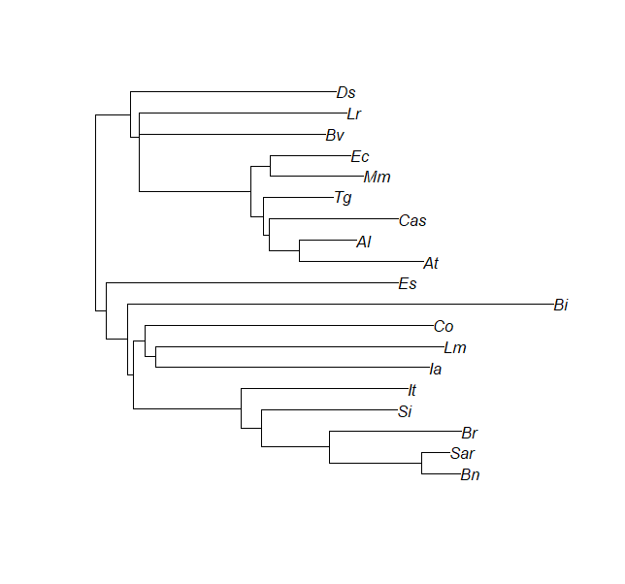
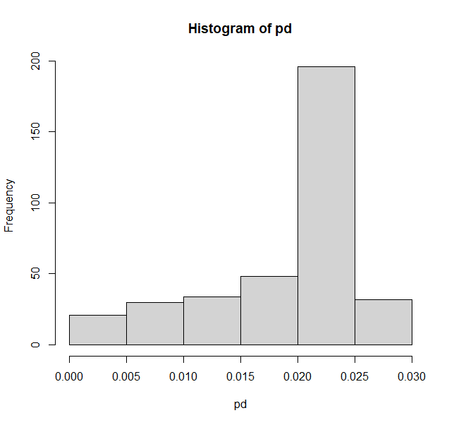
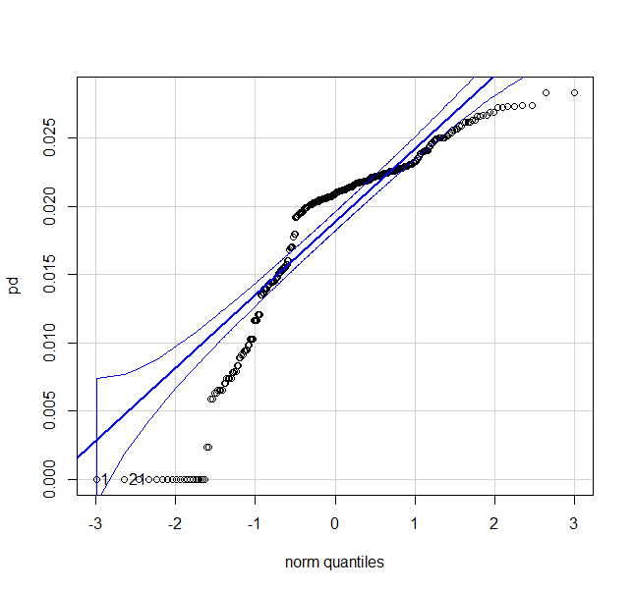
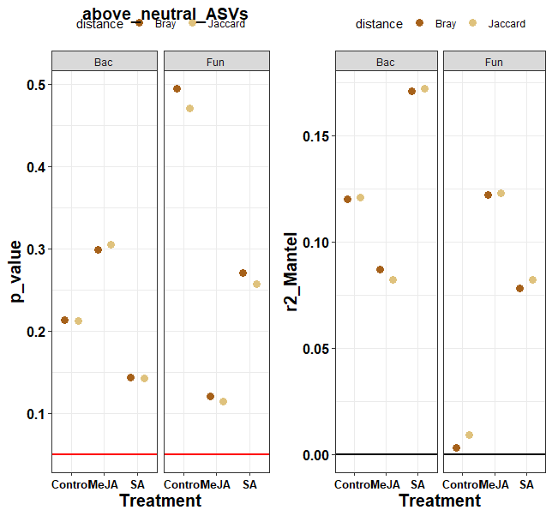
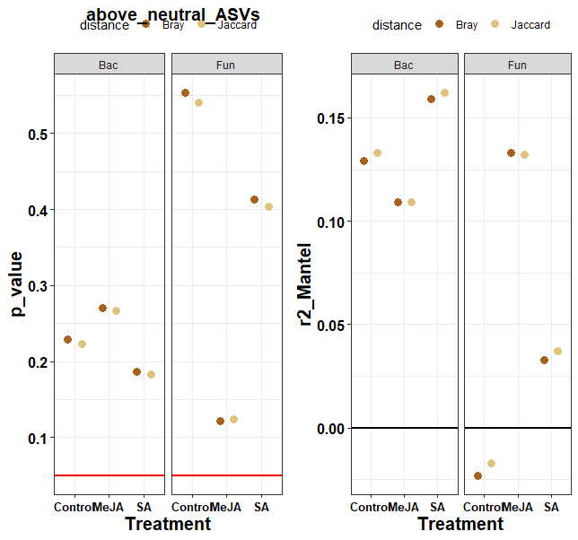
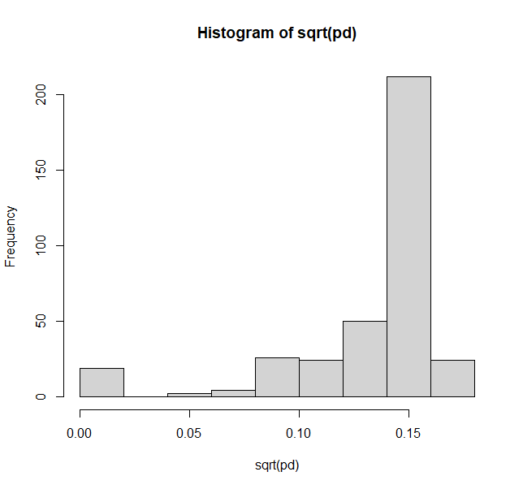
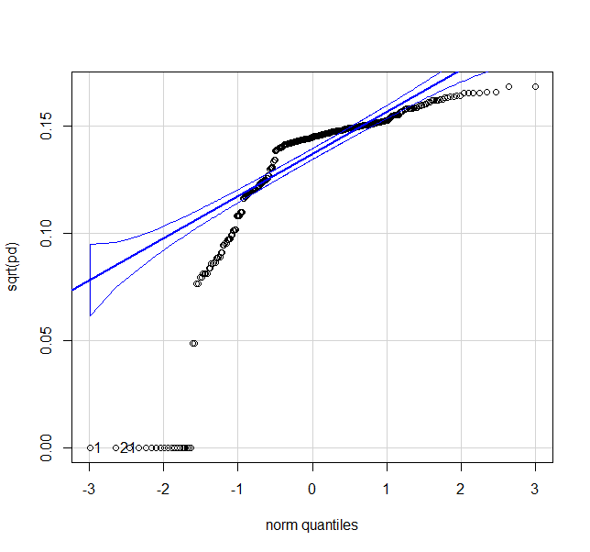
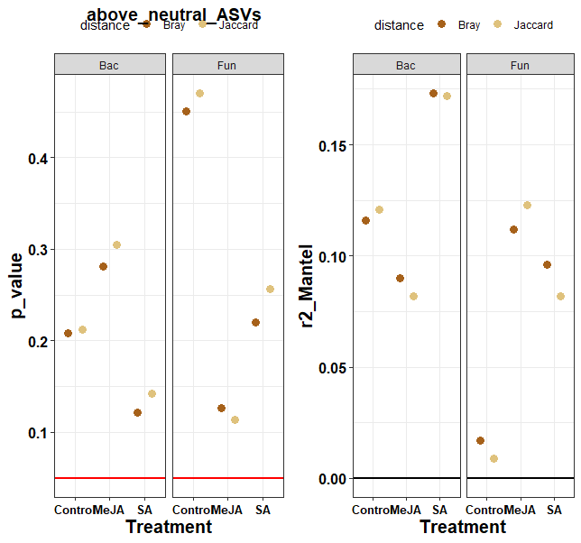
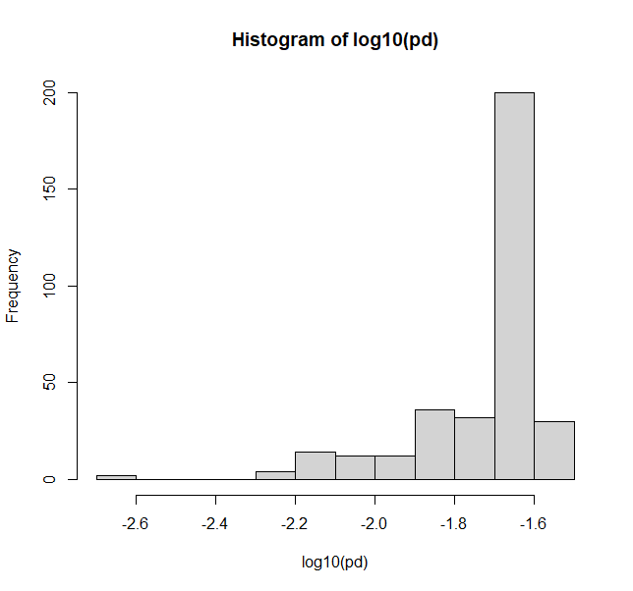
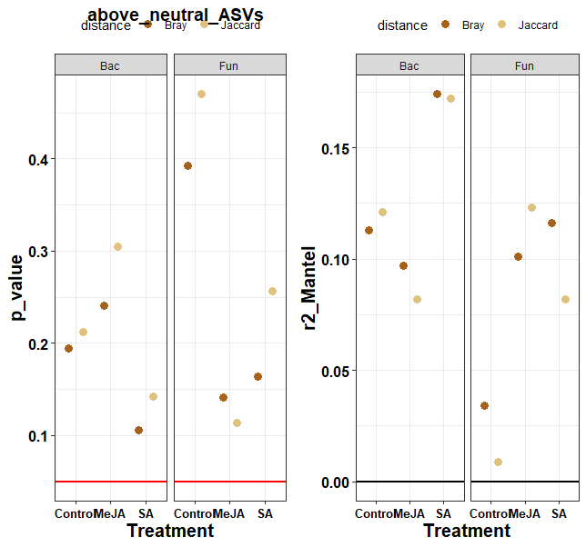
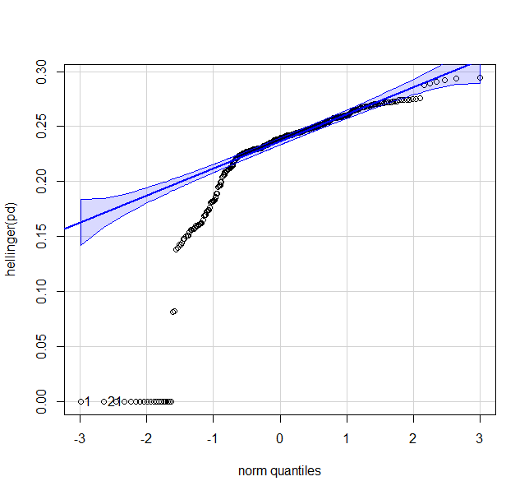
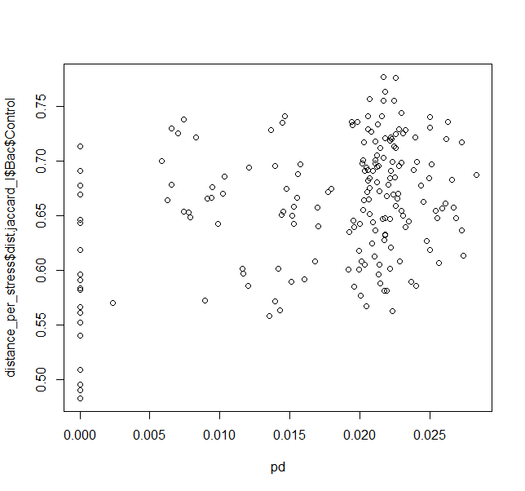
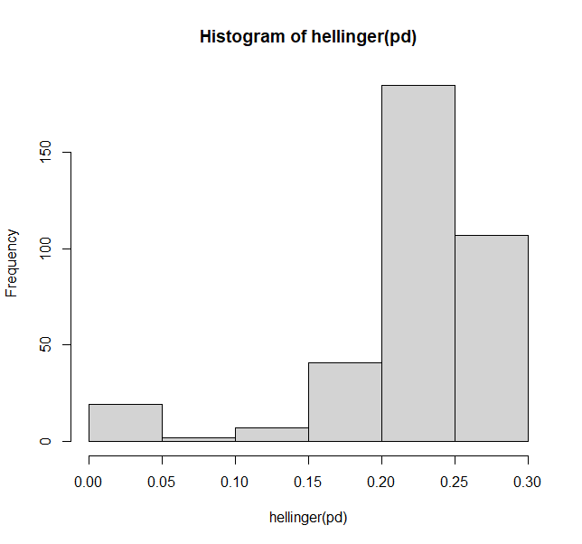
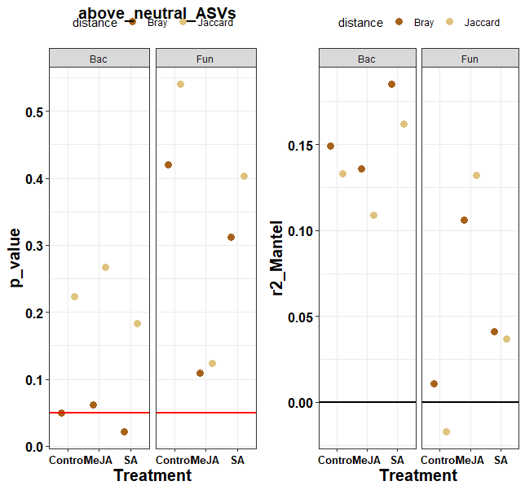
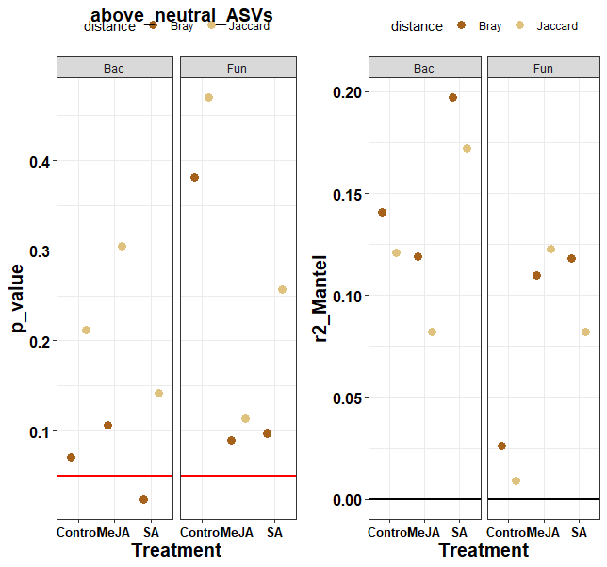
Pearson
Spearman
Base substitution tree
Bac
Fun

Slide 3
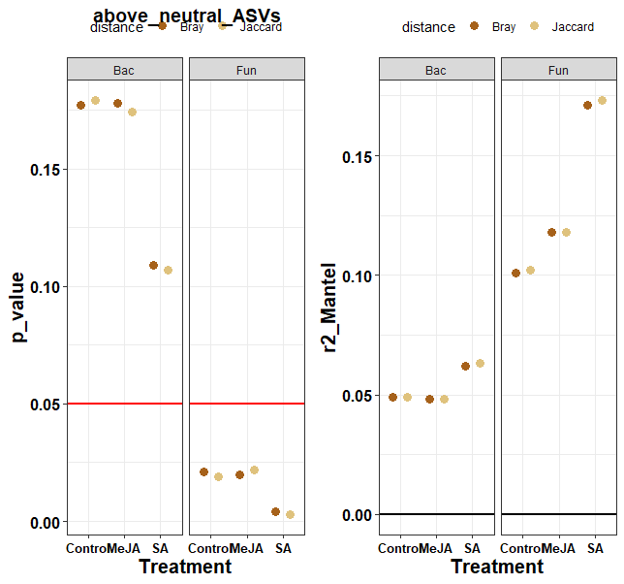
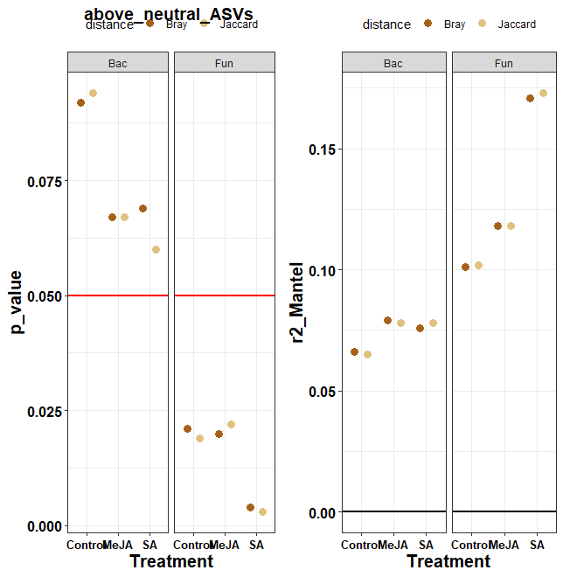
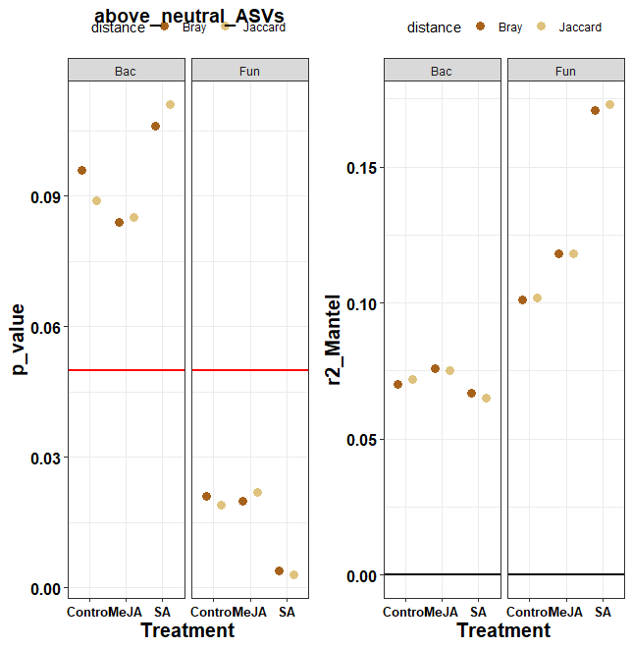
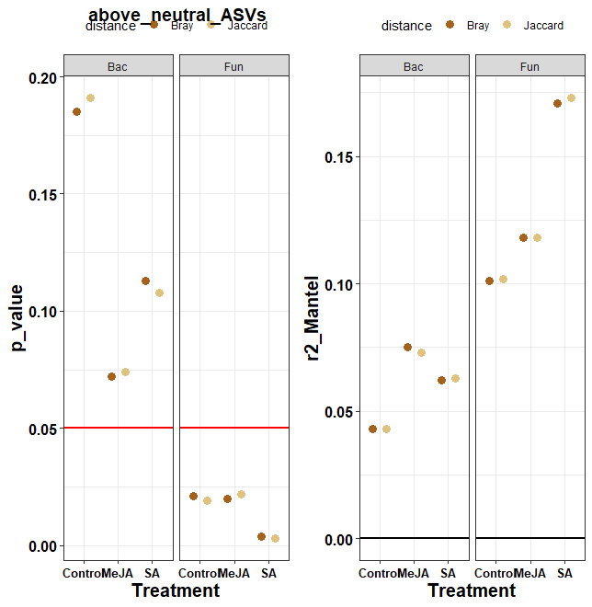
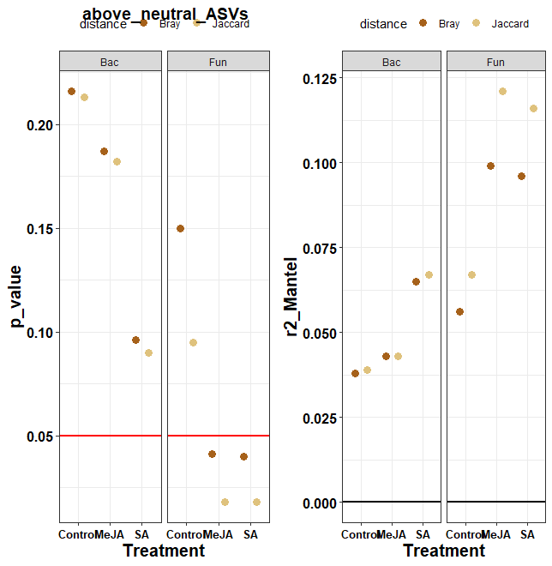
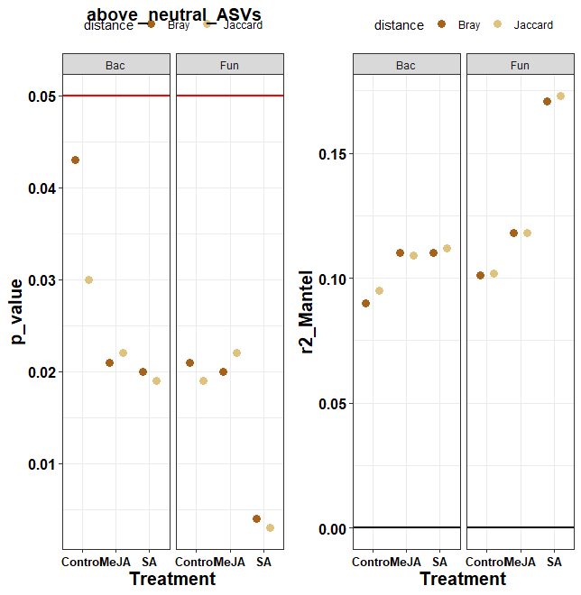
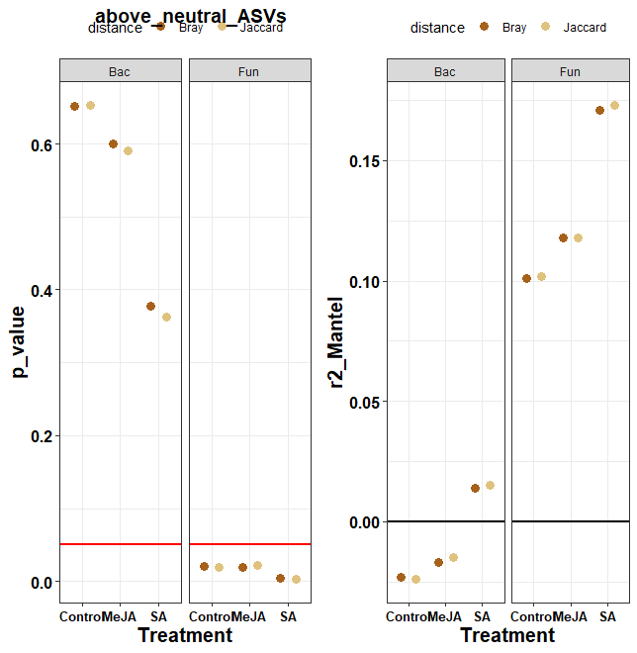
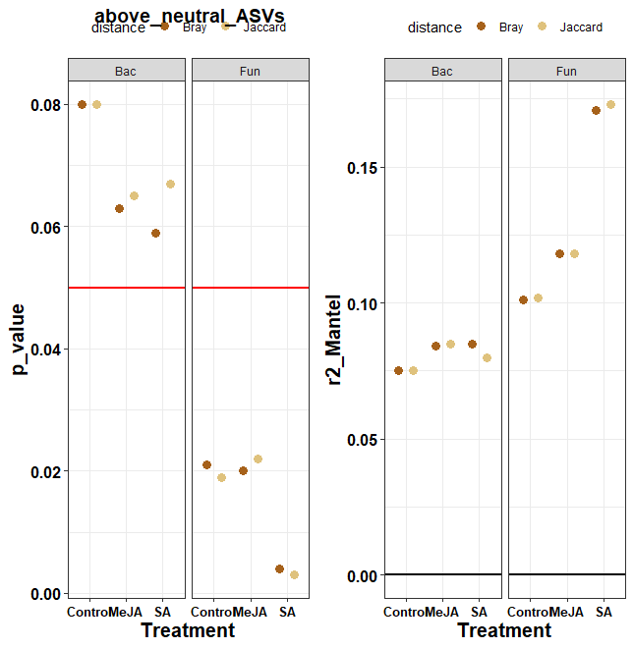
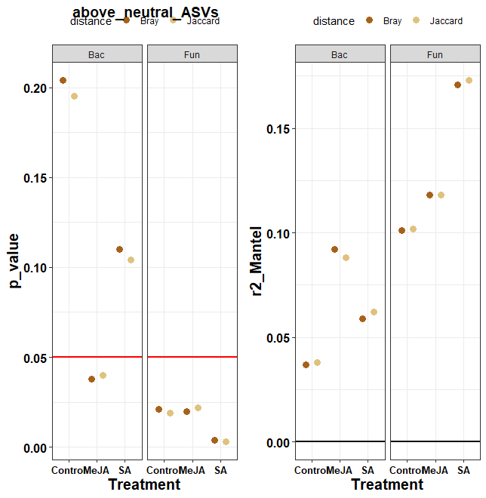
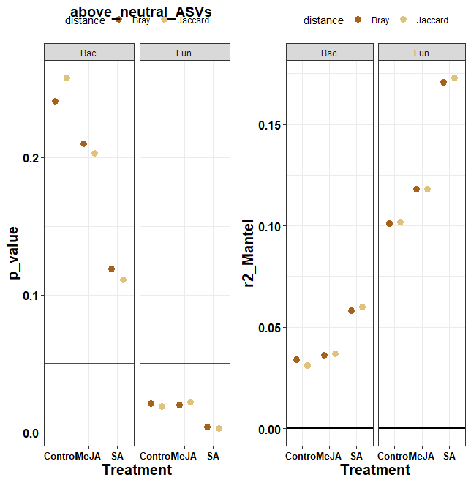
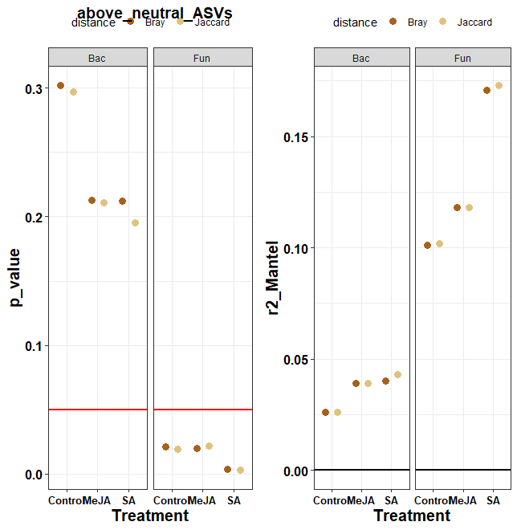

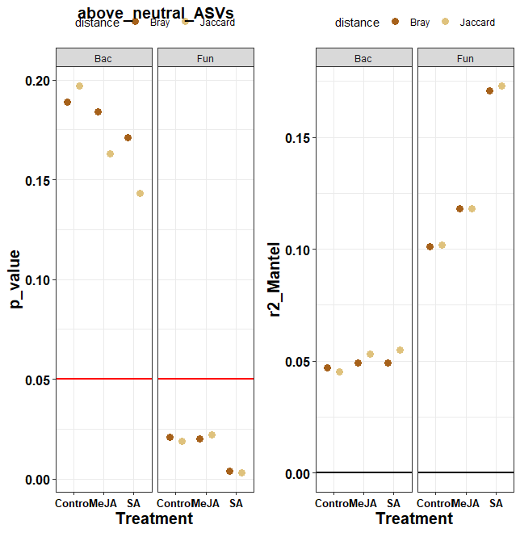
Kendall, MY, no transformations, 3 neutral families
Only above-neutral
5 neutral genus
o__Chitinophagales
g__Phenylobacterium
Fungi, g__Penicilium
O__Caulobacterales
g__Arenimonas
g__Niastella
g__Massilia
F__commamonadaceae
F__xanthomonadaceae
F__chitinophagaceae
g__Lysobacter

Slide 4
All above-Neutral ASVs
BAC PC_1 | Phylogenetic_signal | p_value | test
Control.1 | 0.06284376 | 0.75906688 | lambda
Control.2 | 0.45033694 | 0.45745746 | K
MeJA.1 | 0.36968937 | 0.12972026 | lambda
MeJA.2 | 0.57675185 | 0.14114114 | K
SA.1 | 0.46840079 | 0.12244573 | lambda
SA.2 | 0.68077944 | 0.04204204 | K
FUN PC_1 | Phylogenetic_signal | p_value | test
Control.1 | 0.3665413 | 0.03697095 | lambda
Control.2 | 0.4263493 | 0.52852853 | K
MeJA.1 | 0.2317318 | 0.17677933 | lambda
MeJA.2 | 0.3020993 | 0.86886887 | K
SA.1 | 0.4118797 | 0.03431264 | lambda
SA.2 | 0.4713065 | 0.38238238 | K
BAC PC_2 | Phylogenetic_signal | p_value | test
Control.1 | 0.6816450 | 0.06584882 | lambda
Control.2 | 0.7661053 | 0.02402402 | K
MeJA.1 | 0.3750040 | 0.52246194 | lambda
MeJA.2 | 0.6345264 | 0.06206206 | K
SA.1 | 0.7534883 | 0.15151928 | lambda
SA.2 | 0.7349227 | 0.02502503 | K
FUN PC_2 | Phylogenetic_signal | p_value | test
Control.1 | 6,61E+01 | 1 | lambda
Control.2 | 3,60E+05 | 0.6886887 | K
MeJA.1 | 6,61E+01 | 1 | lambda
MeJA.2 | 4,72E+05 | 0.3673674 | K
SA.1 | 4,89E+03 | 0.9817922 | lambda
SA.2 | 4,62E+05 | 0.3743744 | K
Are distances in microbime matrixes correlated to distances in plant phylogeny matries?
Do similar plant species have a similar phenotype/microbiome metric?
$Bac | P VALUES
Beta_PCoA_PC1_mean | Beta_PCoA_PC2_mean | Beta_PCoA_PC3_mean | Stress | test
0.338 | 0.018 | 0.808 | Control | moran
0.243 | 0.008 | 0.921 | Control | abouheif
0.085 | 0.269 | 0.159 | MeJA | moran
0.048 | 0.302 | 0.177 | MeJA | abouheif
0.023 | 0.138 | 0.316 | SA | moran
0.014 | 0.195 | 0.440 | SA | abouheif
$Fun
Beta_PCoA_PC1_mean | Beta_PCoA_PC2_mean | Beta_PCoA_PC3_mean | Stress | test
0.022 | 0.709 | 0.153 | Control | moran
0.016 | 0.717 | 0.092 | Control | abouheif
0.139 | 0.595 | 0.993 | MeJA | moran
0.108 | 0.564 | 0.983 | MeJA | abouheif
0.019 | 0.616 | 0.211 | SA | moran
0.019 | 0.651 | 0.163 | SA | abouheif

Slide 5
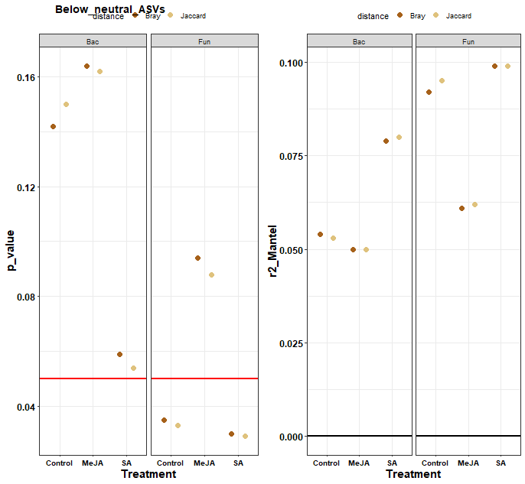
$Bac | PC_1
 | Phylogenetic_signal | p_value | test
Control.1 | 0.2478763 | 0.31644327 | lambda
Control.2 | 0.5593708 | 0.17311731 | K
MeJA.1 | 0.5904177 | 0.01976785 | lambda
MeJA.2 | 0.7688659 | 0.01560156 | K
SA.1 | 0.7318389 | 0.01670411 | lambda
SA.2 | 0.8553034 | 0.00590059 | K
$Fun | PC_1
 | Phylogenetic_signal | p_value | test
Control.1 | 6,61E+01 | 1 | lambda
Control.2 | 2,93E+05 | 0.9256926 | K
MeJA.1 | 6,61E+01 | 1 | lambda
MeJA.2 | 3,24E+05 | 0.8458846 | K
SA.1 | 6,61E+01 | 1 | lambda
SA.2 | 4,34E+05 | 0.4413441 | K
> | extract_lambda_k_p(PC2_lambda_k)
$Bac | PC_2
 | Phylogenetic_signal | p_value | test
Control.1 | 0.5832554 | 0.14791557 | lambda
Control.2 | 0.6411195 | 0.07780778 | K
MeJA.1 | 0.1135945 | 0.77384477 | lambda
MeJA.2 | 0.5956369 | 0.12311231 | K
SA.1 | 0.7899800 | 0.23061123 | lambda
SA.2 | 0.7169301 | 0.03210321 | K
$Fun | PC_2
 | Phylogenetic_signal | p_value | test
Control.1 | 0.5165833 | 0.009929092 | lambda
Control.2 | 0.6834912 | 0.053805381 | K
MeJA.1 | 0.3945823 | 0.038258757 | lambda
MeJA.2 | 0.4789166 | 0.380238024 | K
SA.1 | 0.2221164 | 0.221655520 | lambda
SA.2 | 0.3085339 | 0.869186919 | K
All below-Neutral ASVs
$Bac
 | Stress | Beta_PCoA_PC1_mean | Beta_PCoA_PC2_mean | m | Rsqr | test
1 | Control | 0.0754 | 0.1218 | 0.2011 | 0.1223 | moran
2 | Control | 0.0551 | 0.1437 | 0.1600 | 0.1502 | abouheif
3 | MeJA | 0.0039 | 0.4883 | 0.1586 | 0.2603 | moran
4 | MeJA | 0.0043 | 0.5503 | 0.1429 | 0.2207 | abouheif
5 | SA | 0.0020 | 0.2875 | 0.1237 | 0.2376 | moran
6 | SA | 0.0018 | 0.3965 | 0.1266 | 0.2048 | abouheif
$Fun
 | Stress | Beta_PCoA_PC1_mean | Beta_PCoA_PC2_mean | m | Rsqr | test
1 | Control | 0.8363 | 0.0032 | 0.1125 | 0.4051 | moran
2 | Control | 0.8453 | 0.0031 | 0.0831 | 0.3845 | abouheif
3 | MeJA | 0.8832 | 0.0220 | 0.2186 | 0.4499 | moran
4 | MeJA | 0.8912 | 0.0143 | 0.1509 | 0.4167 | abouheif
5 | SA | 0.6011 | 0.2011 | 0.2481 | 0.6826 | moran
6 | SA | 0.6463 | 0.1614 | 0.1974 | 0.6594 | abouheif

Slide 6
Neutral model R and m against phylogenetic signal
> | extract_lambda_k_p(m_neutral_lambda_k)
$Bac
 | Phylogenetic_signal | p_value | test
Control.1 | 0.02984678 | 0.9125842 | lambda
Control.2 | 0.47544576 | 0.3743744 | K
MeJA.1 | 0.14966449 | 0.5770398 | lambda
MeJA.2 | 0.46337989 | 0.3843844 | K
SA.1 | 0.18637642 | 0.5434872 | lambda
SA.2 | 0.47230584 | 0.3443443 | K
$Fun
 | Phylogenetic_signal | p_value | test
Control.1 | 0.2407537 | 0.1442279 | lambda
Control.2 | 0.2833333 | 0.8728729 | K
MeJA.1 | 0.2006780 | 0.2922564 | lambda
MeJA.2 | 0.3235352 | 0.7747748 | K
SA.1 | 0.2421377 | 0.2794105 | lambda
SA.2 | 0.3963852 | 0.5955956 | K
> | Abouheif_and_moran_p
$Bac
 | Stress |  |  | m | Rsqr | test
1 | Control |  |  | 0.212 | 0.144 | moran
2 | Control |  |  | 0.166 | 0.159 | abouheif
3 | MeJA |  |  | 0.152 | 0.249 | moran
4 | MeJA |  |  | 0.149 | 0.257 | abouheif
5 | SA |  |  | 0.108 | 0.236 | moran
6 | SA |  |  | 0.138 | 0.206 | abouheif
$Fun
 | Stress |  |  | m | Rsqr | test
1 | Control |  |  | 0.126 | 0.430 | moran
2 | Control |  |  | 0.068 | 0.390 | abouheif
3 | MeJA |  |  | 0.215 | 0.444 | moran
4 | MeJA |  |  | 0.152 | 0.439 | abouheif
5 | SA |  |  | 0.221 | 0.685 | moran
6 | SA |  |  | 0.191 | 0.674 | abouheif

Slide 7
Kendall, MY, no transformations, 3 neutral families
All Above-Neutral ASVs
Up to discussion: figures/plots details in specific taxonomies?
Fungi, g__Penicilium
O__Caulobacterales
g__Massilia

Slide 8
