Slide 1


Meeting Log MICROP’s Brassiaceae Family experiment & Pariya Behrouzi
Pedro Beschoren da Costa, PhD
Marcela Aragon Gomes, Msc
Zulema Carracedo Lorenzo, Msc
Melissa Uribe, Msc
Karen Kloth, PhD
Prof. Marcel Dicke

Slide 2
Meeting 1 – 20/May/2022
Pedro Beschoren
Pariya Behrouzi

Slide 3

Brassicaceae family experiment
Plant Sp harvesting was binned on 3 different dates according plant speed of growth: Fast, Medium and Slow
Transplant to 1L pots with microp soil
Per species, Induction of stress by dipping
Harvest
Sowing + germination in microp soil
+ B.o
Sp. 1
Sp. 2
Sp. 3
(6)
(6)
(6)
(6)
(6)
(6)
MeJA
+Silwet
SA
+Silwet
Water + Silwet
(...)
Sp. 4
Sp. 5
Sp. 33
4 dippings, every 4 days
Growth until 3-5 leaf stage
7 days
14-21 days
12 days
26Brassicaceae
2 Gramineae
2 Fabaceae
2 Solanaceae
1 Cucurbitaceae
1 bulk soil control
1632 pots
102 treatments
Methyl Jasmonate (MeJA) – mimics insect attack
Salicilic acid (SA) - mimics pathogen attack
Control – water, silwet (surfactant) and ethanol
This is a significant slice of the core experiment

Slide 4
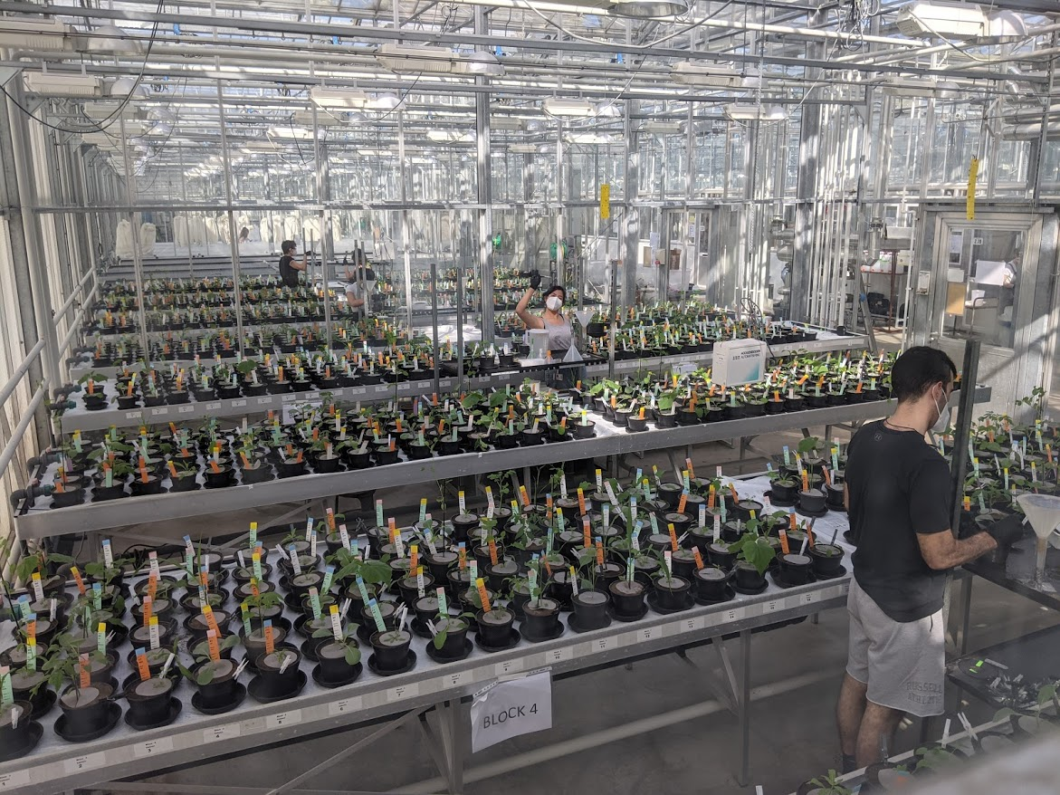
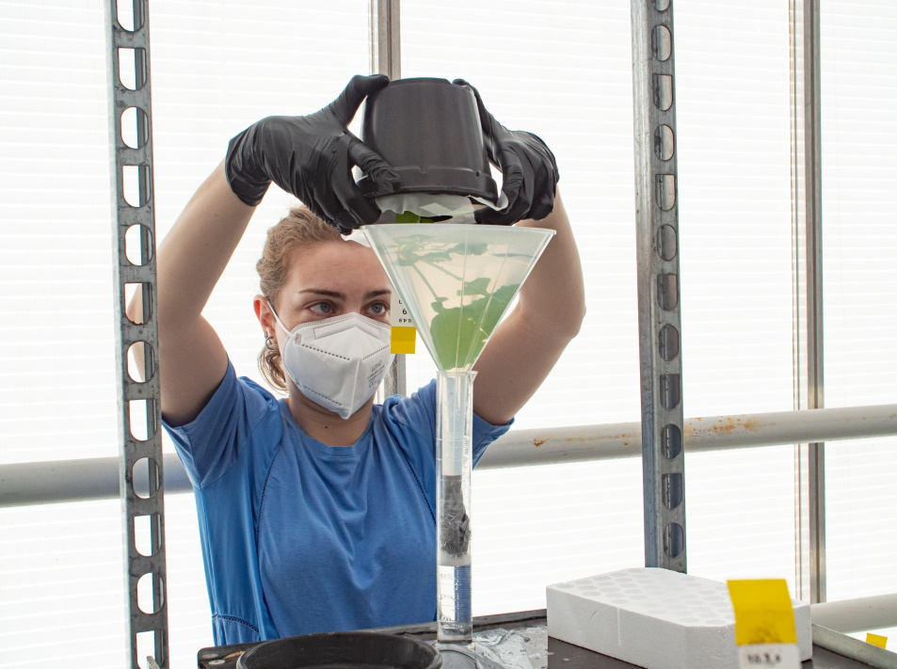
1632 pots
33 plant species
3 stress treatments
16 rep/treatment
99 independent treatments
+ 3 no-plant soil controls

Slide 5
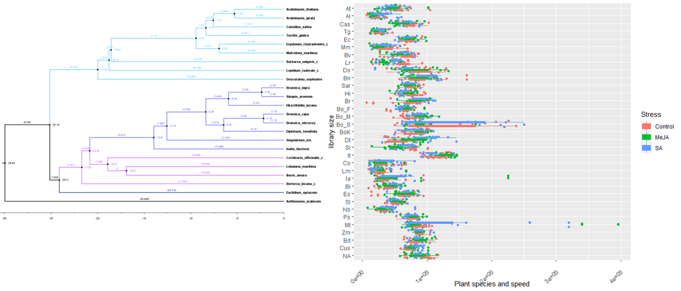
Example of microbiome X plant phylogeny comparions
Figure 1: phylogeny of brassicaceae plant species (left) and 16S sequencing library sizes (right). Note that last 7 plant species on the right plot are not part of the brassicaceae family and won’t be present in the tree

Slide 6

Main research goals
Our main goal is to check if microbiome responses to Herbivore and phatogen stress are conserved across the brassicaceae phylogeny. For research questions examples:
Are the microbial communities in brassicaceae species of the first clade as strongly affected by MeJA stresses as the brassicae plants in the second clade?
Are the bacterial OTUs found as differentially abundant in the first brassicacea species clade from the same families and orders as the differentialy abundant OTUs from the second clade?

Slide 7
Role of a network analysis
Some of our major goals with OTU-OTU networks are:
Detecting keystone species, module hubs, and module connectors
Checking if network structure differs according the brassicace plant species and clades
Detecting modules that may be strongly correlated to plant metadata and stress treatments
Detecting a pattern for interkingdom connections between bacteria and fungi

Slide 8
Initial data structure
120 million 16S reads across 60k OTUs in ~ 1600 samples
118 million ITS reads across 3k OTUs in ~ 1600 samples
If rarefied, each sample contains 10k reads (counts)
Plant species phylogenetic relatedness can be reduced to a bray-curtis dissimilarity matrix
Our initial approach could be:
Strongly Filter OTUs by only retaining Core Microbiome OTUs
(expect a few hundred OTUs per plant species, a few thousand OTUs total)
Construct one network per stress treatment (n =~ 416, 3 networks), checking the effect of stress on network structure

Slide 9
Proceeding with Collaboration
We can have a parallel approach to collaborate
First option for short-term result:
Action: Pariya oversees networks that Pedro constructs. Discussions during meetings.
Outcome: Pariya as a co-author in the first paper for this dataset
Second option for long-term collaboration:
Action: Pariya officially joins MICROP, Funding for a PhD student is arranged
Outcome: Mathematical models that account for our experimental designs are developed

