Slide 1
SA-BCM 2D optimisation — reruns for the article and the branch problem
Status deck, 2026-09-14, updated 2026-09-18 (dense mesh + cross-evaluation of the optima + pressure-gradient sensor, slides 22–27) · Deucalion SA_BCM_ARTICLE/2d_opt · repo docs/studies/21_c2_branch_campaign
• Question: C2 (NACA0012 → SA-BCM, cl = 0.3, Tu = 0.5 %) gave −18 % with the buggy code, −4…−6 % with the corrected one; C3 gives −24 %.
• Constraint set by the user: keep the C2 definition (NACA start, SA-BCM only, article constraints, fs ≤ 0.15); only the optimizer/solver strategy may change.
• All SA-BCM numbers here: cold start (fresh process, 16 ranks), trimmed to cl = 0.3, ev = 1e-7, fs = 0.08. SA numbers: run2d, 32 ranks.
• Contents: diagnosis (why the optimizer stalls) → every strategy tried → results per Tu → the branch mechanism → proposals.

Slide 2
1. The baseline itself is not unique
NACA0012, cl = 0.3, Tu = 0.5 %, same code, same mesh
Solver path | cd | note
cold, 16 or 32 ranks | 0.006149 | bit-for-bit reproducible at fixed rank count
cold, 48 ranks | 0.006202 | +0.9 %
cold, 64 ranks (opt_c2) | 0.006456 | +5 %
trim recipe (ANK CFL 3e5) | 0.008061 | +31 %
ev = 1e-10 | 0.005197 | −15 % (different farfield BC)
article C2 geometry, today's code | 0.0064 | worse than the NACA — the old −18 % came from the bug
The partition/pseudo-transient path selects the converged state. Deterministic for a fixed rank count.

Slide 3
2. Line test NACA → C3 in FFD space: no barrier, but discrete jumps
11 points + fine scan t = 0.80–1.00; adjoint directional derivative at every point
t | cd (fs 0.08) | cd (fs 0.15) | adjoint dcd/dt | x_tr upper
0.0 (NACA) | 0.006309 | 0.006309 | −2.1e-4 | 0.317
0.5 | 0.005765 | 0.005766 | −1.5e-4 | 0.352
0.80–0.87 | 0.005638 → 0.005634 (ramp −6.7e-5/unit) | same | −7.3e-5 … −6.1e-5 ✔ | 0.369
0.88–0.96 | 0.005733 / 0.005631 alternating | same | −4e-5 | 0.352 / 0.369
0.97–1.00 (C3) | 0.004703 → 0.004695 | 0.004977 | −2.3e-4 | 0.550
• Within a plateau the adjoint is exact (measured slope = adjoint). The drop is carried by branch switches: ±1.8 % (transition moving one cell) and −16 % (x_tr 0.37 → 0.55).
• fs = 0.15 gives identical plateaus and jumps (and +5.8 % on the good branch) → smoothing is not the lever.

Slide 4
3. Hysteresis chains and Tu-ramp probe: several steady states per geometry
t | cold | warm from NACA (fwd) | warm from C3 (bwd) | Tu₀ = 0.1 % → 0.5 % | Tu₀ = 3 % → 0.5 %
0.0 | 0.006149 | 0.006149 | 0.006255 | 0.006248 | 0.009386
0.5 | 0.005765 | 0.006069 | 0.005963 | 0.005863 | 0.009387
0.8 | 0.005639 | 0.006047 | 0.005639 | 0.005738 | 0.009446
0.96 | 0.005630 | 0.006045 | 0.005244 | 0.005244 | 0.009459
1.0 (C3) | 0.004695 | 0.006045 | 0.004643 | 0.004643 | 0.009464
• Warm from the NACA carries the tripped branch all the way to the C3 shape (0.00605 instead of 0.00464) — a classic warm-started optimization can never see the C3 gain.
• Starting turbulent (Tu₀ = 3 %) → fully turbulent state (0.0094 ≈ SA) is stable at Tu = 0.5 % for every geometry: a spurious self-sustained mode.
• The good branch (x_tr 0.55) is a narrow basin around C3 (collapses within Δt = 0.04).

Slide 5
4. The three stable modes and why the gradient cannot see the gain
• Mode 1 — turbulent from the leading edge (cd 0.0094): the ν_t/ν term keeps γ = 1, which keeps ν_t high. Self-sustained; only reached by starting turbulent. Spurious.
• Mode 2 — transition mid-chord (0.32–0.37 c) in pairs of neighbouring cells: γ switches where Re_v crosses the Tu threshold; on a flat pressure region Re_v grows slowly, so the crossing is ill-conditioned; transition at cell i changes the downstream boundary layer and the pressure, which moves the crossing — two adjacent cells are both self-consistent (±1.8 % cd). Discrete because of the mesh; fsmooth does not remove it.
• Mode 3 — long laminar run (x_tr 0.55 c): only for shapes with a pressure plateau (C3 family). Narrow basin.
• SLSQP: the adjoint measures the slope inside a step (correct, tiny); the line search samples 1–5 points on one line with shrinking steps; a +1.8 % landing at every trial ⇒ 'converged'. The accepted point can also switch branch (objective drifts up).
• A denser mesh makes the steps smaller (more, lower equilibria); the ill-conditioning of the crossing on a flat pressure plateau remains.

Slide 6
5. Optimizer strategies tried (NACA0012 start, Tu = 0.5 %, fs 0.08)
best cd cold-verified; Δ vs baseline 0.006149; C4 = −11.4 %, C3 = −24.5 %
Strategy | Idea | cd | Δ | Verdict
SLSQP as in the article (scale 10) | — | 0.00617 / 0.00583 (fs 0.04) | −4.4 / −5.2 % | stalls on branch noise
B1/B1′ warm start + guard | continuity | 0.00756 / 0.00631 | +17 / +2.6 % | hysteresis poisons the base point
B cold, DV scale 2 | smaller steps | 0.00571 (not reproducible) | −7 % then drifts | —
B4 / B5 cold + warm-from-best; laminar-first | branch selection | 0.00591 / 0.00590 | −4 % | false minima
B6 branch envelope (cold | lam | best) + SLSQP restarts | lower envelope, clean BFGS | 0.005571 | −9.4 % | first method that keeps its gains
B7/B9 Tu continuation from below (0.1 → 0.5) | laminar shapes first | 0.0059–0.0061 | −2…−5 % | low-Tu shapes lose laminarity at 0.5 %
B10 Tu continuation from above (1.0/0.75 → 0.5) | plateau shapes first | 0.0062–0.0069 | worse than NACA | BCM stalls at any Tu
B11 SLSQP restarted from best ±0.01 probe point | probe + descend | 0.005484 | −10.8 % | adjoint result, V/V0 0.994
Cold pattern search (derivative-free), 7 rounds | compare cold values, no gradient | 0.005237 / 0.005052 / 0.005035 | −14.8 / −17.8 / −18.1 % | V/V0 0.9997 / 0.988 / 0.973 — NOT adjoint

Slide 7
6. Article-style tables per free-stream Tu (cold, cl = 0.3)
ΔCd vs the SA-BCM baseline at the same Tu; C1 (SA) = −3.0 % vs the SA baseline at any Tu
Tu | Baseline SA-BCM cd | C2 cd (Δ) | C3 cd (Δ) | C4 cd (Δ) | x_tr C2 up / lo
0.5 % (article) | 6.15e-3 | 5.48e-3 (−10.8 %) adjoint · 5.05e-3 (−17.8 %) derivative-free | 4.64e-3 (−24.5 %) | 5.45e-3 (−11.4 %) | 0.352 / 0.658 · 0.420 / 0.713
0.25 % | 5.12e-3 | 4.04e-3 (−21.1 %) adjoint | 4.10e-3 (−19.9 %) | 4.59e-3 (−10.4 %) | 0.485 / 0.971
0.1 % | 4.30e-3 | 3.49e-3 (−18.9 %) adjoint | 3.84e-3 (−10.7 %) | 4.25e-3 (−1.3 %) | 0.634 / 0.982
• Tu = 0.25 %: the laminar basin is wide enough for the gradient; C2 reaches the C3 level with a clear aft movement of transition (upper +0.08 c, lower +0.16 c; small laminar separation bubble near the TE on the lower surface at x/c ≈ 0.94).
• Tu = 0.1 %: the baseline is already very laminar (x_tr 0.52/0.92); C4 ≈ baseline, the 'SA misleads' message weakens.
• Tu = 0.5 %: with adjoint only, C2 (−10.8 %) is slightly below C4 (−11.4 %); ≥ −12 % needs the derivative-free stage. Full tables (Cd/Cdv/Cdp, %Cdv/%Cdp, x_tr): tables_by_tu.md.

Slide 8
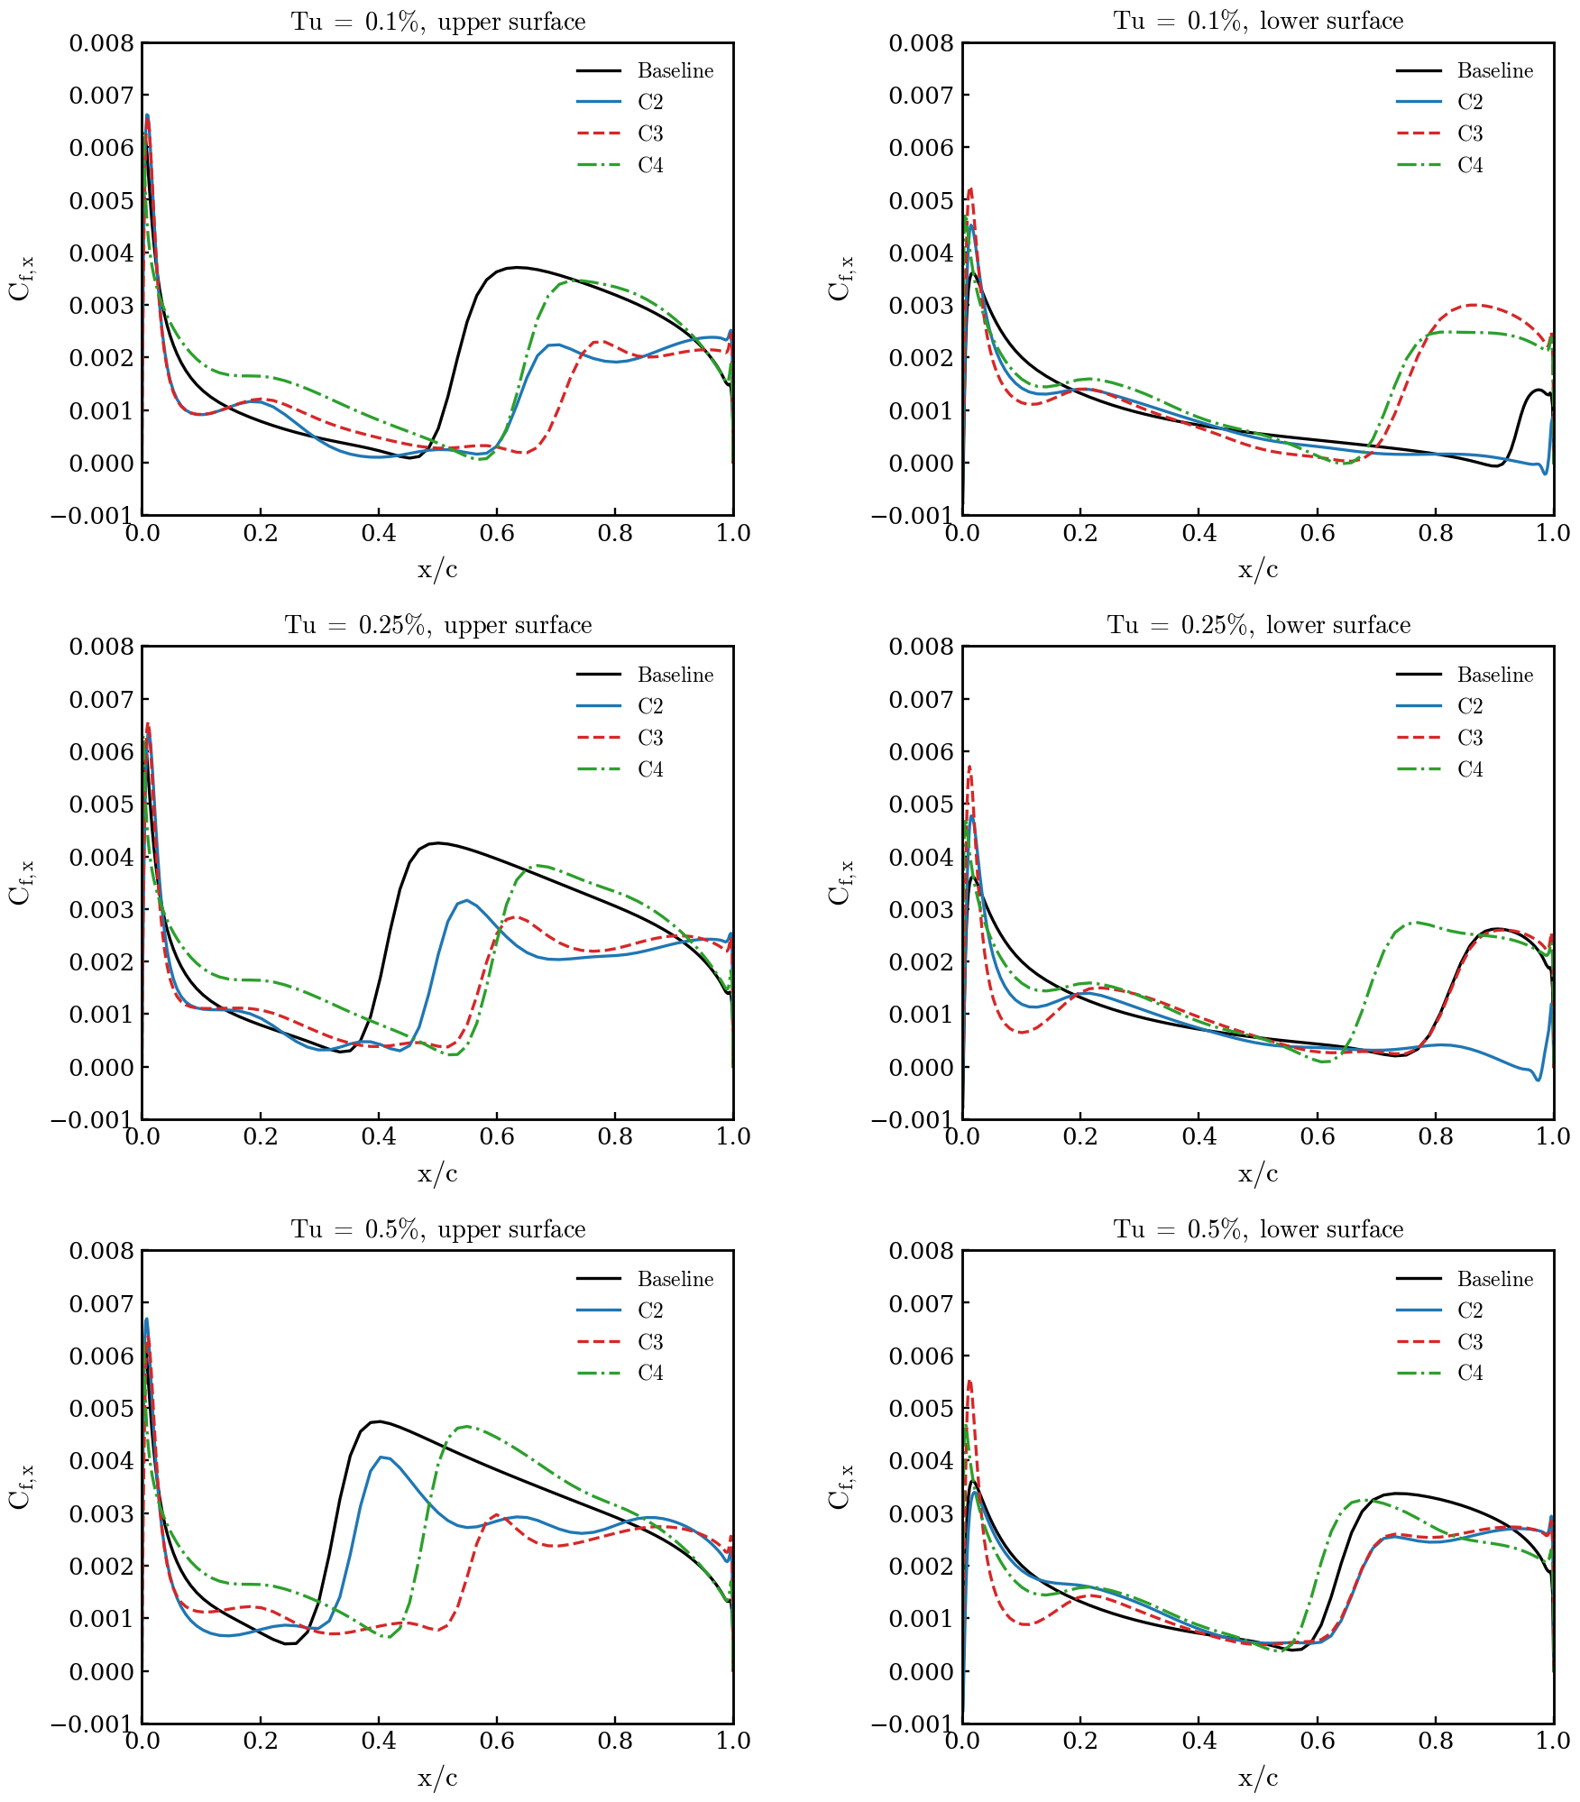
7. Skin friction, upper / lower surface, Tu = 0.1 / 0.25 / 0.5 %
Baseline, C2 (adjoint result at 0.5 %), C3, C4 — cold, cl = 0.3

Slide 9
8. What is reportable as C2 at Tu = 0.5 %
Option | C2 | Method | How to describe it
1 | −10.8 % (x_tr 0.35 / 0.66, V/V0 0.994) | SLSQP + adjoint, branch-envelope evaluation + restarts | gradient-based with a branch-consistent evaluation — clean
2 | −4…−5 % | SLSQP + adjoint exactly as in the article | the original setup; shows the fragility
3 | ≈ −17 % (B12 running: SLSQP + adjoint restarted from the pattern-search points) | hybrid | must state an explicit derivative-free exploration stage
4 | −21 % at Tu = 0.25 % | SLSQP + adjoint (same evaluation) | 100 % adjoint; changes the article's Tu
• Every optimum must be re-evaluated cold in a fresh process before it is quoted: values living on warm branches are not reproducible (this cost the HOP/B11 'gains').
• The pattern search (108 cold solves per round) is cheap only because the case is 2D (16 k cells) — in 3D the adjoint is the only option, and the adjoint itself is verified exact within each branch.

Slide 10
9. Proposals to remove the branch problem (ranked)
• 1. Chordwise mesh refinement in the transition zone (0.25–0.65 c): the one-cell step ±1.8 % → ±0.5 % or less; SLSQP stops mistaking a step for a minimum. Most defensible in a paper ('grid-induced multiple equilibria'). Cost: new mesh + redo the 2D cases (~half a day). Untested.
• 2. Branch-averaged objective: solve each design twice (cold and laminar-first), use the mean of cd and of the two adjoints → the staircase becomes a ramp consistent with the gradient. Still pure adjoint; ~1 h to implement in the envelope script; 2×2 solves per evaluation. Untested.
• 3. Adjoint direction + sampled line search: keep the (good) gradient direction, replace SLSQP's line search by 6–8 cold evaluations along it. ~8 solves/iteration; custom loop, half a day.
• 4. Report at Tu = 0.25 % (−21 %): zero work, changes the article's condition.
• 5. Fixed cold protocol (done): reproducibility, not the optimizer.
• Outside the user's rules: soften the ν_t/ν feedback term of BCM (the source of the hysteresis) — a physics decision.
Recommendation: 1 for the article; 2 to test now with the existing scripts. Nothing launched without approval.

Slide 11
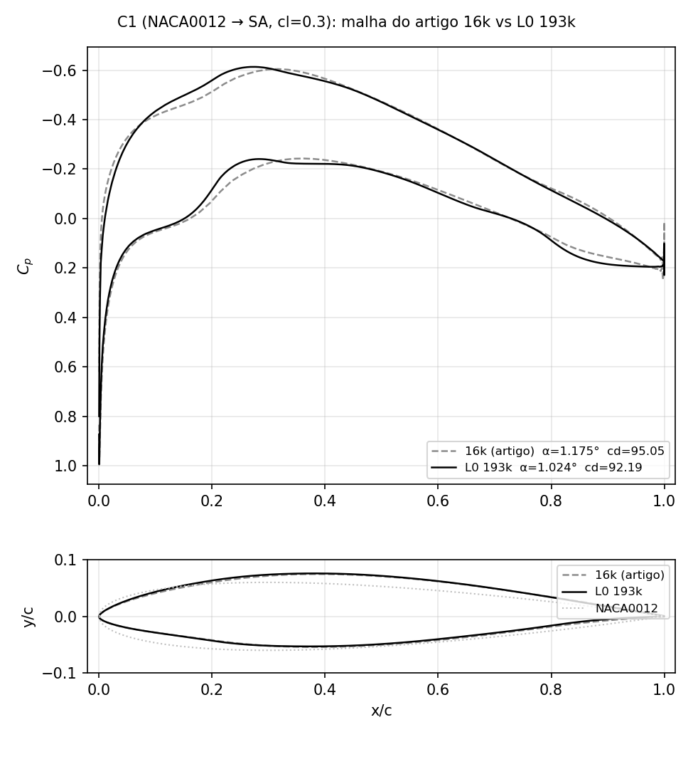
10. Dense mesh L0 (193k): SA optimisation is robust
C1 = NACA0012 → SA, cl = 0.3, SLSQP + adjoint, article script; 16k article mesh vs L0 (one level below the NLF article mesh)
 | 16k (article) | L0 (193k)
baseline SA cd | 9.77e-3 | 9.42e-3
C1 cd | 9.48e-3 | 9.22e-3
ΔCd | −3.0 % | −2.1 %
α | 1.175° | 1.024°
t_max (x/c) | 0.129 (0.38) | 0.129 (0.38)
Cp,min (x/c) | −0.60 (0.32) | −0.61 (0.27)
SLSQP exit | 0, 58 evals | 0, 119 evals
• Same optimum on both meshes: identical thickness distribution, camber and lower-surface flattening; only the Cp details differ (suction peak 5 % c further forward, softer TE recovery on L0).
• The coarse mesh over-predicts the baseline SA drag by 3.7 % and the gain by 1 point; the design itself is mesh independent → for fully turbulent flow the 16k mesh was enough.

Slide 12
11. SA-BCM cases on the two meshes (Tu = 0.5 %, cl = 0.3)
fs 0.08, ev 1e-7; drag counts; Δ vs the SA-BCM baseline on the same mesh; L0 C2/C3 still running (job 1926969, 32 ranks each)
Case | 16k cd | 16k Δ | 16k x_tr up/lo | L0 cd | L0 Δ | L0 x_tr up/lo | L0 status
Baseline SA | 97.7 | — | — | 94.21 | — | — | done (NK recipe)
Baseline SA-BCM | 61.49 | — | 0.317 / 0.624 | 68.20 | — | 0.216 / 0.486 | done (cold trim)
C1 (SA opt) | 94.8 | −3.0 % vs SA | — | 92.19 | −2.1 % vs SA | — | done, SLSQP exit 0
C2 (SA-BCM opt from NACA) | 54.84 | −10.8 % | 0.352 / 0.658 | 58.80 | −13.8 % | pending | iter 18, plateau since iter 12; 13 failed trial solves
C3 (C1 re-optimised with SA-BCM) | 46.43 | −24.5 % | 0.550 / 0.658 | 51.92 (cl 0.313, not trimmed) | ≈ −24 % | pending | iter 3
C4 (C1 geometry, SA-BCM) | 54.50 | −11.4 % | 0.469 / 0.590 | 57.14 | −16.2 % | 0.419 / 0.523 | done (cold trim)
• The SA baseline moves −3.7 % from 16k to L0; the SA-BCM baseline moves +11 % (transition on the NACA0012 moves forward: 0.32 → 0.22 c upper, 0.62 → 0.49 c lower). The transition location was not mesh-converged on the 16k mesh.
• On L0 the ordering C2 < C4 appears with the plain adjoint run (−13.8 % vs −16.2 % after 18 iterations, still going) — no derivative-free stage. C3 keeps ≈ −24 % on both meshes.
• L0 SA-BCM solves need L2Convergence 1e-8 (ANK stalls at ~1e-8); every second SLSQP trial on L0 lands on a failed/far solve (cl 0.1–0.5) and is rejected by the line search — same staircase mechanism as on 16k, smaller steps.

Slide 13
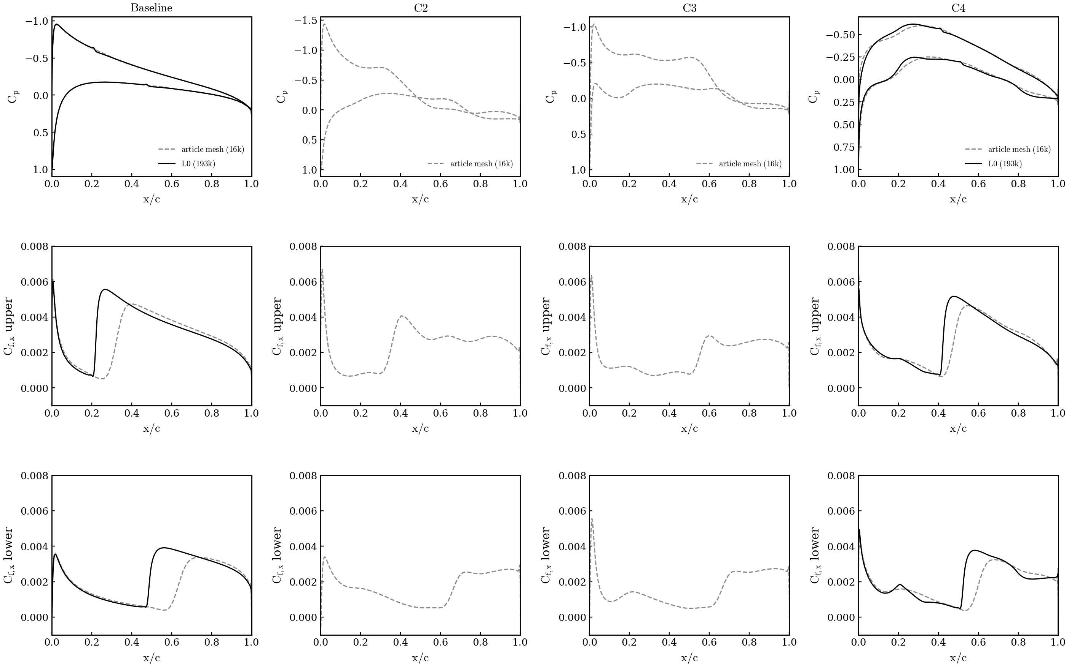
12. SA-BCM is mesh dependent: Cp, Cf 16k vs L0
Tu = 0.5 %, cold trimmed solves at cl = 0.3; 16k dashed, L0 solid; C2/C3 on L0 added when the optimisations finish
• Baseline NACA0012: the L0 mesh trips the upper surface at 0.22 c instead of 0.32 c and the lower at 0.49 instead of 0.62; Cf on the laminar run is the same, the turbulent part is longer → +11 % cd.
• C4 (C1 geometry): transition on L0 at 0.42 / 0.52 c vs 0.47 / 0.59 c on 16k — the coarse mesh sustained a longer laminar run on both surfaces (x_tr = first cell with γ > 0.5 ten cells above the wall; on L0 that height is smaller).
• Per Tu (slide 7): the same figure on the article mesh at Tu = 0.1 / 0.25 / 0.5 %; the L0 baselines at 0.25 and 0.1 % are queued in the same verification job.

Slide 14
13. SA-γ-R̅eθt cases on two meshes (Tu 0.5 %, cl 0.3)
counts; Δ vs GR baseline on the same mesh; L1 = original GR setup (Re 6e6, ±0.03), L0 = article condition (Re 2.92e6, ±0.05); all finished 2026-09-16
Case | L1 cd | L1 Δ | L1 x_tr up/lo | L0 cd | L0 Δ | L0 x_tr up/lo | status
Baseline SA | — | — | — | 94.21 | — | — | L0: article campaign (NK recipe)
Baseline SA-γ-R̅eθt | 73.41 | — | 0.098 / 0.363 | 69.36 | — | 0.192 / 0.584 | done (cold trim, α 2.594° / 2.700°)
C1 (SA opt) | — | — | — | 92.19 | −2.1 % vs SA | — | L0: article campaign, SLSQP exit 0
C2 (GR opt from NACA) | 42.91 | −41.5 % | 0.429 / 0.766 | 34.94 | −49.6 % | 0.760 / 0.889 | L1: SLSQP exit 0, 82 majors, 14.8 h; L0: stopped flat at 126 solves, trimmed (job 1929206)
C3 (C1 re-optimised with GR) | — | — | — | 34.02 | −49.0 % | 0.774 / 0.900 | L0: job 1929321, flat after 122 majors, trimmed (1930514); article FFD
C4 (C1 geometry, GR) | — | — | — | 53.12 | −23.4 % | — | L0: cold trim, α 0.902° (job 1929321)
• The GR baseline moves −5.5 % from L1 to L0 (73.4 → 69.4 counts) — but the two runs are NOT the same Re (6e6 vs 2.92e6): the lower Re on L0 delays transition (0.10 → 0.19 c upper, 0.36 → 0.58 c lower) and lowers cdv; a like-for-like mesh check needs the same condition on both (prepared: 2d_tu05_meshcmp, 16k / L1 / L0 at Re 2.92e6, not submitted).
• C2 on both: same mechanism — transition pushed to 0.43 / 0.77 c (L1, α 1.996°) and 0.76 / 0.89 c (L0, α 1.118°), gain mostly cdv (−42 % and −53 %); the L0 optimum is flatter and aft-loaded (cp peak at 0.70 c), the L1 one keeps a strong peak at 0.39 c and is thicker (14.5 % vs 12.2 %). L0 values are trimmed re-solves (cl = 0.3 ± 1e-5); C2 ≈ C3 on L0 (Δy ≤ 0.005 c): the GR optimum does not depend on the start point or the FFD.
• GR solves on both meshes need the CSANK-only recipe (nkswitchtol 1e-8, CFL 1e8, L2 1e-8): NK@1e-6 stalled at ~1e-6 abs and was flagged fail in every solve — the same stall the original Tu 0.0937 % runs had silently (96/99 fails in job 1803832). x_tr = steepest c_f rise per surface.
Data: $R/08_optimization/2d_tu05_L1 and 2d_tu05_L0 (trim_gammaretheta/trim.json, logs/opt_c2_*.log, surf/); x_tr from make_mesh_effect_gr.py.

Slide 15
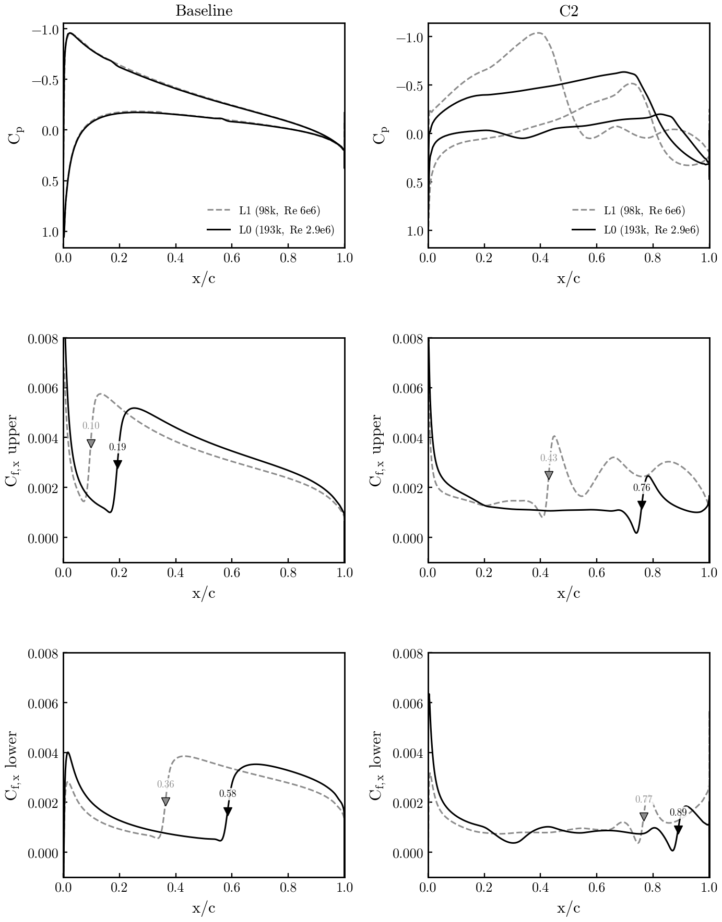
14. SA-γ-R̅eθt on the two meshes: Cp, Cf L1 vs L0
Tu = 0.5 %, cl = 0.3; L1 dashed (Re 6e6), L0 solid (Re 2.92e6); baseline = cold trims, C2 = final best point; ▼ = x_tr
• Baseline NACA0012: identical cp on both meshes; the L0/Re 2.92e6 run keeps laminar flow to 0.19 c upper and 0.58 c lower vs 0.10 / 0.36 c on L1/Re 6e6 — a Re effect, not a mesh effect (transition Reθ,crit reached later at lower Re); the laminar cf level is the same.
• C2 optima: both optimizers push transition aft and flatten the lower surface; on L0 the upper-surface laminar run reaches 0.76 c with cf ≈ 0.001 up to there (lower 0.89 c), on L1 it ends at 0.43 c with a separation-bubble signature (cf dip to 0 then peak) — 42.9 vs 34.9 counts.
• Like-for-like mesh dependence (same Re on 16k / L1 / L0) is prepared in 2d_tu05_meshcmp and not yet run; GR C3/C4 on L0 prepared (article FFD + C1 shape).
Data: same as slide 13; figure 08_optimization/make_mesh_effect_gr.py (surf CGNS of the trims and of the best C2 evaluations).

Slide 16
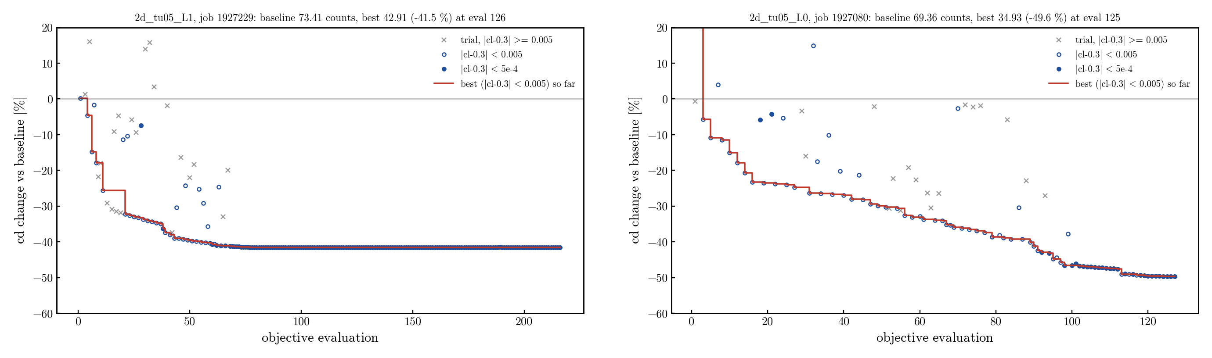
15. SA-γ-R̅eθt C2 convergence: L1 vs L0
Δcd vs the trimmed GR baseline per objective evaluation; red = best point so far; × = line-search trials off the cl constraint
• L1 (Re 6e6, ±0.03): −25.7 % at 20 evals, −39.5 % at 50, −41.5 % at 75, then flat for 140 more evaluations (SLSQP exit 0 at 82 majors; last 10 majors within ±2e-5 counts). L0 (Re 2.92e6, ±0.05): −23.5 % at 20, −29.9 % at 50, −36.9 % at 75, −46.6 % at 100, −49.6 % at 125 with a step at 90–100; stopped by the user at 126 solves (still creeping, ~0.1 count per 10 evals).
• Neither run has a plateau/branch problem: the objective is smooth in the DVs, failed solves are only the far line-search trials (cl 0.1–0.5), rejected by SLSQP.
Data: $R/08_optimization/2d_tu05_L1/logs/opt_c2_1927229.log, 2d_tu05_L0/logs/opt_c2_1927080.log; figure 08_optimization/plot_c2_history.py.

Slide 17
16. Cross-evaluation of the optima (L0, Tu 0.5 %)
row = geometry, column = analysing model · cl 0.3 · counts · Δ vs NACA baseline of the SAME model · blue = own model
Shape (row) ↓ · analysed with (column) → | α | cd SA-GR | cdp / cdv | Δ vs 69.36 | α | cd SA-BCM | cdp / cdv | Δ vs 68.20
NACA0012 (baseline) | 2.700 | 69.36 | 16.66 / 52.70 | — | 2.656 | 68.20 | 12.71 / 55.48 | —
C1 = SA optimum (→ C4) | 0.902 | 53.12 | 9.14 / 43.97 | -23.4 % | 0.921 | 57.14 | 8.20 / 48.94 | -16.2 %
C2 GR (from NACA) | 1.118 | 34.94 | 10.34 / 24.60 | -49.6 % | 0.888 | 51.38 | 8.35 / 43.04 | -24.7 %
C3 GR (from C1) | 1.104 | 34.02 | 10.06 / 23.96 | -51.0 % | 1.087 | 39.22 | 7.33 / 31.89 | -42.5 %
C2 BCM (eval 57) | 2.741 | 73.18 | 21.73 / 51.45 | +5.5 % | 2.679 | 58.71 | 11.77 / 46.94 | -13.9 %
C2 BCM (restart, eval 50) | 2.642 | 79.50 | 24.24 / 55.26 | +14.6 % | 2.620 | 53.55 | 11.71 / 41.84 | -21.5 %
C3 BCM (eval 40, cl 0.312 in opt) | 1.577 | 49.58 | 10.80 / 38.78 | -28.5 % | 1.574 | 48.23 | 7.44 / 40.79 | -29.3 %
C3 BCM (eval 118) | 1.924 | 71.18 | 21.75 / 49.43 | +2.6 % | 1.852 | 46.39 | 8.96 / 37.43 | -32.0 %
• Method: optimum shape (FFD vector) → warped L0 mesh → trim to cl = 0.3 with SA-GR (CSANK-only, L2 1e-8) and with SA-BCM (cold, ev 1e-7, fs 0.08, L2 1e-8, 16 ranks = baseline branch). Same mesh, same Tu, same stopping criterion.
• Baselines agree (NACA −1.7 %, C1 +7 %): the primal is comparable. The optima do NOT: GR optima keep most of their gain in BCM (−25 % C2, −42 % C3 — the GR C3 is the best airfoil BCM has seen, 39.2 < 46.4); BCM optima are WORSE than the NACA in GR (+5.5 %, +14.6 %, +2.6 %) — only the intermediate C3 eval 40 survives (−28 %).
• The later the SLSQP-BCM point (e57 → restart e50, e40 → e118), the worse it is in GR: the last increments are gains of the transition criterion, not of the shape.
Data: jobs 1929206, 1929323, 1930476, 1930514 (trims), 1927080/1929321 (GR opts), 1926969/1928596 (BCM opts + cold verif); $R/08_optimization/2d_tu05_L0/cross_eval/{trim_gr_on_*/trim.json, bcm_on_*/out/result.json, PURPOSE.md}.

Slide 18
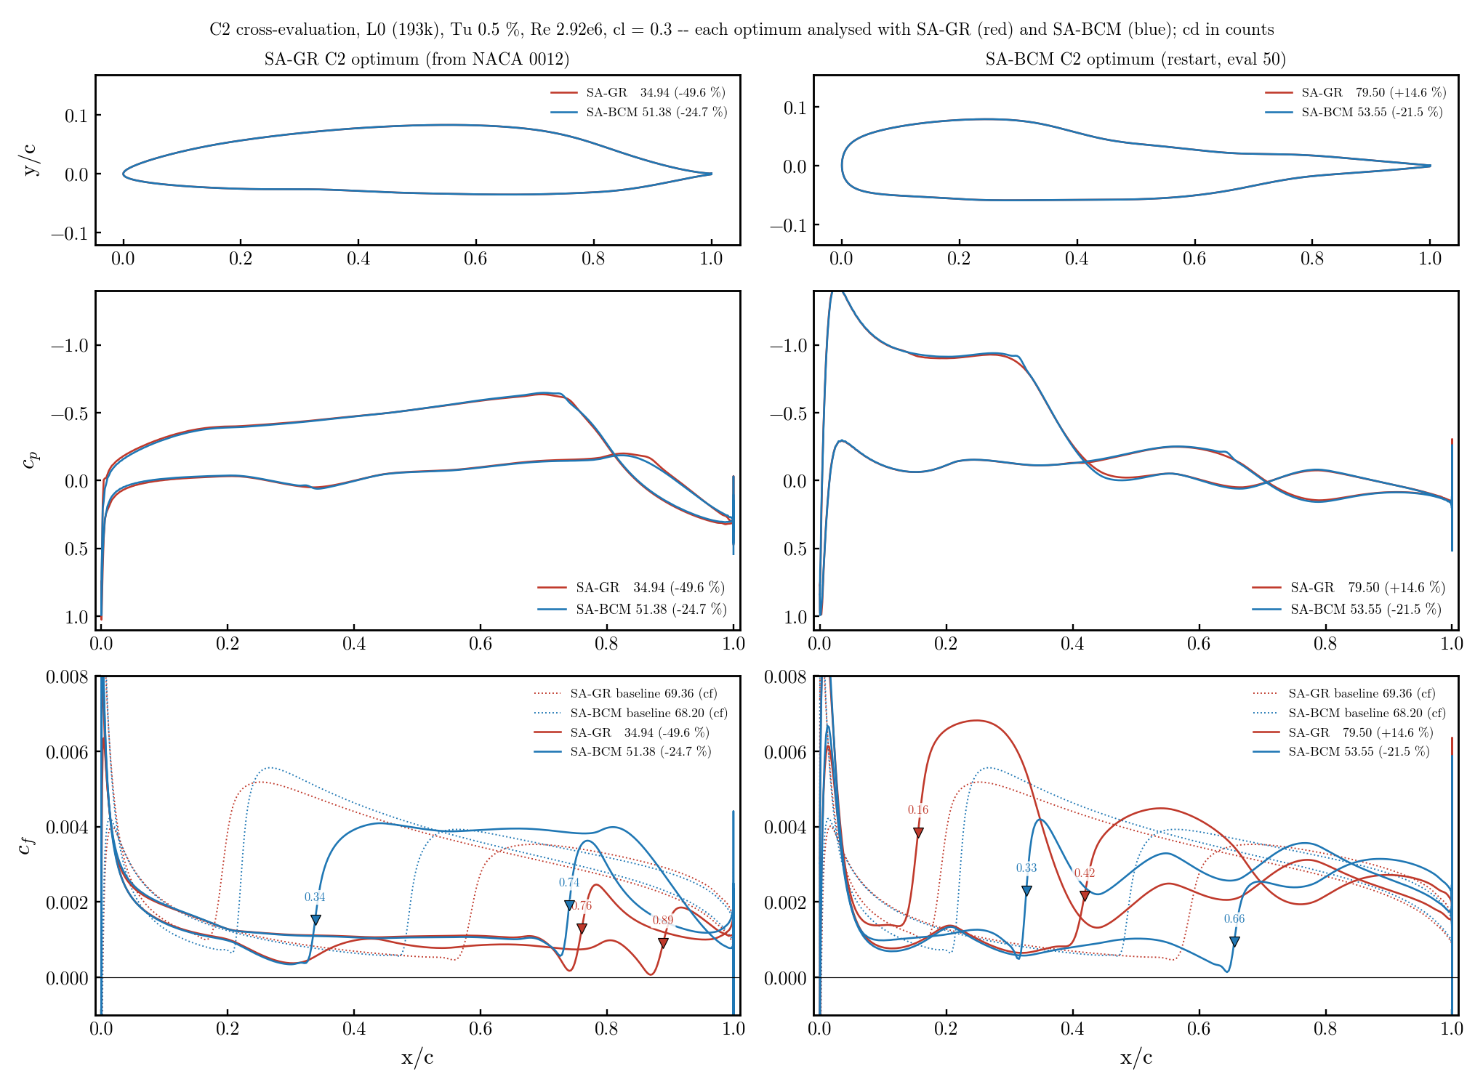
17. C2 cross-evaluated: GR optimum | BCM optimum
red = analysed with SA-GR, blue = with SA-BCM; dotted = baseline cf; ▼ = x_tr (steepest cf rise, same criterion for both models)
GR shape (left): same cp in both models; SA-BCM trips the lower surface at 0.34 c (cp dip, cf → 0) where GR stays laminar to 0.89 c → 51 vs 35 counts. BCM shape (right): full nose with suction peak; GR transitions in the recovery at 0.16 c (cf 0.007), BCM only at 0.33 c → 80 vs 54 counts.

Slide 19
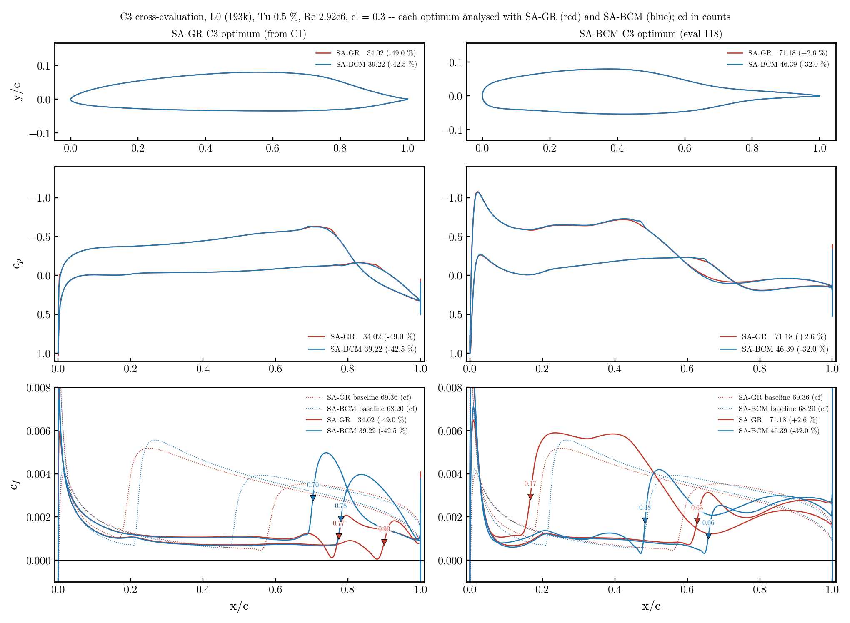
18. C3 cross-evaluated: GR optimum | BCM optimum
red = analysed with SA-GR, blue = with SA-BCM; dotted = baseline cf; ▼ = x_tr (steepest cf rise, same criterion for both models)
GR shape (left): no lower-surface dip → SA-BCM stays laminar to 0.70 / 0.78 c → 39 counts (−42 %). BCM shape (right): suction peak at 0.02 c followed by an adverse gradient to 0.2 c — tolerated by BCM (laminar to 0.48 c), not by GR (0.17 c) → 71 vs 46 counts.

Slide 20
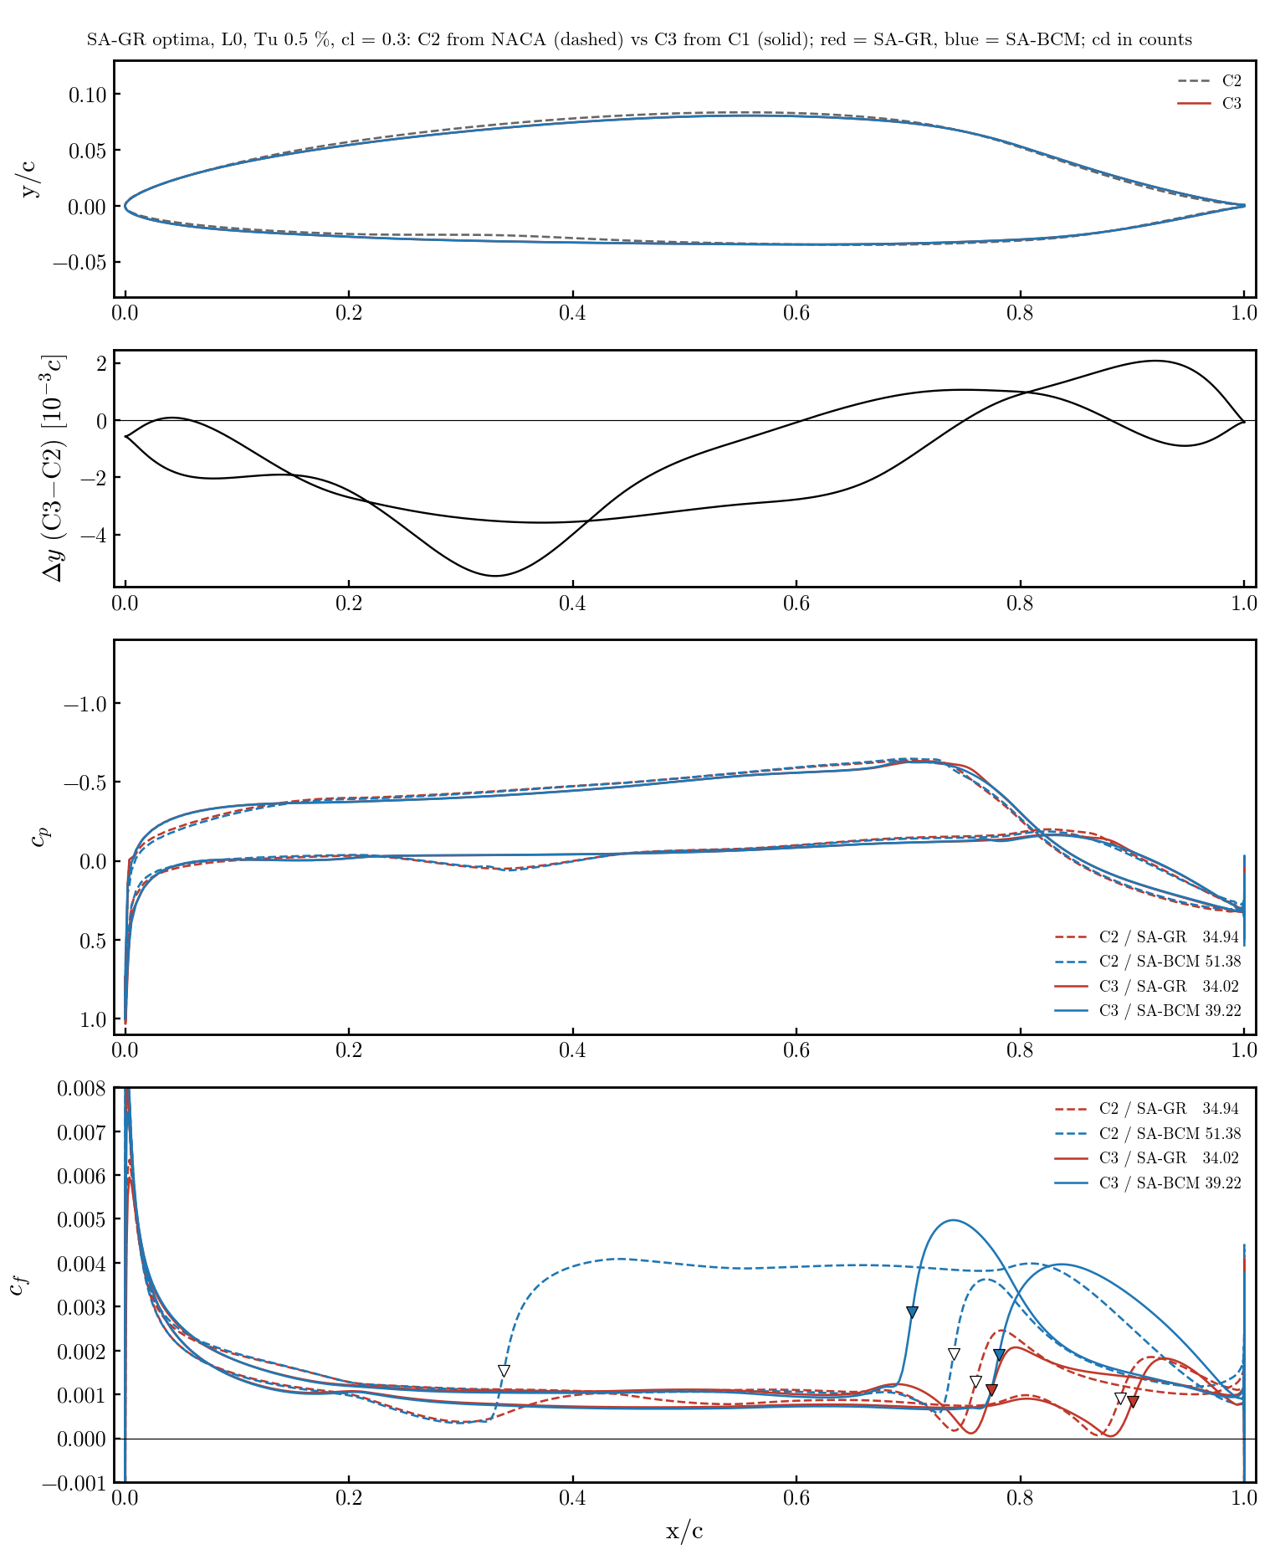
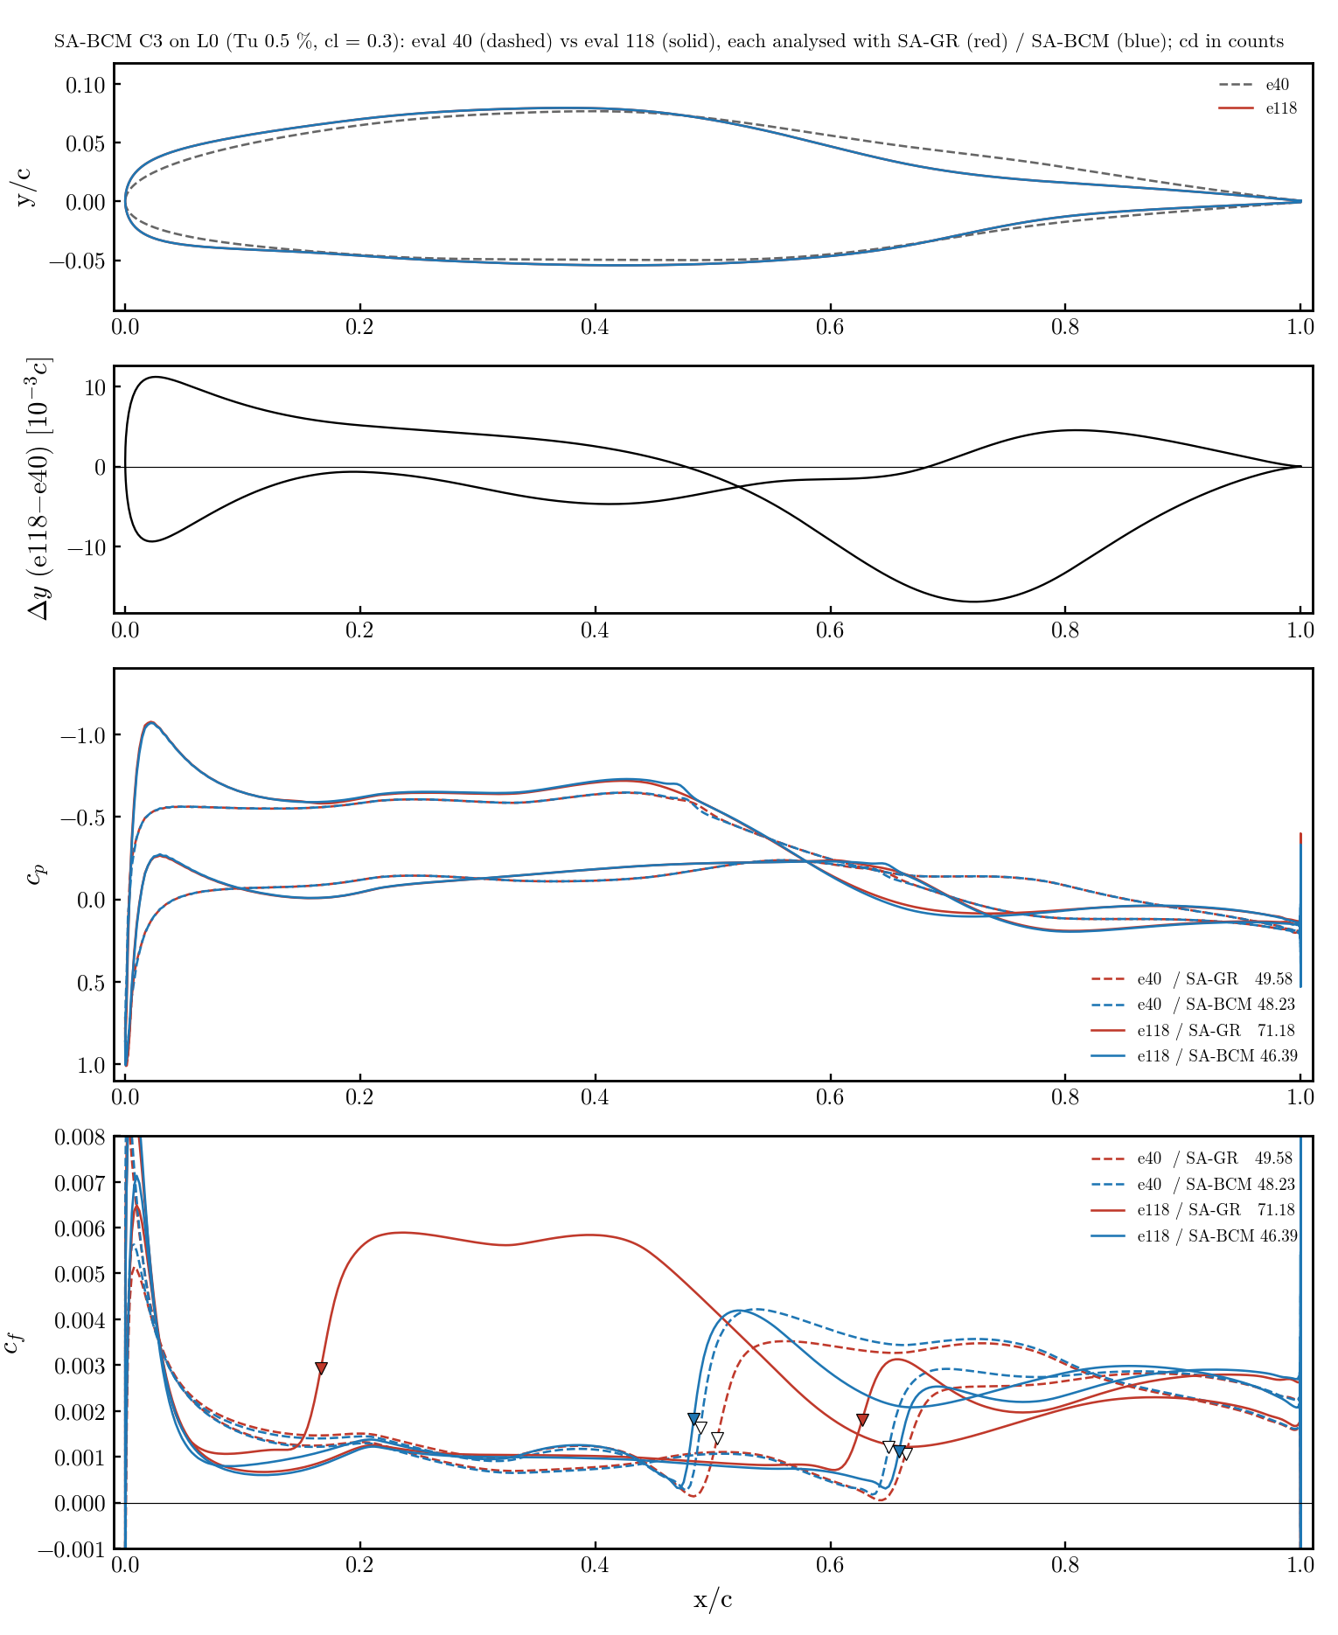
19. Robustness: GR C2 ≈ C3 · BCM C3 e40 → e118
left: GR C2 (from NACA) vs C3 (from C1) · right: BCM C3 eval 40 vs 118 · both models each · Δy = wall difference
GR: C2 and C3 differ by ≤ 0.005 c and give the same cp, cf, x_tr (0.76/0.89 vs 0.77/0.90) — a well-defined optimum, independent of start and FFD; the small difference (no lower-surface dip) is worth 12 counts in BCM (51 → 39). BCM: eval 40 → 118 gains 2 counts in its own model by adding a round nose with a suction peak; in GR that costs +22 counts (49.6 → 71.2).

Slide 21
20. Conclusion: the gain does not transfer in %
L0, Tu 0.5 %, cl 0.3 — what the 2×2 matrix says
• Primal agreement on ordinary geometries (NACA −1.7 %, C1 +7 %) → comparing the models is legitimate; what diverges is what each optimizer exploits.
• Each optimizer pushes the laminar boundary layer to the separation threshold (cf → 0) that ITS transition criterion tolerates. SA-GR (Reθt transport, sensitive to the λθ history) rejects suction peaks followed by an early adverse gradient; SA-BCM (algebraic, local) rejects mid-chord cp dips on the lower surface.
• SA-GR has one well-defined optimum (C2 ≈ C3, two starts, two FFDs). SA-BCM has several (branches, rank dependence, restart dependence) and its late increments are criterion gains, not shape gains.
• GR optimum seen by BCM: −49 % → −42 % (keeps most). BCM optimum seen by GR: −32 % → +2.6 % (loses everything). The best airfoil in SA-BCM is the SA-GR optimum (39.2 vs BCM's own 46.4).
• For the article: report each model's gain only next to this cross matrix; the GR optimum is the robust candidate. Open: BCM C3 still running (eval 118 = last feasible); like-for-like mesh check (2d_tu05_meshcmp) not run.
Details, incidents and replication: $R/08_optimization/2d_tu05_L0/cross_eval/PURPOSE.md (2026-09-16).

Slide 22
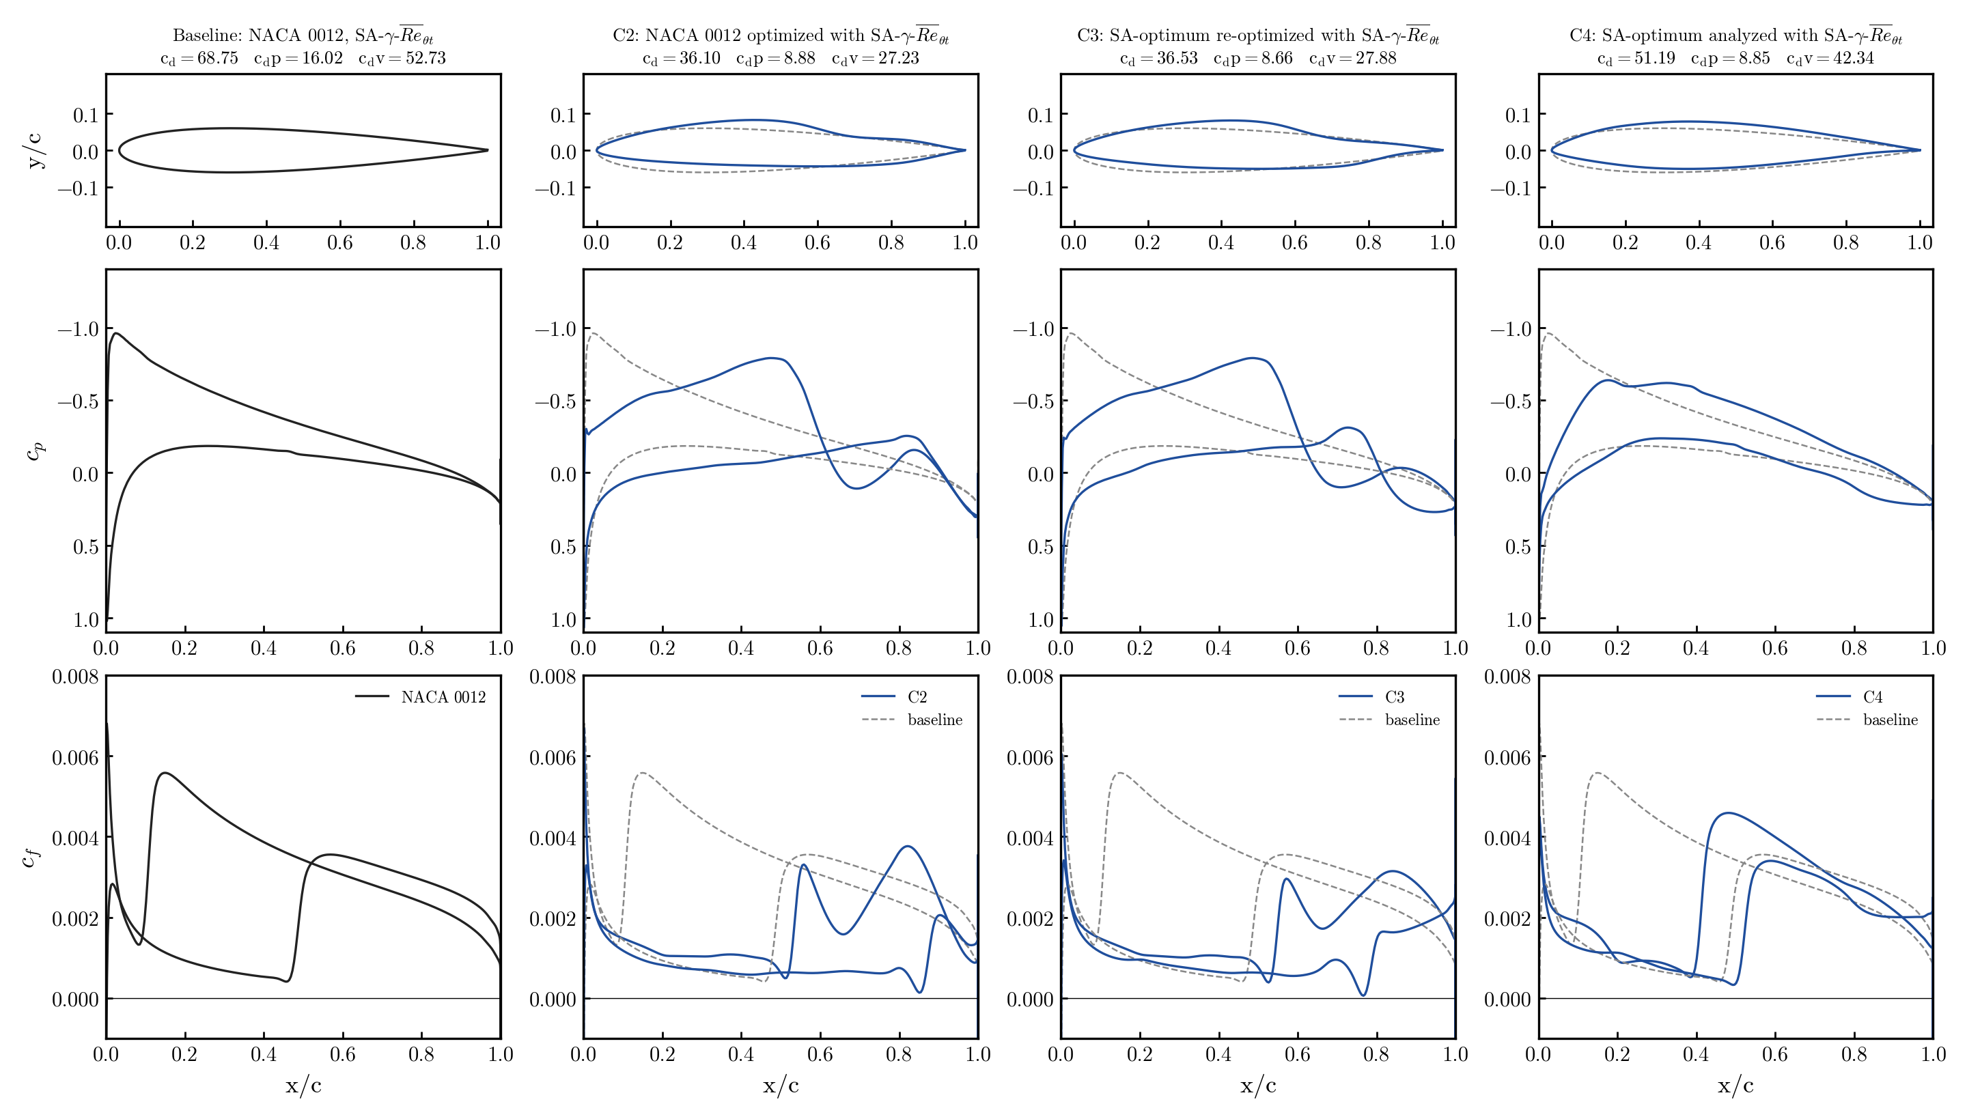
21. γ-R̅eθt full table, Tu = 0.0937 % (L1, Re 6e6)
Original GR campaign (2026-08-04), cl = 0.3, trimmed re-solves (except C3*); counts; Δ vs same-model baseline, C3 vs its start C4
Case | Geometry | Model | α | cd | cdp | cdv | Δcd % | Δcdp % | Δcdv %
— | NACA 0012 | SA | 2.579 | 88.75 | 20.39 | 68.36 | — | — | —
C1 | NACA opt. | SA | 0.710 | 85.66 | 16.93 | 68.73 | −3.5 | −17.0 | +0.5
— | NACA 0012 | GR | 2.616 | 68.75 | 16.02 | 52.73 | — | — | —
C2 | NACA opt. | GR | 2.170 | 36.10 | 8.88 | 27.23 | −47.5 | −44.6 | −48.4
C4 | C1 analysed | GR | 0.611 | 51.19 | 8.85 | 42.34 | −25.5 | −44.7 | −19.7
C3 | C1 re-opt.* | GR | — | 36.53 | 8.66 | 27.88 | −28.6 | −2.2 | −34.2
 | C3 vs base |  |  |  |  |  | −46.9 | −46.0 | −47.1
• Tu = 0.0937 % was calibrated at α = 0 on this mesh (set A of the α-sweep) — five times lower than the 0.5 % of slides 11–14; same FFD, bounds ±0.03, ladder with NK@1e-6 (which, as found on 2026-09-14, stalled at ~1e-6 abs in 96/99 solves of the C3 job — SLSQP ignored the flag).
• C4 shows the SA optimum is already a good transition shape for the wrong reason: −25.5 % almost entirely cdp; the γ-R̅eθt optimizer then only has cdv left (−34 %). Starting from NACA (C2) ends 1.2 % lower than from C1 (C3).
• * C3: best feasible point of job 1803832's log (cl 0.30004); its trim (job 1804386) was cancelled, α not recorded.
Data: $R/08_optimization/2d/{trim_*/trim.json, RESULTS.md, REPORT.md}; figure 2d/profiles/cp_cf_cases.png (make_cp_cf.py).

Slide 23
22. SA-BCM + pressure-gradient sensor (SABCM_PG)
why: the BCM threshold Re_θc(Tu) ignores the gradient GR penalises (slides 16–20) · branch sa-bcm-pg, machV4 2026-09-18
• Mechanism found on slides 17–18: same cp in both models, only the cf jump moves. The BCM optimizer parks laminar flow in adverse gradients (nose suction peak + recovery) that GR trips through Re_θt(Tu)·F(λ_θ).
• Model (handoff option E, kept algebraic and local): λ_θL = −7.57e-3 (d²/ν) nᵀ∇u n + off (Menter 2015), λ = smooth clip(gain·λ_θL, ±0.1), F = Langtry–Menter F(λ) in the Piotrowski–Zingg smooth form (Eqs. 54–57) → Re_θc ← Re_θc^BCM · F. Everything else (KS max, tanh/fsmooth 0.08) untouched; PG off = bit-identical.
• n = exact unit wall normal (foot point → cell centre) from the approximate wall-distance update, stored per cell (new block array nWall) and differentiated (new independent in both Tapenade heads); helpers smoothMinMax/bcmFlambda ported from the GR branch.
• Options: SABCM_PG (False), _coef 7.57e-3, _off 0.0128 (Menter), _gain 1, _lamMax 0.1, _p 300. Runs use the calibrated off = 0.01623 and gain = 2 (next slide). Volume CGNS: BCM_lambda, BCM_Flambda.
• Not adopted from the handoff: the Ψ/tanh(k, δ) intermittency (the sa-bcm smooth form already removes those kinks; one effect at a time) and Menter's own F_PG (too weak at low Tu).
Code: adflow_sabcm sa.F90 (saSource), blockette.F90 (mirror), wallDistance.F90 (nWall), turbUtils.F90 (helpers), Makefile_tapenade heads; docs/studies/22_bcm_pressure_gradient/PURPOSE.md.

Slide 24
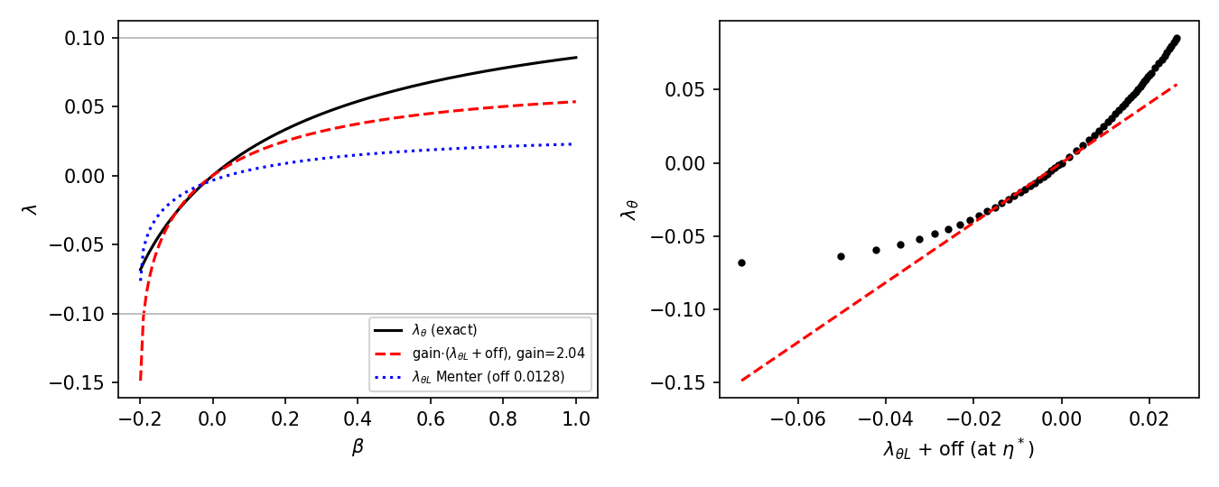
23. Calibration on Falkner–Skan profiles (no CFD)
for each β: exact λ_θ = θ²U'/ν vs the local sensor λ_θL evaluated at η* = argmax(η² f'') — where Term1 fires
• Blasius at η*: λ_θL = −0.0162. Menter's offset 0.0128 leaves −0.0034 → F ≈ 0.96 on a flat plate (not neutral). Calibrated offset 0.01623 → neutral (the effective max over the layer changes it by < 1 %).
• Linear map λ_θ ≈ gain·(λ_θL + off): LS over |λ_θ| ≤ 0.1 gives gain 2.0 (adverse-only 1.4, favourable 3.0) — exact for |λ| ≲ 0.03 (suction-peak regime), over-predicts near separation (clipped at −0.1 anyway).
• Gains 1, 2, 3 swept on the cross set (slide 25); 2 kept.
docs/studies/22_bcm_pressure_gradient/falkner_skan_gain.py, falkner_skan_effective.py.

Slide 25
24. Verification of the differentiated model
reg suite (tutorial wing, 2 ranks) + NACA0012 L2 adjoint vs complex step · three sensors tried, one kept
check | PG off (smooth, hard) | sensor 1 (Menter λθL) | sensor 2 (wall dp/ds, kept)
fwd/rev/fast AD vs references | pass (AD unchanged) | pass | pass
forward AD vs complex step | pass | pass | pass
fwd ↔ rev dot products, _b vs _fast_b | pass | pass (after in-place fix) | pass
adjoint vs CS, NACA L2, max |Δ| cl / cd | 0.008 % / 0.26 % | 187 % / 181 % — primal not smooth (FD: sign flips with step) | 0.000 % / 0.004 % (α), 0.001 % (DV12), 0.4 % (DV8, cd ≈ 1e-4) at the same state
independent code audit (3 lenses + refutation) | — | — | signs, stencil, Bernoulli, non-dim, mirror: correct; 3 fixes applied
• Bugs found and fixed on the way: in-place Re_θc·F broke the fast-reverse state Jacobian (no push/pop stack); Tapenade head had the reference-state scalars as input-only (seeds zeroed at entry); F(0) = 0.9986 at p = 300 (smoothMax/Min bias) → exact tanh blend; ŝ = local velocity flips sign in bubbles → wall tangent oriented by the free stream.
• The 10–35 % adjoint-vs-CS 'gap' of sensor 2 was the two sides sitting on different steady states of the multi-state BCM primal (ANK/NK vs DADI path); formed at the same state they agree to 0.004 %.
• Sensor 3 (θ = Re_θc ν/U_e, the reference's own definition) is not smooth near stagnation (λ ∝ 1/U_e²): adjoint vs CS 46–105 %, trips both surfaces at 0.1 c — dropped.
Jobs: 1935762/1936305/1936446 (reg suite), 1935763/1935808 (sensor 1 CS + FD), 1936308/1936311/1936444 (loop it0–it2); adflow_sabcm docs/studies/22_bcm_pressure_gradient/PURPOSE.md §3e, §5.1.

Slide 26
25. Cross-evaluation with the sensor on (L0, Tu 0.5 %)
BCM-PG vs GR, cl 0.3 · trims as slide 16 · sensor 1 (Menter, gain 1/2) and sensor 2 (wall dp/ds, K Blasius) · counts
Shape | SA-GR (target) | SA-BCM | Δ vs GR | sensor 1 g=1.0 | Δ vs GR | sensor 1 g=2.0 | Δ vs GR | sensor 2 (kept) | Δ vs GR
NACA 0012 | 69.36 | 68.20 | -1.7 % | 71.24 | +2.7 % | 73.28 | +5.7 % | — | —
C2 GR | 34.94 | 51.38 | +47.1 % | 52.09 | +49.1 % | 52.49 | +50.2 % | 52.12 | +49.2 %
C3 GR | 34.02 | 39.22 | +15.3 % | 33.63* | -1.2 % | 32.50 | -4.5 % | — | —
C2 BCM (restart e50) | 79.50 | 53.55 | -32.6 % | 70.63 | -11.2 % | 83.59* | +5.1 % | 83.82 | +5.4 %
C3 BCM (e118) | 71.18 | 46.39 | -34.8 % | 69.10 | -2.9 % | 74.07* | +4.1 % | 88.44 | +24.2 %
• Sensor 1 g=1 gets closest to GR's numbers (mean |Δcd| 26 % → 13 %) — by under-reading adverse gradients ~2× (Falkner–Skan map) — and is not differentiable; sensor 2 reads the LM edge λ_θ exactly (checked against the GR's own transported R̅eθt outside the layer: 950/560/966/667 vs 880·F = 970/537/970/560) and over-trips.
• What every variant achieves: the ranking becomes the GR one (GR C3 < GR C2 < NACA < BCM optima) — an optimiser driven by BCM-PG no longer exploits the nose suction-peak loophole; the BCM optimum that GR rejects (+14.6 %) is rejected by BCM-PG (+5…+7 %).
• What none can: GR C2 (+50 %) and the absolute levels — GR's onset fires at Re_S ≈ 2.46·R̅eθt (transported, lagged near the wall) vs the BCM's Re_v ≈ 2.19·Re_θc·F: with F = 0.61 in the short adverse zone at x = 0.06–0.10 the BCM-PG trips at 0.12 c, GR at 0.42 c. That gap is the base onset criterion, not the gradient sensitivity.
Data: jobs 1934907/08 (sensor 1), 1936444 (sensor 2, pg_loop/it2_s2_sdir2); $R/08_optimization/2d_tu05_L0/{cross_eval_pg,pg_loop}; study 22 PURPOSE.md §3d.

Slide 27
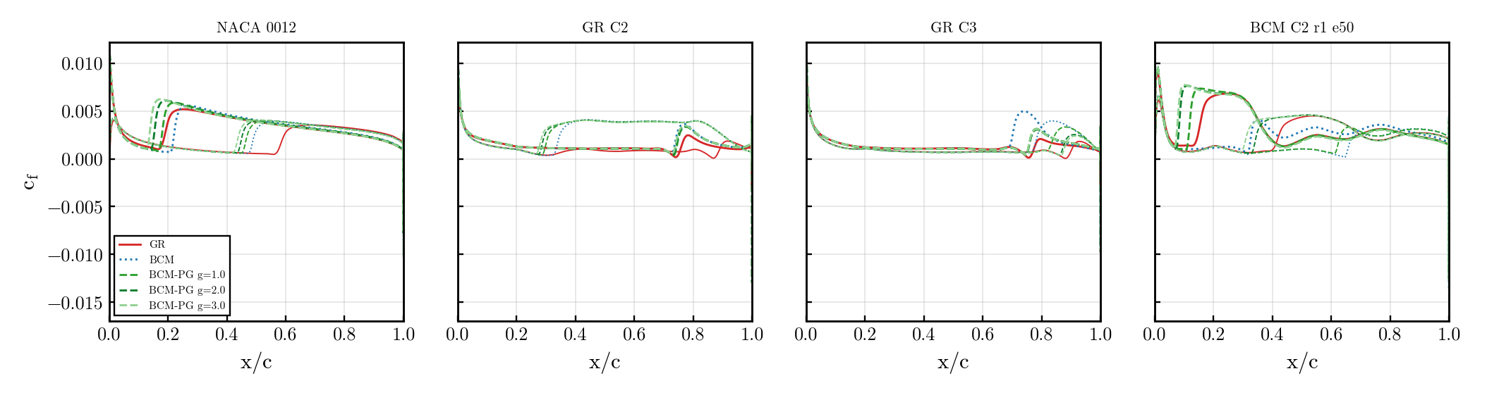
26. cf along the chord with the sensor on
GR red · BCM blue dotted · BCM-PG green per gain · upper thick, lower thin · C3 GR and the BCM optimum move toward GR
cross_eval_pg/make_cross_pg.py → cross_pg_cf.png (surfaces from the trims).

Slide 28
27. Direct predictions with the sensor, and the decision
NLF0416 L1 (Tu 0.15 %) / S809 L1 (Tu 0.07 %), 3 α each, 11 ranks, rNK · counts · x_tr upper/lower
case | SA-BCM (no sensor) | SA-BCM + sensor 2 | SA-γ-R̅eθt | experiment x_tr,up
NLF0416 α2 | 58.2 · 0.38/0.60 | 65.1 · 0.31/0.60 | 57.0 · 0.38/0.60 | —
NLF0416 α4 | 65.5 · 0.33/0.61 | 79.4 · 0.21/0.60 | 64.4 · 0.34/0.61 | ≈ 0.34
NLF0416 α6 | 85.6 · 0.21/0.61 | 102.3 · 0.11/0.61 (not conv.) | 79.3 · 0.25/0.61 | —
S809 α4 | 47.6 (not conv.) | 48.7 (not conv.) | 67.5 | —
S809 α6 | 75.0 · 0.49/0.49 | 74.6 · 0.50/0.49 | 69.8 · 0.50/0.50 | —
S809 α8 | 149.1 · 0.96/0.50 | 149.9 · 0.96/0.49 | 131.8 | —
• S809 (transition by laminar separation): the sensor is neutral — as it should be. NLF0416 (attached transition in a mild adverse gradient): the local F(λ) trips the upper surface too early (α4: 0.21 vs 0.34 GR/experiment, cd +21 %); plain SA-BCM already matched experiment there.
• Same mechanism as slide 25: the local LM correlation applies F ≈ 0.8 where the reference's lagged near-wall R̅eθt and higher onset level do not. Sensor 1 (Menter, gain 2) behaved the same on this polar (0.19 at α4) and limit-cycled in ANK at NLF α6 / S809 α4–6 (no recipe helped: p, gain, CFL cap, early NK, ν̃∞ 1e-8/1e-10, restart from the converged PG-off state).
• Verdict on the direct-prediction criterion: the local sensor is NOT a net improvement — it fixes the ranking of optimised shapes at Tu 0.5 % but degrades the NLF polar. It stays in the code as an option (SABCM_PG, sensor 2 default) with a verified adjoint; closing the gap to GR for real would mean adopting GR's onset/transport, i.e. using GR.
• Decision (2026-09-19): line closed — "worse, and no significant improvement". The C2/C3 BCM-PG optimisation was cancelled at SLSQP major 1. Recommendation: optimise with SA-γ-R̅eθt (the robust model, slide 20), keep SA-BCM for cheap primal evaluation, leave SABCM_PG off. Kept from the work: exact wall-normal array + adjoint plumbing, two Tapenade traps documented, the one-state rule for adjoint-vs-CS checks on this multi-state primal.
Data: 15_sabcm_polars/{results/*_ref11,*_pg,*_pgs2, plot_polars_pg.py}, jobs 1934910/11, 1935125, 1935764, 1935776, 1936549; study 22 PURPOSE.md §5.3, §5.3b.

Slide 29
28. Multipoint C2: does robustness rescue SA-BCM?
L0, Re 2.9e6; one design, Σ cd/n over the points, one α per point; best feasible point of each history (36 h), counts
case | points (Tu %, cl) | baseline cd | SA-γ-R̅eθt optimum | Δ GR | SA-BCM optimum | Δ BCM
single-point C2 | (0.5, 0.3) | 69.4 / 68.2 | 34.9 | −49.6 % | 48.7 | −28.6 %
multi-Tu C2 | (0.5, 0.3) + (0.1, 0.3) | 69.4 · 62.7 / 68.2 · 51.4 | 34.9 · 34.6 | −49.7 · −44.8 % | 60.2 · 50.9 | −11.7 · −1.0 %
multi-cl C2 | (0.5, 0.2) + (0.5, 0.3) + (0.5, 0.4) | 65.4 · 69.4 · 73.9 / 66.2 · 68.2 · 71.0 | 36.4 · 36.7 · 38.4 | −44 · −47 · −48 % | 65.6 · 49.0 · 49.8 | −1 · −28 · −30 %
• Story: the SA-BCM weakness is its response to pressure gradients (slides 4, 20, 25) — the optimiser can only exploit the nose suction peak. Putting several points in the objective does not cure that: multi-Tu BCM gains 12 % at Tu 0.5 and nothing at Tu 0.1; multi-cl BCM gives up the cl 0.2 point entirely (−1 %) to keep −28/−30 % at 0.3/0.4 — i.e. its single-point gain, no bucket.
• SA-γ-R̅eθt: the multi-Tu optimum IS the single-point optimum (34.9 at Tu 0.5, and 34.6 at Tu 0.1 for free); the multi-cl optimum forms a real drag bucket, 36.4–38.4 counts over cl 0.2–0.4, at a cost of 1.8 counts (5 %) at the design point.
• Why: GR moves transition with the whole pressure distribution (x_tr 0.55–0.63 / 0.9 on every point), so one aft-loaded shape works everywhere; BCM keeps x_tr ≈ 0.3 on the upper surface in every case and trades the points against each other. Same three-family picture as slide 20: GR optima are one family, BCM optima another.
• Baselines per point are cold trims of the NACA 0012 with each model (base 0.1 %: GR −10 %, BCM −25 % vs Tu 0.5). All 5 runs hit the 36 h walltime (SLSQP still running); multi-Tu GR was still creeping (−0.4 counts / 13 evals), the rest flat for > 20 evaluations. Second Tu = 0.1 %: lower end of both models' credible range (Mack correlation valid 0.1–2 %; LM Reθt calibration from ≈ 0.1 %), free-flight vs tunnel.
Data: $R/08_optimization/2d_tu05_L0_multipoint/{out_*/opt.hst, logs/opt_*_19308{55,56,57}.log, trim_base_*/trim.json, best_evals.txt}, jobs 1930855/56/57 (3 packed nodes, 32 ranks per point); PURPOSE.md there.

Slide 30
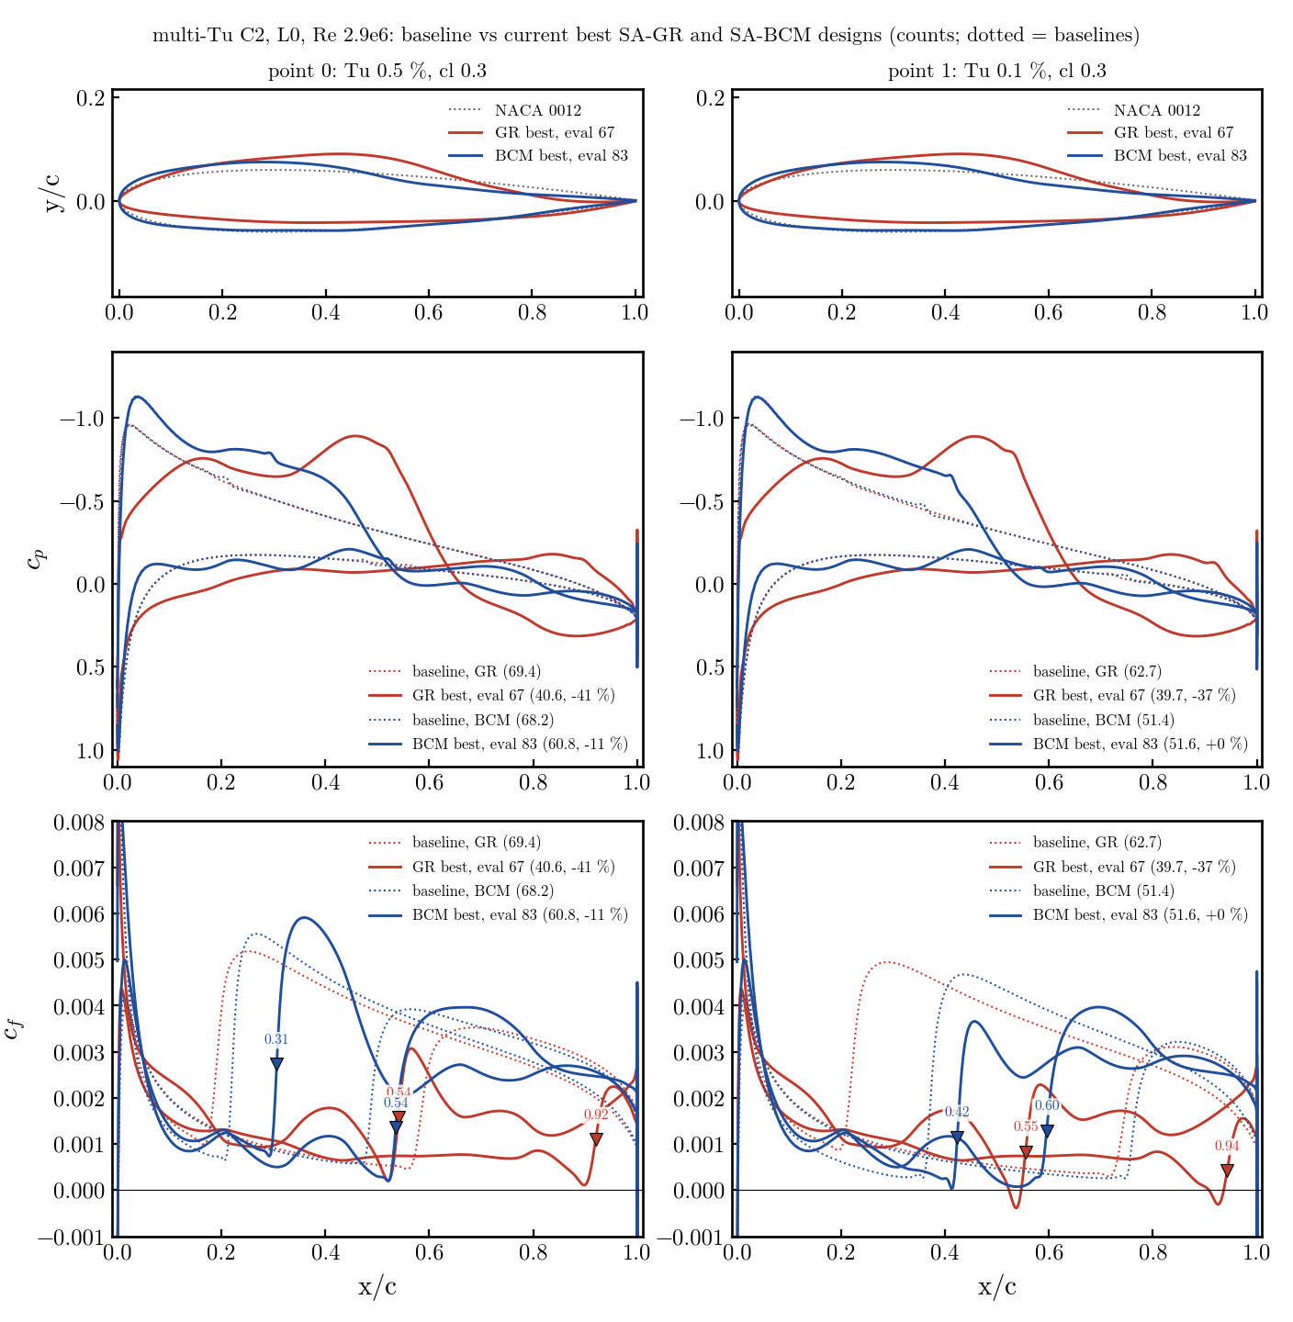
29. Multi-Tu C2: baselines vs GR and BCM optima
Tu 0.5 % (left), 0.1 % (right), cl 0.3 · dotted = baselines · red GR (eval 111), blue BCM (eval 140) · ▼ x_tr
08_optimization/2d_tu05_L0_multipoint/plot_mp_overlay_models.py (surfaces of the best evaluations, surf/).

Slide 31
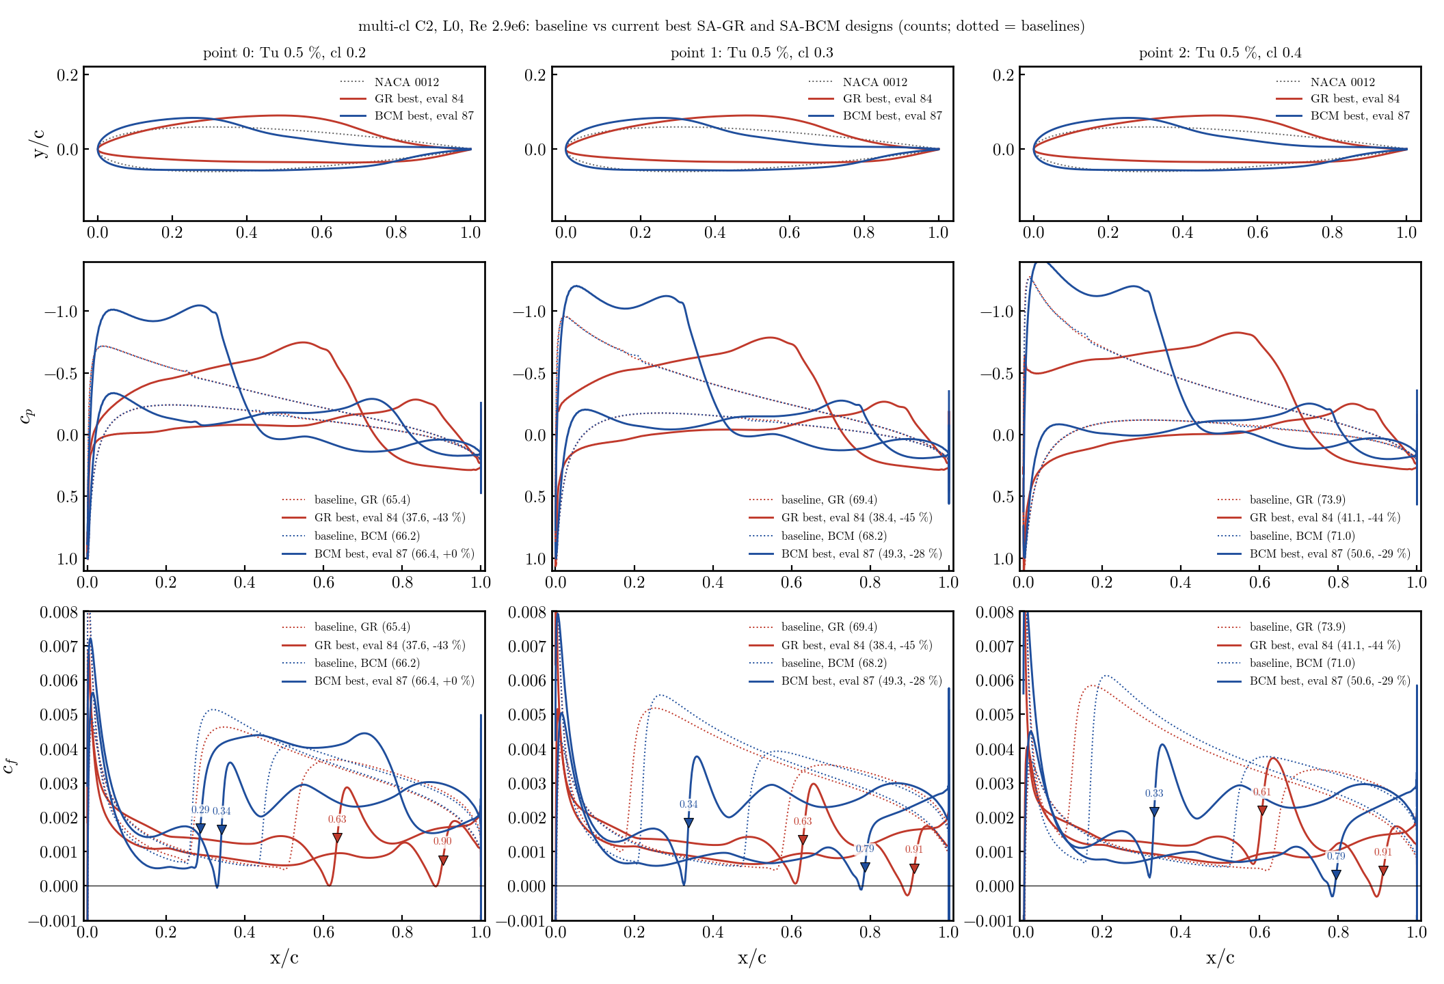
30. Multi-cl C2: baselines vs GR and BCM optima
Tu 0.5 %, cl 0.2 / 0.3 / 0.4 · dotted = baselines · red GR (eval 124), blue BCM (eval 144) · ▼ x_tr
GR keeps x_tr ≈ 0.63 / 0.91 at all three cl; BCM ≈ 0.34 upper and, at cl 0.2, 0.29 on the lower surface → that point stays at its baseline. Same script as slide 29.

Slide 32
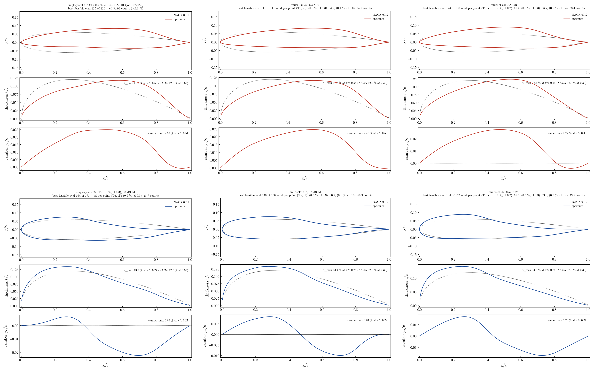
31. The optimum airfoils: GR family vs BCM family
top row GR (single / multi-Tu / multi-cl), bottom row BCM · dotted NACA 0012 · thickness and camber under each
• GR: t_max 11.6–12.4 % at 0.54–0.58 c, camber 2.5–2.8 % at ≈ 0.5 c, thin nose, positive camber to 0.9 c — the same airfoil whatever the objective. BCM: t_max 13.4–14.3 % at 0.25–0.28 c, camber 0.7–1.7 % at 0.27 c, full nose, S-shaped camber (negative aft) — also the same whatever the objective.
• Conclusion for the article: SA-BCM is not a usable optimisation model; its pressure-gradient weakness is a property of the model, and multipoint formulations do not remove it. Optimise with SA-γ-R̅eθt; SA-BCM stays a cheap analysis model.
08_optimization/2d_tu05_L0_multipoint/plot_final_foils.py → foil_*.png; montage figures/mp_foils_all.png.

Slide 33
32. A third model: SA-G-s (smoothed γ eq., local onset)
transition-models b92746f0/281a6d0a, option transitionLocalReTheta · machV3 · 22_sa_g_model/ · derivative gate adjoint vs CS 0.001 % / 0.008 % (GR 0.000 / 0.012 %)
• Why: the BCM-vs-GR gap could not be closed by any local sensor on the algebraic BCM (slides 22–27) nor by a transported threshold (BCM + R̅eθt: fixes the BCM optima, breaks the GR optima and the NLF polar — user vetoed transport in BCM). Question asked: does a one-equation SA-γ exist and does it work?
• Literature (9-agent sweep, memo in 22_sa_g_model/literature_memo.md): Menter 2015 one-equation γ coupled to SA exists (Nichols 2019 Kestrel, Lee & Baeder 2021, Jung 2022, Liu 2020, D'Alessandro 2025, STAR-CCM+ 'SA Gamma'); none smoothed / adjoint-ready; Jung reports it weaker than γ-R̅eθt for Re ≳ 3e6. P&Z's 'sLM2015' is the two-equation model, not this.
• Implemented: GR-s γ equation unchanged; onset (Re_θc, Flength) from the local LM Re_θt(Tu∞, λ_θL) with Menter's wall-distance λ_θL = 7.57e-3 d²/ν dU/ds + 0.0128 (smooth clip ±0.1); R̅eθt kept as diagnostic (option to make it inert). Naming G / G-s as GR / GR-s.
• Analysis results: NACA α 0–6 mean |Δcd| vs GR 2.5 % with x_tr ≈ GR; NLF0416 polar = GR (57.9/64.5/78.6 vs 57.0/64.4/79.3); S809 +1…+8 %. Convergence: opt ladder 251 its on NLF a4 (GR 604), no coupled ANK needed; NK before 1e-8 stalls (as GR). Cost per evaluation ≈ GR (same 3-eq block; adjoint 2× slower).
Data: 22_sa_g_model/{01_convergence_strategy (jobs 1937426/1937464/1939932), 02_derivative_check (1937469/70/78), 03_naca_sweep (1937402), 05_polars (1937404)}; docs CORE_BASE/CORE_01 option table.

Slide 34
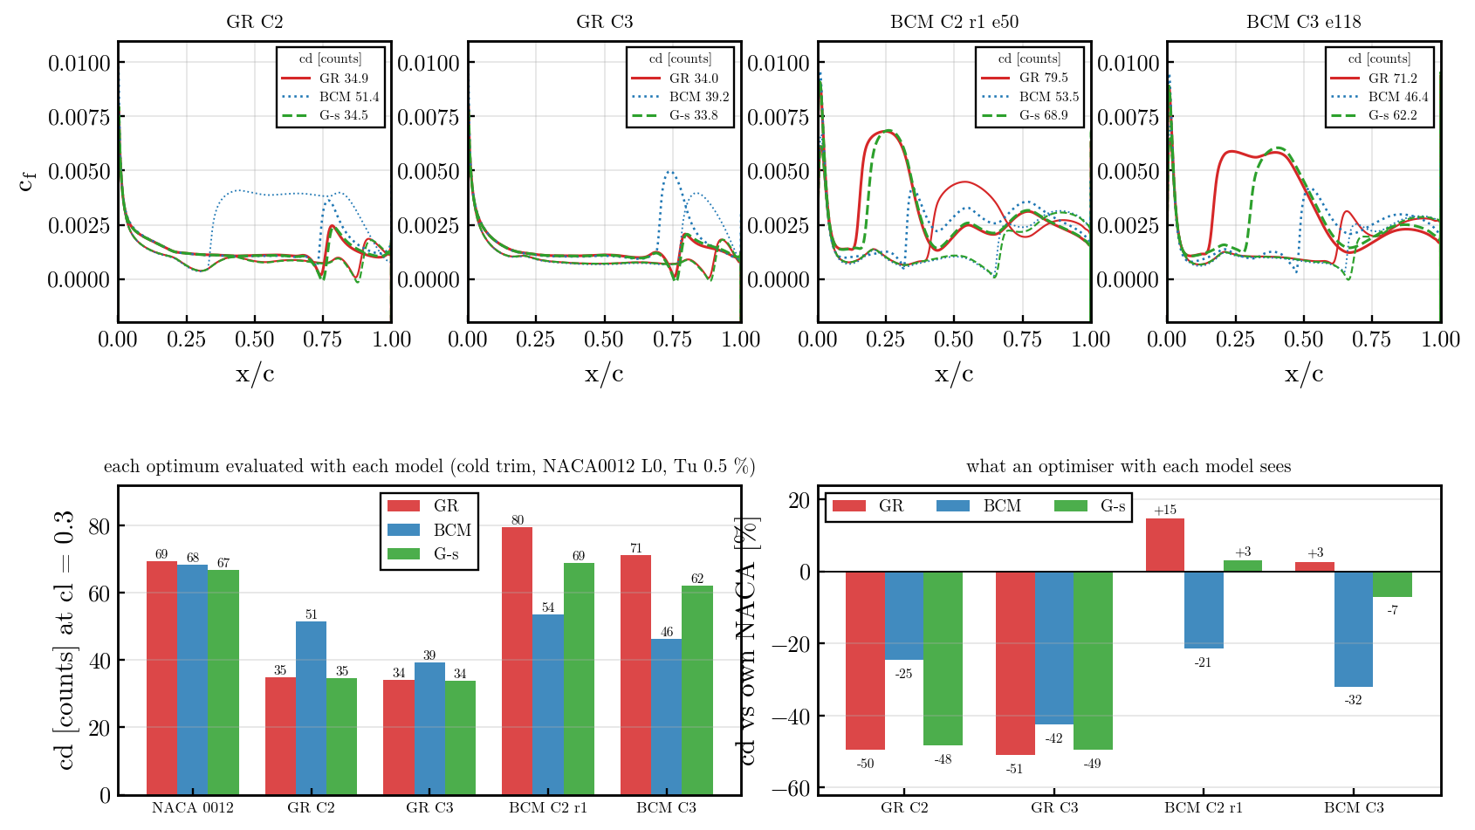
33. Cross-evaluation: SA-G-s reproduces GR on given shapes
NACA0012 L0, Tu 0.5 %, cl 0.3, cold trims · red GR, blue BCM, green G-s · counts
GR optima: G-s 34.5 / 33.8 (GR 34.9 / 34.0; BCM 51.4 / 39.2). BCM optima: G-s 68.9 / 62.2 (GR 79.5 / 71.2; BCM 53.5 / 46.4) → the BCM loophole reads +3 % vs NACA in G-s (GR +15 %, BCM −21 %). Cross mean vs GR: BCM 26 %, G-s 6.3 %. 22_sa_g_model/04_cross_eval/plot_cross_gs.py, job 1937403.

Slide 35
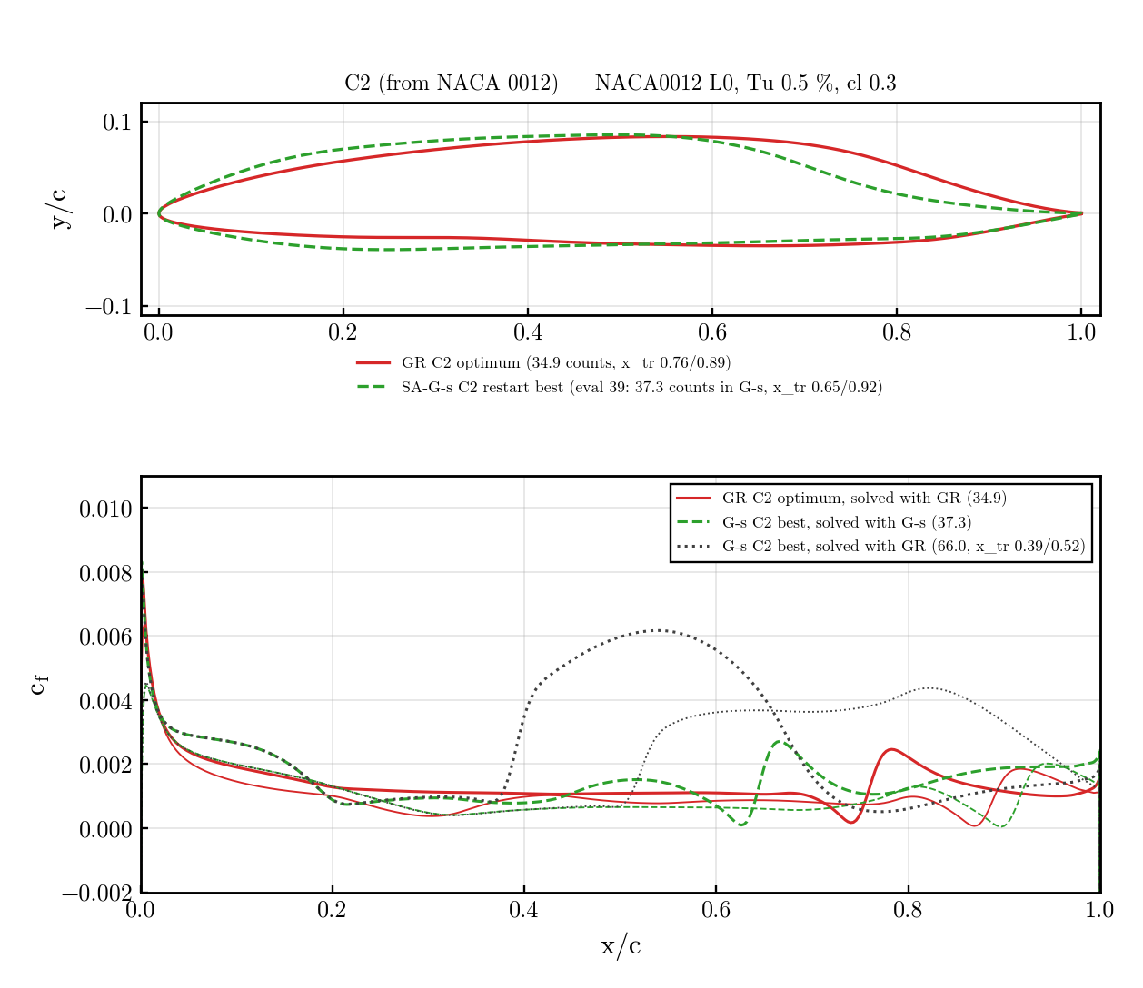
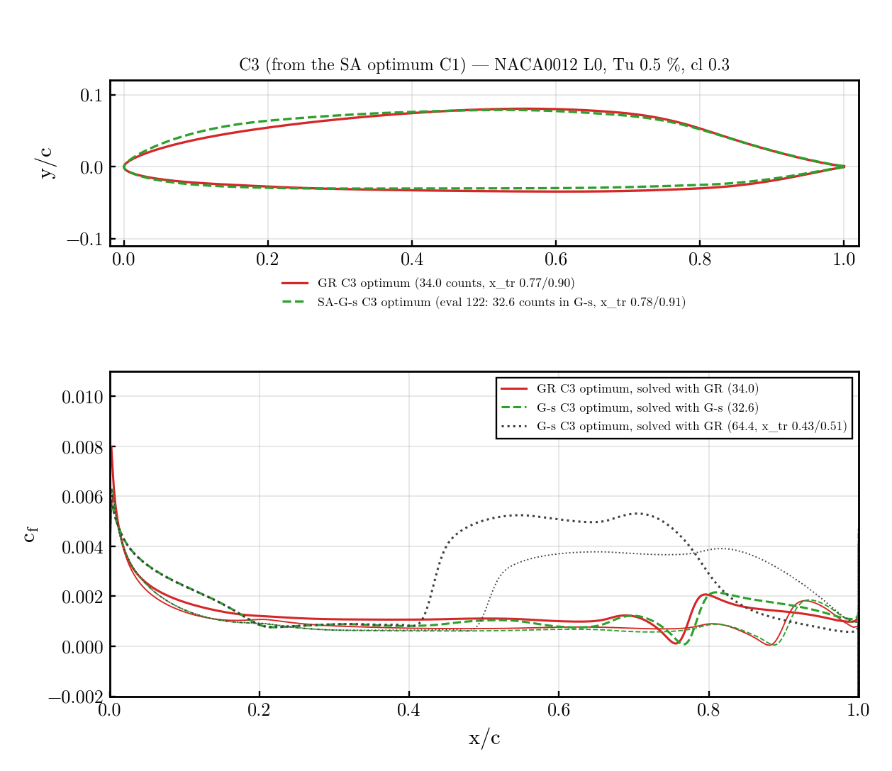
34. SA-G-s C2 / C3 optima: rejected by GR
32 ranks, same problems as GR C2/C3 · left C2 (restart eval 39), right C3 (converged eval 122) · red GR opt · green G-s opt in G-s · grey = G-s opt solved with GR
design | own model | in GR | vs NACA in GR (69.4)
G-s C3 optimum | 32.6 (−51 %) | 64.4 (x_tr 0.43/0.51) | −7 %
G-s C2 best | 37.3 (−44 %) | 66.0 (x_tr 0.39/0.52) | −5 %
GR C2 / C3 optima | 34.9 / 34.0 | — | −50 / −51 %
22_sa_g_model/06_optimization/{output_c3 (1937508), output_c2_r1 (1939986), cross_gs_optima (1939938), resolve_now (1941002)}. G-s C3 converged in 65 majors / 35 h; C2 stalled at eval 50 (CANK plateau + adjoint failures) and was restarted with the no-CANK structure.

Slide 36
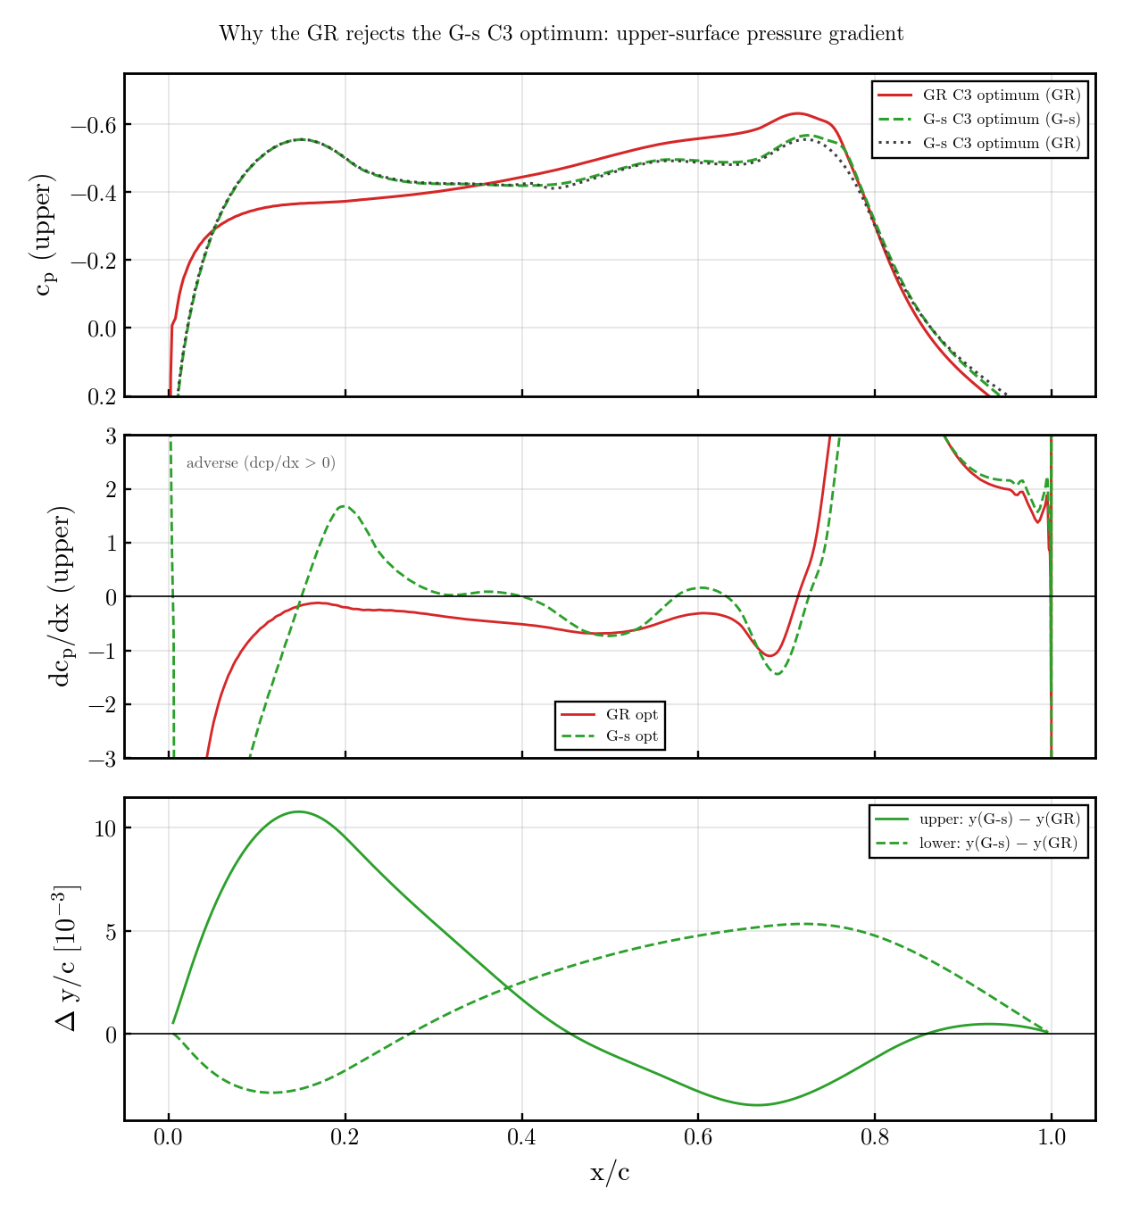
35. Why: optimisers exploit models without gradient history
C3: the two optima differ by 1 % of chord (Δy ≤ 0.011) but the sign of dcp/dx on the upper surface flips · cp / dcp/dx (>0 adverse) / Δy
• GR optimum: dcp/dx < 0 continuously from 0.05 to 0.65 c — a monotone favourable ramp, transition 0.77.
• G-s optimum: 1 % more thickness at 0.15 c → suction peak at 0.15 (cp −0.55) followed by a mild ADVERSE plateau (dcp/dx +1.7 → 0) to 0.35 c.
• The local onset (λ_θL) only sees the instantaneous gradient: a mild plateau never trips it. GR's transported R̅eθt is pushed down along those 20 % of chord (history) and trips at 0.43 → 64 counts.
• BCM: same story with a stronger nose peak (Cp_min −1.45, slide 20/25) and an instant switch. Both models, both loopholes = 'peak then mild adverse run'.
• C2 (gs_c2_why.png) shows the same signature plus a second peak at 0.55 c and a steep aft recovery.
22_sa_g_model/06_optimization/{gs_c3_why.png, gs_c2_why.png} (cp from the opt surface files cruise_130 / cruise_072 and the GR cross trims).

Slide 37
36. Main conclusion (2026-09-22)
three transition models, one problem: NACA0012 → min cd at cl 0.3, Tu 0.5 %, Re 2.9e6, L0 mesh
• For ANALYSIS of given shapes all three models are fine: SA-BCM, SA-G-s and SA-γ-R̅eθt agree on the NACA polar (2–3 %), on NLF0416 / S809 and on the GR optima; BCM and G-s are cheaper only in code complexity, not in cost per evaluation (G-s ≈ GR; BCM ~1/3).
• For OPTIMISATION only SA-γ-R̅eθt (GR) is reliable: its optima survive every cross-check (cold re-trim, other models, multipoint, restarts); the SA-BCM and SA-G-s optima do NOT — evaluated with GR they are worth −5…−7 % vs the NACA instead of the −44…−51 % they claim.
• Why: an optimiser is a weakness detector. Both BCM (algebraic switch Re_v ≥ 2.19 Re_θc(Tu)) and G-s (local λ_θL onset) judge transition from the LOCAL state; neither carries the upstream pressure-gradient history. The optimiser therefore learns to build a suction peak followed by a mild adverse run — lower cdp, 'laminar' for the model — which a real boundary layer (and GR's transported R̅eθt) does not tolerate. Every fix tried on the local side failed: local sensors (F=1 over-trips NLF, F=2 does not close the peak), integral Thwaites criteria, a transported threshold inside BCM (breaks the GR optima), multipoint objectives, Cp constraints (running).
• The history is the physics: R̅eθt transport is what makes the model see the whole pressure distribution, and it is exactly the term the optimiser cannot game. It costs one more equation and the CANK phase — the price of a trustworthy optimum.
• Recommendation: optimise with SA-γ-R̅eθt; use SA-BCM (and G-s) for cheap polars, screening and cross-checks; never trust an optimum from a local-onset model without re-evaluating it with GR.
Evidence: slides 20, 25–27 (BCM + sensors), 28–31 (multipoint), 33–35 (G-s); 22_sa_g_model/README.md; adflow_sabcm docs/studies/22 §6–7.

