Slide 1
SA-BCM 2D optimisation — reruns for the article and the branch problem
Status deck, 2026-09-14, updated 2026-09-18 (dense mesh + cross-evaluation of the optima + pressure-gradient sensor, slides 22–27) · Deucalion SA_BCM_ARTICLE/2d_opt · repo docs/studies/21_c2_branch_campaign
• Question: C2 (NACA0012 → SA-BCM, cl = 0.3, Tu = 0.5 %) gave −18 % with the buggy code, −4…−6 % with the corrected one; C3 gives −24 %.
• Constraint set by the user: keep the C2 definition (NACA start, SA-BCM only, article constraints, fs ≤ 0.15); only the optimizer/solver strategy may change.
• All SA-BCM numbers here: cold start (fresh process, 16 ranks), trimmed to cl = 0.3, ev = 1e-7, fs = 0.08. SA numbers: run2d, 32 ranks.
• Contents: diagnosis (why the optimizer stalls) → every strategy tried → results per Tu → the branch mechanism → proposals.

Slide 2
1. The baseline itself is not unique
NACA0012, cl = 0.3, Tu = 0.5 %, same code, same mesh
Solver path | cd | note
cold, 16 or 32 ranks | 0.006149 | bit-for-bit reproducible at fixed rank count
cold, 48 ranks | 0.006202 | +0.9 %
cold, 64 ranks (opt_c2) | 0.006456 | +5 %
trim recipe (ANK CFL 3e5) | 0.008061 | +31 %
ev = 1e-10 | 0.005197 | −15 % (different farfield BC)
article C2 geometry, today's code | 0.0064 | worse than the NACA — the old −18 % came from the bug
The partition/pseudo-transient path selects the converged state. Deterministic for a fixed rank count.

Slide 3
2. Line test NACA → C3 in FFD space: no barrier, but discrete jumps
11 points + fine scan t = 0.80–1.00; adjoint directional derivative at every point
t | cd (fs 0.08) | cd (fs 0.15) | adjoint dcd/dt | x_tr upper
0.0 (NACA) | 0.006309 | 0.006309 | −2.1e-4 | 0.317
0.5 | 0.005765 | 0.005766 | −1.5e-4 | 0.352
0.80–0.87 | 0.005638 → 0.005634 (ramp −6.7e-5/unit) | same | −7.3e-5 … −6.1e-5 ✔ | 0.369
0.88–0.96 | 0.005733 / 0.005631 alternating | same | −4e-5 | 0.352 / 0.369
0.97–1.00 (C3) | 0.004703 → 0.004695 | 0.004977 | −2.3e-4 | 0.550
• Within a plateau the adjoint is exact (measured slope = adjoint). The drop is carried by branch switches: ±1.8 % (transition moving one cell) and −16 % (x_tr 0.37 → 0.55).
• fs = 0.15 gives identical plateaus and jumps (and +5.8 % on the good branch) → smoothing is not the lever.

Slide 4
3. Hysteresis chains and Tu-ramp probe: several steady states per geometry
t | cold | warm from NACA (fwd) | warm from C3 (bwd) | Tu₀ = 0.1 % → 0.5 % | Tu₀ = 3 % → 0.5 %
0.0 | 0.006149 | 0.006149 | 0.006255 | 0.006248 | 0.009386
0.5 | 0.005765 | 0.006069 | 0.005963 | 0.005863 | 0.009387
0.8 | 0.005639 | 0.006047 | 0.005639 | 0.005738 | 0.009446
0.96 | 0.005630 | 0.006045 | 0.005244 | 0.005244 | 0.009459
1.0 (C3) | 0.004695 | 0.006045 | 0.004643 | 0.004643 | 0.009464
• Warm from the NACA carries the tripped branch all the way to the C3 shape (0.00605 instead of 0.00464) — a classic warm-started optimization can never see the C3 gain.
• Starting turbulent (Tu₀ = 3 %) → fully turbulent state (0.0094 ≈ SA) is stable at Tu = 0.5 % for every geometry: a spurious self-sustained mode.
• The good branch (x_tr 0.55) is a narrow basin around C3 (collapses within Δt = 0.04).

Slide 5
4. The three stable modes and why the gradient cannot see the gain
• Mode 1 — turbulent from the leading edge (cd 0.0094): the ν_t/ν term keeps γ = 1, which keeps ν_t high. Self-sustained; only reached by starting turbulent. Spurious.
• Mode 2 — transition mid-chord (0.32–0.37 c) in pairs of neighbouring cells: γ switches where Re_v crosses the Tu threshold; on a flat pressure region Re_v grows slowly, so the crossing is ill-conditioned; transition at cell i changes the downstream boundary layer and the pressure, which moves the crossing — two adjacent cells are both self-consistent (±1.8 % cd). Discrete because of the mesh; fsmooth does not remove it.
• Mode 3 — long laminar run (x_tr 0.55 c): only for shapes with a pressure plateau (C3 family). Narrow basin.
• SLSQP: the adjoint measures the slope inside a step (correct, tiny); the line search samples 1–5 points on one line with shrinking steps; a +1.8 % landing at every trial ⇒ 'converged'. The accepted point can also switch branch (objective drifts up).
• A denser mesh makes the steps smaller (more, lower equilibria); the ill-conditioning of the crossing on a flat pressure plateau remains.

Slide 6
5. Optimizer strategies tried (NACA0012 start, Tu = 0.5 %, fs 0.08)
best cd cold-verified; Δ vs baseline 0.006149; C4 = −11.4 %, C3 = −24.5 %
Strategy | Idea | cd | Δ | Verdict
SLSQP as in the article (scale 10) | — | 0.00617 / 0.00583 (fs 0.04) | −4.4 / −5.2 % | stalls on branch noise
B1/B1′ warm start + guard | continuity | 0.00756 / 0.00631 | +17 / +2.6 % | hysteresis poisons the base point
B cold, DV scale 2 | smaller steps | 0.00571 (not reproducible) | −7 % then drifts | —
B4 / B5 cold + warm-from-best; laminar-first | branch selection | 0.00591 / 0.00590 | −4 % | false minima
B6 branch envelope (cold | lam | best) + SLSQP restarts | lower envelope, clean BFGS | 0.005571 | −9.4 % | first method that keeps its gains
B7/B9 Tu continuation from below (0.1 → 0.5) | laminar shapes first | 0.0059–0.0061 | −2…−5 % | low-Tu shapes lose laminarity at 0.5 %
B10 Tu continuation from above (1.0/0.75 → 0.5) | plateau shapes first | 0.0062–0.0069 | worse than NACA | BCM stalls at any Tu
B11 SLSQP restarted from best ±0.01 probe point | probe + descend | 0.005484 | −10.8 % | adjoint result, V/V0 0.994
Cold pattern search (derivative-free), 7 rounds | compare cold values, no gradient | 0.005237 / 0.005052 / 0.005035 | −14.8 / −17.8 / −18.1 % | V/V0 0.9997 / 0.988 / 0.973 — NOT adjoint

Slide 7
6. Article-style tables per free-stream Tu (cold, cl = 0.3)
ΔCd vs the SA-BCM baseline at the same Tu; C1 (SA) = −3.0 % vs the SA baseline at any Tu
Tu | Baseline SA-BCM cd | C2 cd (Δ) | C3 cd (Δ) | C4 cd (Δ) | x_tr C2 up / lo
0.5 % (article) | 6.15e-3 | 5.48e-3 (−10.8 %) adjoint · 5.05e-3 (−17.8 %) derivative-free | 4.64e-3 (−24.5 %) | 5.45e-3 (−11.4 %) | 0.352 / 0.658 · 0.420 / 0.713
0.25 % | 5.12e-3 | 4.04e-3 (−21.1 %) adjoint | 4.10e-3 (−19.9 %) | 4.59e-3 (−10.4 %) | 0.485 / 0.971
0.1 % | 4.30e-3 | 3.49e-3 (−18.9 %) adjoint | 3.84e-3 (−10.7 %) | 4.25e-3 (−1.3 %) | 0.634 / 0.982
• Tu = 0.25 %: the laminar basin is wide enough for the gradient; C2 reaches the C3 level with a clear aft movement of transition (upper +0.08 c, lower +0.16 c; small laminar separation bubble near the TE on the lower surface at x/c ≈ 0.94).
• Tu = 0.1 %: the baseline is already very laminar (x_tr 0.52/0.92); C4 ≈ baseline, the 'SA misleads' message weakens.
• Tu = 0.5 %: with adjoint only, C2 (−10.8 %) is slightly below C4 (−11.4 %); ≥ −12 % needs the derivative-free stage. Full tables (Cd/Cdv/Cdp, %Cdv/%Cdp, x_tr): tables_by_tu.md.

Slide 8
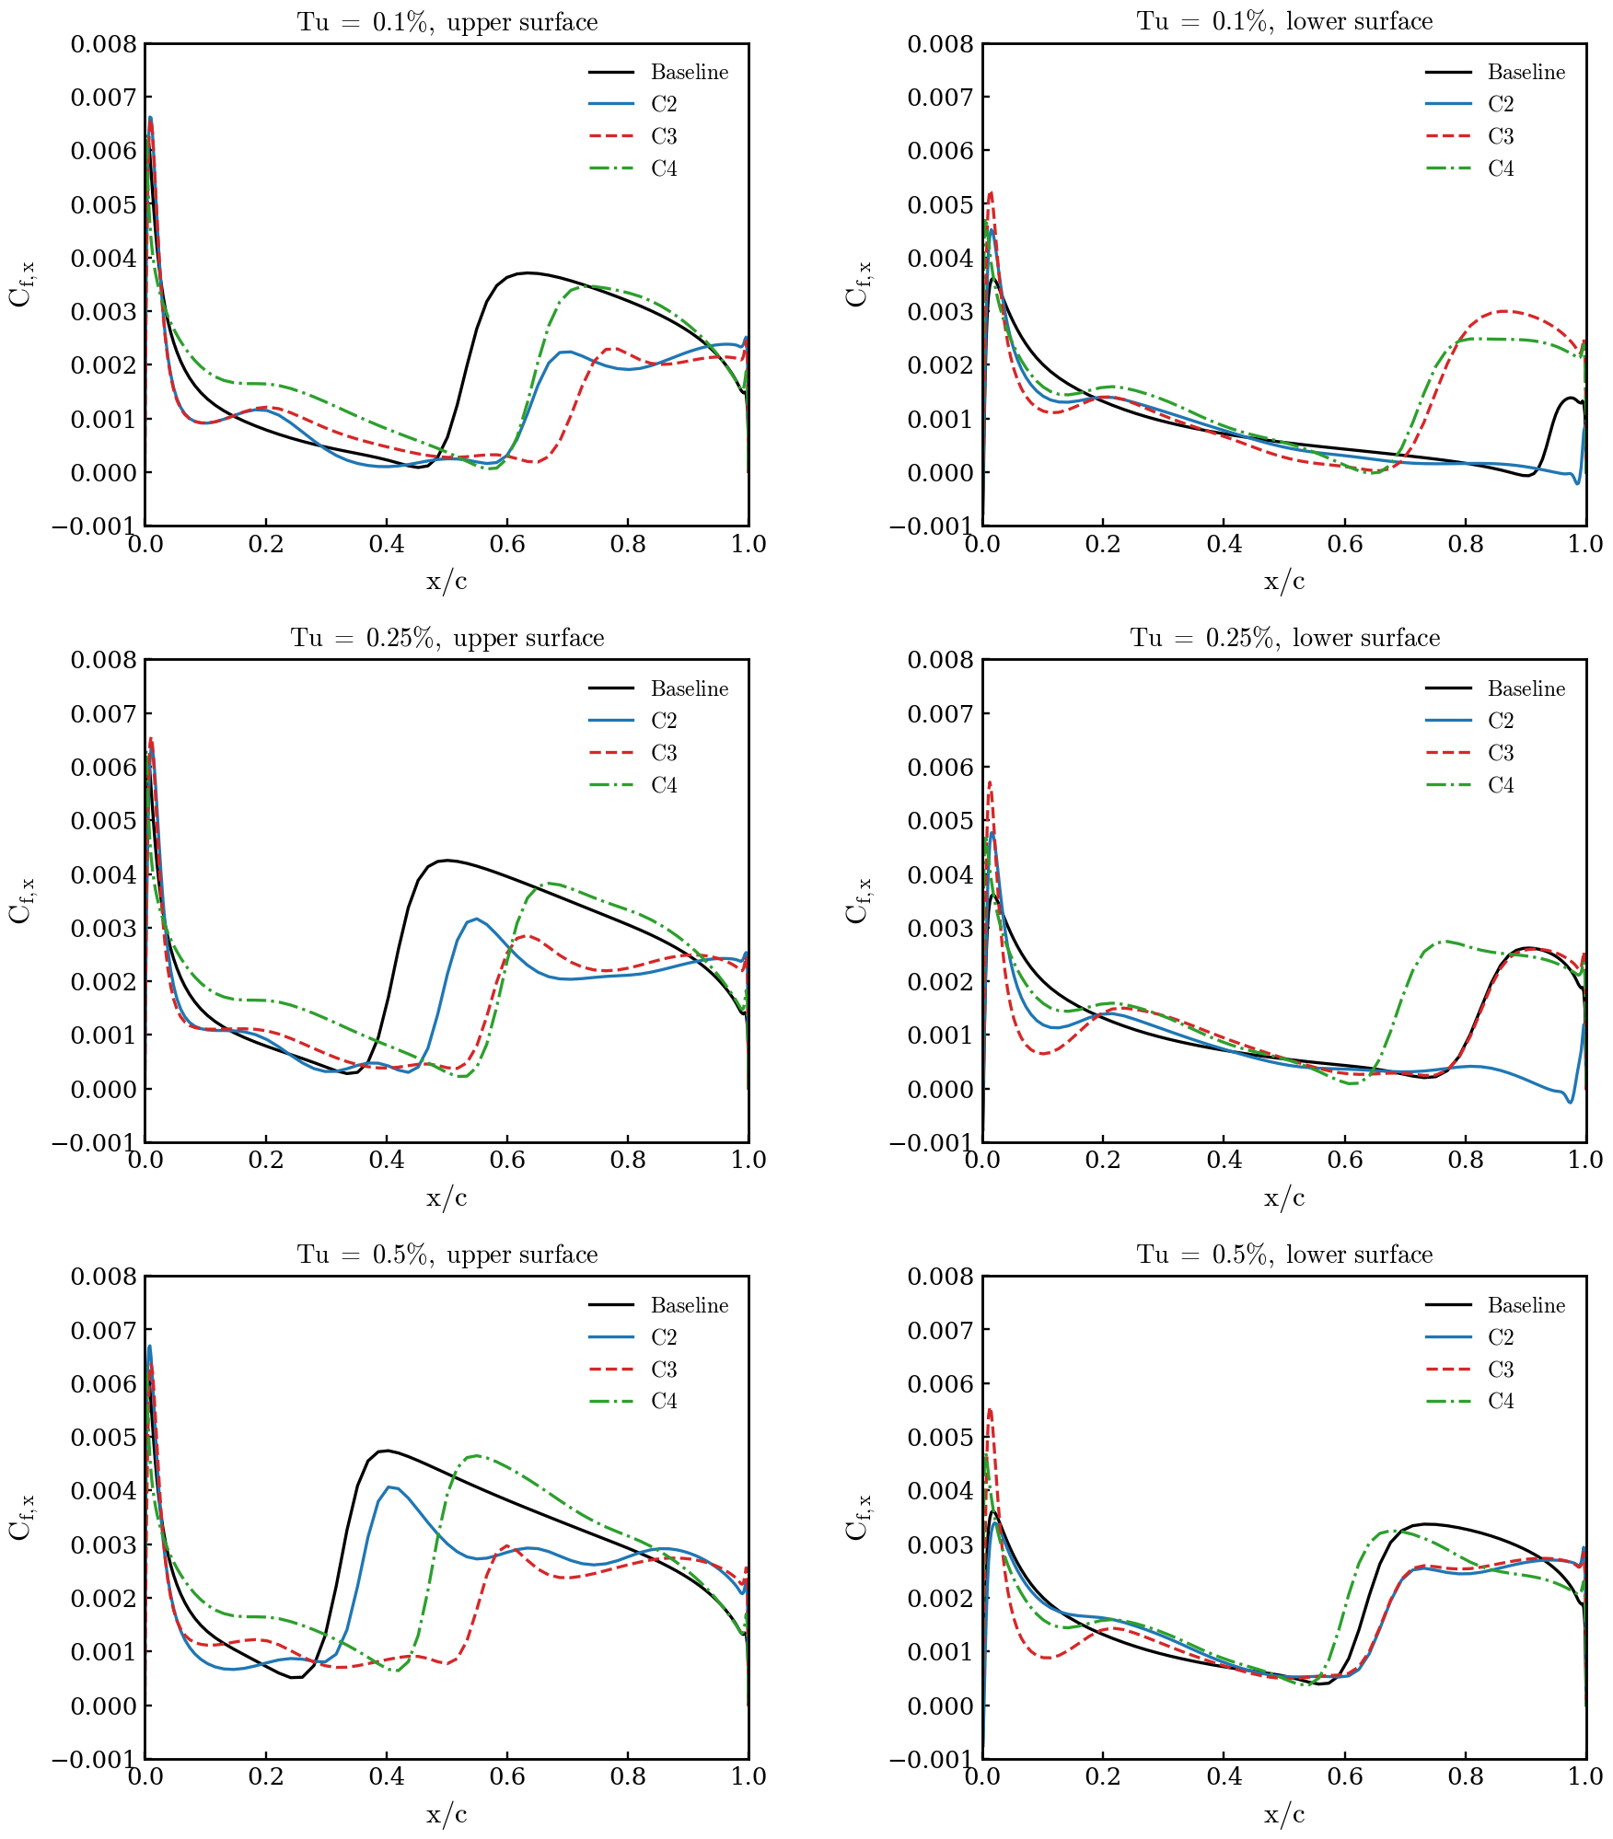
7. Skin friction, upper / lower surface, Tu = 0.1 / 0.25 / 0.5 %
Baseline, C2 (adjoint result at 0.5 %), C3, C4 — cold, cl = 0.3

Slide 9
8. What is reportable as C2 at Tu = 0.5 %
Option | C2 | Method | How to describe it
1 | −10.8 % (x_tr 0.35 / 0.66, V/V0 0.994) | SLSQP + adjoint, branch-envelope evaluation + restarts | gradient-based with a branch-consistent evaluation — clean
2 | −4…−5 % | SLSQP + adjoint exactly as in the article | the original setup; shows the fragility
3 | ≈ −17 % (B12 running: SLSQP + adjoint restarted from the pattern-search points) | hybrid | must state an explicit derivative-free exploration stage
4 | −21 % at Tu = 0.25 % | SLSQP + adjoint (same evaluation) | 100 % adjoint; changes the article's Tu
• Every optimum must be re-evaluated cold in a fresh process before it is quoted: values living on warm branches are not reproducible (this cost the HOP/B11 'gains').
• The pattern search (108 cold solves per round) is cheap only because the case is 2D (16 k cells) — in 3D the adjoint is the only option, and the adjoint itself is verified exact within each branch.

Slide 10
9. Proposals to remove the branch problem (ranked)
• 1. Chordwise mesh refinement in the transition zone (0.25–0.65 c): the one-cell step ±1.8 % → ±0.5 % or less; SLSQP stops mistaking a step for a minimum. Most defensible in a paper ('grid-induced multiple equilibria'). Cost: new mesh + redo the 2D cases (~half a day). Untested.
• 2. Branch-averaged objective: solve each design twice (cold and laminar-first), use the mean of cd and of the two adjoints → the staircase becomes a ramp consistent with the gradient. Still pure adjoint; ~1 h to implement in the envelope script; 2×2 solves per evaluation. Untested.
• 3. Adjoint direction + sampled line search: keep the (good) gradient direction, replace SLSQP's line search by 6–8 cold evaluations along it. ~8 solves/iteration; custom loop, half a day.
• 4. Report at Tu = 0.25 % (−21 %): zero work, changes the article's condition.
• 5. Fixed cold protocol (done): reproducibility, not the optimizer.
• Outside the user's rules: soften the ν_t/ν feedback term of BCM (the source of the hysteresis) — a physics decision.
Recommendation: 1 for the article; 2 to test now with the existing scripts. Nothing launched without approval.

Slide 11
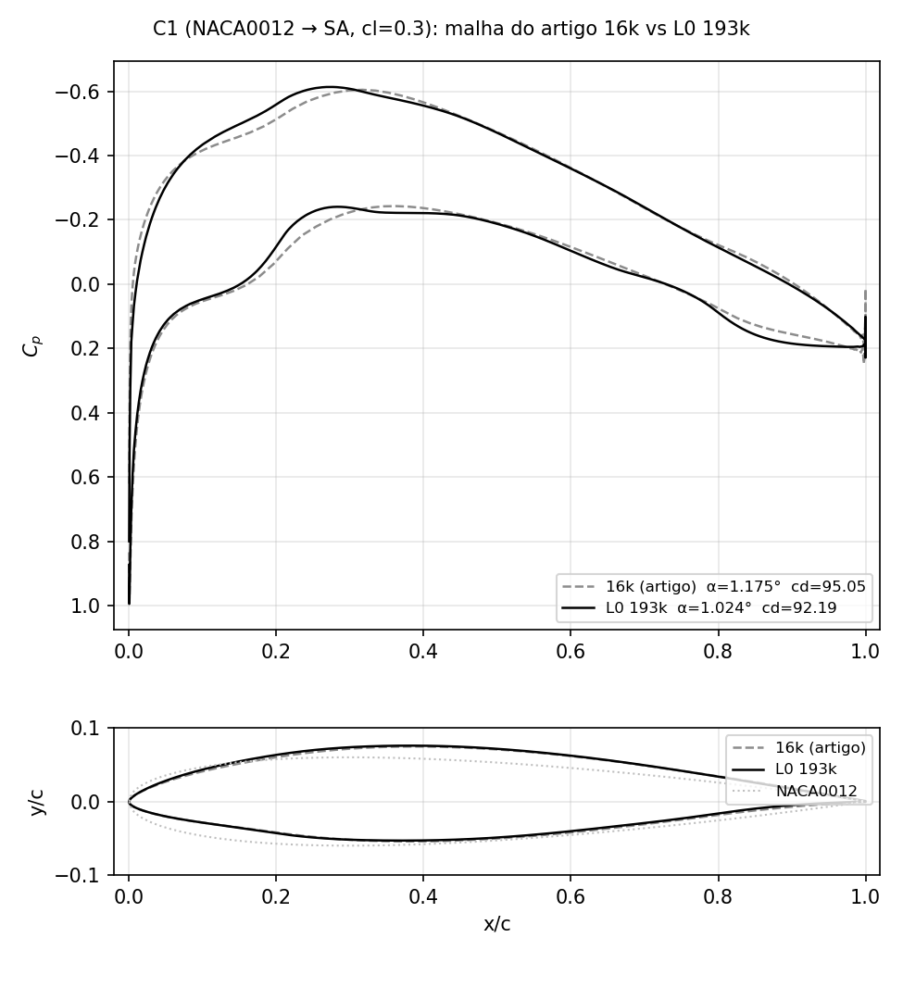
10. Dense mesh L0 (193k): SA optimisation is robust
C1 = NACA0012 → SA, cl = 0.3, SLSQP + adjoint, article script; 16k article mesh vs L0 (one level below the NLF article mesh)
 | 16k (article) | L0 (193k)
baseline SA cd | 9.77e-3 | 9.42e-3
C1 cd | 9.48e-3 | 9.22e-3
ΔCd | −3.0 % | −2.1 %
α | 1.175° | 1.024°
t_max (x/c) | 0.129 (0.38) | 0.129 (0.38)
Cp,min (x/c) | −0.60 (0.32) | −0.61 (0.27)
SLSQP exit | 0, 58 evals | 0, 119 evals
• Same optimum on both meshes: identical thickness distribution, camber and lower-surface flattening; only the Cp details differ (suction peak 5 % c further forward, softer TE recovery on L0).
• The coarse mesh over-predicts the baseline SA drag by 3.7 % and the gain by 1 point; the design itself is mesh independent → for fully turbulent flow the 16k mesh was enough.

Slide 12
11. SA-BCM cases on the two meshes (Tu = 0.5 %, cl = 0.3)
fs 0.08, ev 1e-7; drag counts; Δ vs the SA-BCM baseline on the same mesh; L0 C2/C3 still running (job 1926969, 32 ranks each)
Case | 16k cd | 16k Δ | 16k x_tr up/lo | L0 cd | L0 Δ | L0 x_tr up/lo | L0 status
Baseline SA | 97.7 | — | — | 94.21 | — | — | done (NK recipe)
Baseline SA-BCM | 61.49 | — | 0.317 / 0.624 | 68.20 | — | 0.216 / 0.486 | done (cold trim)
C1 (SA opt) | 94.8 | −3.0 % vs SA | — | 92.19 | −2.1 % vs SA | — | done, SLSQP exit 0
C2 (SA-BCM opt from NACA) | 54.84 | −10.8 % | 0.352 / 0.658 | 58.80 | −13.8 % | pending | iter 18, plateau since iter 12; 13 failed trial solves
C3 (C1 re-optimised with SA-BCM) | 46.43 | −24.5 % | 0.550 / 0.658 | 51.92 (cl 0.313, not trimmed) | ≈ −24 % | pending | iter 3
C4 (C1 geometry, SA-BCM) | 54.50 | −11.4 % | 0.469 / 0.590 | 57.14 | −16.2 % | 0.419 / 0.523 | done (cold trim)
• The SA baseline moves −3.7 % from 16k to L0; the SA-BCM baseline moves +11 % (transition on the NACA0012 moves forward: 0.32 → 0.22 c upper, 0.62 → 0.49 c lower). The transition location was not mesh-converged on the 16k mesh.
• On L0 the ordering C2 < C4 appears with the plain adjoint run (−13.8 % vs −16.2 % after 18 iterations, still going) — no derivative-free stage. C3 keeps ≈ −24 % on both meshes.
• L0 SA-BCM solves need L2Convergence 1e-8 (ANK stalls at ~1e-8); every second SLSQP trial on L0 lands on a failed/far solve (cl 0.1–0.5) and is rejected by the line search — same staircase mechanism as on 16k, smaller steps.

Slide 13
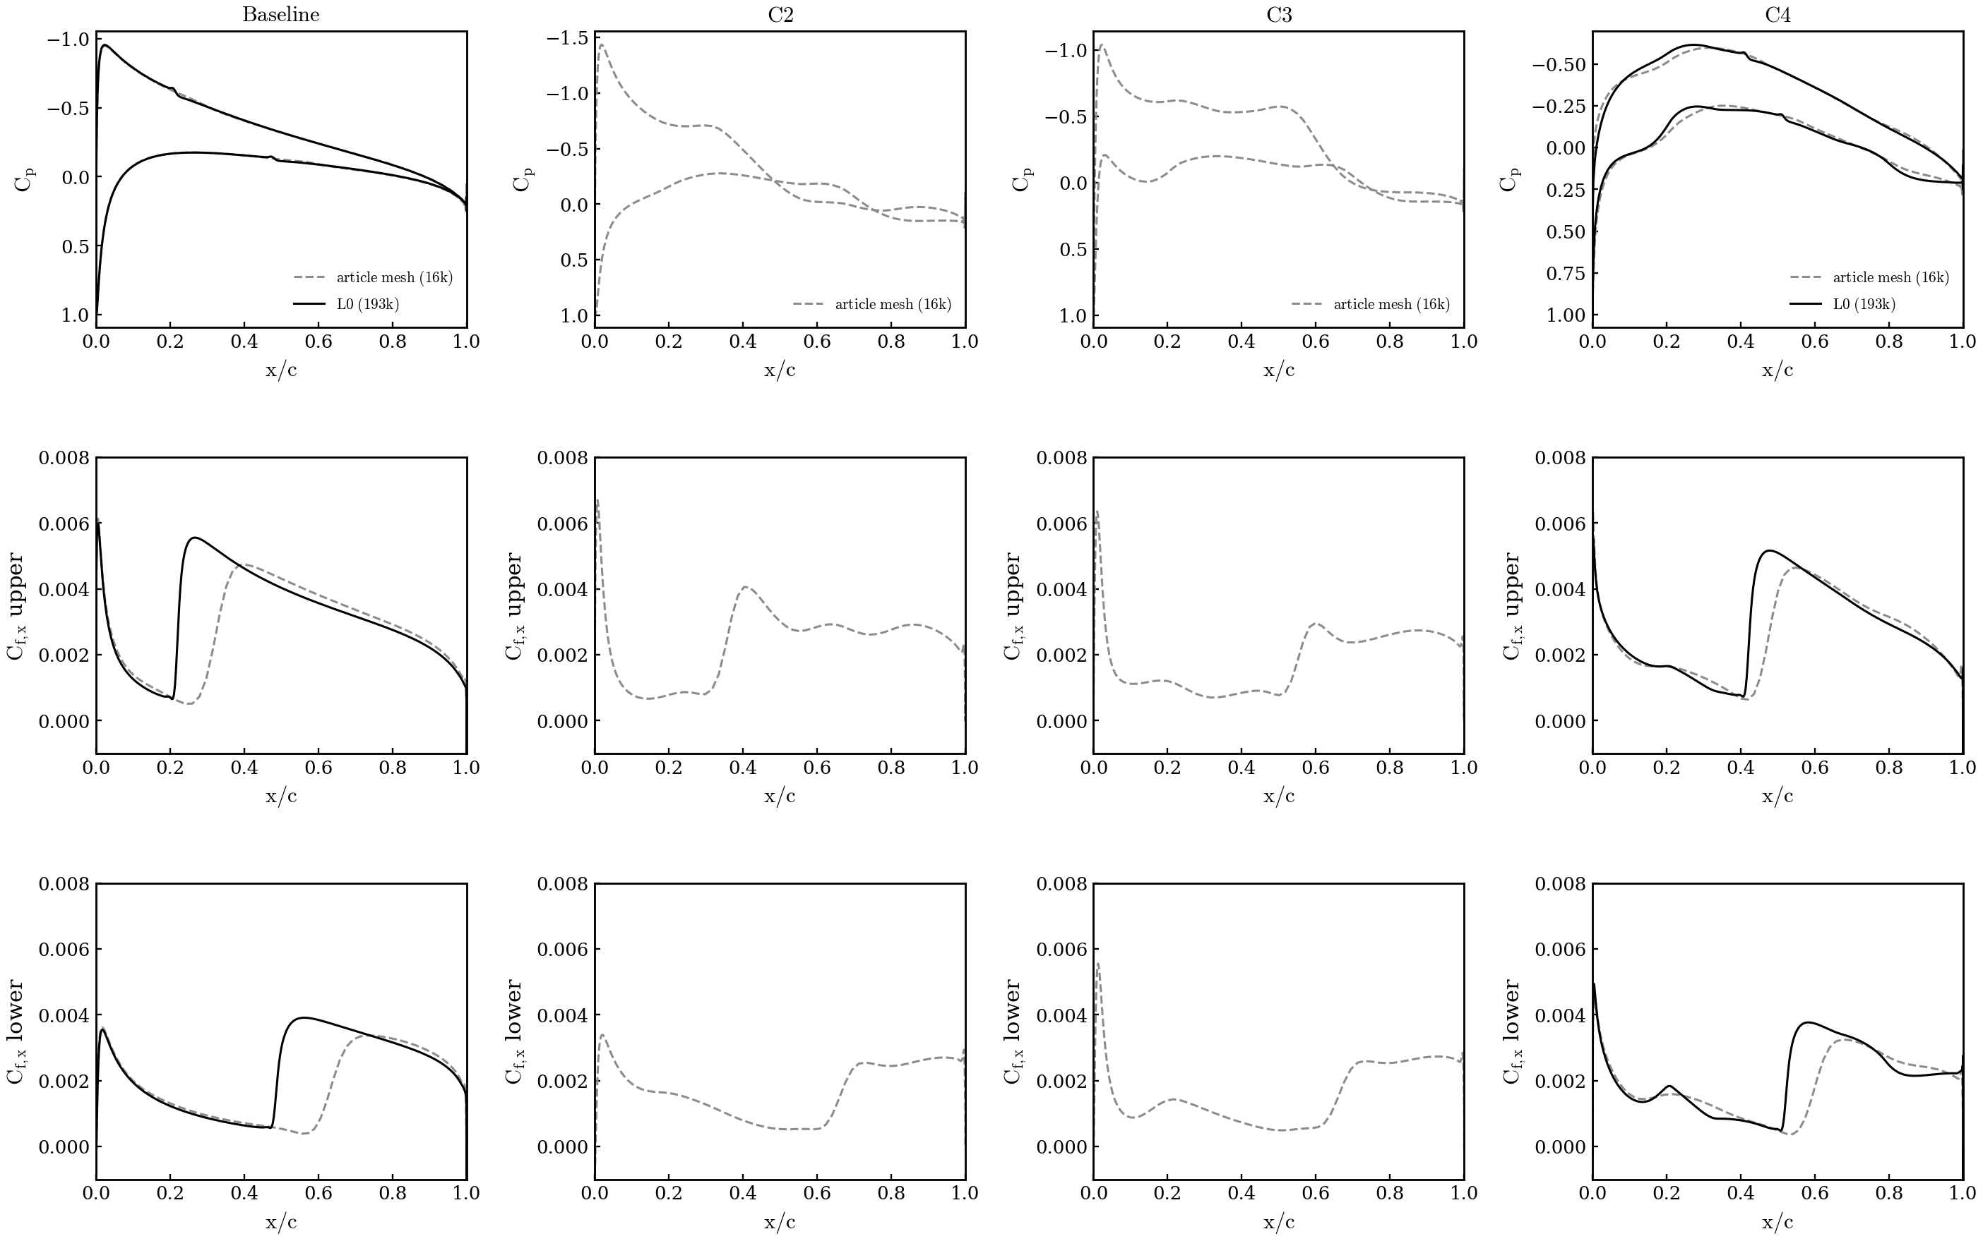
12. SA-BCM is mesh dependent: Cp, Cf 16k vs L0
Tu = 0.5 %, cold trimmed solves at cl = 0.3; 16k dashed, L0 solid; C2/C3 on L0 added when the optimisations finish
• Baseline NACA0012: the L0 mesh trips the upper surface at 0.22 c instead of 0.32 c and the lower at 0.49 instead of 0.62; Cf on the laminar run is the same, the turbulent part is longer → +11 % cd.
• C4 (C1 geometry): transition on L0 at 0.42 / 0.52 c vs 0.47 / 0.59 c on 16k — the coarse mesh sustained a longer laminar run on both surfaces (x_tr = first cell with γ > 0.5 ten cells above the wall; on L0 that height is smaller).
• Per Tu (slide 7): the same figure on the article mesh at Tu = 0.1 / 0.25 / 0.5 %; the L0 baselines at 0.25 and 0.1 % are queued in the same verification job.

Slide 14
13. SA-γ-R̅eθt cases on two meshes (Tu 0.5 %, cl 0.3)
counts; Δ vs GR baseline on the same mesh; L1 = original GR setup (Re 6e6, ±0.03), L0 = article condition (Re 2.92e6, ±0.05); all finished 2026-09-16
Case | L1 cd | L1 Δ | L1 x_tr up/lo | L0 cd | L0 Δ | L0 x_tr up/lo | status
Baseline SA | — | — | — | 94.21 | — | — | L0: article campaign (NK recipe)
Baseline SA-γ-R̅eθt | 73.41 | — | 0.098 / 0.363 | 69.36 | — | 0.192 / 0.584 | done (cold trim, α 2.594° / 2.700°)
C1 (SA opt) | — | — | — | 92.19 | −2.1 % vs SA | — | L0: article campaign, SLSQP exit 0
C2 (GR opt from NACA) | 42.91 | −41.5 % | 0.429 / 0.766 | 34.94 | −49.6 % | 0.760 / 0.889 | L1: SLSQP exit 0, 82 majors, 14.8 h; L0: stopped flat at 126 solves, trimmed (job 1929206)
C3 (C1 re-optimised with GR) | — | — | — | 34.02 | −49.0 % | 0.774 / 0.900 | L0: job 1929321, flat after 122 majors, trimmed (1930514); article FFD
C4 (C1 geometry, GR) | — | — | — | 53.12 | −23.4 % | — | L0: cold trim, α 0.902° (job 1929321)
• The GR baseline moves −5.5 % from L1 to L0 (73.4 → 69.4 counts) — but the two runs are NOT the same Re (6e6 vs 2.92e6): the lower Re on L0 delays transition (0.10 → 0.19 c upper, 0.36 → 0.58 c lower) and lowers cdv; a like-for-like mesh check needs the same condition on both (prepared: 2d_tu05_meshcmp, 16k / L1 / L0 at Re 2.92e6, not submitted).
• C2 on both: same mechanism — transition pushed to 0.43 / 0.77 c (L1, α 1.996°) and 0.76 / 0.89 c (L0, α 1.118°), gain mostly cdv (−42 % and −53 %); the L0 optimum is flatter and aft-loaded (cp peak at 0.70 c), the L1 one keeps a strong peak at 0.39 c and is thicker (14.5 % vs 12.2 %). L0 values are trimmed re-solves (cl = 0.3 ± 1e-5); C2 ≈ C3 on L0 (Δy ≤ 0.005 c): the GR optimum does not depend on the start point or the FFD.
• GR solves on both meshes need the CSANK-only recipe (nkswitchtol 1e-8, CFL 1e8, L2 1e-8): NK@1e-6 stalled at ~1e-6 abs and was flagged fail in every solve — the same stall the original Tu 0.0937 % runs had silently (96/99 fails in job 1803832). x_tr = steepest c_f rise per surface.
Data: $R/08_optimization/2d_tu05_L1 and 2d_tu05_L0 (trim_gammaretheta/trim.json, logs/opt_c2_*.log, surf/); x_tr from make_mesh_effect_gr.py.

Slide 15
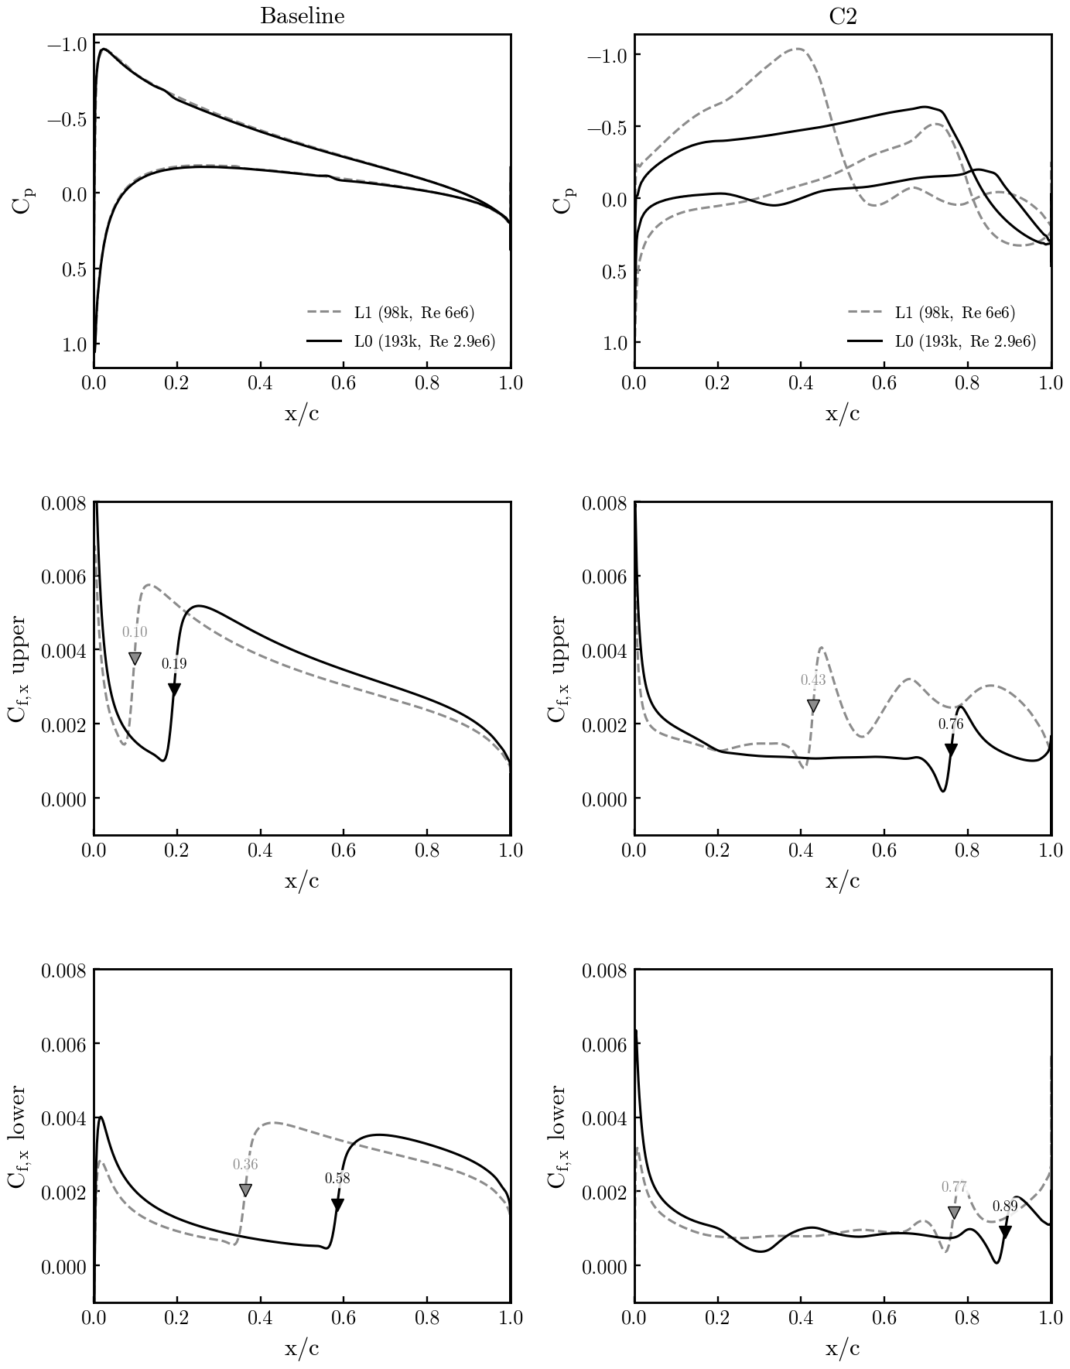
14. SA-γ-R̅eθt on the two meshes: Cp, Cf L1 vs L0
Tu = 0.5 %, cl = 0.3; L1 dashed (Re 6e6), L0 solid (Re 2.92e6); baseline = cold trims, C2 = final best point; ▼ = x_tr
• Baseline NACA0012: identical cp on both meshes; the L0/Re 2.92e6 run keeps laminar flow to 0.19 c upper and 0.58 c lower vs 0.10 / 0.36 c on L1/Re 6e6 — a Re effect, not a mesh effect (transition Reθ,crit reached later at lower Re); the laminar cf level is the same.
• C2 optima: both optimizers push transition aft and flatten the lower surface; on L0 the upper-surface laminar run reaches 0.76 c with cf ≈ 0.001 up to there (lower 0.89 c), on L1 it ends at 0.43 c with a separation-bubble signature (cf dip to 0 then peak) — 42.9 vs 34.9 counts.
• Like-for-like mesh dependence (same Re on 16k / L1 / L0) is prepared in 2d_tu05_meshcmp and not yet run; GR C3/C4 on L0 prepared (article FFD + C1 shape).
Data: same as slide 13; figure 08_optimization/make_mesh_effect_gr.py (surf CGNS of the trims and of the best C2 evaluations).

Slide 16
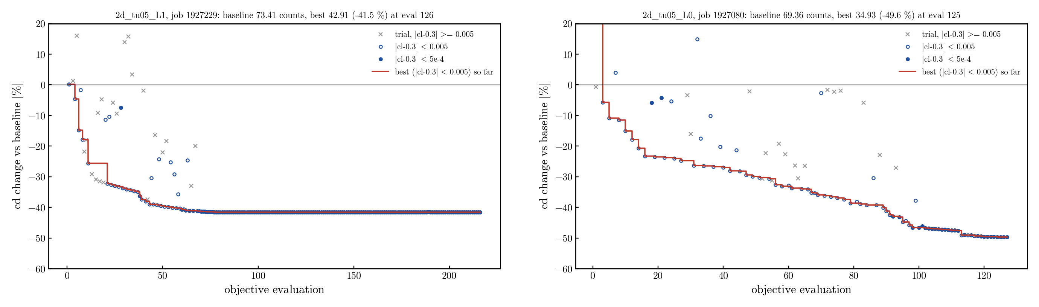
15. SA-γ-R̅eθt C2 convergence: L1 vs L0
Δcd vs the trimmed GR baseline per objective evaluation; red = best point so far; × = line-search trials off the cl constraint
• L1 (Re 6e6, ±0.03): −25.7 % at 20 evals, −39.5 % at 50, −41.5 % at 75, then flat for 140 more evaluations (SLSQP exit 0 at 82 majors; last 10 majors within ±2e-5 counts). L0 (Re 2.92e6, ±0.05): −23.5 % at 20, −29.9 % at 50, −36.9 % at 75, −46.6 % at 100, −49.6 % at 125 with a step at 90–100; stopped by the user at 126 solves (still creeping, ~0.1 count per 10 evals).
• Neither run has a plateau/branch problem: the objective is smooth in the DVs, failed solves are only the far line-search trials (cl 0.1–0.5), rejected by SLSQP.
Data: $R/08_optimization/2d_tu05_L1/logs/opt_c2_1927229.log, 2d_tu05_L0/logs/opt_c2_1927080.log; figure 08_optimization/plot_c2_history.py.

Slide 17
16. Cross-evaluation of the optima (L0, Tu 0.5 %)
row = geometry, column = analysing model · cl 0.3 · counts · Δ vs NACA baseline of the SAME model · blue = own model
Shape (row) ↓ · analysed with (column) → | α | cd SA-GR | cdp / cdv | Δ vs 69.36 | α | cd SA-BCM | cdp / cdv | Δ vs 68.20
NACA0012 (baseline) | 2.700 | 69.36 | 16.66 / 52.70 | — | 2.656 | 68.20 | 12.71 / 55.48 | —
C1 = SA optimum (→ C4) | 0.902 | 53.12 | 9.14 / 43.97 | -23.4 % | 0.921 | 57.14 | 8.20 / 48.94 | -16.2 %
C2 GR (from NACA) | 1.118 | 34.94 | 10.34 / 24.60 | -49.6 % | 0.888 | 51.38 | 8.35 / 43.04 | -24.7 %
C3 GR (from C1) | 1.104 | 34.02 | 10.06 / 23.96 | -51.0 % | 1.087 | 39.22 | 7.33 / 31.89 | -42.5 %
C2 BCM (eval 57) | 2.741 | 73.18 | 21.73 / 51.45 | +5.5 % | 2.679 | 58.71 | 11.77 / 46.94 | -13.9 %
C2 BCM (restart, eval 50) | 2.642 | 79.50 | 24.24 / 55.26 | +14.6 % | 2.620 | 53.55 | 11.71 / 41.84 | -21.5 %
C3 BCM (eval 40, cl 0.312 in opt) | 1.577 | 49.58 | 10.80 / 38.78 | -28.5 % | 1.574 | 48.23 | 7.44 / 40.79 | -29.3 %
C3 BCM (eval 118) | 1.924 | 71.18 | 21.75 / 49.43 | +2.6 % | 1.852 | 46.39 | 8.96 / 37.43 | -32.0 %
• Method: optimum shape (FFD vector) → warped L0 mesh → trim to cl = 0.3 with SA-GR (CSANK-only, L2 1e-8) and with SA-BCM (cold, ev 1e-7, fs 0.08, L2 1e-8, 16 ranks = baseline branch). Same mesh, same Tu, same stopping criterion.
• Baselines agree (NACA −1.7 %, C1 +7 %): the primal is comparable. The optima do NOT: GR optima keep most of their gain in BCM (−25 % C2, −42 % C3 — the GR C3 is the best airfoil BCM has seen, 39.2 < 46.4); BCM optima are WORSE than the NACA in GR (+5.5 %, +14.6 %, +2.6 %) — only the intermediate C3 eval 40 survives (−28 %).
• The later the SLSQP-BCM point (e57 → restart e50, e40 → e118), the worse it is in GR: the last increments are gains of the transition criterion, not of the shape.
Data: jobs 1929206, 1929323, 1930476, 1930514 (trims), 1927080/1929321 (GR opts), 1926969/1928596 (BCM opts + cold verif); $R/08_optimization/2d_tu05_L0/cross_eval/{trim_gr_on_*/trim.json, bcm_on_*/out/result.json, PURPOSE.md}.

Slide 18
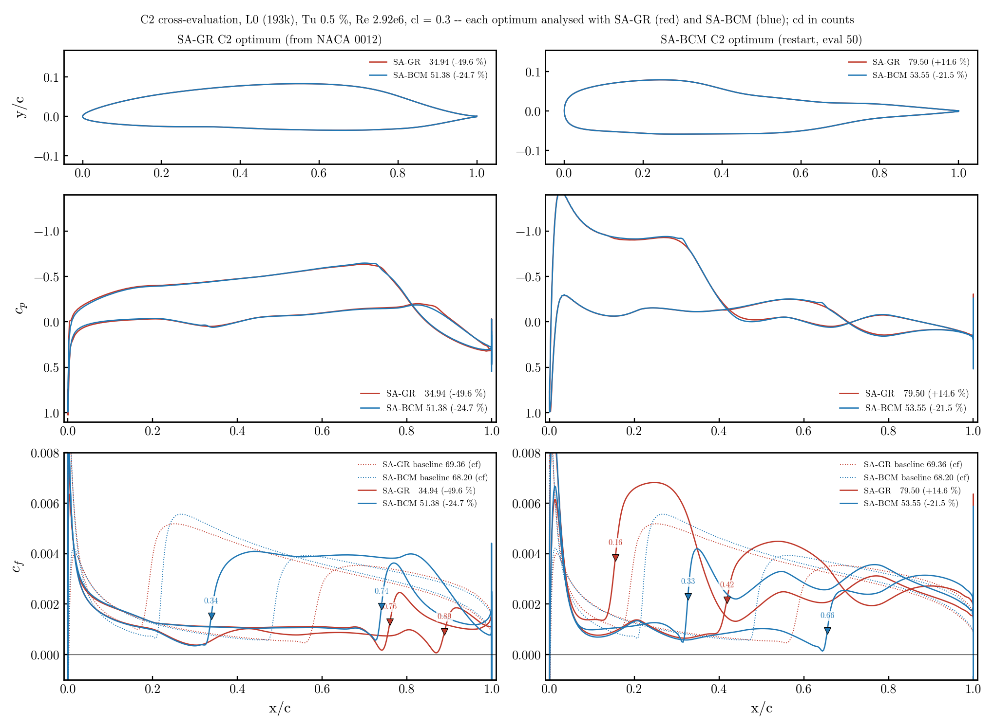
17. C2 cross-evaluated: GR optimum | BCM optimum
red = analysed with SA-GR, blue = with SA-BCM; dotted = baseline cf; ▼ = x_tr (steepest cf rise, same criterion for both models)
GR shape (left): same cp in both models; SA-BCM trips the lower surface at 0.34 c (cp dip, cf → 0) where GR stays laminar to 0.89 c → 51 vs 35 counts. BCM shape (right): full nose with suction peak; GR transitions in the recovery at 0.16 c (cf 0.007), BCM only at 0.33 c → 80 vs 54 counts.

Slide 19
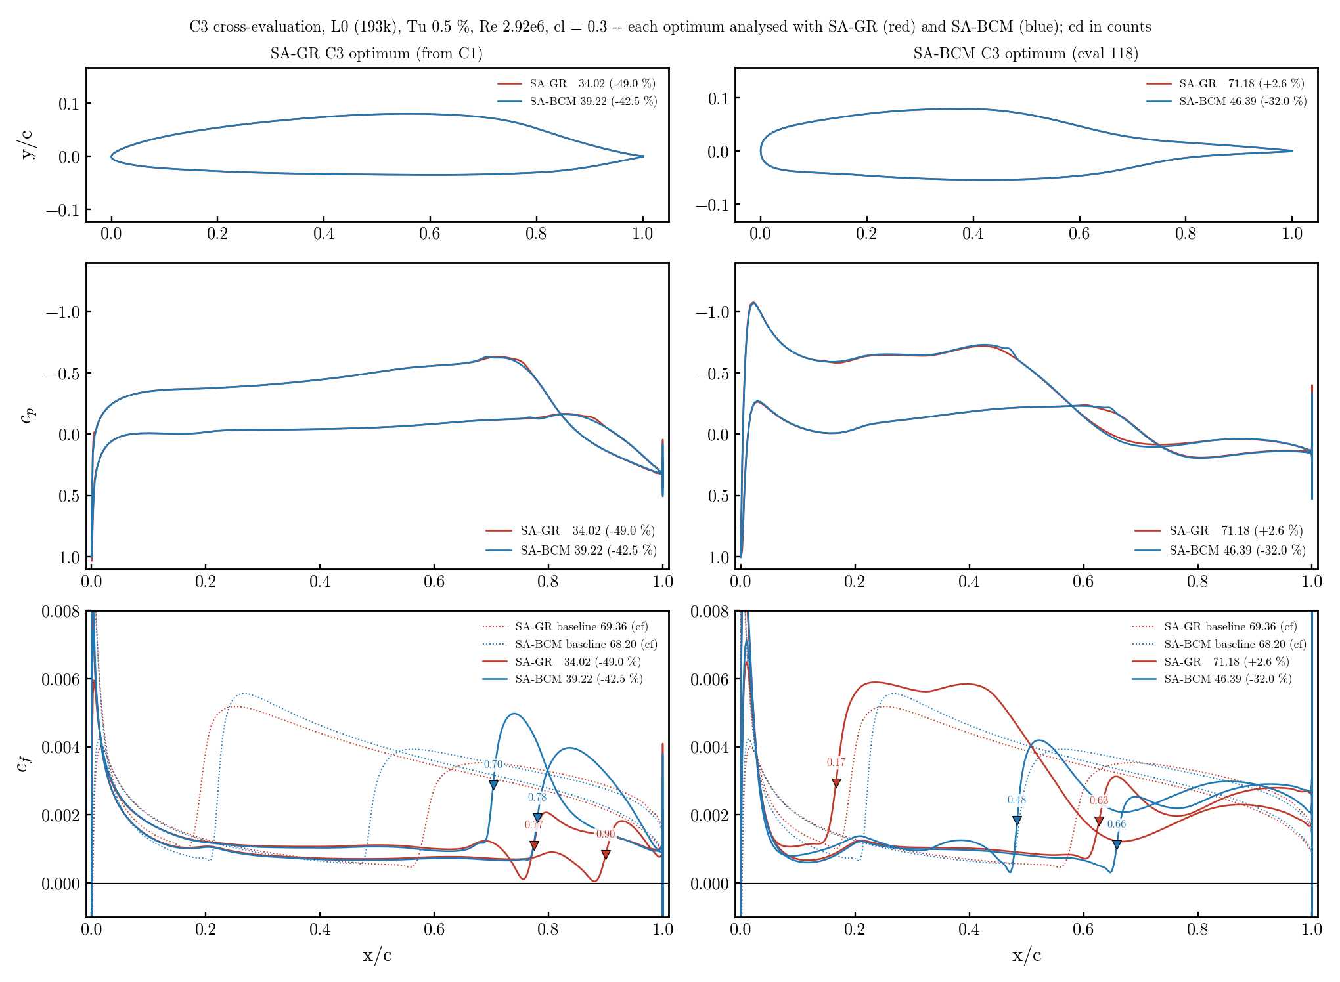
18. C3 cross-evaluated: GR optimum | BCM optimum
red = analysed with SA-GR, blue = with SA-BCM; dotted = baseline cf; ▼ = x_tr (steepest cf rise, same criterion for both models)
GR shape (left): no lower-surface dip → SA-BCM stays laminar to 0.70 / 0.78 c → 39 counts (−42 %). BCM shape (right): suction peak at 0.02 c followed by an adverse gradient to 0.2 c — tolerated by BCM (laminar to 0.48 c), not by GR (0.17 c) → 71 vs 46 counts.

Slide 20
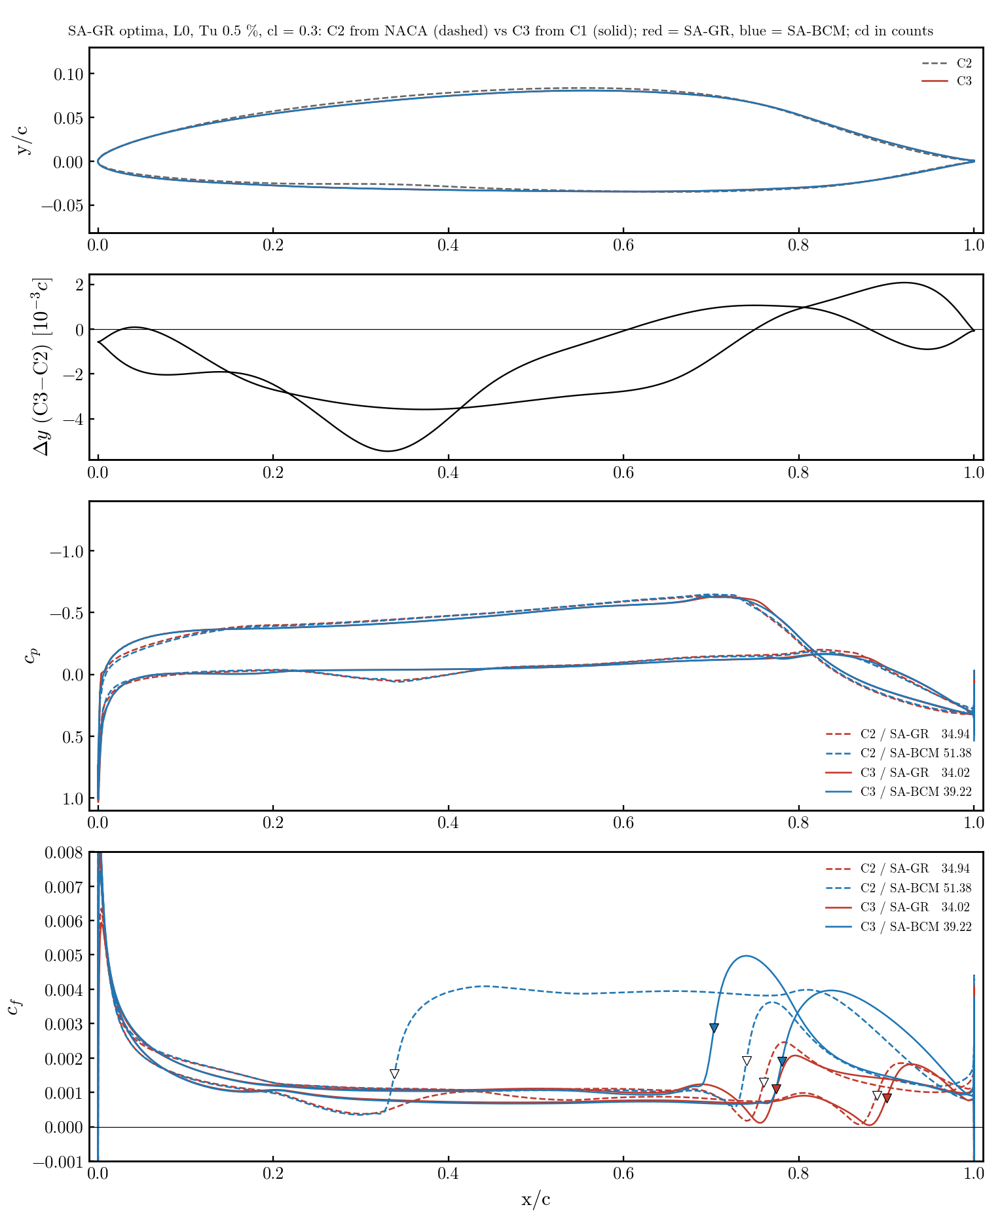
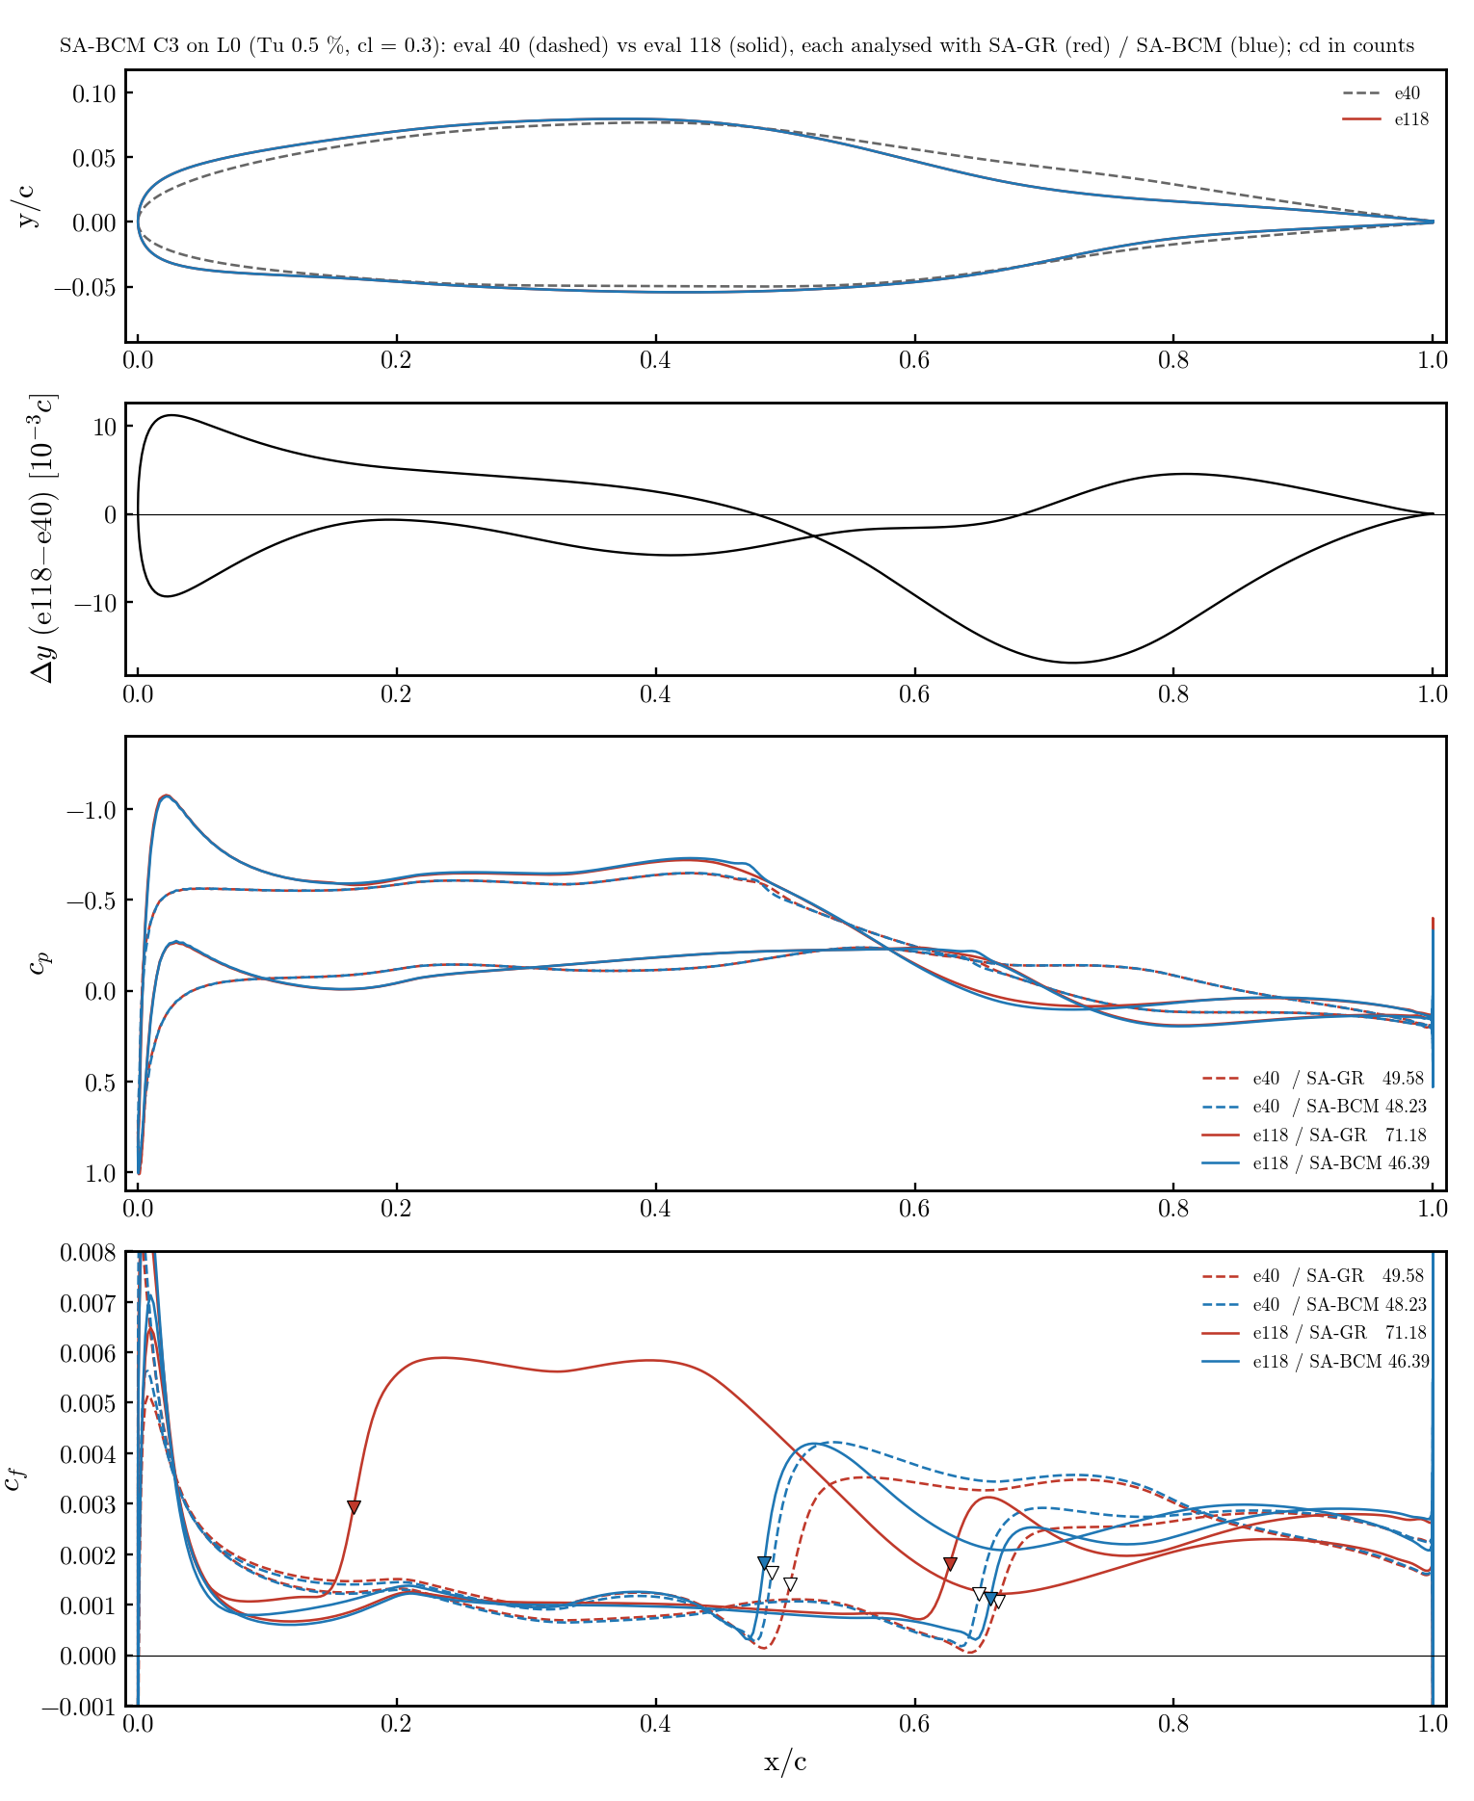
19. Robustness: GR C2 ≈ C3 · BCM C3 e40 → e118
left: GR C2 (from NACA) vs C3 (from C1) · right: BCM C3 eval 40 vs 118 · both models each · Δy = wall difference
GR: C2 and C3 differ by ≤ 0.005 c and give the same cp, cf, x_tr (0.76/0.89 vs 0.77/0.90) — a well-defined optimum, independent of start and FFD; the small difference (no lower-surface dip) is worth 12 counts in BCM (51 → 39). BCM: eval 40 → 118 gains 2 counts in its own model by adding a round nose with a suction peak; in GR that costs +22 counts (49.6 → 71.2).

Slide 21
20. Conclusion: the gain does not transfer in %
L0, Tu 0.5 %, cl 0.3 — what the 2×2 matrix says
• Primal agreement on ordinary geometries (NACA −1.7 %, C1 +7 %) → comparing the models is legitimate; what diverges is what each optimizer exploits.
• Each optimizer pushes the laminar boundary layer to the separation threshold (cf → 0) that ITS transition criterion tolerates. SA-GR (Reθt transport, sensitive to the λθ history) rejects suction peaks followed by an early adverse gradient; SA-BCM (algebraic, local) rejects mid-chord cp dips on the lower surface.
• SA-GR has one well-defined optimum (C2 ≈ C3, two starts, two FFDs). SA-BCM has several (branches, rank dependence, restart dependence) and its late increments are criterion gains, not shape gains.
• GR optimum seen by BCM: −49 % → −42 % (keeps most). BCM optimum seen by GR: −32 % → +2.6 % (loses everything). The best airfoil in SA-BCM is the SA-GR optimum (39.2 vs BCM's own 46.4).
• For the article: report each model's gain only next to this cross matrix; the GR optimum is the robust candidate. Open: BCM C3 still running (eval 118 = last feasible); like-for-like mesh check (2d_tu05_meshcmp) not run.
Details, incidents and replication: $R/08_optimization/2d_tu05_L0/cross_eval/PURPOSE.md (2026-09-16).

Slide 22
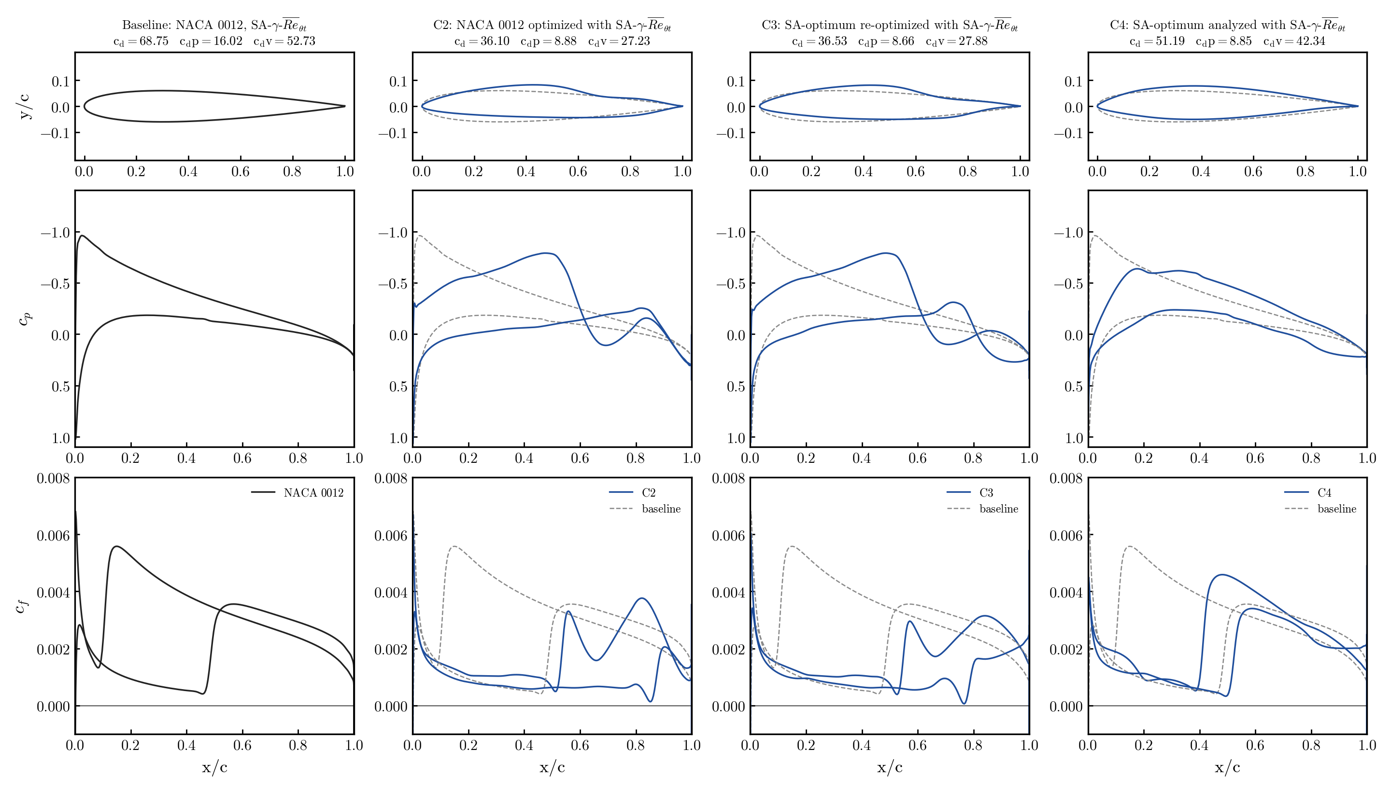
21. γ-R̅eθt full table, Tu = 0.0937 % (L1, Re 6e6)
Original GR campaign (2026-08-04), cl = 0.3, trimmed re-solves (except C3*); counts; Δ vs same-model baseline, C3 vs its start C4
Case | Geometry | Model | α | cd | cdp | cdv | Δcd % | Δcdp % | Δcdv %
— | NACA 0012 | SA | 2.579 | 88.75 | 20.39 | 68.36 | — | — | —
C1 | NACA opt. | SA | 0.710 | 85.66 | 16.93 | 68.73 | −3.5 | −17.0 | +0.5
— | NACA 0012 | GR | 2.616 | 68.75 | 16.02 | 52.73 | — | — | —
C2 | NACA opt. | GR | 2.170 | 36.10 | 8.88 | 27.23 | −47.5 | −44.6 | −48.4
C4 | C1 analysed | GR | 0.611 | 51.19 | 8.85 | 42.34 | −25.5 | −44.7 | −19.7
C3 | C1 re-opt.* | GR | — | 36.53 | 8.66 | 27.88 | −28.6 | −2.2 | −34.2
 | C3 vs base |  |  |  |  |  | −46.9 | −46.0 | −47.1
• Tu = 0.0937 % was calibrated at α = 0 on this mesh (set A of the α-sweep) — five times lower than the 0.5 % of slides 11–14; same FFD, bounds ±0.03, ladder with NK@1e-6 (which, as found on 2026-09-14, stalled at ~1e-6 abs in 96/99 solves of the C3 job — SLSQP ignored the flag).
• C4 shows the SA optimum is already a good transition shape for the wrong reason: −25.5 % almost entirely cdp; the γ-R̅eθt optimizer then only has cdv left (−34 %). Starting from NACA (C2) ends 1.2 % lower than from C1 (C3).
• * C3: best feasible point of job 1803832's log (cl 0.30004); its trim (job 1804386) was cancelled, α not recorded.
Data: $R/08_optimization/2d/{trim_*/trim.json, RESULTS.md, REPORT.md}; figure 2d/profiles/cp_cf_cases.png (make_cp_cf.py).

Slide 23
22. SA-BCM + pressure-gradient sensor (SABCM_PG)
why: the BCM threshold Re_θc(Tu) ignores the gradient GR penalises (slides 16–20) · branch sa-bcm-pg, machV4 2026-09-18
• Mechanism found on slides 17–18: same cp in both models, only the cf jump moves. The BCM optimizer parks laminar flow in adverse gradients (nose suction peak + recovery) that GR trips through Re_θt(Tu)·F(λ_θ).
• Model (handoff option E, kept algebraic and local): λ_θL = −7.57e-3 (d²/ν) nᵀ∇u n + off (Menter 2015), λ = smooth clip(gain·λ_θL, ±0.1), F = Langtry–Menter F(λ) in the Piotrowski–Zingg smooth form (Eqs. 54–57) → Re_θc ← Re_θc^BCM · F. Everything else (KS max, tanh/fsmooth 0.08) untouched; PG off = bit-identical.
• n = exact unit wall normal (foot point → cell centre) from the approximate wall-distance update, stored per cell (new block array nWall) and differentiated (new independent in both Tapenade heads); helpers smoothMinMax/bcmFlambda ported from the GR branch.
• Options: SABCM_PG (False), _coef 7.57e-3, _off 0.0128 (Menter), _gain 1, _lamMax 0.1, _p 300. Runs use the calibrated off = 0.01623 and gain = 2 (next slide). Volume CGNS: BCM_lambda, BCM_Flambda.
• Not adopted from the handoff: the Ψ/tanh(k, δ) intermittency (the sa-bcm smooth form already removes those kinks; one effect at a time) and Menter's own F_PG (too weak at low Tu).
Code: adflow_sabcm sa.F90 (saSource), blockette.F90 (mirror), wallDistance.F90 (nWall), turbUtils.F90 (helpers), Makefile_tapenade heads; docs/studies/22_bcm_pressure_gradient/PURPOSE.md.

Slide 24
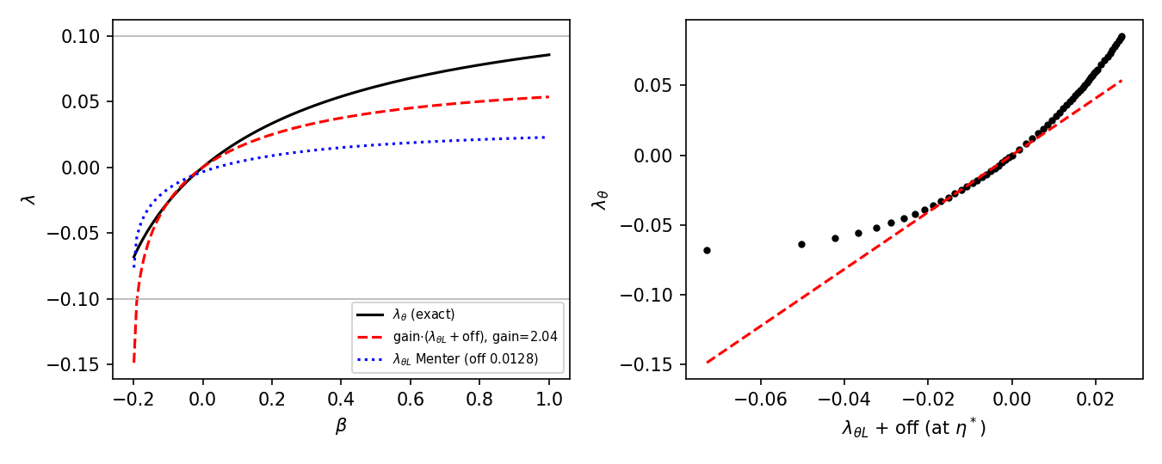
23. Calibration on Falkner–Skan profiles (no CFD)
for each β: exact λ_θ = θ²U'/ν vs the local sensor λ_θL evaluated at η* = argmax(η² f'') — where Term1 fires
• Blasius at η*: λ_θL = −0.0162. Menter's offset 0.0128 leaves −0.0034 → F ≈ 0.96 on a flat plate (not neutral). Calibrated offset 0.01623 → neutral (the effective max over the layer changes it by < 1 %).
• Linear map λ_θ ≈ gain·(λ_θL + off): LS over |λ_θ| ≤ 0.1 gives gain 2.0 (adverse-only 1.4, favourable 3.0) — exact for |λ| ≲ 0.03 (suction-peak regime), over-predicts near separation (clipped at −0.1 anyway).
• Gains 1, 2, 3 swept on the cross set (slide 25); 2 kept.
docs/studies/22_bcm_pressure_gradient/falkner_skan_gain.py, falkner_skan_effective.py.

Slide 25
24. Verification of the differentiated model
reg suite (tutorial wing, 2 ranks) + NACA0012 L2 adjoint vs complex step · three sensors tried, one kept
check | PG off (smooth, hard) | sensor 1 (Menter λθL) | sensor 2 (wall dp/ds, kept)
fwd/rev/fast AD vs references | pass (AD unchanged) | pass | pass
forward AD vs complex step | pass | pass | pass
fwd ↔ rev dot products, _b vs _fast_b | pass | pass (after in-place fix) | pass
adjoint vs CS, NACA L2, max |Δ| cl / cd | 0.008 % / 0.26 % | 187 % / 181 % — primal not smooth (FD: sign flips with step) | 0.000 % / 0.004 % (α), 0.001 % (DV12), 0.4 % (DV8, cd ≈ 1e-4) at the same state
independent code audit (3 lenses + refutation) | — | — | signs, stencil, Bernoulli, non-dim, mirror: correct; 3 fixes applied
• Bugs found and fixed on the way: in-place Re_θc·F broke the fast-reverse state Jacobian (no push/pop stack); Tapenade head had the reference-state scalars as input-only (seeds zeroed at entry); F(0) = 0.9986 at p = 300 (smoothMax/Min bias) → exact tanh blend; ŝ = local velocity flips sign in bubbles → wall tangent oriented by the free stream.
• The 10–35 % adjoint-vs-CS 'gap' of sensor 2 was the two sides sitting on different steady states of the multi-state BCM primal (ANK/NK vs DADI path); formed at the same state they agree to 0.004 %.
• Sensor 3 (θ = Re_θc ν/U_e, the reference's own definition) is not smooth near stagnation (λ ∝ 1/U_e²): adjoint vs CS 46–105 %, trips both surfaces at 0.1 c — dropped.
Jobs: 1935762/1936305/1936446 (reg suite), 1935763/1935808 (sensor 1 CS + FD), 1936308/1936311/1936444 (loop it0–it2); adflow_sabcm docs/studies/22_bcm_pressure_gradient/PURPOSE.md §3e, §5.1.

Slide 26
25. Cross-evaluation with the sensor on (L0, Tu 0.5 %)
BCM-PG vs GR, cl 0.3 · trims as slide 16 · sensor 1 (Menter, gain 1/2) and sensor 2 (wall dp/ds, K Blasius) · counts
Shape | SA-GR (target) | SA-BCM | Δ vs GR | sensor 1 g=1.0 | Δ vs GR | sensor 1 g=2.0 | Δ vs GR | sensor 2 (kept) | Δ vs GR
NACA 0012 | 69.36 | 68.20 | -1.7 % | 71.24 | +2.7 % | 73.28 | +5.7 % | — | —
C2 GR | 34.94 | 51.38 | +47.1 % | 52.09 | +49.1 % | 52.49 | +50.2 % | 52.12 | +49.2 %
C3 GR | 34.02 | 39.22 | +15.3 % | 33.63* | -1.2 % | 32.50 | -4.5 % | — | —
C2 BCM (restart e50) | 79.50 | 53.55 | -32.6 % | 70.63 | -11.2 % | 83.59* | +5.1 % | 83.82 | +5.4 %
C3 BCM (e118) | 71.18 | 46.39 | -34.8 % | 69.10 | -2.9 % | 74.07* | +4.1 % | 88.44 | +24.2 %
• Sensor 1 g=1 gets closest to GR's numbers (mean |Δcd| 26 % → 13 %) — by under-reading adverse gradients ~2× (Falkner–Skan map) — and is not differentiable; sensor 2 reads the LM edge λ_θ exactly (checked against the GR's own transported R̅eθt outside the layer: 950/560/966/667 vs 880·F = 970/537/970/560) and over-trips.
• What every variant achieves: the ranking becomes the GR one (GR C3 < GR C2 < NACA < BCM optima) — an optimiser driven by BCM-PG no longer exploits the nose suction-peak loophole; the BCM optimum that GR rejects (+14.6 %) is rejected by BCM-PG (+5…+7 %).
• What none can: GR C2 (+50 %) and the absolute levels — GR's onset fires at Re_S ≈ 2.46·R̅eθt (transported, lagged near the wall) vs the BCM's Re_v ≈ 2.19·Re_θc·F: with F = 0.61 in the short adverse zone at x = 0.06–0.10 the BCM-PG trips at 0.12 c, GR at 0.42 c. That gap is the base onset criterion, not the gradient sensitivity.
Data: jobs 1934907/08 (sensor 1), 1936444 (sensor 2, pg_loop/it2_s2_sdir2); $R/08_optimization/2d_tu05_L0/{cross_eval_pg,pg_loop}; study 22 PURPOSE.md §3d.

Slide 27
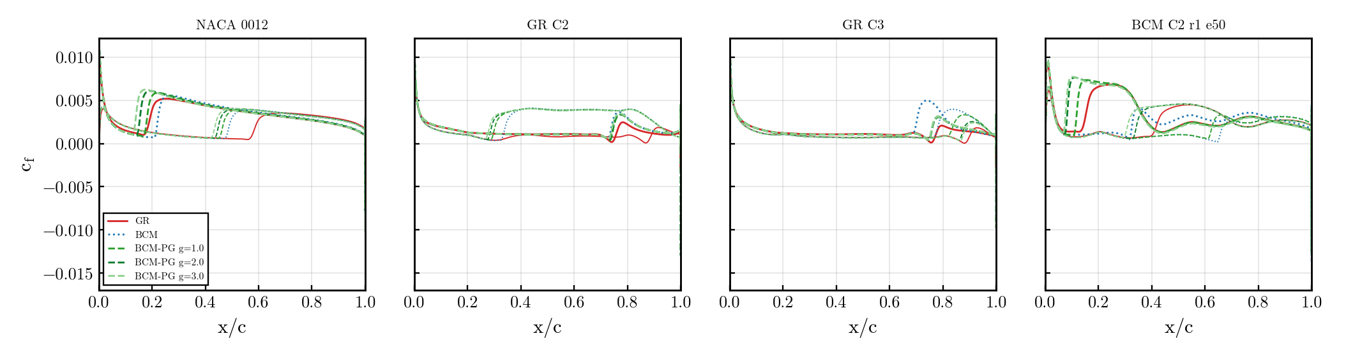
26. cf along the chord with the sensor on
GR red · BCM blue dotted · BCM-PG green per gain · upper thick, lower thin · C3 GR and the BCM optimum move toward GR
cross_eval_pg/make_cross_pg.py → cross_pg_cf.png (surfaces from the trims).

Slide 28
27. Direct predictions with the sensor, and the decision
NLF0416 L1 (Tu 0.15 %) / S809 L1 (Tu 0.07 %), 3 α each, 11 ranks, rNK · counts · x_tr upper/lower
case | SA-BCM (no sensor) | SA-BCM + sensor 2 | SA-γ-R̅eθt | experiment x_tr,up
NLF0416 α2 | 58.2 · 0.38/0.60 | 65.1 · 0.31/0.60 | 57.0 · 0.38/0.60 | —
NLF0416 α4 | 65.5 · 0.33/0.61 | 79.4 · 0.21/0.60 | 64.4 · 0.34/0.61 | ≈ 0.34
NLF0416 α6 | 85.6 · 0.21/0.61 | 102.3 · 0.11/0.61 (not conv.) | 79.3 · 0.25/0.61 | —
S809 α4 | 47.6 (not conv.) | 48.7 (not conv.) | 67.5 | —
S809 α6 | 75.0 · 0.49/0.49 | 74.6 · 0.50/0.49 | 69.8 · 0.50/0.50 | —
S809 α8 | 149.1 · 0.96/0.50 | 149.9 · 0.96/0.49 | 131.8 | —
• S809 (transition by laminar separation): the sensor is neutral — as it should be. NLF0416 (attached transition in a mild adverse gradient): the local F(λ) trips the upper surface too early (α4: 0.21 vs 0.34 GR/experiment, cd +21 %); plain SA-BCM already matched experiment there.
• Same mechanism as slide 25: the local LM correlation applies F ≈ 0.8 where the reference's lagged near-wall R̅eθt and higher onset level do not. Sensor 1 (Menter, gain 2) behaved the same on this polar (0.19 at α4) and limit-cycled in ANK at NLF α6 / S809 α4–6 (no recipe helped: p, gain, CFL cap, early NK, ν̃∞ 1e-8/1e-10, restart from the converged PG-off state).
• Verdict on the direct-prediction criterion: the local sensor is NOT a net improvement — it fixes the ranking of optimised shapes at Tu 0.5 % but degrades the NLF polar. It stays in the code as an option (SABCM_PG, sensor 2 default) with a verified adjoint; closing the gap to GR for real would mean adopting GR's onset/transport, i.e. using GR.
• Decision (2026-09-19): line closed — "worse, and no significant improvement". The C2/C3 BCM-PG optimisation was cancelled at SLSQP major 1. Recommendation: optimise with SA-γ-R̅eθt (the robust model, slide 20), keep SA-BCM for cheap primal evaluation, leave SABCM_PG off. Kept from the work: exact wall-normal array + adjoint plumbing, two Tapenade traps documented, the one-state rule for adjoint-vs-CS checks on this multi-state primal.
Data: 15_sabcm_polars/{results/*_ref11,*_pg,*_pgs2, plot_polars_pg.py}, jobs 1934910/11, 1935125, 1935764, 1935776, 1936549; study 22 PURPOSE.md §5.3, §5.3b.

