Slide 1
SA-BCM 2D optimisation — reruns for the article and the branch problem
Status deck, 2026-09-14 · Deucalion SA_BCM_ARTICLE/2d_opt · repo docs/studies/21_c2_branch_campaign
• Question: C2 (NACA0012 → SA-BCM, cl = 0.3, Tu = 0.5 %) gave −18 % with the buggy code, −4…−6 % with the corrected one; C3 gives −24 %.
• Constraint set by the user: keep the C2 definition (NACA start, SA-BCM only, article constraints, fs ≤ 0.15); only the optimizer/solver strategy may change.
• All SA-BCM numbers here: cold start (fresh process, 16 ranks), trimmed to cl = 0.3, ev = 1e-7, fs = 0.08. SA numbers: run2d, 32 ranks.
• Contents: diagnosis (why the optimizer stalls) → every strategy tried → results per Tu → the branch mechanism → proposals.

Slide 2
1. The baseline itself is not unique
NACA0012, cl = 0.3, Tu = 0.5 %, same code, same mesh
Solver path | cd | note
cold, 16 or 32 ranks | 0.006149 | bit-for-bit reproducible at fixed rank count
cold, 48 ranks | 0.006202 | +0.9 %
cold, 64 ranks (opt_c2) | 0.006456 | +5 %
trim recipe (ANK CFL 3e5) | 0.008061 | +31 %
ev = 1e-10 | 0.005197 | −15 % (different farfield BC)
article C2 geometry, today's code | 0.0064 | worse than the NACA — the old −18 % came from the bug
The partition/pseudo-transient path selects the converged state. Deterministic for a fixed rank count.

Slide 3
2. Line test NACA → C3 in FFD space: no barrier, but discrete jumps
11 points + fine scan t = 0.80–1.00; adjoint directional derivative at every point
t | cd (fs 0.08) | cd (fs 0.15) | adjoint dcd/dt | x_tr upper
0.0 (NACA) | 0.006309 | 0.006309 | −2.1e-4 | 0.317
0.5 | 0.005765 | 0.005766 | −1.5e-4 | 0.352
0.80–0.87 | 0.005638 → 0.005634 (ramp −6.7e-5/unit) | same | −7.3e-5 … −6.1e-5 ✔ | 0.369
0.88–0.96 | 0.005733 / 0.005631 alternating | same | −4e-5 | 0.352 / 0.369
0.97–1.00 (C3) | 0.004703 → 0.004695 | 0.004977 | −2.3e-4 | 0.550
• Within a plateau the adjoint is exact (measured slope = adjoint). The drop is carried by branch switches: ±1.8 % (transition moving one cell) and −16 % (x_tr 0.37 → 0.55).
• fs = 0.15 gives identical plateaus and jumps (and +5.8 % on the good branch) → smoothing is not the lever.

Slide 4
3. Hysteresis chains and Tu-ramp probe: several steady states per geometry
t | cold | warm from NACA (fwd) | warm from C3 (bwd) | Tu₀ = 0.1 % → 0.5 % | Tu₀ = 3 % → 0.5 %
0.0 | 0.006149 | 0.006149 | 0.006255 | 0.006248 | 0.009386
0.5 | 0.005765 | 0.006069 | 0.005963 | 0.005863 | 0.009387
0.8 | 0.005639 | 0.006047 | 0.005639 | 0.005738 | 0.009446
0.96 | 0.005630 | 0.006045 | 0.005244 | 0.005244 | 0.009459
1.0 (C3) | 0.004695 | 0.006045 | 0.004643 | 0.004643 | 0.009464
• Warm from the NACA carries the tripped branch all the way to the C3 shape (0.00605 instead of 0.00464) — a classic warm-started optimization can never see the C3 gain.
• Starting turbulent (Tu₀ = 3 %) → fully turbulent state (0.0094 ≈ SA) is stable at Tu = 0.5 % for every geometry: a spurious self-sustained mode.
• The good branch (x_tr 0.55) is a narrow basin around C3 (collapses within Δt = 0.04).

Slide 5
4. The three stable modes and why the gradient cannot see the gain
• Mode 1 — turbulent from the leading edge (cd 0.0094): the ν_t/ν term keeps γ = 1, which keeps ν_t high. Self-sustained; only reached by starting turbulent. Spurious.
• Mode 2 — transition mid-chord (0.32–0.37 c) in pairs of neighbouring cells: γ switches where Re_v crosses the Tu threshold; on a flat pressure region Re_v grows slowly, so the crossing is ill-conditioned; transition at cell i changes the downstream boundary layer and the pressure, which moves the crossing — two adjacent cells are both self-consistent (±1.8 % cd). Discrete because of the mesh; fsmooth does not remove it.
• Mode 3 — long laminar run (x_tr 0.55 c): only for shapes with a pressure plateau (C3 family). Narrow basin.
• SLSQP: the adjoint measures the slope inside a step (correct, tiny); the line search samples 1–5 points on one line with shrinking steps; a +1.8 % landing at every trial ⇒ 'converged'. The accepted point can also switch branch (objective drifts up).
• A denser mesh makes the steps smaller (more, lower equilibria); the ill-conditioning of the crossing on a flat pressure plateau remains.

Slide 6
5. Optimizer strategies tried (NACA0012 start, Tu = 0.5 %, fs 0.08)
best cd cold-verified; Δ vs baseline 0.006149; C4 = −11.4 %, C3 = −24.5 %
Strategy | Idea | cd | Δ | Verdict
SLSQP as in the article (scale 10) | — | 0.00617 / 0.00583 (fs 0.04) | −4.4 / −5.2 % | stalls on branch noise
B1/B1′ warm start + guard | continuity | 0.00756 / 0.00631 | +17 / +2.6 % | hysteresis poisons the base point
B cold, DV scale 2 | smaller steps | 0.00571 (not reproducible) | −7 % then drifts | —
B4 / B5 cold + warm-from-best; laminar-first | branch selection | 0.00591 / 0.00590 | −4 % | false minima
B6 branch envelope (cold | lam | best) + SLSQP restarts | lower envelope, clean BFGS | 0.005571 | −9.4 % | first method that keeps its gains
B7/B9 Tu continuation from below (0.1 → 0.5) | laminar shapes first | 0.0059–0.0061 | −2…−5 % | low-Tu shapes lose laminarity at 0.5 %
B10 Tu continuation from above (1.0/0.75 → 0.5) | plateau shapes first | 0.0062–0.0069 | worse than NACA | BCM stalls at any Tu
B11 SLSQP restarted from best ±0.01 probe point | probe + descend | 0.005484 | −10.8 % | adjoint result, V/V0 0.994
Cold pattern search (derivative-free), 7 rounds | compare cold values, no gradient | 0.005237 / 0.005052 / 0.005035 | −14.8 / −17.8 / −18.1 % | V/V0 0.9997 / 0.988 / 0.973 — NOT adjoint

Slide 7
6. Article-style tables per free-stream Tu (cold, cl = 0.3)
ΔCd vs the SA-BCM baseline at the same Tu; C1 (SA) = −3.0 % vs the SA baseline at any Tu
Tu | Baseline SA-BCM cd | C2 cd (Δ) | C3 cd (Δ) | C4 cd (Δ) | x_tr C2 up / lo
0.5 % (article) | 6.15e-3 | 5.48e-3 (−10.8 %) adjoint · 5.05e-3 (−17.8 %) derivative-free | 4.64e-3 (−24.5 %) | 5.45e-3 (−11.4 %) | 0.352 / 0.658 · 0.420 / 0.713
0.25 % | 5.12e-3 | 4.04e-3 (−21.1 %) adjoint | 4.10e-3 (−19.9 %) | 4.59e-3 (−10.4 %) | 0.485 / 0.971
0.1 % | 4.30e-3 | 3.49e-3 (−18.9 %) adjoint | 3.84e-3 (−10.7 %) | 4.25e-3 (−1.3 %) | 0.634 / 0.982
• Tu = 0.25 %: the laminar basin is wide enough for the gradient; C2 reaches the C3 level with a clear aft movement of transition (upper +0.08 c, lower +0.16 c; small laminar separation bubble near the TE on the lower surface at x/c ≈ 0.94).
• Tu = 0.1 %: the baseline is already very laminar (x_tr 0.52/0.92); C4 ≈ baseline, the 'SA misleads' message weakens.
• Tu = 0.5 %: with adjoint only, C2 (−10.8 %) is slightly below C4 (−11.4 %); ≥ −12 % needs the derivative-free stage. Full tables (Cd/Cdv/Cdp, %Cdv/%Cdp, x_tr): tables_by_tu.md.

Slide 8
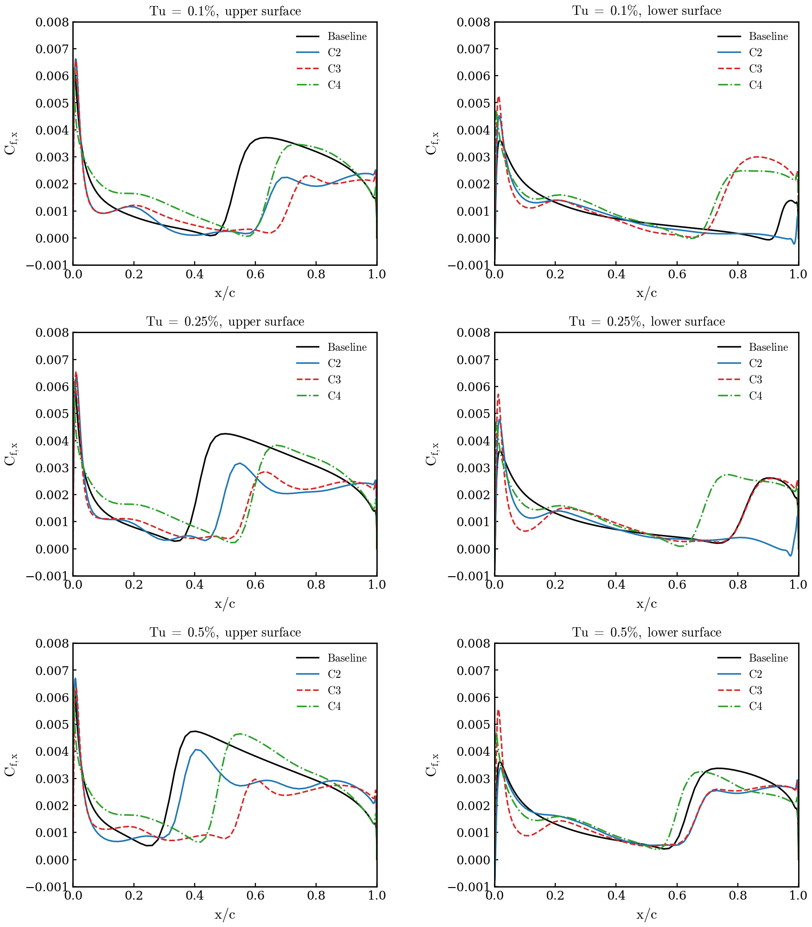
7. Skin friction, upper / lower surface, Tu = 0.1 / 0.25 / 0.5 %
Baseline, C2 (adjoint result at 0.5 %), C3, C4 — cold, cl = 0.3

Slide 9
8. What is reportable as C2 at Tu = 0.5 %
Option | C2 | Method | How to describe it
1 | −10.8 % (x_tr 0.35 / 0.66, V/V0 0.994) | SLSQP + adjoint, branch-envelope evaluation + restarts | gradient-based with a branch-consistent evaluation — clean
2 | −4…−5 % | SLSQP + adjoint exactly as in the article | the original setup; shows the fragility
3 | ≈ −17 % (B12 running: SLSQP + adjoint restarted from the pattern-search points) | hybrid | must state an explicit derivative-free exploration stage
4 | −21 % at Tu = 0.25 % | SLSQP + adjoint (same evaluation) | 100 % adjoint; changes the article's Tu
• Every optimum must be re-evaluated cold in a fresh process before it is quoted: values living on warm branches are not reproducible (this cost the HOP/B11 'gains').
• The pattern search (108 cold solves per round) is cheap only because the case is 2D (16 k cells) — in 3D the adjoint is the only option, and the adjoint itself is verified exact within each branch.

Slide 10
9. Proposals to remove the branch problem (ranked)
• 1. Chordwise mesh refinement in the transition zone (0.25–0.65 c): the one-cell step ±1.8 % → ±0.5 % or less; SLSQP stops mistaking a step for a minimum. Most defensible in a paper ('grid-induced multiple equilibria'). Cost: new mesh + redo the 2D cases (~half a day). Untested.
• 2. Branch-averaged objective: solve each design twice (cold and laminar-first), use the mean of cd and of the two adjoints → the staircase becomes a ramp consistent with the gradient. Still pure adjoint; ~1 h to implement in the envelope script; 2×2 solves per evaluation. Untested.
• 3. Adjoint direction + sampled line search: keep the (good) gradient direction, replace SLSQP's line search by 6–8 cold evaluations along it. ~8 solves/iteration; custom loop, half a day.
• 4. Report at Tu = 0.25 % (−21 %): zero work, changes the article's condition.
• 5. Fixed cold protocol (done): reproducibility, not the optimizer.
• Outside the user's rules: soften the ν_t/ν feedback term of BCM (the source of the hysteresis) — a physics decision.
Recommendation: 1 for the article; 2 to test now with the existing scripts. Nothing launched without approval.

