Slide 1
SA-BCM 2D optimisation — reruns for the article and the branch problem
Status deck, 2026-09-14, updated 2026-09-15 (dense-mesh check) · Deucalion SA_BCM_ARTICLE/2d_opt · repo docs/studies/21_c2_branch_campaign
• Question: C2 (NACA0012 → SA-BCM, cl = 0.3, Tu = 0.5 %) gave −18 % with the buggy code, −4…−6 % with the corrected one; C3 gives −24 %.
• Constraint set by the user: keep the C2 definition (NACA start, SA-BCM only, article constraints, fs ≤ 0.15); only the optimizer/solver strategy may change.
• All SA-BCM numbers here: cold start (fresh process, 16 ranks), trimmed to cl = 0.3, ev = 1e-7, fs = 0.08. SA numbers: run2d, 32 ranks.
• Contents: diagnosis (why the optimizer stalls) → every strategy tried → results per Tu → the branch mechanism → proposals.

Slide 2
1. The baseline itself is not unique
NACA0012, cl = 0.3, Tu = 0.5 %, same code, same mesh
Solver path | cd | note
cold, 16 or 32 ranks | 0.006149 | bit-for-bit reproducible at fixed rank count
cold, 48 ranks | 0.006202 | +0.9 %
cold, 64 ranks (opt_c2) | 0.006456 | +5 %
trim recipe (ANK CFL 3e5) | 0.008061 | +31 %
ev = 1e-10 | 0.005197 | −15 % (different farfield BC)
article C2 geometry, today's code | 0.0064 | worse than the NACA — the old −18 % came from the bug
The partition/pseudo-transient path selects the converged state. Deterministic for a fixed rank count.

Slide 3
2. Line test NACA → C3 in FFD space: no barrier, but discrete jumps
11 points + fine scan t = 0.80–1.00; adjoint directional derivative at every point
t | cd (fs 0.08) | cd (fs 0.15) | adjoint dcd/dt | x_tr upper
0.0 (NACA) | 0.006309 | 0.006309 | −2.1e-4 | 0.317
0.5 | 0.005765 | 0.005766 | −1.5e-4 | 0.352
0.80–0.87 | 0.005638 → 0.005634 (ramp −6.7e-5/unit) | same | −7.3e-5 … −6.1e-5 ✔ | 0.369
0.88–0.96 | 0.005733 / 0.005631 alternating | same | −4e-5 | 0.352 / 0.369
0.97–1.00 (C3) | 0.004703 → 0.004695 | 0.004977 | −2.3e-4 | 0.550
• Within a plateau the adjoint is exact (measured slope = adjoint). The drop is carried by branch switches: ±1.8 % (transition moving one cell) and −16 % (x_tr 0.37 → 0.55).
• fs = 0.15 gives identical plateaus and jumps (and +5.8 % on the good branch) → smoothing is not the lever.

Slide 4
3. Hysteresis chains and Tu-ramp probe: several steady states per geometry
t | cold | warm from NACA (fwd) | warm from C3 (bwd) | Tu₀ = 0.1 % → 0.5 % | Tu₀ = 3 % → 0.5 %
0.0 | 0.006149 | 0.006149 | 0.006255 | 0.006248 | 0.009386
0.5 | 0.005765 | 0.006069 | 0.005963 | 0.005863 | 0.009387
0.8 | 0.005639 | 0.006047 | 0.005639 | 0.005738 | 0.009446
0.96 | 0.005630 | 0.006045 | 0.005244 | 0.005244 | 0.009459
1.0 (C3) | 0.004695 | 0.006045 | 0.004643 | 0.004643 | 0.009464
• Warm from the NACA carries the tripped branch all the way to the C3 shape (0.00605 instead of 0.00464) — a classic warm-started optimization can never see the C3 gain.
• Starting turbulent (Tu₀ = 3 %) → fully turbulent state (0.0094 ≈ SA) is stable at Tu = 0.5 % for every geometry: a spurious self-sustained mode.
• The good branch (x_tr 0.55) is a narrow basin around C3 (collapses within Δt = 0.04).

Slide 5
4. The three stable modes and why the gradient cannot see the gain
• Mode 1 — turbulent from the leading edge (cd 0.0094): the ν_t/ν term keeps γ = 1, which keeps ν_t high. Self-sustained; only reached by starting turbulent. Spurious.
• Mode 2 — transition mid-chord (0.32–0.37 c) in pairs of neighbouring cells: γ switches where Re_v crosses the Tu threshold; on a flat pressure region Re_v grows slowly, so the crossing is ill-conditioned; transition at cell i changes the downstream boundary layer and the pressure, which moves the crossing — two adjacent cells are both self-consistent (±1.8 % cd). Discrete because of the mesh; fsmooth does not remove it.
• Mode 3 — long laminar run (x_tr 0.55 c): only for shapes with a pressure plateau (C3 family). Narrow basin.
• SLSQP: the adjoint measures the slope inside a step (correct, tiny); the line search samples 1–5 points on one line with shrinking steps; a +1.8 % landing at every trial ⇒ 'converged'. The accepted point can also switch branch (objective drifts up).
• A denser mesh makes the steps smaller (more, lower equilibria); the ill-conditioning of the crossing on a flat pressure plateau remains.

Slide 6
5. Optimizer strategies tried (NACA0012 start, Tu = 0.5 %, fs 0.08)
best cd cold-verified; Δ vs baseline 0.006149; C4 = −11.4 %, C3 = −24.5 %
Strategy | Idea | cd | Δ | Verdict
SLSQP as in the article (scale 10) | — | 0.00617 / 0.00583 (fs 0.04) | −4.4 / −5.2 % | stalls on branch noise
B1/B1′ warm start + guard | continuity | 0.00756 / 0.00631 | +17 / +2.6 % | hysteresis poisons the base point
B cold, DV scale 2 | smaller steps | 0.00571 (not reproducible) | −7 % then drifts | —
B4 / B5 cold + warm-from-best; laminar-first | branch selection | 0.00591 / 0.00590 | −4 % | false minima
B6 branch envelope (cold | lam | best) + SLSQP restarts | lower envelope, clean BFGS | 0.005571 | −9.4 % | first method that keeps its gains
B7/B9 Tu continuation from below (0.1 → 0.5) | laminar shapes first | 0.0059–0.0061 | −2…−5 % | low-Tu shapes lose laminarity at 0.5 %
B10 Tu continuation from above (1.0/0.75 → 0.5) | plateau shapes first | 0.0062–0.0069 | worse than NACA | BCM stalls at any Tu
B11 SLSQP restarted from best ±0.01 probe point | probe + descend | 0.005484 | −10.8 % | adjoint result, V/V0 0.994
Cold pattern search (derivative-free), 7 rounds | compare cold values, no gradient | 0.005237 / 0.005052 / 0.005035 | −14.8 / −17.8 / −18.1 % | V/V0 0.9997 / 0.988 / 0.973 — NOT adjoint

Slide 7
6. Article-style tables per free-stream Tu (cold, cl = 0.3)
ΔCd vs the SA-BCM baseline at the same Tu; C1 (SA) = −3.0 % vs the SA baseline at any Tu
Tu | Baseline SA-BCM cd | C2 cd (Δ) | C3 cd (Δ) | C4 cd (Δ) | x_tr C2 up / lo
0.5 % (article) | 6.15e-3 | 5.48e-3 (−10.8 %) adjoint · 5.05e-3 (−17.8 %) derivative-free | 4.64e-3 (−24.5 %) | 5.45e-3 (−11.4 %) | 0.352 / 0.658 · 0.420 / 0.713
0.25 % | 5.12e-3 | 4.04e-3 (−21.1 %) adjoint | 4.10e-3 (−19.9 %) | 4.59e-3 (−10.4 %) | 0.485 / 0.971
0.1 % | 4.30e-3 | 3.49e-3 (−18.9 %) adjoint | 3.84e-3 (−10.7 %) | 4.25e-3 (−1.3 %) | 0.634 / 0.982
• Tu = 0.25 %: the laminar basin is wide enough for the gradient; C2 reaches the C3 level with a clear aft movement of transition (upper +0.08 c, lower +0.16 c; small laminar separation bubble near the TE on the lower surface at x/c ≈ 0.94).
• Tu = 0.1 %: the baseline is already very laminar (x_tr 0.52/0.92); C4 ≈ baseline, the 'SA misleads' message weakens.
• Tu = 0.5 %: with adjoint only, C2 (−10.8 %) is slightly below C4 (−11.4 %); ≥ −12 % needs the derivative-free stage. Full tables (Cd/Cdv/Cdp, %Cdv/%Cdp, x_tr): tables_by_tu.md.

Slide 8
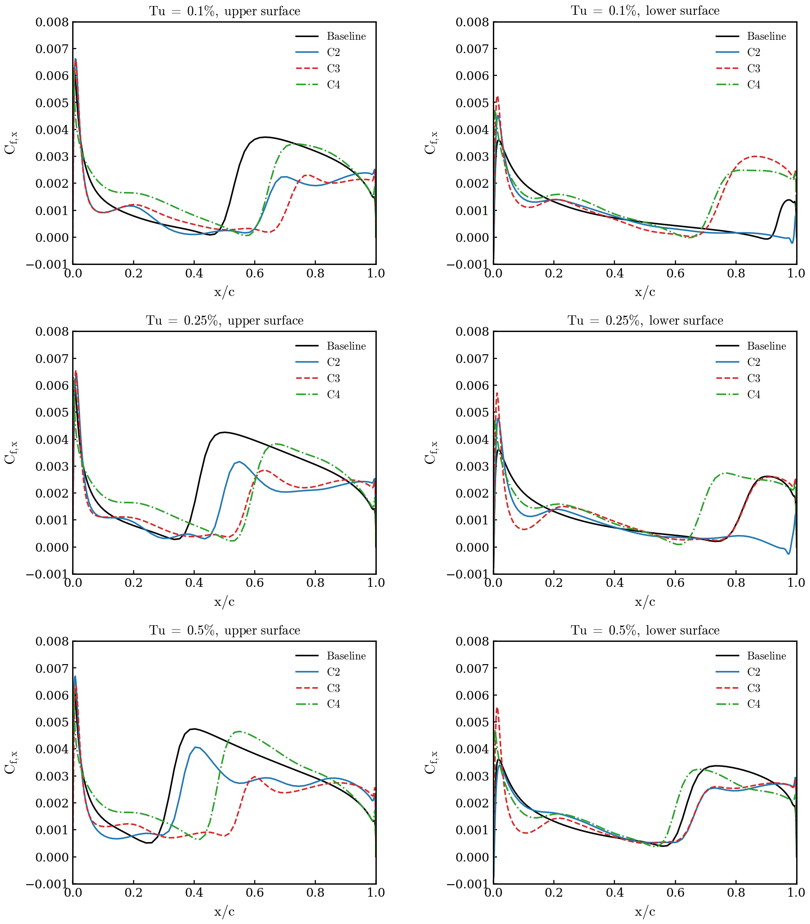
7. Skin friction, upper / lower surface, Tu = 0.1 / 0.25 / 0.5 %
Baseline, C2 (adjoint result at 0.5 %), C3, C4 — cold, cl = 0.3

Slide 9
8. What is reportable as C2 at Tu = 0.5 %
Option | C2 | Method | How to describe it
1 | −10.8 % (x_tr 0.35 / 0.66, V/V0 0.994) | SLSQP + adjoint, branch-envelope evaluation + restarts | gradient-based with a branch-consistent evaluation — clean
2 | −4…−5 % | SLSQP + adjoint exactly as in the article | the original setup; shows the fragility
3 | ≈ −17 % (B12 running: SLSQP + adjoint restarted from the pattern-search points) | hybrid | must state an explicit derivative-free exploration stage
4 | −21 % at Tu = 0.25 % | SLSQP + adjoint (same evaluation) | 100 % adjoint; changes the article's Tu
• Every optimum must be re-evaluated cold in a fresh process before it is quoted: values living on warm branches are not reproducible (this cost the HOP/B11 'gains').
• The pattern search (108 cold solves per round) is cheap only because the case is 2D (16 k cells) — in 3D the adjoint is the only option, and the adjoint itself is verified exact within each branch.

Slide 10
9. Proposals to remove the branch problem (ranked)
• 1. Chordwise mesh refinement in the transition zone (0.25–0.65 c): the one-cell step ±1.8 % → ±0.5 % or less; SLSQP stops mistaking a step for a minimum. Most defensible in a paper ('grid-induced multiple equilibria'). Cost: new mesh + redo the 2D cases (~half a day). Untested.
• 2. Branch-averaged objective: solve each design twice (cold and laminar-first), use the mean of cd and of the two adjoints → the staircase becomes a ramp consistent with the gradient. Still pure adjoint; ~1 h to implement in the envelope script; 2×2 solves per evaluation. Untested.
• 3. Adjoint direction + sampled line search: keep the (good) gradient direction, replace SLSQP's line search by 6–8 cold evaluations along it. ~8 solves/iteration; custom loop, half a day.
• 4. Report at Tu = 0.25 % (−21 %): zero work, changes the article's condition.
• 5. Fixed cold protocol (done): reproducibility, not the optimizer.
• Outside the user's rules: soften the ν_t/ν feedback term of BCM (the source of the hysteresis) — a physics decision.
Recommendation: 1 for the article; 2 to test now with the existing scripts. Nothing launched without approval.

Slide 11
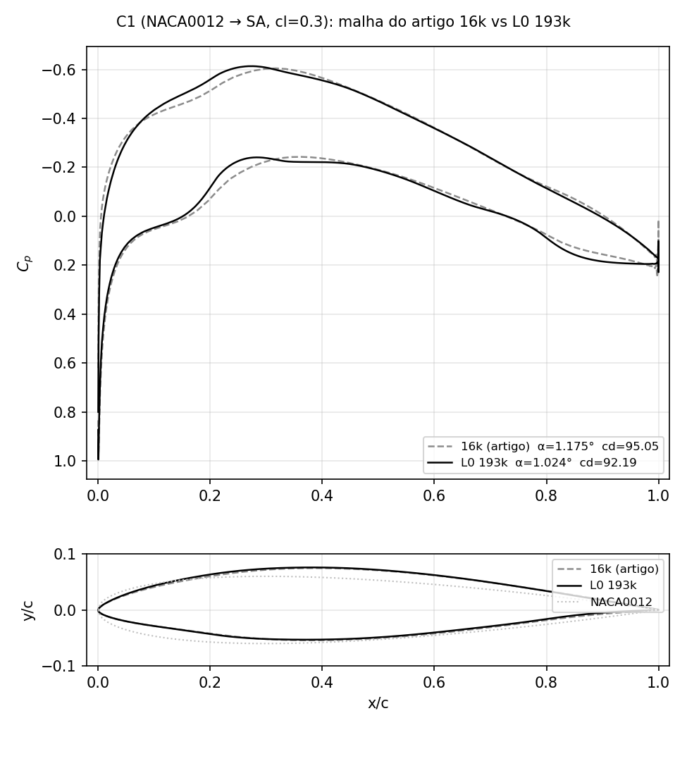
10. Dense mesh L0 (193k): SA optimisation is robust
C1 = NACA0012 → SA, cl = 0.3, SLSQP + adjoint, article script; 16k article mesh vs L0 (one level below the NLF article mesh)
 | 16k (article) | L0 (193k)
baseline SA cd | 9.77e-3 | 9.42e-3
C1 cd | 9.48e-3 | 9.22e-3
ΔCd | −3.0 % | −2.1 %
α | 1.175° | 1.024°
t_max (x/c) | 0.129 (0.38) | 0.129 (0.38)
Cp,min (x/c) | −0.60 (0.32) | −0.61 (0.27)
SLSQP exit | 0, 58 evals | 0, 119 evals
• Same optimum on both meshes: identical thickness distribution, camber and lower-surface flattening; only the Cp details differ (suction peak 5 % c further forward, softer TE recovery on L0).
• The coarse mesh over-predicts the baseline SA drag by 3.7 % and the gain by 1 point; the design itself is mesh independent → for fully turbulent flow the 16k mesh was enough.

Slide 12
11. SA-BCM cases on the two meshes (Tu = 0.5 %, cl = 0.3)
fs 0.08, ev 1e-7; drag counts; Δ vs the SA-BCM baseline on the same mesh; L0 C2/C3 still running (job 1926969, 32 ranks each)
Case | 16k cd | 16k Δ | 16k x_tr up/lo | L0 cd | L0 Δ | L0 x_tr up/lo | L0 status
Baseline SA | 97.7 | — | — | 94.21 | — | — | done (NK recipe)
Baseline SA-BCM | 61.49 | — | 0.317 / 0.624 | 68.20 | — | 0.216 / 0.486 | done (cold trim)
C1 (SA opt) | 94.8 | −3.0 % vs SA | — | 92.19 | −2.1 % vs SA | — | done, SLSQP exit 0
C2 (SA-BCM opt from NACA) | 54.84 | −10.8 % | 0.352 / 0.658 | 58.80 | −13.8 % | pending | iter 18, plateau since iter 12; 13 failed trial solves
C3 (C1 re-optimised with SA-BCM) | 46.43 | −24.5 % | 0.550 / 0.658 | 51.92 (cl 0.313, not trimmed) | ≈ −24 % | pending | iter 3
C4 (C1 geometry, SA-BCM) | 54.50 | −11.4 % | 0.469 / 0.590 | 57.14 | −16.2 % | 0.419 / 0.523 | done (cold trim)
• The SA baseline moves −3.7 % from 16k to L0; the SA-BCM baseline moves +11 % (transition on the NACA0012 moves forward: 0.32 → 0.22 c upper, 0.62 → 0.49 c lower). The transition location was not mesh-converged on the 16k mesh.
• On L0 the ordering C2 < C4 appears with the plain adjoint run (−13.8 % vs −16.2 % after 18 iterations, still going) — no derivative-free stage. C3 keeps ≈ −24 % on both meshes.
• L0 SA-BCM solves need L2Convergence 1e-8 (ANK stalls at ~1e-8); every second SLSQP trial on L0 lands on a failed/far solve (cl 0.1–0.5) and is rejected by the line search — same staircase mechanism as on 16k, smaller steps.

Slide 13
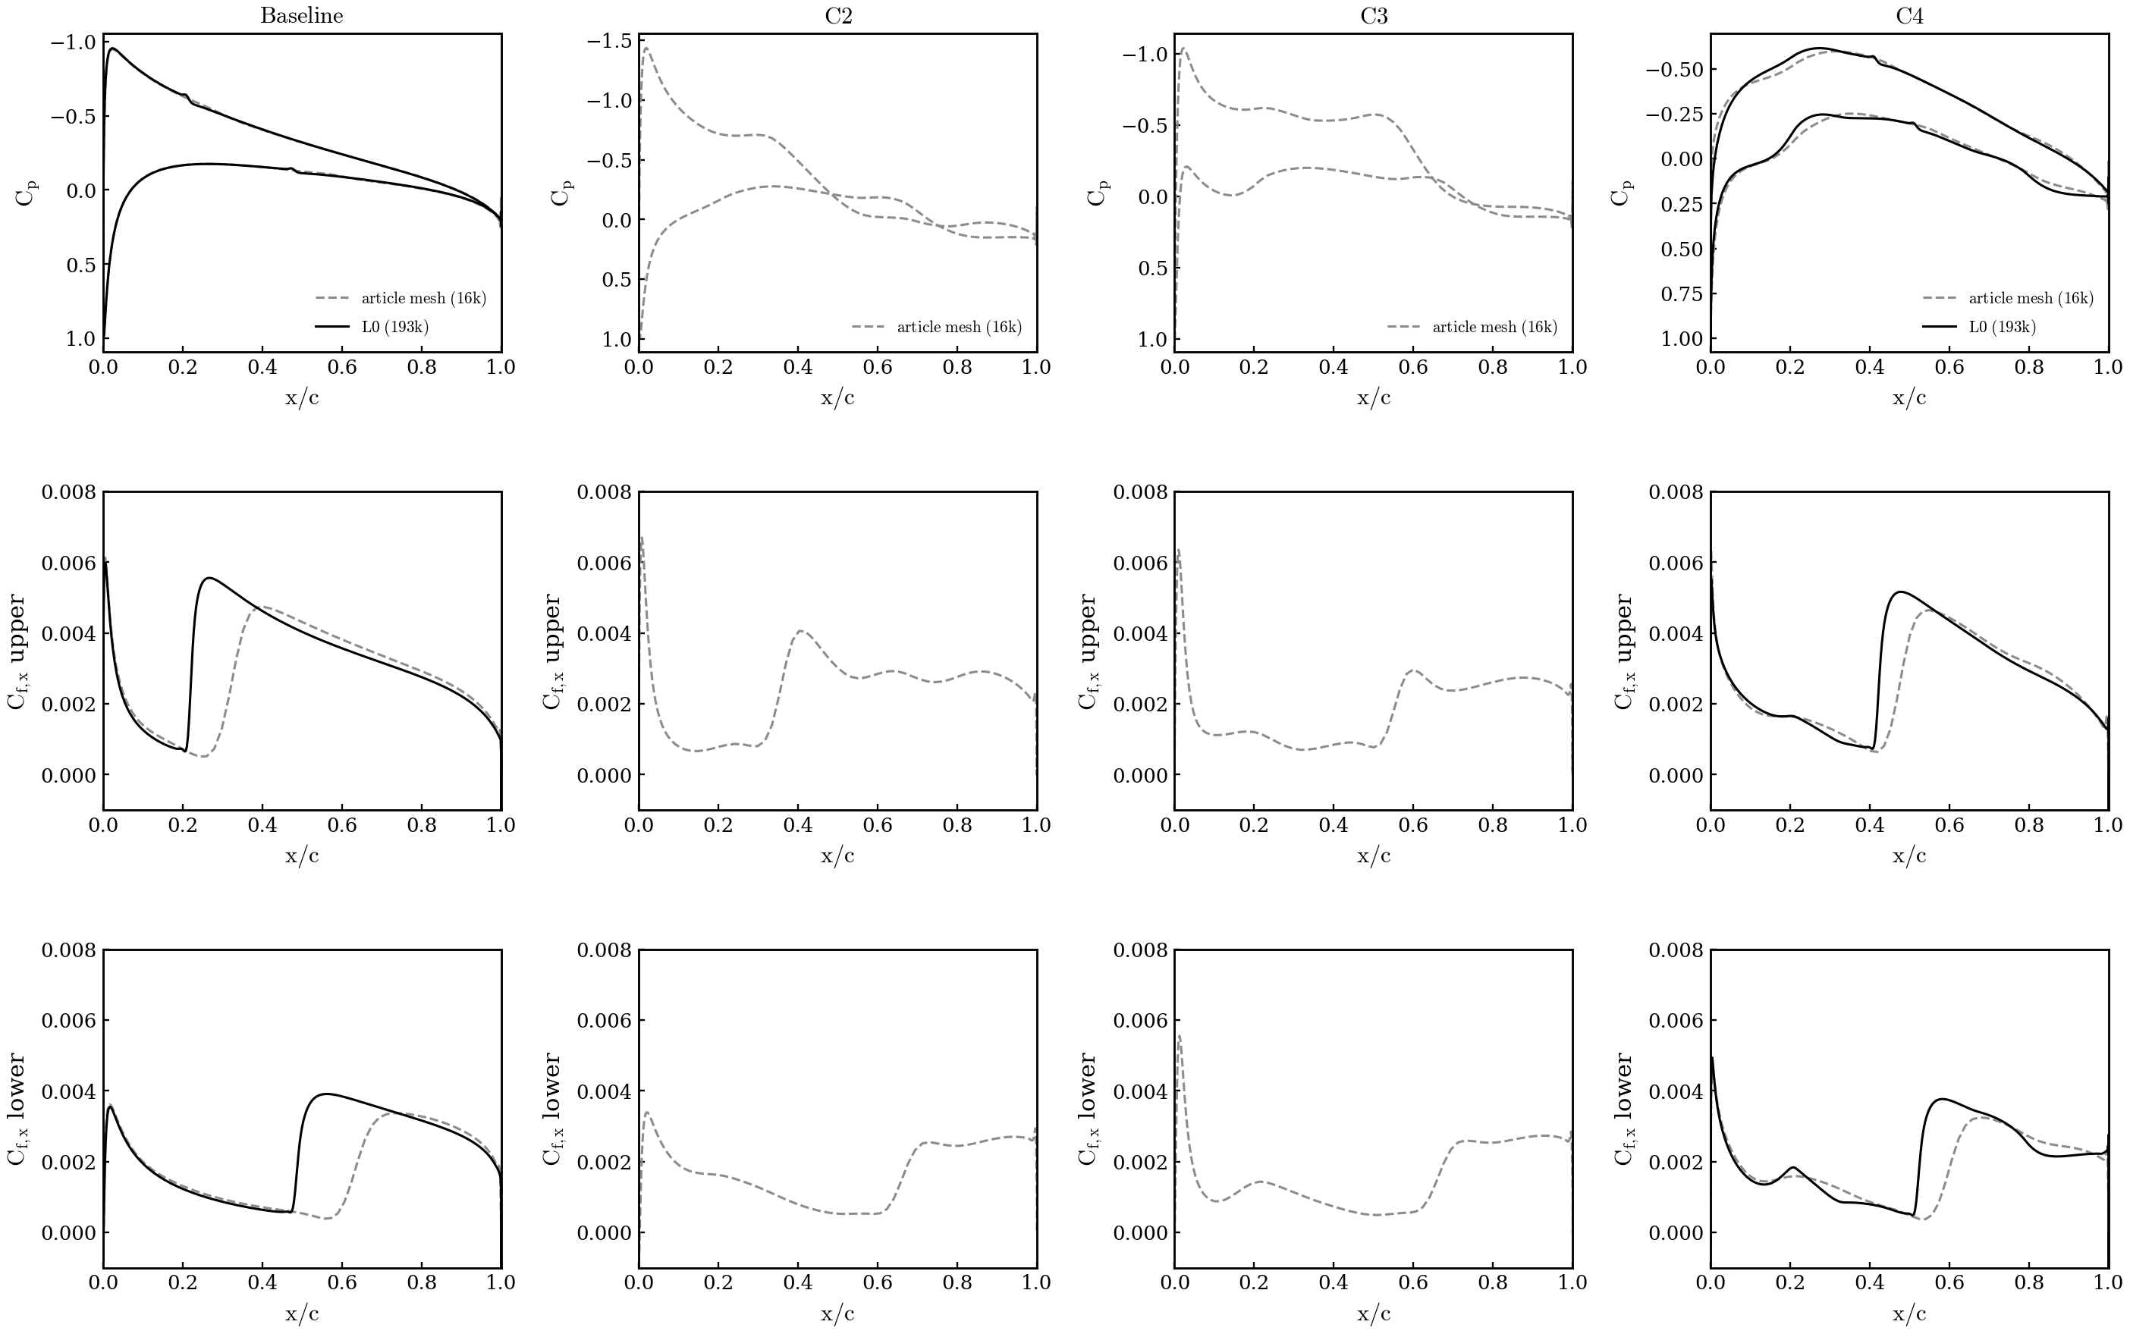
12. SA-BCM is mesh dependent: Cp, Cf 16k vs L0
Tu = 0.5 %, cold trimmed solves at cl = 0.3; 16k dashed, L0 solid; C2/C3 on L0 added when the optimisations finish
• Baseline NACA0012: the L0 mesh trips the upper surface at 0.22 c instead of 0.32 c and the lower at 0.49 instead of 0.62; Cf on the laminar run is the same, the turbulent part is longer → +11 % cd.
• C4 (C1 geometry): transition on L0 at 0.42 / 0.52 c vs 0.47 / 0.59 c on 16k — the coarse mesh sustained a longer laminar run on both surfaces (x_tr = first cell with γ > 0.5 ten cells above the wall; on L0 that height is smaller).
• Per Tu (slide 7): the same figure on the article mesh at Tu = 0.1 / 0.25 / 0.5 %; the L0 baselines at 0.25 and 0.1 % are queued in the same verification job.

Slide 14
13. SA-γ-R̅eθt cases on two meshes (Tu 0.5 %, cl 0.3)
counts; Δ vs GR baseline on the same mesh; L1 = original GR setup (Re 6e6, ±0.03), L0 = article condition (Re 2.92e6, ±0.05); finished
Case | L1 cd | L1 Δ | L1 x_tr up/lo | L0 cd | L0 Δ | L0 x_tr up/lo | status
Baseline SA | — | — | — | 94.21 | — | — | L0: article campaign (NK recipe)
Baseline SA-γ-R̅eθt | 73.41 | — | 0.098 / 0.363 | 69.36 | — | 0.192 / 0.584 | done (cold trim, α 2.594° / 2.700°)
C1 (SA opt) | — | — | — | 92.19 | −2.1 % vs SA | — | L0: article campaign, SLSQP exit 0
C2 (GR opt from NACA) | 42.91 | −41.5 % | 0.429 / 0.766 | 34.93 | −49.6 % | 0.760 / 0.889 | L1: SLSQP exit 0, 82 majors / 216 solves, 14.8 h; L0: stopped at 126 solves / 17.3 h (flat)
C3 (C1 re-optimised with GR) | — | — | — | pending | — | — | prepared (article FFD + C1 shape vector)
C4 (C1 geometry, GR) | — | — | — | pending | — | — | prepared (trim)
• The GR baseline moves −5.5 % from L1 to L0 (73.4 → 69.4 counts) — but the two runs are NOT the same Re (6e6 vs 2.92e6): the lower Re on L0 delays transition (0.10 → 0.19 c upper, 0.36 → 0.58 c lower) and lowers cdv; a like-for-like mesh check needs the same condition on both (prepared: 2d_tu05_meshcmp, 16k / L1 / L0 at Re 2.92e6, not submitted).
• C2 on both: same mechanism — transition pushed to 0.43 / 0.77 c (L1, α 1.996°) and 0.76 / 0.89 c (L0, α 1.118°), gain mostly cdv (−42 % and −53 %); the L0 optimum is flatter and aft-loaded (cp peak at 0.70 c), the L1 one keeps a strong peak at 0.39 c and is thicker (14.5 % vs 12.2 %). Both are best-feasible history points (|cl−0.3| < 5e-4), not yet trimmed.
• GR solves on both meshes need the CSANK-only recipe (nkswitchtol 1e-8, CFL 1e8, L2 1e-8): NK@1e-6 stalled at ~1e-6 abs and was flagged fail in every solve — the same stall the original Tu 0.0937 % runs had silently (96/99 fails in job 1803832). x_tr = steepest c_f rise per surface.
Data: $R/08_optimization/2d_tu05_L1 and 2d_tu05_L0 (trim_gammaretheta/trim.json, logs/opt_c2_*.log, surf/); x_tr from make_mesh_effect_gr.py.

Slide 15
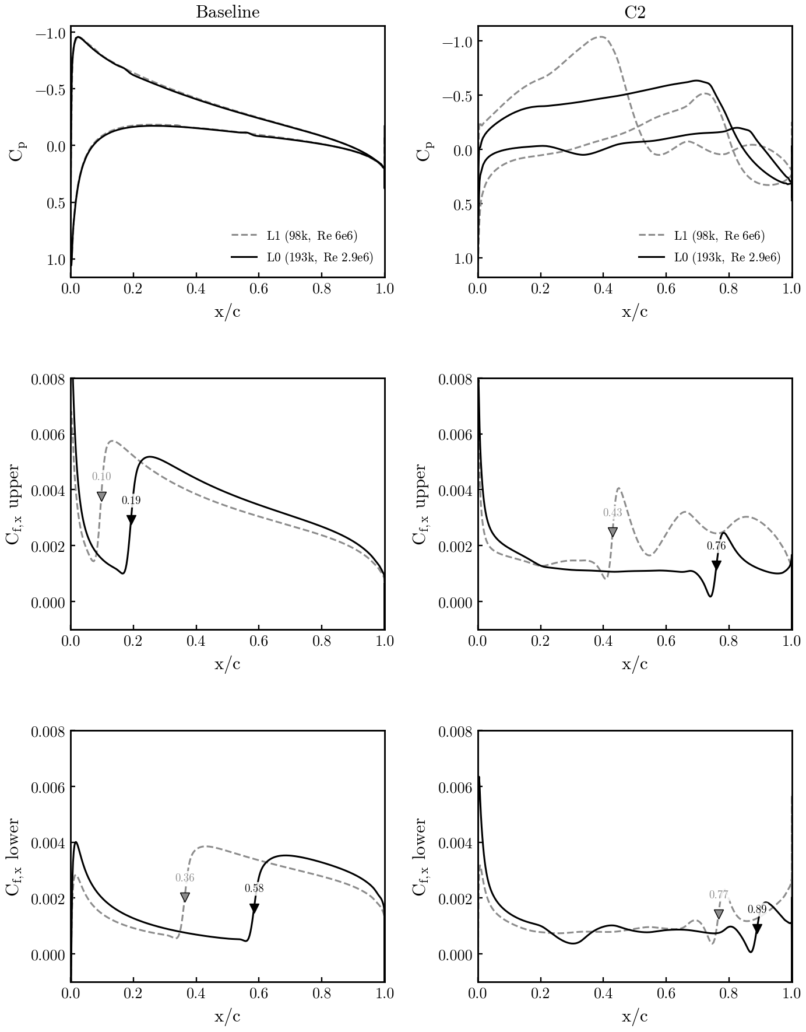
14. SA-γ-R̅eθt on the two meshes: Cp, Cf L1 vs L0
Tu = 0.5 %, cl = 0.3; L1 dashed (Re 6e6), L0 solid (Re 2.92e6); baseline = cold trims, C2 = final best point; ▼ = x_tr
• Baseline NACA0012: identical cp on both meshes; the L0/Re 2.92e6 run keeps laminar flow to 0.19 c upper and 0.58 c lower vs 0.10 / 0.36 c on L1/Re 6e6 — a Re effect, not a mesh effect (transition Reθ,crit reached later at lower Re); the laminar cf level is the same.
• C2 optima: both optimizers push transition aft and flatten the lower surface; on L0 the upper-surface laminar run reaches 0.76 c with cf ≈ 0.001 up to there (lower 0.89 c), on L1 it ends at 0.43 c with a separation-bubble signature (cf dip to 0 then peak) — 42.9 vs 34.9 counts.
• Like-for-like mesh dependence (same Re on 16k / L1 / L0) is prepared in 2d_tu05_meshcmp and not yet run; GR C3/C4 on L0 prepared (article FFD + C1 shape).
Data: same as slide 13; figure 08_optimization/make_mesh_effect_gr.py (surf CGNS of the trims and of the best C2 evaluations).

Slide 16
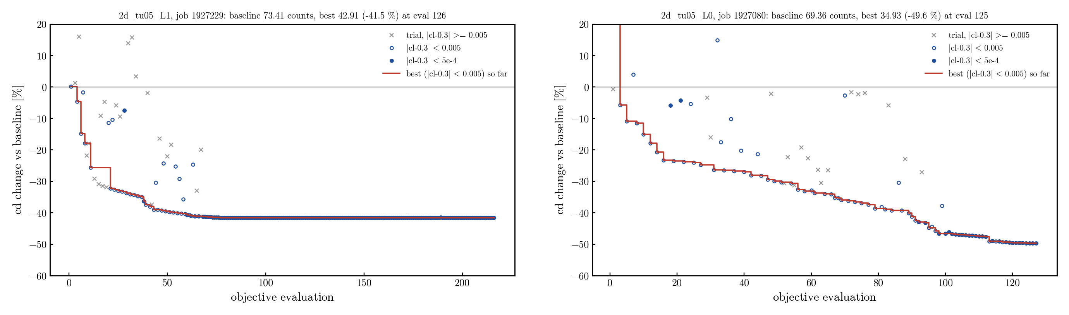
15. SA-γ-R̅eθt C2 convergence: L1 vs L0
Δcd vs the trimmed GR baseline per objective evaluation; red = best point so far; × = line-search trials off the cl constraint
• L1 (Re 6e6, ±0.03): −25.7 % at 20 evals, −39.5 % at 50, −41.5 % at 75, then flat for 140 more evaluations (SLSQP exit 0 at 82 majors; last 10 majors within ±2e-5 counts). L0 (Re 2.92e6, ±0.05): −23.5 % at 20, −29.9 % at 50, −36.9 % at 75, −46.6 % at 100, −49.6 % at 125 with a step at 90–100; stopped by the user at 126 solves (still creeping, ~0.1 count per 10 evals).
• Neither run has a plateau/branch problem: the objective is smooth in the DVs, failed solves are only the far line-search trials (cl 0.1–0.5), rejected by SLSQP.
Data: $R/08_optimization/2d_tu05_L1/logs/opt_c2_1927229.log, 2d_tu05_L0/logs/opt_c2_1927080.log; figure 08_optimization/plot_c2_history.py.

Slide 17
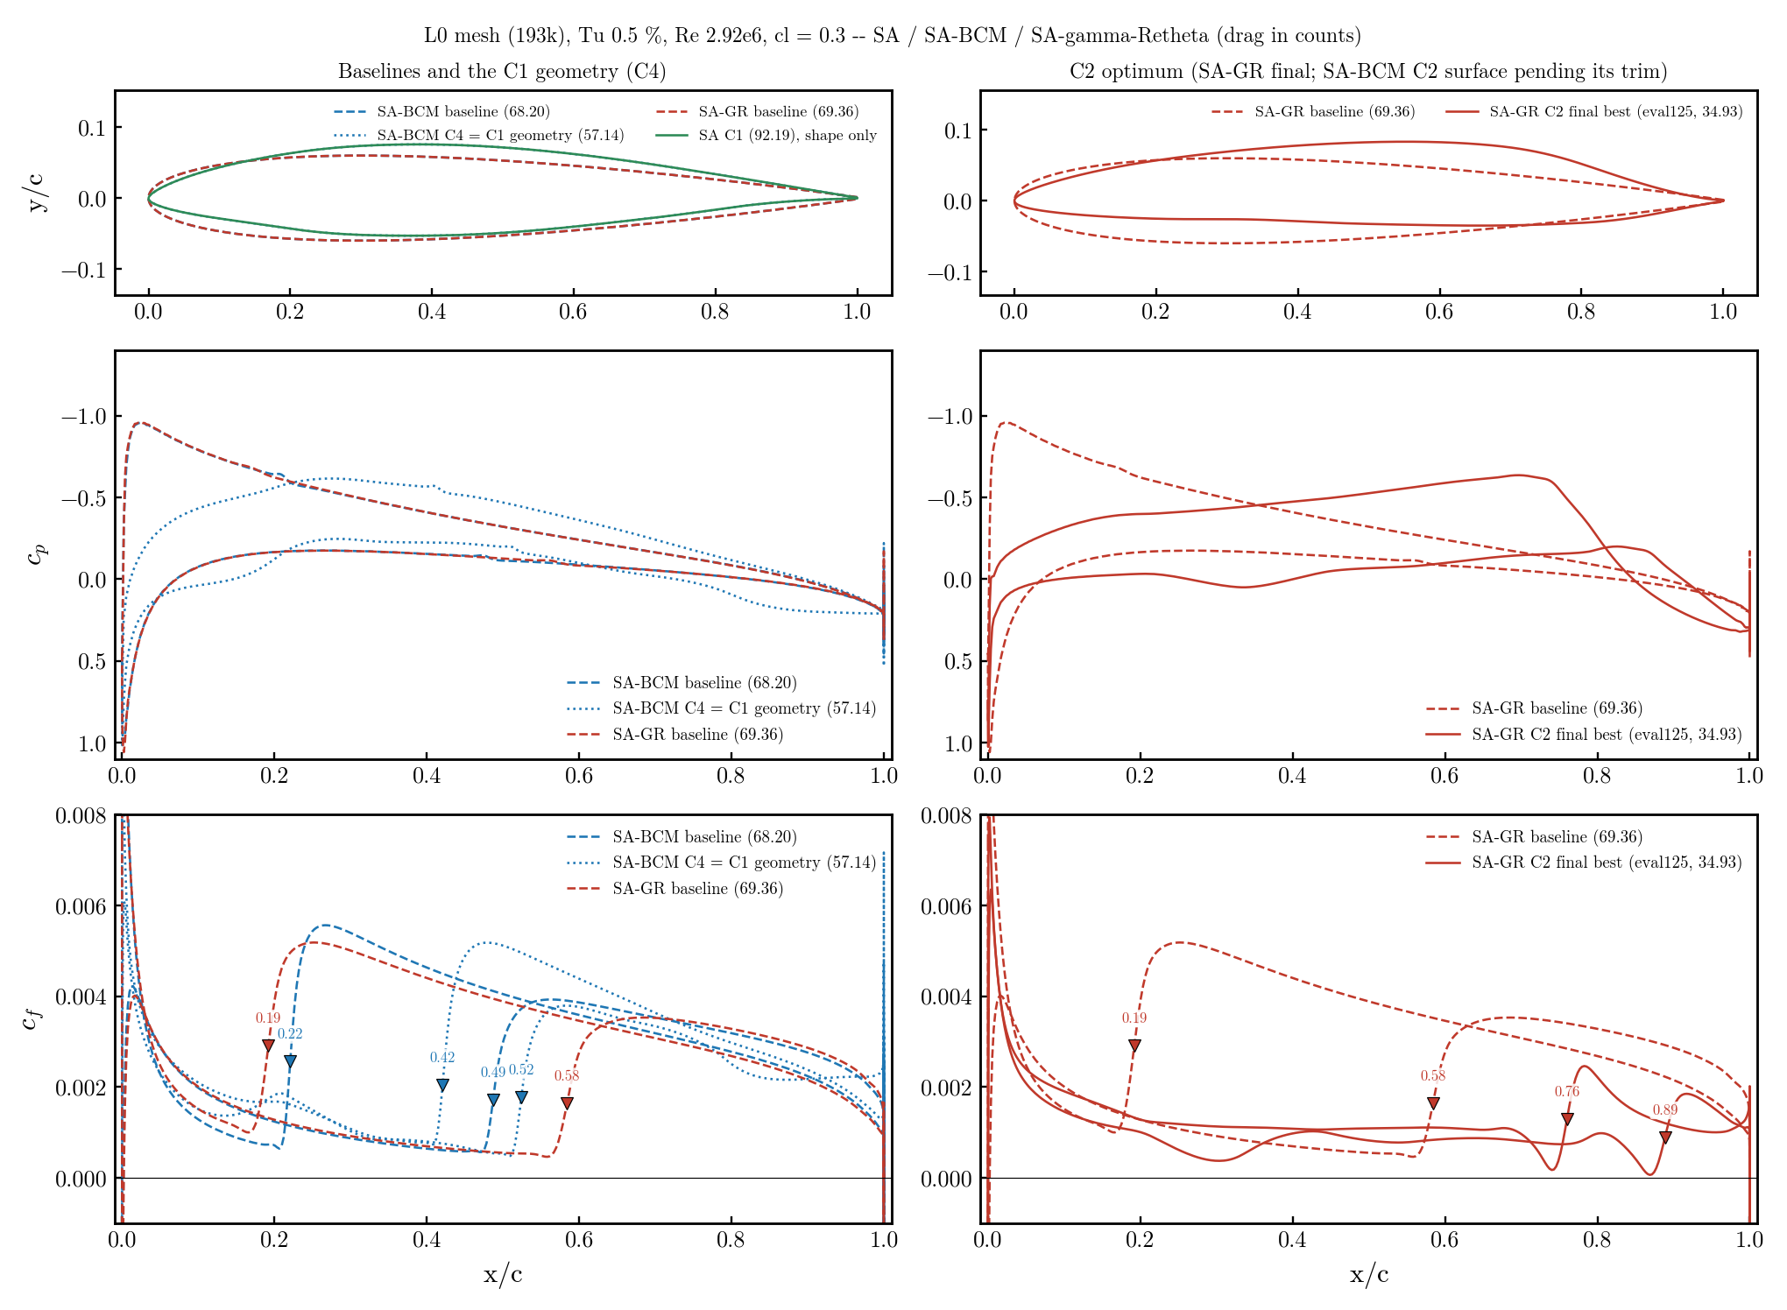
16. Models on L0 (Tu 0.5 %) — current state
L0 193k, Re 2.92e6, cl = 0.3; cd in counts (Δ vs own baseline); GR C2 final, BCM C2/C3 still running (2026-09-15 13:30)
Case | SA | SA-BCM | BCM x_tr | SA-GR | GR x_tr
Baseline NACA0012 | 94.21 | 68.20 | 0.22/0.49 | 69.36 | 0.19/0.58
C1 (SA opt, α 1.02°) | 92.19 (−2.1%) | — | — | — | —
C2 (from NACA) | — | 58.72* (−13.9%) | pending | 34.93 (−49.6%) | 0.76/0.89
C3 (C1 re-opt.) | — | 51.92* (≈−24%) | pending | pending | —
C4 (C1 geometry) | — | 57.14 (−16.2%) | 0.42/0.52 | pending | —
• * BCM still running: best feasible point of the history (|cl−0.3| < 5e-4), 53 evals (job 1926969); BCM C3 from the earlier snapshot (cl 0.313). GR C2 finished (stopped flat at 126 solves / 17.3 h, job 1927080; best eval 125, α 1.118°, cl 0.30001) — best history point, trim pending.
• Baselines: GR and BCM give the same cp on the NACA 0012 and nearly the same cd (69.4 vs 68.2); GR trips the upper surface slightly earlier (0.19 vs 0.22 c) and the lower later (0.58 vs 0.49 c). x_tr: GR = steepest cf rise, BCM = γ > 0.5 ten cells above the wall.
• C2: GR reaches −49.6 % (cdp 16.66 → 10.34, −38 %; cdv 52.70 → 24.59, −53 %) against BCM's −14 %: the γ-R̅eθt optimizer moves transition to 0.76 / 0.89 c (▼ in the cf panels) with a smooth aft-loaded cp, no plateau, every solve converged (CSANK-only, L2 1e-8 — NK@1e-6 stalled at ~1e-6 abs on this mesh, as it silently did in the Tu 0.0937 % runs).
• GR C3/C4 prepared from the article's C1 (its FFD + shape vector reproduce the C1 wall to 3e-8 c); C2 uses the GR tree's own FFD — same bounds ±0.05 and constraints, different box. Figure: left = baselines + C1 geometry (BCM C4), right = GR C2 vs its baseline; BCM C2 surface added when it is trimmed.
Data: $R/08_optimization/2d_tu05_L0/{trim_gammaretheta/trim.json, logs/opt_c2_1927080.log, models_cmp/}; figure 2d_tu05_L0/plot_models_L0_cp_cf.py; BCM: SA_BCM_ARTICLE/2d_opt/dense_L0v2/{base_bcm32,c1,c2,c3,c4}.

Slide 18
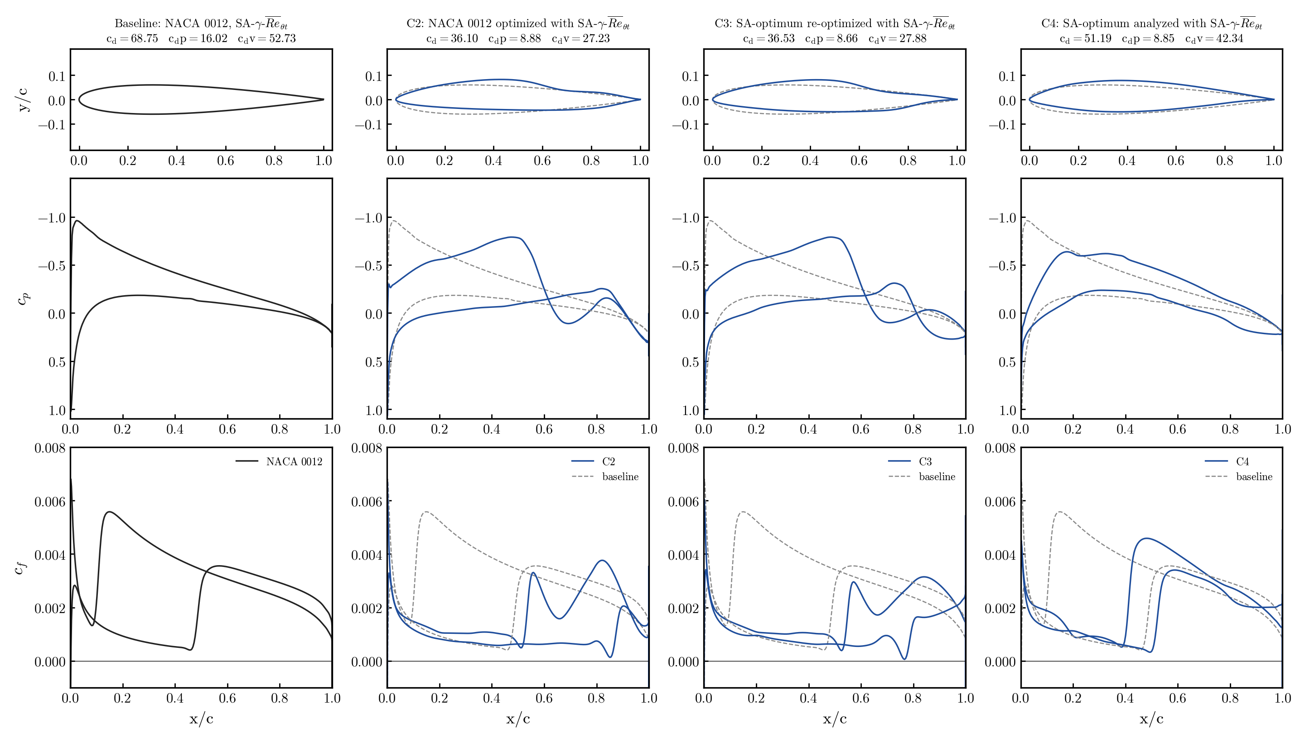
17. γ-R̅eθt full table, Tu = 0.0937 % (L1, Re 6e6)
Original GR campaign (2026-08-04), cl = 0.3, trimmed re-solves (except C3*); counts; Δ vs same-model baseline, C3 vs its start C4
Case | Geometry | Model | α | cd | cdp | cdv | Δcd % | Δcdp % | Δcdv %
— | NACA 0012 | SA | 2.579 | 88.75 | 20.39 | 68.36 | — | — | —
C1 | NACA opt. | SA | 0.710 | 85.66 | 16.93 | 68.73 | −3.5 | −17.0 | +0.5
— | NACA 0012 | GR | 2.616 | 68.75 | 16.02 | 52.73 | — | — | —
C2 | NACA opt. | GR | 2.170 | 36.10 | 8.88 | 27.23 | −47.5 | −44.6 | −48.4
C4 | C1 analysed | GR | 0.611 | 51.19 | 8.85 | 42.34 | −25.5 | −44.7 | −19.7
C3 | C1 re-opt.* | GR | — | 36.53 | 8.66 | 27.88 | −28.6 | −2.2 | −34.2
 | C3 vs base |  |  |  |  |  | −46.9 | −46.0 | −47.1
• Tu = 0.0937 % was calibrated at α = 0 on this mesh (set A of the α-sweep) — five times lower than the 0.5 % of slides 11–14; same FFD, bounds ±0.03, ladder with NK@1e-6 (which, as found on 2026-09-14, stalled at ~1e-6 abs in 96/99 solves of the C3 job — SLSQP ignored the flag).
• C4 shows the SA optimum is already a good transition shape for the wrong reason: −25.5 % almost entirely cdp; the γ-R̅eθt optimizer then only has cdv left (−34 %). Starting from NACA (C2) ends 1.2 % lower than from C1 (C3).
• * C3: best feasible point of job 1803832's log (cl 0.30004); its trim (job 1804386) was cancelled, α not recorded.
Data: $R/08_optimization/2d/{trim_*/trim.json, RESULTS.md, REPORT.md}; figure 2d/profiles/cp_cf_cases.png (make_cp_cf.py).

