Slide 1





Text Summarization using Reinforcement Learning
SI-II MP1
Beatriz Costa
Luís Silva
Pedro Carvalho
Tiago Pinho
Intro
1
2
3
4
Notes:
Bea

Slide 2
Table of Contents
Introduction
Text
Summarization
Methodology 1
Access
Access
Access
Methodology 2
Results
Analysis
Conclusion
Access
Access
Access
Intro
1
2
3
4
End
Notes:
Bea

Slide 3
Introduction
Reinforcement learning is about taking actions in order to maximize reward in a specific situation.
Facing a task, the reinforcement learning differs from other types of learning in a way that there is no correct answer.
The algorithm itself is bound to learn from its experience and choose for itself.
Intro
1
2
3
4
End
Notes:
Bea

Slide 4
Introduction
Text summarization produces concise and fluent summaries while preserving key information content and overall meaning
The two broad categories of approaches to automatic text summarization are extraction and abstraction
Intro
1
2
3
4
End
Notes:
Bea

Slide 5


Text Summarization
Extractive
Abstractive
Intro
Extractive
Abstractive
Our
Choice
Intro
1
2
3
4
End
Notes:
Tiago

Slide 6
Extractive Method
Identifies the relevant sentences or phrases from the original text and extracts and groups them together in order to form a concise summary.
Intro
Extractive
Abstractive
Our
Choice
Intro
1
2
3
4
End
Notes:
Tiago

Slide 7
Abstractive Method
Focuses on the vital information of the original sentences and
generates a new set of sentences for the summary, being that this sentences might not be present in the original sentences.
Intro
Extractive
Abstractive
Our
Choice
Intro
1
2
3
4
End
Notes:
Tiago

Slide 8
Our choice
Abstractive Method
It enables the machine to understand the semantic of the text
Create new sentences using NLP (Natural Language Processing)
Intro
Extractive
Abstractive
Our
Choice
Intro
1
2
3
4
End
Notes:
Tiago

Slide 9
Methodologies
Methodology 1
Methodology 2
Supervised Learning using Abstractive Method of Text Summarization (Seq2Seq)
Reinforcement Learning for optimization of the metrics associated with Text Summarization
Methods
Method 1
Method 2
Intro
1
2
3
4
End
Notes:
Bea

Slide 10
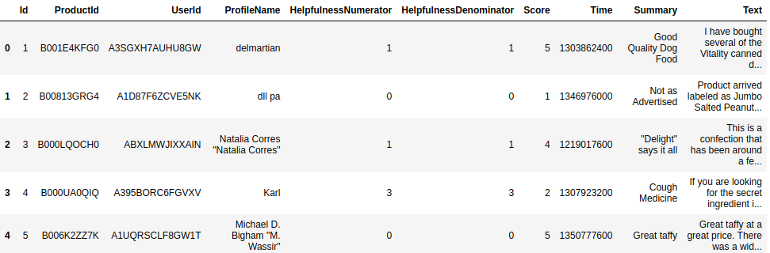
Methodology 1
Dataset
”Amazon Fine Food Reviews”
This dataset consists of more than 500,000 reviews of foods from the amazon site, which include product and user information, ratings, and, for the text summarization, a plain text review (where we focused).
Methods
Method 1
Method 2
Intro
1
2
3
4
End
Notes:
Pedro

Slide 11
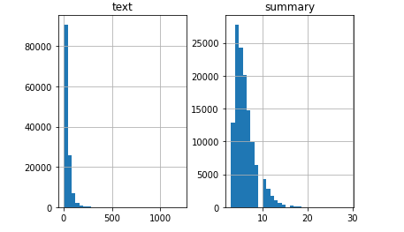
Methodology 1
Pre-processing of the Data
200,000 examples
Text and Summary Cleaning
Eliminate stop-words
Contraction Mapping
Adding special tokens (start and end)
Analysis of the distribution of lengths
Split the data (holdout method 80/20)
Tokenizer
Methods
Method 1
Method 2
Intro
1
2
3
4
End
Notes:
Pedro

Slide 12
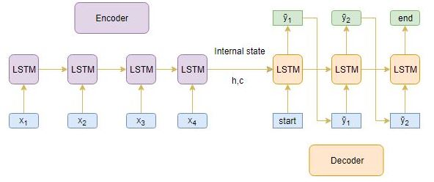
Methodology 1
Architecture – Components of Seq2Seq
LSTM (Long-Short-Term Memory)
Encoder
Decoder
Attention Layer
Inference Phase
Methods
Method 1
Method 2
Intro
1
2
3
4
End
Notes:
Pedro

Slide 13
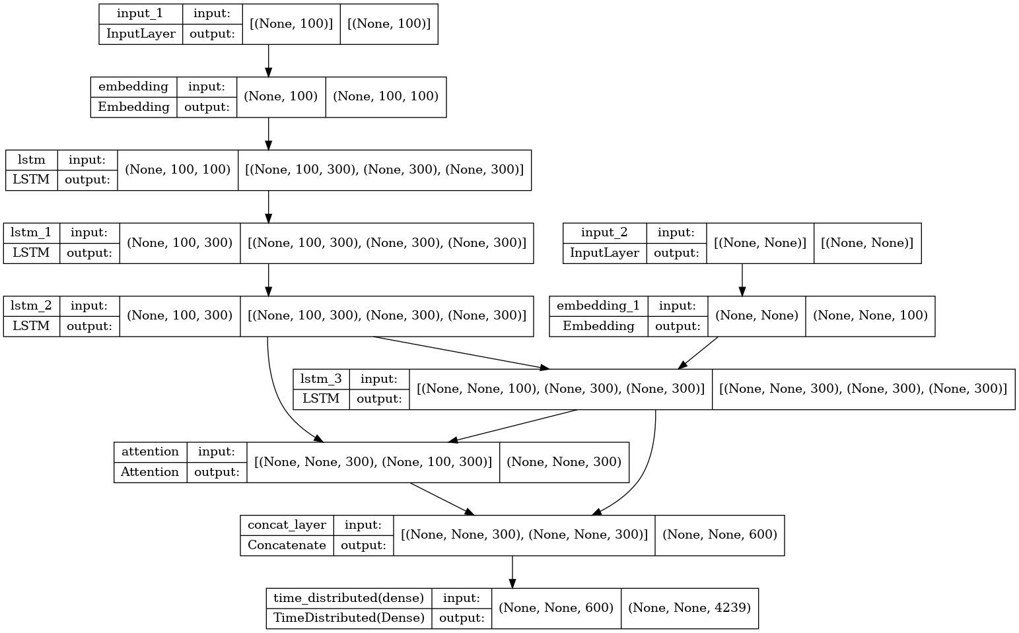
Methodology 1
Architecture Layers
Methods
Method 1
Method 2
Intro
1
2
3
4
End
Notes:
Pedro

Slide 14

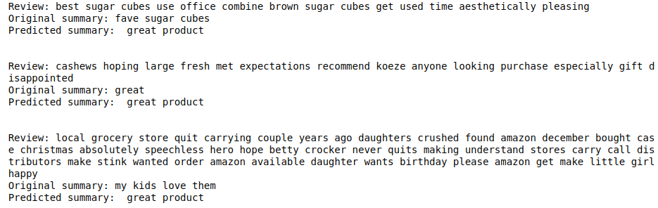
Result Analysis
Non-satisfatory
Boosting Results
Repetitive, General
Better results require
Reinforcement Learning
Results
Method 1
Method 2
Comparison
Intro
1
2
3
4
End
Notes:
Luís

Slide 15
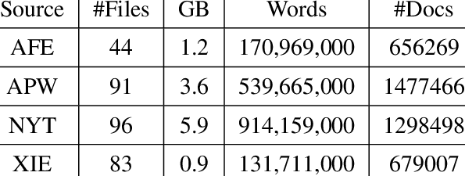
Methodology 2
Dataset
”Gigaword”
This dataset consists of more than 10-million documents, with a total of more than 4-billion words. It is one of the most used in studies globally due to its richness in semantics and vocabulary.
Methods
Method 1
Method 2
Intro
1
2
3
4
End
Notes:
Bea

Slide 16
Methodology 2
Dataset
”Gigaword”
 | Text | Summary
Training Set | at least two people were killed in a suspected bomb attack on a passenger bus in the strife-torn southern philippines on monday , the military said . | at least two dead in southern philippines blast
Testing Set | us business leaders lashed out wednesday at legislation that would penalize companies for employing illegal immigrants . | us business attacks tough immigration law
Methods
Method 1
Method 2
Intro
1
2
3
4
End
Notes:
Tiago

Slide 17
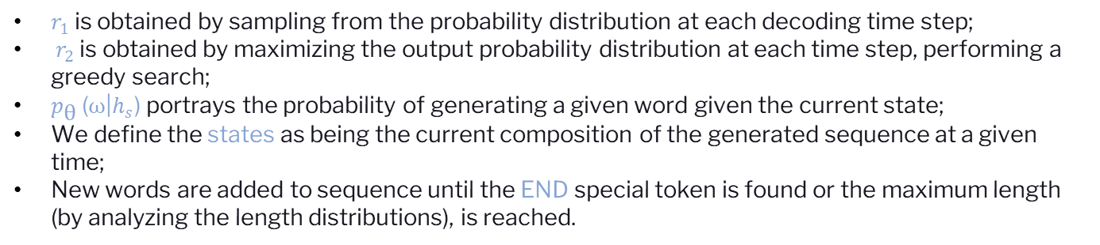
Methodology 2
Cost-Reward Function
What is the reward function?
$$\text{−(}r_{1} \text{(}ω\text{) − }r_{2} \text{(}ω\text{)) ∗ }p_{\text{θ}}\text{ (}ω\text{|}h_{s}\text{)}$$
$r_{1}$ is obtained by sampling from the probability distribution at each decoding time step;
$r_{2}$ is obtained by maximizing the output probability distribution at each time step, performing a greedy search;
$p_{\text{θ}}\text{ (}ω\text{|}h_{s}\text{)}$portrays the probability of generating a given word given the current state;
We define the states as being the current composition of the generated sequence at a given time;
New words are added to sequence until the END special token is found or the maximum length (by analyzing the length distributions), is reached.
Methods
Method 1
Method 2
Intro
1
2
3
4
End
Notes:
Tiago

Slide 18
Methodology 2
State of Art
In this project we studied and applied an adaptation [1] in Pytorch that uses a combination of a Deep Reinforced Model for Abstractive Summarization [2] and the hybrid Point Generator Network.
The Point Generator Network methodology goes by making copies of words from the source text via pointing, which then helps to get an accurate reproduction of information, while at the same time retains the functionality to produce novel words through the generator. [3]
This outperforms the current abstractive state-of-the-art results by at least 2 ROUGE points, which is a major evolution.
Methods
Method 1
Method 2
Intro
1
2
3
4
End
Notes:
Tiago

Slide 19
Methodology 2
Pre-processing of the Data
tf_example.features.feature["article"].bytes_list.
value.extend([b"article"])
tf_example.features.feature["abstract"].bytes_list.
value.extend([b"abstract"])
Code Listing 1. Adaptation of the original code [1] that was used as the base study.
Methods
Method 1
Method 2
Intro
1
2
3
4
End
Notes:
Tiago

Slide 20



Methodology 2
ROUGE
ROUGE-N
ROUGE-L
ROUGE-S
Matching
Longest common sequence
Consecutive words
Methods
Method 1
Method 2
Intro
1
2
3
4
End
Notes:
Pedro

Slide 21
Methodology 2
Architecture
Maximize ROUGE metric;
Use self-critical policy gradient training algorithm;
We produce two separate output sequences at each training iteration:
Obtained by sampling from the probability distribution at each decoding time step
Obtained by maximizing the output probability distribution at each time step performing
a greedy search
To better capture human-readability it is better to define a self-critic policy;
The author optimizes the gradient of the expected reward by sampling from
the model during training and treating these as ground truth.
Methods
Method 1
Method 2
Intro
1
2
3
4
End
Notes:
Luís

Slide 22
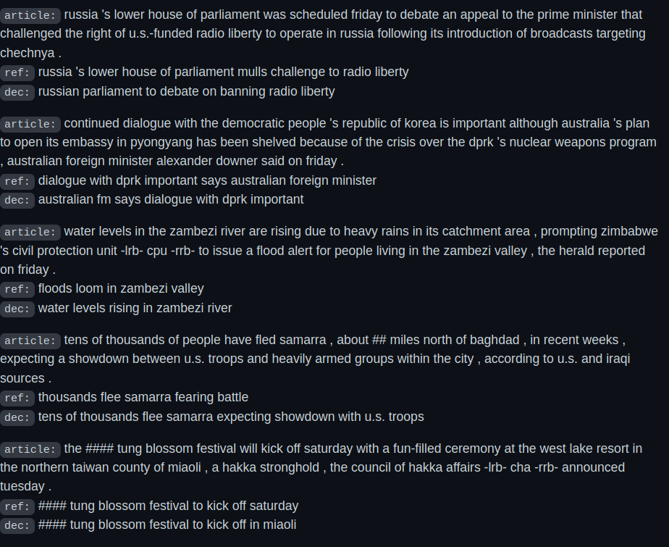
Result Analysis
Results
Method 1
Method 2
Comparison
Intro
1
2
3
4
End
Notes:
Luís

Slide 23
Result Analysis
Method 1 vs Method 2
Highly specific summaries (RL) vs Repetitive and General (Seq2Seq)
Datasets changes:
Amazon
Gigaword
Review
News article
Subjective
Objective
Results
Method 1
Method 2
Comparison
Intro
1
2
3
4
End
Notes:
Luís

Slide 24
Conclusion
Better results with Reinforcement Learning
In a future approach, try different metrics (example: BLEU)
Intro
1
2
3
4
End
Notes:
Bea

Slide 25
THANKS!
We are happy to now answer your questions!
Intro
1
2
3
4
End
Notes:
Bea

Slide 26

References
[1] R. Reddy, “Pytorch implementation of ”a deep reinforced model for abstractive summarization”
paper and pointer generator network.” [Online].
Available: https://github.com/PedroCarvalho98/Text-Summarizer-Pytorch
[2] R. Paulus, C. Xiong, and R. Socher, “A deep reinforced model for abstractive summarization,”
arXiv preprint arXiv:1705.04304, 2017
Available: https://arxiv.org/pdf/1705.04304.pdf
[3] A. See, P. J. Liu, and C. D. Manning, “Get to the point: Summarization with pointer-generator
networks,” 2017. [Online].
Available: https://arxiv.org/abs/1704.0
Intro
1
2
3
4
End
Notes:
Bea

