Slide 2
Datasets
 | Descriptions | Example
Global Supply Chain Relationships | B2B mapping of buyers and suppliers | revenue dependencies
Supplier Implied Risk Attributes | monthly measure of a company's financial health | no. of late payments, company active status etc.
Market US End of Day | market close prices | adj_close, momentum, MACD, rolling Vol.

Slide 3
Global Supply Chain Relationships
 | Customer | Supplier | Revenue Dependency (Supplier relies on Customer) | Supplier Price Momentum
2016-01-02 | Apple | Foxcon | 0.5567 | 3.23
 | Samsung | Foxcon | 0.1000 | -1.33
 | Ticker | Adj_Close | Rev_dep_mom
2016-01-02 | Foxcon | 150 | 0.5567*3.23 + 0.100*1.33 = 1.9311

Slide 4
Supplier Implied Risk Attributes
Credit ratings, indicator of prior bankruptcy, condition indicator, Debtor-In-Possession status
Number of negative/ slow payments, financial stress classes
normalized (median) PAYDEX score
Business deterioration scores

Slide 5
Backtest tearsheets
Feature importance, confusion matrix
Baseline models by dropping feature sets {risk, momentum, supply chain(mixed with momentum)}
Describe ml pipeline

Slide 6
ML Pipeline
Features, 1 month Forward Return
StandardScalar(features), Vol_adj_Classifier(Winsorize(1 month Forward Return), tanh, vol)
XGBoost
Long(1), Do Nothing(0), Short(-1)

Slide 7
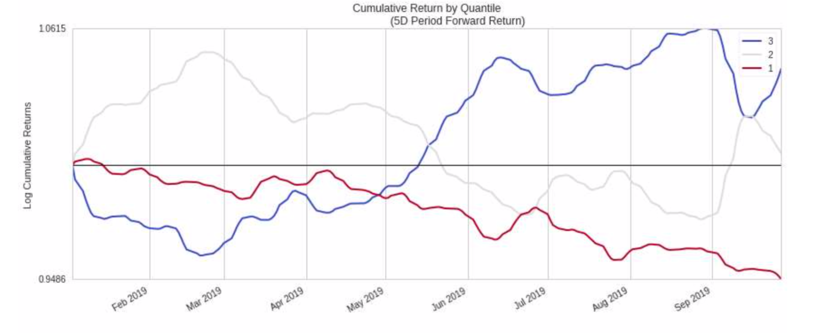
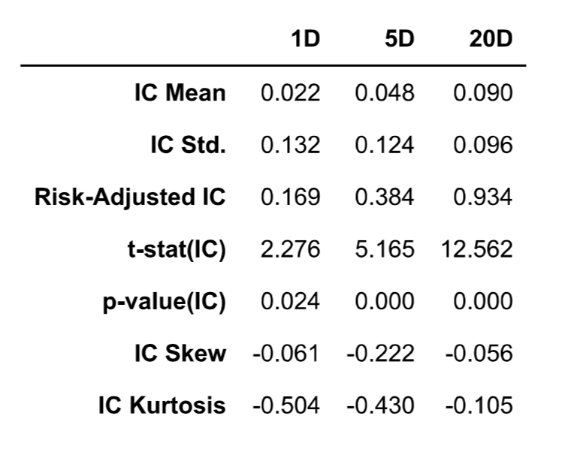
Backtest

