Slide 1
Bl0ke Chain
Theme: Theme 2: Supply Chain networks
Datasets: Global Supply Chain Relationships
, Supplier Implied Risk Attributes
, Market US End of Day
Alex Mukhachou, King Wong , Pedro Castro, Piotr Kram

Slide 2
Datasets
 | Descriptions | Example
Global Supply Chain Relationships | B2B mapping of buyers and suppliers | revenue dependencies
Supplier Implied Risk Attributes | monthly measure of a company's financial health | no. of late payments, company active status etc.
Market US End of Day | market close prices | adj_close, momentum, MACD, rolling Vol.

Slide 3
Global Supply Chain Relationships
 | Customer | Supplier | Revenue Dependency (Supplier relies on Customer) | Supplier Price Momentum
2016-01-02 | Apple | Foxcon | 0.5567 | 3.23
 | Samsung | Foxcon | 0.1000 | -1.33
 | Ticker | Adj_Close | Rev_dep_mom
2016-01-02 | Foxcon | 150 | 0.5567*3.23 + 0.100*1.33 = 1.9311

Slide 4
Supplier Implied Risk Attributes
Credit ratings, indicator of prior bankruptcy, condition indicator, Debtor-In-Possession status
Number of negative/ slow payments, financial stress classes
normalized (median) PAYDEX score
Business deterioration scores
sales

Slide 5
ML Pipeline
Features, 1 month Forward Return
StandardScalar(features), Vol_adj_Classifier(Winsorize(1 month Forward Return), tanh, vol)
XGBoost
Long(1), Do Nothing(0), Short(-1)

Slide 6
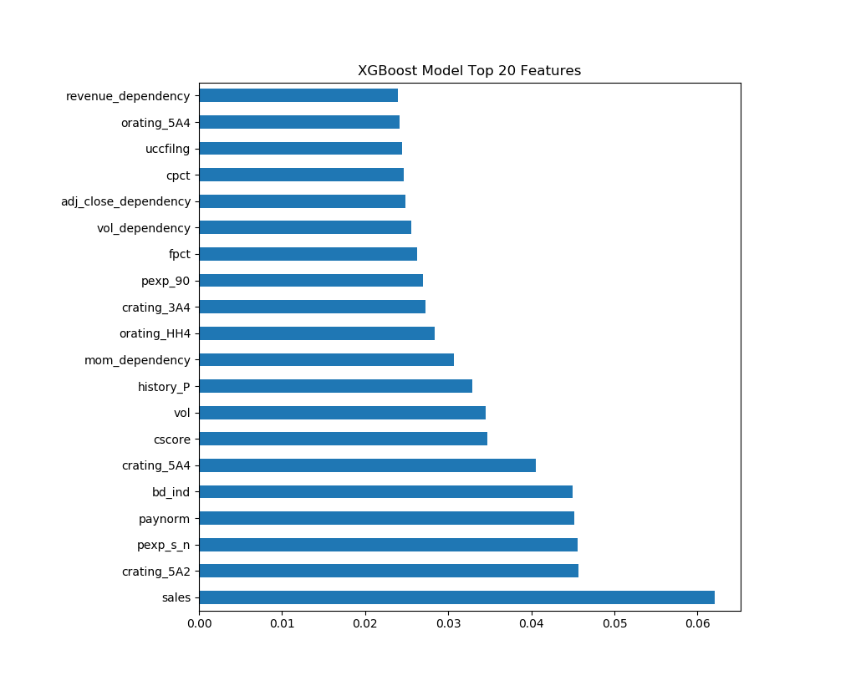
Accuracy Score: 56% of testing set (2019 data)
with a trained model based on 2010-2018 data

Slide 7
Backtest
https://www.quantopian.com/posts/algothon2019-supplychain-and-governance

