Slide 1
James Bond
Forecasting changes in corporate bond ratings using machine learning

Slide 2
Introduction
Objective: develop a machine learning model that predicts a change in credit ratings for a corporate bond over the following 12 months
Stakeholders: bond investors, risk professionals in bond collateral, corporate treasuries
Classification models: logistic regression, random forest and GradientBoost
Training data: historical corporate financial, ratings, asset pricing and macro data
Feature selection and transformation across various datasets
Experimented with number of credit target variables, settled on directional ratings change
Key challenge: imbalanced dataset with relatively few ratings events
Future improvements: dataset enhancement, feature transformations, model finetuning and optimizing target variables
Notes:
Kwame

Slide 3
DATA

Slide 4
Data Sources
Obtained access to SQL databases developed by a company active in corporate credit default probability modelling
41 real-time datatables accessed through Microsoft Azure Studios for SQL queries and download csv files
Key datatables:
‘Core_us_fundamentals’ (676,000 records, ‘93-’21): quarterly updated corporate financial information incl. financial statement data, financial ratios, valuation ratios across over 14,000 bond issuers
‘Edi_bond_price’ (53m records, ‘09-’21): daily updated bond price, volume, security terms, cusip codes, exchange
‘Ratings’ (280,552 records, ‘12-’21): corporate credit ratings across over 280,000 issuers
‘Cleansed_fred_macro_daily’ (6,309 records, ‘96-’21): daily readings across 32 macro variables incl. GDP, inflation, interest rates, commodity pricing, vix etc.
Notes:
Kwame

Slide 5
Credit Rating And Rating Migration
Credit Rating quantifies the creditworthiness of borrower in general terms or with respect to a particular debt or financial obligation
Credit rating is sought by an Entity looking to borrow money - corporation, province authority, sovereign government etc.
Common practice to map frequency of defaults with Credit Rating though Rating not indicative of Probability of Default
Credit Rating mainly determined by Entity’s past history of borrowing and paying off debts and future economic growth prospects
What causes migration?
Credit Migration is moving of a security issuer from one class of risk into new one.
It leads to downgrade or upgrade from current rating
Credit migration event could cause significant movement in bond prices
Notes:
Ketan

Slide 6
DataSets Cleaning and Challenges
Usage of AsyncIO Library to Process Large Dataset:
561 Issuer Cusips found common between all tables
561 cusips divided into batch of 10 Issuer Cusips for concurrent processing
AsyncIO Concurrent Tasks created are created for each of Issuer Cusip to fetch most recent Bond price and Rating
Each Issue Cusip is looped for each bond and each bond is looped over Quarterly date
Results from Concurrent tasks are combined and final data frame is created
Total 41K records extracted from Core-Bond-Rating
Filters:
Dropped the records with Bond prices older than 60 days from Quarterly date
Final Data Set:
After dropping NAs Final Data size is 13K rows of quarterly data with Bond price and valid Rating
Main Data Source :
Company Fundamentals: Quarterly data of 17,776 bonds since 1998
Bond Price & Coupon , Credit Ratings
Macro Economic Data: Key Interest Rate, Commodity price
Target Data: Rating & Rating Change
Data Cleaning Challenges:
Bond Price dates not aligned with quarterly date for many cusips
Rating publish dates not aligned with quarterly date
Joining Core Fundamental - Bonds - Rating tables
Large data size: EDI Bonds - total 52 mil records, Core Fundamental - 700K quarterly records
Stale Bond prices for many cusips
Notes:
Ketan

Slide 7
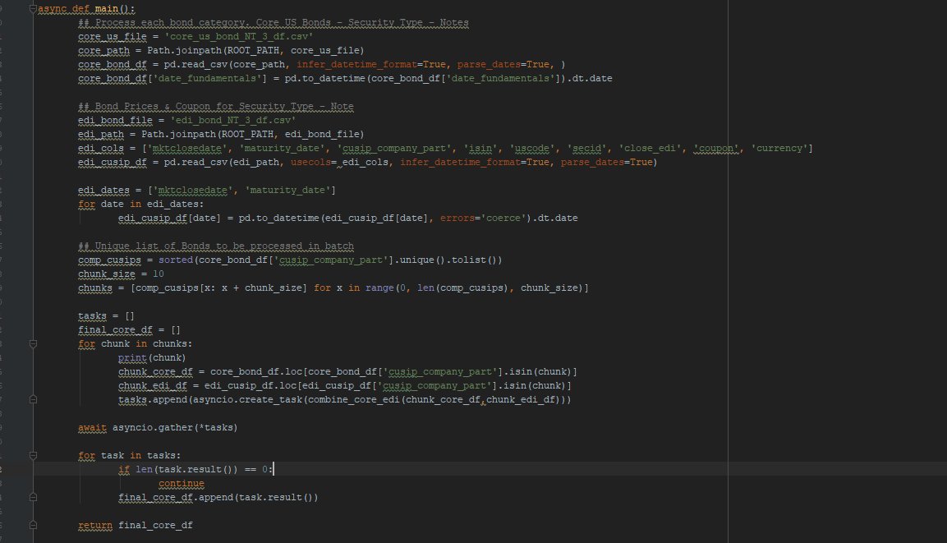
AsyncIO Concurrent Tasks:

Slide 8
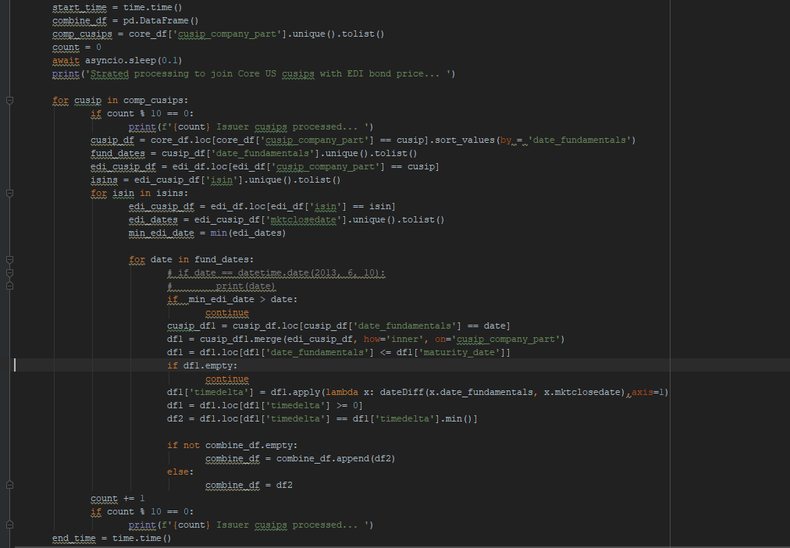
AsyncIO Concurrent Tasks:

Slide 9
Feature Selection
Scope: selected 4 out of 16 security types (Bonds, Debentures, Medium Term Notes, Notes)
Focused on absolute feature values vs trends
Number of Bonds - Total Issuers - 561 & Total Bonds - 865
Features Used:
Financials:
Revenue,EBITDA, EBITDA margin, Net inc, Net inc margin, Cash & equivalents, Working capital, Debt, Liabilities, Equity, Market cap, EV, FCF, Net CF/debt, Current ratio, Debt-to-equity ratio, Dividend yield, EPS, Payout ratio, EV/EBITDA, P/B, P/E,
Bond:
Bond price,
Coupon,
Maturity Date
Macroeconomic indicators:
30yr Treasury yield
3mo T-bill yield
GDP Growth
OIL
Inflation
VIX
Notes:
Ketan/Susan

Slide 10
MODELING

Slide 11
Logistic Regression
Logistic Regression is a statistical method for predicting binary outcomes from data.
from sklearn.linear_model import Logistic Regression
Dataset: original dataset
Train_test_split
Feature scaling using StandardScaler()
Key parameters:
C: float, default=1.0
Inverse of regularization strength; must be a positive float. Like in support vector machines, smaller values specify stronger regularization..
fit_intercept : bool, default=True
Specifies if a constant (a.k.a. bias or intercept) should be added to the decision function.
solver : {‘newton-cg’, ‘lbfgs’, ‘liblinear’, ‘sag’, ‘saga’}, default=’lbfgs’
For multiclass problems, only ‘newton-cg’, ‘sag’, ‘saga’ and ‘lbfgs’ handle multinomial loss
Model evaluation: classification report, balanced accuracy score, feature importance
Notes:
Susan

Slide 12
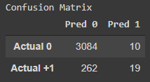
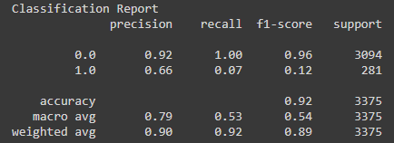
Logistic Regression: Original Data, Default Parameters
Notes:
Susan

Slide 13
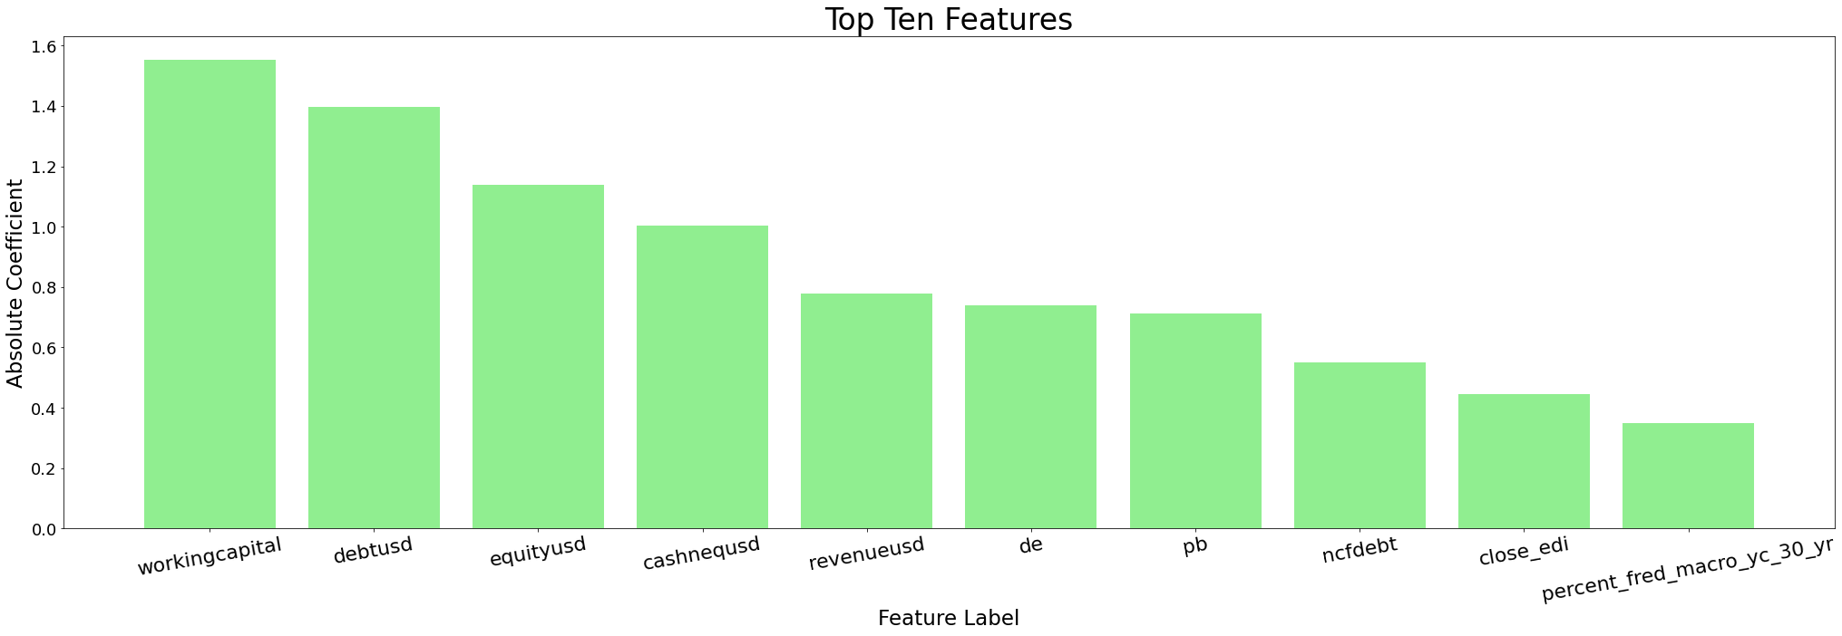
Visualizations: Logistic Regression
Notes:
Susan

Slide 14
Random Forest
Random forest is an ensemble of decision tree algorithms, popular machine learning algorithm across classification and regression problems
from sklearn.ensemble import RandomForestClassifier
Dataset: original, imbalanced dataset
Train_test_split
Feature scaling using StandardScaler()
Key hyperparameters:
max_samples: Default=None (sample size=training set size)
Tuning: [0.1-1] > sensitive
max_features: Default= sqrt(input features)
Tuning: [1-10]
n-estimators: Default= 100
Tuning: [10 - 1000]
max_depth: Default=None (arbitrary, no max. depth)
Tuning: [1-10] > sensitive
Model evaluation: classification report, balanced accuracy score, feature importance
Notes:
Kwame

Slide 15
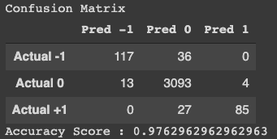
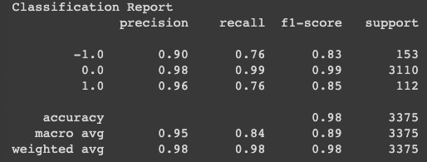
Random Forest: Original Data, Default Parameters
Notes:
Kwame

Slide 16
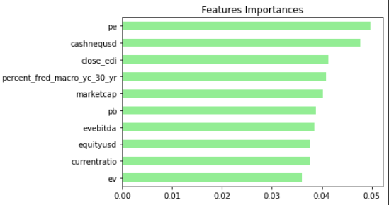
Random Forest: Original Data, Default Parameters
Notes:
Kwame

Slide 17
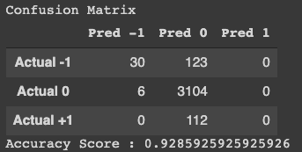
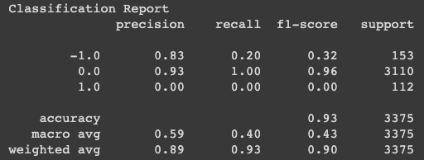
Random Forest: Original Data, Max_depth = 5
Notes:
Kwame

Slide 18
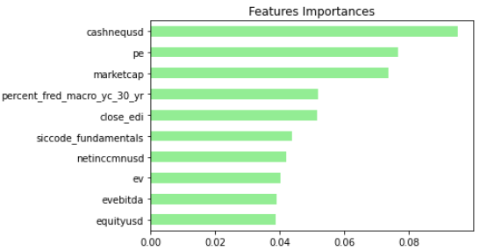
Random Forest: Original Data, Max_depth = 5
Notes:
Kwame

Slide 19
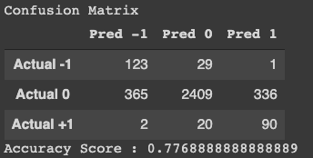
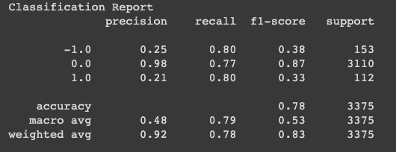
Random Forest: SMOTE Oversampling, Max_depth = 5
Notes:
Kwame

Slide 20
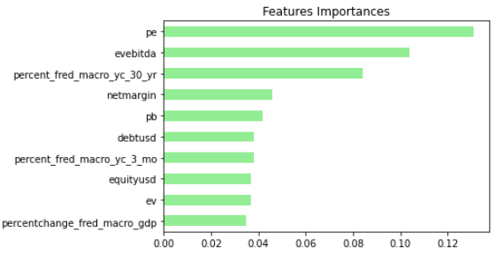
Random Forest: SMOTE Oversampling, Max_depth = 5
Notes:
Kwame

Slide 21
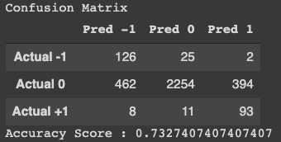
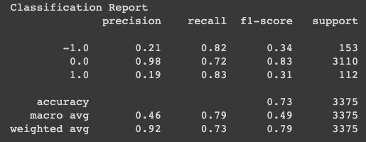
Random Forest: SMOTTEEN Resampling, Max_depth = 5
Notes:
Kwame

Slide 22
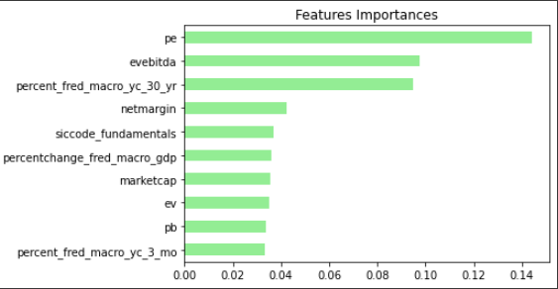
Random Forest: SMOTTEEN Resampling, Max_depth = 5
Notes:
Kwame

Slide 23
Gradient Boosting for Classification
from sklearn.ensemble import GradientBoostClassifier
Feature scaling using StandardScaler()
Key hyperparameters:
loss {‘deviance’, ‘exponential’}, default=’deviance’
The loss function to be optimized. ‘deviance’ refers to deviance (= logistic regression) for classification with probabilistic outputs. For loss ‘exponential’ gradient boosting recovers the AdaBoost algorithm.
learning_rate float, default=0.1
Learning rate shrinks the contribution of each tree by learning_rate. There is a trade-off between learning_rate and n_estimators.
n_estimators int, default=100
The number of boosting stages to perform. Gradient boosting is fairly robust to over-fitting so a large number usually results in better performance.
criterion{‘friedman_mse’, ‘mse’, ‘mae’}, default=’friedman_mse’
The function to measure the quality of a split. Supported criteria are ‘friedman_mse’ for the mean squared error with improvement score by Friedman, ‘mse’ for mean squared error, and ‘mae’ for the mean absolute error. The default value of ‘friedman_mse’ is generally the best as it can provide a better approximation in some cases.
Model evaluation: classification report, balanced accuracy score, feature importance
Notes:
Wes
Description of model
Parameters
Outputs
Our modeling setup (X, y, feature selection)

Slide 24
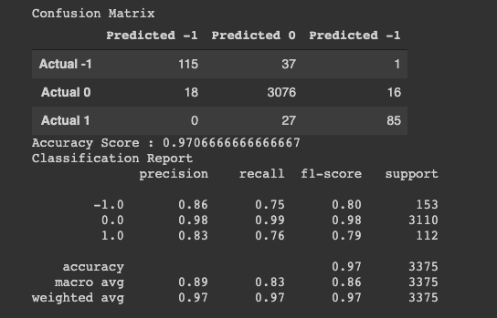
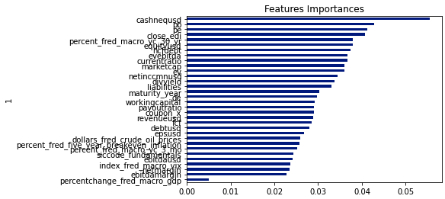
Visualizations: GradientBoost
Gradient Boosting - Classification Report, Confusion Matrix, Balanced Accuracy Score, Feature Importance
Notes:
Wes

Slide 25
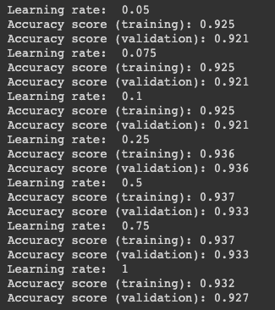
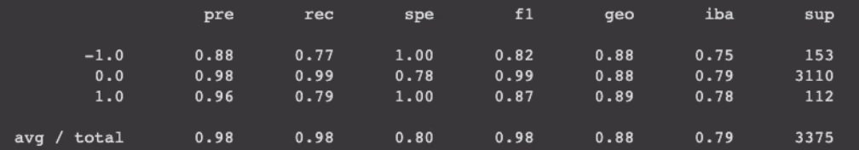
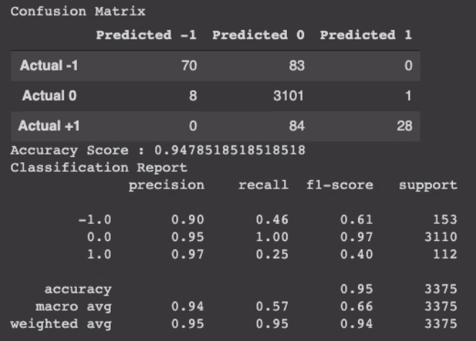
Visualizations: GradientBoost
Gradient Boosting - Classification Report, Confusion Matrix, Balanced Accuracy Score, Feature Importance
Notes:
Wes

Slide 26
CONCLUSION

Slide 27
Conclusions/Future Improvements
Understanding and manipulating large number of sizable datasets is a big job
Random Forest and Gradient Boost models seem to outperform Logistic Regression model with balanced accuracy scores of around 83% using the original, imbalanced dataset
Rebalancing dataset via SMOTE or SMOTEENN improved performance of Random Forest all other things being equal
Future improvements:
Enhance the dataset from the current 13,000 of eligible records
Enhance current features by applying transformations like trended features for corporate financial data
Include additional features like equity prices
Explore more granular target variables like future rating and future rating changes
Further model parameter finetuning
Notes:
Kwame/Wes?

