Slide 1

ESMAM ALGORITHM
FINAL VERSION

Slide 2



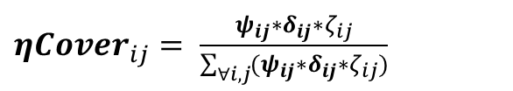
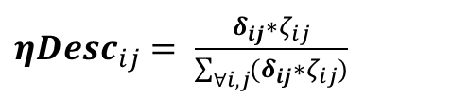

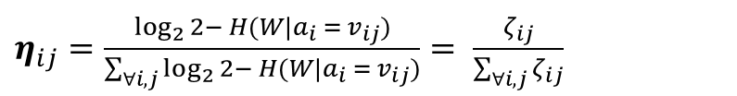
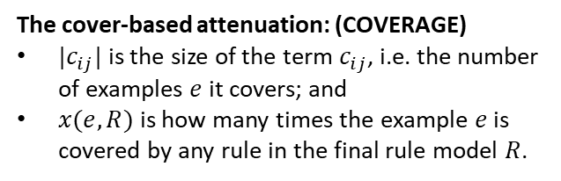
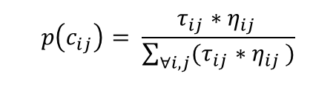
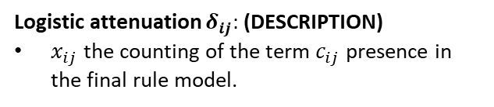
IMPLEMENTED ALGORITHMS
v2
v4
Logistic attenuation
Weighted cover
vs.
Population
BRACIS
v0
v1
v3
Quantile Discretisation
Dataset stagnation
Logistic attenuation
Weighted cover
vs.
Complement
RESULTS AND POST-PROCESSING CODES OF THE ABOVE DEVELOPING ARE IN D:\GoogleDrive\Mestrado-UFPE\_Pesquisa-Mestrado\__ESM-AM\_algorithm_improvement_results
TRANSITION RULE
Approached degrees of redundancy:
$$p\left(c_{ij}\right)= \frac{τ_{ij}∗η_{ij }}{\sum_{∀i,j}{(τ_{ij}∗η_{ij })}}$$
$$δ_{ij}=1−\frac{1}{1+e^{−\left(x_{ij}−5\right)}}$$
$$ψ_{ij}=\frac{1}{\left|c_{ij}\right|}\sum_{e ∈c_{ij}}{{0.9}^{x\left(e,R\right)}}$$
Logistic attenuation $δ_{ij}:$ (DESCRIPTION)
$x_{ij}$ the counting of the term $c_{ij}$ presence in the final rule model.
The cover-based attenuation: (COVERAGE)
$|c_{ij}|$ is the size of the term $c_{ij}$, i.e. the number of examples $e$ it covers; and
$x(e,R)$ is how many times the example $e$ is covered by any rule in the final rule model $R$.
$η_{ij}=\frac{\log_{2}{2− H(W|a_{i} = v_{ij})}}{\sum_{∀i,j}{\log_{2}{2− H(W|a_{i} = v_{ij})}}}= \frac{ζ_{ij}}{\sum_{∀i,j}{ζ_{ij}}}$
${ηDesc}_{ij}= \frac{{δ_{ij}∗ζ}_{ij}}{\sum_{∀i,j}{(δ_{ij}∗ζ_{ij})}}$
${ηCover}_{ij}= \frac{ψ_{ij}∗δ_{ij}∗ζ_{ij}}{\sum_{∀i,j}{({ψ_{ij}∗δ}_{ij}∗ζ_{ij})}}$
HEURISTIC FUNCTIONS

Slide 3
PROBLEM
MANY RULES WITH SIMILAR MODELS
Keep the general one
TERM
INTERSECTION
R0: ('X204015_s_at', '[7.00,8.00)')
R1: ('X204015_s_at', '[7.00,8.00)') & ('X217815_at', '[10.00,10.00]')
NO
INTERSECTION
R2: ('size', '[1.00,2.00)')
R5: ('X202240_at', '[6.00,7.00)')
Add both rules
ATTRIBUTE
INTERSECTION
R5: ('X202240_at', '[6.00,7.00)')
R6: ('X202240_at', '[4.00,6.00)')
Try to merge

Slide 4

PROPOSAL
R0: ('X204015_s_at', '[7.00,8.00)')
R1: ('X204015_s_at', '[7.00,8.00)') & ('X217815_at', '[10.00,10.00]')
R5: ('X202240_at', '[6.00,7.00)')
R6: ('X202240_at', '[4.00,6.00)')
SIMILAR MODELS
&
SIMILARITIES IN DESCRIPTION
KEEP GENERALIZATION
CHANGE THE FUNCTION FOR ADDING RULES TO THE LIST
proposal:
v2
v4
v6
Logistic attenuation
Weighted cover
New rule addition
vs.
Population
BRACIS
v0
v1
v3
v5
Quantile Discretisation
Dataset stagnation
Logistic attenuation
Weighted cover
New rule addition
vs.
Complement

Slide 5

FINAL VERSION: ESMAM-DS (Diverse Search)
Diverse Search
ESMAM-DS
Dynamic heuristic function
New addition rule
vs.
Population
BRACIS
v0
ESMAM-DS
Quantile Discretisation
Dataset stagnation
Dynamic heuristic function
New addition rule
vs.
Complement
v2
v4
v6
Logistic attenuation
Weighted cover
New rule addition
vs.
Population
BRACIS
v0
v1
v3
v5
Quantile Discretisation
Dataset stagnation
Logistic attenuation
Weighted cover
New rule addition
vs.
Complement

Slide 6
FINAL VERSION: ESMAM-DS (Diverse Search)
Diverse Search
DIVERSITY
ESMAM-DS
Dynamic heuristic function
New addition rule
vs.
Population
BRACIS
v0
Search Exploration
Tackling description and cover redundancy
RuleSet Diversity Tackling description and model redundancy
ESMAM-DS
Quantile Discretisation
Dataset stagnation
vs.
Complement
v2
v4
v6
Logistic attenuation
Weighted cover
New rule addition
vs.
Population
BRACIS
v0
v1
v3
v5
Quantile Discretisation
Dataset stagnation
Logistic attenuation
Weighted cover
New rule addition
vs.
Complement

Slide 7
FINAL VERSION: ESMAM-DS (Diverse Search)
Diverse Search
ESMAM
DIVERSITY
ESMAM-DS
Dynamic heuristic function
New addition rule
vs.
Population
BRACIS
v0
ESMAM
Search Exploration
Tackling description and cover redundancy
RuleSet Diversity Tackling description and model redundancy
ESMAM-DS
Discretisation
Algorithm stagnation
Rule construction
vs.
Complement
STRUCTURAL ADJUSTMENTS
Discretisation: using quantile (equal frequency) [instead of Kmeans]
Algorithm stagnation: removed max_uncovered_cases: executes until covers all, or dataset stagnation (20 its – no change in coverage) or heuristic goes to zero
Rule construction: iteratively constructed by sorting from the set of items related to the partial-rule coverage [instead from the hole set of items]
Min_cases_per_rule: a percentual (5%) from population

Slide 8

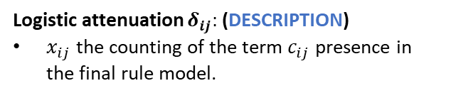


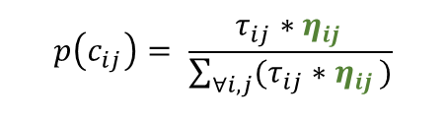
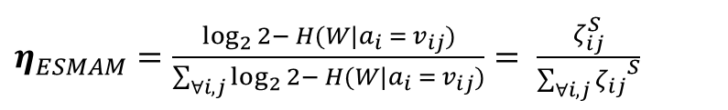
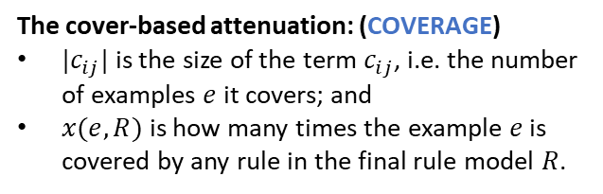
TACKLING REDUNDANCY: SEARCH EXPLORATION
DIVERSITY
Dynamic heuristic function
Approached degrees of redundancy:
$η_{ESMAM}=\frac{\log_{2}{2− H(W|a_{i} = v_{ij})}}{\sum_{∀i,j}{\log_{2}{2− H(W|a_{i} = v_{ij})}}}= \frac{ζ_{ij}^{S}}{{\sum_{∀i,j}{ζ_{ij}}}^{S}}$
$$δ_{ij}=1−\frac{1}{1+e^{−\left(x_{ij}−5\right)}}$$
Search Exploration
Tackling description and cover redundancy
*
Logistic attenuation $δ_{ij}:$ (DESCRIPTION)
$x_{ij}$ the counting of the term $c_{ij}$ presence in the final rule model.
$η_{ESMAM−DS}= \frac{ψ_{ij}∗δ_{ij}∗ζ_{ij}^{D}}{\sum_{∀i,j}{({ψ_{ij}∗δ}_{ij}∗ζ_{ij}^{D})}}$
$$ψ_{ij}=\frac{1}{\left|c_{ij}\right|}\sum_{e ∈c_{ij}}{{0.9}^{x\left(e,R\right)}}$$
[S] STATIC: over initial set (initialization)
[D] DINAMIC: over the uncovered set
TRANSITION RULE
*
The cover-based attenuation: (COVERAGE)
$|c_{ij}|$ is the size of the term $c_{ij}$, i.e. the number of examples $e$ it covers; and
$x(e,R)$ is how many times the example $e$ is covered by any rule in the final rule model $R$.
$$p\left(c_{ij}\right)= \frac{τ_{ij}∗η_{ij }}{\sum_{∀i,j}{(τ_{ij}∗η_{ij })}}$$
OBS.: A term only has $ζ_{ij}!=0$ if it covers more than minimum cases

Slide 9


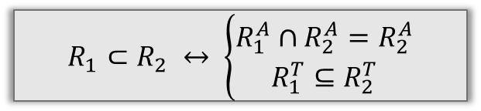
TACKLING REDUNDANCY: SEARCH EXPLORATION
DIVERSITY
R0: ('X204015_s_at', '[7.00,8.00)')
R1: ('X204015_s_at', '[7.00,8.00)') & ('X217815_at', '[10.00,10.00]')
New addition rule
R5: ('X202240_at', '[6.00,7.00)')
R6: ('X202240_at', '[4.00,6.00)')
RuleSet Diversity Tackling description and model redundancy
SIMILAR MODELS
&
SIMILARITIES IN DESCRIPTION
KEEP GENERALIZATION
INITIAL DEFINITIONS:
$$dataset:Ω$$
Rule $R_{1}$ IS IN $R_{2}$
$$A=\left(a_{1},…,a_{n}\right) −descriptive attributes$$
$$V^{i}=\left(v_{1}^{i},…,v_{k}^{i}\right)∀i∈\left(1,n\right)−values of a_{i} domain$$
$$R_{1}⊂R_{2} ↔ \left\{\begin{aligned}R_{1}^{A}∩R_{2}^{A}=R_{2}^{A} \\ R_{1}^{T}⊆R_{2}^{T}\end{aligned}\right.$$
$T=\{(a_{i}={\{v}_{j}^{i}\})|∀a_{i}∈A \& v_{j}^{i}∈V^{i}\}$ – the set of Terms
$$R^{A} −the set of attributes in R description$$
DESCRIPTION GENERALITY
$$R^{T} −the set of terms in R description$$

Slide 10
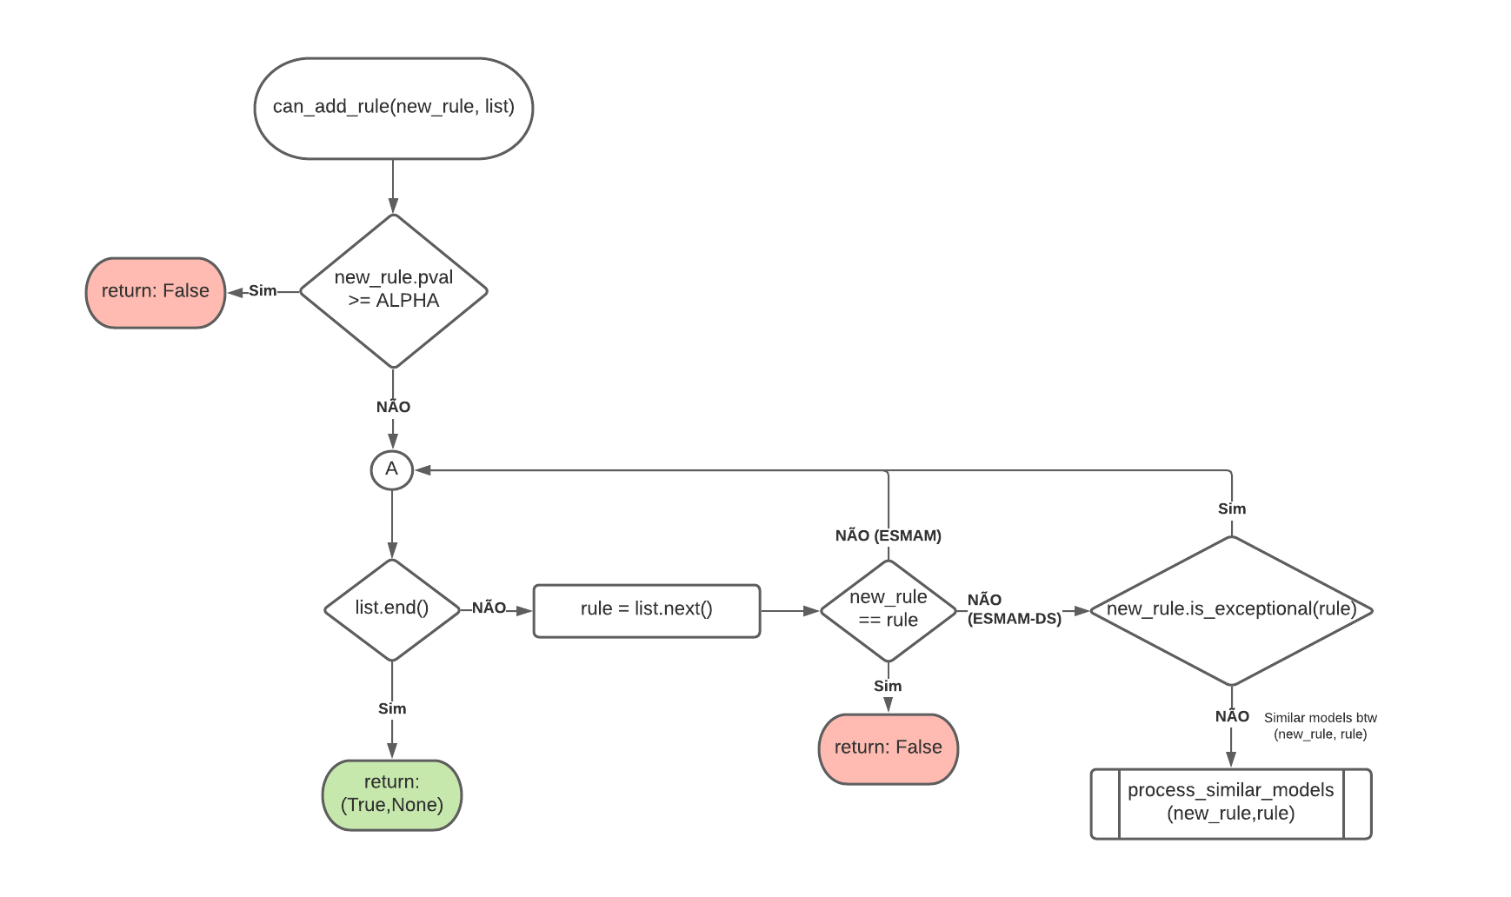
TACKLING REDUNDANCY: RULE SELECTION
DIVERSITY
New addition rule
RuleSet Diversity Tackling description and model redundancy
Model diversity
Description diversity

Slide 11
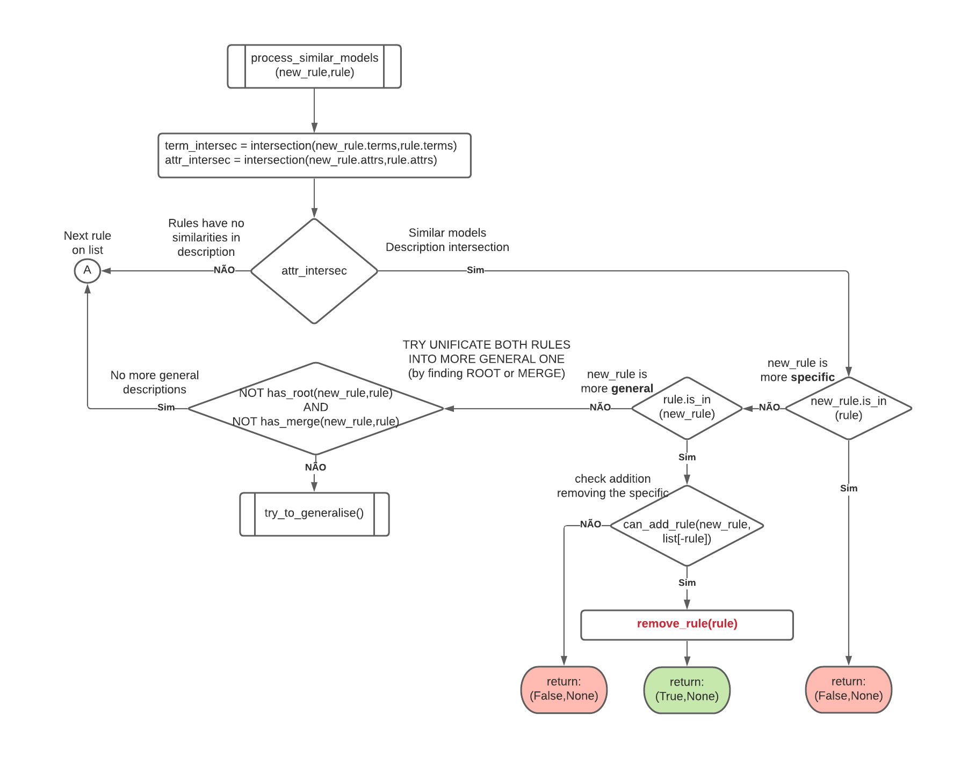
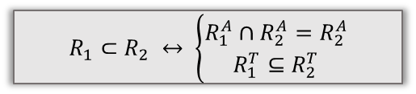



TACKLING REDUNDANCY: RULE SELECTION
DIVERSITY
For rules with similar models
New addition rule
RuleSet Diversity Tackling description and model redundancy
New_rule is more GENERAL than existent rule
New_rule is more SPECIFIC than existent rule
MERGE
&
ROOT
GENERALIZATION
Rule $R_{1}$ IS IN $R_{2}$
$$MERGE(R_{1},R_{2})↔R_{1}^{A}=R_{2}^{A}$$
$$R_{1}⊂R_{2} ↔ \left\{\begin{aligned}R_{1}^{A}∩R_{2}^{A}=R_{2}^{A} \\ R_{1}^{T}⊆R_{2}^{T}\end{aligned}\right.$$
OTHER
GENERALIZATION
$$R_{MERGE}=R_{1}^{T}∪R_{2}^{T}$$
$$ROOT\left(R_{1},R_{2}\right)=R_{1}^{T}∩R_{2}^{T}↔∃{ R}_{1}^{T}∩R_{2}^{T}$$

Slide 12
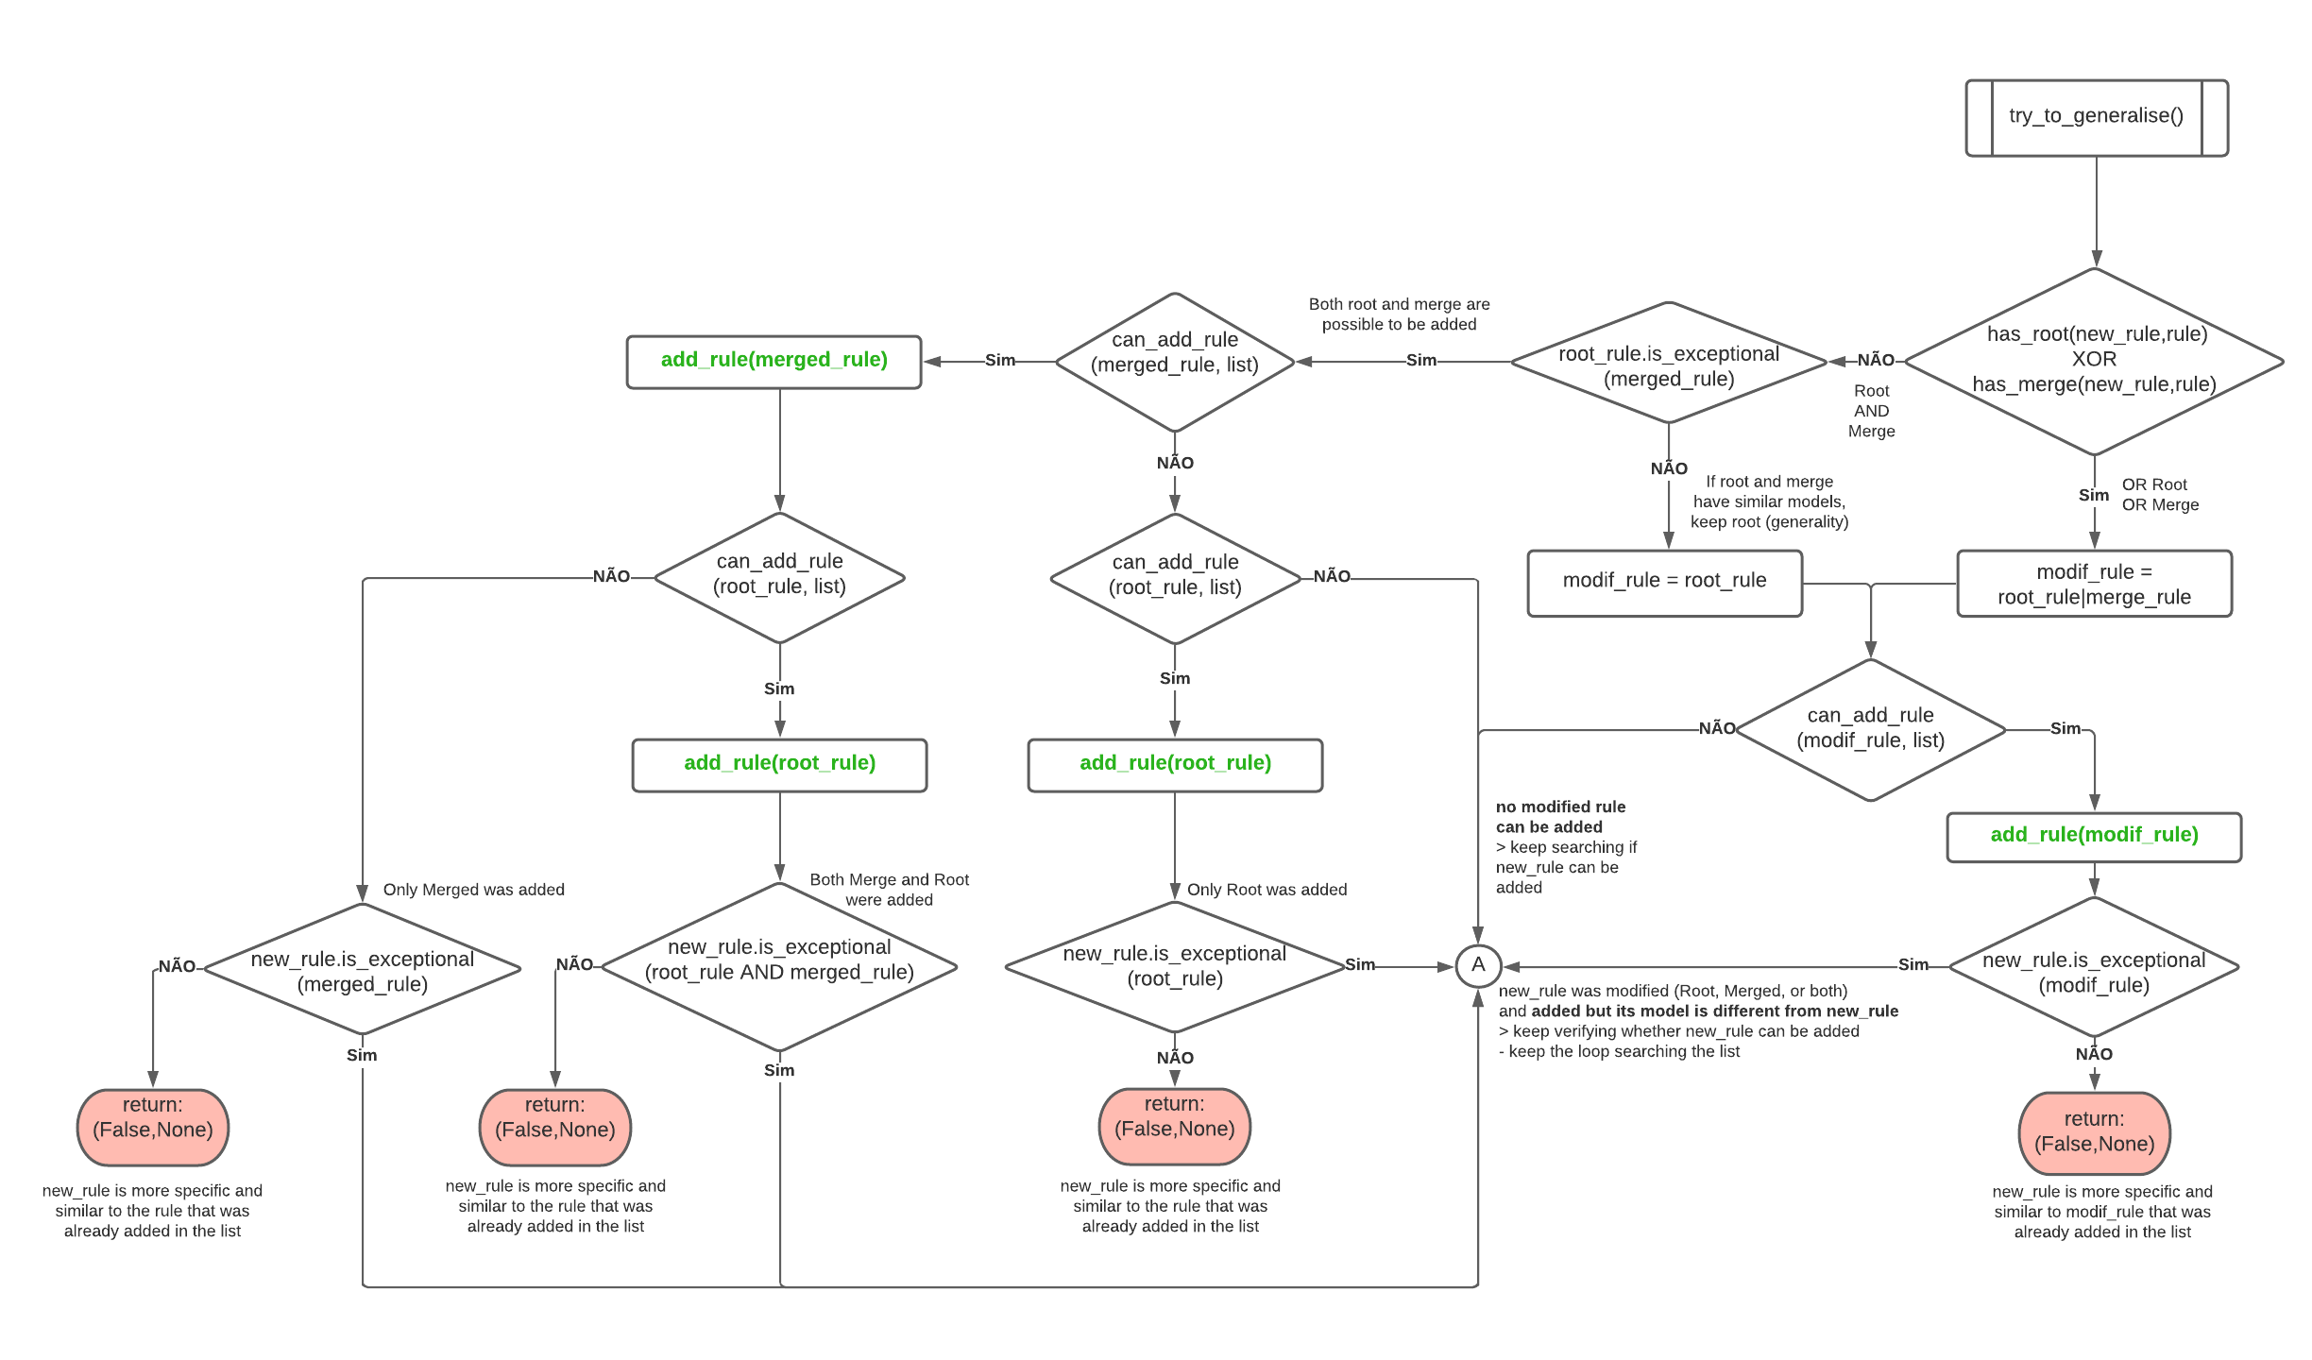
TACKLING REDUNDANCY: RULE SELECTION
DIVERSITY
Root and Merge have different models
Root and Merge have similar models
Only one generalisation is possible
New addition rule
RuleSet Diversity Tackling description and model redundancy
new_rule was generalised and the generalisation was added
- If new_rule model is different from the added generalisation > goes to next in list

Slide 13
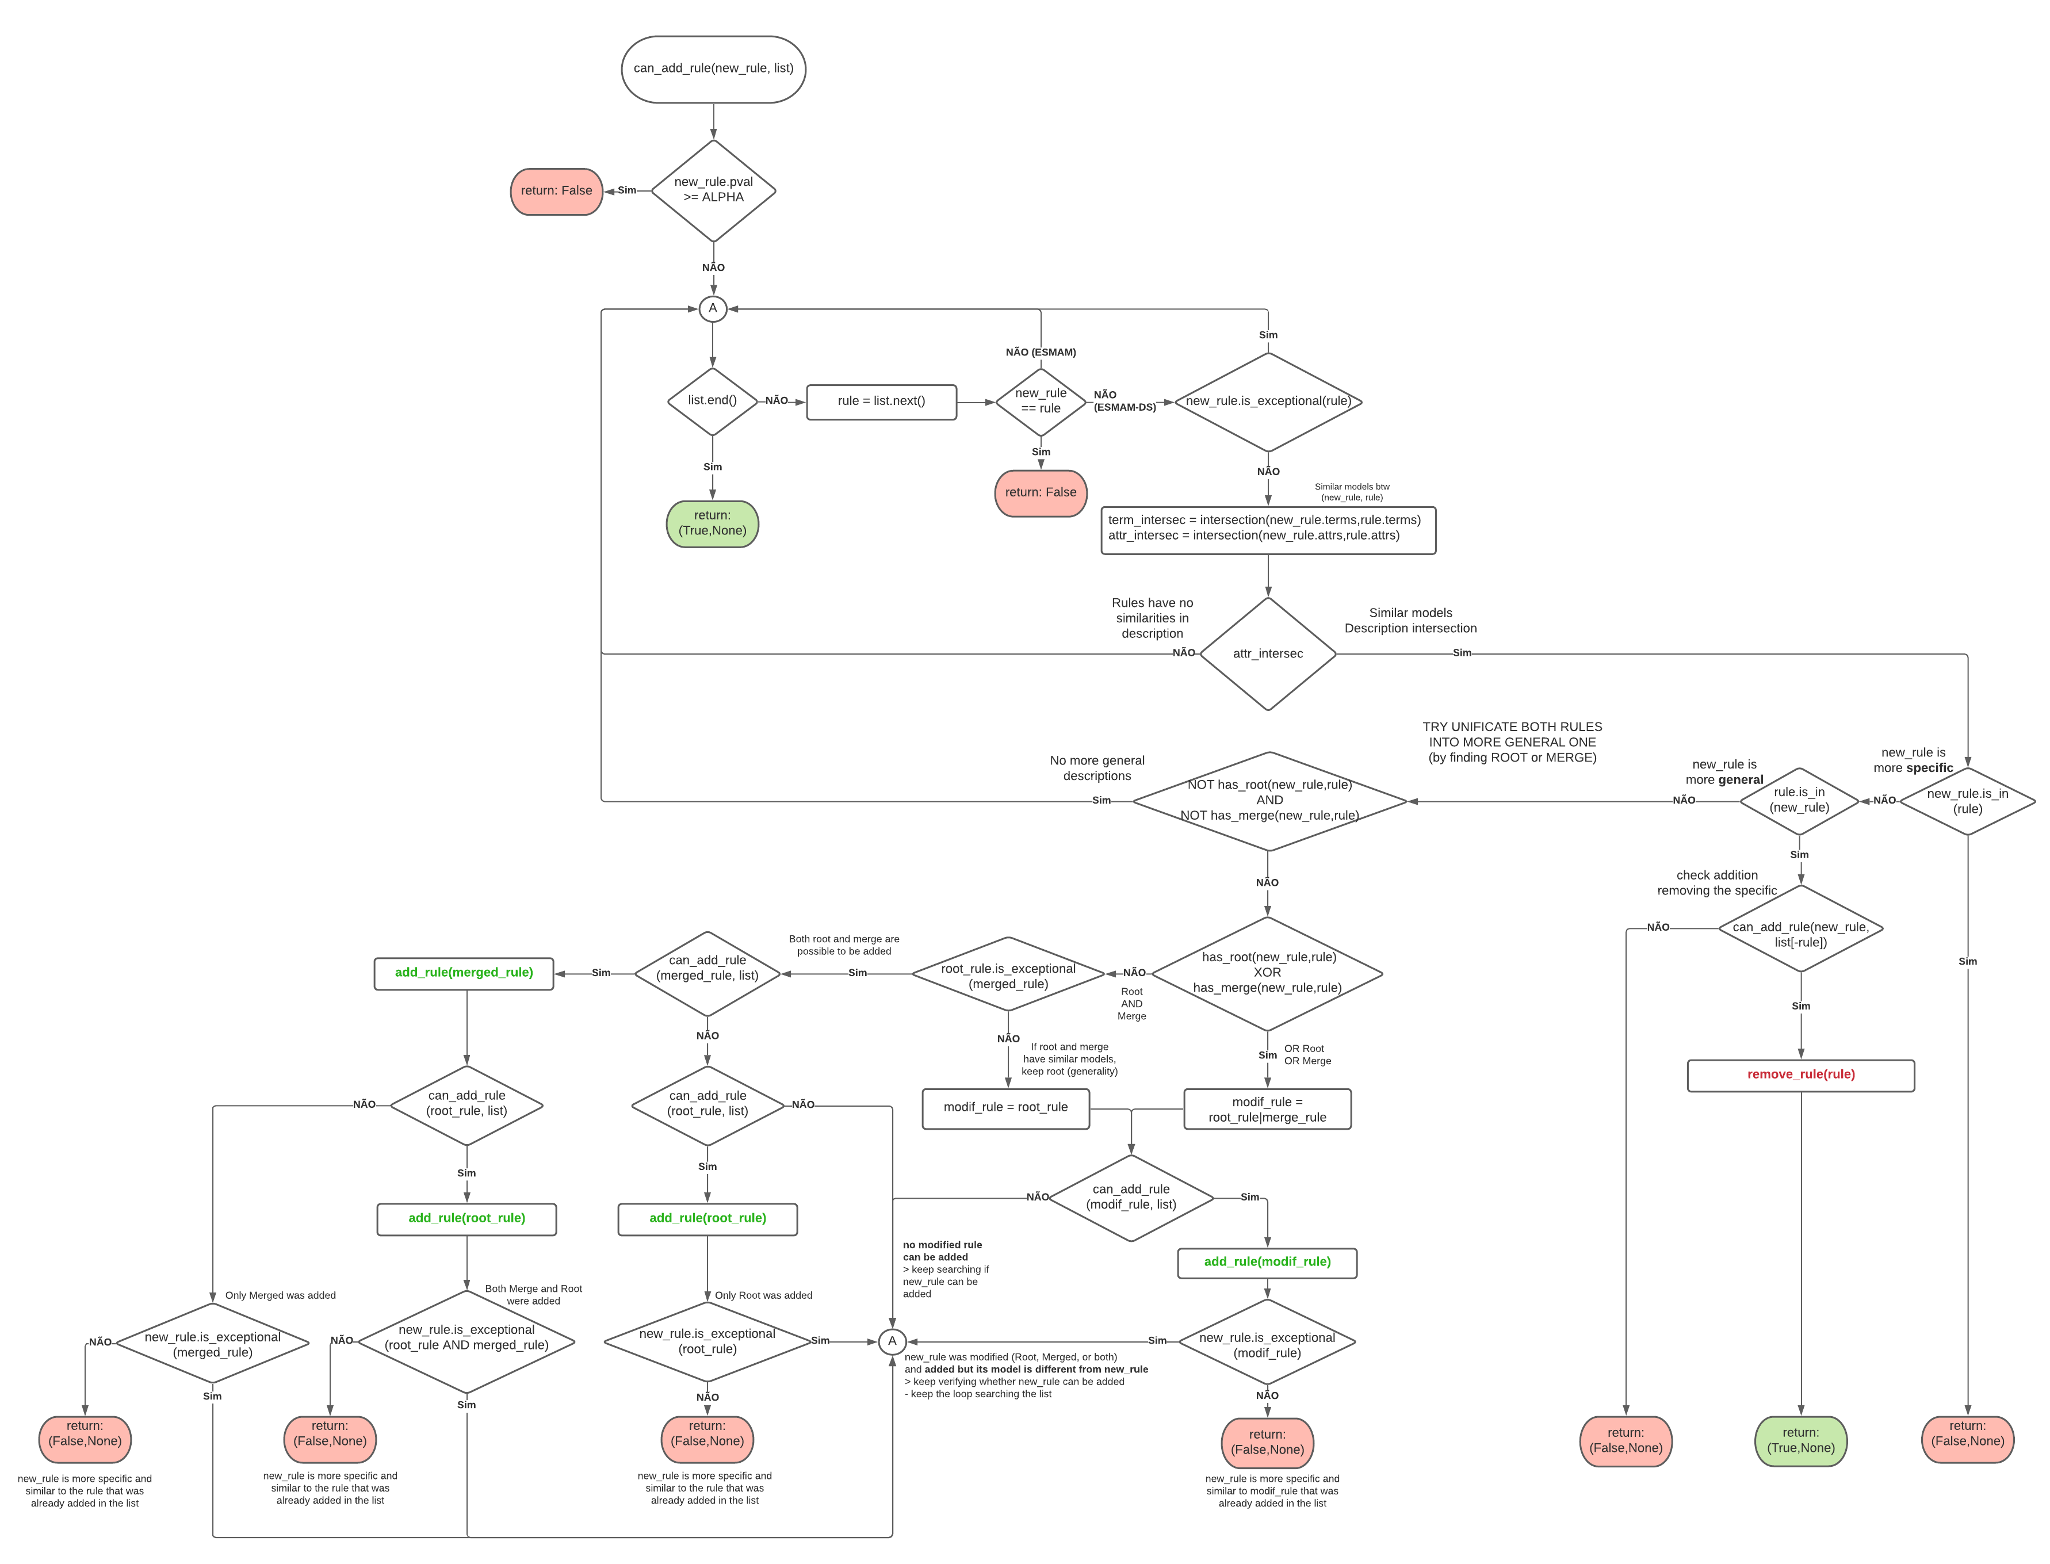
TACKLING REDUNDANCY: RULE SELECTION
DIVERSITY
New addition rule
RuleSet Diversity Tackling description and model redundancy

Slide 14
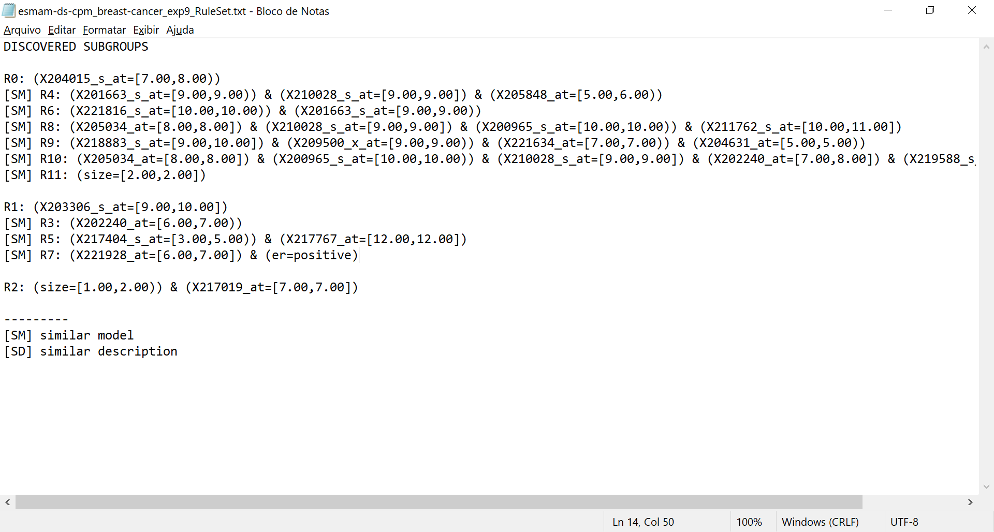
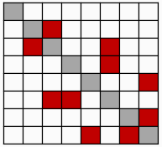
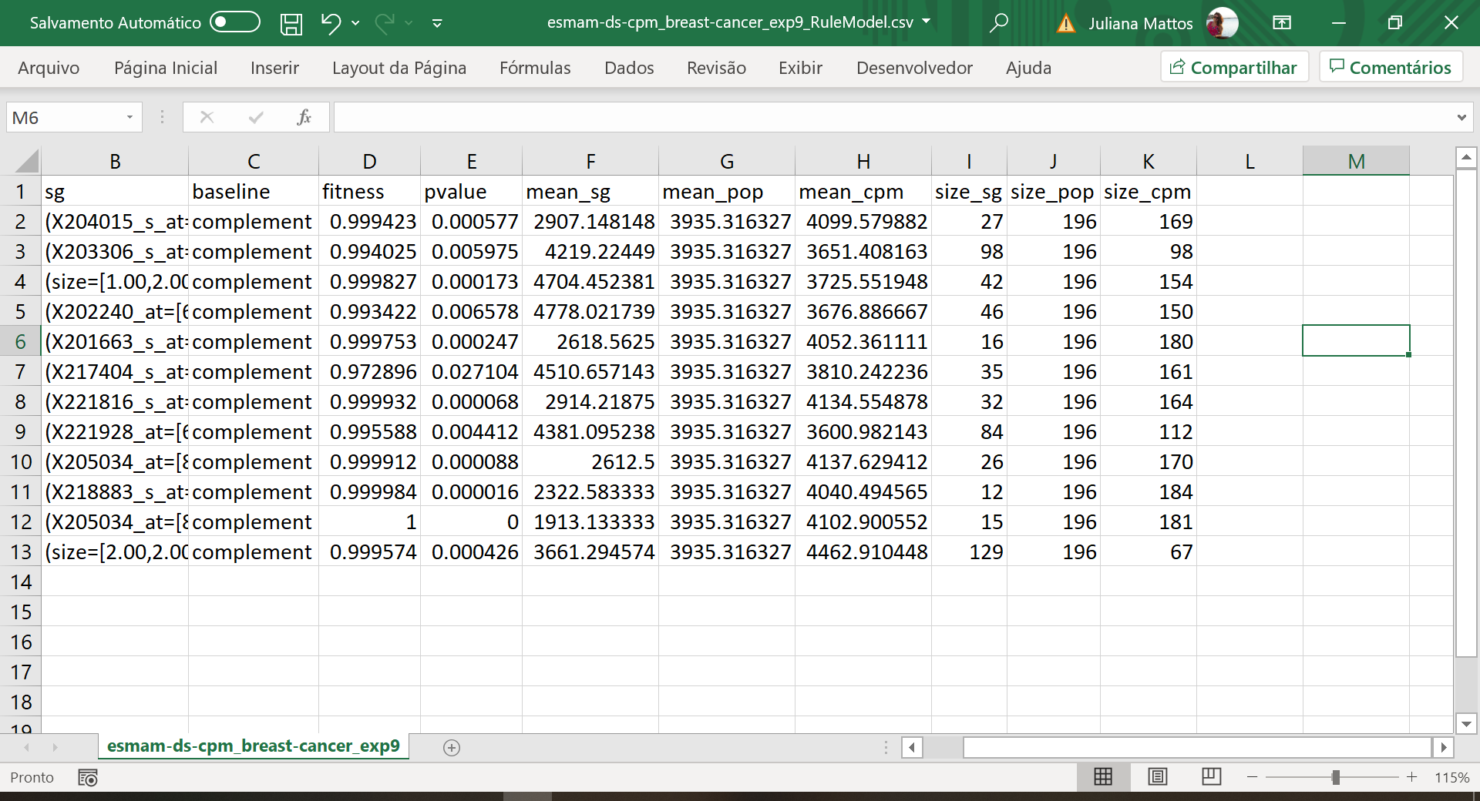
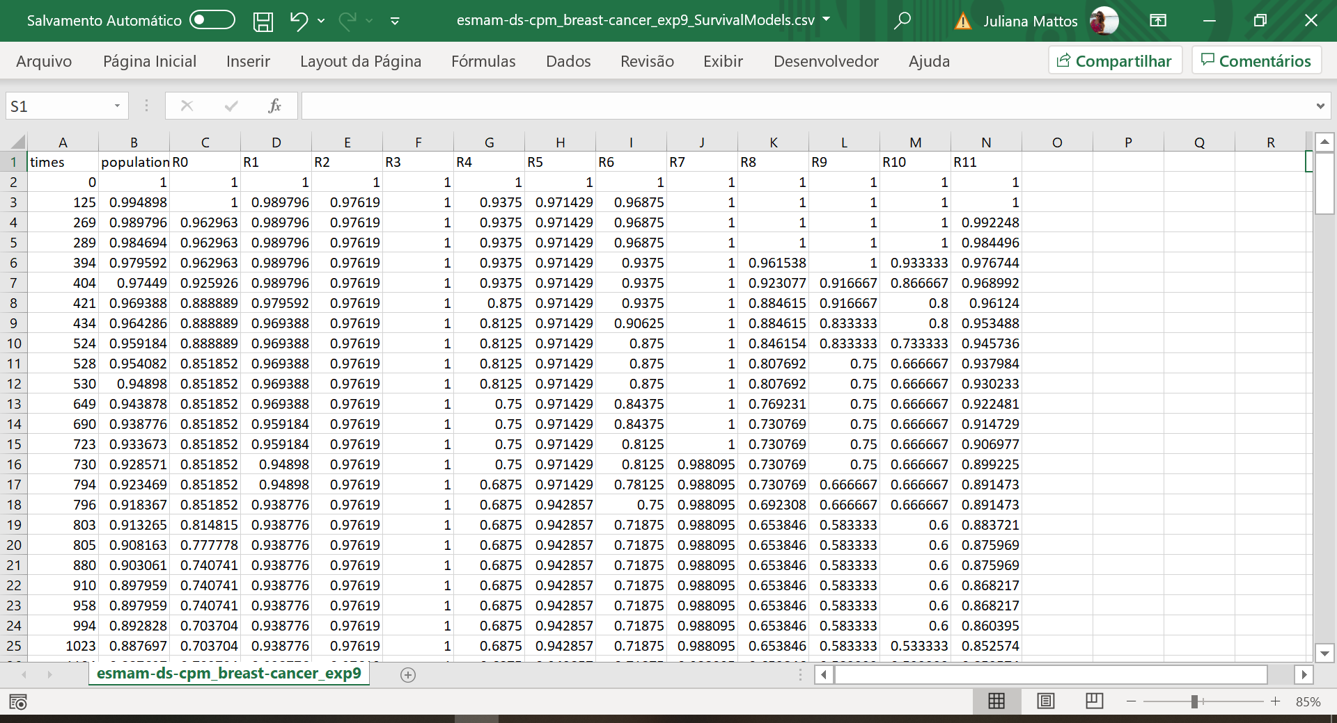
RESULTS DISPLAY
RuleSet.txt
Rules
Disjunctive rules: different rules but similar models
HYPER-PARAMETERS
Rules
P-VALUES
MIN_SIZE_SUBGROUP = 0.05 WEIGH_SCORE = 0.9 F_LOGISTIC_OFFSET = 5 ALPHA = 0.05 ITS_TO_STAGNATION = 20 RULES_TO_CONVERGENCE = 10 NUM_OF_ANTS = 3000 JACCARD_THRESHOLD = 0.5
Rules
JACCARD INDEX
Grouped rules: different rules but similar descriptions
Rules
PARAMETERS
SG_BASELINE = ['complement’,
'population'] DIVERSE_SEARCH = [True,
False]
RuleModel.csv
SurvivalModels.csv

Slide 15

STATISTICAL TESTS
14 datasets
30 experiments
Keeping the same seed for equivalent executions (same dataset & experiment)
BRACIS
ESMAM
ESMAM
ESMAM-DS
Discretisation
Algorithm stagnation
Rule construction
Dynamic heuristic function
New addition rule
vs.
Complement & Population
NEXT: adjust codes for computing results
DISCUSS: which metrics and results are to compute

