Slide 1

IPM – Assignment 1
Pedro Gasparinho
Lab class P1
Number 60590
Willyam Bradberry/Shutterstock.com

Slide 2

Introduction
Be-fit is a gym chain
Like many others they have a mobile app
Main features: training plans and diet plans

Slide 3
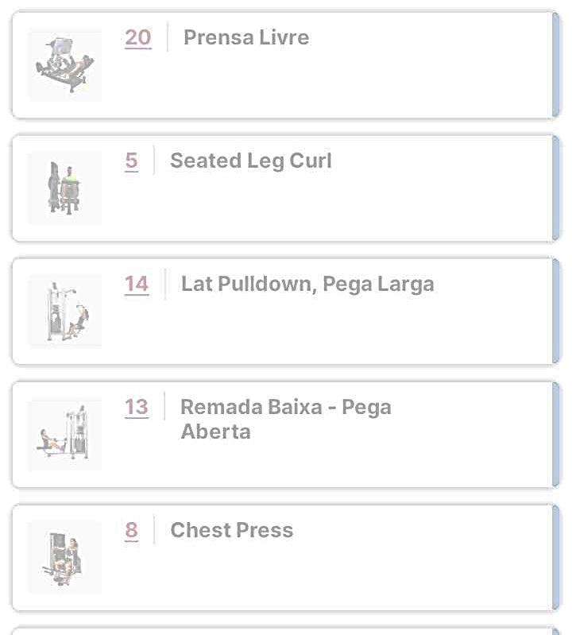
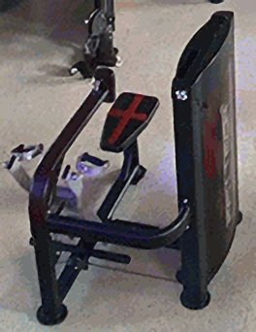
Good Design
Each type of machine is attributed a unique number
In the app, the exercises have the number of the machine needed to perform it
This helps users locate the machine before performing the exercise, in case they’re new to the gym

Slide 4
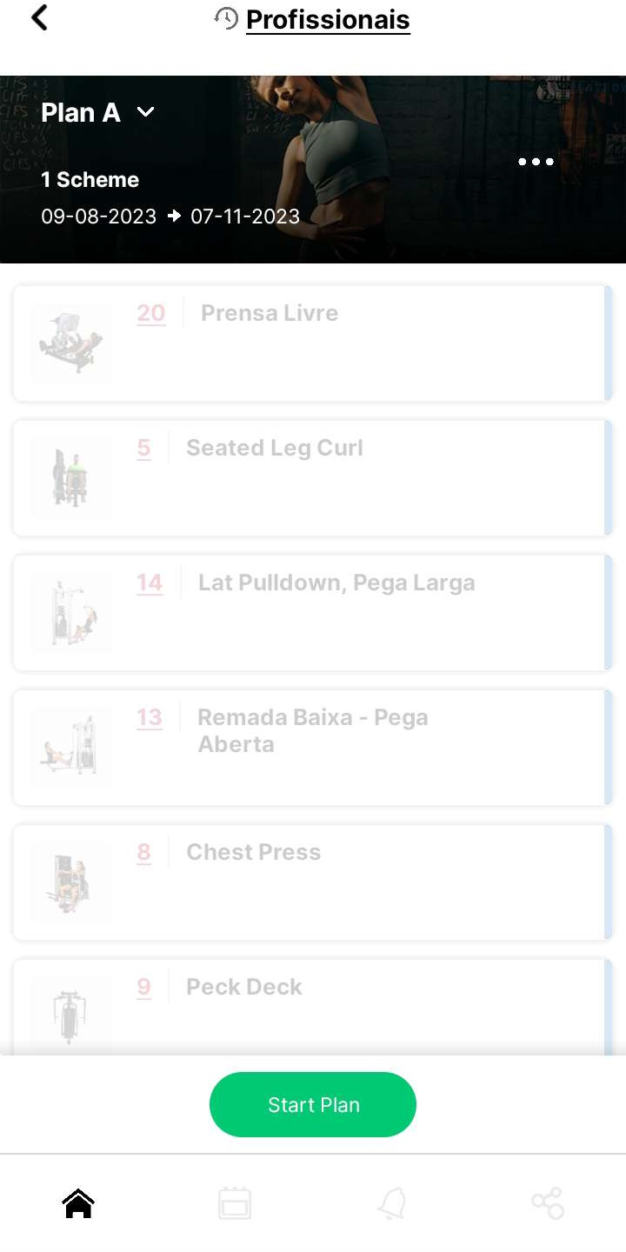
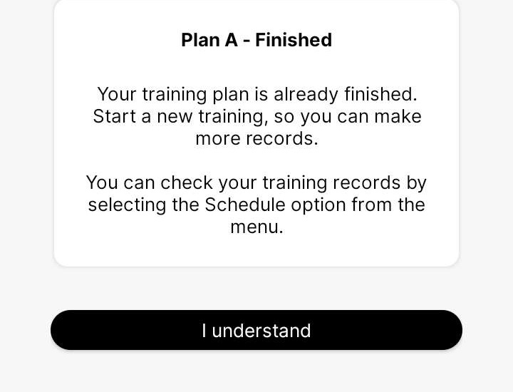
Bad Design
During a free physical evaluation the Personal Trainer in charge creates you a training plan
That plan is available in the app, however to see the exercises in depth you have to start the train, and then you should also finish it because there is a timer counting the time past
To solve this issue, I suggest that exercises are available to see at anytime.

