Slide 1
[Project Dome]
4th Year Software Development GMIT

Slide 2
Contents
System Architecture
Technologies
Insights

Slide 3
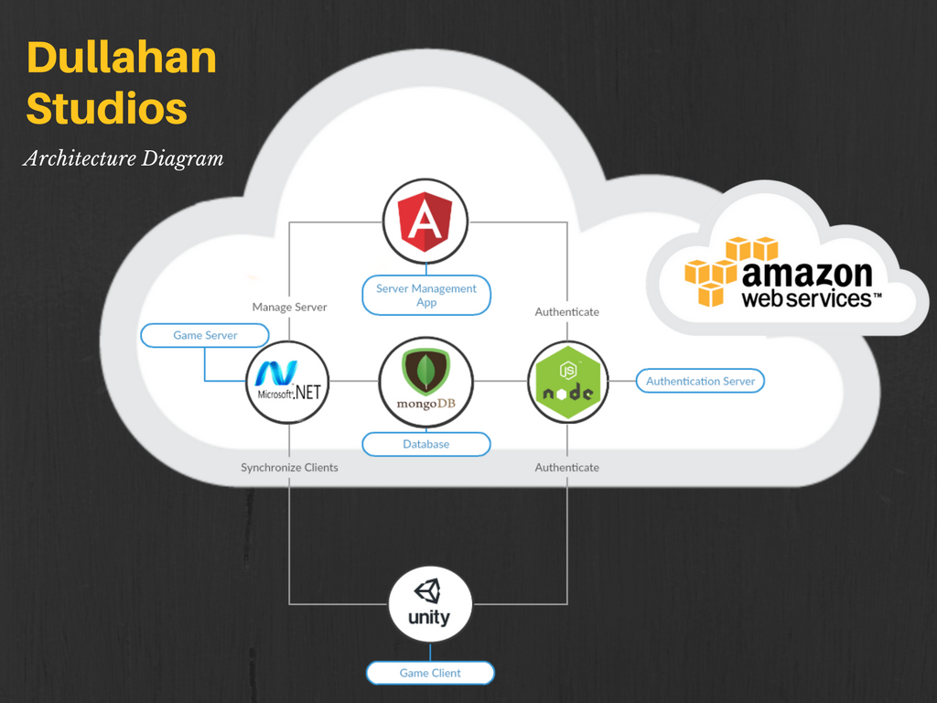
System Architecture / Design

Slide 4
Technologies
GameClient Built with Unity.
LoginServer on NodeJs and Express.
Game Server on dotNet.
MongoDB hosted on mLab.
Management App on Angular 5.

Slide 5
Insights
Main language used is C# followed by typescript and JavaScript.
Full-stack project (MEAN + Client Server .NET architecture)
Microservices oriented.

Slide 6
Add a Slide Title - 1

Slide 7
Add a Slide Title - 2

Slide 8
Add a Slide Title - 3

Slide 10
Add a Slide Title - 4

Slide 11
Add a Slide Title - 5

