Slide 1
[Project Dome]
4th Year Software Development GMIT

Slide 2
Contents
Objectives
System Architecture
Technologies
Insights

Slide 3
Objectives
Initial
Final
Story based game
Multiplayer
Focus on game mechanics
Multiplayer
Architecture oriented
Microservices
Focus on overall system.

Slide 4
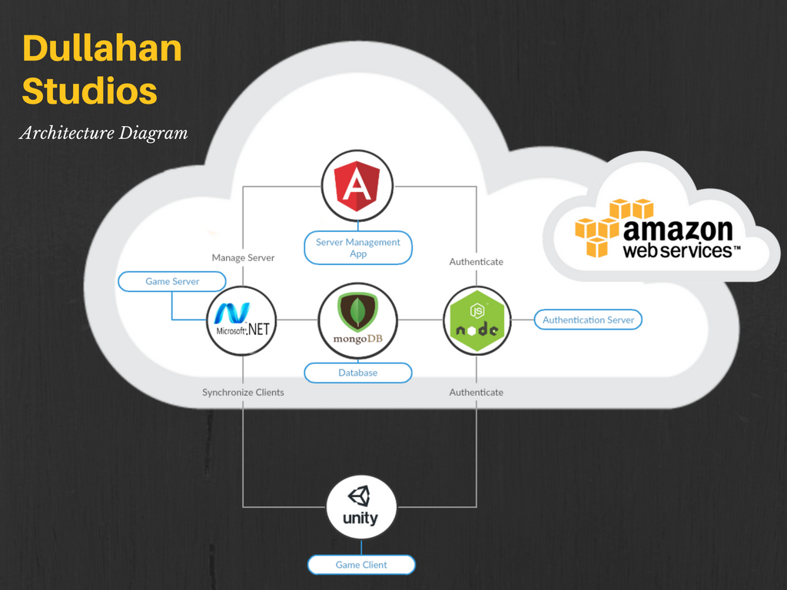
System Architecture / Design

Slide 5
Technologies
GameClient Built with Unity.
LoginServer on NodeJs and Express.
Game Server on dotNet.
MongoDB hosted on mLab.
Management App on Angular 5.

Slide 6
Insights
Main language used is C# followed by typescript and JavaScript.
Full-stack project (MEAN + Client Server .NET architecture)
Microservices oriented.

Slide 7
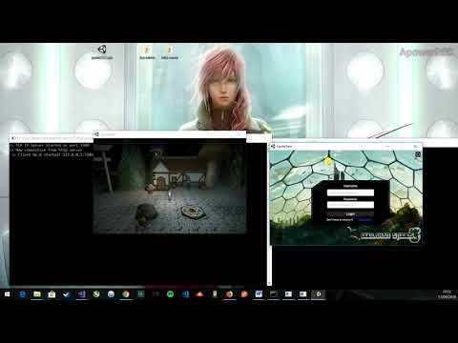
Project Demo
Small video demonstrating components working all together.

