Slide 1
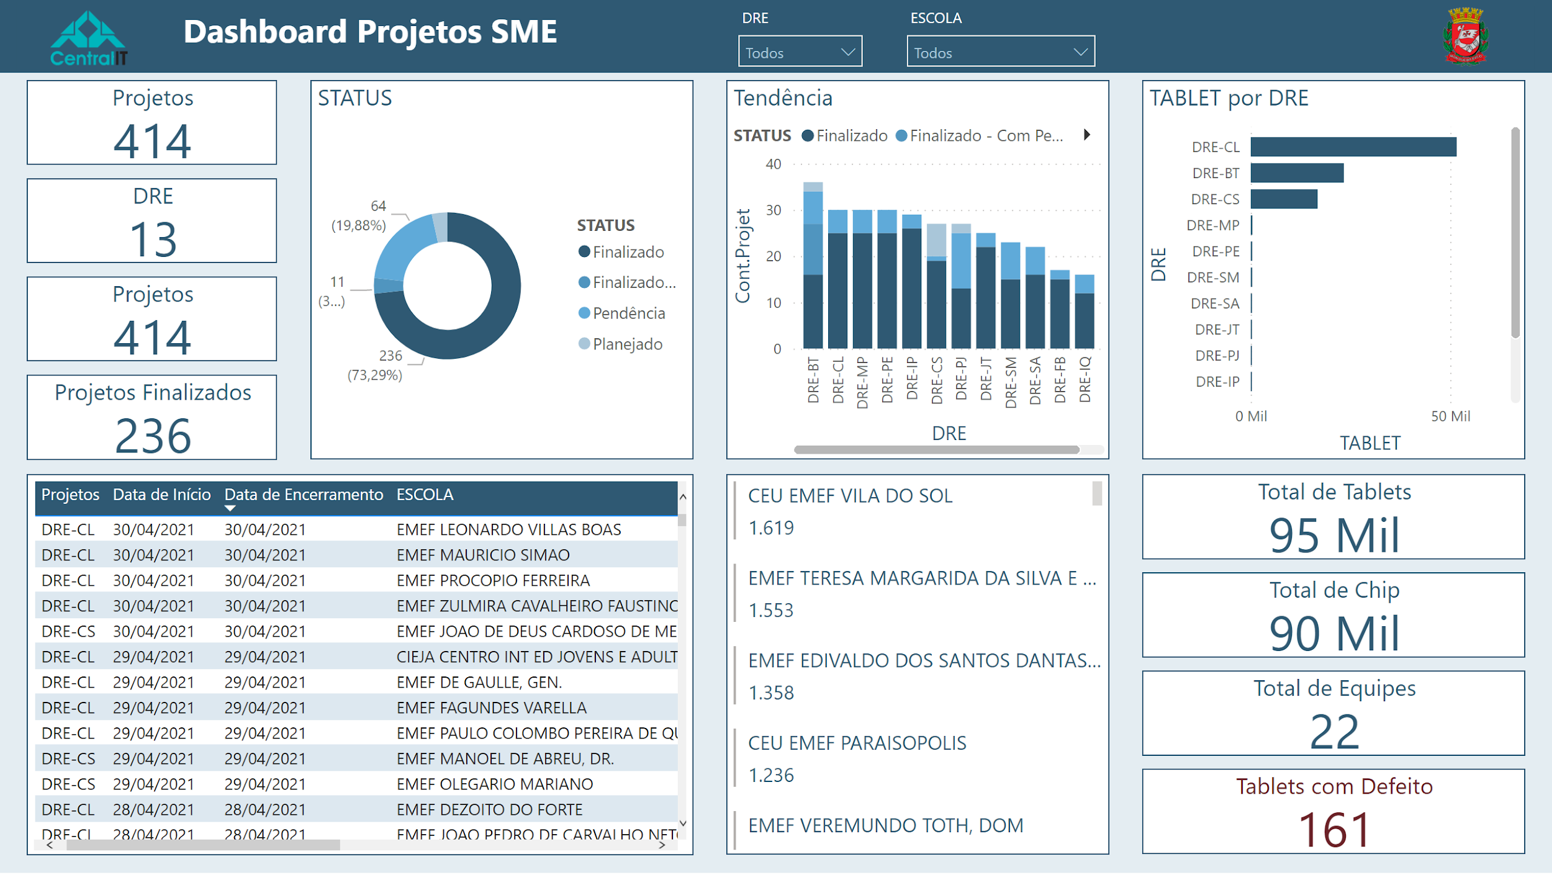
Notes:
basicShape
No alt text provided
textbox
No alt text provided
image
No alt text provided
image
No alt text provided
Projetos Finalizados
No alt text provided
tableEx
No alt text provided
Projetos
No alt text provided
Tendência
No alt text provided
clusteredBarChart
No alt text provided
Total de Tablets
No alt text provided
Total de Chip
No alt text provided
Total de Equipes
No alt text provided
Tablets com Defeito
No alt text provided
DRE
No alt text provided
slicer
No alt text provided
slicer
No alt text provided
Projetos
No alt text provided
multiRowCard
No alt text provided
STATUS
No alt text provided

