Slide 1
Videogame Dataset Analysis
Statistical Methods in Data Mining
P. Ferreira | A. Capela | L. Franco | M. Frazão

Slide 2
Dataset
Feature | Data type
Name | Categorical
Platform | Categorical
Year of Release | Numerical
Genre | Categorical
Publisher | Categorical
NA Sales | Numerical
EU Sales | Numerical
JP Sales | Numerical
Other Sales | Numerical
Global Sales | Numerical
Critic Score | Numerical
Critic Count | Numerical
User Score | Numerical
User Count | Numerical
Developer | Categorical
Rating | Categorical
Video Game Sales with Ratings
Video game sales from Vgchartz and
corresponding ratings from Metacritic
16 Features
16719 Samples
https://www.kaggle.com/

Slide 3
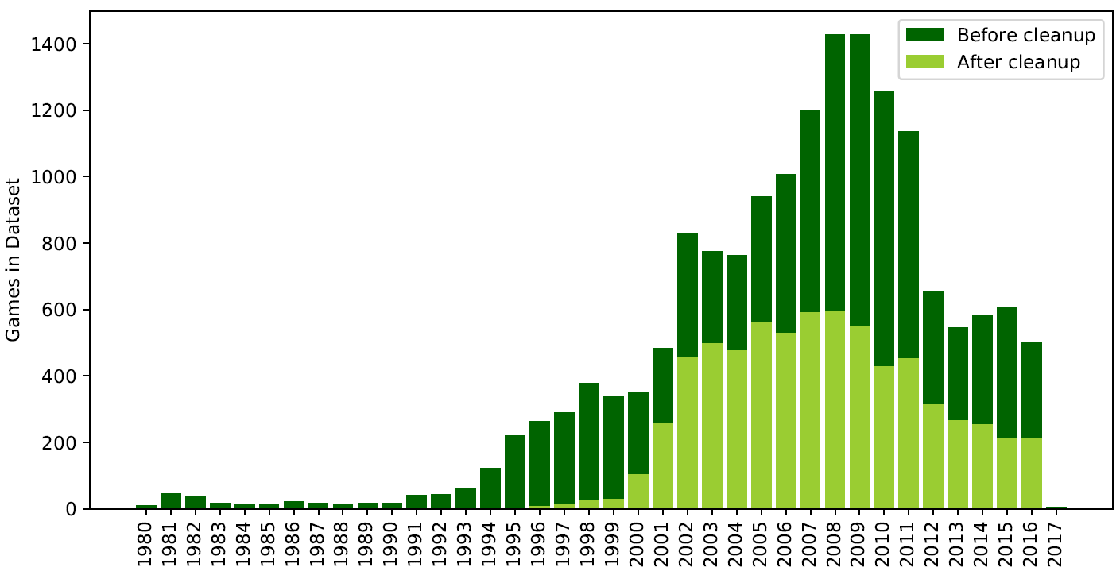
Data Preparation

Slide 4
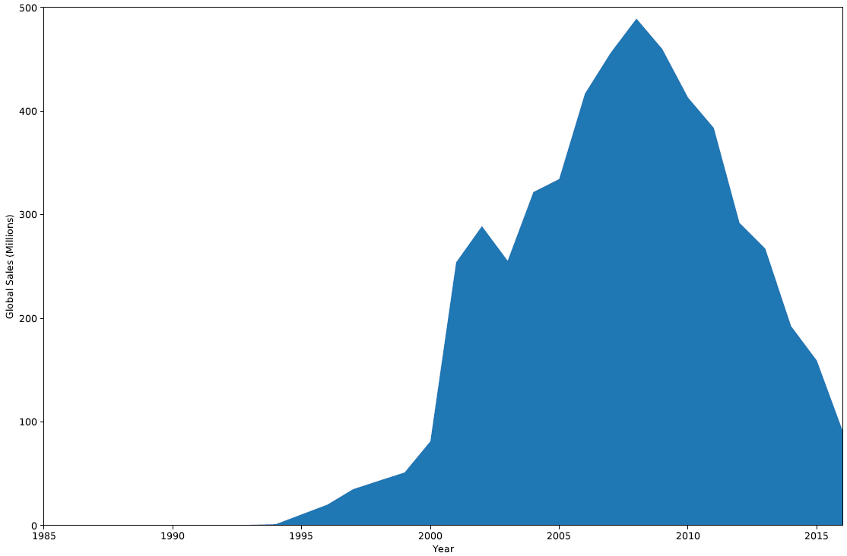
EDA
Yearly Sales Distribution

Slide 5
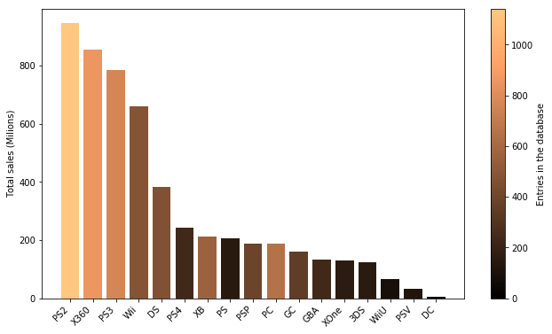
EDA
Platform Distribution

Slide 6
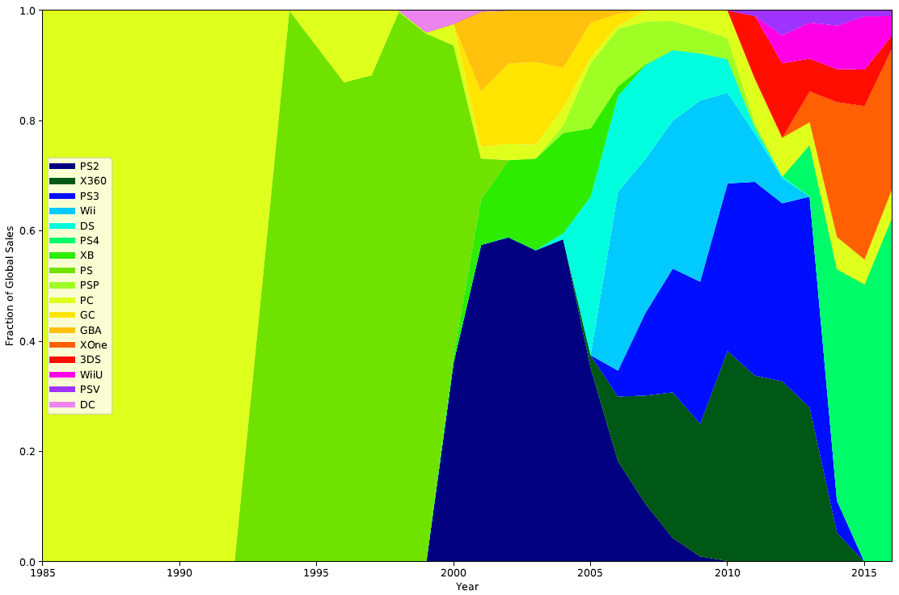
EDA
Platform Distribution

Slide 7
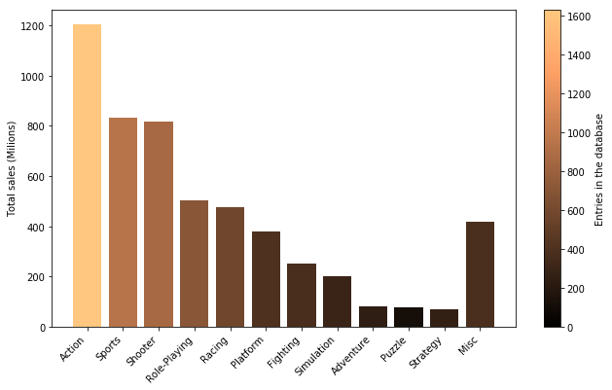
EDA
Genre Distribution

Slide 8
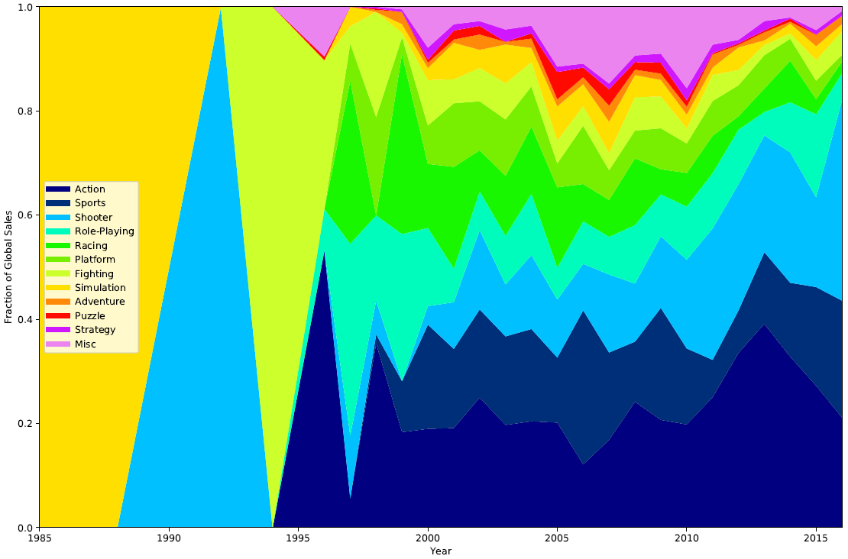
EDA
Genre Distribution

Slide 9
Platform Classification

Slide 10
Unsupervised Learning

