Slide 1
Videogame Dataset Analysis
Statistical Methods in Data Mining
P. Ferreira | A. Capela | L. Franco | M. Frazão

Slide 2
Dataset
Feature | Data type
Name | Categorical
Platform | Categorical
Year of Release | Numerical
Genre | Categorical
Publisher | Categorical
NA Sales | Numerical
EU Sales | Numerical
JP Sales | Numerical
Other Sales | Numerical
Global Sales | Numerical
Critic Score | Numerical
Critic Count | Numerical
User Score | Numerical
User Count | Numerical
Developer | Categorical
Rating | Categorical
Video Game Sales with Ratings
Video game sales from Vgchartz and
corresponding ratings from Metacritic
16 Features
16719 Samples
https://www.kaggle.com/

Slide 3
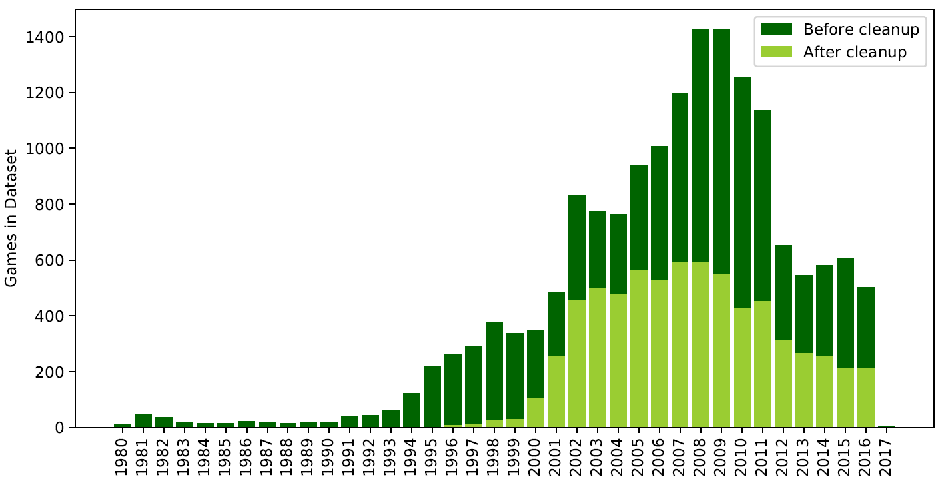
Data Preparation

Slide 4
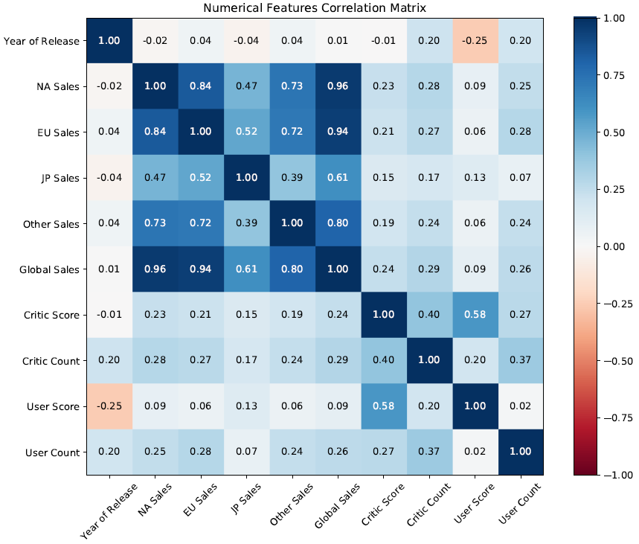
EDA

Slide 5
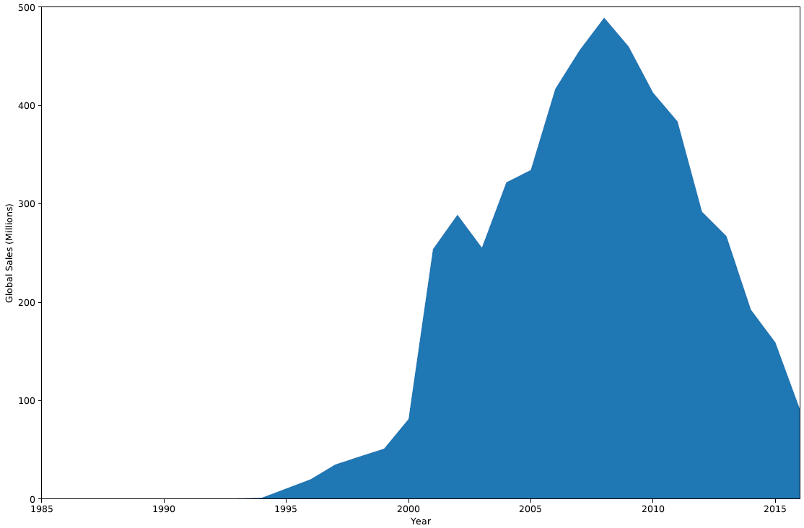
EDA
Yearly Sales Distribution

Slide 6
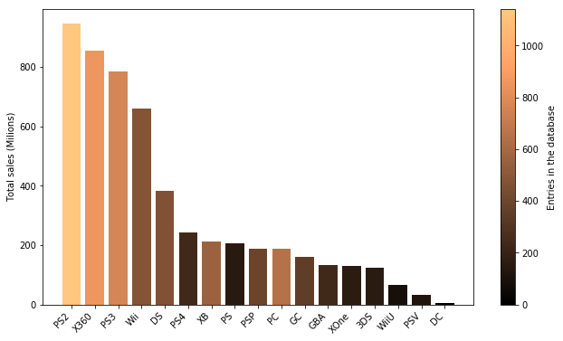
EDA
Platform Distribution

Slide 7
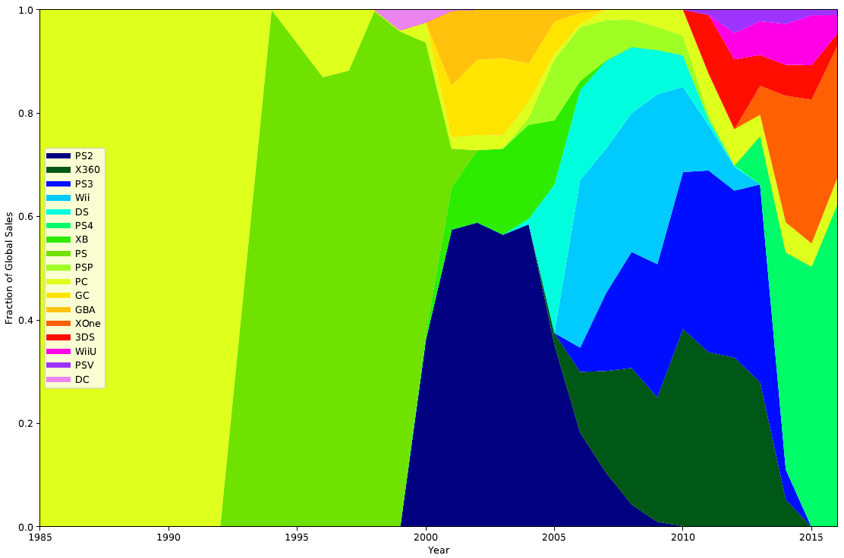
EDA
Platform Distribution

Slide 8
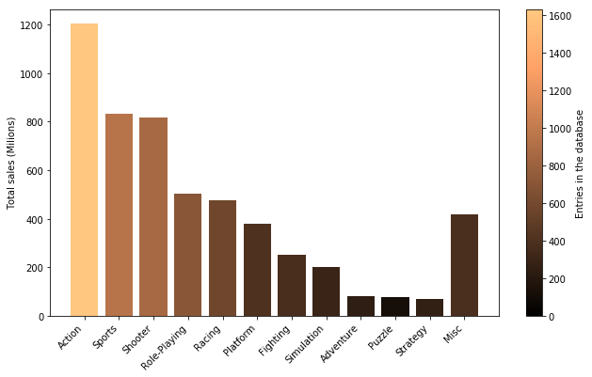
EDA
Genre Distribution

Slide 9
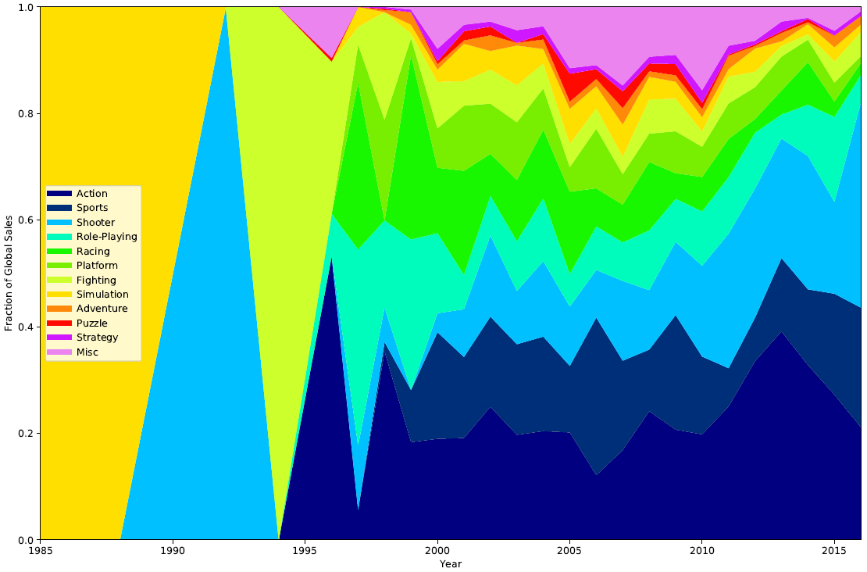
EDA
Genre Distribution

Slide 10
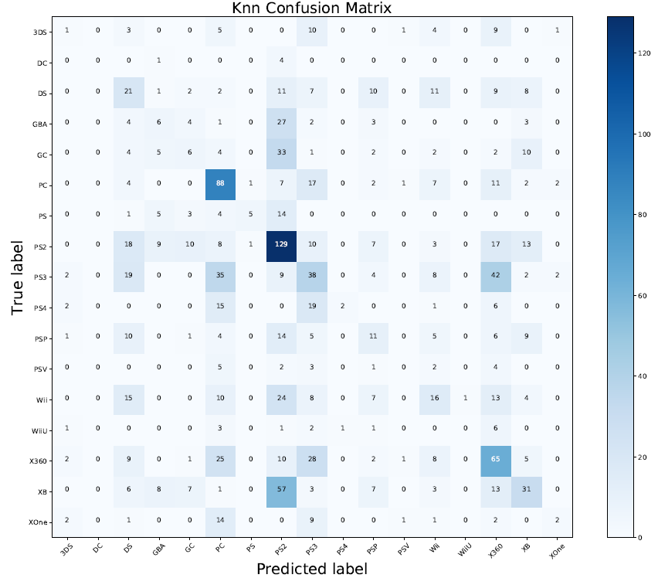
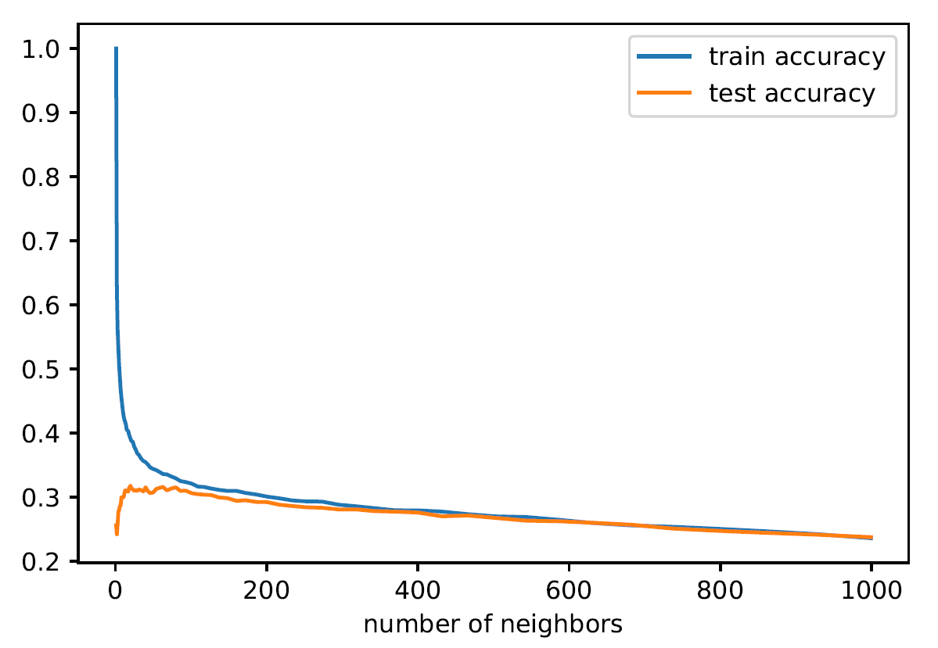
Platform Classification

Slide 11
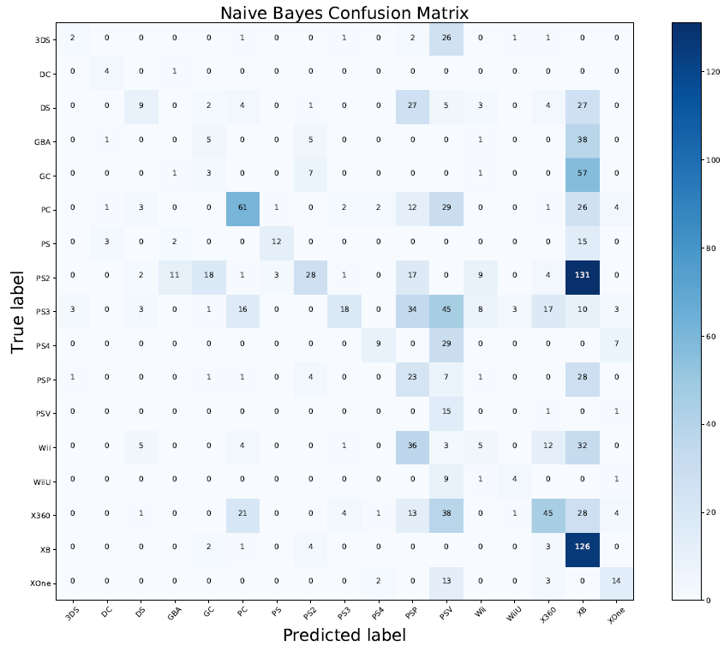
Platform Classification

Slide 12
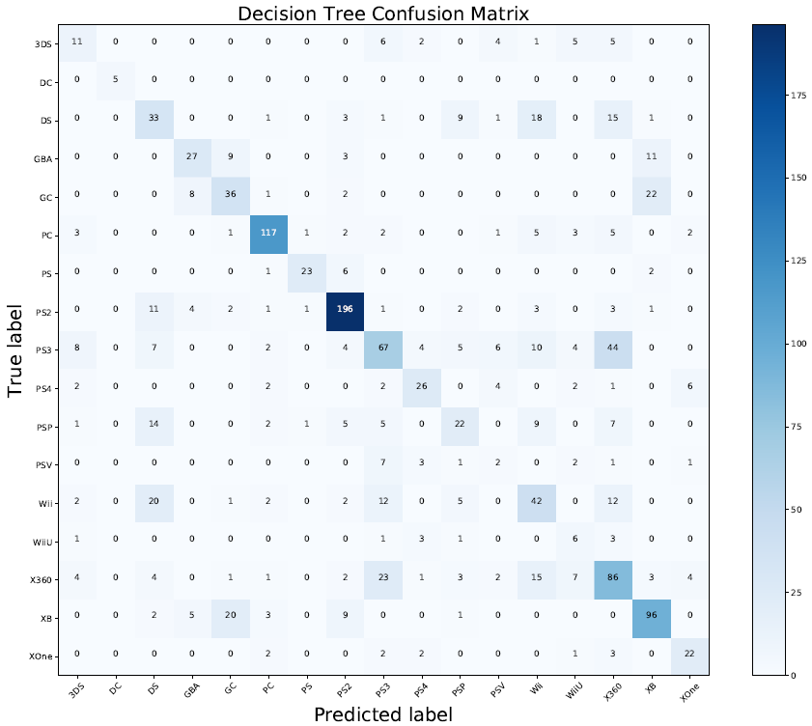
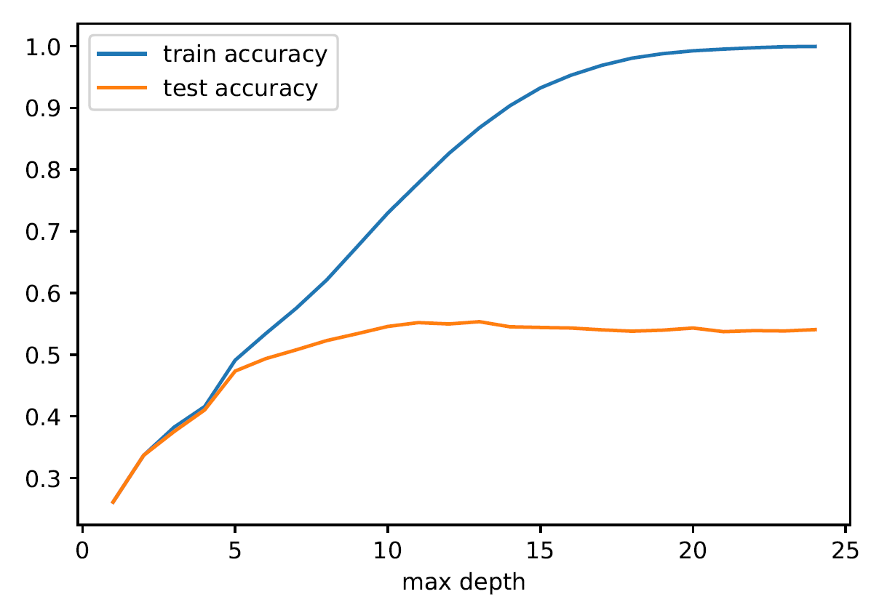
Platform Classification

Slide 13
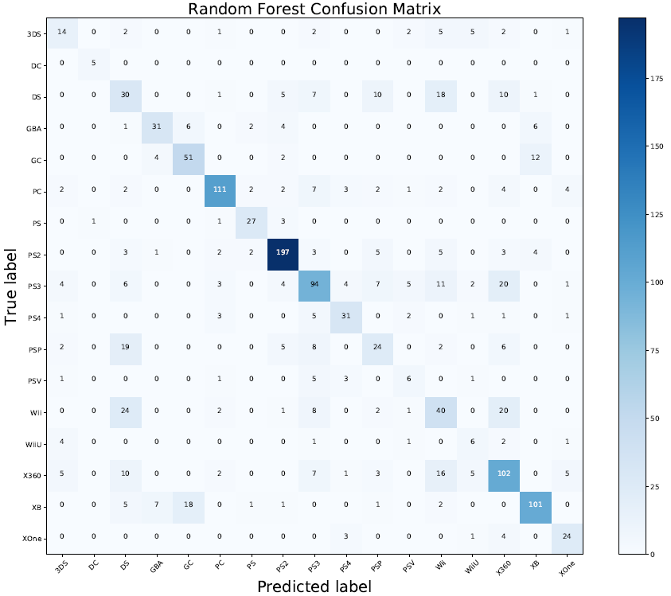
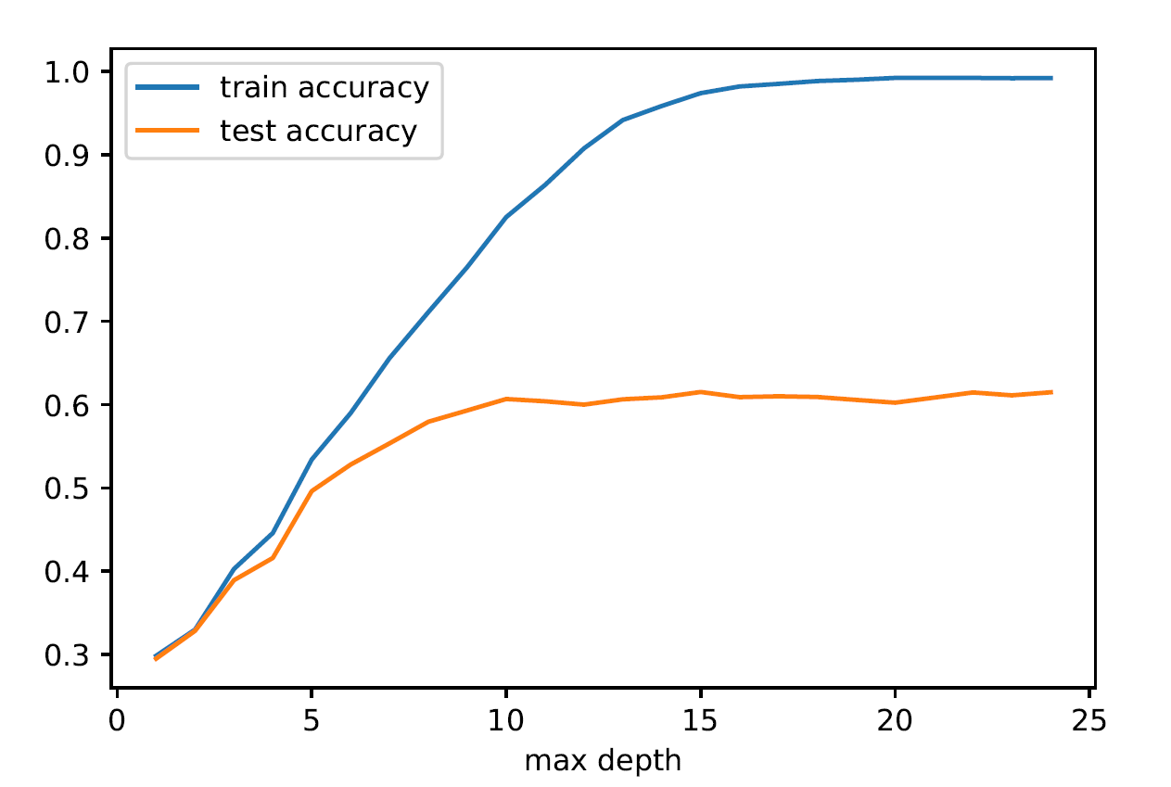
Platform Classification

Slide 14
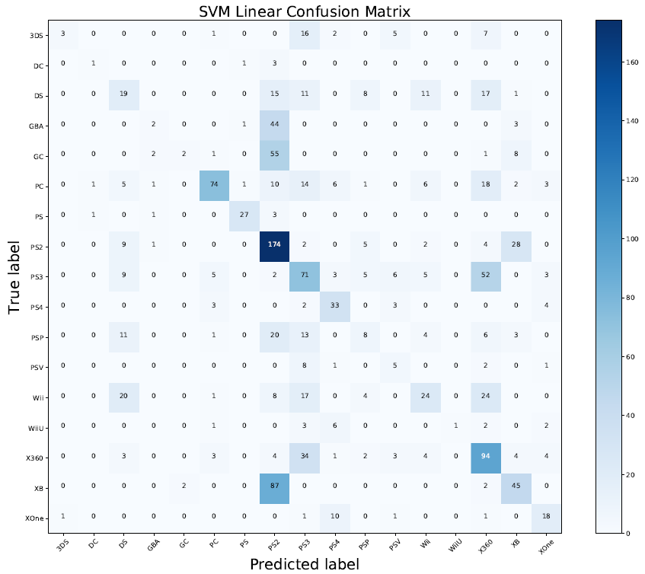
Platform Classification

Slide 15
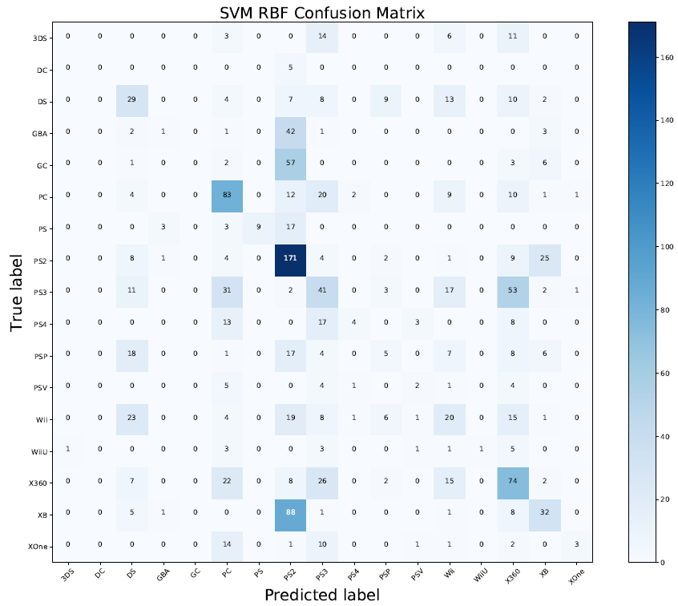
Platform Classification

Slide 16
Platform Classification
Method | Accuracy (%) | Train Accuracy(%) | Accuracy with PCA (%) | Accuracy with LDA (%)
KNN | 30.84 | 39.91 | 30.84 | 44.98
Naïve Bayes | 27.69 | 27.18 | 24.84 | 31.50
Decision Tree | 59.85 | 84.78 | 47.69 | 38.68
Random Forest | 65.49 | 92.54 | 47.18 | 38.32
SVM (linear) | 44.03 | 46.93 | 51.79 | 59.78
SVM (radial) | 34.80 | 43.35 | 34.80 | 53.55

