Slide 1
Videogame Dataset Analysis
Statistical Methods in Data Mining
P. Ferreira | A. Capela | L. Franco | M. Frazão

Slide 2
Dataset
Feature | Data type
Name | Categorical
Platform | Categorical
Year of Release | Numerical
Genre | Categorical
Publisher | Categorical
NA Sales | Numerical
EU Sales | Numerical
JP Sales | Numerical
Other Sales | Numerical
Global Sales | Numerical
Critic Score | Numerical
Critic Count | Numerical
User Score | Numerical
User Count | Numerical
Developer | Categorical
Rating | Categorical
Video Game Sales with Ratings
Video game sales from Vgchartz and
corresponding ratings from Metacritic
16 Features
16719 Samples
https://www.kaggle.com/

Slide 3
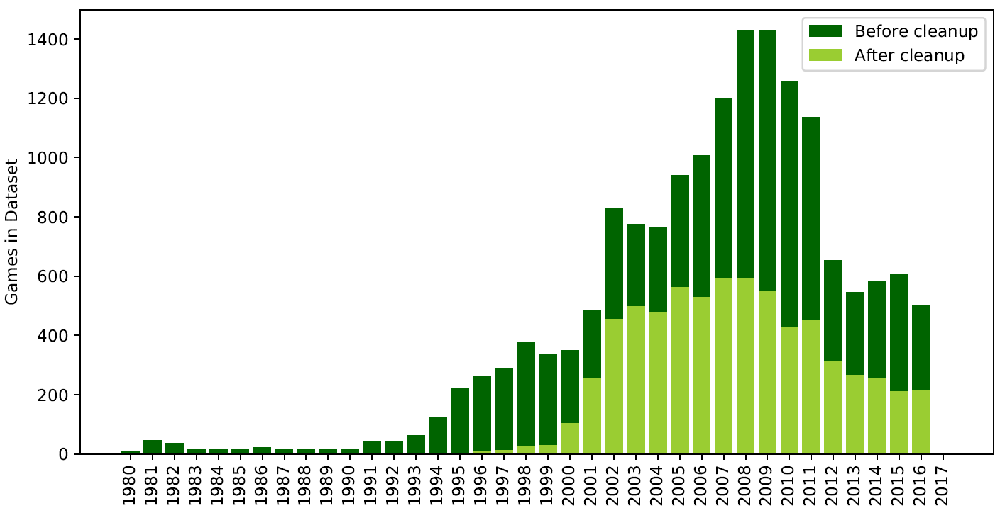
Data Preparation

Slide 4
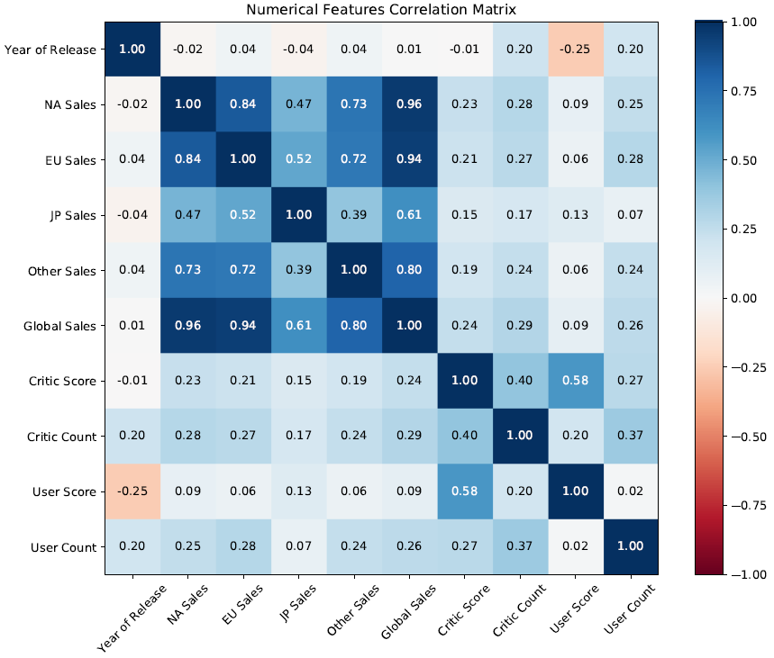
EDA

Slide 5
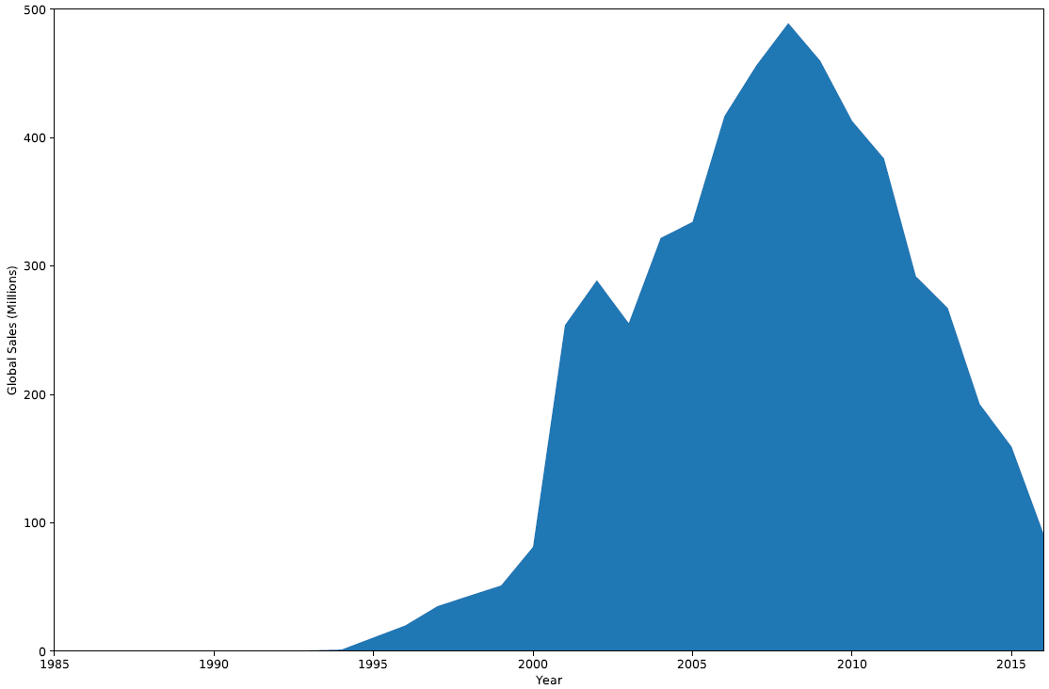
EDA
Yearly Sales Distribution

Slide 6
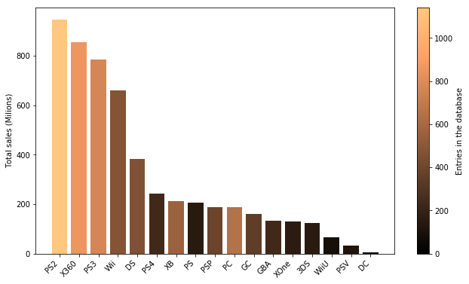
EDA
Platform Distribution

Slide 7
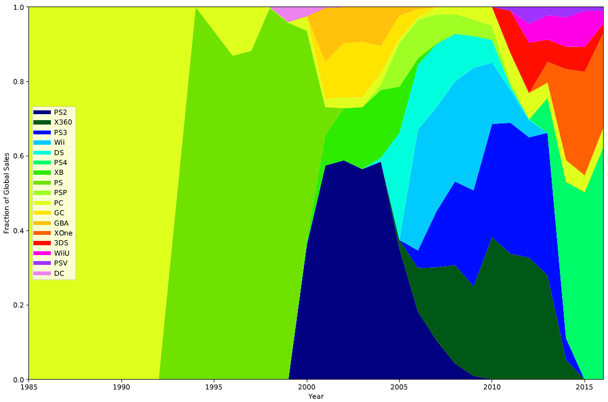
EDA
Platform Distribution

Slide 8
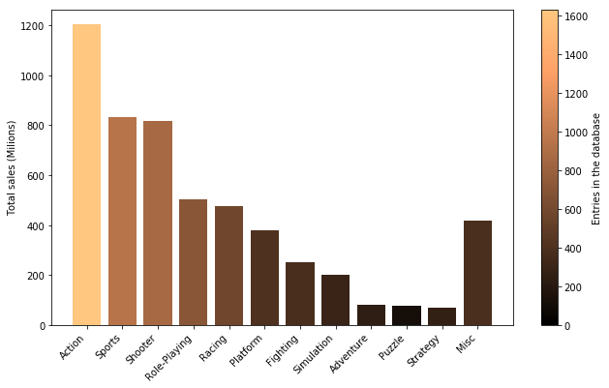
EDA
Genre Distribution

Slide 9
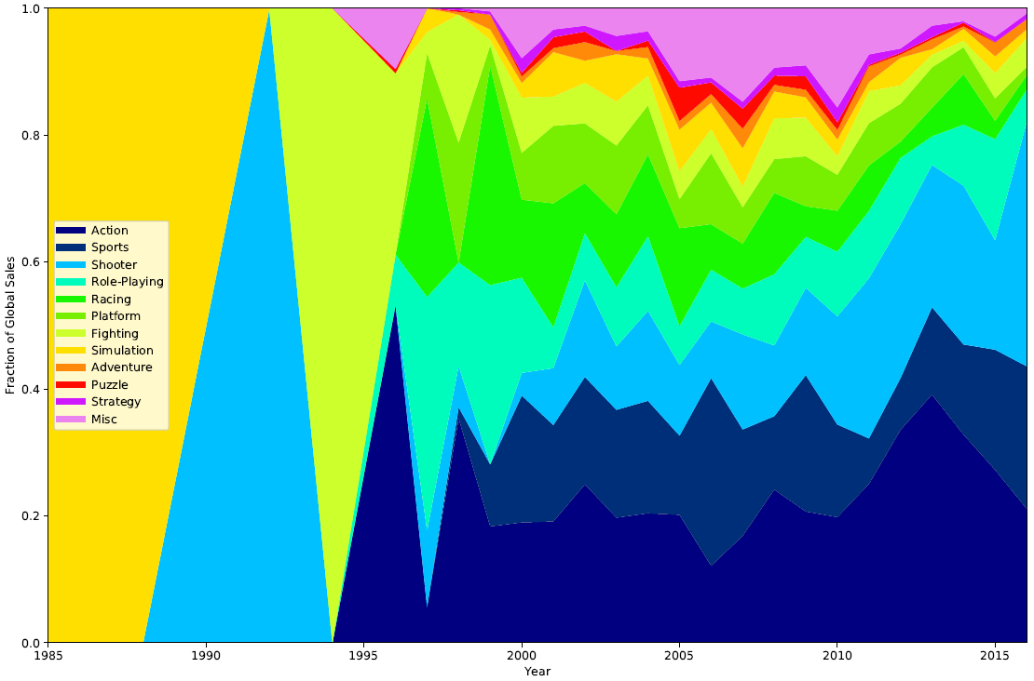
EDA
Genre Distribution

Slide 10
Platform Classification
Method | Accuracy (%) | Train Accuracy(%) | Accuracy with PCA (%) | Accuracy with LDA (%)
KNN | 30.84 | 39.91 | 30.84 | 44.98
Naïve Bayes | 27.69 | 27.18 | 24.84 | 31.50
Decision Tree | 59.85 | 84.78 | 47.69 | 38.68
Random Forest | 65.49 | 92.54 | 47.18 | 38.32
SVM (linear) | 44.03 | 46.93 | 51.79 | 59.78
SVM (radial) | 34.80 | 43.35 | 34.80 | 53.55

