Slide 1
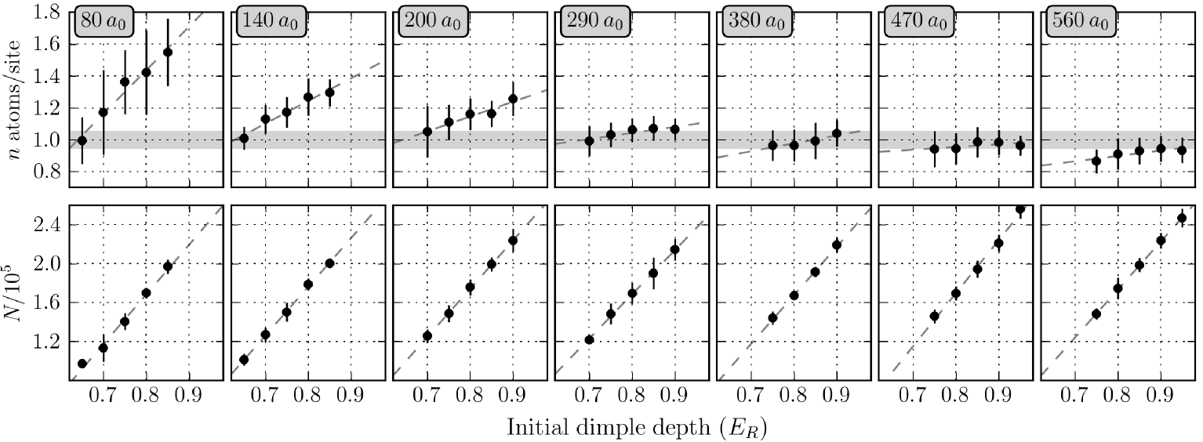
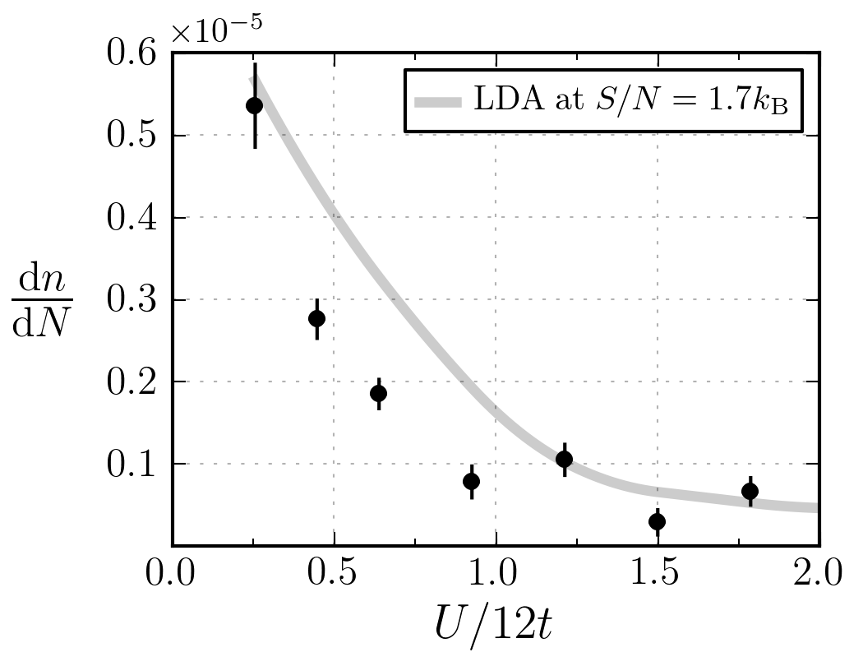
Change in density for change in atom number
Comparison between dn/dN as measured in experiment and calculated using the trap geometry and the local density approximation at S/N=1.7kb
LDA results at lower S/N will be obtained from Ehsan’s data but this is not done yet.

Slide 2
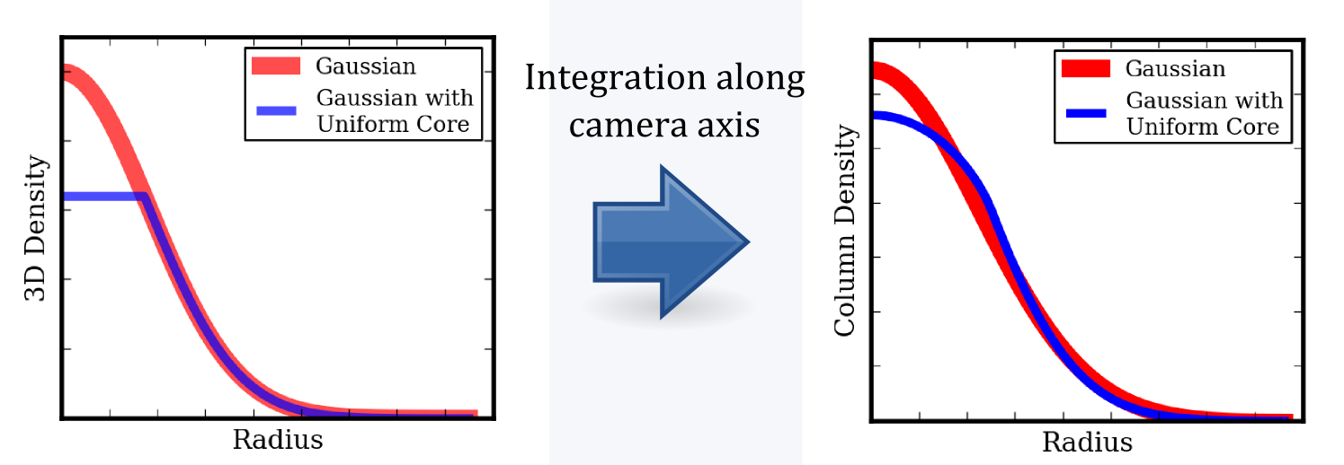
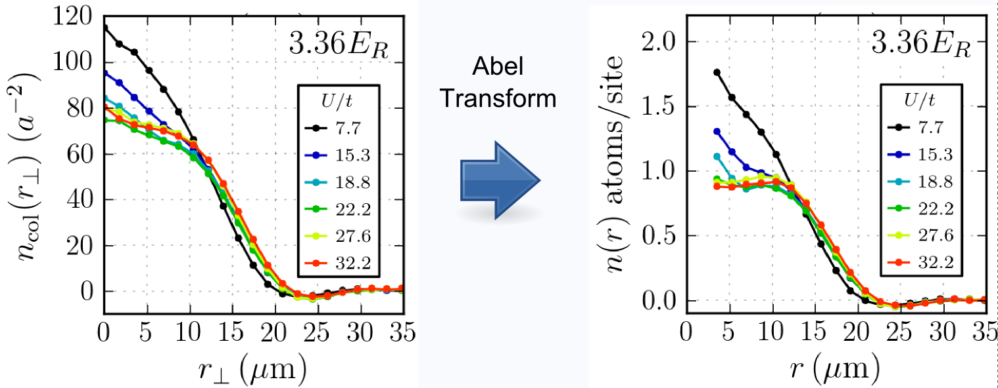

Slide 3
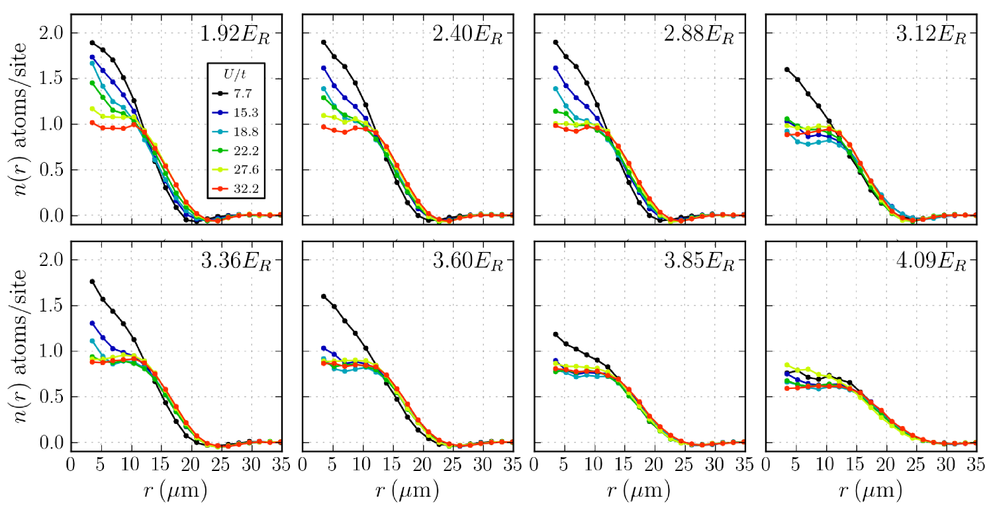
These density profiles are comparable with the insitu density profiles observed by Cheng Ching in a Mott insulator of bosons, see next slide

Slide 4
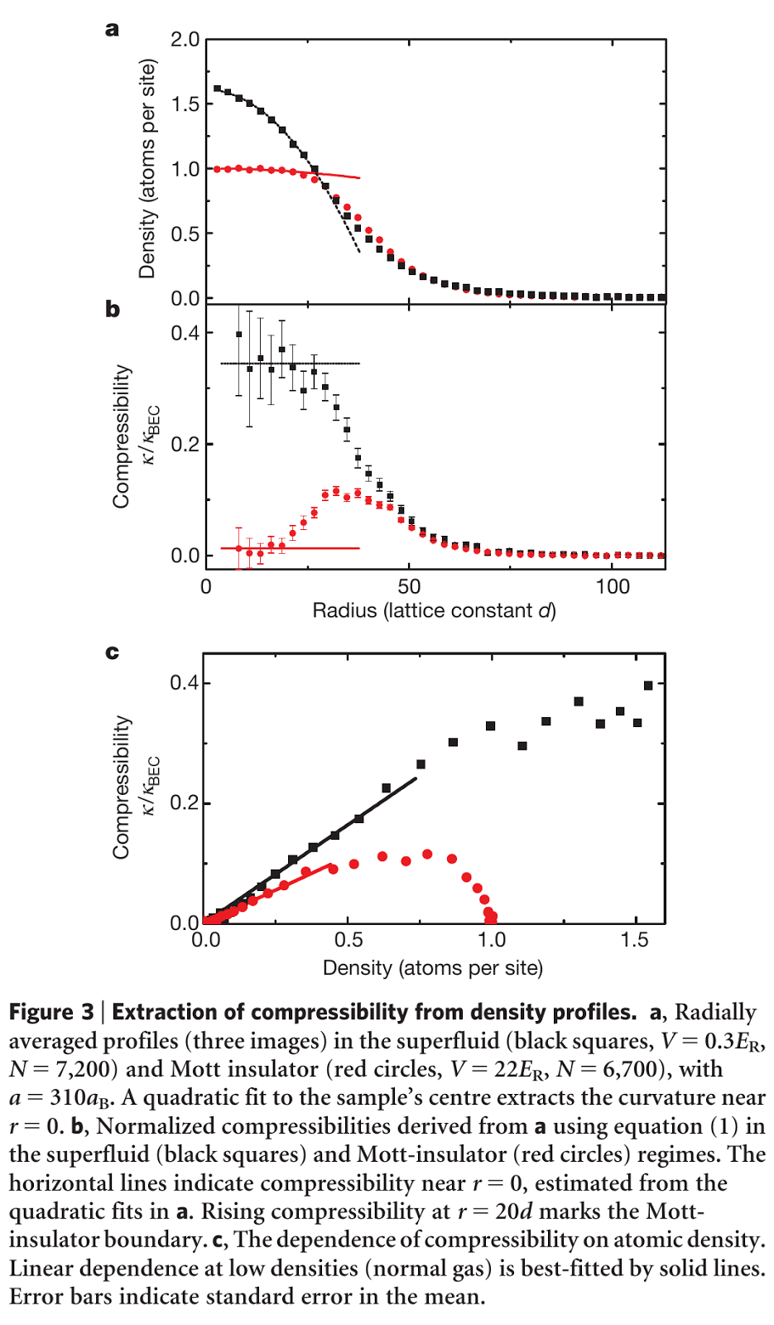
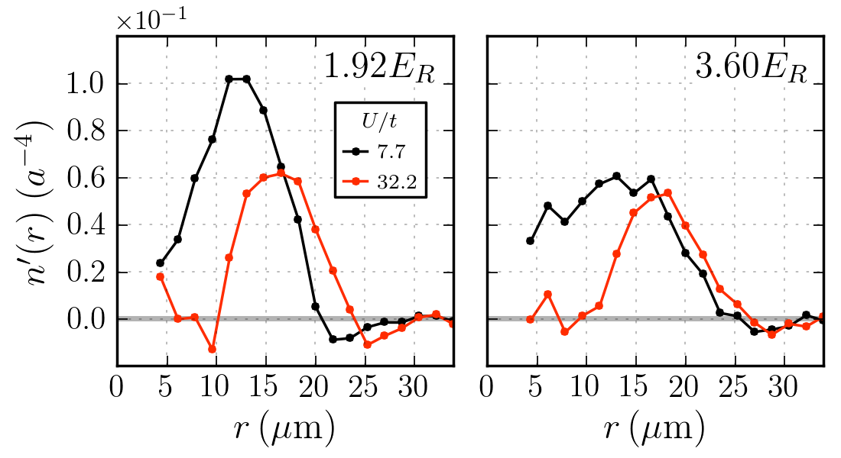
Compare data on the previous slide with Cheng Chin’s Fig 3a.
Compare data on two panels above (numerical derivative of the density, which is proportional to the compressibility) with Cheng Chin’s Fig 3b
In our case for 1.92 Er compensation we see the incompressibility of a band insulator at U/t=7.7 and the incompressibility of the Mott insulator at U/t =32.2
At 3.60 Er we can see the transition from a metal at U/t=7.7 to a Mott insulator at U/t=32.2.
For all these plots we have the same number of atoms, so the interactions are driving the transitions and the shape of the potential determines what phases are accessible via the local chemical potential

