Slide 1


Joint-Embedding Predictive Architectures (JEPA)
Vision, Robotics and Imaging Laboratory
IPASP-PR
Research Line V
Study and implementation of techniques for hierarchical consistency, confidence calibration and VLM.
Student: Pedro P. M. (Undergraduate Student)
Advisor: Prof. PhD. Luiz E. S. de Oliveira
24/08/2026

Slide 2
The UFPR-VeSV Dataset: 99.5% of the Hierarchical Label Space is Invalid
Dataset Structure & Subgroups
UFPR-VeSV Dataset: Focuses on fine-grained vehicle classification using 24,945 image crops from 16,297 real-world vehicles.
Subgroup Mix: Composed of standard daylight RGB images and a critical subgroup of 21.5% Infrared (IR) night camera images.
Hierarchical Tasks: Multi-task classification predicting three labels: Type (14 classes), Make (26 classes), and Model (136 classes).
The Combinatorial Trap
Exploding Search Space: Multiplying the hierarchy classes yields 49,504 potential combinations (14 x 26 x 136).
Physical Catalog Restraints: In reality, only 225 real vehicle tuples exist in the physical world (0.45% of the total space).
Marginal Decoding Issue: Decodifying each label independently creates 99.55% dead zones, resulting in absurd predictions (e.g., *Motocicleta Ford Civic*).

Slide 3
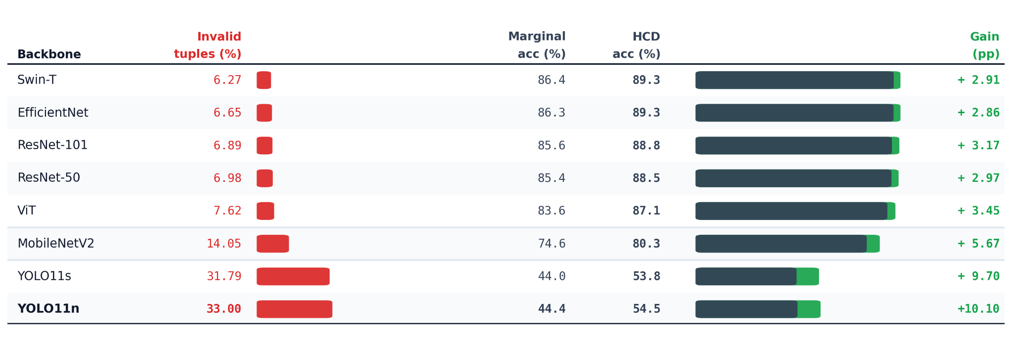
Lightweight Edge Models Generate Up to 33.0% Physically Impossible Tuples
The Cost of Edge Deployment
Hardware Constraints: Public safety cameras rely on real-time, lightweight networks (such as YOLO or MobileNet) due to edge processing limits.
The Reliability Gap: Independent marginal decoding on small models results in catastrophic logical failures.
Correction Overhead: Fixing this requires post-processing scripts like Hierarchically Consistent Decoding (HCD), which adds latency.

Slide 4
The JEPA Paradigm: Predicting in Abstract Latent Space to Ignore Pixel Noise
Generative (e.g., MAE)
Pixel Reconstruction: Forces the decoder to predict raw RGB values of masked blocks.
Wasteful Compute: Spends high training capacity on irrelevant details (rain, shadows, leaves).
Noise Sensitive: Fails easily under camera distortions or infrared shifts.
Contrastive (e.g., CLIP)
Complete Image Matching: Contrasts whole augmented views of images.
Domain Fragility: Severely degraded by domain changes where color/texture shortcuts disappear.
Heavy Scaling: Needs massive datasets and extremely large batches to avoid collapse.
Predictive Latent (JEPA)
Embedding Prediction: Predicts masked targets in an abstract, learned representation space.
Noise Filtering: Bypasses raw pixel prediction, focusing purely on high-level semantical structures.
10x Faster: Converges up to ten times faster than generative MAE baselines.

Slide 5
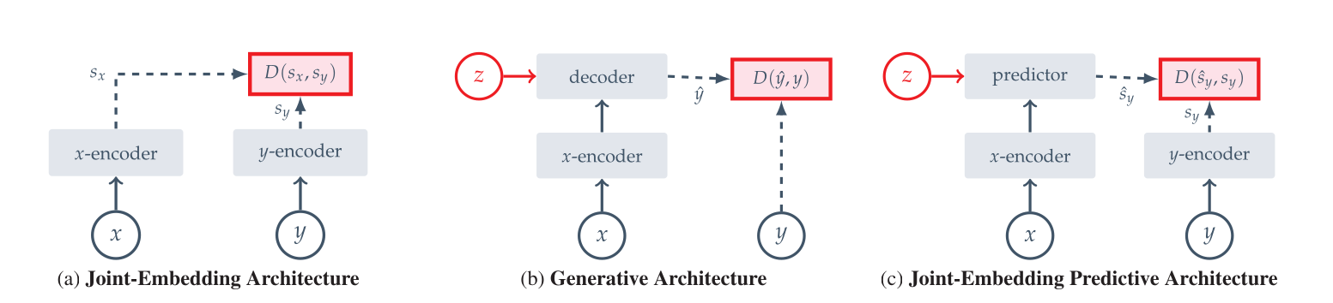

Slide 6
I-JEPA Pipeline: Learning Invariant Vehicle Geometry Without Human Labels
The Latent Guessing Game
Context Block: A large visible portion (0.85 to 1.0 scale) is fed through the Context Encoder.
Target Blocks: 4 hidden blocks (0.15 to 0.2 scale) are processed by a Target Encoder to generate ground-truth representations.
Predictor Scratchpad: A narrow ViT that predicts target features using only the context output and positional tokens.
Eliminating Domain Disparity
Mixed Pretraining: Raw vehicle crops (both RGB Daylight and 21.5% Infrared Night) are trained together without any labels.
Preventing Collapse: Target Encoder weights are updated via Exponential Moving Average (EMA, momentum 0.996 to 1.0).
Geometric Invariance: Forces the encoder to learn structural geometry (wheel arches, rooflines, chassis) rather than color shortcuts.

Slide 7
LeJEPA: Eliminating Heuristics via Isotropic Gaussian Regularization
Theoretical Foundation & Core Concepts
• Isotropic Gaussian Target: Forces the model's representations to follow an isotropic standard normal distribution. This creates a perfectly symmetric and uniform spherical shape in the latent space, eliminating directional bias.
• Worst-Case Risk Minimization: Mathematically guarantees the minimization of the expected error on downstream linear probing tasks, providing robust bounds on unseen target domains.
• Heuristic-Free Learning: Completely bypasses manual tricks like target-encoders, asymmetric network architectures, or stop-gradient operations, replacing them with statistical guarantees.
Implementation via SIGReg
• Random 1D Projections: Projects high-dimensional representations into a set of 1D directions. Testing a sphere along multiple random slices is computationally efficient.
• Epps-Pulley Test Statistic: Calculates a smooth, continuous test for Gaussianity directly on the projected 1D representations, generating stable gradients to update the model.
• SIGReg Regularization: Penalizes deviations from the target Gaussian shape, ensuring the latent space never collapses while keeping complexity strictly linear.

Slide 8
Experimental Results
Model | Epochs | Type (%) | Mark (%) | Model (%) | Marginal Tuple (%) | Tuple with HCD-C (%) | HCD-C Gain | Invalid Tuples
EfficientNet-V2 Baseline (JBCS) | Superv. 100 ep | 96.10 ± 0.70 | 94.4 ± 0.6 | 90.9 ± 0.6 | 85.50 ± 1.10% | - | - | -
Swin-Base + LeJEPA | SSL → 30 ep | 94.10 ± 0.50 | 88.75 ± 1.08 | 81.07 ± 0.93 | 76.60 ± 1.27% | 78.84 ± 1.20% | +2.24 pp | 6.52% → 0%
ConvNeXt-Base + LeJEPA | SSL → 30 ep | 94.98 ± 0.73 | 91.34 ± 0.87 | 84.97 ± 0.99 | 80.92 ± 1.48% | 82.83 ± 1.44% | +1.91 pp | 5.64% → 0%
EfficientNet-V2 + LeJEPA | SSL → 30 ep | 94.96 ± 0.71 | 91.10 ± 0.91 | 84.84 ± 1.04 | 81.36 ± 1.38% | 82.81 ± 1.32% | +1.45 pp | 4.56% → 0%

Slide 9
Experimental Results
Significant Boost in Joint Tuple Accuracy (Exact Match):
• Jumps from 76.00% → 81.66%
(+5.66pp net gain, +7.45% relative improvement)
• Closes the gap to the literature ceiling (86.30%)
Reduction of Taxonomic Hallucinations:
• Invalid combinations plummet from 7.51% 4.41% (Fold 0) and 4.56 ± 0.49% (10-fold mean)
• Lowest invalid tuple rate across all tested architectures
Cross-Modal Invariance (Visible RGB & Nighttime Infrared):
• Infrared exact-match accuracy surges from 57.48% → 68.60% (+11.12 pp gain).
• SIGReg + Grayscale transformations

Slide 10
VL-JEPA: Direct Semantic Prediction in Joint Vision-Language Space
Joint Latent Alignment Concepts
• Unified Semantic Space: Maps both visual features and text descriptions into the same continuous latent space, allowing direct geometric comparison instead of discrete token matching.
• Predictive Modeling: Avoids slow letter-by-letter (autoregressive) token prediction during training, guessing the complete target text embedding in one swift forward pass.
• Resolving Synonyms: Places conceptually identical answers (e.g., *'black SUV'* and *'dark vehicle'*) close together in the latent space, resolving the synonym penalty of traditional VLMs.
Unified Component Architecture
• X-Encoder (Vision): Utilizes a frozen spatiotemporal V-JEPA 2 ViT-L model to extract geometric and motion features from both RGB day and IR night video streams.
• Y-Encoder (Language): Utilizes a frozen Gemma-300M model to map target labels into text embeddings, serving as the ground-truth prediction targets.
• Predictor & Y-Decoder: A Llama 3.2-1B predictor guesses text embeddings from vision context. The Y-Decoder translates them back to text only when semantic changes are detected (Selective Decoding).

Slide 11
Future Possible Stra
Recommendation 1: LeJEPA (Low-Compute)
Backbone Choice: Use a lightweight ConvNeXt-V2 Nano (14M params) or ResNet-34 (21M params).
Methodology: Run with SIGReg to regularize daylight and infrared features into an isotropic Gaussian space.
Consistency: Feed highly calibrated embeddings into the lab's existing HCD-C post-processing correction scripts.
Recommendation 2: VL-JEPA (Zero-Shot)
Backbone Choice: Frozen V-JEPA 2 (304M) and Gemma-300M paired with Llama-3.2-1B predictor layers (~1.6B total params).
Methodology: Perform zero-shot matching directly against the 225 valid catalog text prompts at inference time.
Inconsistency: Reduces invalid tuple predictions to exactly 0% without needing HCD-C.

Slide 12
References
Lima, G. E., Nascimento, V., Santos, E., Nascimento Jr., E., Laroca, R., Menotti, D. Toward Unified Fine-Grained Vehicle Classification and Automatic License Plate Recognition. JBCS, 32(1):783–799, 2026.
Assran, M., Duval, Q., Misra, I., Bojanowski, P., Vincent, P., Rabbat, M., LeCun, Y., Ballas, N. Self-Supervised Learning from Images with a Joint-Embedding Predictive Architecture. CVPR, 15619–15629, 2023.
Balestriero, R., LeCun, Y. LeJEPA: Provable and Scalable Self-Supervised Learning Without the Heuristics. arXiv:2511.08544, 2025.
Chen, D., Shukor, M., Moutakanni, T., Chung, W., Yu, J., Kasarla, T., Bolourchi, A., LeCun, Y., Fung, P. VL-JEPA: Joint Embedding Predictive Architecture for Vision-Language. ICLR, 2026.
Bardes, A., Garrido, Q., Ponce, J., Chen, X., Rabbat, M., LeCun, Y., Assran, M., Ballas, N. V-JEPA: Latent Video Prediction for Visual Representation Learning. arXiv:2404.08471, 2024.
Assran, M. et al. V-JEPA 2: Self-Supervised Video Models Enable Understanding, Prediction and Planning. arXiv:2506.09985, 2025.
Mur-Labadia, L. et al. V-JEPA 2.1: Unlocking Dense Features in Video Self-Supervised Learning. arXiv:2603.14482, 2026

