Slide 1
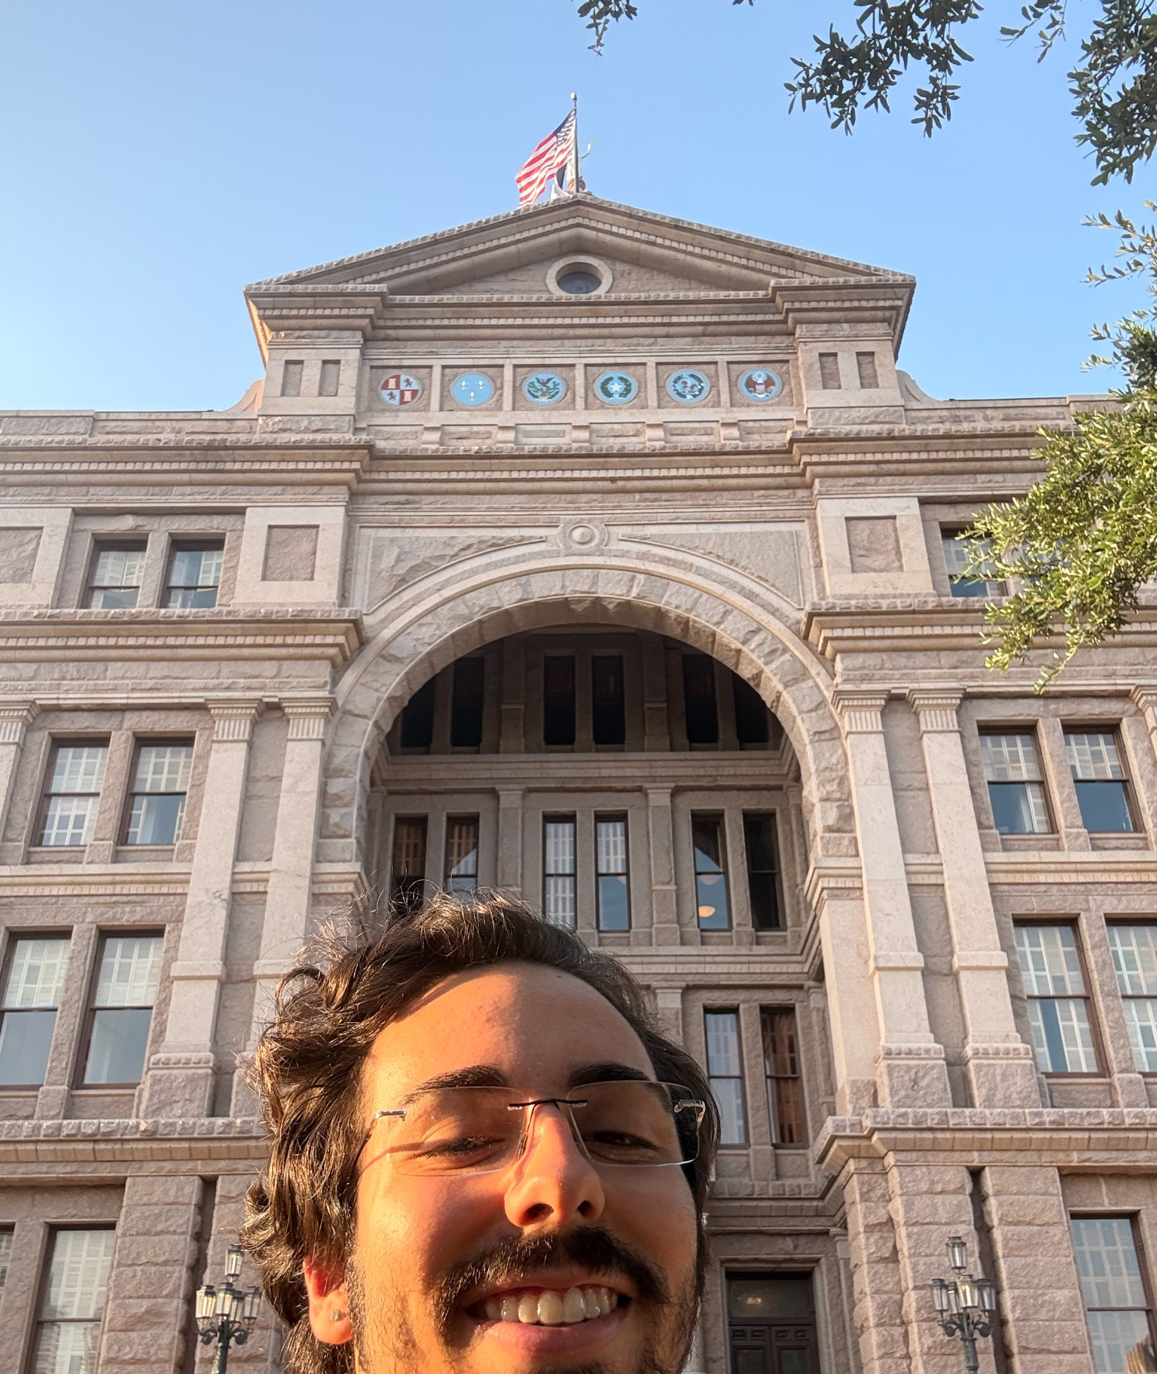
From Transformer Math
to Silicon
Tracing GPT-2 inference from equations to GPU kernels
GPT-2 • TRANSFORMERS • CUDA • RUST
Inference • attention • GEMMs • memory • execution

Slide 2
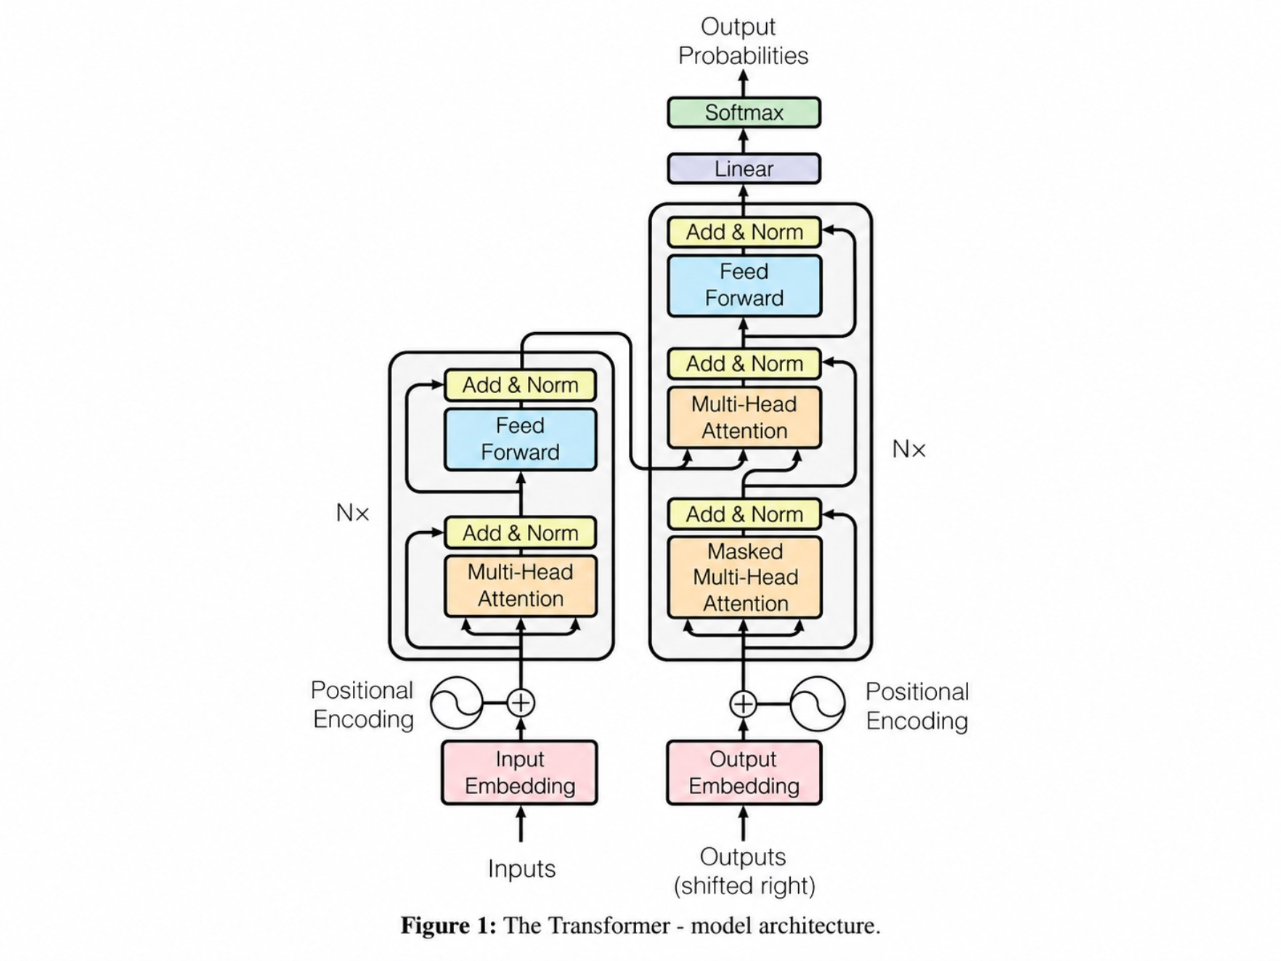
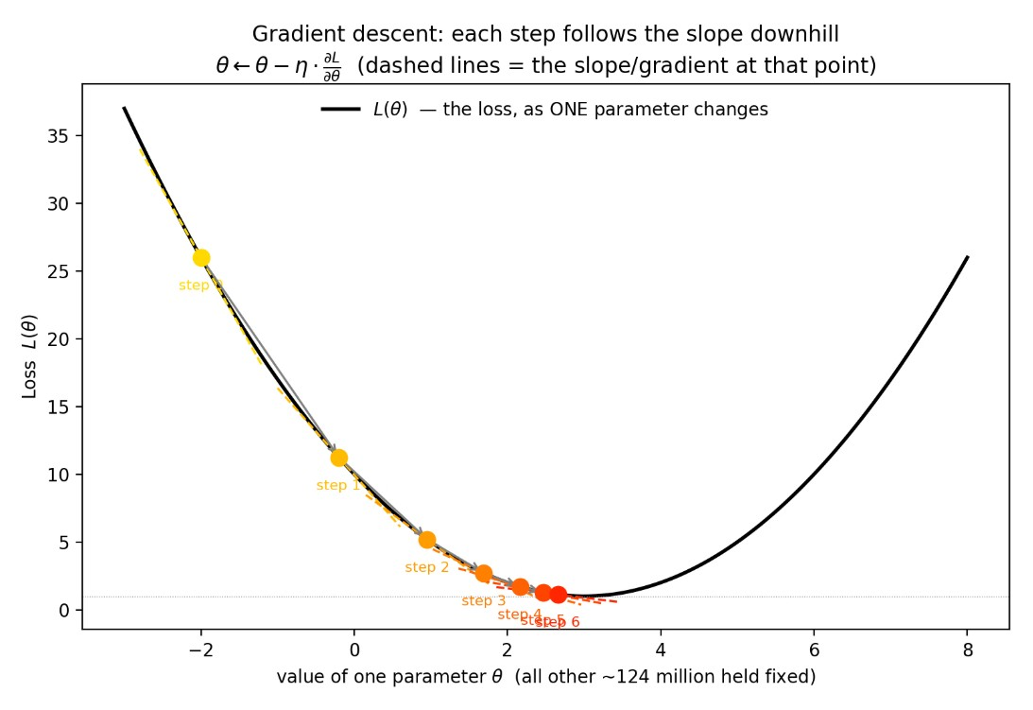

What is a machine-learning model?
x: input representation
f: model architecture and computation flow
θ: learned parameters
y: output prediction
Training vs. Inference: Training learns θ. Today's focus is inference only: θ is frozen and we evaluate (note: GPT-2 is decoder-only).

Slide 3
GPT-2 Small: what we run
GPT-2 is compact enough to expose the complete computation pipeline on CPU and GPU without distributed complexity.
Execution pipeline: tokens → embeddings → 12 blocks → ln_f → logits
SPECIFICATION | GPT-2 SMALL CONFIGURATION
Parameters | 124M
Transformer blocks | 12 layers
Hidden size | 768 dimensions
Attention heads | 12 heads × 64 dimensions
Vocabulary | 50,257 tokens (byte-level BPE)
Context window | 1,024 tokens
Scale reference: 124M parameters vs. modern massive models with 100B+ parameters (educational baseline, not a quality ranking).
02

Slide 4
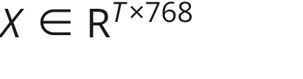
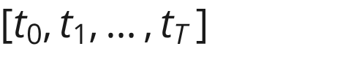
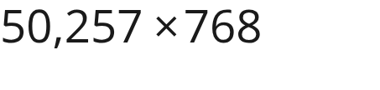
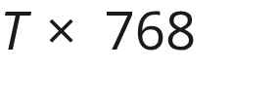
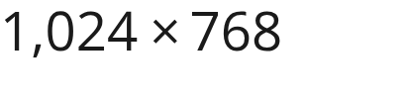
Text → tokens → vectors
The tokenizer maps text to discrete token IDs; embedding lookup turns IDs and sequence positions into dense vectors.
01
02
03
04
Raw string input
Tokenizer (BPE)
Embedding lookup
Input tensor
"The strangest thing I found inside my refrigerator was"
Fixed mapping produces a sequence of token IDs
Token IDs index into learned weight matrices
Yields matrix ready for block 0
W_te: Token embeddings ( )
W_pe: Position embeddings ( )
Tensor shape:
03

Slide 5
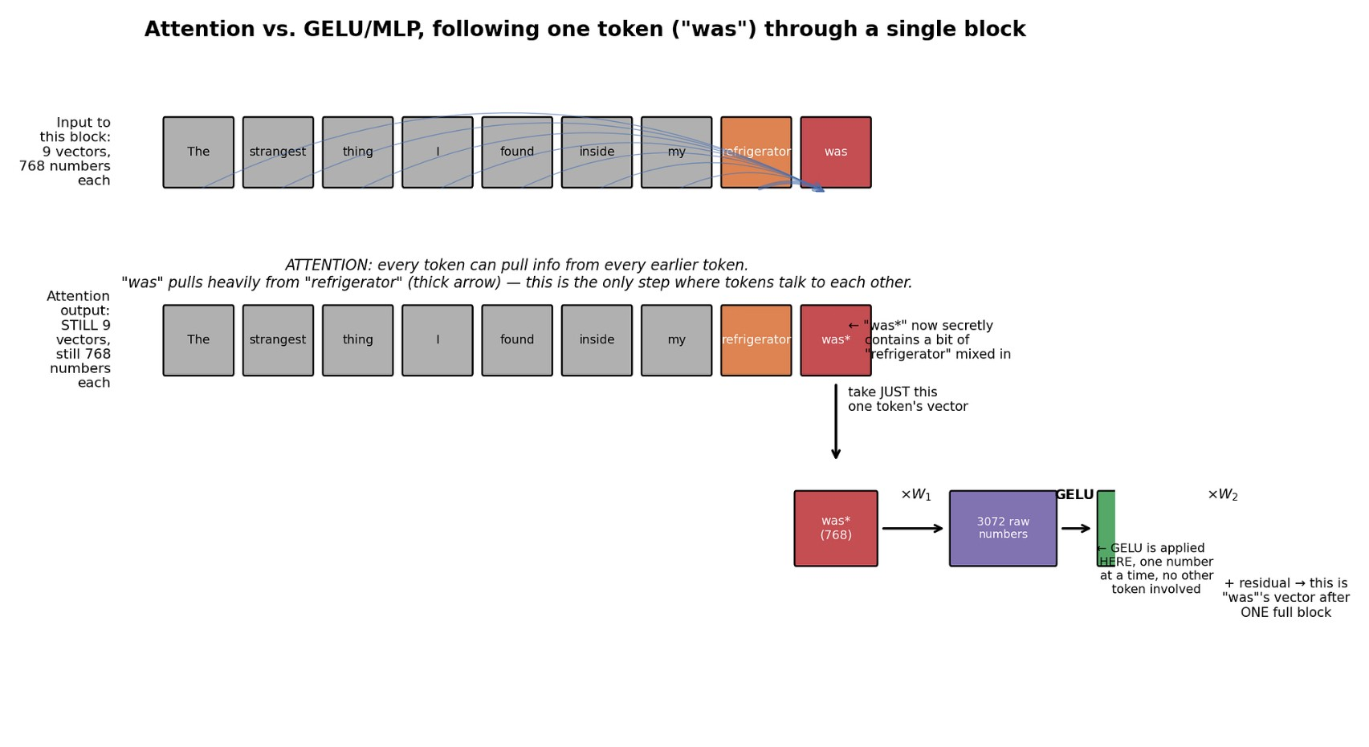
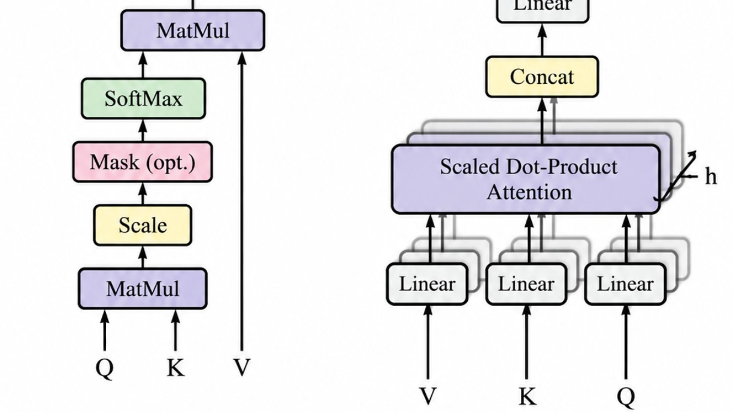
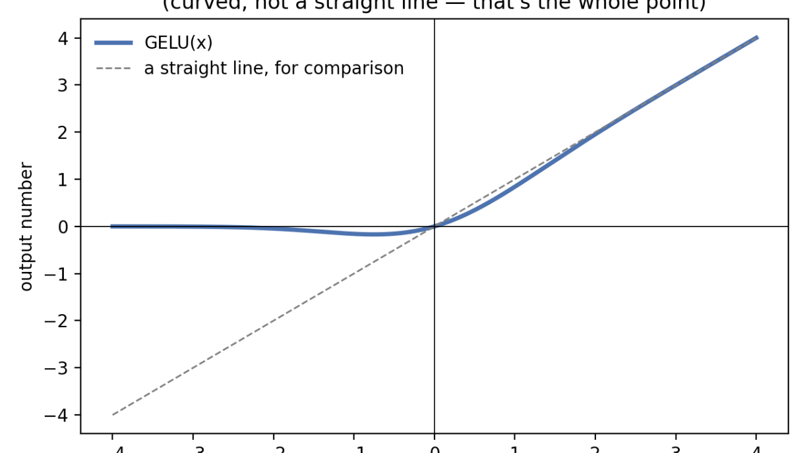
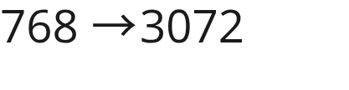
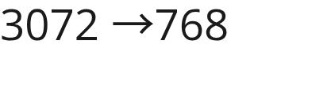

What does a Transformer block actually do?
A block alternates between communication across tokens and independent computation within each token.
2. MLP (Per token): Transforms each token independently without mixing. Expands , applies GELU nonlinearity, then compresses .
1. Attention (Mix tokens): Moves information across positions. "was" attends back to "refrigerator" so its vector absorbs context. Causal mask prevents looking into the future.
04

Slide 6
From Transformer math to computer operations
High-level attention equations compile down to four fundamental computer primitives: GEMMs, reductions, elementwise ops, and memory transfers.
TRANSFORMER OPERATION | HARDWARE PRIMITIVE
Q / K / V & Output Projections | Matrix multiplication (GEMM)
QK^T and Attention × V | Matrix multiplication (GEMM)
Softmax | Reductions (max, sum) + elementwise exp
LayerNorm | Reductions (mean, var) + elementwise scale/bias
Residual addition | Elementwise add
Embedding lookup | Indexed memory read / gather
05

Slide 7
Our NumPy reference implementation (cpu/gpt2.py)
x = w.wte[token_ids] + w.wpe[pos]
qkv = linear(x, c_attn_w, c_attn_b)
q, k, v = np.split(qkv, 3, axis=-1)
scores = (qh @ kh.transpose(0, 2, 1)) * scale
attn = softmax(scores, axis=-1)
out = attn @ vh
h = layer_norm(x); h = causal_self_attention(h); x = x + h
h = layer_norm(x); h = gelu_new(linear(h, ...)); x = x + h # MLP
x = final_layer_norm(x)
logits = x @ w.wte.T
A line-by-line Python reference that mirrors the exact mathematics and serves as the ground-truth oracle for GPU verification.
Equation → NumPy → future CUDA kernels: Clean 1-to-1 correspondence between mathematical tensor operations and executable kernels.
06

Slide 8

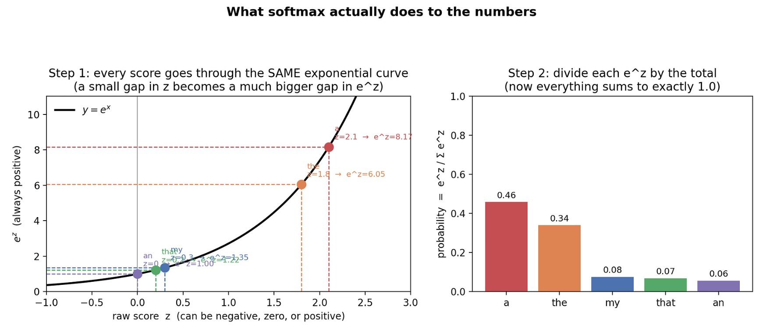
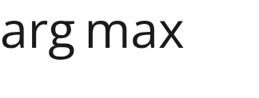
Logits, softmax, and decoding
The forward pass produces raw scores (logits) across the 50,257-token vocabulary; softmax normalizes them into probabilities for token selection.
Pipeline: 50k logits → softmax → probability distribution → decoding strategy → next token
Decoding strategies: Greedy vs. Top-k / Top-p stochastic sampling.
Key takeaway:
07

Slide 9
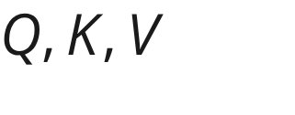


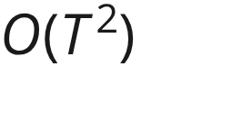

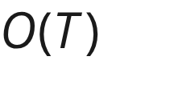
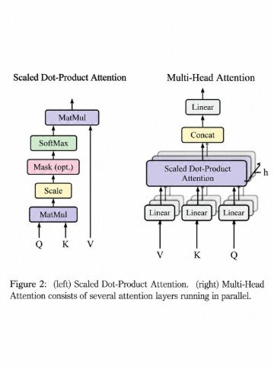
Q, K, V: no KV cache (demo) vs. KV cache (production)
Autoregressive decoding generates one token at a time. Caching past Keys and Values avoids recalculating prior token representations.
Single linear projection: Generates vectors at each layer.
Our run.py (No KV cache)
Production KV cache
Full forward pass every token, recomputing all past and ( total work). Directly tied to `--verbose-timing` in our CPU benchmark.
Stores previous and in GPU VRAM; only new query attends over the stored history ( per step).
08

Slide 10
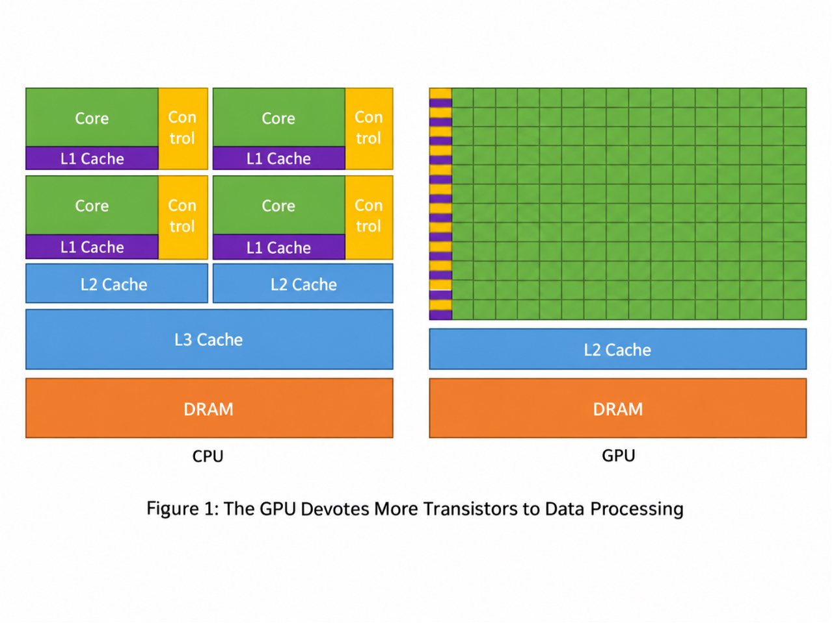
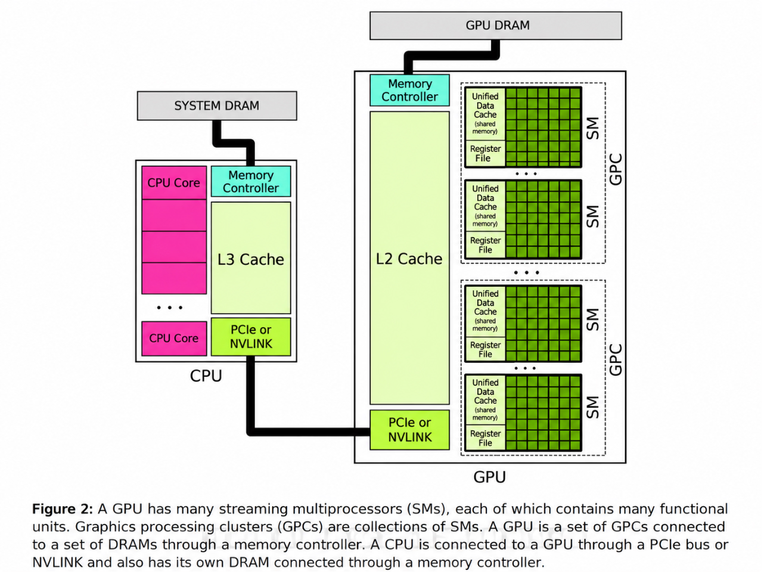
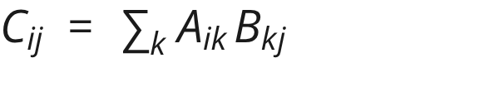
Why GPU + CUDA execution: mapping GEMMs to silicon
CPUs optimize for low-latency serial execution; GPUs dedicate silicon to massive SIMT parallel throughput for independent matrix tiles.
GEMM parallelism: Each is computed independently across thousands of GPU cores.
Memory hierarchy & tiling: Output matrices are broken into tiles; threads cooperate via registers, shared memory, and L1/L2 caches to minimize global DRAM traffic.
CUDA-Oxide note: Targets these same hardware kernels via Rust and NVIDIA's `cargo oxide` toolchain.
CUDA execution hierarchy: Kernel launch → Grid → Thread Blocks → Warps (32 threads) → Individual Threads.
09

Slide 11
Same math, three runtimes + live CPU demo
Same GPT-2 weights, same mathematical operations, implemented across three execution systems to verify numerical logits and measure performance.
RUNTIME | EXECUTION UNIT | PREFILL LATENCY | DECODE THROUGHPUT | P50 LATENCY | P95 LATENCY
NumPy reference | CPU (x86_64) | Live measured | Live tok/s | Live measured | Live measured
CUDA C++ | GPU (NVCC) | TBD | TBD tok/s | TBD | TBD
CUDA-Oxide | GPU (Rust SIMT) | TBD | TBD tok/s | TBD | TBD
Live demonstration: Run prompt on CPU oracle → compare logits → generate tokens → inspect `--verbose-timing`.
Status: CPU oracle live today; GPU paths (CUDA C++ & CUDA-Oxide) target identical math on NVIDIA hardware.
# Live demonstration trace:
make verify # Assert logits match within tolerance (logits_CPU ≈ logits_GPU)
python run.py --prompt "The strangest thing I found inside my refrigerator was" --verbose-timing
10

