Slide 1
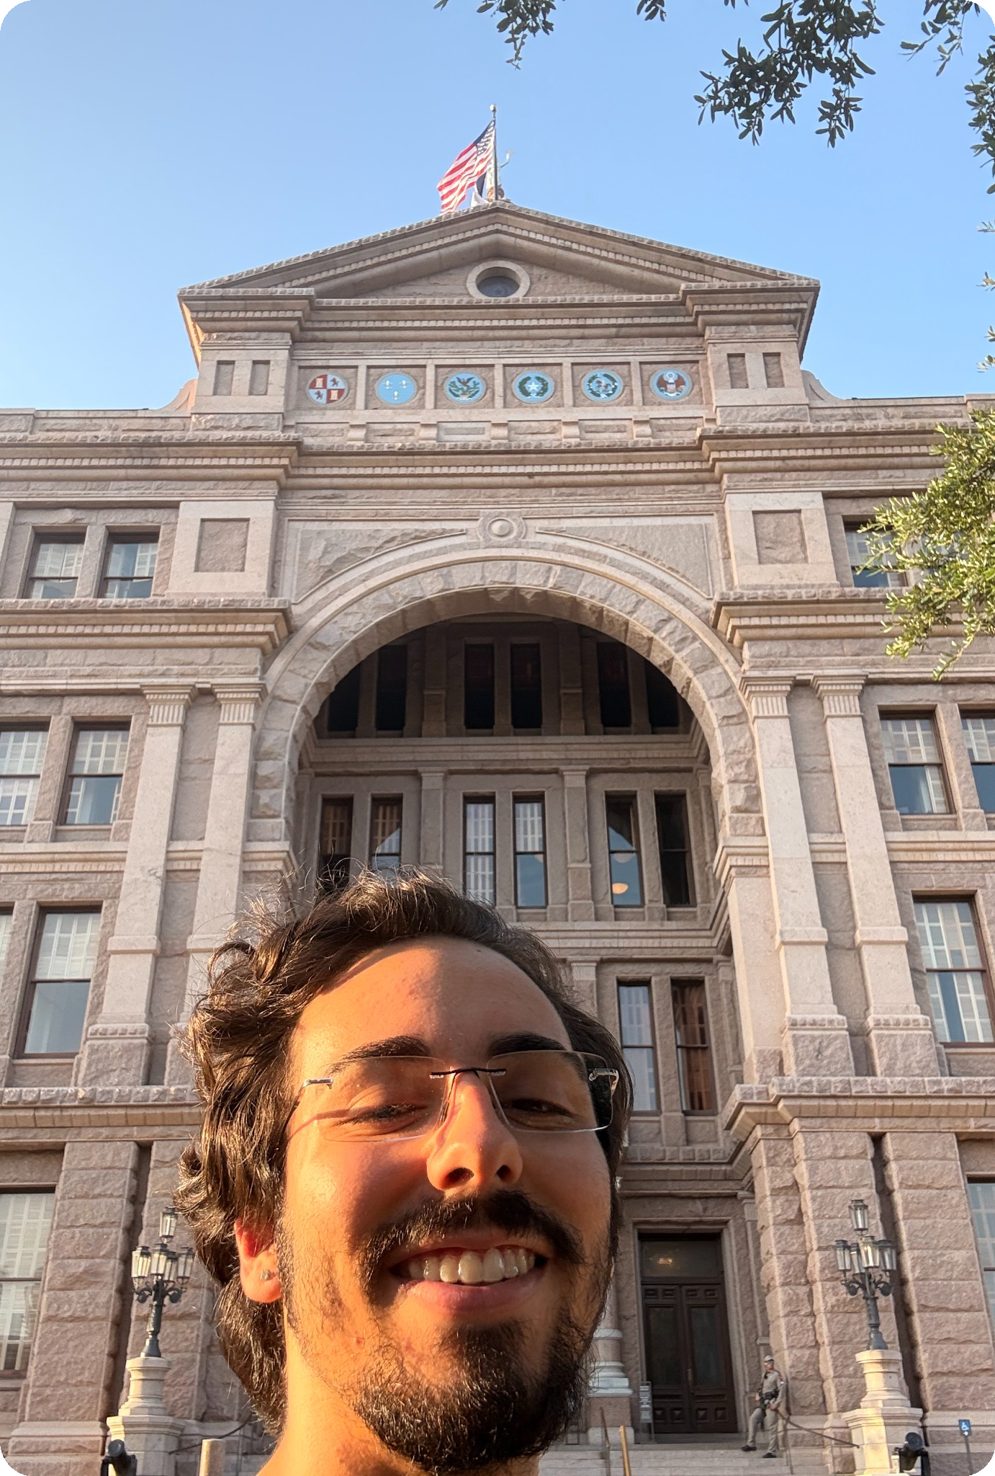

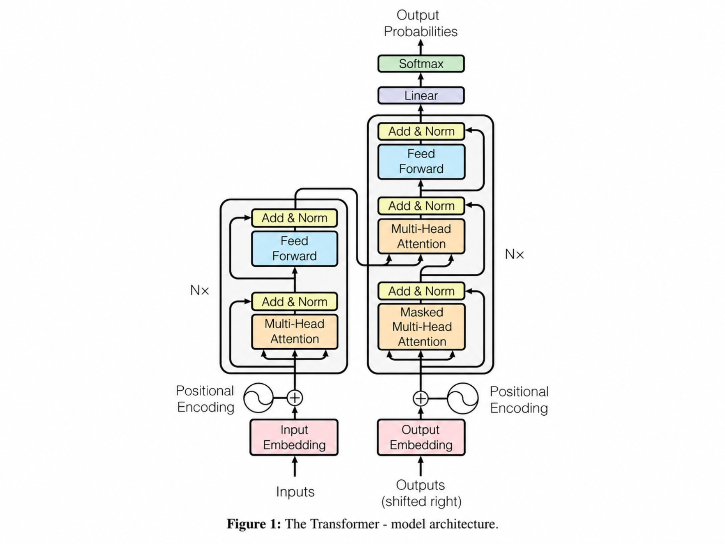
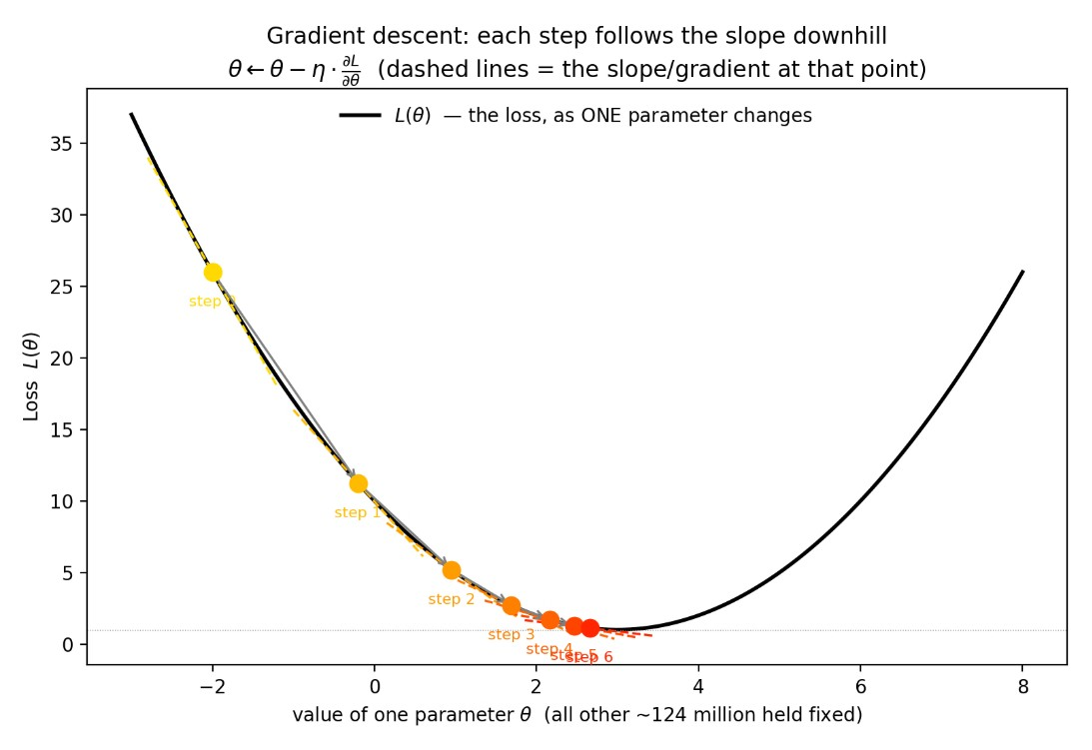
What is a machine-learning model?
From tokens and embeddings to Transformers, logits, and CUDA
y = fθ(x)
A concrete walkthrough using GPT-2 Small
Inference pipeline • Transformer internals • GPU execution
01
WHAT IS INSIDE THE MODEL?

Slide 2
GPT-2 Small: what we run
GPT-2 is compact enough to expose the complete computation pipeline on CPU and GPU without distributed complexity.
Execution pipeline: tokens → embeddings → 12 blocks → ln_f → logits
SPECIFICATION | GPT-2 SMALL CONFIGURATION
Parameters | 124M
Transformer blocks | 12 layers
Hidden size | 768 dimensions
Attention heads | 12 heads × 64 dimensions
Vocabulary | 50,257 tokens (byte-level BPE)
Context window | 1,024 tokens
Scale reference: 124M parameters vs. modern massive models with 100B+ parameters (educational baseline, not a quality ranking).
02

Slide 3
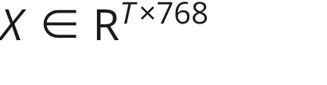
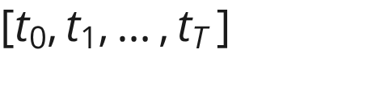
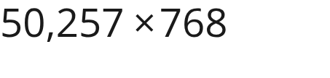
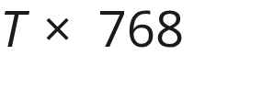
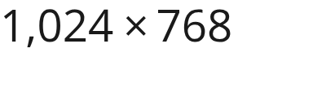
Text → tokens → vectors
The tokenizer maps text to discrete token IDs; embedding lookup turns IDs and sequence positions into dense vectors.
01
02
03
04
Raw string input
Tokenizer (BPE)
Embedding lookup
Input tensor
"The strangest thing I found inside my refrigerator was"
Fixed mapping produces a sequence of token IDs
Token IDs index into learned weight matrices
Yields matrix ready for block 0
W_te: Token embeddings ( )
W_pe: Position embeddings ( )
Tensor shape:
03

Slide 4
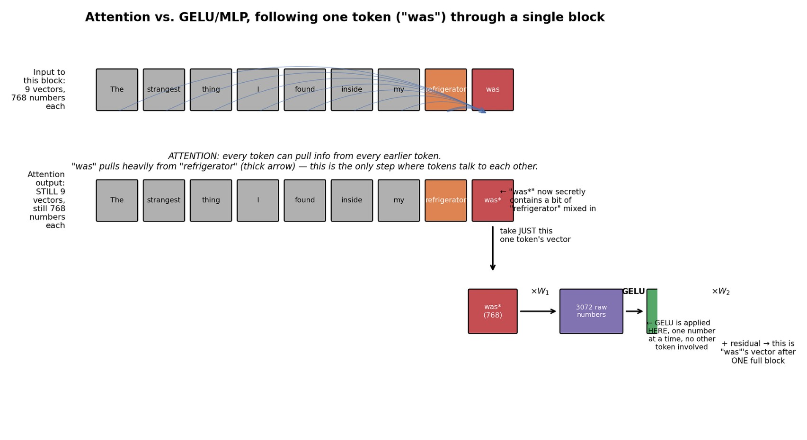
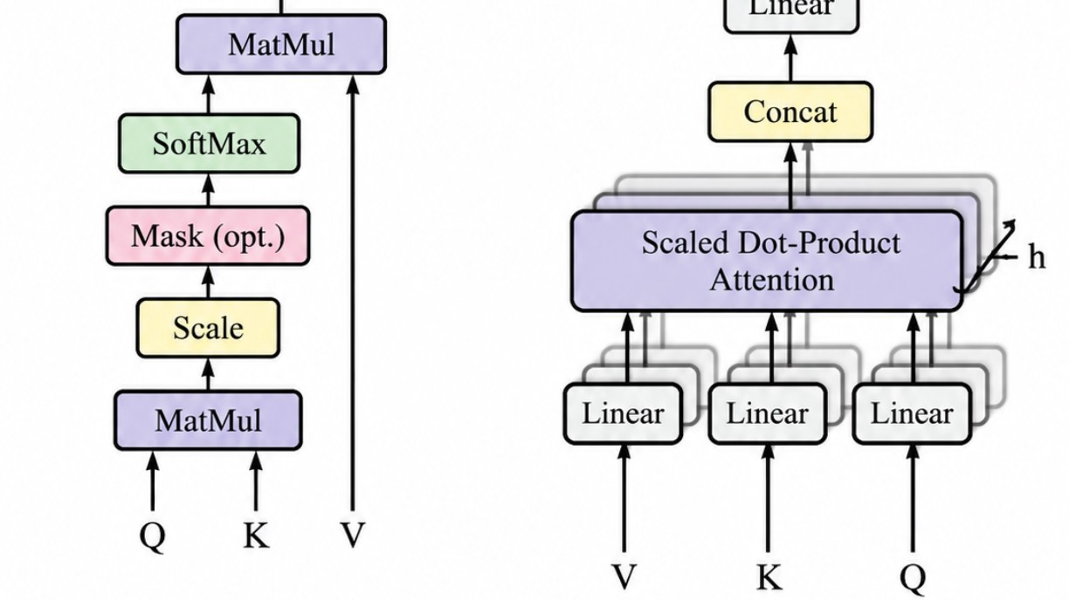
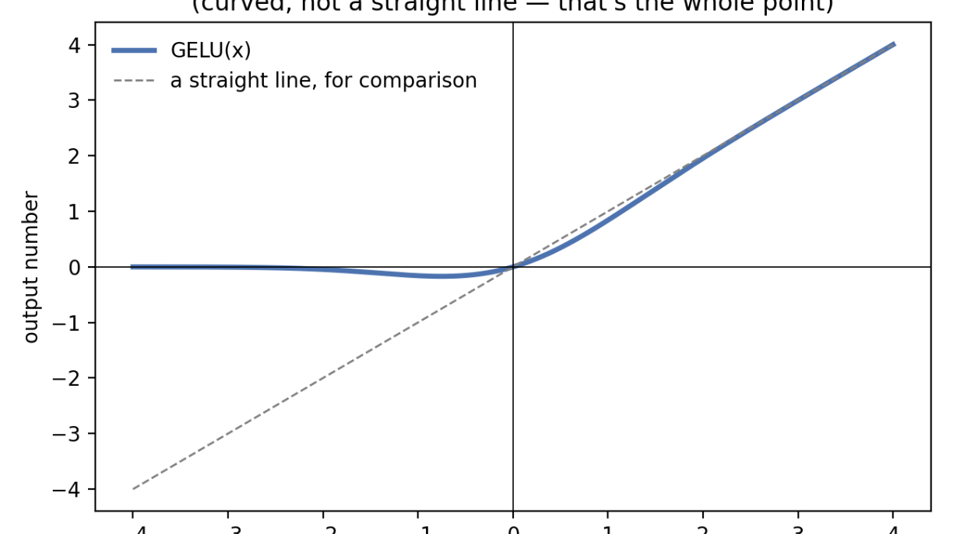
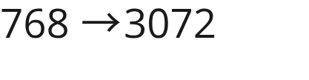
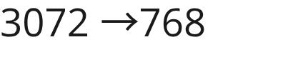

What does a Transformer block actually do?
A block alternates between communication across tokens and independent computation within each token.
2. MLP (Per token): Transforms each token independently. Expands to 3072 features, applies GELU, then compresses back to 768.
1. Attention (Mix tokens): Moves information across positions. "was" attends back to "refrigerator" so its vector absorbs context. Causal mask prevents looking into the future.
04

Slide 5
Why not just stack linear layers?
Matrix multiplication is powerful — but without a nonlinearity, depth collapses.
W₁
3072
W₂
x
y
768 features
768 features
3072 × 768
intermediate
768 × 3072
Two linear layers can be collapsed into one linear transformation.
W₂(W₁x) = (W₂W₁)x
Linear layer = learned matrix multiplication
No nonlinearity → no extra expressive power
GELU breaks the collapse by making the composition nonlinear
05

Slide 6
What the MLP is actually doing
One token expands into a larger feature space, gets a nonlinear transform, then comes back to 768.
W₁
3072 × 768
GELU
W₂
768 × 3072
768
3072
768
token vector
features
nonlinearity
Example: a few of the 3072 intermediate values
2.40
−0.30
0.02
5.10
↓ GELU
[2.38, −0.11, 0.01, 5.10, …]
GELU is not normalization. It adds the nonlinearity that makes the two linear layers more expressive together.
Every token follows this path independently; attention is the part that mixes tokens.
06

Slide 7
LayerNorm: keep activations in a workable range
In GPT-2, LayerNorm is applied across the 768 features of each token before the attention and MLP sublayers.
One token, before LayerNorm
Then the model can learn its preferred scale and offset
2
4
6
8
normalized
γ
β
y
mean = 5.00 std ≈ 2.24
scale
offset
Normalize: (x − μ) / √(σ² + ε)
Where it sits in the GPT-2 block
≈ [−1.34, −0.45, 0.45, 1.34]
LayerNorm
Attention
+ residual
Key idea: normalization stabilizes scale; γ and β remain trainable.
Then the same pattern repeats for the MLP: LayerNorm → MLP → + residual.
07

Slide 8
Logits: the model’s raw scores for the next token
The final projection turns the current 768-dimensional representation into one score for every vocabulary entry.
W_out
≈ 50,257 × 768
768
50,257 logits
One number per token in the vocabulary.
Logits are not probabilities.
Illustrative logits for five candidate tokens
“a”
2.1
“the”
1.8
“my”
0.3
“that”
0.2
“an”
0.0
Higher logit means the model scores that token more strongly relative to the others.
They can be negative, zero, or positive. Softmax comes next if we want probabilities.
GPT-2 reference code: logits = x @ w.wte.T (output projection tied to the token-embedding weights)
08

Slide 9
From logits to probabilities — then to a learning signal
Softmax turns relative scores into a distribution; cross-entropy asks how much probability the model gave the correct token.
Softmax: convert scores into probabilities
Loss for one training target
pᵢ = e^{zᵢ} / Σⱼ e^{zⱼ}
Correct token = “a”
P(correct) = 0.46
L = −log(0.46) ≈ 0.78
a
2.1
0.46
→
the
1.8
0.34
→
my
0.3
0.08
→
Low loss ⇔ high probability on the correct token
that
0.2
0.07
→
an
0.0
0.06
→
Across a sequence, probabilities multiply:
0.8 × 0.6 × 0.9 = 0.432
−log(0.432) = −log(0.8) − log(0.6) − log(0.9) ≈ 0.84
Why the log? It turns a product of probabilities into a sum of per-token losses — much easier to optimize numerically.
09

Slide 10
From Transformer math to computer operations
High-level attention equations compile down to four fundamental computer primitives: GEMMs, reductions, elementwise ops, and memory transfers.
TRANSFORMER OPERATION | HARDWARE PRIMITIVE
Q / K / V & Output Projections | Matrix multiplication (GEMM)
QK^T and Attention × V | Matrix multiplication (GEMM)
Softmax | Reductions (max, sum) + elementwise exp
LayerNorm | Reductions (mean, var) + elementwise scale/bias
Residual addition | Elementwise add
Embedding lookup | Indexed memory read / gather
10

Slide 11
Our NumPy reference implementation (cpu/gpt2.py)
x = w.wte[token_ids] + w.wpe[pos]
qkv = linear(x, c_attn_w, c_attn_b)
q, k, v = np.split(qkv, 3, axis=-1)
scores = (qh @ kh.transpose(0, 2, 1)) * scale
attn = softmax(scores, axis=-1)
out = attn @ vh
h = layer_norm(x); h = causal_self_attention(h); x = x + h
h = layer_norm(x); h = gelu_new(linear(h, ...)); x = x + h # MLP
x = final_layer_norm(x)
logits = x @ w.wte.T
A line-by-line Python reference that mirrors the exact mathematics and serves as the ground-truth oracle for GPU verification.
Equation → NumPy → future CUDA kernels: Clean 1-to-1 correspondence between mathematical tensor operations and executable kernels.
11

Slide 12

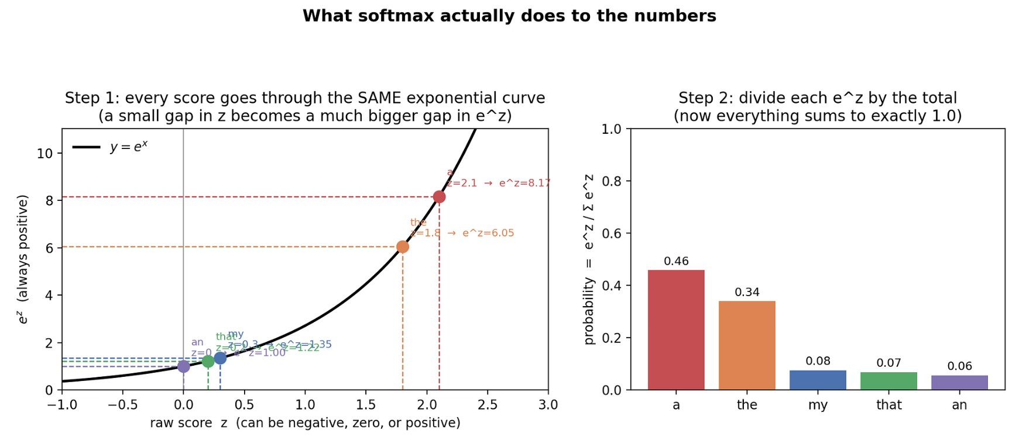

Decoding: choosing the next token
Once we have a probability distribution, decoding turns it into one concrete next token.
Pipeline: probabilities → decoding strategy → next token
Decoding strategies: Greedy vs. Top-k / Top-p stochastic sampling.
Inference ends by turning scores into a token; training uses the loss to learn θ.
12

Slide 13
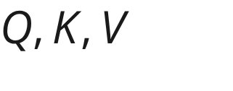


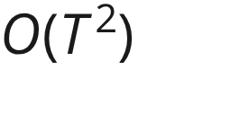

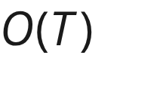
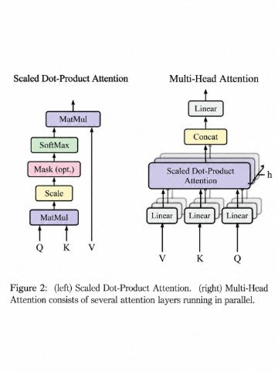
Q, K, V: no KV cache (demo) vs. KV cache (production)
Autoregressive decoding generates one token at a time. Caching past Keys and Values avoids recalculating prior token representations.
Single linear projection: Generates vectors at each layer.
Our run.py (No KV cache)
Production KV cache
Full forward pass every token, recomputing all past and ( total work). Directly tied to `--verbose-timing` in our CPU benchmark.
Stores previous and in GPU VRAM; only new query attends over the stored history ( per step).
13

Slide 14
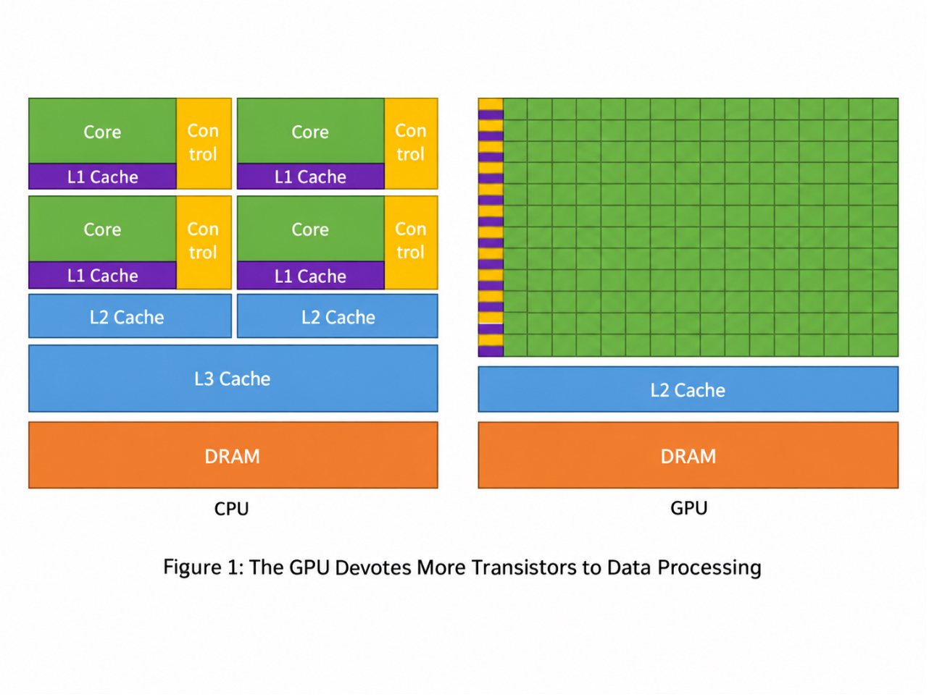
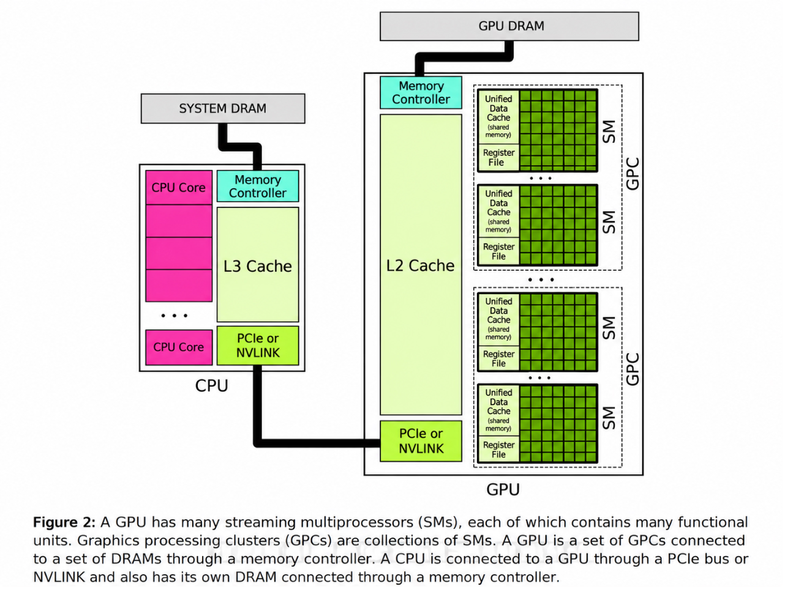
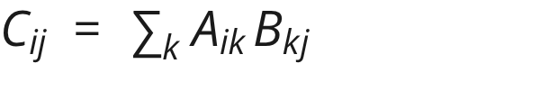
Why GPU + CUDA execution: mapping GEMMs to silicon
CPUs optimize for low-latency serial execution; GPUs dedicate silicon to massive SIMT parallel throughput for independent matrix tiles.
GEMM parallelism: Each is computed independently across thousands of GPU cores.
Memory hierarchy & tiling: Output matrices are broken into tiles; threads cooperate via registers, shared memory, and L1/L2 caches to minimize global DRAM traffic.
CUDA-Oxide note: Targets these same hardware kernels via Rust and NVIDIA's `cargo oxide` toolchain.
CUDA execution hierarchy: Kernel launch → Grid → Thread Blocks → Warps (32 threads) → Individual Threads.
14

Slide 15
Same math, three runtimes + live CPU demo
Same GPT-2 weights, same mathematical operations, implemented across three execution systems to verify numerical logits and measure performance.
RUNTIME | EXECUTION UNIT | PREFILL LATENCY | DECODE THROUGHPUT | P50 LATENCY | P95 LATENCY
NumPy reference | CPU (x86_64) | Live measured | Live tok/s | Live measured | Live measured
CUDA C++ | GPU (NVCC) | TBD | TBD tok/s | TBD | TBD
CUDA-Oxide | GPU (Rust SIMT) | TBD | TBD tok/s | TBD | TBD
Live demonstration: Run prompt on CPU oracle → compare logits → generate tokens → inspect `--verbose-timing`.
Status: CPU oracle live today; GPU paths (CUDA C++ & CUDA-Oxide) target identical math on NVIDIA hardware.
# Live demonstration trace:
make verify # Assert logits match within tolerance (logits_CPU ≈ logits_GPU)
python run.py --prompt "The strangest thing I found inside my refrigerator was" --verbose-timing
15

