Slide 1

MLS Goalkeeper
& Match Analysis
Evelyn Tan, Justin Johnson, Pedro Salvo

Slide 2
Agenda
Topics covered in this presentation
DATA & ANALYSIS
MODELING & STATISTICS
03
Overview
08
Predictive Modeling: Logistic Regression
04
Exploratory Data Analysis
09
Key Takeaways & Predictions
05
Descriptive Statistics
06
Insights 1
07
Insights 2

Slide 3
Overview
Datasets, tools, and analysis components
DATASETS
AUDIENCE & KEY QUESTIONS
all_goalkeepers.csv
Season-level GK stats (2012–2020)
matches.csv
Match-level results (2012–2020)
Soccer Coaches, GMs, and analytical staff
Key Prediction:
Predict winning record from Save %, GAA, Shutouts, Games Played, and Win %
2012–2020
25
2
2
Time Period
Seasons
Models
Datasets
03

Slide 4
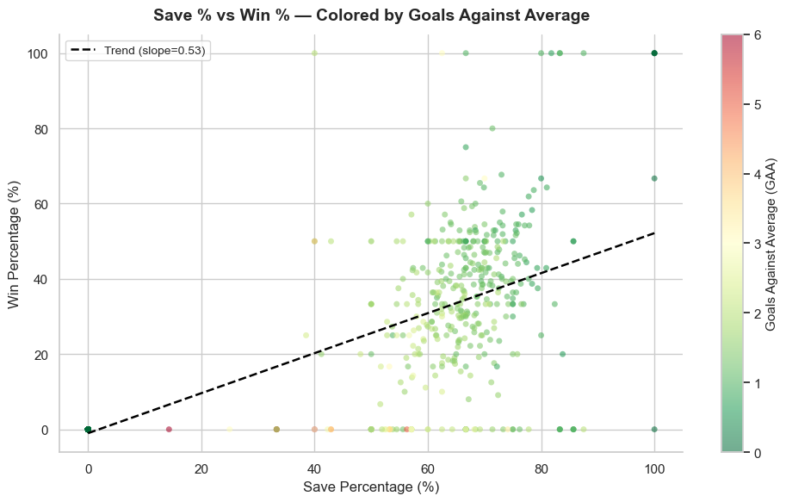
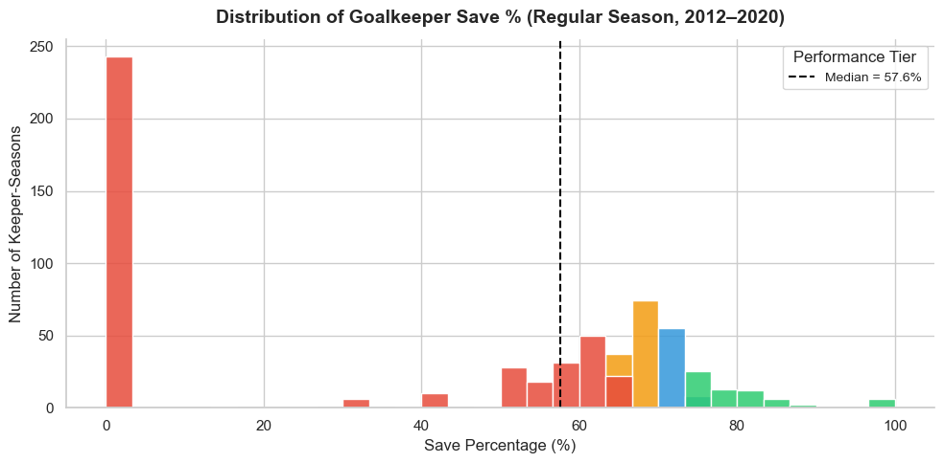
Exploratory Data Analysis
Save % tier classification and analysis
KEY FINDINGS
Elite tiers (≥75%) strongly correlate with higher win %
Good: 70–74% | Average: 65–69% | Below Average: <65%
Clear separation between performance groups in win outcomes
Cross-tabulation confirms Elite tier GKs have significantly higher win %. Save % is a meaningful predictor of team success.
04

Slide 5
Descriptive Statistics
Key metrics and data quality assessment
METRIC | DETAILS
Key GK Stats | GP (Games Played), minutes, shots faced, saves, GA (Goals Against), GAA (Goals Against Average), save %, win %, shutouts
Save % Median | ≈57.6%
GAA Median | ≈1.09
MISSING DATA
57.6%
1.09
Matches: attendence
Goalkeepers: Club
Overall data quality is high
Save % Median
GAA Median
05

Slide 6
Insights (1)
Club performance and home advantage analysis
DEFENSIVE STRENGTH
HOME ADVANTAGE
Clubs with highest career save % historically:
Seattle Sounders, D.C. United, Minnesota United
Rankings vary by era
Home win % ~52 – 63.3%
Away win % ~21.4 – 35.3 %
Strong, persistent home-field effect
LEAGUE TOTALS BY YEAR
~56%
~26%
Avg Home Win Rate
Avg Away Win Rate
06

Slide 7
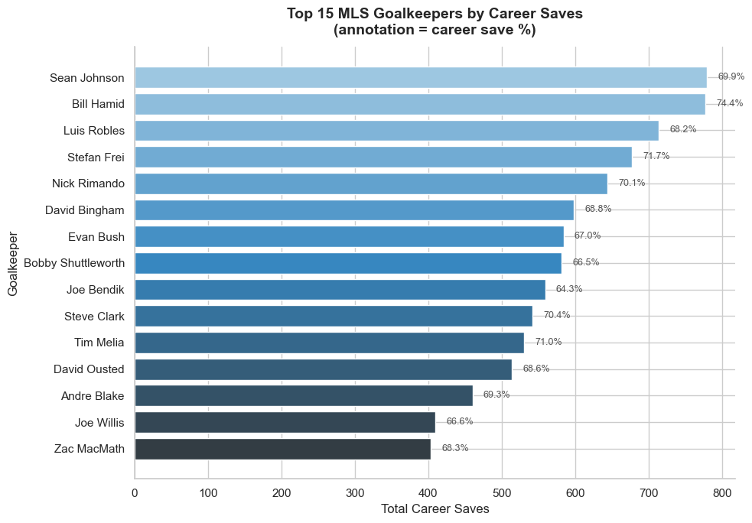
Insights (2)
Volume + efficiency view
High total saves = longevity + workload
Played many seasons,
Logged high minutes,
Played behind a defense that allowed many shots.
Save% annotation adds efficiency context
High-volume, high-efficiency keepers (elite careers)
High-volume, average-efficiency keepers (workhorses)
Lower-volume but extremely efficient keepers (not shown because they didn’t make top 15 in saves)
LEAGUE TOTALS BY YEAR
07

Slide 8
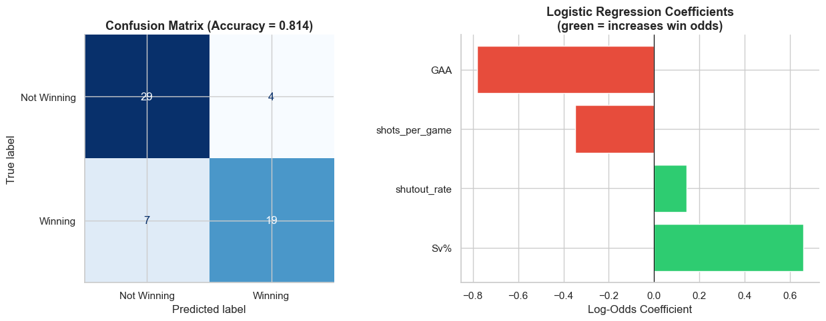
Predictive Modeling
Logistic Regression — Predicting Winning Records
GOAL: Predict winning record (Win > Loss seasons) using GK performance metrics
0.81
TOP PREDICTORS
Save % — positive influence on winning | GAA — strong negative (higher GAA hurts) | Shutout Rate — slight negative effect
Model Accuracy (81%)
08

Slide 9
Key Takeaways & Predictions
Major findings from the full Colab analysis
LEAGUE TRENDS
KEEPER INSIGHTS
MODELING
Save % remains stable across eras
GAA has improved over time
Home advantage is strong and consistent (~56% home win rate)
Rimando, Hartman, and Meola dominate career metrics
Elite save % tiers (≥75%) strongly correlate with winning seasons
Logistic regression achieves 81% accuracy predicting winning seasons
GAA is the strongest negative predictor; Save % is the strongest positive predictor
BOTTOM LINE: Goalkeeper save % and goals-against average are reliable, actionable metrics for predicting MLS team success – Get a Great Goalie!!

