Slide 1
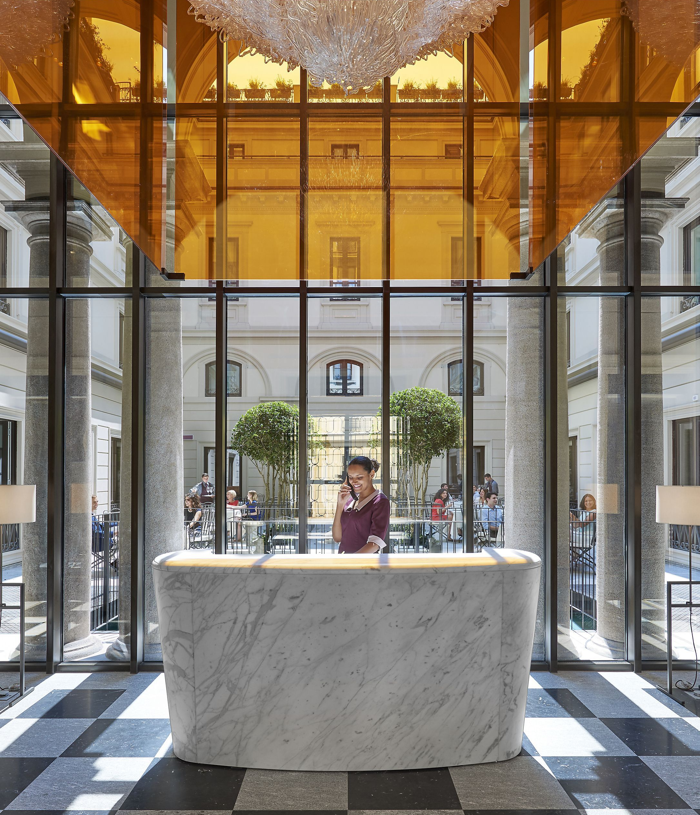

Predicting booking cancellations
Group Y:
João Alves Henriques;
João Paulo César
Pedro Sancho
Vilmar Adriano Bussolaro
Notes:
Good afternoon everyone, We will now present Group Y’s assessment of predicting booking cancellations for Hotel Chain C.

Slide 2

Context
Situation:
Hotel chain C wants to reduce their losses with cancellation from 40% to 20% for Hotel H2;
Goal:
Predict Cancellations in order to reduce this rate;
Expected Outcome:
Source through a predictive model for Cancellations an overbooking policy to increase profits;
Notes:
The Situation is that Hotel Chain C wants to reduce their cancellation rate from 40% to 20% for H2.
So, the goal is to predict cancelled bookings in order to reduce this rate and meet Michael’s desire.
Therefore, we must service a predictive model for Cancellations, that will supply clear decision rules for overbooking policies with the aim of increasing profits.

Slide 3
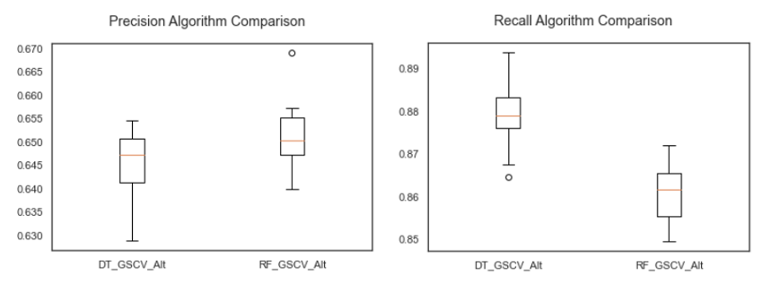
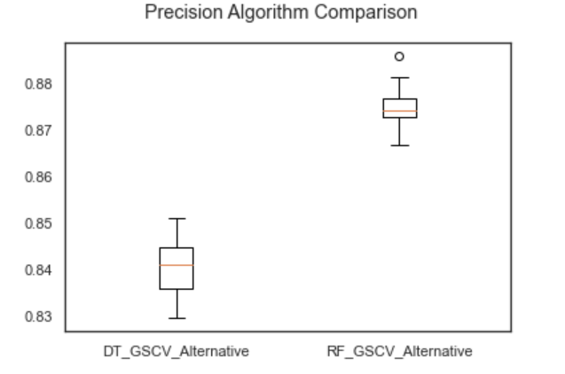
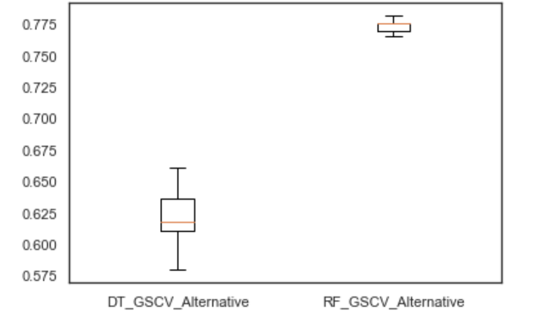
How did we do it?
Maximize getting cancelled bookings right;
Without letting more than 40% of true cancellations be marked as non-cancelled bookings;
To summarize, we aimed for solving this problem:
Max 𝑃𝑟𝑒𝑐𝑖𝑠𝑖𝑜𝑛1
subject to 𝑅𝑒𝑐𝑎𝑙𝑙1 >= 0.68
and 𝑃𝑟𝑒𝑐𝑖𝑠𝑖𝑜𝑛1 >= 0.79
Benchmark algorithms
Notes:
How did we do it?
Our goal was to maximize getting the cancelled bookings right predictions, without letting more than 40% of cancelled bookings be predicted as non-cancellations.
To summarize, we construct an optimization problem displayed here: Maximizing Recall for Cancellations subject to Precision for Cancellations at least 60%.
This way we will solve the cancellation rate problem, Michael’s Desire, without creating a new one, like overbooked customers appearing in the lobby without having rooms, generated with a poor recall model.
From a pool of white-box models and black-box models, we selected the two most adequate ones (Decision Trees and Random Forests) and proceeded to find best their implementation. Here we present an example of comparing the two algorithms for the desired metrics.
Since Decision Trees are more interpretable and displayed better results with its best found specification we decided that we would proceed with this algorithm.

Slide 4
Data Overview
Data analyzed was gathered from bookings that arrived between July 1, 2015, and August 31, 2017.
Random Forest lets us analyze how variables differ from each other, and how they influence the prediction model.
Lead Time
Special Requests
Previous Cancellations
Number of days that elapsed between the entering date of the booking into the PMS and the arrival date
Number of special requests made by the customer (e.g. twin bed or high floor)
Number of previous bookings that were cancelled by the customer prior to the current booking

Slide 5
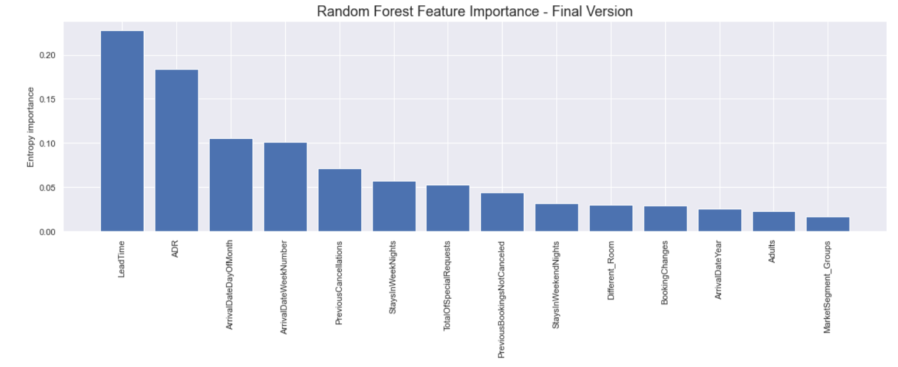
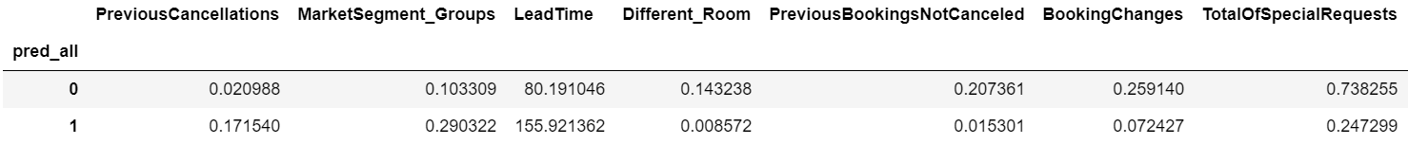
Data Overview

Slide 6
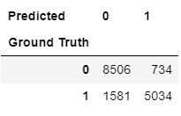
Predictions
Specification found in a Repeated Stratified 10-fold fashion (2 repeats);
Important metrics:
Recall for cancelled bookings of 0.78:
Precision for cancelled bookings of 0.88:
Notes:
After running our model, we ended with the following confusion matrix:

Slide 7
How to interpret these results?
Suggestions for Increasing Revenue with the predictive model:
Overbook 80% predicted cancelled bookings;
Cancellation will be close to 14%
Create go-to discount policy practices for these 14% bookings cancelled that were not predicted as such;
43% Revenue Loss on Cancellations
Predictive Model
5% Revenue Increase through Overbooking
Implementation

Slide 8
Slide 9
Implementation
GATHER MORE DATA
CREATE APPLICATION
Because we analyzed just part of the database, historical data
.
That gathers info from reservations 7 days prior to arrival and calculates the prediction to cancel
.
REFINE MODEL
DASHBOARD
Models can always be improved, with more data and more clear business objectives
Show results in a dashboard to the bookings manager, so that he can make the best decision possible
.

Slide 9
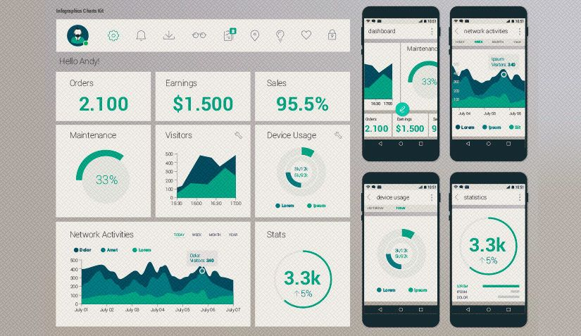
Takeaways
Continuous investment in Machine Learning to better keep track of recall and precision degradation in order to fine-tune the model back into numbers that produced the intended results

