Slide 1
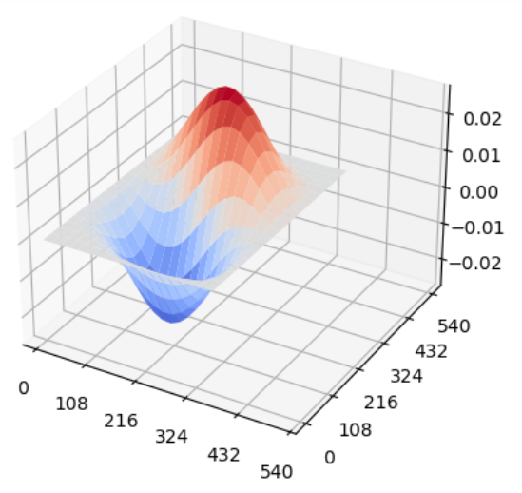
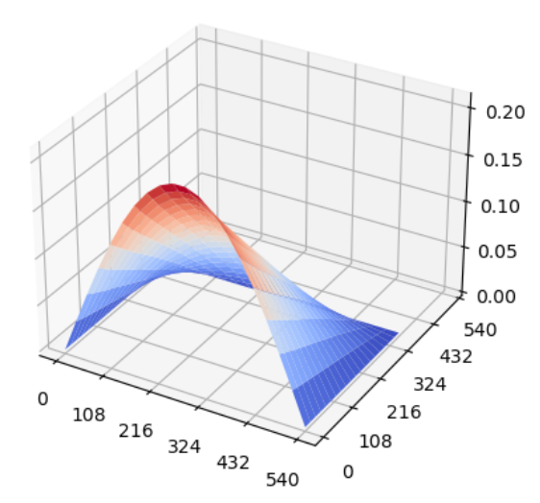
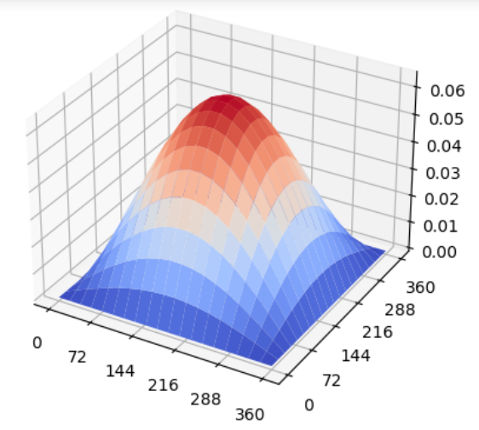
Pinned Nxx
Clamped Nxy and Nyy
Free Edge Nxx (custom BC)

