Slide 1
2026/05/07

Slide 2
More deep testing on object detector models

Slide 3
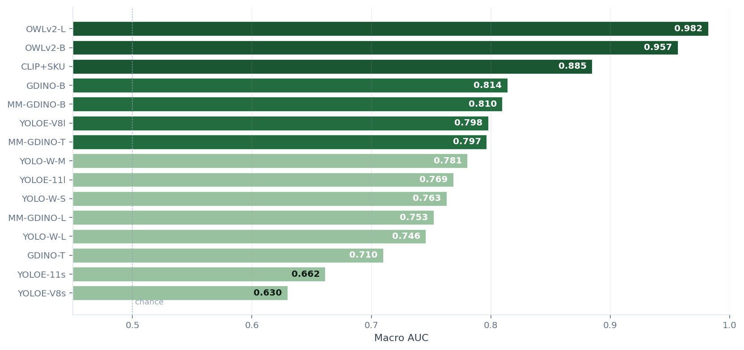
Recap · last week's AUC ranking
Top 3 by macro AUC
#1
OWLv2-L
AUC = 0.982
latency 1582 ms
#2
OWLv2-B
AUC = 0.957
latency 281 ms
#3
CLIP+SKU
AUC = 0.885
latency 51 ms
AUC measures how well the score separates present vs absent — but does not check WHERE the box landed.
2026/05/07
3

Slide 4
The problem
02
01
What AUC ignores
What AUC checks
Does not check if the model really detected the correct object in the image with target
Score of image with target >
Score of image without target
2026/05/07
4

Slide 5
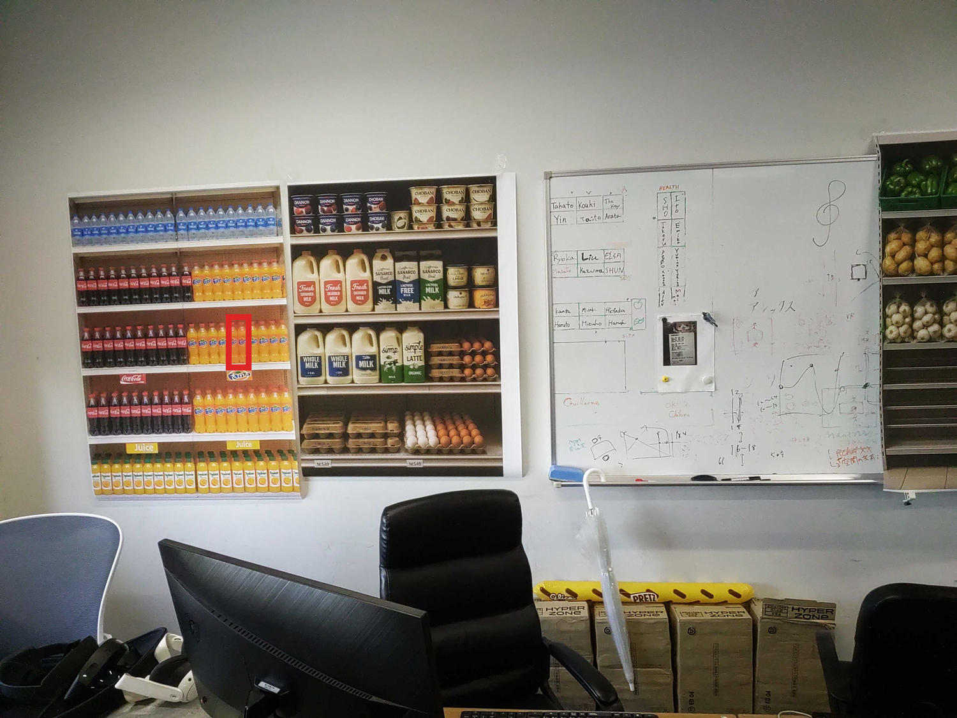
Concrete failure · 99.7% confidence, wrong box
Real eval entry
Question
Where is orange juice?
Model · CLIP + SKU-110K
Score on the predicted box
0.997
Manual review
✗ wrong
The box is on the wrong product — the model can't actually find orange juice.
2026/05/07
5

Slide 6
Solution · manual review + new metric
CAVA Lab
👤 Review
New metric
Check manually if the output of the models is correct or not.
Reliability
= Macro AUC × LocAcc
Captures both calibration and localisation
AUC ≈ 1 → score correlates with presence.
Top 5 models reviewed → 790 manual judgements.
LocAcc ≈ 1 → box really sits on the target.
Reliability is high only when BOTH are high.
2026/05/07
6

Slide 7
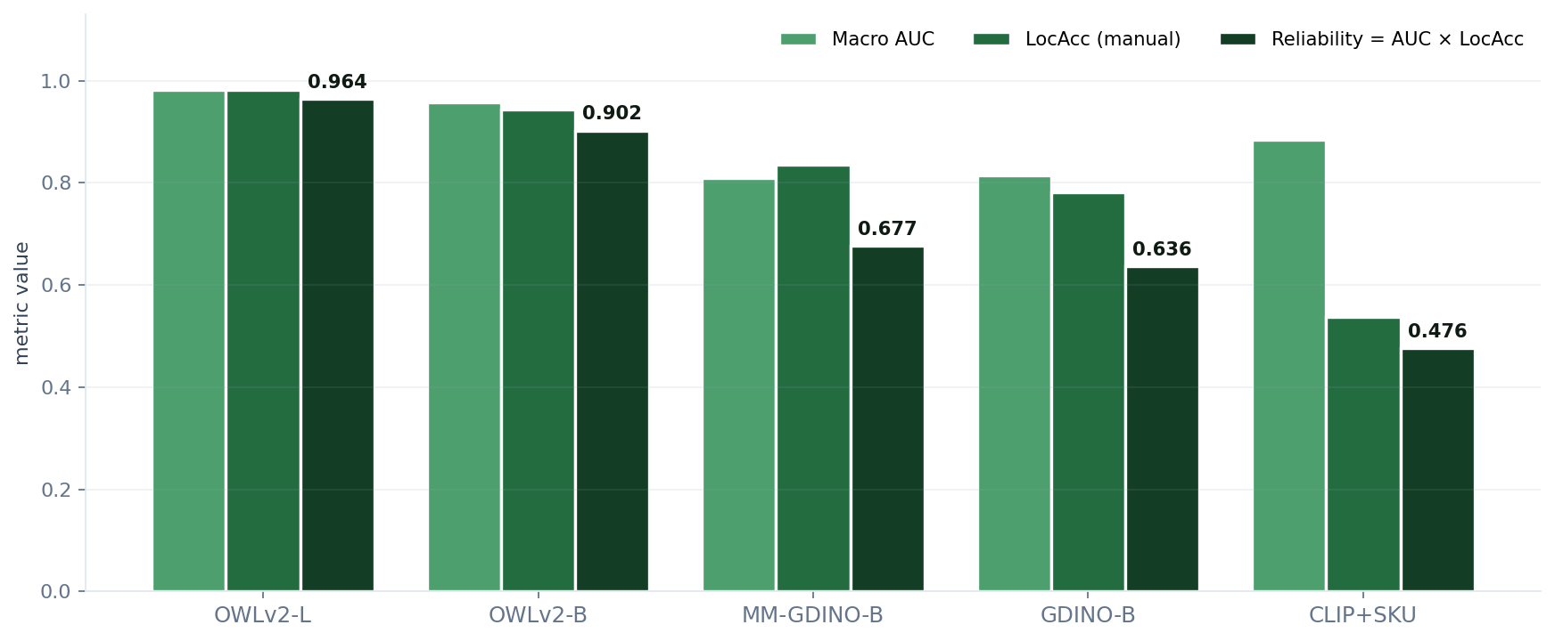
Combined ranking · Reliability = AUC × LocAcc
Reliability ranking
#1
OWLv2-L
R = 0.964
#2
OWLv2-B
R = 0.902
#3
MM-GDINO-B
R = 0.677
#4
GDINO-B
R = 0.636
#5
CLIP+SKU
R = 0.476
2026/05/07
7

Slide 8
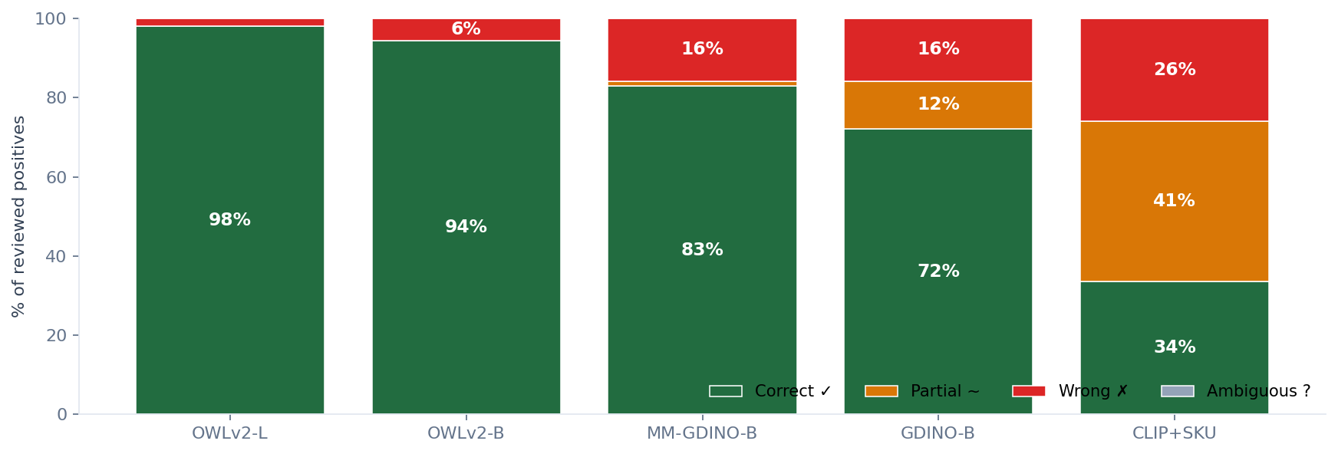
Where each model fails · verdict distribution
2026/05/07
8

Slide 9
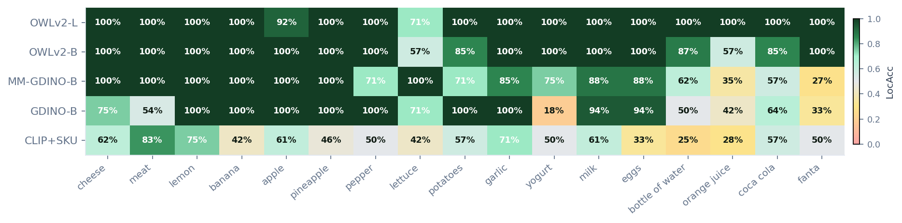
LocAcc per target · where each top model fails
2026/05/07
9

Slide 10
Implement OWLv2-B on device
Explore next steps:
(Using LLM for additional understanding of environment?)
(Update voice/action policy?)

