Slide 1
2026/05/14

Slide 2
Measure end-to-end latency of OWLv2-B deployed to the Glass
Determine threshold values for OWLv2-B
Explore additional implementation with LLM

Slide 3
End-to-end latency · OWLv2-B offloaded to PC
01
02
03
Cold start
Inference (warm)
Total round-trip
6–9 s
240–450 ms
500–900 ms
First frame · loading the OWLv2-B weights into VRAM
OWLv2-B forward pass + post-processing in PC GPU
Glass capture → Wi-Fi → PC infer → response

Slide 4
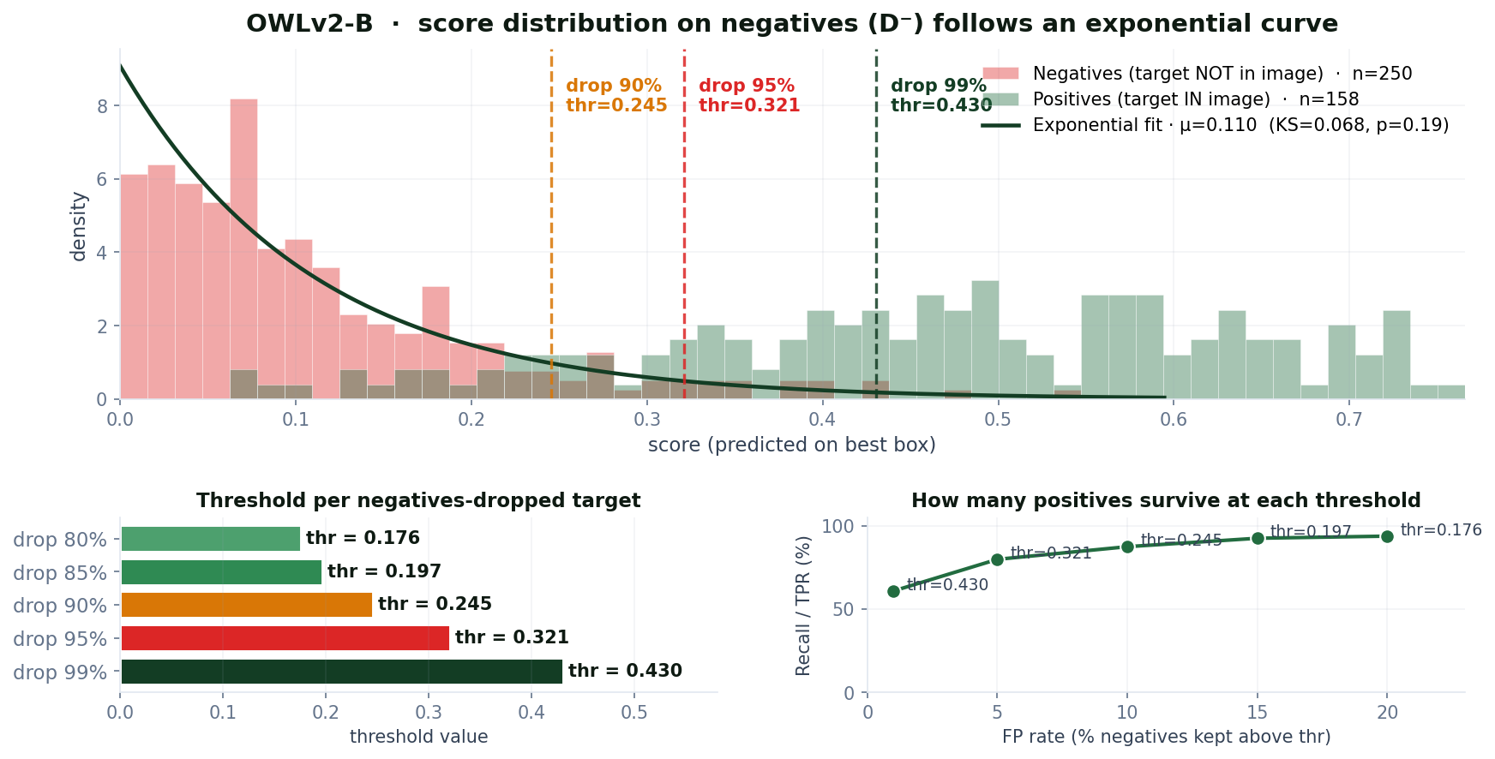
OWLv2-B · the global negatives curve
4

Slide 5
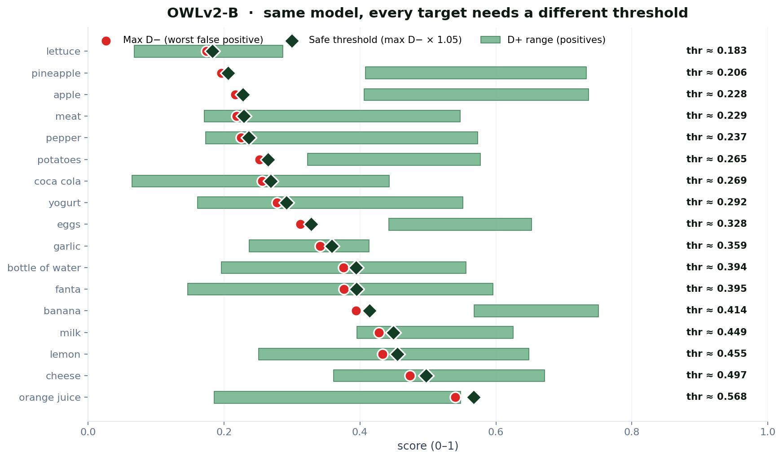
Same model · every target needs a different threshold
Easy targets (low thr)
lettuce
0.183
pineapple
0.206
apple
0.228
Hard targets (high thr)
lemon
0.455
cheese
0.497
orange juice
0.568
Ratio
3.1×
2026/05/14
5

Slide 6
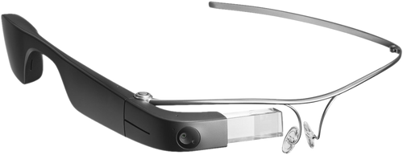

My Research – Baseline System
User
querie
- Is it a valid request? Makes sense?
- Confirmation: “Are you sure?”
Are we inside the store?
e.g.
Generate predicates (Conditions)
We see the section?
“I want to buy potatoes”
We see the product?
Object detector
Run perception models
Store Evidences: “Belief graph”
Check if we fullfill the predicates
OCR
Scene recognition
Guide
Voice Policy
Action Policy
“Potatoes are lower to your right”

Slide 7
My Research – Baseline System
User
querie
Are we inside the store?
- Is it a valid request? Makes sense?
- Confirmation: “Are you sure?”
e.g.
We see the section?
Generate predicates (Conditions)
We see the product?
“I want to buy potatoes”
Is the user seing the panels?
Is the user seing the panels?
Object detector → OWLv2-b + LLM?
…
Run perception models
Store Evidences: “Belief graph”
Check if we fullfill the predicates
OCR
Scene recognition by LLM
Guide
Voice Policy
Action Policy
“Potatoes are lower to your right”

Slide 8
Try to solve threshold issue
Implement LLM in scene recognition
Explore LLMs models and latency

