Slide 1
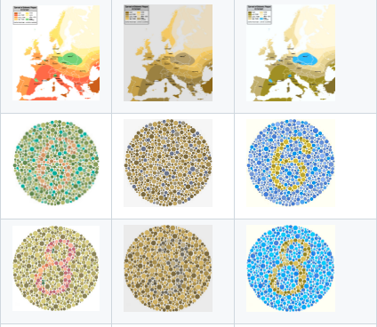
CVD Img Recolor, Pedro Henrique Rosso, Unicamp
Summary of the project
Plan:
Make it run in FPGA
Optimize according to lab 1
Other optimizations
Final project
Made it run in FPGA
Made some optimizations
Details of the optimization process are available here
How it Works
A more descriptive explanation is available here
Learning
How to analyse with emulations and Vitis Analyzes
Few optmizations, evalute code, making kernels
Difficulties
Optimizing the kernel code
Running the program with multiple CUs.
Reference Perception Recolored
Results:
Avg Speed Up:
2,02x
Full Results
Read Img
Init Data Structures
Adapt ElMap
Center White Node
Project Pixels on CVD plane
Write
Img

