Slide 1
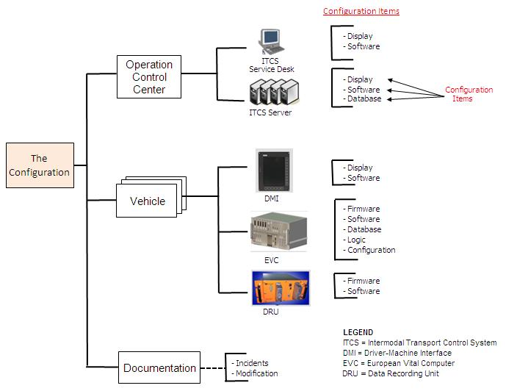
Aggregate Configuration Items
Configuration Items

Slide 2
Identify potential CIs in work package
Report potential CIs to QA Manager and Configuration Manager
Determine if item is suitable for configuration control
Enter CI in Configuration Item Register
Provide feedback
Yes
No

Slide 3
Identify potential CIs in baseline
Determine if CIs are under configuration control
Enter CIs in Configuration Item Register
No
Yes
CIS successfully tested/reviewed?
Initiate change request
No
Yes
Determine if baseline is suitable for approval
Enter baseline in Configuration Item Register
Yes
No

Slide 4
Evaluations & Reviews
Configuration Identification
Status Accounting
Identification of software items that must be controlled
Baseline Definition
Record of the configuration at a point in time
Configuration Control
Control of changes
No
New Release?
Yes

