Slide 1
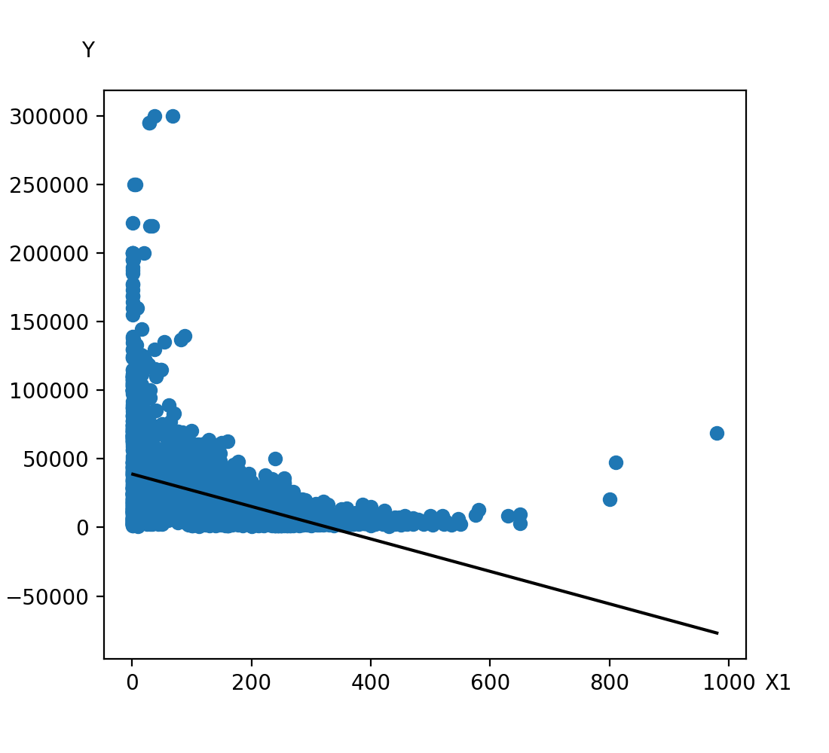
('X1',), Polynomial degree 1
Equation: y = -1.18E+02*X1+3.90E+04
R-squared: 0.224

Slide 2
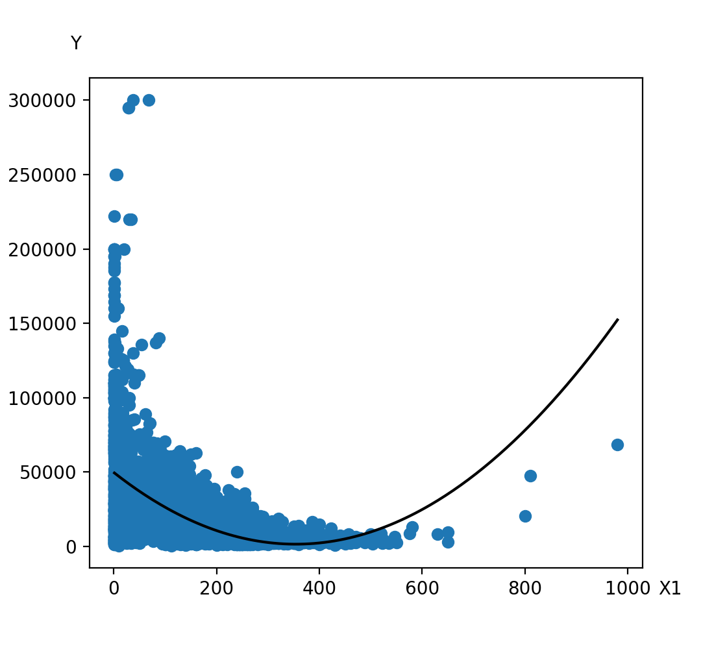
('X1',), Polynomial degree 2
Equation: y = -2.72E+02*X1+3.85E-01*X1^2+4.97E+04
R-squared: 0.308

Slide 3
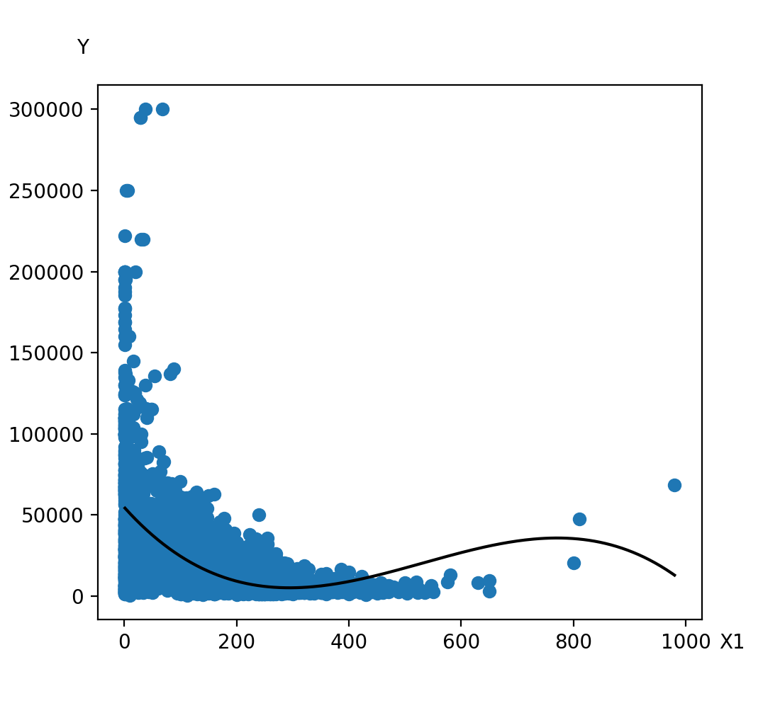
('X1',), Polynomial degree 3
Equation: y = -3.85E+02*X1+9.05E-01*X1^2-5.66E-04*X1^3+5.46E+04
R-squared: 0.326

Slide 4
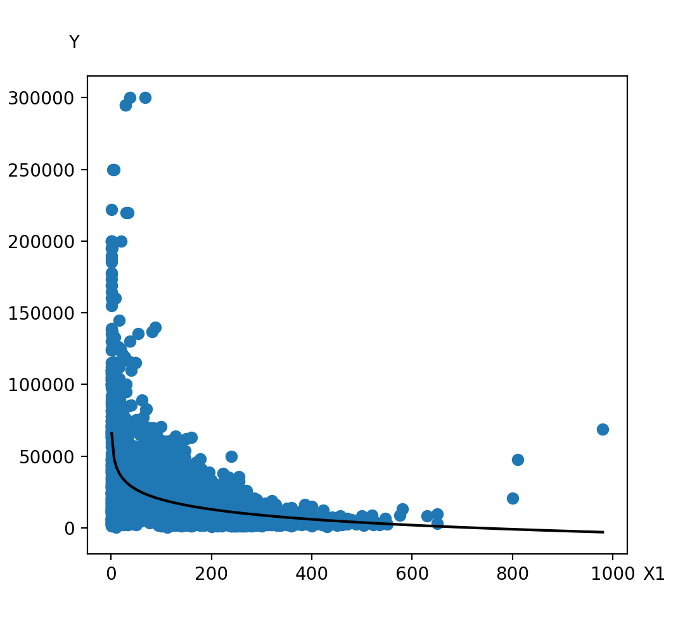
X1, Logarithm
Equation: y = -9.99E+03*ln(X1)6.58E+04
R-squared: 0.308

Slide 5

X1, Exponential
Equation: y = 2.93E+04*exp(-5.33E-03*X1)
R-squared: 0.182

Slide 6

X1, Power
Equation: y = 5.85E+04*X1^(-3.38E-01)
R-squared: 0.213

Slide 7
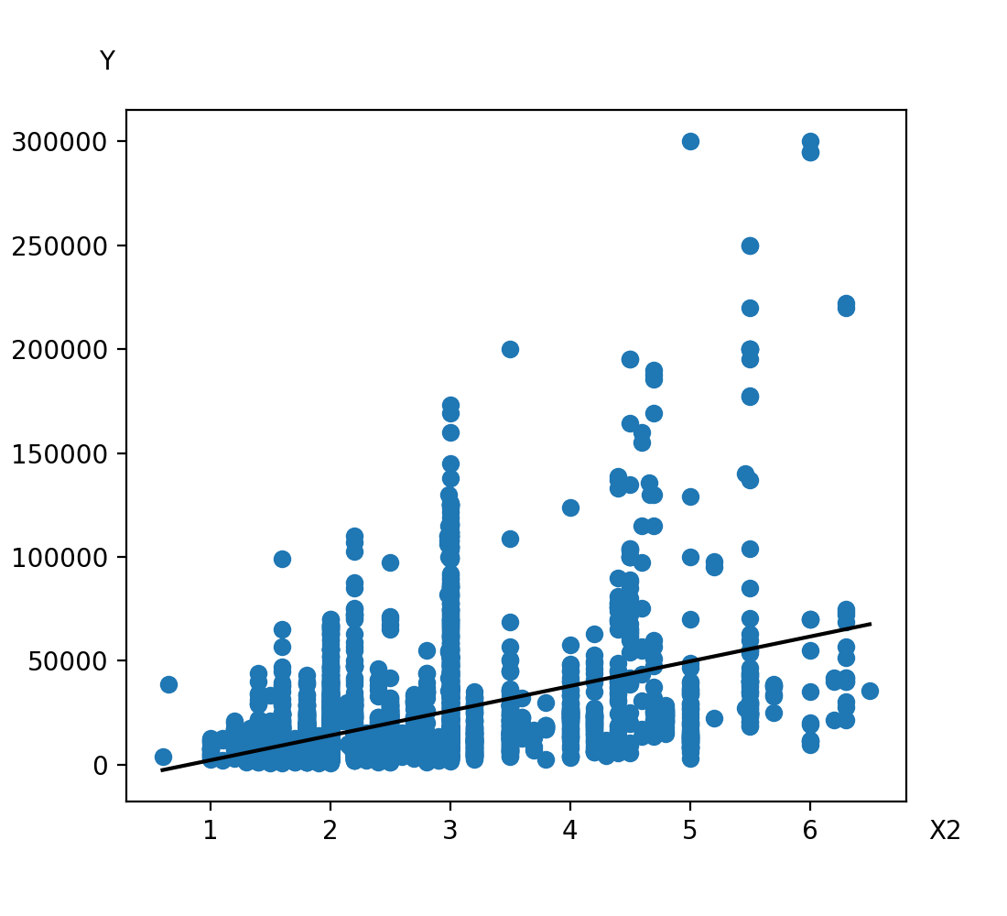
('X2',), Polynomial degree 1
Equation: y = 1.19E+04*X2-9.73E+03
R-squared: 0.201

Slide 8
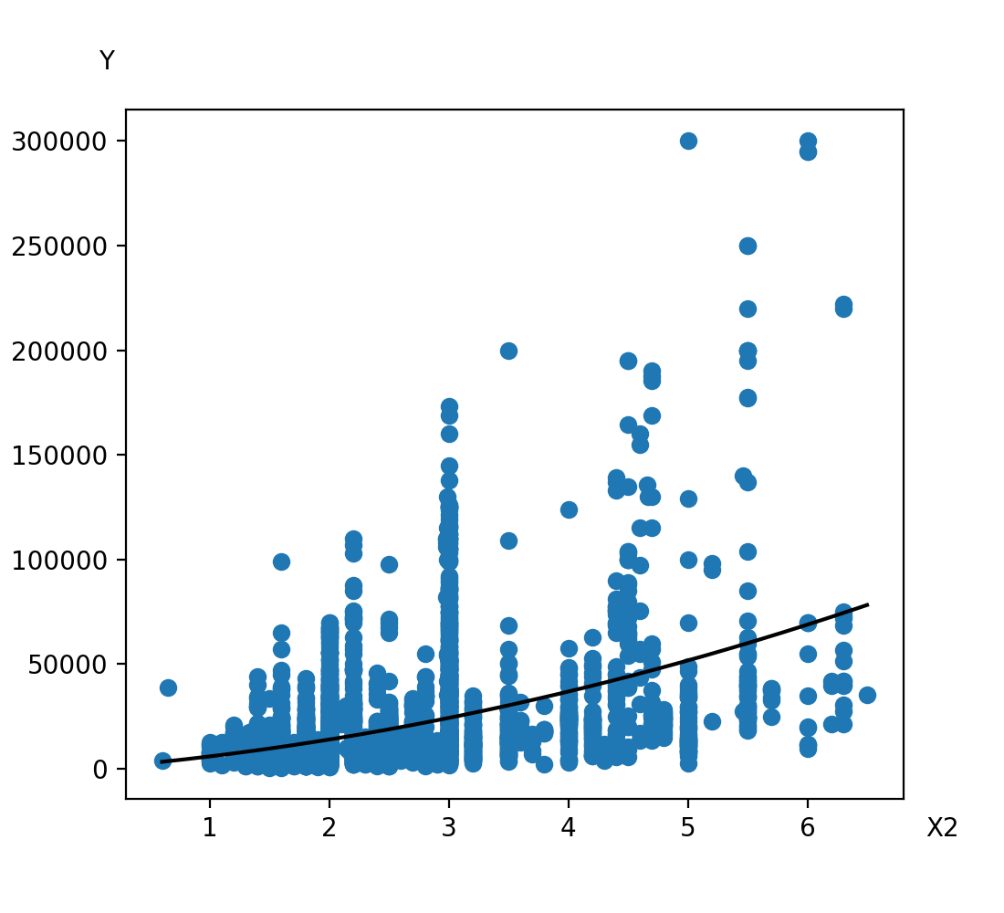
('X2',), Polynomial degree 2
Equation: y = 4.68E+03*X2+1.13E+03*X2^2+1.21E+02
R-squared: 0.205

Slide 9

('X2',), Polynomial degree 3
Equation: y = 5.22E+03*X2+9.52E+02*X2^2+1.75E+01*X2^3-3.74E+02
R-squared: 0.205

Slide 10
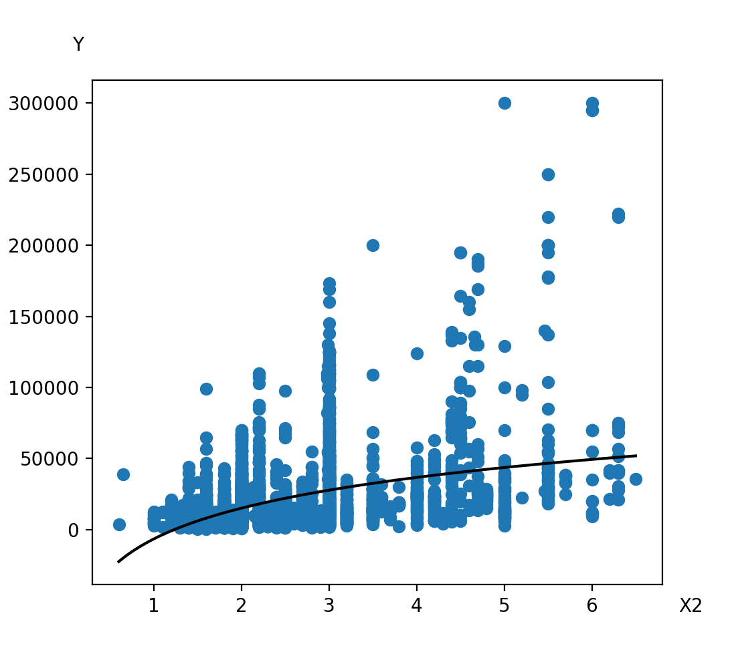
X2, Logarithm
Equation: y = 3.12E+04*ln(X2)+-6.52E+03
R-squared: 0.179

Slide 11
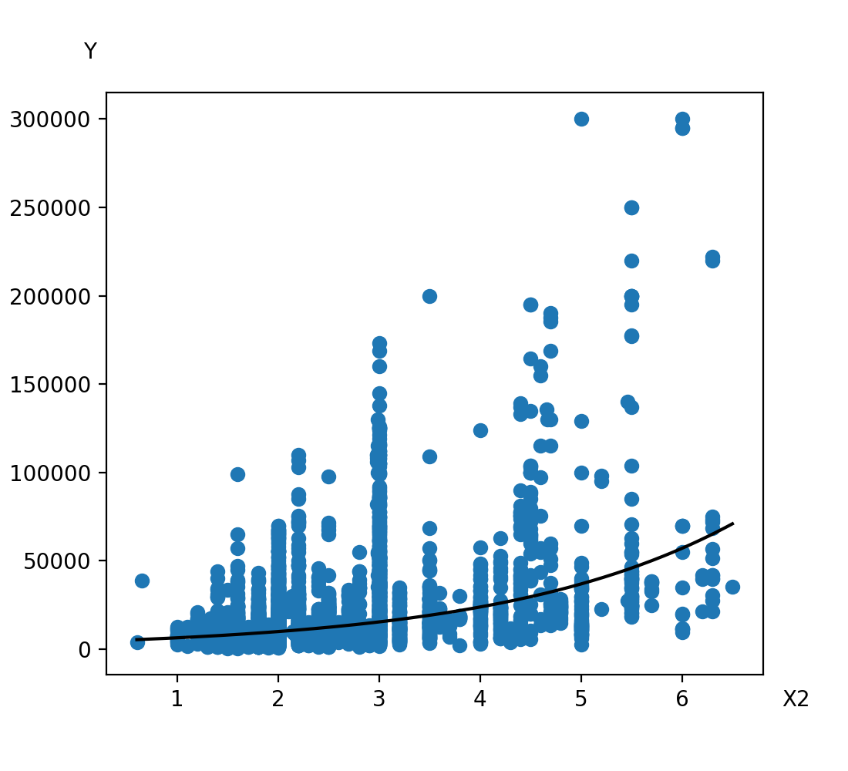
X2, Exponential
Equation: y = 4.18E+03*exp(4.36E-01*X2)
R-squared: 0.131

Slide 12

X2, Power
Equation: y = 4.52E+03*X2^(1.19E+00)
R-squared: 0.107

Slide 13
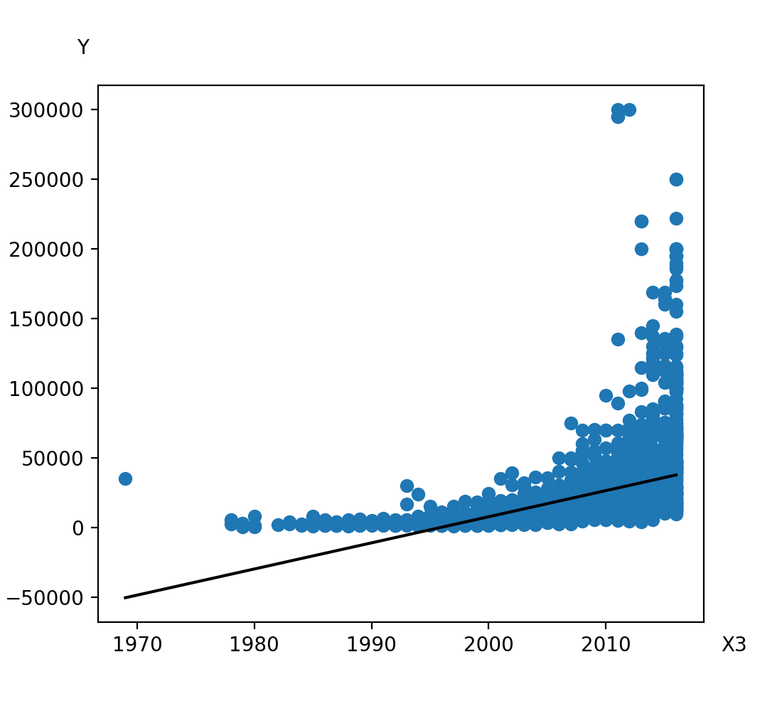
('X3',), Polynomial degree 1
Equation: y = 1.88E+03*X3-3.75E+06
R-squared: 0.236

Slide 14
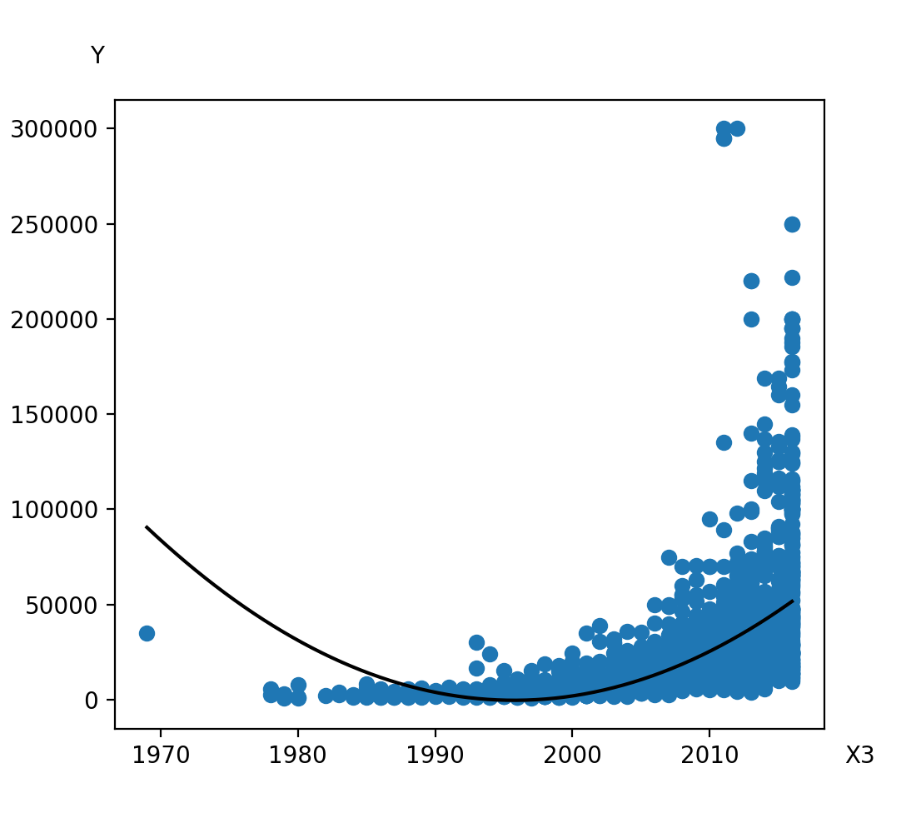
('X3',), Polynomial degree 2
Equation: y = -5.06E+05*X3+1.27E+02*X3^2+5.05E+08
R-squared: 0.336

Slide 15
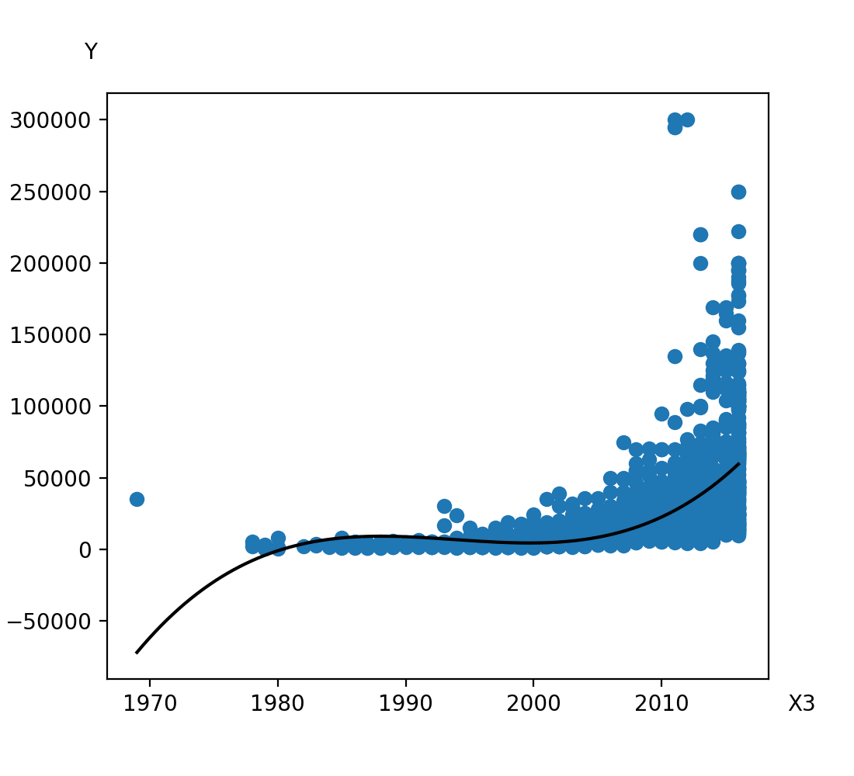
('X3',), Polynomial degree 3
Equation: y = 7.29E+07*X3-3.66E+04*X3^2+6.12E+00*X3^3-4.85E+10
R-squared: 0.368

Slide 16

X3, Logarithm
Equation: y = 3.75E+06*ln(X3)+-2.85E+07
R-squared: 0.235

Slide 17
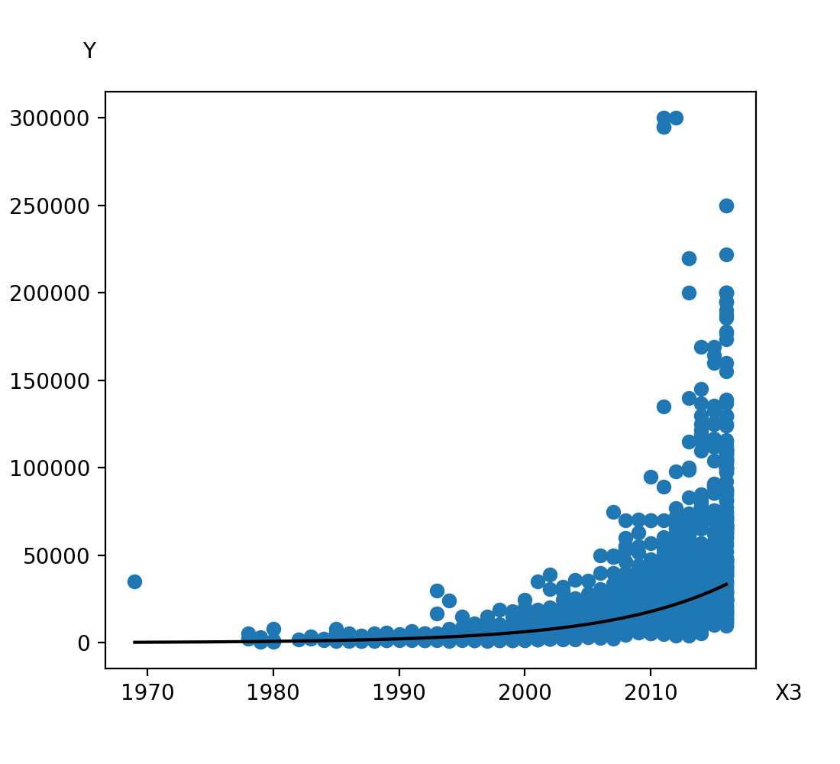
X3, Exponential
Equation: y = 1.30E-87*exp(1.04E-01*X3)
R-squared: 0.244

Slide 18
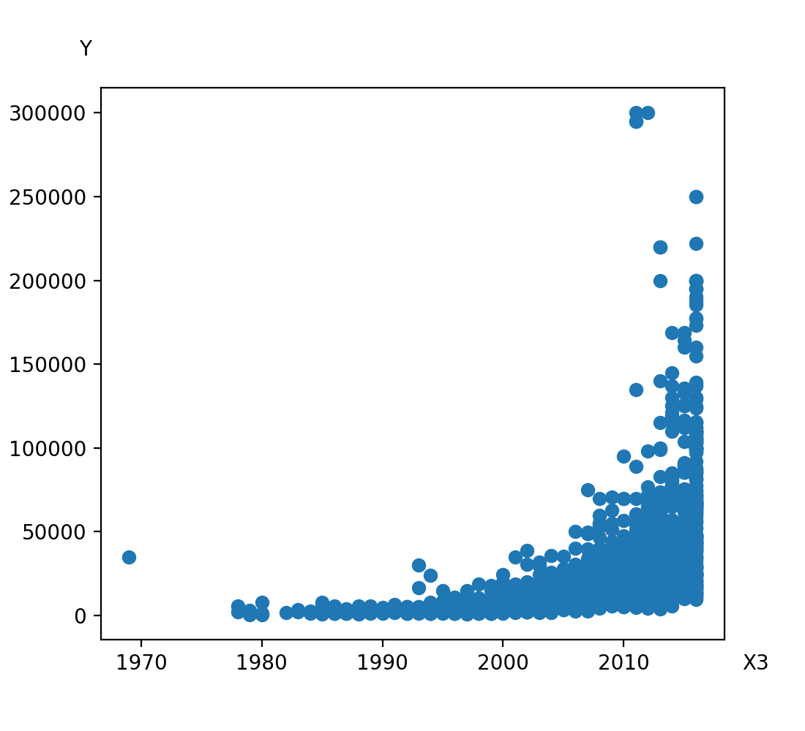
X3, Power
Equation: y = 0.00E+00*X3^(2.09E+02)
R-squared: Error

Slide 19
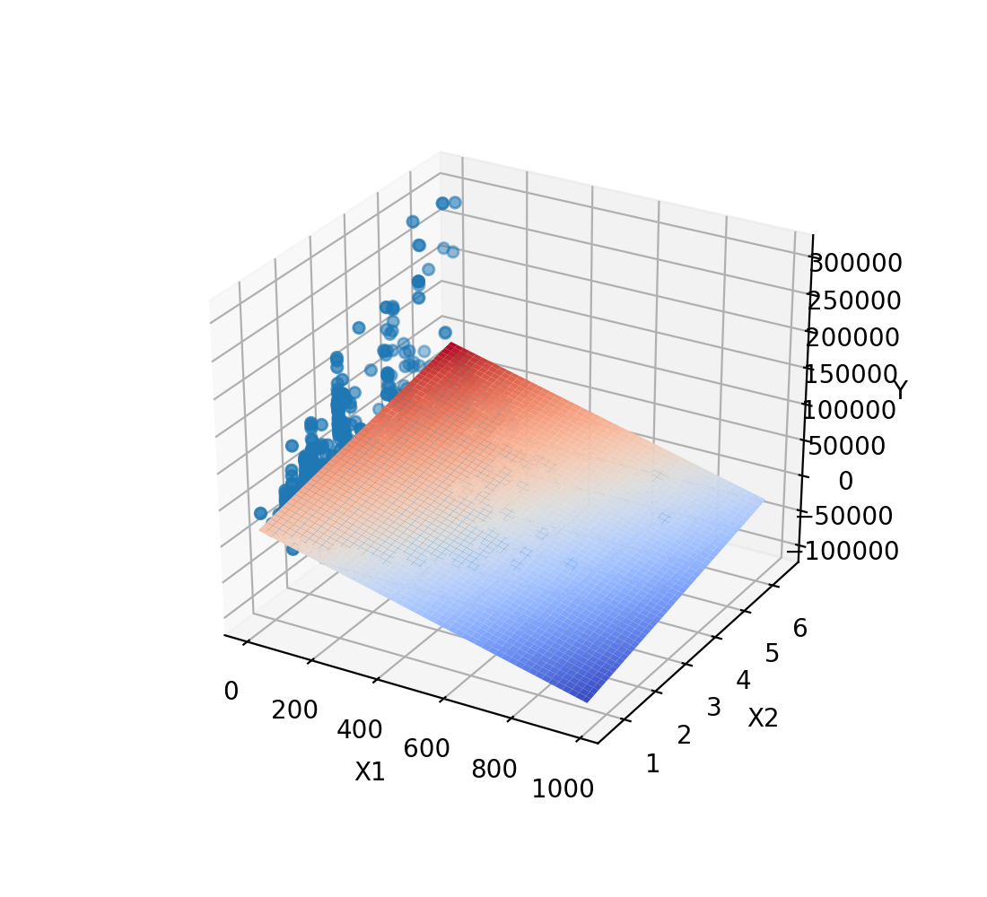
('X1', 'X2'), Polynomial degree 1
Equation: y = -1.15E+02*X1+1.15E+04*X2+1.00E+04
R-squared: 0.411

Slide 20
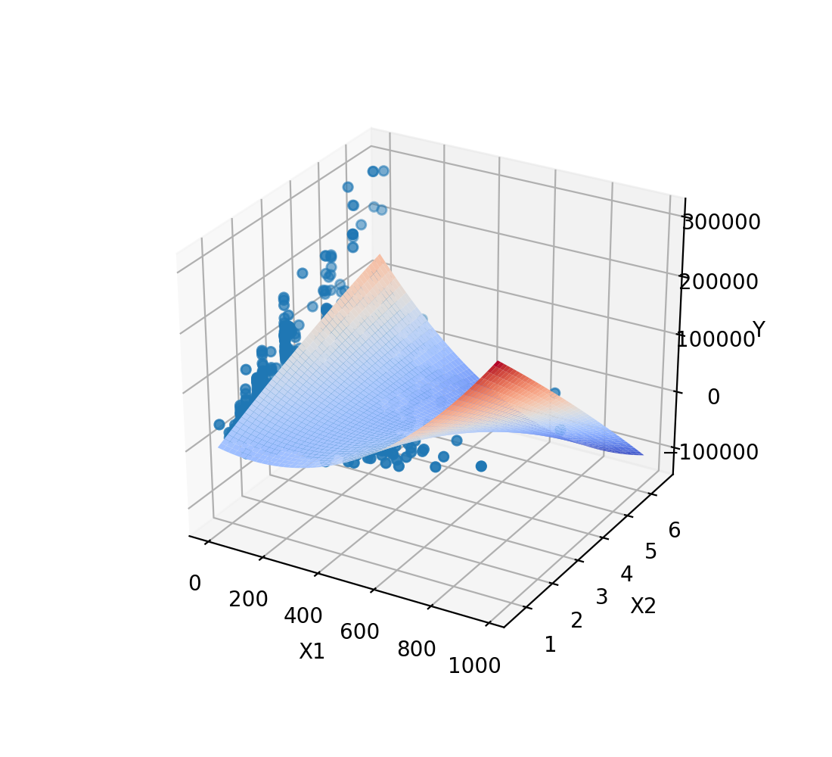
('X1', 'X2'), Polynomial degree 2
Equation: y = -5.00E+01*X1+2.87E+04*X2+3.85E-01*X1^2-8.82E+01*X1*X2-8.58E+02*X2^2-1.62E+04
R-squared: 0.586

Slide 21
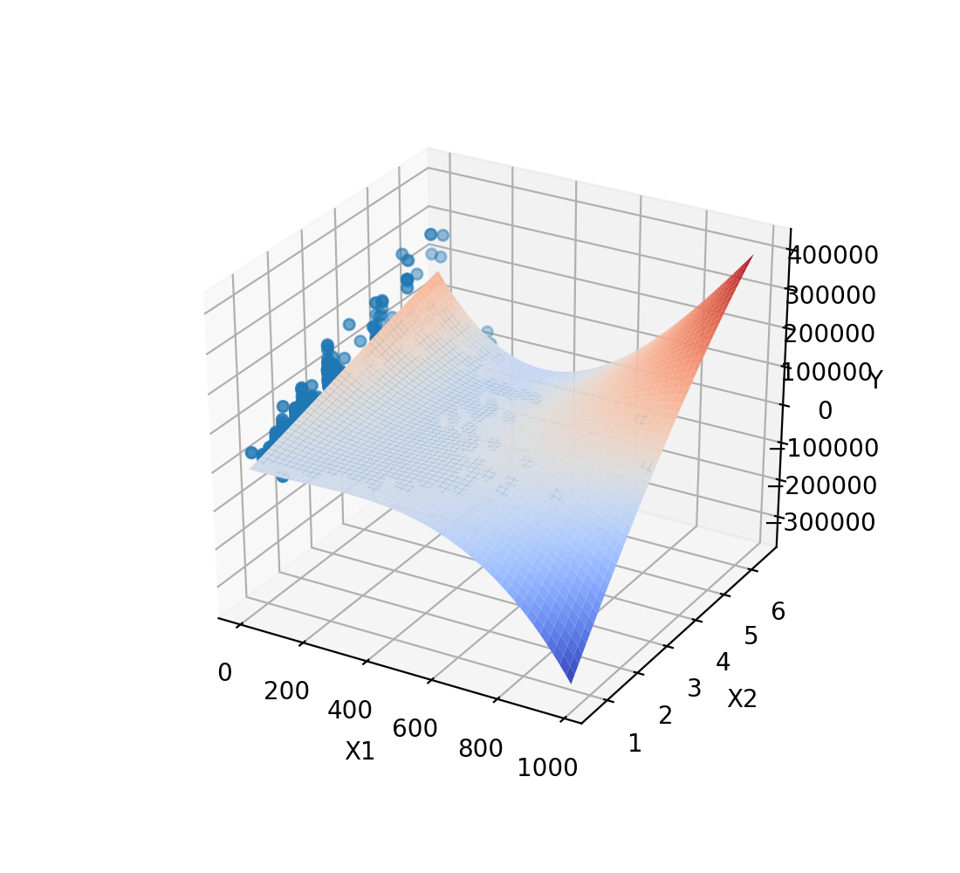
('X1', 'X2'), Polynomial degree 3
Equation: y = 6.78E+01*X1+2.39E+04*X2+1.72E-01*X1^2-1.63E+02*X1*X2+2.06E+03*X2^2-6.79E-04*X1^3+3.06E-01*X1^2*X2-5.72E+00*X1*X2^2-2.14E+02*X2^3-1.61E+04
R-squared: 0.639

Slide 22
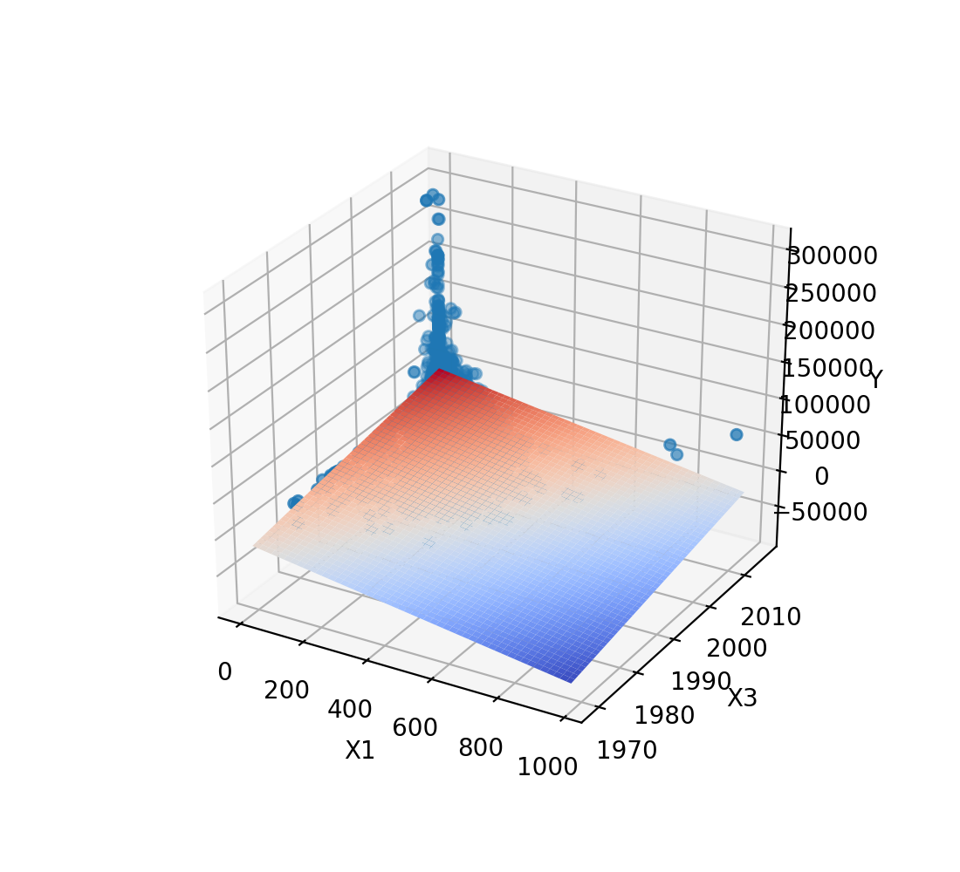
('X1', 'X3'), Polynomial degree 1
Equation: y = -6.73E+01*X1+1.19E+03*X3-2.35E+06
R-squared: 0.276

Slide 23
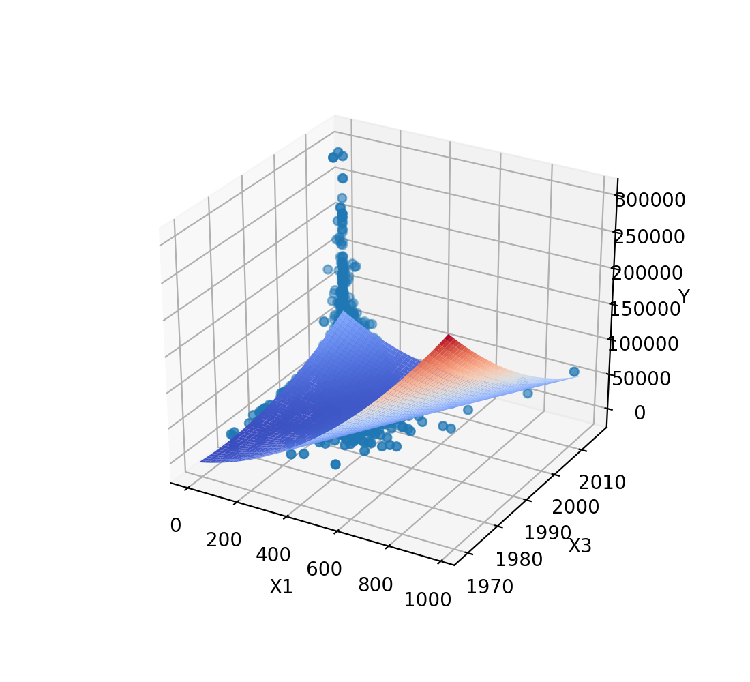
('X1', 'X3'), Polynomial degree 2
Equation: y = 1.18E+04*X1-1.66E+05*X3+2.04E-01*X1^2-5.98E+00*X1*X3+4.19E+01*X3^2+1.64E+08
R-squared: 0.395

Slide 24
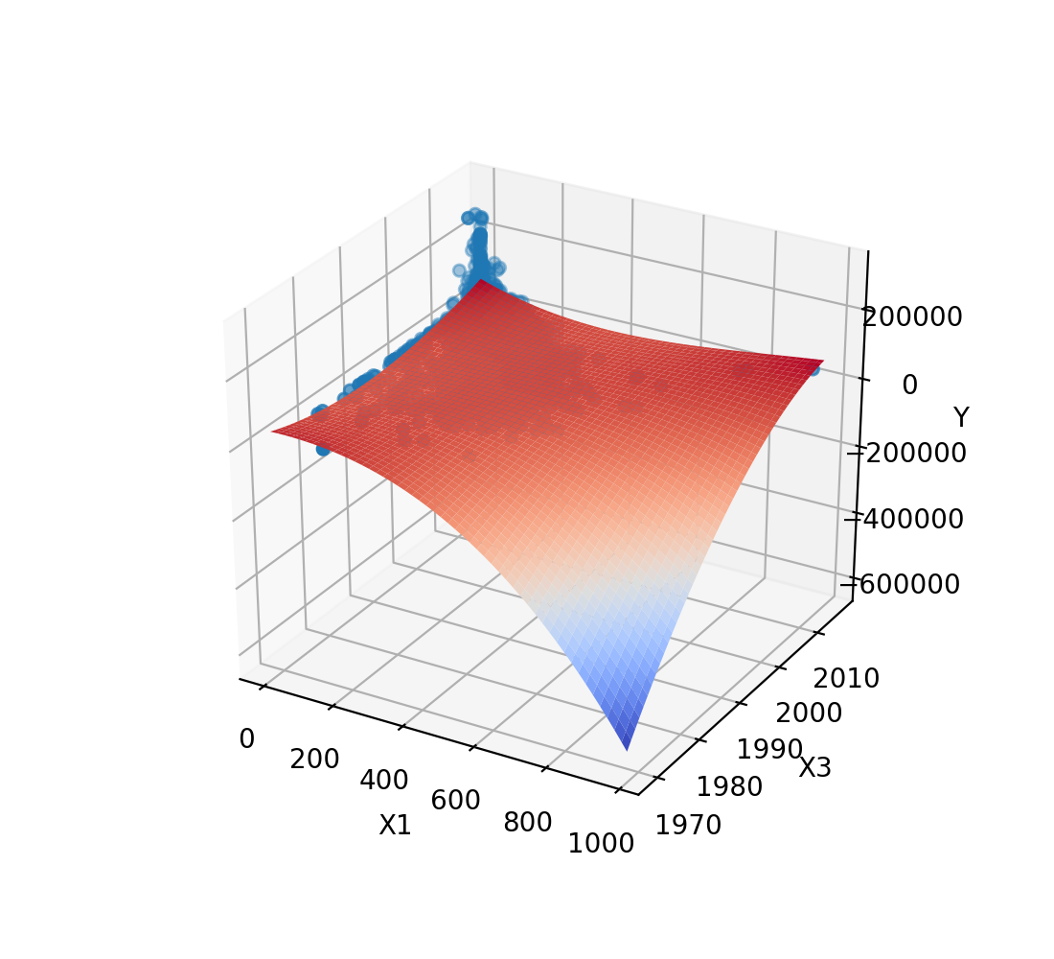
('X1', 'X3'), Polynomial degree 3
Equation: y = -1.38E+06*X1-6.07E+06*X3-4.54E+01*X1^2+1.40E+03*X1*X3+2.94E+03*X3^2-2.41E-04*X1^3+2.28E-02*X1^2*X3-3.52E-01*X1*X3^2-4.74E-01*X3^3+4.18E+09
R-squared: 0.427

Slide 25
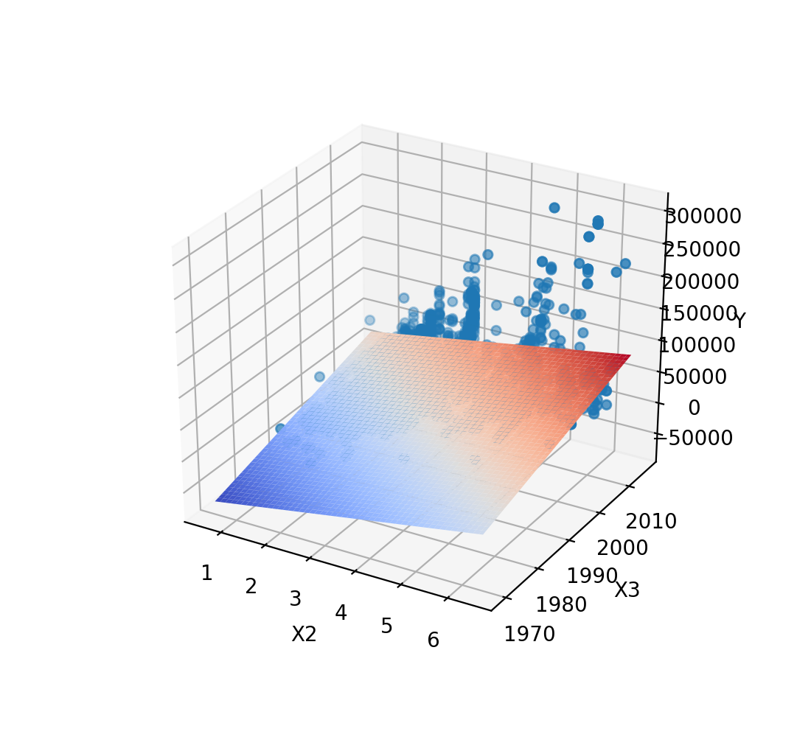
('X2', 'X3'), Polynomial degree 1
Equation: y = 1.14E+04*X2+1.81E+03*X3-3.64E+06
R-squared: 0.421

Slide 26
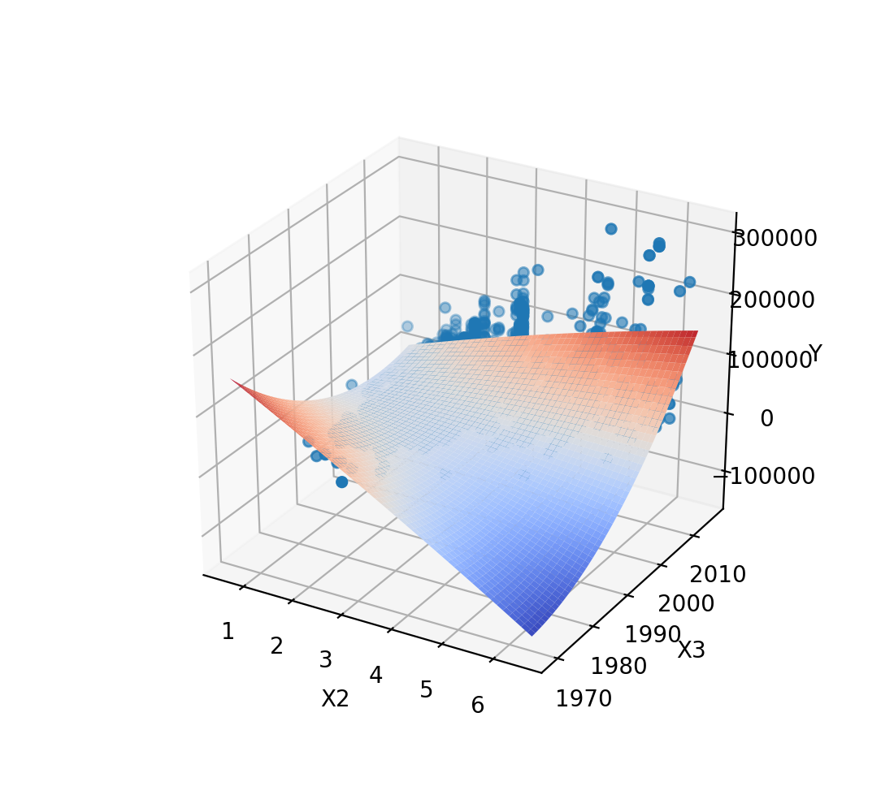
('X2', 'X3'), Polynomial degree 2
Equation: y = -3.14E+06*X2-4.64E+05*X3-7.41E+02*X2^2+1.57E+03*X2*X3+1.15E+02*X3^2+4.67E+08
R-squared: 0.649

Slide 27
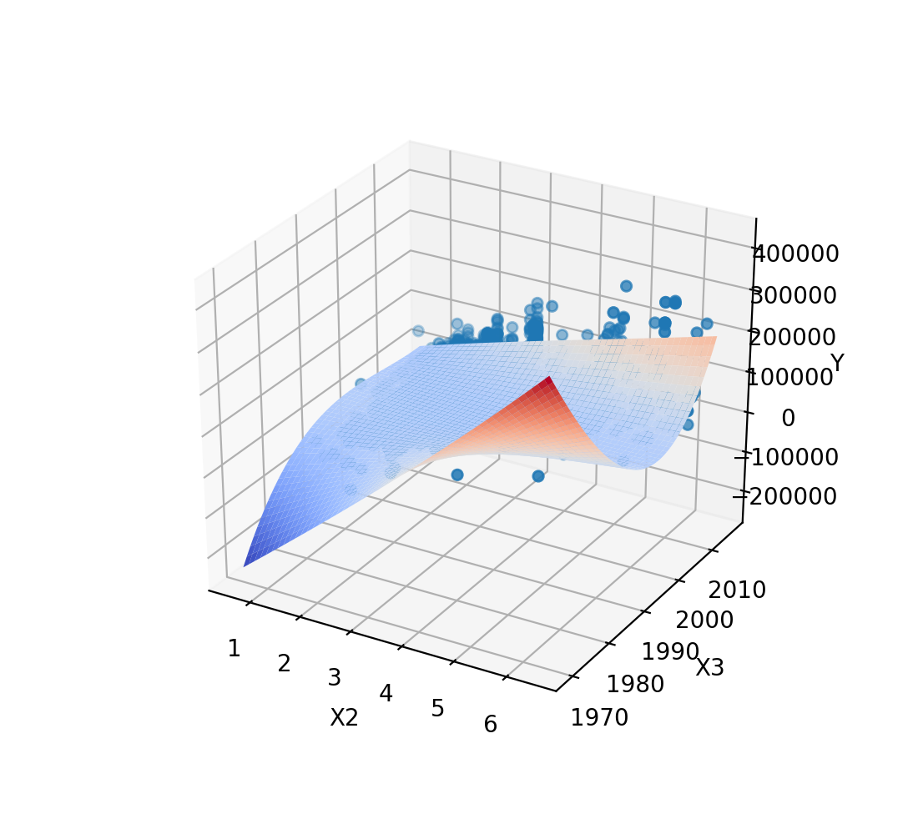
('X2', 'X3'), Polynomial degree 3
Equation: y = 4.89E+08*X2+6.69E+07*X3+9.15E+04*X2^2-4.89E+05*X2*X3-3.33E+04*X3^2+1.02E+02*X2^3-4.61E+01*X2^2*X3+1.22E+02*X2*X3^2+5.51E+00*X3^3-4.48E+10
R-squared: 0.730

Slide 28
('X1', 'X2', 'X3'), Polynomial degree 1
Cannot display graph
Equation: y = -6.57E+01*X1+1.14E+04*X2+1.14E+03*X3-2.28E+06
R-squared: 0.459

Slide 29
('X1', 'X2', 'X3'), Polynomial degree 2
Cannot display graph
Equation: y = 8.55E+03*X1-2.11E+06*X2-2.39E+05*X3+1.63E-01*X1^2-3.63E+01*X1*X2-4.27E+00*X1*X3-8.56E+02*X2^2+1.06E+03*X2*X3+5.95E+01*X3^2+2.39E+08
R-squared: 0.687

Slide 30
('X1', 'X2', 'X3'), Polynomial degree 3
Cannot display graph
Equation: y = -7.92E+05*X1+2.37E+08*X2+1.74E+07*X3-2.74E+01*X1^2+6.39E+03*X1*X2+7.93E+02*X1*X3+3.37E+05*X2^2-2.39E+05*X2*X3-8.68E+03*X3^2-2.30E-04*X1^3+1.07E-01*X1^2*X2+1.37E-02*X1^2*X3-8.82E+00*X1*X2^2-3.19E+00*X1*X2*X3-1.98E-01*X1*X3^2+5.82E+01*X2^3-1.67E+02*X2^2*X3+6.02E+01*X2*X3^2+1.44E+00*X3^3-1.17E+10
R-squared: 0.757

Slide 31
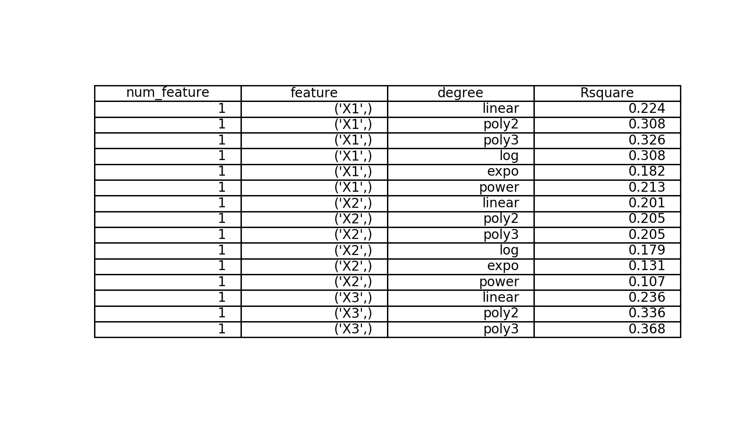
R-squared Summary

Slide 32
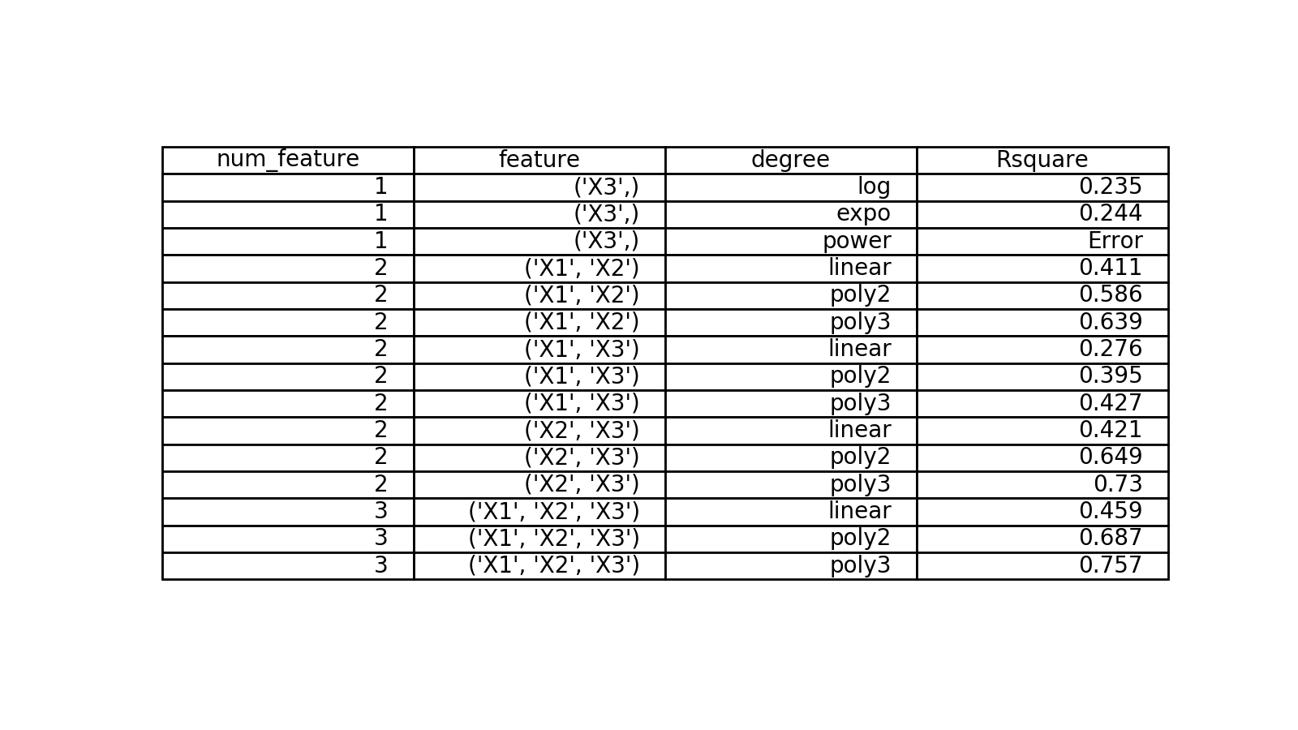
R-squared Summary

Slide 33
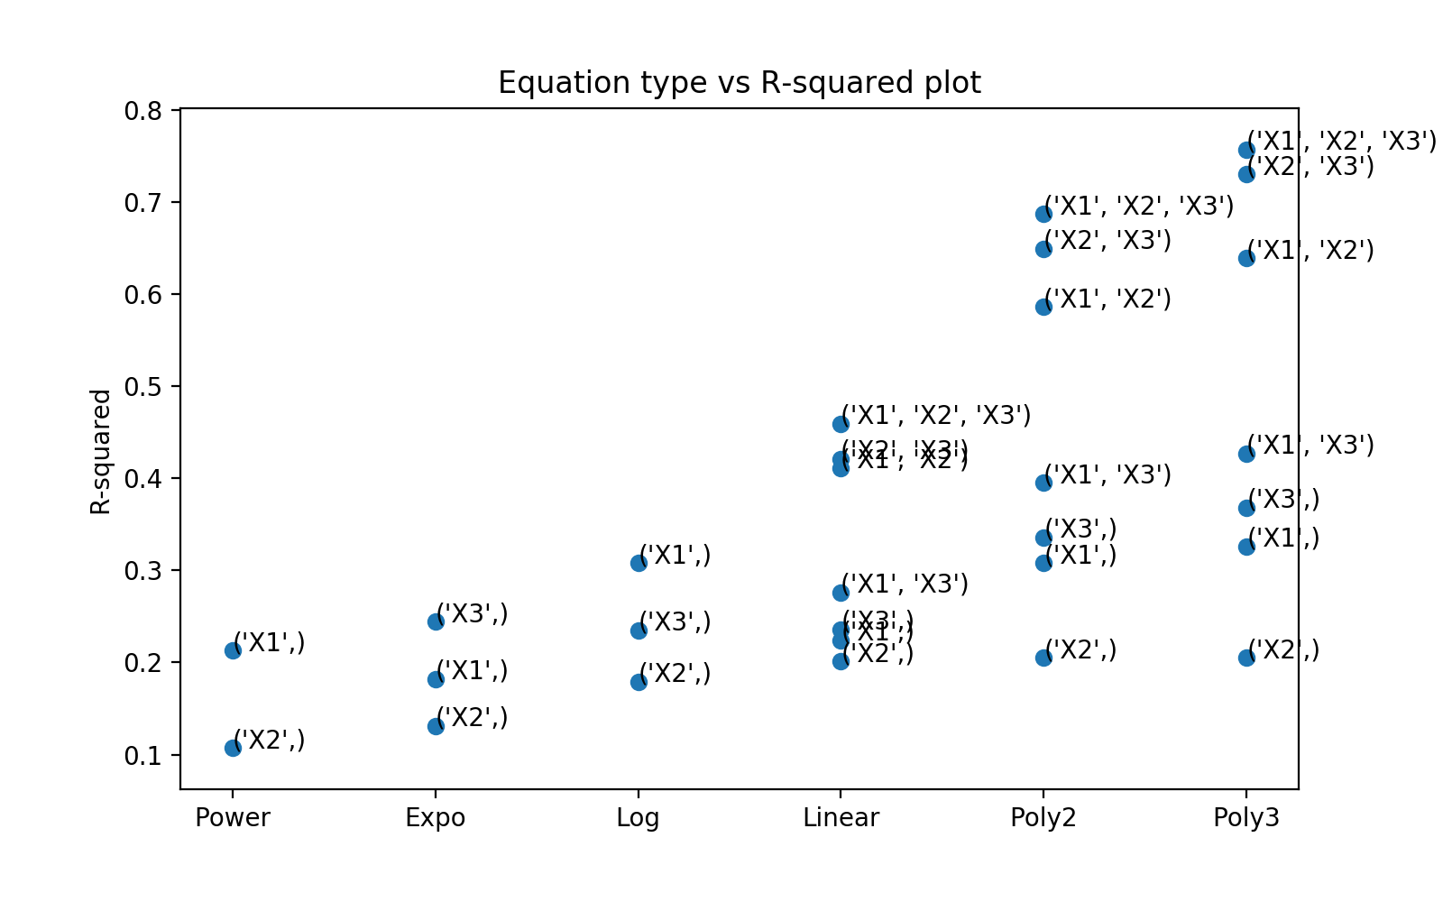
R-squared Summary

