Slide 1
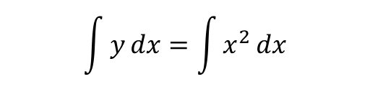





$$y=x^{2}$$
$$\int{y}dx=\int{x^{2}}dx$$
$$=\frac{x^{3}}{3}$$
For interval [1,10]
$$=\frac{{10}^{3}}{3}−\frac{1^{3}}{3}$$
$$=\frac{1000−1}{3}$$
$$=333$$

Slide 2
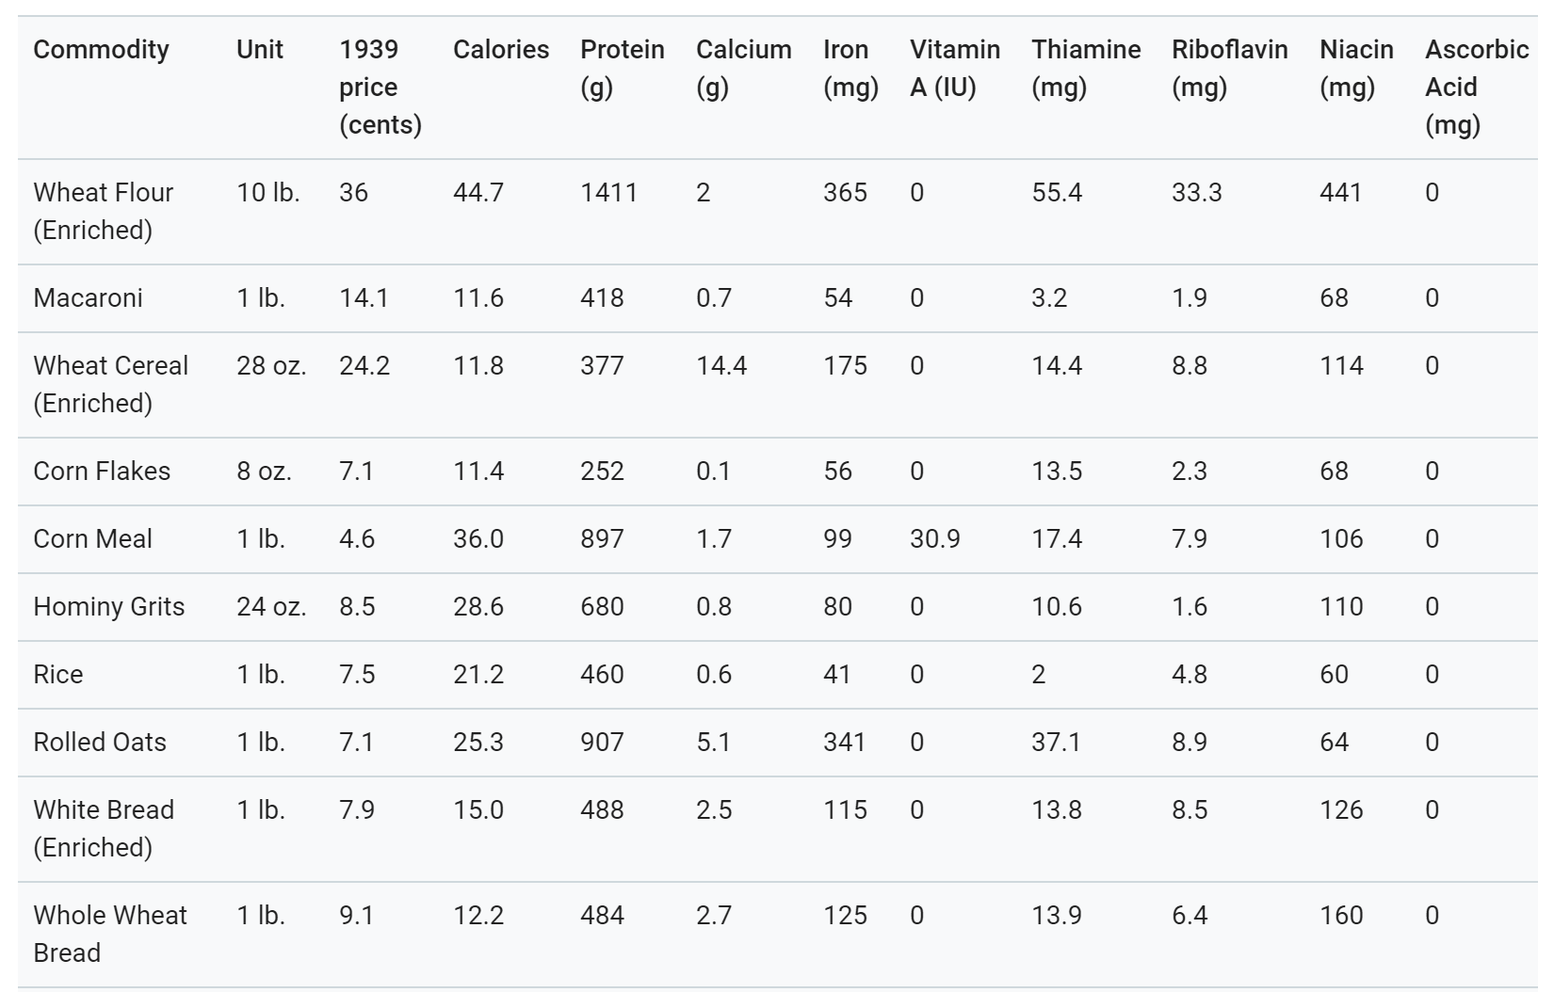
Food (F)

Slide 3
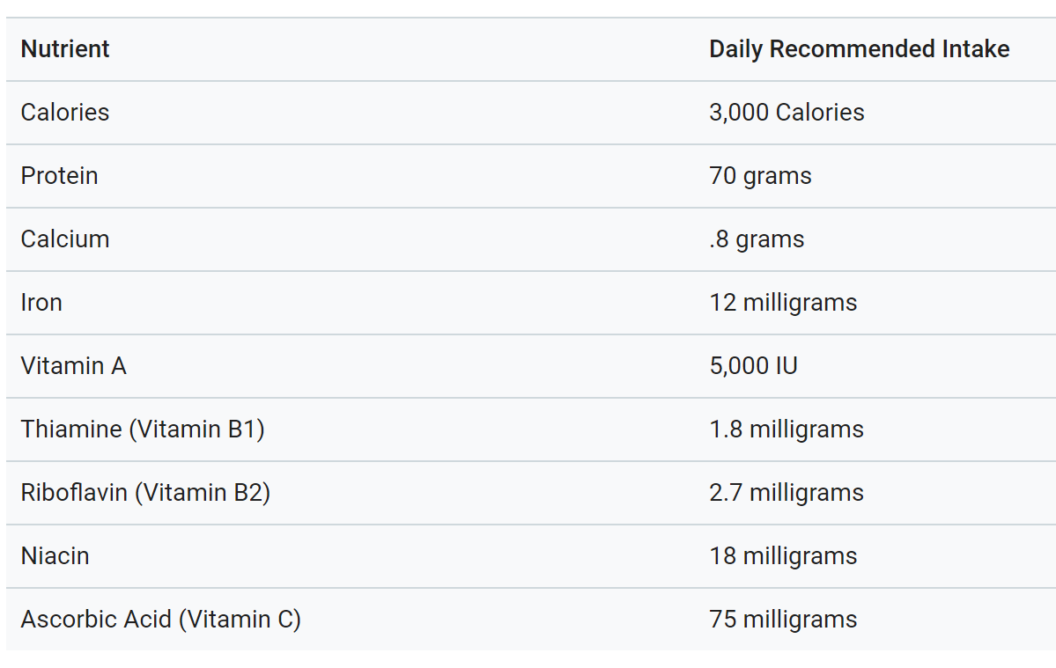
Constraints

Slide 4

$$F_{i}$$

