Slide 1
EC683 FINAL PROJECT • MACHINE LEARNING
Customer Churn Prediction
& Personalized Retention
An end-to-end machine-learning pipeline on the UCI Online Retail II dataset
Peerachai
April 2026
4,302
52.4%
£1.35M
41
0.763
customers
churn rate
revenue at risk
countries
best AUC

Slide 2



01 • PROBLEM & MOTIVATION
Why Predict Churn?
Acquiring a new customer costs 5–7× more than retaining an existing one. For online retailers operating on thin margins, even small reductions in churn translate into meaningful revenue protection.
52.4%
Customers churned
2,254 of 4,302 in scope
The questions this project addresses
Which customers are most likely to stop purchasing?
What behavioural signals predict churn earliest?
How do we route a personalized offer to each at-risk customer?
£1.35M
Revenue at risk
16% of £8.45M total revenue
41
Countries reached
UK-anchored, global tail
Customer Churn Prediction • Final Project
2 / 13

Slide 3
02 • DATA
Dataset: UCI Online Retail II
Two-sheet transactional dataset of a UK-based, registered online retail business — primarily wholesalers — covering Dec 2009 to Dec 2011.
Schema
Column | Description
Invoice | Transaction ID
StockCode | Product code
Description | Product name
Quantity | Units purchased
InvoiceDate | Transaction timestamp
Price | Unit price (GBP)
Customer ID | Unique customer identifier
Country | Customer country
£8.45M
41
Total revenue
Countries
~1M
2 yrs
Transactions
Time span
Customer Churn Prediction • Final Project
3 / 13

Slide 4







03 • ARCHITECTURE
End-to-End Pipeline
STEP 1
STEP 2
STEP 3
STEP 4
STEP 5
STEP 6
Load
Clean
Engineer
Select
Train
Recommend
Two XLSX sheets → concat
Drop cancellations, NaNs
RFM + rolling windows
VIF + Mutual Info
LGBM / XGB / ANN / LSTM
Apriori + value tiers
Design choices
Churn defined as ≥ 90 days of inactivity, with features built from a 365-day observation window. Modular Python pipeline (loader → cleaner → engineer → selector → trainer → recommender) — each stage independently testable. Outputs are persisted (CSV, JSON, .pkl, .keras) so the dashboard layer (FastAPI + React) can serve results without re-training.
Customer Churn Prediction • Final Project
4 / 13

Slide 5



04 • REPRESENTING THE CUSTOMER
Feature Engineering
RFM Core
Rolling Windows (30/60/90 d)
Behaviour & Cadence
Recency — days since last purchase
Frequency — total transaction count
Monetary — total spend in GBP
Tenure — days since first purchase
Revenue, transaction count, quantity
Unique SKUs touched in window
Revenue acceleration (recent vs prior)
Avg / std / CV of inter-purchase gap
Std day-of-week — purchase regularity
Avg basket size, unique SKUs lifetime
LSTM monthly sequences
In parallel to the tabular features above, each customer is also represented as a 6-month sequence of [revenue, txn_count, qty, unique_sku, avg_price] — fed to the LSTM head to capture temporal trajectory rather than a static snapshot.
Customer Churn Prediction • Final Project
5 / 13

Slide 6
05 • PRUNING TO SIGNAL
Feature Selection
Top 15 Selected Features
1
VIF Collinearity Pruning
recency
frequency
monetary
Iteratively drop features with Variance Inflation Factor > 10 to avoid multicollinearity.
tenure_days
purchase_rate
unique_skus
txn_last30d
qty_last30d
accel_rev
2
Top-K by Mutual Information
std_gap_days
cv_gap
std_dow
Rank surviving features by MI with the churn label and keep the top 15.
rev_last60d
unique_sku_last30d
unique_sku_last90d
Customer Churn Prediction • Final Project
6 / 13

Slide 7


06 • MODELING
Four Models, Two Paradigms
LightGBM
XGBoost
ANN
LSTM
Gradient Boosted Trees
Gradient Boosted Trees
Feed-Forward Neural Net
Recurrent Neural Net
Histogram-based GBDT. Fast on tabular data; handles non-linear feature interactions natively.
Regularized GBDT — strong baseline for structured data with sparse + dense features.
3-layer MLP (128→64→32) on the tabular feature matrix; learns higher-order interactions from data.
Two-layer LSTM over 6-month sequences — only model that consumes raw temporal trajectory.
Customer Churn Prediction • Final Project
7 / 13

Slide 8

07 • RESULTS
Model Performance
Model | AUC | F1 | Acc
LGBM | 0.763 | 0.685 | 0.685
XGBoost | 0.762 | 0.681 | 0.696
ANN | 0.752 | 0.688 | 0.699
LSTM | 0.728 | 0.679 | 0.652
BEST MODEL
LightGBM
AUC 0.763 — narrow lead, but consistently strong across all four metrics. Selected for the production recommender.
Customer Churn Prediction • Final Project
8 / 13

Slide 9
08 • FEATURE IMPORTANCE
What Drives Churn?
Recency dominates
Days since last purchase is the single strongest signal — confirms that lapsed activity is the earliest, clearest churn indicator.
Breadth beats depth
Unique SKU count outranks frequency. Customers exploring a wider catalogue are stickier than those repeating a narrow basket.
Cadence regularity matters
Std day-of-week and CV of gap quantify rhythm. Erratic buyers churn more often than steady ones, even at equal volume.
Customer Churn Prediction • Final Project
9 / 13

Slide 10
09 • ASSOCIATION RULES
Apriori — From Baskets to Cross-Sell Rules
Apriori scans every invoice in the cleaned transaction log to find products that co-occur frequently. Each frequent itemset is converted into a rule
PLUGGING INTO THE CHURN MODEL
IF {products bought} THEN {likely to buy}
1
Score customers
LGBM outputs churn probability per customer.
Three metrics rank every rule
2
Flag at-risk
Support
How often the combination appears across all baskets.
Keep customers with p ≥ 0.50.
P(A ∪ B)
3
Pull purchase history
Confidence
Of customers who buy A, the share who also buy B.
Take each churner's top-3 most-bought products.
P(B | A)
4
Match Apriori rules
Lift
How much A boosts B versus its baseline frequency.
Filter rules whose antecedent contains a top product.
Conf(A→B) / P(B)
Recommend & promote
5
Config: min_support = 0.02 • min_confidence = 0.30 • min_lift = 1.20
Surface top-3 consequents, pair with tier offer.
Customer Churn Prediction • Final Project
10 / 13

Slide 11
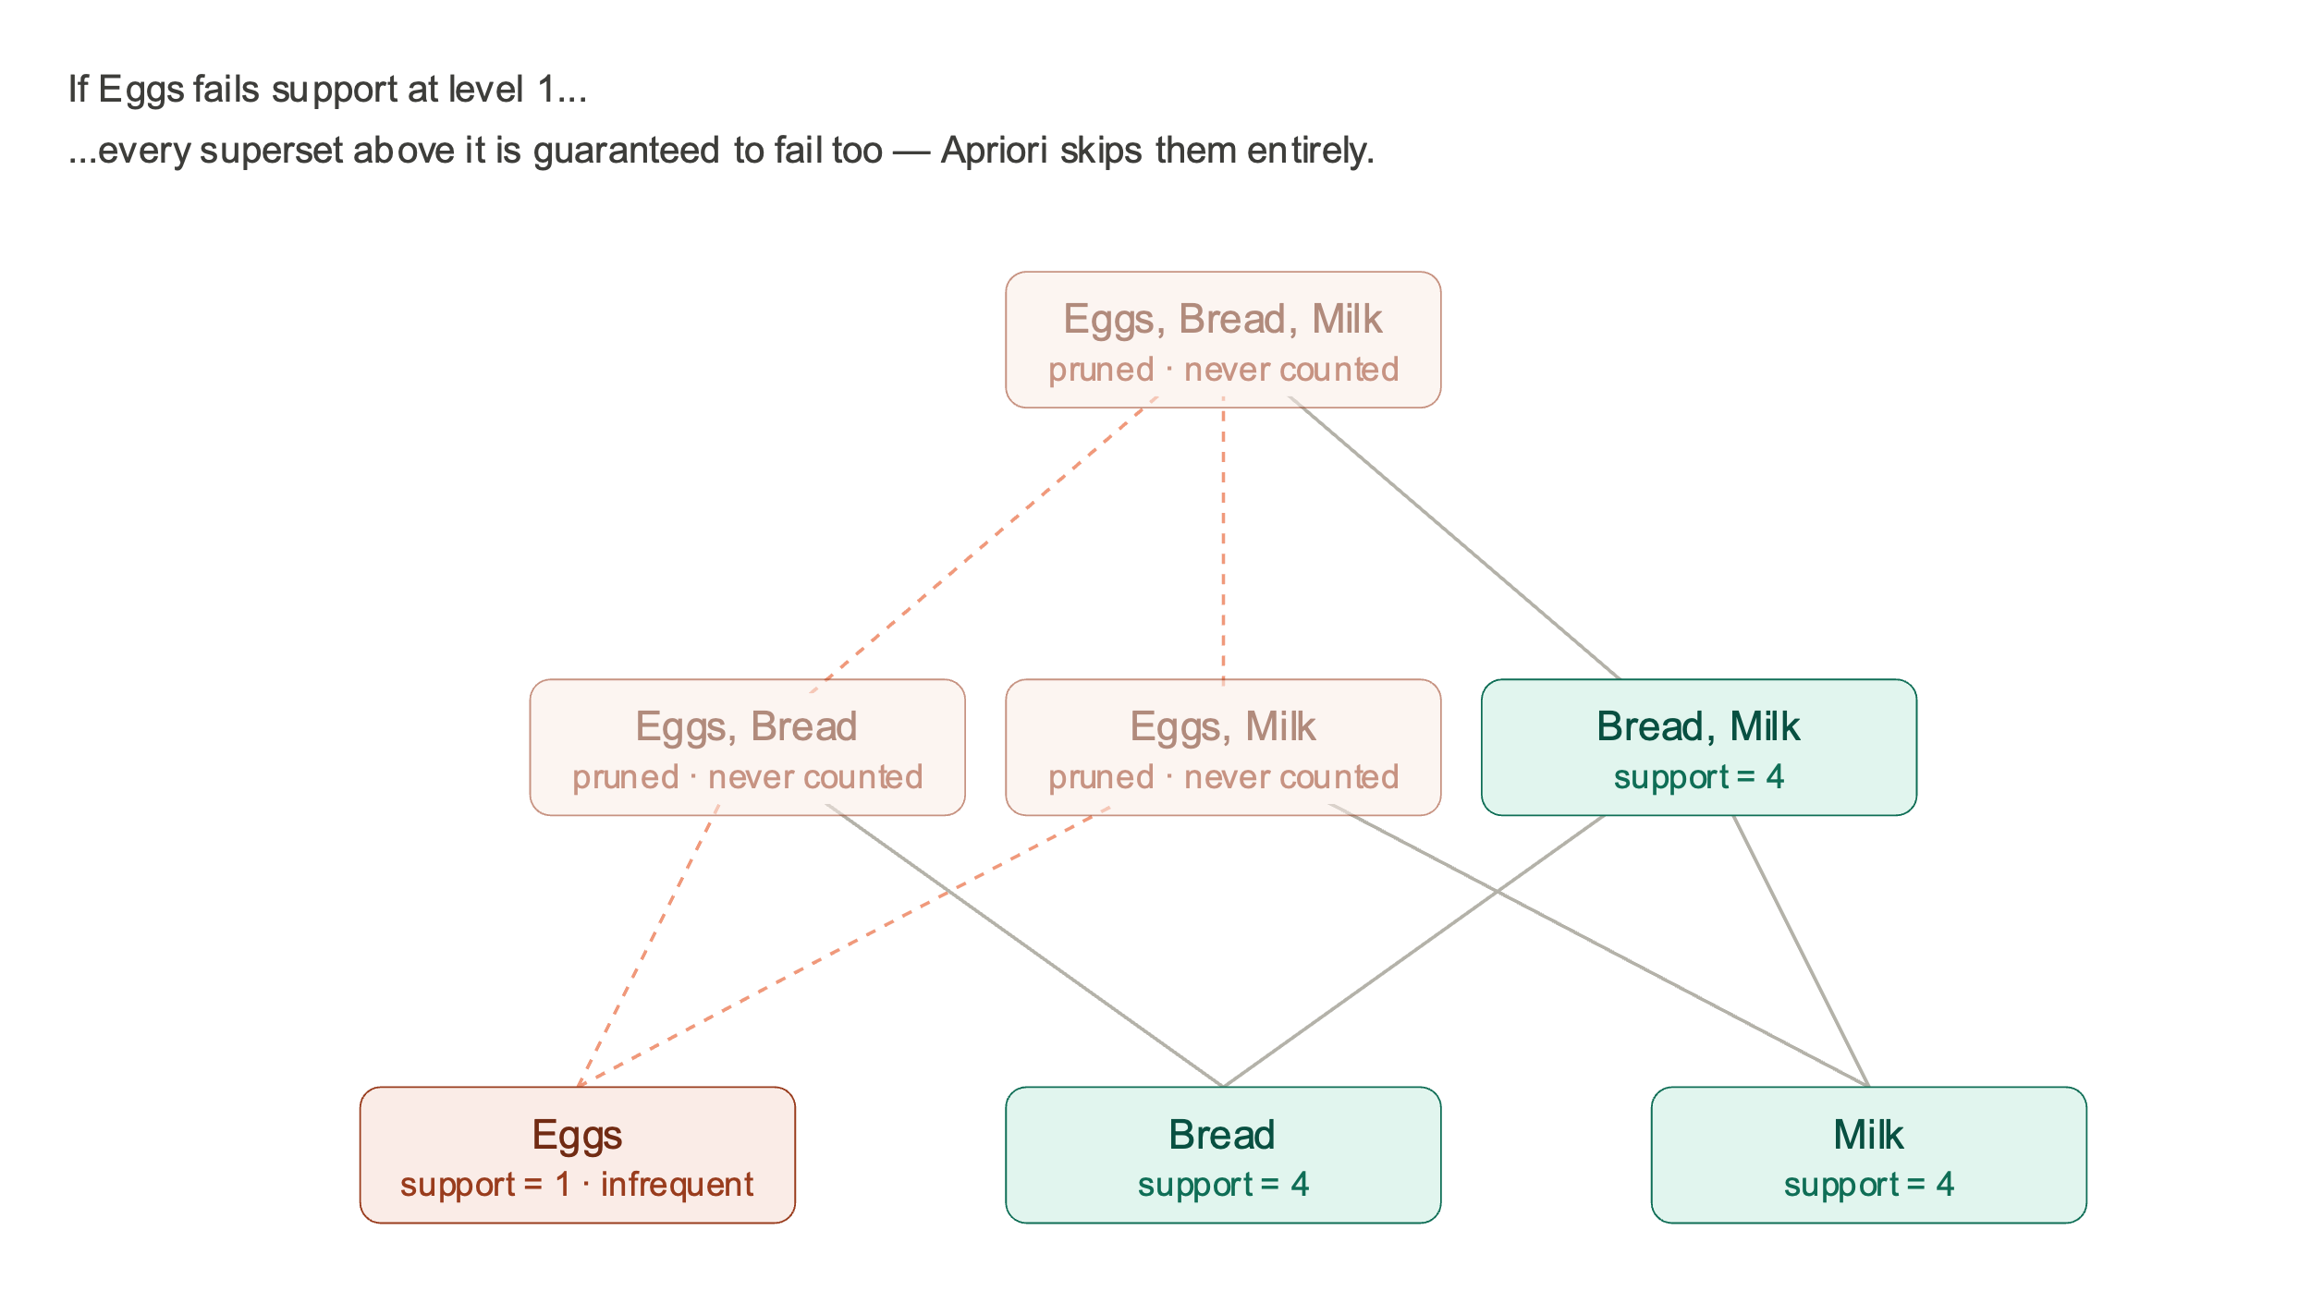
09 • ASSOCIATION RULES
Apriori — From Baskets to Cross-Sell Rules
Customer Churn Prediction • Final Project
10 / 13

Slide 12
10 • FROM PREDICTION TO ACTION
Personalized Retention Engine
01
Score
02
Segment
03
Recommend
LGBM probabilities flag predicted churners (≥ 0.50).
Tier customers High / Medium / Low by monetary quantile.
Apriori rules surface complementary products per buyer.
Promotion mapping by value tier
HIGH
MEDIUM
LOW
Premium loyalty
Comeback offer
Reactivation
20% off entire basket + free priority shipping
15% off your favourite categories
£5 off next purchase (min. £20 spend)
Customer Churn Prediction • Final Project
11 / 13

Slide 13
11 • DELIVERY
Business Impact & Dashboard
2,254
£1.35M
CHURN INTELLIGENCE DASHBOARD
FastAPI + React + Recharts
Predicted churners
Revenue at risk
Routed into 3 retention tiers
Addressable via personalized offers
Model Performance — metrics, bar chart, importance
Outcomes — KPI cards, churn distribution, customer table
What-If Tools — threshold slider, retention simulator, PR curve
Executive Dashboard — revenue trend, country chart, actions
0.763
15
AUC of best model
Features driving the model
LightGBM, hold-out test set
Pruned from ~40 candidates
Operational levers exposed to the business
Marketing teams can adjust the churn-probability cutoff to trade campaign volume against precision, simulate retention rates per tier, and export the per-customer recommendation list (CSV) directly into their CRM workflow.
Customer Churn Prediction • Final Project
12 / 13

Slide 14
12 • CONCLUSION
Takeaways & Future Work
What we showed
Where to take it next
An end-to-end ML pipeline that turns raw retail transactions into per-customer retention actions.
Recency, breadth of catalogue and cadence regularity are the strongest churn signals — beating raw frequency.
LightGBM matches deep models on this tabular regime (AUC 0.763) at a fraction of the training cost.
Outputs are productionised through a FastAPI + React dashboard, exposing a threshold lever for the business.
A/B test the tier-specific promotions to measure causal lift versus a held-out control.
Explore survival-analysis framing (time-to-churn) for richer scheduling of outreach.
Add embedding features over product text — push beyond ID-level association rules.
Move to streaming features so the model scores customers in near-real-time.
Thank you • Questions?

