Slide 1
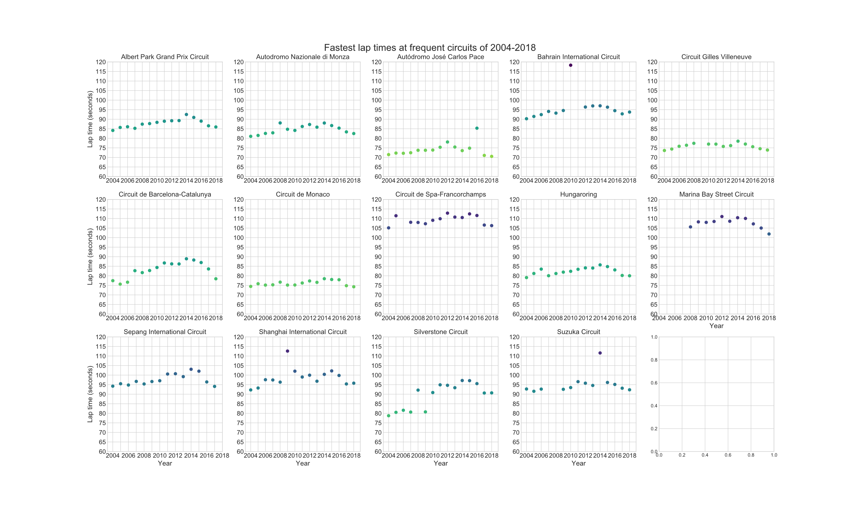
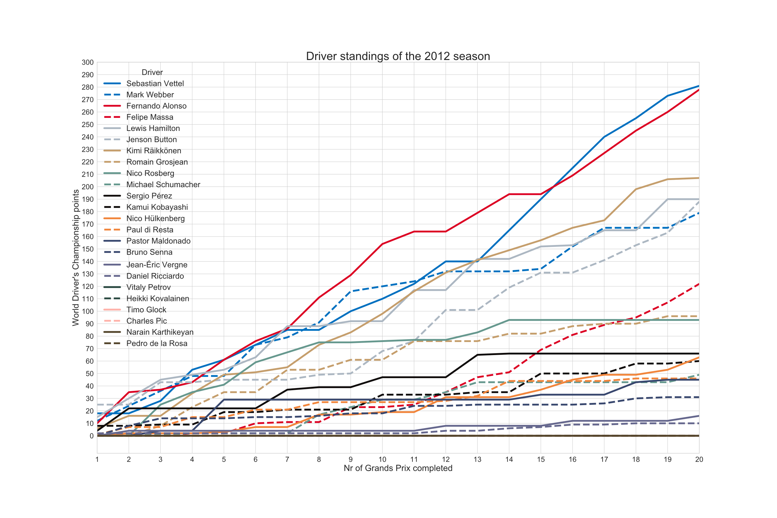
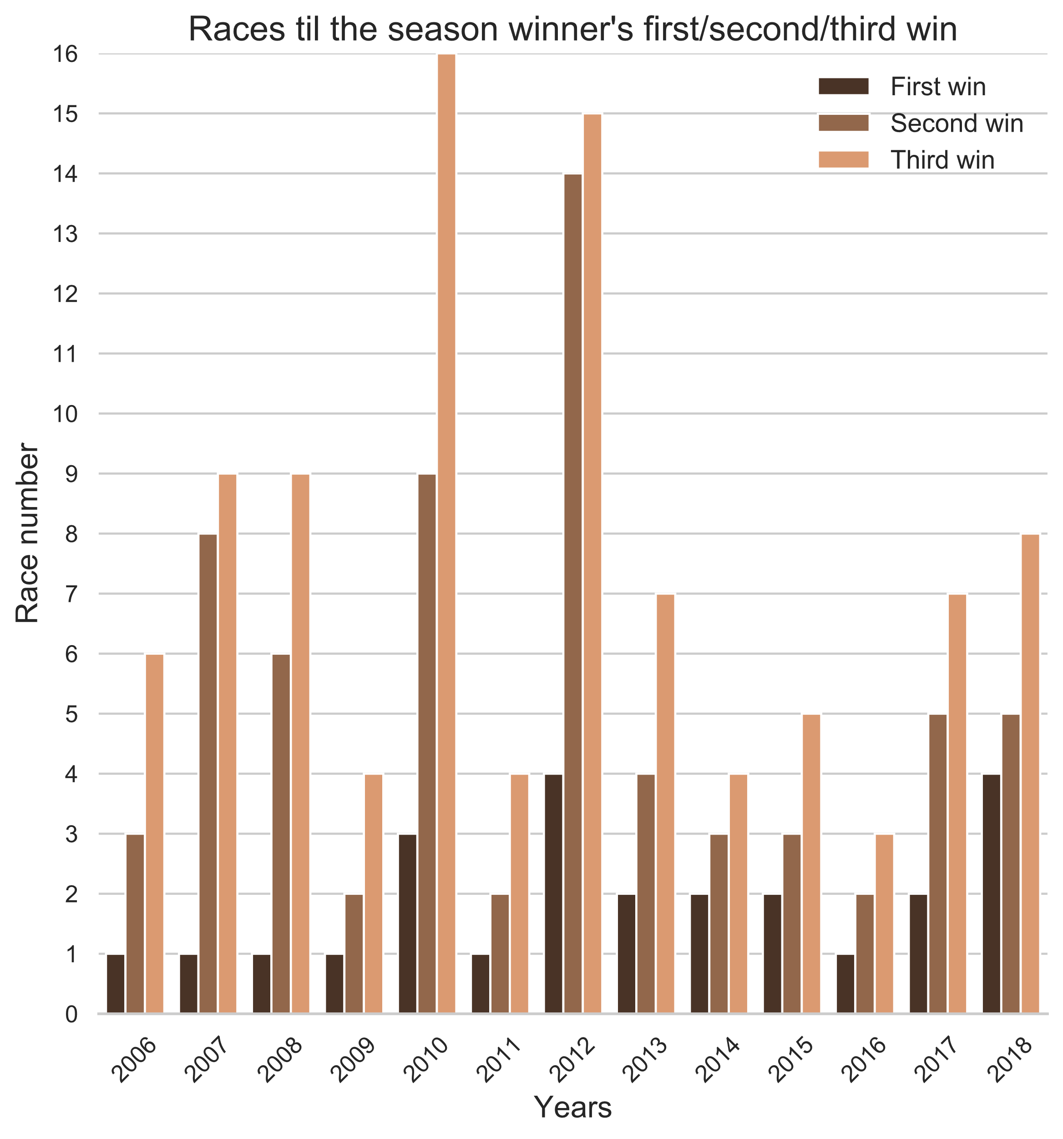
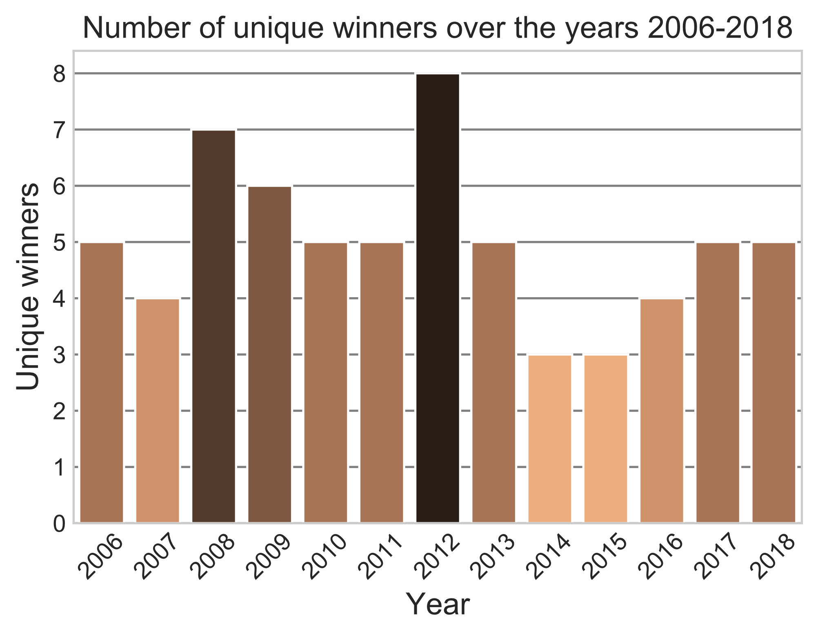
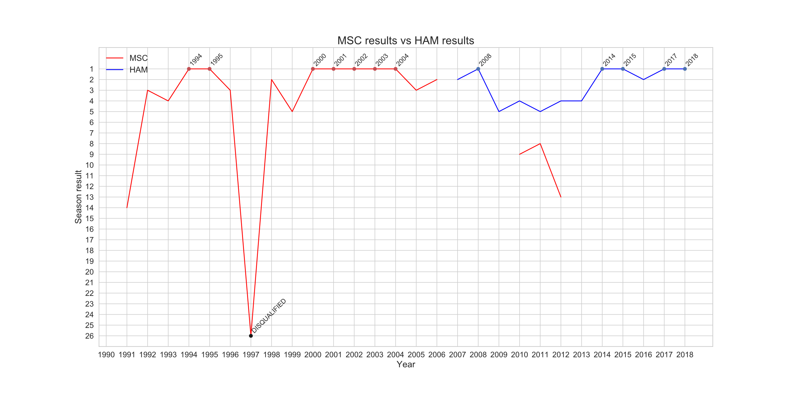
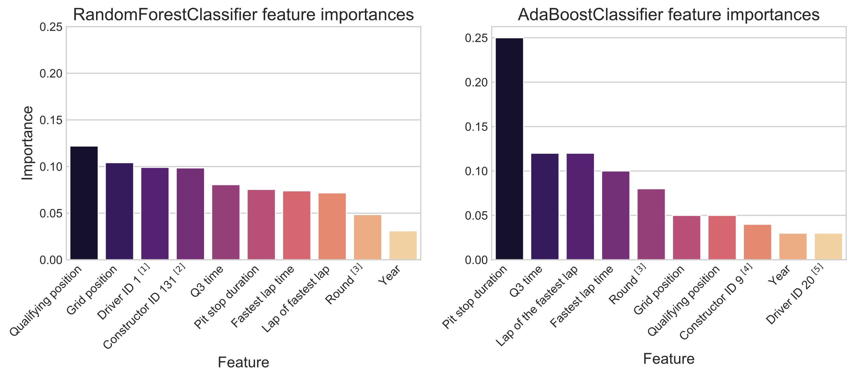
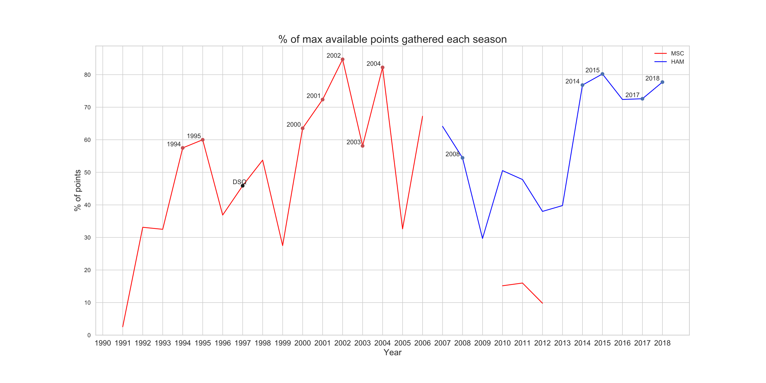
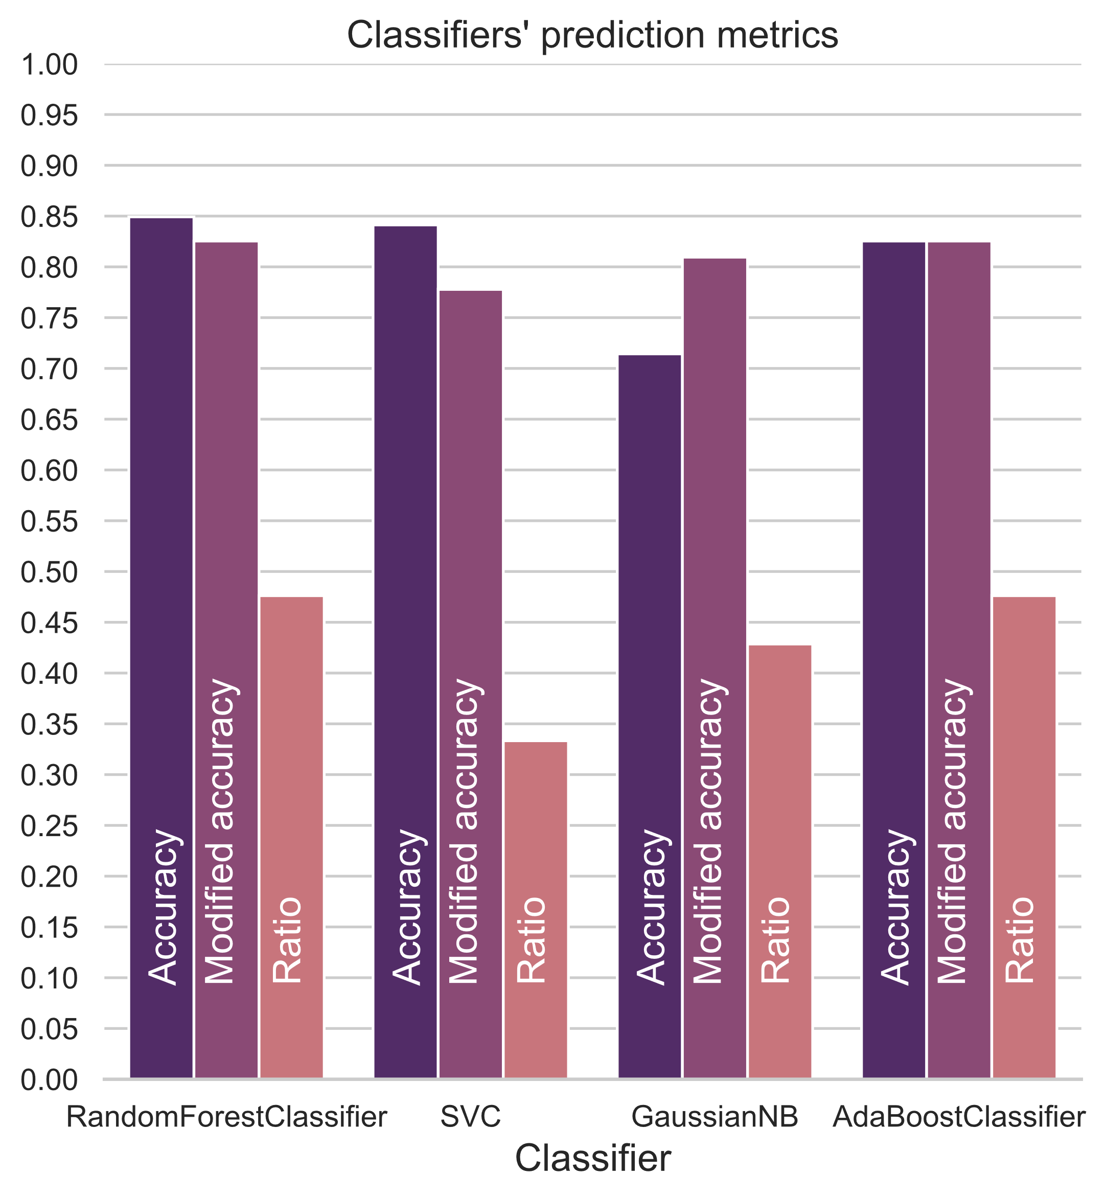


FORMULA 1 DATA ANALYSIS
Peeter Paal, Aveli Klaos, Siim Tanel Laisaar
Introduction
Formula 1 (F1) is the highest class of single-seater auto racing sanctioned by FIA. The FIA Formula One World Championship has been one of the premier forms of racing around the world since its inaugural season in 1950. Each race in F1 generates huge amounts of data. We have set 4 main goals based on the F1 dataset which will be further explained in their according sections.
2004-2018 lap times
Analysis of the 2012 season
The lap times are taken from racetracks that have been used 11 or more times during the 2004-2018 period. This restriction was placed because many Formula 1 tracks have been added and replaced year by year.
The 2012 season was one of the most competitive seasons of the last decade. Thus we decided to analyse the data from it in order to visualise it and compare it to previous and following seasons.
The jump in lap time at the Bahrain International circuit is caused by track changes only on that year.
The general large increase in lap times at the Silverstone Circuit is caused due to the track length being permanently increased.
The rest of the larger jumps in lap time are caused by difficult weather conditions, mainly rain.
Michael Schumacher vs Lewis Hamilton
Michael Schumacher (MSC) and Lewis Hamilton (HAM) are two of the most successful drivers in Formula 1 by the number of World Driver’s Championship titles. This has raised discussion and caused a lot of disagreement among fans. We visualised their careers as well as possible with a dataset that was missing quite a few values from the earlier seasons where Michael Schumacher drove.
Predicting winners of the 2018 season
We used RandomForestClassifier, Support Vector Classifier, GaussianNB and AdaBoostClassifier to predict the winners of the 2018 season. We used the seasons 2014-2016 as the training set, 2017 as the validation set and 2018 as the test set. Because during this period only the drivers from the top 3 teams (Red Bull, Mercedes, Ferrari) won, we only used data of those drivers who drove for them during the year 2018.
[1] Driver ID 1 determines whether the driver was Lewis Hamilton or not.
[2] Constructor ID 131 determines whether the driver raced for the Mercedes team or not.
[3] Round determines which race of the year it was (for example the 4th race).
[4] Constructor ID 9 determines whether the driver raced for the Red Bull team or not.
[5] Driver ID 20 determines whether the driver was Sebastian Vettel or not.
Due to the nature of the sport, the corresponding data is heavily unbalanced. In different eras of Formula 1, one or two teams tend to dominate. After the 2014 regulation changes, the Mercedes team has been the most dominant. Furthermore, Mercedes’ driver Lewis Hamilton has won the championship 4 times during this period with the 5th title belonging to now retired Mercedes driver Nico Rosberg. The reason why the classifiers are not performing as well as they could is that one of the Mercedes’ drivers of the 2018 season – Valtteri Bottas – had a rather awful season, meaning he won 0 times. The classifiers, however, had trained on data where both Mercedes drivers often won.
The 4 classifiers chosen – RandomForestClassifier, SVC, GaussianNB and AdaBoostClassifier – generally performed the best after trainining on the 2014-2016 data and being validated on the 2017 data.
On the graph to the left we have visualised the classifiers’ different metrics.
Accuracy – the accuracy of the predictions on the test set.
Modified accuracy – the accuracy of modified predictions on the test set. The predictions are modified as such that every race is predicted to have exactly one winner (the one with the highest probability). The classifiers don’t know that exactly one driver must win, so they may predict 0 or more than 1.
Ratio – number of wins predicted correctly (after modifying) divided by the number of races.

