Slide 1

Computer Engineering

Slide 2

Benchmarking Erasure Coding Algorithms ( Reed-Solomon & Cauchy Reed-Solomon Encoding)
Peeyush Gupta ( peeyush@iastate.edu )

Slide 3
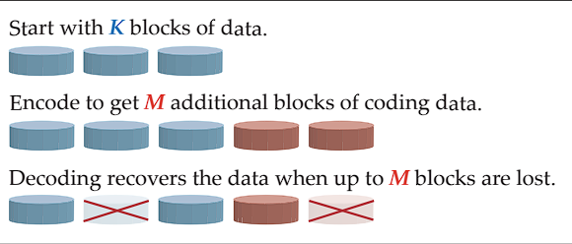

Background
Erasure Coding: Technique used in computer systems to handle data loss and corruption
Source : Jerasure: A Library in C/C++ Facilitating Erasure Coding for Storage Applications Version 2.0
/ 17

Slide 4
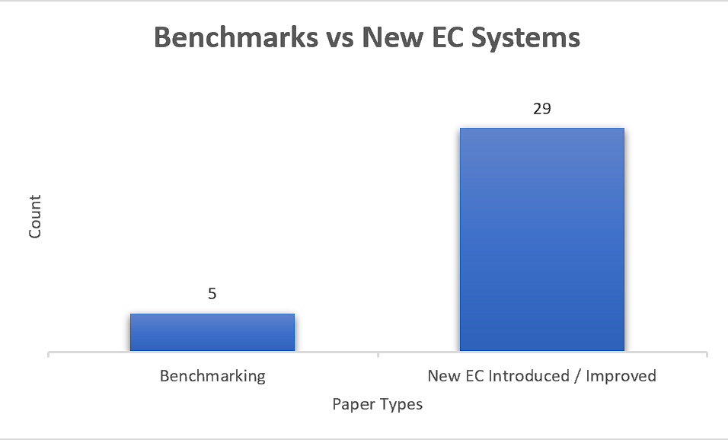
Motivation
Several EC algorithms have been proposed and studied in academic research, only a few have been evaluated.
Are default settings the best? Factors affecting tuning.
Source : Data Collected from Google Scholar ( q: “Benchmark Erasure Code” )
/ 17

Slide 5
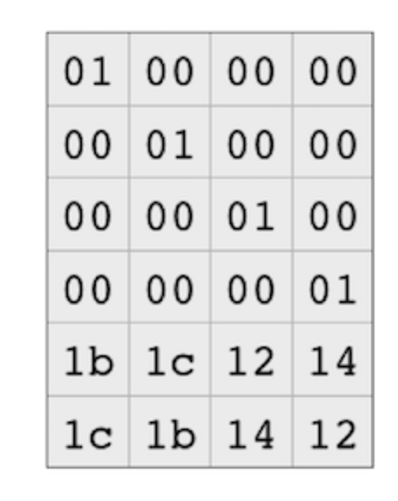
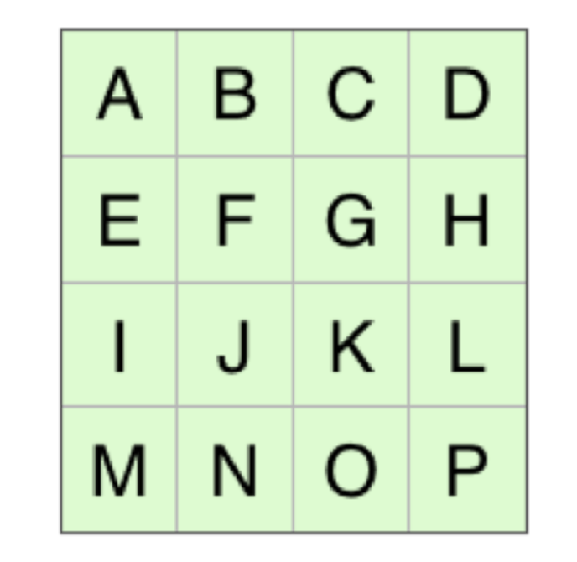
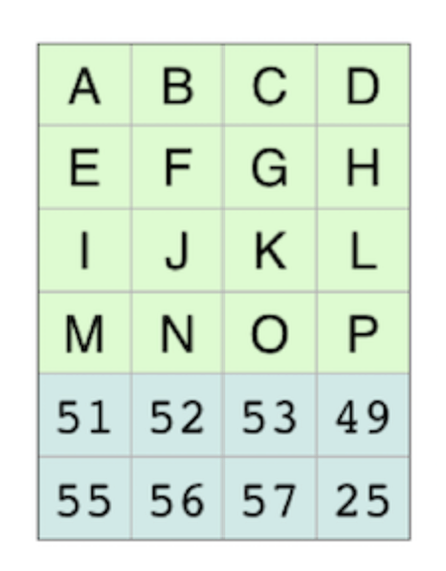
Reed-Solomon based Encoding
Data Loss
The Original Data
Applying Coding Matrix
The Encoding Matrix
Source : https://www.backblaze.com/blog/reed-solomon/
/ 17

Slide 6
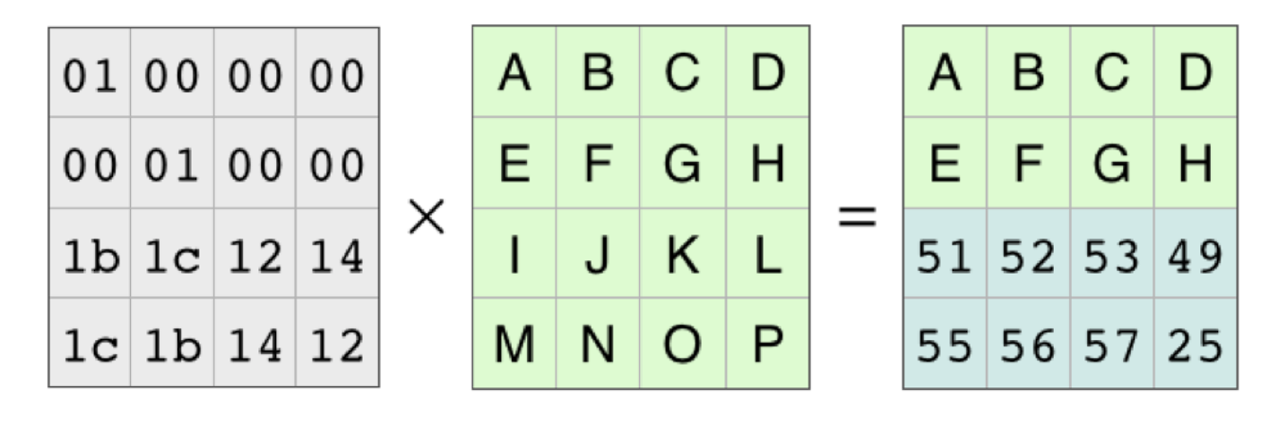
Reed-Solomon based Encoding
Data Loss: The Matrix with two Lost rows
Source : https://www.backblaze.com/blog/reed-solomon/
/ 17

Slide 7
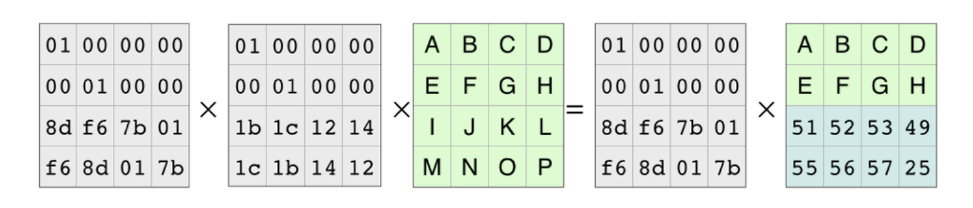
Reed-Solomon based Encoding
Multiply each side by the inverse
Source : https://www.backblaze.com/blog/reed-solomon/
/ 17

Slide 8
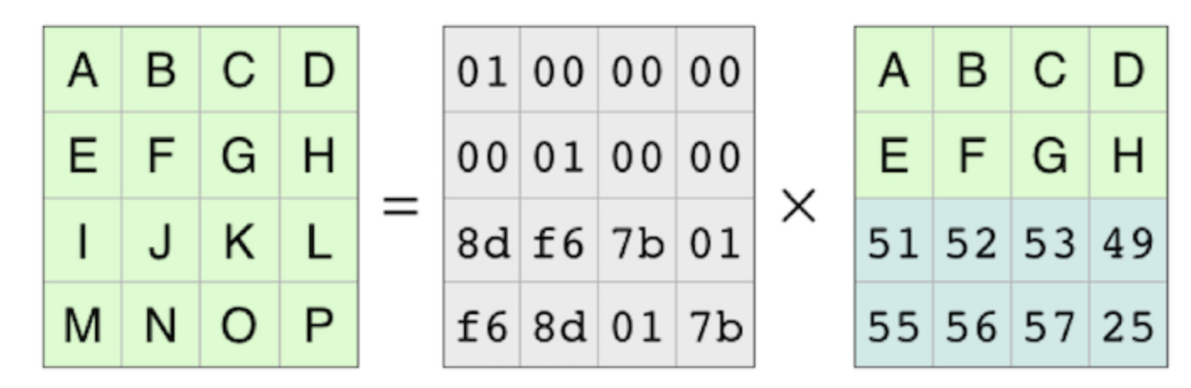
Reed-Solomon based Encoding
Original Data Reconstructed
Source : https://www.backblaze.com/blog/reed-solomon/
/ 17

Slide 9
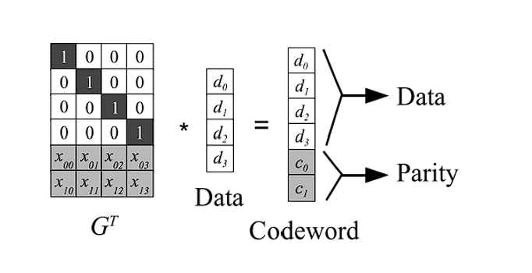
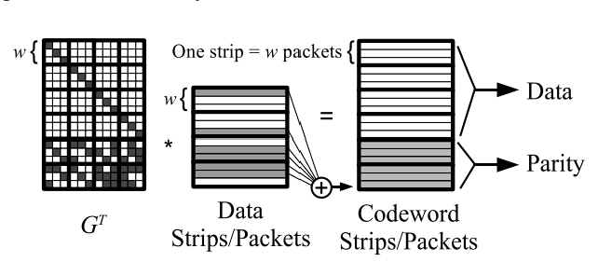
The Differences
Reed-Solomon Encoding
Cauchy Reed-Solomon Encoding
Encoding matrix is generated via Vandermonde matrix and it is expensive.
Encoding Matrix is generated via Cauchy matrices and it is computationally cheaper.
Exchange multiply and divide by use of XOR operations
Use multiply and divide operations
Source : A Performance Evaluation and Examination of Open-Source Erasure Coding Libraries for Storage
Source : A Performance Evaluation and Examination of Open-Source Erasure Coding Libraries for Storage
/ 17

Slide 10
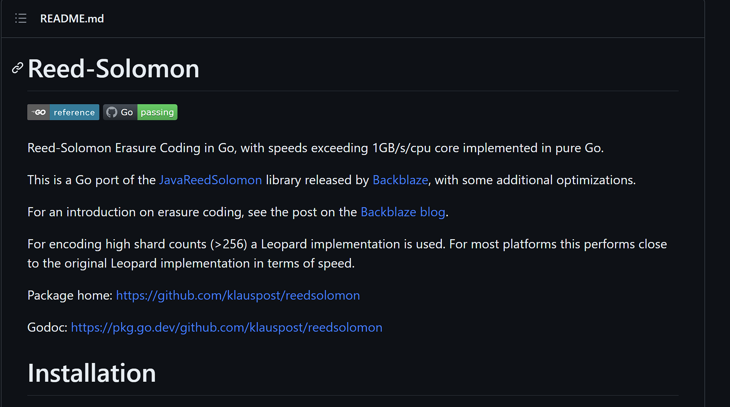
Experiments
Trying different Parity Blocks , Data Blocks and Block size for encoding performance.
Measured their decoding performance.
Using github library - “https://github.com/klauspost/reedsolomon” for experiments. Implemented in GO.
Results are compared with paper – “A Performance Evaluation and Examination of {Open-Source} Erasure Coding Libraries for Storage” presented in FAST 09. by James S. Plank
Source : https://github.com/klauspost/reedsolomon
/ 17

Slide 11
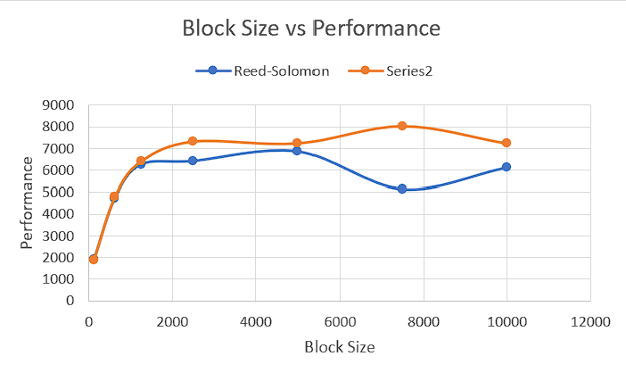
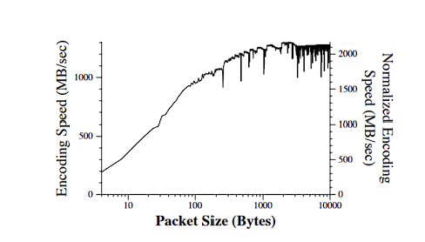
Experiement 1 : Increasing the Data Block Size
The performance initially increases, then remains constant
Optimal block size for Cauchy RS – 7500Kb ( 8000 Mbps ) and for RS – 5000 Kb ( 7000 Mbps ).
Parity Blocks = 4, Data Blocks = 8
Source : A Performance Evaluation and Examination of Open-Source Erasure Coding Libraries for Storage
/ 17

Slide 12
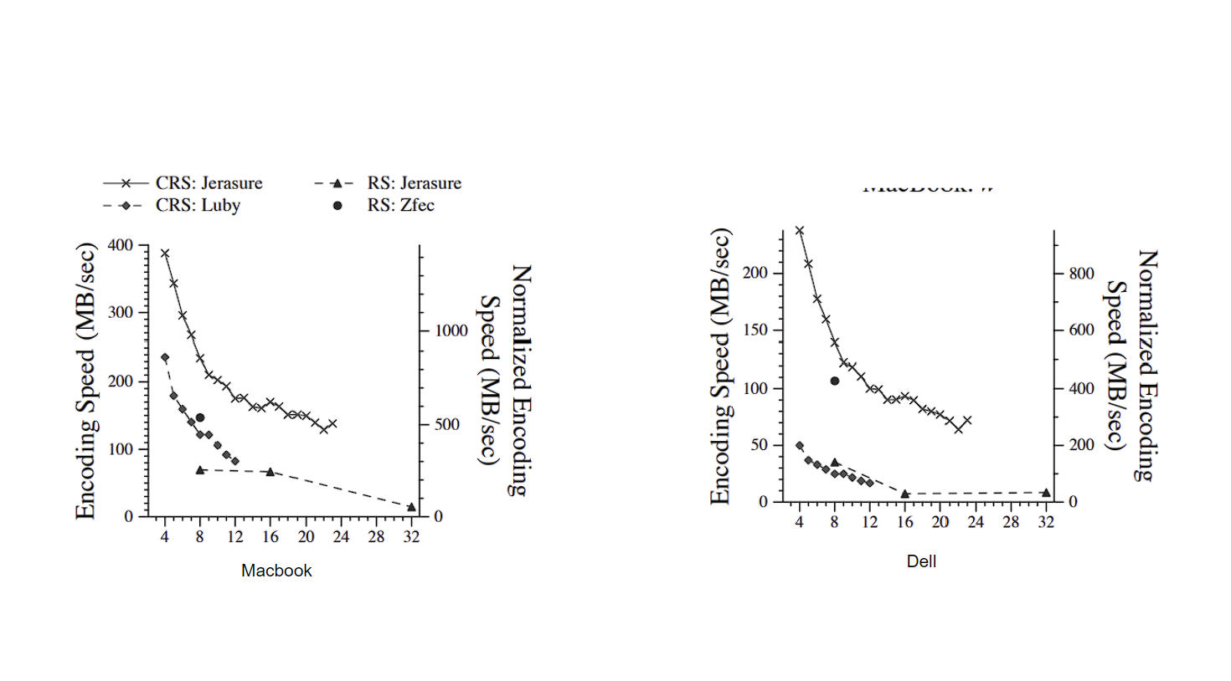
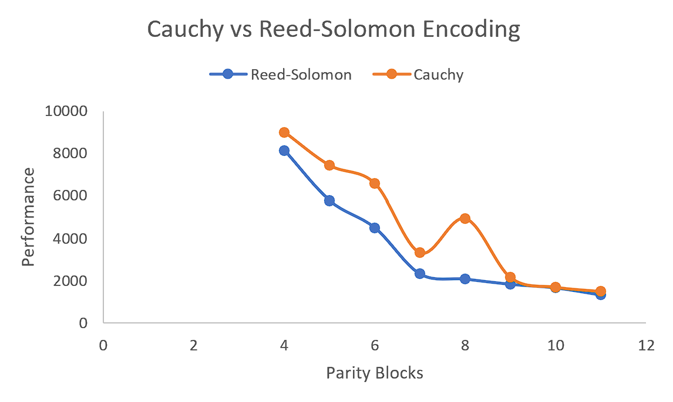
Experiment 2 : Increasing the Parity Block
Performance decreases with increasing the parity blocks.
The performance of Cauchy RS is higher than Reed-Solomon.
Source : A Performance Evaluation and Examination of Open-Source Erasure Coding Libraries for Storage
File Size = 1GB
/ 17

Slide 13
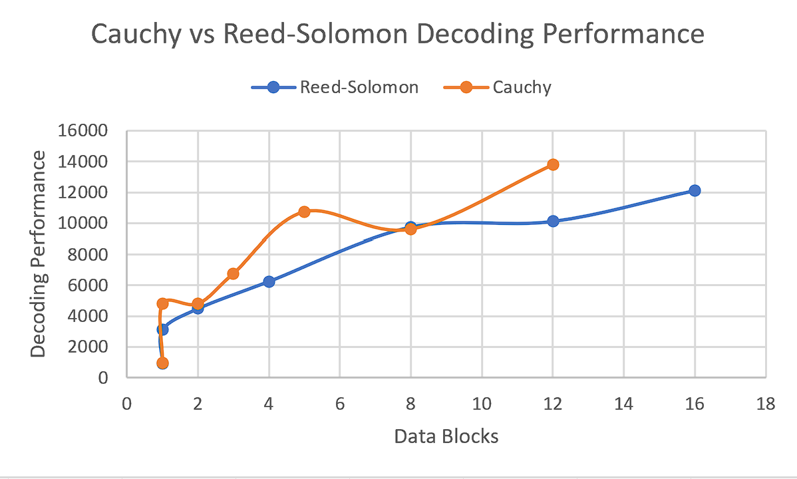
Experiment 3 : Comparison of Decoding Speed
The decoding speed of Cauchy RS is better than Reed-Solomon.
Two Random Blocks deleted
/ 17

Slide 14
Observations
The Cauchy RS performs better than Reed-Solomon.
Bigger block size can improve encoding speeds.
High parity blocks can decrease encoding speeds.
Radical dips in performance can be seen. Due to collisions in L1-Cache.
Radical Dip in performance
/ 17

Slide 15
Conclusion
Default values of erasure coding algorithm might not give best performance.
Cauchy Reed-Solomon Encoding performs better than Reed-Solomon Encoding in both encoding and decoding the files as expected.
/ 17

Slide 16
Thank You!

Slide 17
References
James S Plank et al. “A Performance Evaluation and Examination of Open-Source Erasure Coding Libraries For Storage”.
James S Plank, Scott Simmerman, and Catherine D Schuman. “Jerasure: A Library in C/C++ Facilitating Erasure Coding for Storage Applications Version 2.0”
Reed-Solomon Example - https://www.backblaze.com/blog/reed-solomon/
/ 17

