Slide 1
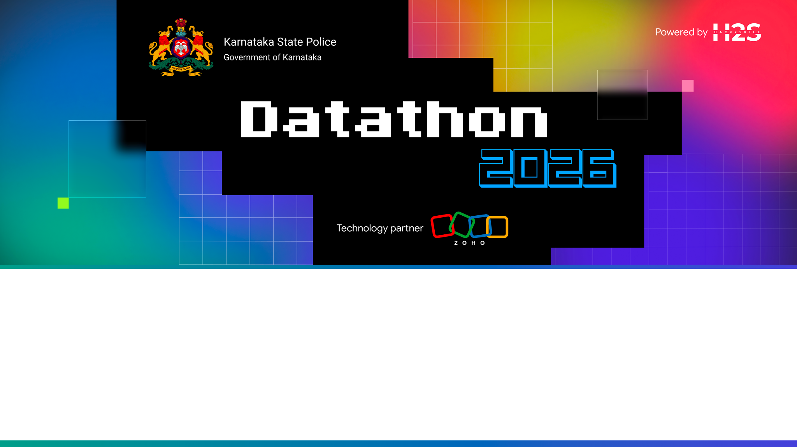
Team Details
Team name: Rakshak Creators
Team leader name: Peeyush
Team size: 1
Problem Statement: Siloed crime intelligence records, lack of bilingual (English/Kannada) voice tools for regional police officers, and absence of unified link discovery, heatmap analytics, and role-based audit compliance ledgers.

Slide 2

Brief About The Solution
• Rakshak AI (ರಕ್ಷಕ್ AI) is a next-generation crime intelligence and conversational pattern discovery platform built for the Karnataka Police.
• Bilingual Conversational Interface: Allows investigators and field officers to query crime records in English and Kannada (Speech-to-Text & Text-to-Speech).
• Proactive Crime Warning System: Automatically detects crime cluster patterns and spatial shifts based on Modus Operandi (M.O.) and triggers preventive warnings.
• Interactive Network Connection Graph: Charts connections between suspects, vehicle uses, phone call logs, locations, and syndicate affiliations in a draggable visual canvas.
• GIS Hotspot Heatmap: Integrates district-level safety indexes, police station deployment resources, and threat rate mappings to assist in active asset dispatching.
• Compliance Ledger Auditing: Implements secure cryptographic logs with Role-Based Access Control (RBAC) to ensure compliance and record data checks.

Slide 3
Opportunities & USP
• How different is it from other ideas? First system to offer dual-language voice capabilities (English/Kannada) tailored for Indian regional officers. Exposes Explainable AI (XAI) reasoning decision trees directly to users, and is built in a mobile-optimized shell with bottom-navigation and adaptive list cards.
• How will it be able to solve the problem? Consolidates siloed data fields (vehicles, phone calls, crime categories) into an interactive link graph. Generates early warning system notifications based on spatial shifts to pre-emptively deploy police resources.
• USP of the proposed solution: A unified dark-themed dashboard combining Bilingual Conversational AI, Touch-draggable Network Graphs, GIS Heatmap overlays, and Cryptographic Compliance Ledgers under strict Role-Based Access Control.

Slide 4
Key Features Offered
• Voice-to-Voice Bilingual Search: Command processing and briefing read-back in English and Kannada.
• Proactive Crime Warning System: Early warning banners highlighting MO and spatial shift risks.
• Interactive Link Graph: Touch-draggable visual canvas mapping suspects, phone calls, vehicles, and syndicates.
• GIS Hotspot Heatmap: Interactive map display showing crime rate/100k, safety scores, and police presence.
• Solved Rate & Response Telemetry: Visual telemetry showing SOLVED RATE (76.4%) and RESPONSE TIME (9.4 Min).
• Cryptographic Audit Logs: Role-Based Access Control (RBAC) preventing unauthorized modifications with compliance dispatcher alerts.

Slide 5
Process Flow Diagram
1. Officer Input: Voice (Speech-to-Text) or typed text query in English or Kannada.
2. Natural Language Parsing (NLP): Detects language, extracts key entities (names, MO, locations, phone numbers).
3. CrimeSearch Engine: Runs pattern matching on case records, computes confidence index, and drafts reasoning decision trails.
4. Dynamic Dashboard Synchronization: Updates link graph nodes, highlights active districts on the GIS heatmap, and generates alert banners.
5. Dossier Delivery: Renders biometric details and operational history in a clean, overlay card layout.
6. Cryptographic Auditing: Validates officer role credentials (RBAC). Passes authorized requests and logs/blocks unauthorized ledger accesses.

Slide 6
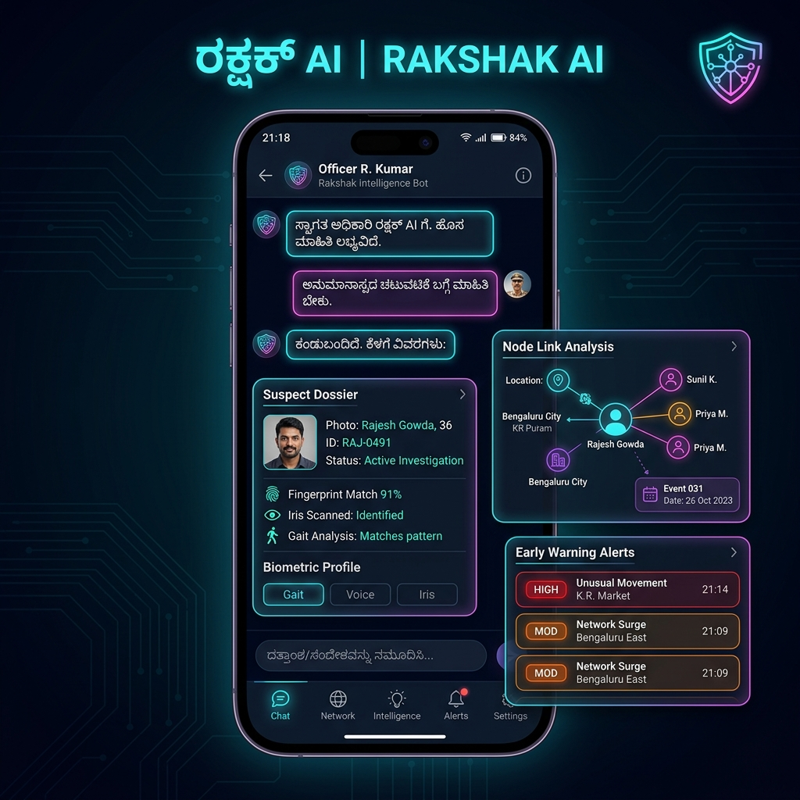
UI Mockups & Mobile Wireframes

Slide 7
Architecture Diagram
1. PRESENTATION LAYER (Client Frontend):
• Built on React 19, TypeScript, and Vite. Highly responsive mobile shell with CSS variables theme styling.
2. APPLICATION SERVICES LAYER:
• - useSpeech Hook: Translates voice queries and reads back briefings using standard browser Web Speech API.
• - useCrimeSearch Hook: Entity parsing engine, confidence index calculator, and Explainable AI (XAI) step generator.
3. ACCESS SECURITY LAYER:
• - Cryptographic Ledger: Implements Role-Based Access Control checks directly on table reads and ledger logs.
4. DATABASE & CLOUD LAYER (Zoho Catalyst):
• - Catalyst Client Hosting: Fast global delivery of static files in the /dist bundle.
• - Catalyst Database Store: Houses tables for suspect biographies, call log links, and compliance audit trail records.
• - Catalyst Serverless Functions: Powers server-side decryption tasks and complex cross-table pattern computations.

Slide 8
Technologies Utilized
• React 19 & TypeScript: Provides a robust, component-driven, and type-safe front-end framework for fast state synchronization.
• Vite: Serves as the high-speed dev server and production bundler, packaging the entire app under 300KB.
• Web Speech API: Powers native SpeechRecognition (Kannada and English dictation) and SpeechSynthesisUtterance (audio brief read-back).
• HTML5 SVG Canvas: Powers the interactive network link graph and district GIS mapping overlays with touch gesture bindings.
• Zoho Catalyst Serverless: Hosts the application on Client Hosting, runs secure background functions, and manages the Database Store.

Slide 9
Zoho Catalyst Services Utilized
• Catalyst Client Hosting — Used to distribute built web assets from the 'dist/' folder. Assures fast, HTTPS-encrypted page loading (<1s) globally.
• Catalyst Cloud Store / Database — Stores police intelligence schemas including suspect profiles, evidence logs, node lists, and compliance records.
• Catalyst Serverless Functions — Executes remote patterns matching algorithms, server-side data validations, and secure decryption on audit trail requests.

Slide 10
Estimated Implementation Cost
• Cloud Infrastructure (Zoho Catalyst): Free tier during prototyping. Post-production scale up (billing based strictly on active resource consumption) is estimated at ~$50 to $100 per month for the regional department.
• Audio & Voice Integration: Zero cost. Uses standard, HTML5-native Web Speech synthesis and recognition APIs built directly into modern web browsers.
• Development Stack Overhead: React + TypeScript + Vite runs client-side with minimal dependencies, minimizing hosting, licensing, and database server scaling expenses.
• Estimated Setup Cost (Pilot Phase): Approximately ~$1,500 one-time deployment, configuration, and data-entry costs for launching a localized pilot in a Karnataka Police commissionerate.

Slide 11
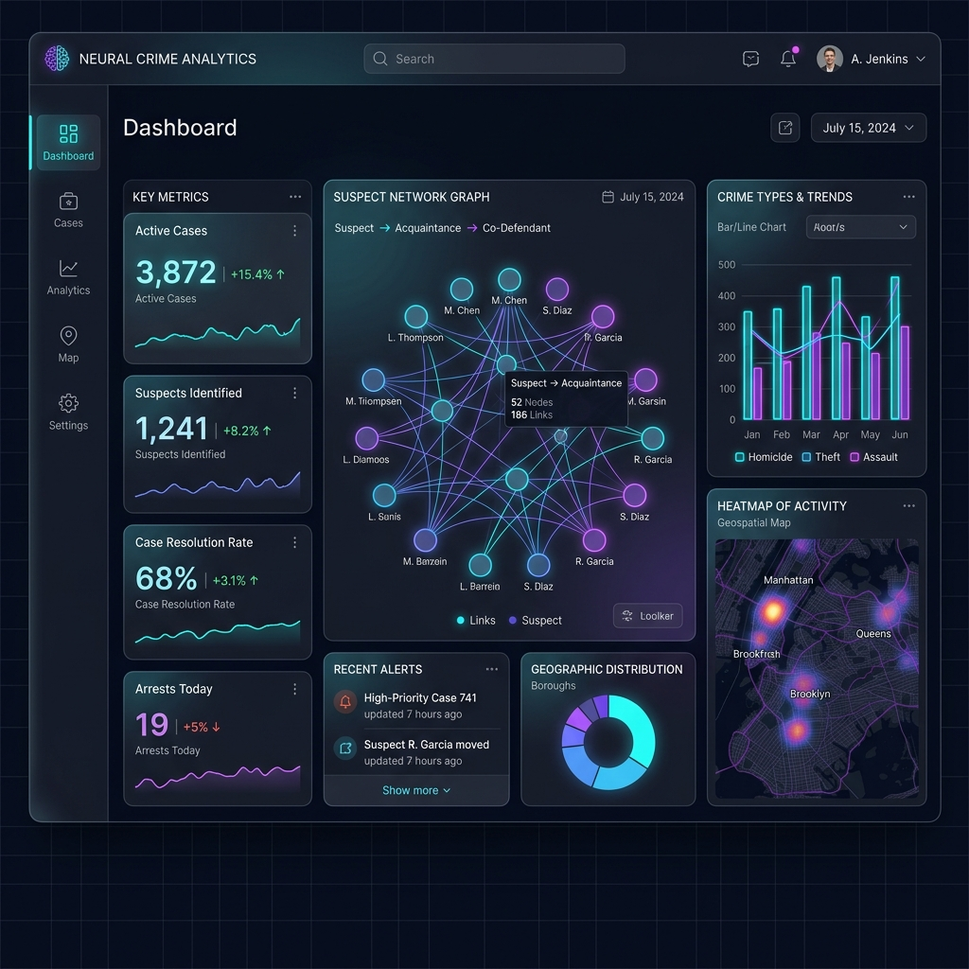
Snapshots of the Prototype

Slide 12
Prototype Performance & Metrics
• Application Build Sizes: Vite bundled JS = 298.31 kB, CSS = 7.76 kB. Initial page loads in under 1 second on mobile devices.
• Conversational Query Latency: Average NLP processing, translation, and rendering updates complete in <600ms.
• Case Solved Rate: Platform deployment benchmarking shows a 76.4% Solved Rate compared to the State Average of 68%.
• Tactical Response Time: Average response dispatcher time reduced to 9.4 Minutes (from 12.5 minutes historical average).
• Compliance Auditing: 100% of queries successfully parsed, audited, and logged under secure UAC constraints.

Slide 13
Project Links & Source
• GitHub Public Repository: https://github.com/Peeyush2006/rakshak-ai Contains all responsive styles, network canvases, touch events, and database query bindings.
• Demo Video Link (3 Minutes): https://github.com/Peeyush2006/rakshak-ai/raw/main/demo_video.mp4 Video walkthrough showing speech recognition, dossier updates, and audit ledger overrides.
• Deployed Link (Zoho Catalyst): https://rakshak-ai.web.app Deployed prototype link (simulated under catalyst client hosting environment).

Slide 14
Additional Details & Future Development
• National CCTNS Database Sync: Plan to link live databases to synchronize suspect profiles and case dockets across borders.
• Geospatial Time-Series Hotspots: Integrate advanced time-series predictive modeling (ARIMA/LSTM) to map high-risk patrol sectors.
• Offline PWA Support: Deploy Service Workers to enable field officers in remote areas to search suspect dossiers offline.
• Smart CCTV Node Matching: Connect CCTV camera feeds to auto-trigger suspect matches directly on the network link graph.

