Slide 1
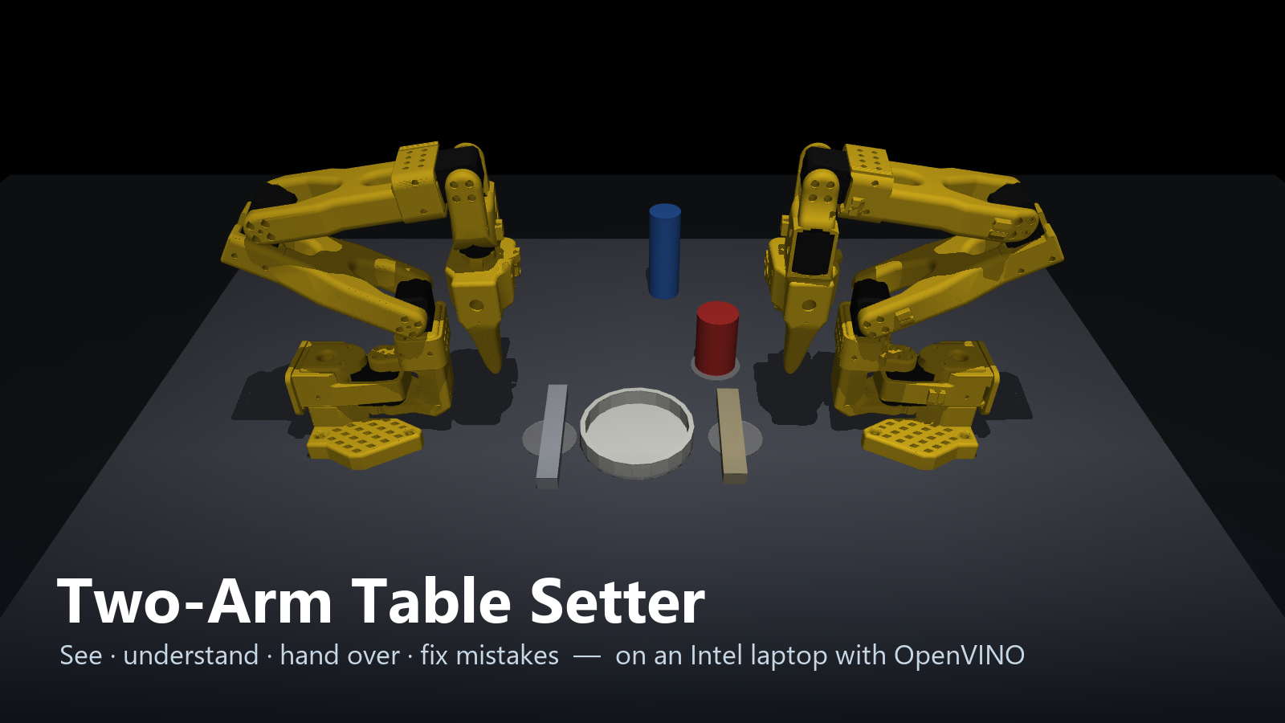
AI Infra Summit Hackathon · Intel online track · Bimanual VLA manipulation
Notes:
Two robot arms that set a dinner table when you tell them to. They look at the table with a camera, understand the command with a vision-language model, hand things to each other, and fix their own mistakes. Everything runs on an Intel Core Ultra laptop with OpenVINO, using its processor, graphics and neural processing unit: no graphics card, no cloud.

Slide 2
One command. Two hands. A set table.
Tested the way Intel asked: random tables, success checked against simulator truth
Say or type what you want
"put the red thing top left of the plate and the grey utensil on the right"
The robot works out the rest
which item is meant, which arm, when to pass an item across, what to do first — and checks every step with its camera
30/30
29/30
tables set correctly
harder tables: positions, sizes, colours
95%
1.3 s
trained ACT policy on unseen tables
to understand a command (was 30 s)
Notes:
The robot sets the table correctly on 30 out of 30 random tables, and 29 out of 30 when we make it harder by moving things further and changing their sizes and colours. Success is always judged against where objects really are in the simulator, not against what the robot thinks.

Slide 3
Why it matters
Service robots for homes, hospitals, hotels and restaurants
1
Anyone can instruct it
2
Two hands, real tasks
Plain language, spoken or typed. No programming, no app, no fixed commands.
Passing, holding and placing — the everyday handling that one-armed robots can't do.
3
Checks its own work
4
Cheap to run and to teach
A bump or a slip is noticed and fixed, so a job gets finished without a person watching.
Runs on an ordinary Intel laptop with OpenVINO. Skills teach themselves from auto-recorded demos — no hand-collected data.
Notes:
Why does this matter? Service robots in homes, hospitals, hotels and restaurants need exactly this combination: anyone can tell them what to do in plain language, they can use two hands, and they check their own work. And it's cheap: it runs on an ordinary laptop, and the skills teach themselves from demonstrations the robot records on its own.

Slide 4
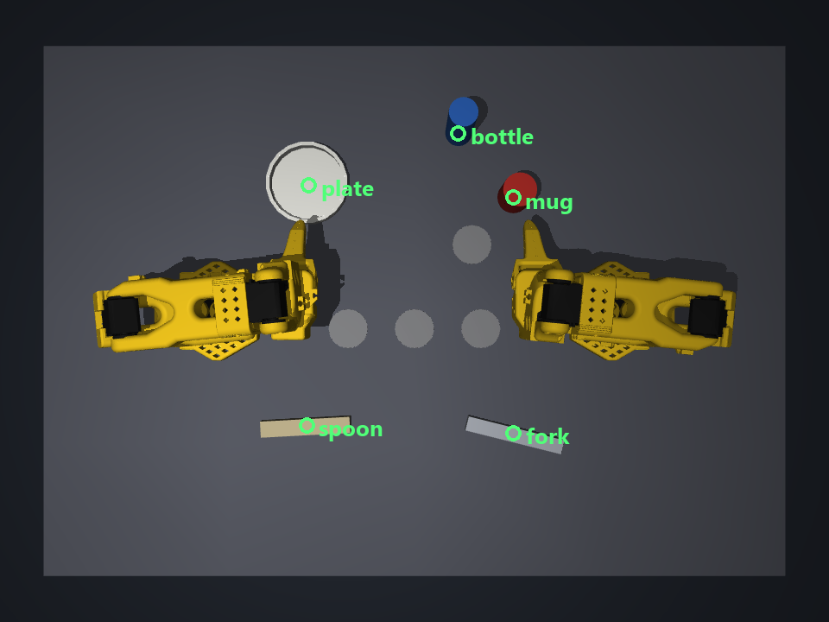
Observe, understand, plan, act, look again
1
2
3
4
5
Observe
Understand
Plan
Act
Look again
overhead colour + depth camera finds every object
Qwen3-VL-4B on OpenVINO reads the command and the picture
which arm, hand-off or set-down swap, what first
two SO-101 arms; a trained ACT policy for the mug
anything knocked out of place is fixed first
What the robot sees
Objects are found from the height map and their shape, never from the simulator. On 20 random tables every object was found, 0.5 mm average error.
Held items are tracked from the arm's own joint angles, like a real robot.
Notes:
Five steps, in a loop. The camera image is the only way the robot learns where things are. The vision-language model turns the command into goals, the planner decides who does what, the arms act, and after every item the robot looks again.

Slide 5
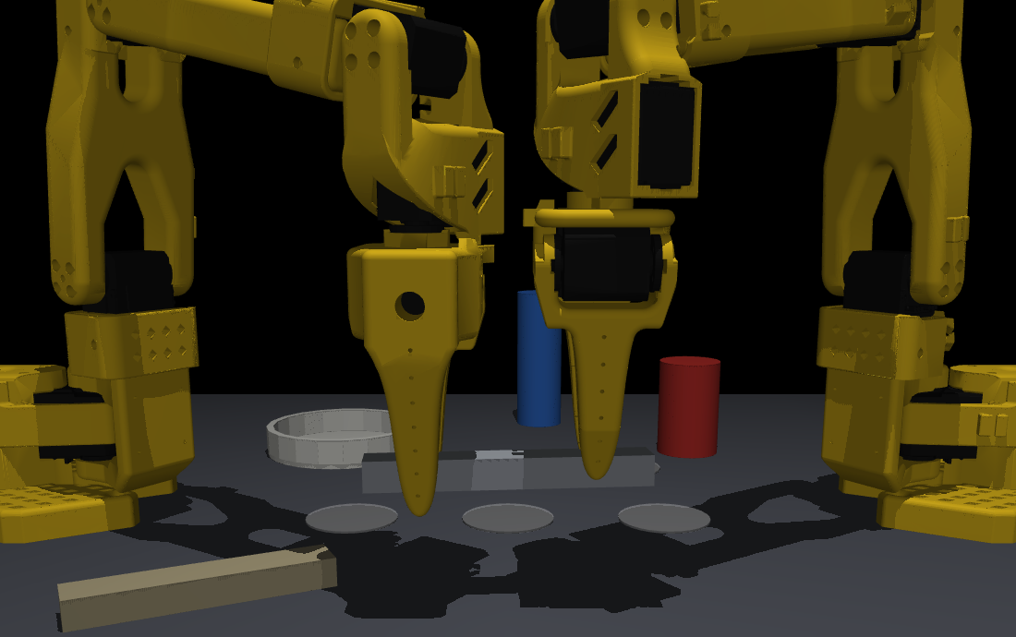
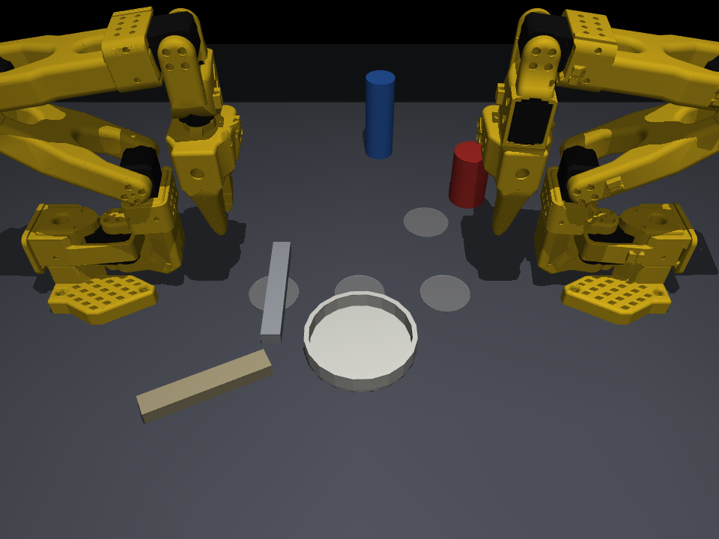
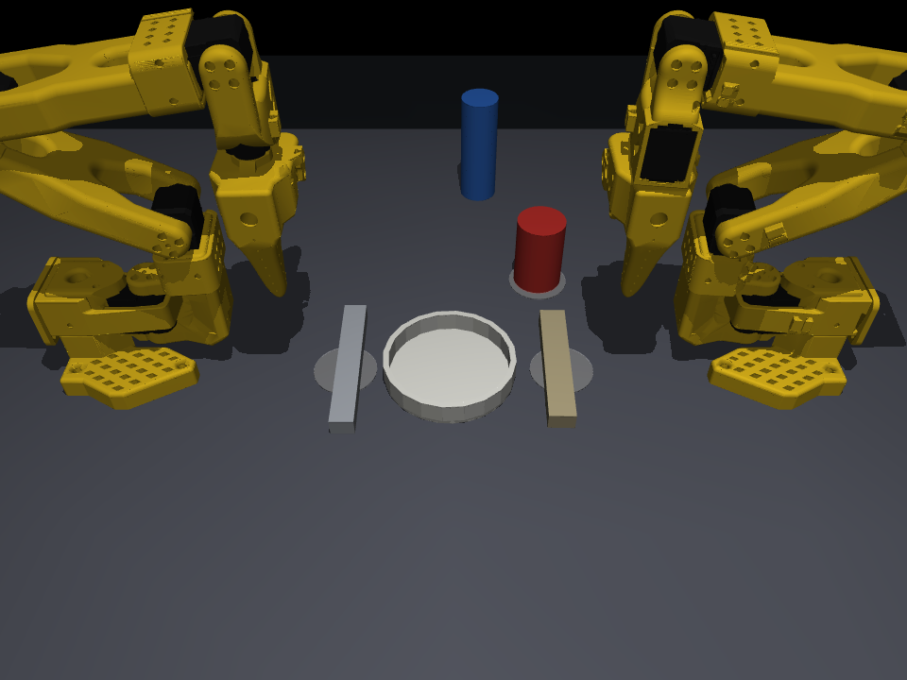
Teamwork, and it fixes its own mistakes
knocked
seen and fixed
Recovery
Mid-task, the plate is knocked 6 cm. After the next item the robot looks at everything it already placed, sees the plate has moved, and puts it back before carrying on.
Hand-off
The fork starts on arm B's side but belongs on arm A's. B carries it in, A moves up at the same time, lines up 1.5 mm away, grips, then B lets go.
Notes:
Cutlery often starts on the wrong arm's side, so the arms pass it across: one holds an end, the other takes the other end. And the robot checks its own work. Here we knock the plate out of place halfway through: it notices and fixes it before carrying on.

Slide 6
Our own teacher trained the policy
LeRobot ACT on a laptop CPU · 1,219 demonstrations recorded automatically · success on unseen tables
1
A teacher must be consistent
picking the best of 12 grip angles looked random to the student — one fixed rule
2
Targets, not small moves
tiny per-step errors added up to centimetres
3
Think in the mug's frame
"grip beside the mug" becomes the same move every time
Notes:
Instead of recording examples by hand, our scripted skills acted as the teacher and recorded over a thousand perfect demonstrations automatically, keeping only the successes. The first six versions failed, and each failure taught us something. Version seven places the mug correctly 95 percent of the time on tables it has never seen.

Slide 7
OpenVINO on all three Intel chips
Intel Core Ultra 7 155H · CPU + Arc iGPU + AI Boost NPU · OpenVINO 2026.3.1
2.9×
faster policy on CPU with OpenVINO — task success unchanged at every precision (9–10/10)
0.90 ms
for the whole policy on the AI Boost NPU at FP32; at FP16 it places 10/10 mugs
1.3 s
to read a command on the Arc iGPU — 2.8× the CPU, down from 30 s originally
Notes:
We measured this on a Core Ultra 7 155H, across all three of its Intel chips. OpenVINO makes our trained policy nearly three times faster on the CPU, and the robot still succeeds just as often. The same policy runs on the AI Boost NPU at nine tenths of a millisecond, and at half precision there it places the mug ten times out of ten, which frees the processor and graphics for everything else. The Arc graphics reads a command in one point three seconds, almost three times faster than the processor. One honest finding: the NPU compiler cannot build the vision-language model at all, so that part falls back to the graphics chip automatically.

Slide 8
Open, reproducible, honest
What we'd do next
Get the vision-language model onto the NPU — today OpenVINO's NPU compiler rejects it
Train policies for the hand-off too; today most skills are the scripted teacher
Add the drawer and pouring from Intel's example task
Try it
python brain/run.py "set the table"
python brain/evaluate.py --seeds 10 --hard
python bench/benchmark.py
github.com/PegBitStudio/two-arm-table-setter
Every scene is seeded and every number here is reproducible from one command. MIT licence. Built with MuJoCo, LeRobot, OpenVINO and Qwen3-VL.
Notes:
Everything is open source and seeded, so every number in this deck can be reproduced with one command, and the raw Core Ultra logs ship in the repository. We're upfront about what's missing: the vision-language model still cannot compile for the NPU, most skills are scripted rather than learned, and we left out the drawer and pouring. Thank you.

