Slide 1
MARKETING ANALYSIS
PRESENTER: PEGAH FATTAHI
OCT 2023

Slide 2
MAJOR QUESTIONS
Which campaigns are most effective in terms of user engagement?
On which days of the week do users spend the most time on the site?

Slide 3

CODE EXPLANATION
This SQL code is designed to provide a comprehensive analysis of user sessions from turing_data_analytics.raw_events table. Initially, it identifies the start of user sessions based on a 30-minute inactivity threshold. It then enriches this session data by assigning a global session ID. Following this, it calculates various session metrics such as the session length, bounce rate... The goal is to give the marketing analyst manager insights into user behavior across different campaigns.

Slide 4
SESSION DURATION CAMPAIGN WISE
Average Session Duration:
Users spend about 7.59 minutes per session on average.
Median Session Duration:
More typical session duration is about 1.29 minutes.
Presence of Outliers:
Significant difference between average and median indicates outliers.
Some sessions are exceptionally long.
User Interactions:
Most users have brief interactions.
A few sessions extend significantly due to:
Open tabs.
Bots.
Genuine long engagements.
0-Second Sessions:
These could be due to quick bounces or errors.
Recommendation:
Important to determine the reason for these brief sessions for accurate analysis.
AVG. Session Duration
455.4 (Second) or 7.59 (Minutes)
Median. Session Duration
77.4 (Second) or 1.29 (Minutes)

Slide 5
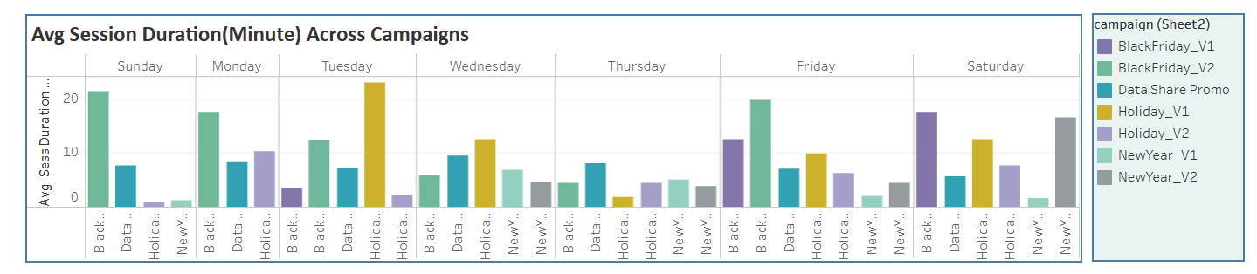
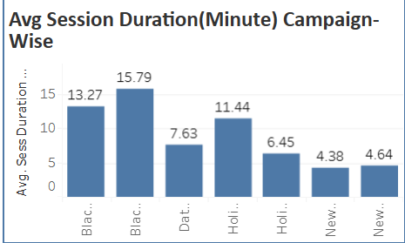
Comparative Analysis of Average Session Durations Across Marketing Campaigns
Upon analysing the data, we observe that users engaged with our website for extended periods. Notably, during the BlackFriday_V2 campaign, the average session duration peaked at 16 minutes

Slide 6
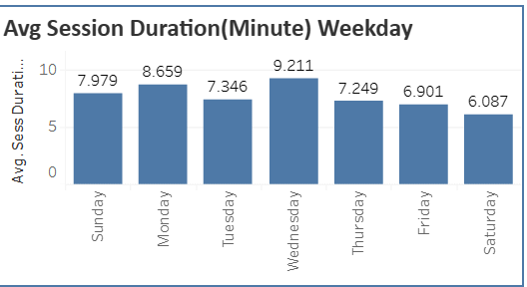
User Engagement Patterns: A Weekday Perspective
An in-depth examination of our user engagement reveals distinct patterns throughout the week. Specifically, users mostly spent time on Wednesdays, dedicating an average of 9 minutes per session. Mondays follow closely with an average session duration of 8 minutes.

Slide 7
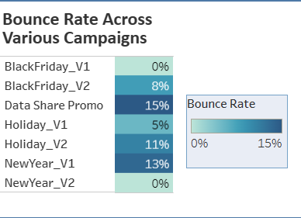
Campaign Efficacy: A Bounce Rate Overview
While most campaigns exhibit varied bounce rates, BlackFriday_V1, and NewYear_V2 notably stand out with a 0% bounce rate.

Slide 8
Interactive Dashboard: Dive Deeper on Tableau
Link: https://public.tableau.com/app/profile/pegah.fattahi/viz/MarketinCampaign-Analysis_Turing/Dashboard1?publish=yes

Slide 9
THANKS!
Pegah Fattahi
Pegah.fattahi1990@gmail.com

