Slide 1

Product Analysis
Data Analyst: Pegah Fattahi

Slide 2


Introduction
"As a team of data analyst, we will explore how long it takes for a user to make their first purchase after landing on our website. By analyzing granular data from our analytics platform, we aim to better understand user behavior and identify opportunities for improving their journey. This data-driven approach will provide actionable insights to enhance user experience and potentially increase revenue."

Slide 3
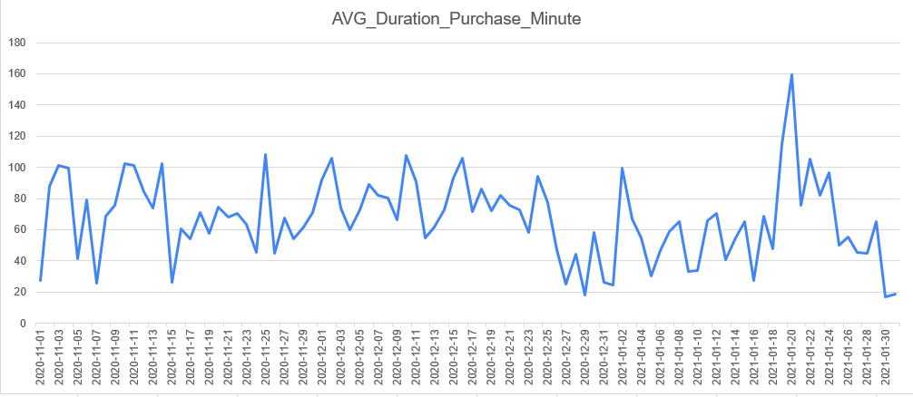
User Purchase Behavior analysis
Volatility in User Behavior: The average duration, indicating the time between a user's first action and purchase, experiences significant fluctuations over the depicted period.
Periodic Peaks: There are distinct peaks in the data, with the most noticeable spike, might be influenced by specific events, promotions, or other external factors.
Outliers and Anomalies: The significant peak in late Jan 2021 stands out and would merit a deeper dive to understand the reasons behind such a surge in average duration.

Slide 4
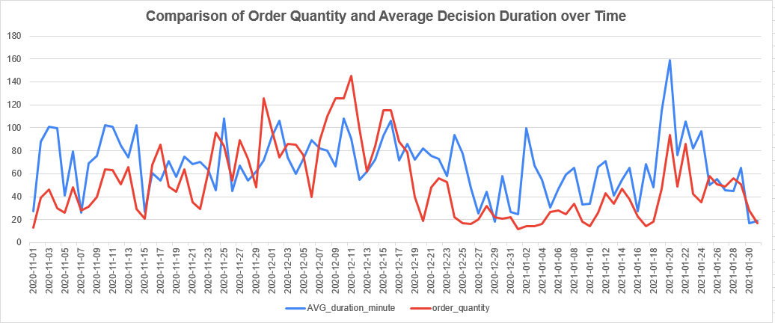
User Purchase Behavior analysis
Insight: During the lead-up to Christmas, we observe a significant rise in order quantities, likely driven by festive shopping. However, this surge is accompanied by an increased decision duration, suggesting holiday promotions or diverse choices may have prompted users to spend more time before finalizing their purchases.
Notes:
The chart illustrates the relationship between the number of orders and the average duration taken by users before making a purchase. Notably, as we approach December, there's a marked increase in order quantity, possibly influenced by the festive shopping during Christmas. Simultaneously, there's a sharp spike in average duration around the same period, suggesting that while more users are shopping, they are also taking more time to decide, perhaps due to a surge in holiday promotions or a wider variety of choices available. Post-Christmas, both metrics show a decline, with order quantity experiencing a more rapid drop

Slide 5
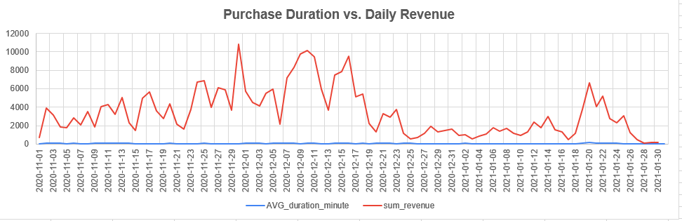
User Purchase Behavior analysis
Insight: Post-Christmas Eve, there was a notable decline in average purchase duration, reflected in the total purchase value. The pre-Christmas period saw higher daily spending by same-day Customers.

Slide 6


THANK YOU
Pegah Fattahi
Pegah.fattahi1990@gmail.com

