Slide 1
Cohort analysis
Pegah Fattahi

Slide 2

INTRODUCTION
In the rapidly changing landscape of digital subscriptions, keeping a close eye on user retention can be the difference between success and stagnation. In line with this, our Product Manager has expressed interest in obtaining weekly churn statistics. Rather than relying on monthly data, which can potentially obscure critical details, we aim to pivot to a more granular, weekly perspective. By applying a Cohort Analysis method, we will be investigating how many subscribers start their subscriptions each week and how many remain active over the subsequent six weeks. Our data for this task is derived from the 'turing_data_analytics.subscriptions' table in BigQuery. The goal is to reveal weekly retention cohorts from our dataset, effectively illustrating the subscription journey from week 0 to week 6. This information will not only enhance our understanding of our user base's behavior but also provide actionable insights for the team to minimize churn and bolster retention.

Slide 3
PRIMARY GOALS
what is the Customer retention rate for our products?

Slide 4
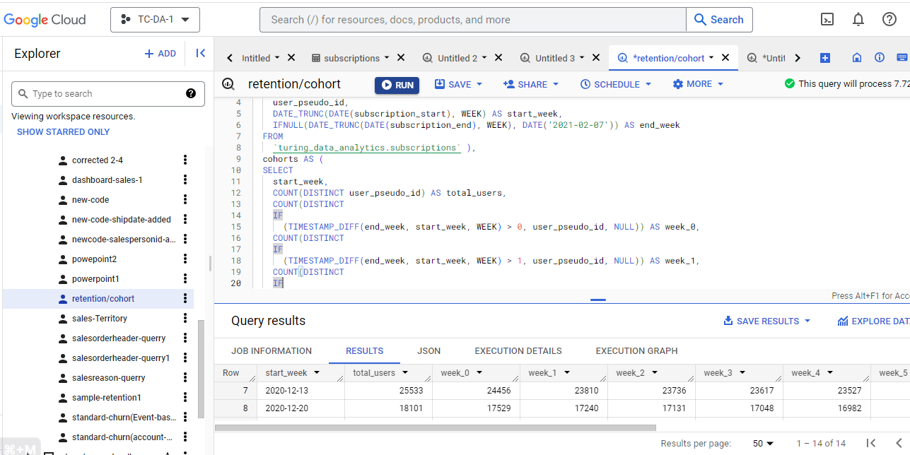
SQL code:

Slide 5
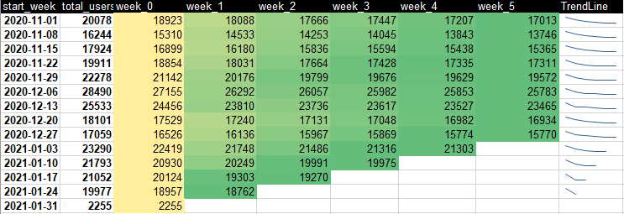
Number of Return customers per week

Slide 6
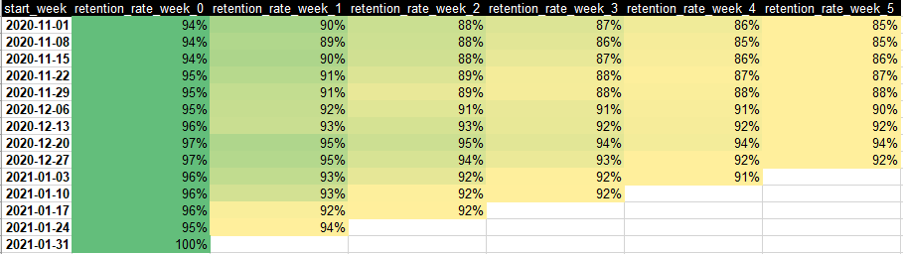
Customer retention rate per week

Slide 7
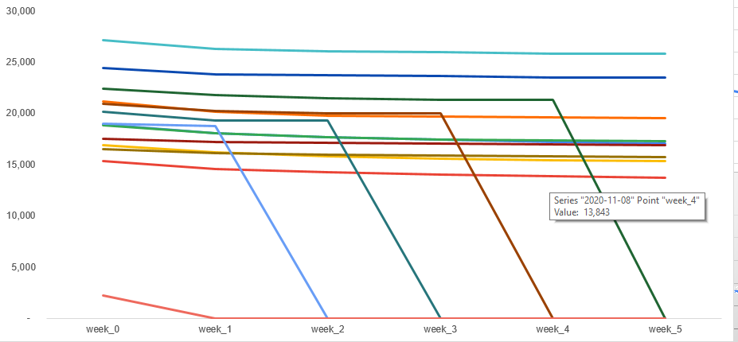
Data interpretation

Slide 8
Data interpretation
This table shows the number of users who began their subscriptions in a given week (start_week), and how many remained active through the subsequent weeks (week_0 through week_6).
For example, if we look at the cohort starting on 2020-11-01, we initially have 20,078 users (total_users). These users are all considered active at week_0 (18,923), because that's when they started their subscription. However, as we move through weeks 1 to 6, we see that this number gradually decreases, reflecting that some users have cancelled their subscriptions. By week_6, there are 17,013 users remaining, indicating that this cohort has experienced some churn over this period.
Looking across all the cohorts, it seems that there is a common trend of a slight decrease in active users week by week. This is expected, as some amount of churn is normal in subscription-based services.
A notable observation is the significant increase in total users for the week starting 2020-12-06. You may want to investigate if there were any special events or promotions during this week that led to the spike in new subscriptions.
Regarding the last few cohorts (from 2021-01-03 onwards), we see that data is incomplete for weeks 3 to 6. However, these cohorts also show a gradual decrease in active users from week_0 to the latest week recorded.
This table is useful in showing how user retention varies over time, and how quickly users tend to churn after starting a subscription. It may also reveal the effectiveness of any strategies or interventions aimed at improving user retention.

Slide 9
Questions:
What is the relationship between churn and retention rate?
What is negative churn?
What is user retention?
What are user retention cohorts?

Slide 10


Question-1:
What is the relationship between churn and retention rate?
Retention rate can be easily calculated from the churn rate and vice versa. Which measurement you look at is a matter of preference.
Most organizations use the churn rate for internal discussions around reducing churn. The retention rate is usually used to report to outsiders (for example, investors) when the emphasis is meant to be positive (“the glass is half full”).

Slide 11
Question-2:
What is negative churn?
Negative churn —When the increase in revenue from upsells(Upsells (retained subscribers change to a higher recurring revenue) is greater than the combined negative effect of down sells(retained subscribers change to a lower recurring revenue) and churns.

Slide 12
Question-3:
What is user retention?
The 3 Phases of User Retention
User retention can be broken down into three distinct phases: the onboarding stage, the nurture stage, and the attrition stage. Each of these stages needs to be analyzed and optimized differently.
Phase 1: Onboarding
Phase 2: The Nurture Stage
Phase 3: The Attrition Stage
Notes:
Onboarding: This is the first phase of user retention. The moment a customer starts using your product or service marks the beginning of this phase. During this phase, the goal is to ensure the customer understands how to use your product or service effectively and sees the value it provides. This can include tutorials, customer support, and follow-ups to ensure a smooth introduction. Proper onboarding can significantly boost initial user retention.
Nurture Stage: After customers have been onboarded, they enter the nurture phase. The goal here is to continually engage the customer and make sure they are getting maximum value from your product or service. This can be achieved through providing updates, introducing new features, offering personalized suggestions, and maintaining regular communication. The aim is to increase engagement and satisfaction, driving users to continue using your service and preventing them from shifting to competitors.
Attrition Stage: Despite your best efforts, some customers may reach a stage where they are no longer actively using your product or service - this is the attrition stage. This is typically characterized by reduced interaction or complete inactivity. Identifying users in this phase is crucial as you can implement strategies to win them back before they completely churn. This may involve reaching out to understand their reasons for disengagement and offering incentives or solutions to address their concerns.
Each of these stages is critical in customer retention and requires distinct strategies to handle. By carefully analyzing and optimizing each stage, you can improve your overall user retention rates.

Slide 13
Question-4:
What are user retention cohorts?
A cohort in the context of user retention is a group of users who share a common characteristic over a certain period of time. This characteristic is often the time of first use or sign-up. For example, a cohort could be all users who signed up for a service in January 2023.
User retention cohorts are used to analyze how many users from a certain cohort continue to use a product or service over time. For example, out of the users who signed up in January 2023, how many are still using the product or service in February, March, April, and so on.

Slide 14
THANK YOU
Pegah Fattahi
Pegah.fattahi@gisma-student.com

