Slide 1
Full-Stack Mini Project
Career Graph
Interactive & Personalized IT Career Roadmap Platform with Topological Prerequisite Locking and Skill Verification
CAPSTONE PROJECT REPORT • GROUP NO. 06
Department of Computer Science • Academic Year: 2026 – 2027
1. Shinde Piyush Anil 4. Tumma Varsha Chandraprakash
2. Surve Archit Milind 5. Vichare Sanika Sanjay
3. Telore Jagruti Kishore 6. Waychal Sanyukta Amol
Architecture: Vue 3 Single Page App | Node.js & Express REST API | MongoDB Atlas Cloud

Slide 2
BACKGROUND & MOTIVATION
Problem Statement: Challenges in Modern IT Learning
1. Premature High-Level Tool Fatigue
• Students frequently dive straight into advanced frameworks (React, Docker, Kubernetes) without mastering fundamental syntax, HTTP protocols, or Linux CLI.
• Leads to severe cognitive overload, tutorial dependency, and over 70% online course abandonment rates among engineering undergraduates.
2. Static & Non-Adaptive Visualizers
• Existing community visualizers (e.g. roadmap.sh) present static, read-only SVG diagrams with zero awareness of what the learner already knows.
• Cannot adapt to university academic curricula, evaluate prior student baseline competencies, or provide personalized step-by-step guidance.
3. Siloed, Non-Portable Skill Progress
• When a student masters shared engineering skills (e.g. Git, Python, SQL) in Web Development, that progress is trapped in an isolated course silo.
• Switching tracks to DevOps or AI/ML forces students to repeat identical modules from scratch, wasting dozens of hours.
4. Unverified 'Honor-System' Checklists
• Mainstream platforms rely on self-marked checkboxes or passive video playback with zero objective evaluation.
• Fails to guarantee conceptual understanding, creating a false sense of competence without employer-verifiable proof.
Career Graph — Project Presentation | Group No. 06 | Department of Computer Science

Slide 3
SYSTEM OVERVIEW
Proposed Solution: The Career Graph Platform
5-Tier Curriculum Hierarchy
Structured Pedagogical Decomposition
• Tier 1: Target Career Tracks
6 Curated industry role pathways (Full Stack, DevOps, AI/ML, Cloud, Data Science, Cyber Security).
• Tier 2: Atomic Skills Catalog
Component skills linked via explicit topological mathematical prerequisite dependencies (DAG).
• Tier 3: Course Syllabus
Comprehensive curriculum connected 1:1 with each roadmap skill node, maintaining clean domain boundaries.
• Tier 4: Staged Progression Levels
Strict tiered progression across Beginner ➔ Intermediate ➔ Advanced modules enforcing gradual mastery.
• Tier 5: Granular Interactive Lessons
Bite-sized practical study units featuring clear theory, key takeaways, and runnable code examples.
4 Core Technical Pillars
Platform Engineering Differentiators
✓ Topological Prerequisite Engine
Advanced phases lock strictly until foundational skills reach 100% completion, eliminating premature tool hopping.
✓ Adaptive Onboarding Baseline
Calibrates roadmap starting points based on student academic degree, stream, and declared baseline knowledge.
✓ Universal Cross-Track Credit
Canonical skill IDs ensure skills mastered in one track immediately reflect across all adjacent tracks.
✓ Server-Graded Proof-of-Skill
Tamper-proof micro-quizzes evaluate advanced phase learners and award verifiable skill badges (🛡️).
Career Graph — Project Presentation | Group No. 06 | Department of Computer Science

Slide 4
RESEARCH & EXISTING SYSTEMS
Literature Survey & Comparative Analysis
Feature / Capability | roadmap.sh | Traditional MOOCs | Career Graph (Proposed)
Interactive Visual Roadmap | Static SVG / Community | Linear Syllabus List | Dynamic SVG Bézier Canvas
Prerequisite Locking Engine | None (All visible) | Course-specific only | Topological Phase & Node Gating
Personalized Gap Analysis | None | Basic quiz placement | Stream, Degree & Baseline Profiling
Cross-Track Skill Credit | Not Supported | Not Supported | Universal skillId Propagation
Proof-of-Skill Validation | Honor system checkmarks | Video watch completion | Server-Graded Anti-Cheat Quizzes
In-Place Career Switching | Requires full reload | Separate course enrollment | Instant Modal Switch with Live State
Career Graph — Project Presentation | Group No. 06 | Department of Computer Science

Slide 5
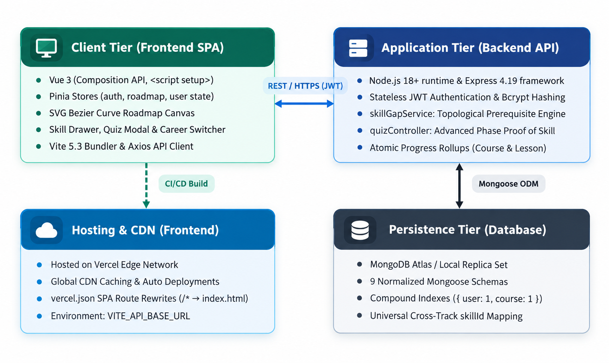
TECHNICAL ARCHITECTURE
Three-Tier Decoupled System Architecture
Figure 1: Three-Tier Cloud Architecture Block Diagram
Architectural Tier Decomposition
Decoupled Modern Cloud Web Stack
• 1. Presentation Tier (Frontend SPA)
Vue 3 Composition API (<script setup>) & Vite 5.3 bundler. Pinia centralized state stores (auth, roadmap, user). Dynamic SVG canvas computing cubic Bézier paths with pan/zoom HUD.
• 2. Application Tier (Backend REST API)
Node.js 18+ runtime with Express 4.19 framework. Stateless JWT auth, bcrypt password hashing, topological DAG prerequisite engine (skillGapService.js), and atomic progress rollups.
• 3. Persistence Tier (Cloud Database)
Managed MongoDB Atlas replica set cluster. 9 normalized Mongoose 8.5 schemas with compound unique indexes guaranteeing idempotent write operations.
• 4. Edge Hosting & CI/CD Pipeline
Frontend on Vercel Global Edge CDN with SPA rewrites (/(.*) -> /). Backend auto-deployed on Render with git-triggered builds.
Career Graph — Project Presentation | Group No. 06 | Department of Computer Science

Slide 6
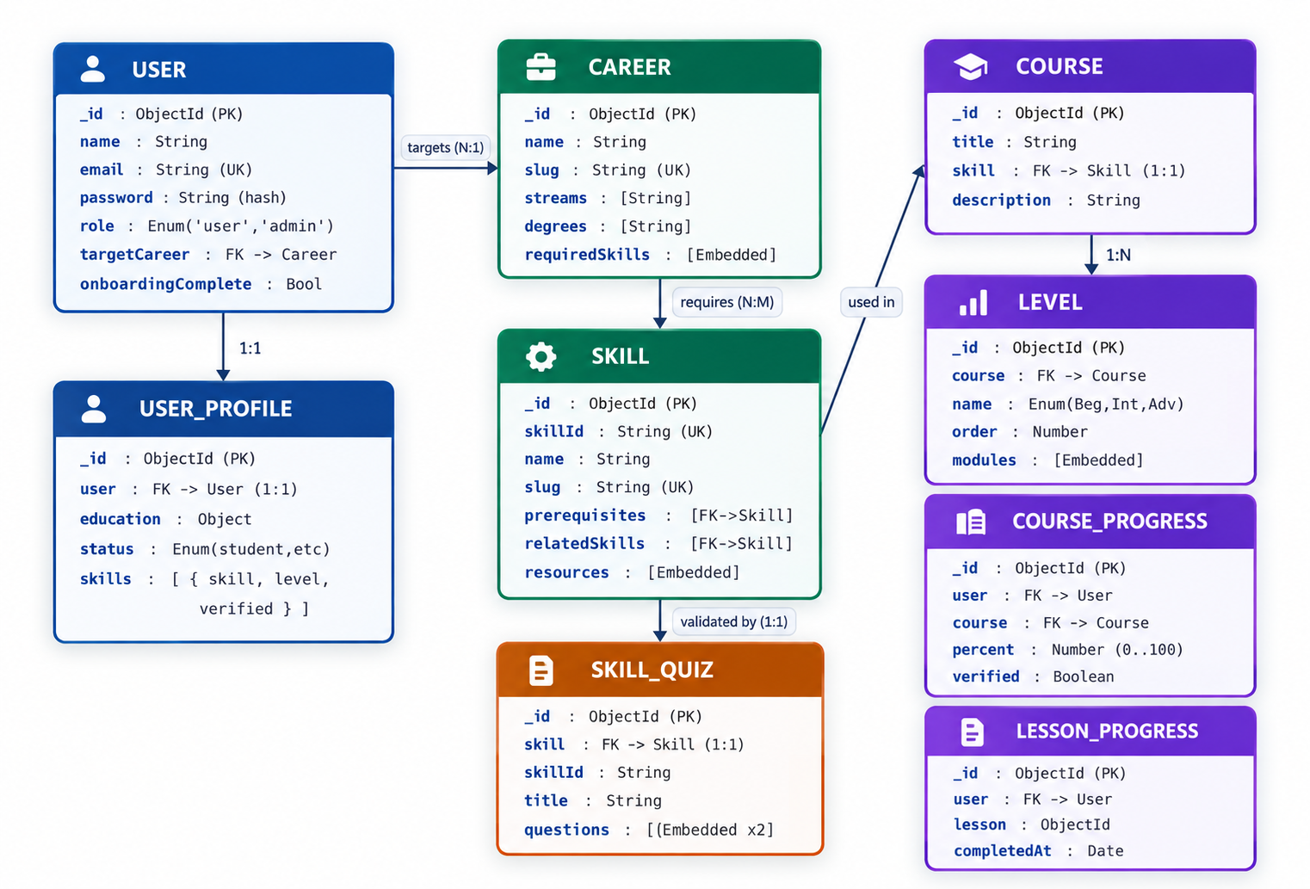
PERSISTENCE & DATA MODEL
Database Schema & Entity-Relationship Modeling
Figure 2: Mongoose 8.5 Normalized ER Model & Cardinalities
Key Data Entities & Relational Logic
Mongoose 8.5 Normalized Schemas
• User & UserProfile (1:1)
Stores identity credentials, bcrypt password hash, academic stream/degree, and declared baseline self-ratings.
• Career & Skill (1:N embedded)
Structured roadmap catalog partitioned into Foundations, Core, and Advanced phases.
• Course, Level & Lesson (1:1 & 1:N)
Granular syllabus mapping directly to skill nodes with Beginner, Intermediate, and Advanced tiers.
• CourseProgress & LessonProgress
Compound unique indexes ({ user, course }, { user, lesson }) guaranteeing idempotent progress tracking.
• SkillQuiz (1:1 with Skill)
Houses multiple-choice validation questions with server-side answer keys for proof-of-skill badging.
Career Graph — Project Presentation | Group No. 06 | Department of Computer Science

Slide 7
ALGORITHMIC WORKFLOW
Core Logic 1: Topological Prerequisite Engine
Phase 1: Foundations
ESSENTIAL PREREQUISITES
• Unconditionally UNLOCKED upon enrollment.
• Core tools: HTML, CSS, JavaScript, Git (Full Stack); Linux, Git, Networking (DevOps).
• Establishes vital syntax and engineering baseline before any framework usage.
Phase 2: Core Stack
MAIN DEVELOPMENT TOOLS
• STRICTLY LOCKED until all Phase 1 skills reach 100% completion.
• Frameworks: Vue.js, Node.js, Express, MongoDB.
• Prevents students from jumping into backend APIs and full-stack frameworks prematurely.
Phase 3: Advanced
PRODUCTION & CLOUD
• STRICTLY LOCKED until all Phase 2 skills are verified or completed.
• Tools: Mongodb
• Ensures code literacy and API proficiency prior to containerized deployments.
Node-Level Dependency Checking & Dynamic Next-Skill Recommendation:
Beyond macro phases, individual nodes verify specific prerequisite ObjectIds (e.g. JavaScript requires HTML & CSS). The engine performs topological sort traversal to dynamically highlight the next recommended skill on the roadmap canvas.
Career Graph — Project Presentation | Group No. 06 | Department of Computer Science

Slide 8
VALIDATION & ASSESSMENT
Core Logic 2: Proof-of-Skill Validation System
Step 1: Advanced Phase Gating
Prerequisite Enforcement
• Micro-quiz is locked on day one.
• A student MUST reach the Advanced level (by completing all Beginner and Intermediate lessons, or holding a baseline rating >= 3).
• Prevents blind guessing and ensures sufficient study preparation.
Step 2: Anti-Cheating Sanitization
Secure Client Payloads
• When quiz questions are fetched by the browser, the backend explicitly strips correctIndex and explanation fields.
• Students cannot extract answer keys via browser DevTools, Network inspect, or local storage inspection.
Step 3: Server-Side Grading
Objective Verification
• Answers are submitted and evaluated securely on the backend API.
• Passing criteria: At least 2 out of 3 correct answers (>= 66.7%).
• Passing instantly awards the Verified Badge (🛡️) and sets 100% course completion.
Tamper-Proof Credentialing & Automated Progress Rollup:
Passing the quiz automatically elevates the user's skill rating to Level 4 (Expert), issues the Verified Badge on the roadmap, and atomically marks all lessons in the course curriculum as completed in a single database transaction.
Career Graph — Project Presentation | Group No. 06 | Department of Computer Science

Slide 9
CORE INNOVATION
Universal Cross-Track Skill Propagation
Scenario: Learning in Track A (Full Stack)
Initial Skill Acquisition
1. Student enrolls in Full Stack Developer track.
2. Completes foundational competencies: Git (100%) and Python (100%).
3. Takes the Proof-of-Skill validation quiz and earns the Verified Badge.
4. Progress is stored under canonical universal identifiers ('skill-git', 'skill-python').
Outcome: Switching to Track B (DevOps / AI)
Instant Automatic Recognition
1. Student switches career track to DevOps Engineer or AI/ML Engineer.
2. The graph engine evaluates universal skill keys across collections.
3. Git & Python are IMMEDIATELY recognized as 100% complete and verified!
4. Student skips redundant modules and focuses purely on new domain skills.
Why Universal Skill Propagation Matters for Engineering:
In conventional learning platforms, student achievements are trapped inside single-course silos. In Career Graph, student progress is centered around the developer, not isolated courses. Foundational skills are portable across any engineering career pathway.
Career Graph — Project Presentation | Group No. 06 | Department of Computer Science

Slide 10
USER EXPERIENCE & FRONTEND
Interactive UI Features & Canvas Engine
1. Dynamic SVG Bézier Canvas Engine
• Organizes skills into 3 responsive phase columns with real-time cubic Bézier curves and directional dependency arrows.
• Features smooth viewport pan/drag and a 50%–150% zoom control HUD with auto-reset.
2. 1-Click Interactive Status Toggling
• Learners click directly on status badges to cycle from 'Not Started' ➔ 'In Progress' ➔ 'Completed' in 1 second.
• Right-click context menu enables direct jumps to any status, instantly updating atomic database rollups.
3. Slide-Out Topic Preview Drawer
• Non-disruptive drawer slides out directly within the roadmap view without losing canvas state or context.
• Provides 'Why It Matters' summaries, official documentation links, video tutorials, and interactive lesson checklists.
4. Instant Career Switcher Modal
• Instant switching across 6 target career tracks with real-time stream (CS, IT, AI/DS) and degree (B.Tech, BCA, B.Sc) filtering.
• Updates the visual roadmap canvas in place while preserving all mastered competencies.
Career Graph — Project Presentation | Group No. 06 | Department of Computer Science

Slide 11
CRITICAL EVALUATION & COMPARISON
System Advantages & Technical Limitations
Advantages & Key Strengths
Architectural & Pedagogical Superiority
✓ Enforced Prerequisite Sequencing
Mathematical topological gating prevents students from skipping fundamental syntax to rush into advanced frameworks, directly combating course abandonment.
✓ Universal Cross-Track Mobility
Competencies mastered in one track (e.g. Git, Python, SQL) carry over immediately when switching tracks, saving dozens of hours of duplicate study.
✓ Tamper-Proof Proof-of-Skill
Server-graded micro-quizzes with client payload sanitization eliminate honor-system cheating and award credible, verifiable badges (🛡️).
✓ Non-Disruptive Dynamic Navigation
In-canvas slide-out drawers and instant status toggling maintain learner focus without continuous page reloads or context loss.
✓ Production-Ready Decoupled Stack
Modern Vue 3 SPA + Node/Express REST API delivers sub-100ms UI response times, modular maintenance, and horizontal cloud scalability.
Limitations & Disadvantages
Realistic Engineering Constraints
• Initial Curriculum Scope
Currently covers 6 high-demand IT tracks (Full Stack, DevOps, AI, Cloud, Data, Cyber); emerging niche fields require ongoing administrator curation.
• Fixed Validation Quiz Pool
Each skill currently draws from a curated 3-question evaluation pool; future expansion requires randomized question banks to prevent repeat memorization.
• Active Network Dependency
Real-time progress synchronization and server-side quiz grading require active internet connectivity, lacking offline-first PWA caching.
• Absence of In-Browser Code Sandbox
Assesses conceptual and architectural understanding through quizzes, but does not yet compile and execute student code in an isolated WebAssembly sandbox.
• Subjective Initial Onboarding
Initial baseline self-ratings rely on student honesty upon sign-up until objectively validated through subsequent micro-quizzes.
Career Graph — Project Presentation | Group No. 06 | Department of Computer Science

Slide 12
DEPLOYMENT & INFRASTRUCTURE
Production Deployment & Operational Architecture
Frontend: Vercel Edge
SINGLE PAGE APPLICATION (SPA)
• Framework: Vue 3 (Composition API, <script setup>), Vite 5.3 bundler.
• Deployment: Hosted on Vercel Global Edge CDN with automated caching.
• SPA Routing: vercel.json catch-all rewrite rule (/(.*) -> /) prevents 404s on browser refresh.
• Environment: VITE_API_BASE_URL pointing to live Render backend API.
Backend: Render Web Service
RESTFUL API & GRAPH ENGINE
• Runtime: Node.js 18+ & Express 4.19 web framework.
• Deployment: Deployed on Render Web Service with continuous integration.
• Auto-Deploy: Triggers automatically on git push to the main branch.
• Security: Strict CORS whitelisting, stateless JWT authorization, and Bcrypt hashing.
Database: MongoDB Atlas
MANAGED CLOUD REPLICA SET
• Clustering: Managed MongoDB Atlas cloud cluster with 99.99% uptime.
• Schema ODM: Mongoose 8.5 with strict normalization & compound unique indexes.
• Idempotency: Compound uniqueness prevents duplicate progress write operations.
• Reliability: Automated daily snapshots, TLS/SSL transport encryption, and connection pooling.
Career Graph — Project Presentation | Group No. 06 | Department of Computer Science

Slide 13
CONCLUSION & NEXT STEPS
Conclusion & Future Enhancements
Key Project Outcomes
Capstone Engineering Deliverables
✓ Delivered Full-Stack Platform
Deployed an interactive 5-tier roadmap platform for computer engineering and IT students.
✓ Eliminated Prerequisite Gaps
Topological gating algorithm strictly prevents premature framework skipping.
✓ Portable Developer Competency
Universal skill propagation eliminates redundant study across adjacent engineering tracks.
✓ Objective Credentialing
Server-graded validation micro-quizzes deliver credible proof-of-skill badges.
Future Roadmap Enhancements
Post-Capstone Vision & Scale
• AI-Powered Adaptive Coaching
Integrate LLM diagnostic tutoring to explain mistakes when a quiz question is failed.
• In-Browser Code Playground
Embed WebAssembly-based code runners (e.g. Pyodide / Node sandbox) inside topic drawers.
• Community Roadmap Builder
Allow university faculty and verified mentors to author new specialized roadmaps.
• Enterprise Talent Matching
Enable tech recruiters to verify student skill credentials directly via public badge URLs.
THANK YOU! — OPEN FOR QUESTIONS & ANSWERS (Q&A)
Career Graph: Interactive & Personalized IT Career Roadmap Platform
Career Graph — Project Presentation | Group No. 06 | Department of Computer Science

