Slide 1
ACADEMIC CAPSTONE PROJECT REPORT PRESENTATION
Career Graph
Interactive & Personalized IT Career Roadmap Platform with Prerequisite Locking and Skill Verification
GROUP NO. 06 | PROJECT TEAM MEMBERS
1. Shinde Piyush Anil 4. Tumma Varsha Chandraprakash
2. Surve Archit Milind 5. Vichare Sanika Sanjay
3. Telore Jagruti Kishore 6. Waychal Sanyukta Amol
Department of Computer Engineering / IT • Academic Year: 2025 – 2026

Slide 2
BACKGROUND & MOTIVATION
Problem Statement: Challenges in Modern IT Learning
1. Unstructured Learning Chaos
Students frequently jump directly into high-level tools (React, Docker, Kubernetes) without mastering fundamental prerequisites (HTML, CSS, JS event loops, Linux CLI). This leads to high abandonment rates.
2. Static, Read-Only Roadmaps
Platforms like roadmap.sh offer static reference diagrams. They cannot assess what a learner already knows, adapt dynamically, or provide real-time progress tracking.
3. Siloed, Non-Transferable Progress
When a student masters a core skill (e.g. Python or SQL) in a web development roadmap, that progress is lost if they switch to an adjacent track such as Data Analysis or DevOps.
4. Lack of Credible Verification
Most platforms rely on unchecked honor-system checkmarks. There is no automated evaluation to confirm whether a student has genuinely understood the underlying concepts.
Career Graph — Project Presentation | Group No. 06 | Department of Computer Engineering / IT

Slide 3
SYSTEM OVERVIEW
Proposed Solution: The Career Graph Platform
5-Tier Curriculum Hierarchy
• Tier 1: Career Track: Target industry role (Full Stack, DevOps, AI/ML).
• Tier 2: Skills Catalog: Atomic competencies with prerequisites (e.g. Git, Docker).
• Tier 3: Course Syllabus: Structured curriculum connected 1:1 with each skill.
• Tier 4: Modules & Levels: Progressive levels: Beginner, Intermediate, Advanced.
• Tier 5: Atomic Lessons: Granular lessons with explanations & runnable code.
4 Core Technical Pillars
✓ Topological Prerequisite Engine:
Advanced phases lock until fundamental skills are completed.
✓ Onboarding Baseline Evaluation:
Adapts the graph to student degree, stream, and declared knowledge.
✓ Universal Cross-Track Credit:
Skills mastered in one track automatically count in all other tracks.
✓ Proof-of-Skill Validation:
Server-graded micro-quizzes award verifiable completion badges.
Career Graph — Project Presentation | Group No. 06 | Department of Computer Engineering / IT

Slide 4
RESEARCH & EXISTING SYSTEMS
Literature Survey & Comparative Analysis
Feature / Capability | roadmap.sh | Traditional MOOCs | Career Graph (Proposed)
Interactive Visual Roadmap | Static SVG / Community | Linear Syllabus List | Dynamic SVG Bézier Canvas
Prerequisite Locking Engine | None (All visible) | Course-specific only | Topological Phase & Node Gating
Personalized Gap Analysis | None | Basic quiz placement | Onboarding + Dynamic Gap Calc
Cross-Track Skill Credit | Not Supported | Not Supported | Universal skillId Propagation
Proof-of-Skill Validation | Honor system checkmarks | Video watch completion | Server-Graded Validation Quiz
In-Place Career Switching | Requires full reload | Separate course enrollment | Instant modal switch with live update
Career Graph — Project Presentation | Group No. 06 | Department of Computer Engineering / IT

Slide 5
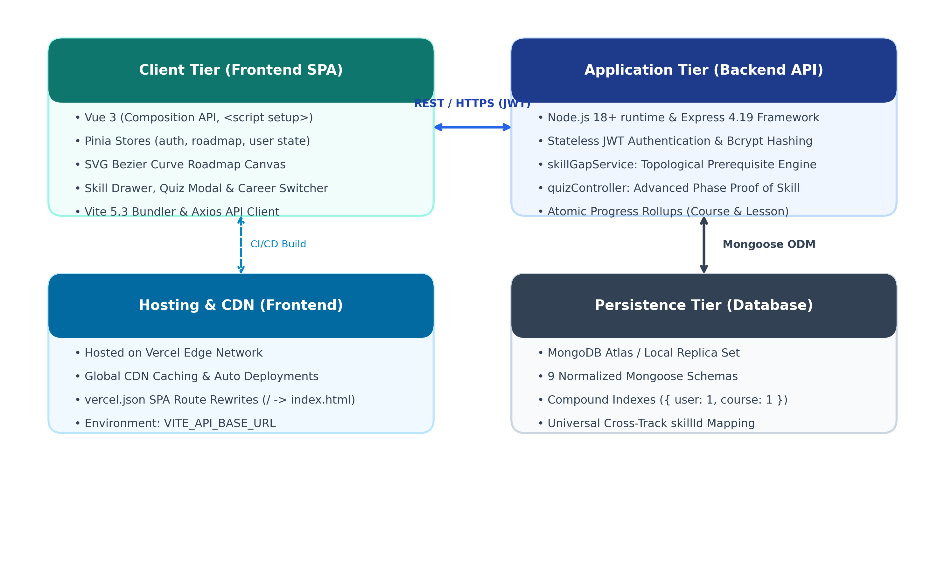
TECHNICAL ARCHITECTURE
Three-Tier Decoupled System Architecture
Architectural Tier Decomposition
• 1. Presentation Tier (Frontend):
Vue 3 Composition API with Vite bundler. Pinia centralized state stores (auth, roadmap, user). Dynamic SVG canvas computing Bézier connector paths.
• 2. Application Tier (Backend API):
Node.js 18+ runtime with Express 4.19 framework. Stateless JWT authentication, bcrypt password hashing, topological graph engine (skillGapService.js).
• 3. Persistence Tier (Database):
MongoDB Atlas managed via Mongoose 8.5 ODM. 9 normalized collections with compound uniqueness indexes guaranteeing idempotency.
• Communication Protocol:
Secure RESTful APIs over HTTPS with JSON payloads and Bearer token authorization.
Career Graph — Project Presentation | Group No. 06 | Department of Computer Engineering / IT

Slide 6
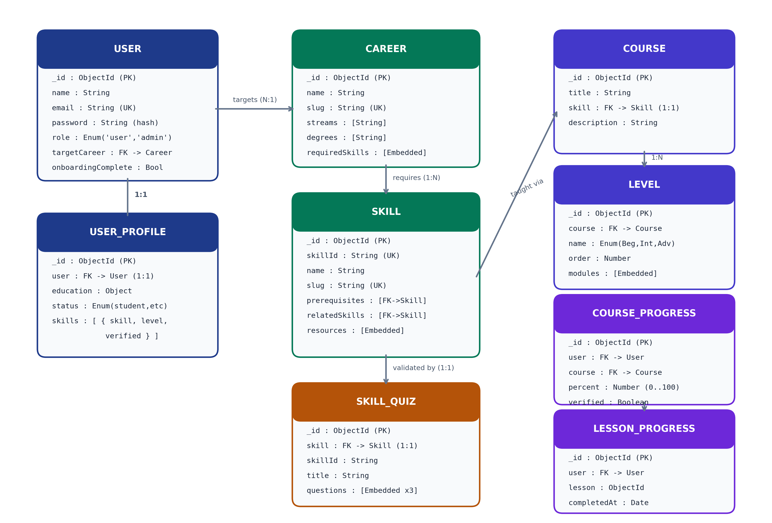
PERSISTENCE & DATA MODEL
Database Schema & Entity-Relationship Modeling
Key Data Entities & Relationships
• User & UserProfile (1:1):
Stores identity, bcrypt password hash, academic stream/degree, and declared baseline ratings.
• Career & Skill (1:N embedded):
Defines career tracks with required skills categorized into Foundations, Core, and Advanced phases.
• Course & Levels (1:1 & 1:N):
Course connects to Skill; divided into Beginner, Intermediate, Advanced levels with embedded modules and lessons.
• CourseProgress & LessonProgress:
Atomic completion logs with compound unique indexes ({ user: 1, course: 1 } and { user: 1, lesson: 1 }).
• SkillQuiz (1:1 with Skill):
Contains validation multiple-choice questions with server-side answer keys.
Career Graph — Project Presentation | Group No. 06 | Department of Computer Engineering / IT

Slide 7
ALGORITHMIC WORKFLOW
Core Logic 1: Topological Prerequisite Engine
Phase 1: Foundations
ESSENTIAL PREREQUISITES
• Unconditionally UNLOCKED by default.
• Core tools: HTML, CSS, JavaScript, Git (for Full Stack); Linux, Git, Networking (for DevOps).
• Establishes baseline engineering fundamentals.
Phase 2: Core Stack
MAIN DEVELOPMENT TOOLS
• STRICTLY LOCKED until all Phase 1 skills are completed.
• Tools: Vue.js, Node.js, Express, MongoDB.
• Prevents jumping into backend/full-stack frameworks prematurely.
Phase 3: Advanced & Ecosystem
PRODUCTION & CLOUD ARCHITECTURE
• STRICTLY LOCKED until all Phase 2 skills are completed.
• Tools: Docker, AWS Cloud, Kubernetes, Microservices.
• Ensures students master coding before cloud deployments.
Node-Level Dependency Checking & Next-Skill Recommendation:
Even inside an unlocked phase, individual nodes verify specific prerequisite ObjectIds (e.g. JavaScript requires HTML and CSS). The engine traverses nodes in topological order to automatically flag the next 'recommended' skill for the learner.
Career Graph — Project Presentation | Group No. 06 | Department of Computer Engineering / IT

Slide 8
VALIDATION & ASSESSMENT
Core Logic 2: Proof-of-Skill Validation Engine
Step 1: Advanced Phase Gating
Access to the quiz is locked on day one.
A student MUST reach the Advanced phase (by completing all Beginner and Intermediate lessons, or having declared baseline level >= 3) before the quiz unlocks.
Step 2: Client Payload Sanitization
When questions are fetched by the browser, the server explicitly strips 'correctIndex' and 'explanation' fields.
Students cannot inspect the answer keys via browser DevTools or Network tabs.
Step 3: Server-Side Grading & Verification
Answers are graded strictly on the backend API.
Passing threshold: At least 2 out of 3 correct answers (>= 66.7%). On pass: awards Verified Badge (🛡️) and sets 100% course completion.
Result of Successful Verification:
Passing the quiz automatically elevates the user's skill rating to Level 4 (Expert), issues the Verified Badge on the roadmap, and atomically marks all lessons in the course curriculum as completed.
Career Graph — Project Presentation | Group No. 06 | Department of Computer Engineering / IT

Slide 9
CORE INNOVATION
Universal Cross-Track Skill Propagation
Scenario: Student Learning in Track A
1. Student enrolls in Full Stack Developer track.
2. Completes foundational skills: Git (100%) and Python (100%).
3. Takes the Proof-of-Skill validation quiz and earns the Verified Badge.
4. Progress is saved with universal identifiers ('skill-git', 'skill-python').
Outcome: Student Switches to Track B
1. Student switches career track to DevOps Engineer or AI/ML Engineer.
2. The system checks universal skill keys across collections.
3. Git and Python are IMMEDIATELY recognized as 100% complete and verified!
4. Student does not waste time re-doing completed competencies.
Why This Solves Real-World Engineering Education:
In traditional platforms, learning is siloed inside single courses. In Career Graph, student progress is modeled around the developer, not isolated silos. Foundational skills are portable across any software engineering pathway.
Career Graph — Project Presentation | Group No. 06 | Department of Computer Engineering / IT

Slide 10
USER EXPERIENCE & FRONTEND
Interactive UI Features & Canvas Engine
1. Dynamic SVG Bézier Canvas
Organized into 3 phase columns. Calculates cubic Bézier curves connecting prerequisite nodes to dependents in real time with directional arrows. Full pan/drag and 50%–150% zoom HUD.
2. Single-Click Status Toggling
Students can click directly on any node status badge to cycle through Not Started ➔ In Progress ➔ Completed in 1 second. Includes a right-click context menu for direct jumps.
3. Slide-Out Topic Preview Drawer
Clicking any node slides open an in-canvas preview drawer without leaving the roadmap. Displays 'Why It Matters', curated documentation, video tutorials, and interactive lesson checklists.
4. In-Place Career Switcher Modal
Allows switching target career tracks instantly with real-time stream (CS, IT, AI/DS) and degree (B.Tech, BCA, B.Sc) filtering while preserving completed progress.
Career Graph — Project Presentation | Group No. 06 | Department of Computer Engineering / IT

Slide 11
QUALITY ASSURANCE & RESULTS
System Testing & Functional Validation
Test ID | Test Scenario | Expected System Behavior | Result
TC-01 | User Auth & Bcrypt Security | Password hashed with 10 salt rounds; stateless JWT issued on login | PASS
TC-02 | Onboarding Gap Calculation | Baseline self-ratings properly map to completed / in-progress states | PASS
TC-03 | Topological Prerequisite Lock | Phase 2 & Phase 3 remain locked until preceding phase skills complete | PASS
TC-04 | 1-Click Canvas Status Toggle | Node badge toggle triggers optimistic UI and atomic database rollup | PASS
TC-05 | Quiz Payload Sanitization | correctIndex and explanation stripped from GET requests in DevTools | PASS
TC-06 | Server-Side Quiz Verification | Score >= 2/3 awards Verified Badge & elevates user skill profile | PASS
TC-07 | Universal Cross-Track Credit | Completed skills in Full Stack reflect automatically in DevOps track | PASS
Career Graph — Project Presentation | Group No. 06 | Department of Computer Engineering / IT

Slide 12
DEPLOYMENT & INFRASTRUCTURE
Production Deployment & Operational Architecture
Frontend: Vercel Edge Network
SINGLE PAGE APPLICATION (SPA)
• Framework: Vue 3 (Composition API, <script setup>), Vite 5.3.
• Deployment: Hosted on Vercel Global Edge CDN.
• SPA Routing: vercel.json catch-all rewrite rule (/(.*) -> /) prevents 404s on browser refresh.
• Environment: VITE_API_BASE_URL pointing to live backend API.
Backend: Render Web Service
RESTFUL API & GRAPH ENGINE
• Runtime: Node.js 18+ & Express 4.19 Framework.
• Deployment: Deployed on Render Web Service with continuous integration.
• Auto-Deploy: Triggers automatically on git push to main branch.
• Security: CORS whitelisting, stateless JWT authorization.
Database: MongoDB Atlas
MANAGED CLOUD REPLICA SET
• Clustering: Managed MongoDB Atlas cloud cluster.
• Schema ODM: Mongoose 8.5 with strict normalization & indexes.
• Reliability: Automated daily snapshots, IP access whitelisting, and connection pooling.
Career Graph — Project Presentation | Group No. 06 | Department of Computer Engineering / IT

Slide 13
CONCLUSION & NEXT STEPS
Conclusion & Future Enhancements
Key Project Outcomes
✓ Delivered a fully responsive, interactive IT career guidance platform.
✓ Solved the problem of skipping core prerequisites via topological gating.
✓ Universal skill credit eliminates redundant learning across adjacent tracks.
✓ Server-graded Proof-of-Skill quizzes provide credible, verifiable competency.
✓ Production deployed on Vercel and Render with verified performance.
Future Roadmap Enhancements
• AI-Driven Adaptive Roadmaps: LLM hints & explanations based on quiz errors.
• In-Browser Code Sandboxes: WebAssembly coding playgrounds inside the topic drawer.
• Community Roadmap Creator: Allowing verified mentors to publish emerging tracks.
• Employer Talent Portal: Verified badge verification for recruiting pipelines.
THANK YOU! — OPEN FOR QUESTIONS & ANSWERS (Q&A)
Career Graph — Project Presentation | Group No. 06 | Department of Computer Engineering / IT

