Slide 1
NTHU Data Science for Digital Health Homework 2
Deadline: Nov. 24 23:59pm

Slide 2
Predicting Mortality of Pulmonary Embolism Patients in the ICU
Features Extraction

Slide 3
Introduction
Pulmonary embolism (PE) is a clot within the pulmonary arteries which prevents blood flow in the lungs, is the third most common cause of cardiovascular death worldwide after stroke and heart attack [1].
PE has a high mortality rate (In the United States, PE killed 300,000 people per year) [2].
ML methods can be used to stratify risk of PE patients -> identify low-risk patients and allow them to discharge from ICU early.
[1] Raskob GE et al. Thrombosis: a major contributor to global disease burden. (2014)
[2] Wendelboe AM et al. Global burden of thrombosis: epidemiologic aspects. (2016)

Slide 4
Introduction
In this way, we can reduce the resource burden of ICU and the unnecessary burden of ICU stay for patients.
In addition, to manage patients with critical PE more effectively and improve their survival rate, as well as their quality of lives [3].
What are the important predictors of mortality in patients with PE who are admitted to the ICU?
[3] Schulman S et al. Post-thrombotic syndrome, recurrence, and death 10 years after the first episode of venous thromboembolism treated with warfarin for 6 weeks or 6 months. (2006)

Slide 5
Cohort Selection
Inclusion
Exclusion
Patients in ICU with Pulmonary Embolism (PE)*
Age older than 18 in MIMIC-IV dataset
Only include the first ICU stay of the admission where the patient was diagnosed with PE.
*ICD-9 code: 415.1, ICD-10 code: I26

Slide 6
Outcome
Mortality (in-hospital) in the first ICU admission for the Pulmonary Embolism patient (patient diagnoses with PE within that hospital admission).

Slide 7
Features
1743
 |  | Missing Data | Outcome |  | P-value
 |  |  | Alive | Die
Number of Patients |  | 0 | 1465 | 278
Urine output (mean+std) |  | 63 | 1638.9 (1106.2) | 1136.9 (975.9) | <0.001
Vasopressin usage during ICU stay (number of patients) | 0 | 0 | 1393 | 181 | <0.001
vasopressin, n (%) | 1 |  | 72 | 97
Gender (number of patients) | Male | 0 | 744 | 132 | 0.345
vasopressin, n (%) | Female |  | 721 | 146
hemoglobin_min (mean+std) |  | 9 | 10.5 (2.3) | 9.6 (2.3) | <0.001
hemoglobin_max (mean+std) |  | 9 | 11.7 (2.2) | 11.0 (2.3) | <0.001
resp_rate_mean (mean+std) |  | 5 | 20.7 (4.1) | 22.2 (4.8) | <0.001
glucose_max (mean+std) |  | 10 | 160.5 (100.7) | 215.7 (153.4) | <0.001
heart_rate_max (mean+std) |  | 4 | 109.6 (16.9) | 115.8 (23.0) | <0.001
glucose_avg (mean+std) |  | 10 | 138.4 (53.1) | 171.3 (91.5) | <0.001
Age (mean+std) |  | 0 | 61.2 (17.0) | 67.2 (14.7) | <0.001
`physionet-data.mimiciv_derived.urine_output`
`physionet-data.mimiciv_derived.vasopressin`
`physionet-data.mimiciv_derived.icustay_detail`
`physionet-data.mimiciv_derived.complete_blood_count`
`physionet-data.mimiciv_derived.vitalsign`
`physionet-data.mimiciv_derived.icustay_detail`
Note: all feature values related to time would be taken from between 6 hours before patients admitted to the ICU to 24 hours after patients admitted to the ICU.

Slide 8

Additional Features (Optional)
Self-reported race, insurance
Congestive heart failure, diabetes, hypertension, history of MI, history of cancer
Vital sign at admission
Ventilation status
Lab values (max, min, avg): creatinine, hemoglobin, INR/PT/PTT, glucose, lactate
24 hr urine output
Pressor requirement
 | Missing Data | Outcome |  | P-value
 |  | Alive | Die
24 hr urine output | 62
Self-reported race | 0 | 154.30248580688041 | 107.41926812348254
insurance
Congestive heart failure
Diabetes
Hypertension
History of MI
History of cancer
Vital sign at admission
Creatinine_max
Hemoglobin_max
INR/PT/PTT max
Lactate_max
24 hr urine output | 62
Pressor requirement

Slide 9
Todo
Extract features in slide 7 (8 optional)
Preprocess the data
e.g.: dealing with the outlier, imputed the missing data.
Do exploratory data analysis (EDA)
e.g.: T-SNE, PCA, histogram, pairplot, heatmaps, etc.

Slide 10
Assignment: A report
Key inclusions in your report:
Table 1: give "Table 1" on Page 7
Data Preprocessing Description: include data preprocessing steps undertaken
Effective Feature Representation: give figures of features.
Preprocessing Impact: include representative examples that illustrate the impact of data preprocessing. These examples should clearly demonstrate the differences observed before and after the preprocessing phase.
Feature Relevance Analysis: Based on "Table 1" and the results of EDA, the report should assess whether there are features correlated with the mortality of PE patients. The methodology used to determine these highly related features should be explained.
Attach your reproducible code

Slide 11
urine output
SELECT patient.label, AVG(urine.urineoutput) FROM `ds-for-digital-health.hw2_cohort.cohort` AS patient
INNER JOIN `physionet-data.mimiciv_derived.urine_output` AS urine ON patient.stay_id = urine.stay_id
GROUP BY patient.label

Slide 12
24 hr urine output
with urineoutput as (SELECT patient.subject_id, SUM(urine.urineoutput) as total FROM `ds-for-digital-health.hw2_cohort.cohort` AS patient
LEFT JOIN `physionet-data.mimiciv_derived.urine_output` AS urine ON patient.stay_id = urine.stay_id
LEFT JOIN `physionet-data.mimiciv_derived.icustay_detail` AS icu ON icu.stay_id = patient.stay_id
WHERE urine.urineoutput IS NOT NULL
AND date_diff(urine.charttime, icu.icu_intime, hour) <= 24
GROUP BY patient.subject_id)
SELECT patient.label, AVG(urineoutput.total) FROM `ds-for-digital-health.hw2_cohort.cohort` AS patient
LEFT JOIN urineoutput ON urineoutput.subject_id = patient.subject_id
WHERE urineoutput.total IS NOT NULL
GROUP BY patient.label
-- SELECT COUNT(patient.subject_id) FROM `ds-for-digital-health.hw2_cohort.cohort` AS patient
-- LEFT JOIN urineoutput ON urineoutput.subject_id = patient.subject_id
-- WHERE urineoutput.total IS NOT NULL

Slide 13
Vasopressin
with vasopressin as (
SELECT patient.subject_id, COUNT(v.vaso_amount) AS cnt_vaso FROM `ds-for-digital-health.hw2_cohort.cohort` AS patient
LEFT JOIN `physionet-data.mimiciv_derived.vasopressin` AS v ON patient.stay_id = v.stay_id
GROUP BY patient.subject_id
-- ORDER BY patient.subject_id
)
SELECT patient.label, COUNT(patient.subject_id) FROM `ds-for-digital-health.hw2_cohort.cohort` AS patient
LEFT JOIN vasopressin ON vasopressin.subject_id = patient.subject_id
WHERE vasopressin.cnt_vaso != 0
GROUP BY patient.label
SELECT patient.label, count(patient.stay_id) FROM `ds-for-digital-health.hw2_cohort.cohort` AS patient
LEFT JOIN `physionet-data.mimiciv_derived.vasopressin` AS v ON v.stay_id = patient.stay_id
-- WHERE v.stay_id is null
GROUP BY patient.label

Slide 14
gender
SELECT patient.label, detail.gender, COUNT(patient.subject_id) FROM `ds-for-digital-health.hw2_cohort.cohort` AS patient
INNER JOIN `physionet-data.mimiciv_derived.icustay_detail` AS detail ON detail.stay_id = patient.stay_id
GROUP BY patient.label, detail.gender

Slide 15
hemoglobin
with hemoglobin as (
SELECT patient.subject_id, MAX(h.hemoglobin) as max_h, MIN(h.hemoglobin) as min_h FROM `ds-for-digital-health.hw2_cohort.cohort` AS patient
LEFT JOIN `physionet-data.mimiciv_derived.complete_blood_count` AS h ON patient.hadm_id = h.hadm_id
WHERE h.hemoglobin IS NOT NULL
GROUP BY patient.subject_id
-- ORDER BY patient.subject_id
)
-- SELECT COUNT(patient.subject_id) FROM `ds-for-digital-health.hw2_cohort.cohort` AS patient
-- LEFT JOIN hemoglobin ON hemoglobin.subject_id = patient.subject_id
-- WHERE hemoglobin.max_h IS NULL
SELECT patient.label, AVG(hemoglobin.max_h), AVG(hemoglobin.min_h) FROM `ds-for-digital-health.hw2_cohort.cohort` AS patient
LEFT JOIN hemoglobin ON hemoglobin.subject_id = patient.subject_id
WHERE hemoglobin.max_h IS NOT NULL
GROUP BY patient.label

Slide 16
resp rate
with vitalsign as (
SELECT patient.subject_id, AVG(v.resp_rate) as avg_resp, AVG(v.heart_rate) as avg_heart, MAX(v.glucose) as max_g, AVG(v.glucose) as avg_g FROM `ds-for-digital-health.hw2_cohort.cohort` AS patient
LEFT JOIN `physionet-data.mimiciv_derived.vitalsign` AS v ON patient.stay_id = v.stay_id
GROUP BY patient.subject_id
-- ORDER BY patient.subject_id
)
-- SELECT COUNT(patient.subject_id) FROM `ds-for-digital-health.hw2_cohort.cohort` AS patient
-- LEFT JOIN vitalsign ON vitalsign.subject_id = patient.subject_id
-- WHERE vitalsign.avg_g IS NOT NULL
SELECT patient.label, AVG(vitalsign.avg_resp) FROM `ds-for-digital-health.hw2_cohort.cohort` AS patient
LEFT JOIN vitalsign ON vitalsign.subject_id = patient.subject_id
WHERE vitalsign.avg_resp IS NOT NULL
GROUP BY patient.label

Slide 17
glucose
with vitalsign as (
SELECT patient.subject_id, AVG(v.resp_rate) as avg_resp, AVG(v.heart_rate) as avg_heart, MAX(v.glucose) as max_g, AVG(v.glucose) as avg_g FROM `ds-for-digital-health.hw2_cohort.cohort` AS patient
LEFT JOIN `physionet-data.mimiciv_derived.vitalsign` AS v ON patient.stay_id = v.stay_id
GROUP BY patient.subject_id
-- ORDER BY patient.subject_id
)
-- SELECT COUNT(patient.subject_id) FROM `ds-for-digital-health.hw2_cohort.cohort` AS patient
-- LEFT JOIN vitalsign ON vitalsign.subject_id = patient.subject_id
-- WHERE vitalsign.avg_g IS NOT NULL
SELECT patient.label, AVG(vitalsign.avg_g), AVG(vitalsign.max_g) FROM `ds-for-digital-health.hw2_cohort.cohort` AS patient
LEFT JOIN vitalsign ON vitalsign.subject_id = patient.subject_id
WHERE vitalsign.avg_g IS NOT NULL
GROUP BY patient.label
glucose_avg (mean+std) | 1238 | 143.1620695232 | 164.9718793999
WITH glucose AS (
SELECT patient.subject_id, avg(bg.glucose) as glucose_avg FROM `ds-for-digital-health.hw2_cohort.cohort` AS patient
LEFT JOIN `physionet-data.mimiciv_derived.bg` AS bg ON bg.hadm_id = patient.hadm_id
GROUP BY patient.subject_id
)
-- SELECT patient.label, AVG(glucose.glucose_avg) FROM glucose
-- JOIN `ds-for-digital-health.hw2_cohort.cohort` AS patient ON patient.subject_id = glucose.subject_id
-- WHERE glucose.glucose_avg is not null
-- GROUP BY patient.label
SELECT count(patient.subject_id) FROM glucose
JOIN `ds-for-digital-health.hw2_cohort.cohort` AS patient ON patient.subject_id = glucose.subject_id
WHERE glucose.glucose_avg is null

Slide 18
Heart rate
with vitalsign as (
SELECT patient.subject_id, AVG(v.resp_rate) as avg_resp, AVG(v.heart_rate) as avg_heart, MAX(v.glucose) as max_g, AVG(v.glucose) as avg_g FROM `ds-for-digital-health.hw2_cohort.cohort` AS patient
LEFT JOIN `physionet-data.mimiciv_derived.vitalsign` AS v ON patient.stay_id = v.stay_id
GROUP BY patient.subject_id
-- ORDER BY patient.subject_id
)
-- SELECT COUNT(patient.subject_id) FROM `ds-for-digital-health.hw2_cohort.cohort` AS patient
-- LEFT JOIN vitalsign ON vitalsign.subject_id = patient.subject_id
-- WHERE vitalsign.avg_g IS NOT NULL
SELECT patient.label, AVG(vitalsign.avg_heart) FROM `ds-for-digital-health.hw2_cohort.cohort` AS patient
LEFT JOIN vitalsign ON vitalsign.subject_id = patient.subject_id
WHERE vitalsign.avg_heart IS NOT NULL
GROUP BY patient.label

Slide 19
age
SELECT patient.label, AVG(detail.admission_age) FROM `ds-for-digital-health.hw2_cohort.cohort` AS patient
INNER JOIN `physionet-data.mimiciv_derived.icustay_detail` AS detail ON detail.stay_id = patient.stay_id
GROUP BY patient.label

Slide 20
Inr, rt, rtt
with coagulation as (
SELECT patient.subject_id,
AVG(c.inr) as avg_inr, MAX(c.inr) as max_inr, MIN(c.inr) as min_inr,
AVG(c.pt) as avg_pt, MAX(c.pt) as max_pt, MIN(c.pt) as min_pt,
AVG(c.ptt) as avg_ptt, MAX(c.ptt) as max_ptt, MIN(c.ptt) as min_ptt,
FROM `ds-for-digital-health.hw2_cohort.cohort` AS patient
LEFT JOIN `physionet-data.mimiciv_derived.coagulation` AS c ON patient.hadm_id = c.hadm_id
GROUP BY patient.subject_id
)
-- SELECT COUNT(patient.subject_id) FROM `ds-for-digital-health.hw2_cohort.cohort` AS patient
-- LEFT JOIN coagulation ON coagulation.subject_id = patient.subject_id
-- WHERE coagulation.avg_ptt IS NULL
SELECT patient.label,
AVG(coagulation.avg_inr) as avg_inr, AVG(coagulation.max_inr) as max_inr, AVG(coagulation.min_inr) as min_inr,
AVG(coagulation.avg_pt) as avg_pt, AVG(coagulation.max_pt) as max_pt, AVG(coagulation.min_pt) as min_pt,
AVG(coagulation.avg_ptt) as avg_ptt, AVG(coagulation.max_ptt) as min_ptt, AVG(coagulation.min_ptt) as min_ptt,
FROM `ds-for-digital-health.hw2_cohort.cohort` AS patient
LEFT JOIN coagulation ON coagulation.subject_id = patient.subject_id
GROUP BY patient.label

Slide 21
Ventilation state
-- SELECT stay_id, ventilation_status FROM `physionet-data.mimiciv_derived.ventilation`
-- ORDER BY stay_id
SELECT DISTINCT ventilation_status FROM `physionet-data.mimiciv_derived.ventilation`

Slide 22
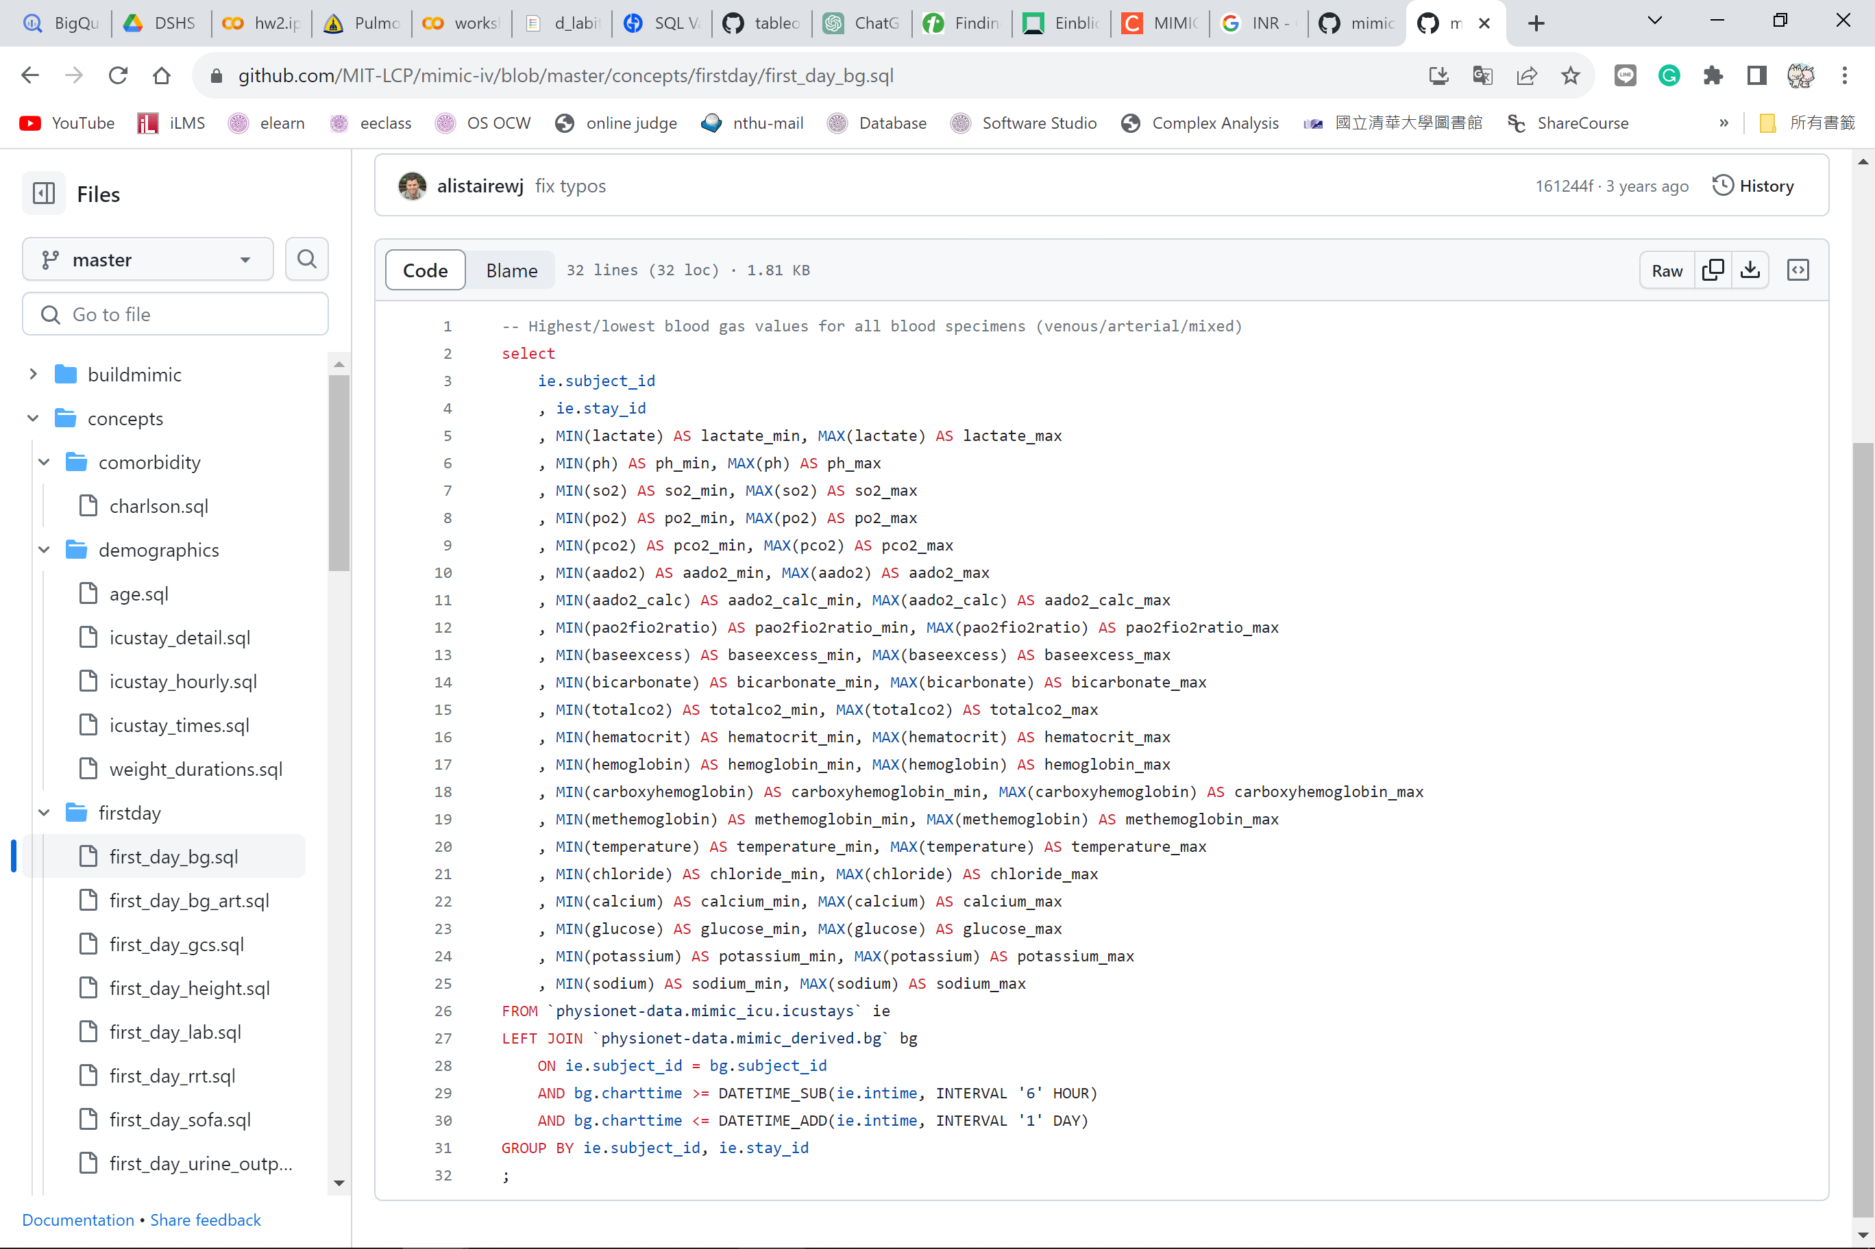

Slide 23
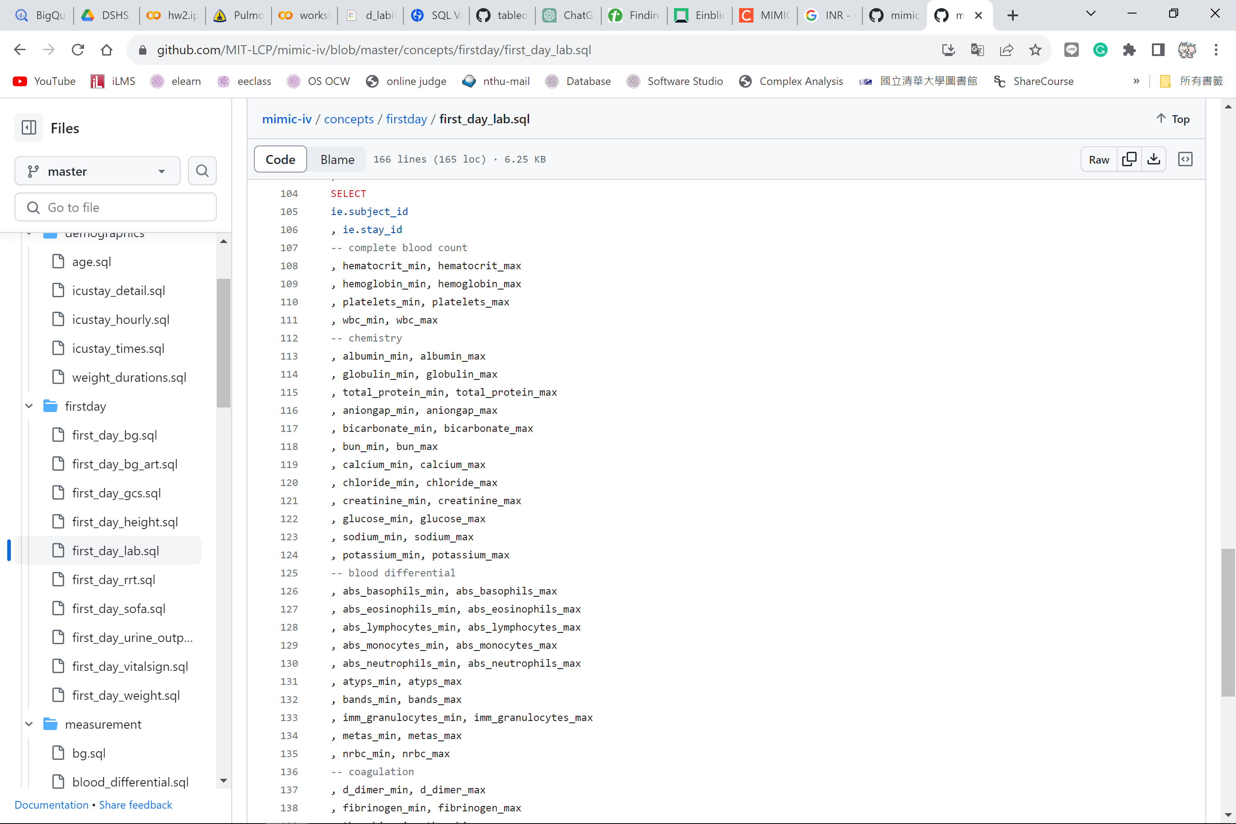

Slide 24
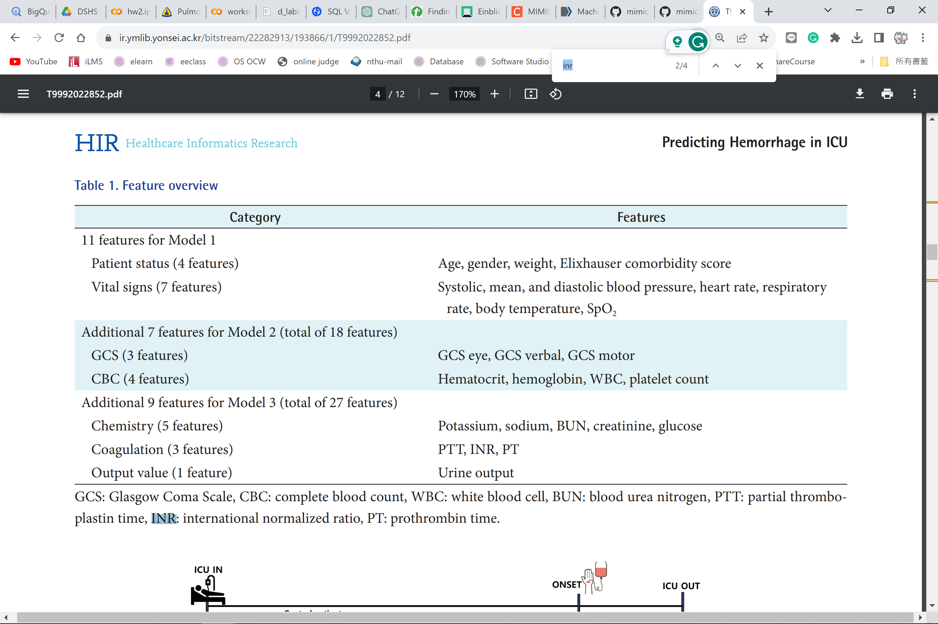

Slide 25
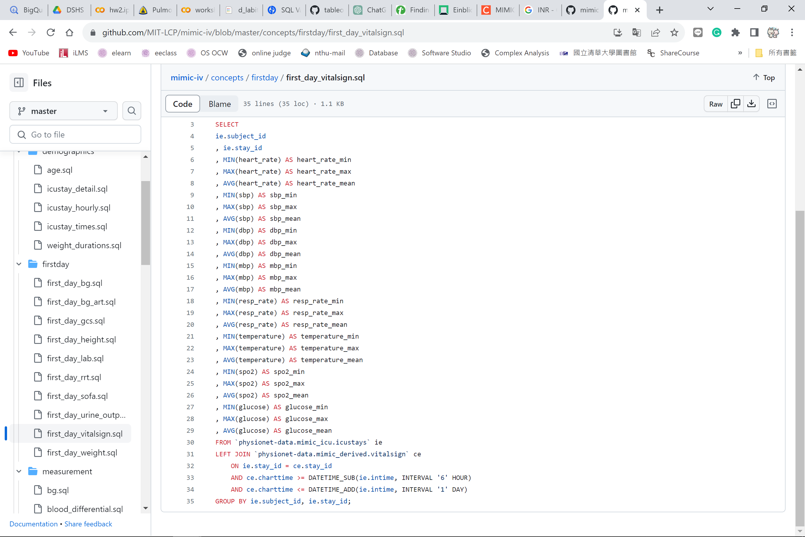

Slide 26
