Slide 1
NTHU Data Science for Digital Health Homework 3
Deadline: Jan. 5 23:59pm

Slide 2
Predicting Mortality of Pulmonary Embolism Patients in the ICU
Model Development

Slide 3
Introduction
Pulmonary embolism (PE) is a clot within the pulmonary arteries which prevents blood flow in the lungs, is the third most common cause of cardiovascular death worldwide after stroke and heart attack [1].
PE has a high mortality rate (In the United States, PE killed 300,000 people per year) [2].
ML methods can be used to stratify risk of PE patients -> identify low-risk patients and allow them to discharge from ICU early.
[1] Raskob GE et al. Thrombosis: a major contributor to global disease burden. (2014)
[2] Wendelboe AM et al. Global burden of thrombosis: epidemiologic aspects. (2016)

Slide 4
Introduction
In this way, we can reduce the resource burden of ICU and the unnecessary burden of ICU stay for patients.
In addition, to manage patients with critical PE more effectively and improve their survival rate, as well as their quality of lives [3].
What are the important predictors of mortality in patients with PE who are admitted to the ICU?
[3] Schulman S et al. Post-thrombotic syndrome, recurrence, and death 10 years after the first episode of venous thromboembolism treated with warfarin for 6 weeks or 6 months. (2006)

Slide 5
Cohort Selection
Inclusion
Exclusion
Patients in ICU with Pulmonary Embolism (PE)*
Age older than 18 in MIMIC-IV dataset
Only include the first ICU stay of the admission where the patient was diagnosed with PE.
*ICD-9 code: 415.1, ICD-10 code: I26

Slide 6
Outcome
Mortality (in-hospital) in the first ICU admission for the Pulmonary Embolism patient (patient diagnoses with PE within that hospital admission).

Slide 7
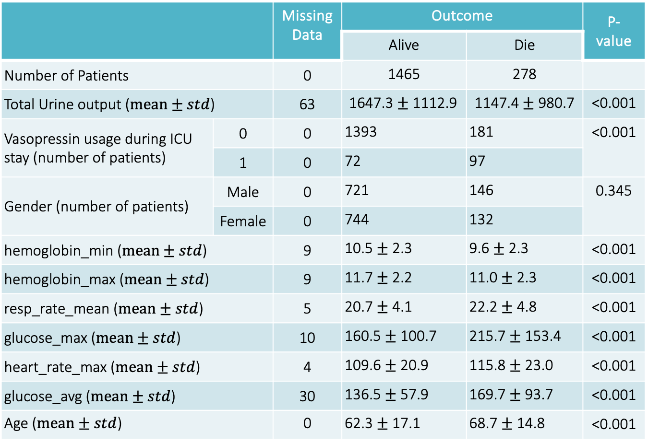
Features (before from assignment 2)
 |  | Missing Data | Outcome |  | P-value
 |  |  | Alive | Die
Number of Patients |  | 0 | 1465 | 278
Total Urine output ($mean±std$) |  | 63 | 1647.3 $±$ 1112.9 | 1147.4 $±$ 980.7 | <0.001
Vasopressin usage during ICU stay (number of patients) | 0 | 0 | 1393 | 181 | <0.001
vasopressin, n (%) | 1 | 0 | 72 | 97
Gender (number of patients) | Male | 0 | 721 | 146 | 0.345
vasopressin, n (%) | Female | 0 | 744 | 132
hemoglobin_min ($mean±std$) |  | 9 | 10.5 $±$ 2.3 | 9.6 $±$ 2.3 | <0.001
hemoglobin_max ($mean±std$) |  | 9 | 11.7 $±$ 2.2 | 11.0 $±$ 2.3 | <0.001
resp_rate_mean ($mean±std$) |  | 5 | 20.7 $±$ 4.1 | 22.2 $±$ 4.8 | <0.001
glucose_max ($mean±std$) |  | 10 | 160.5 $±$ 100.7 | 215.7 $±$ 153.4 | <0.001
heart_rate_max ($mean±std$) |  | 4 | 109.6 $±$ 20.9 | 115.8 $±$ 23.0 | <0.001
glucose_avg ($mean±std$) |  | 30 | 136.5 $±$ 57.9 | 169.7 $±$ 93.7 | <0.001
Age ($mean±std$) |  | 0 | 62.3 $±$ 17.1 | 68.7 $±$ 14.8 | <0.001

Slide 8
Todo
Build machine learning models for mortality prediction
Model evaluation

Slide 9
Assignment
Code (50%):
can reproduce your results and figures in the report. (25%)
achieve averaged AUC above 0.68 via 5-fold cross-validation (25%)
Key inclusions in your report (50%)
Data pre-processing (5%)
e.g.: normalization
Details of model setup (10%)
e.g.: classifier, hyperparameter tuning
Tables or plots for performance evaluation metrics (10%)
e.g.: AUC, F1-score, specificity, sensitivity, accuracy, etc…
ROC curve (4%), confusion matrix (3%), calibration plot (3%)
Feature importance (5%)
Fairness analysis (report AUC scores in different race groups) (10%)

