Slide 1
NEW YORK TIMES SUMMARIZER
A Data Visualization Project using Topic Modeling on New York Times comments on presidential candidates
Peggy Fan

Slide 2
Motivation
Analyzing large number of text
Discover topics and associate text with a topic
Good for discussion- topic detection and tracking

Slide 3
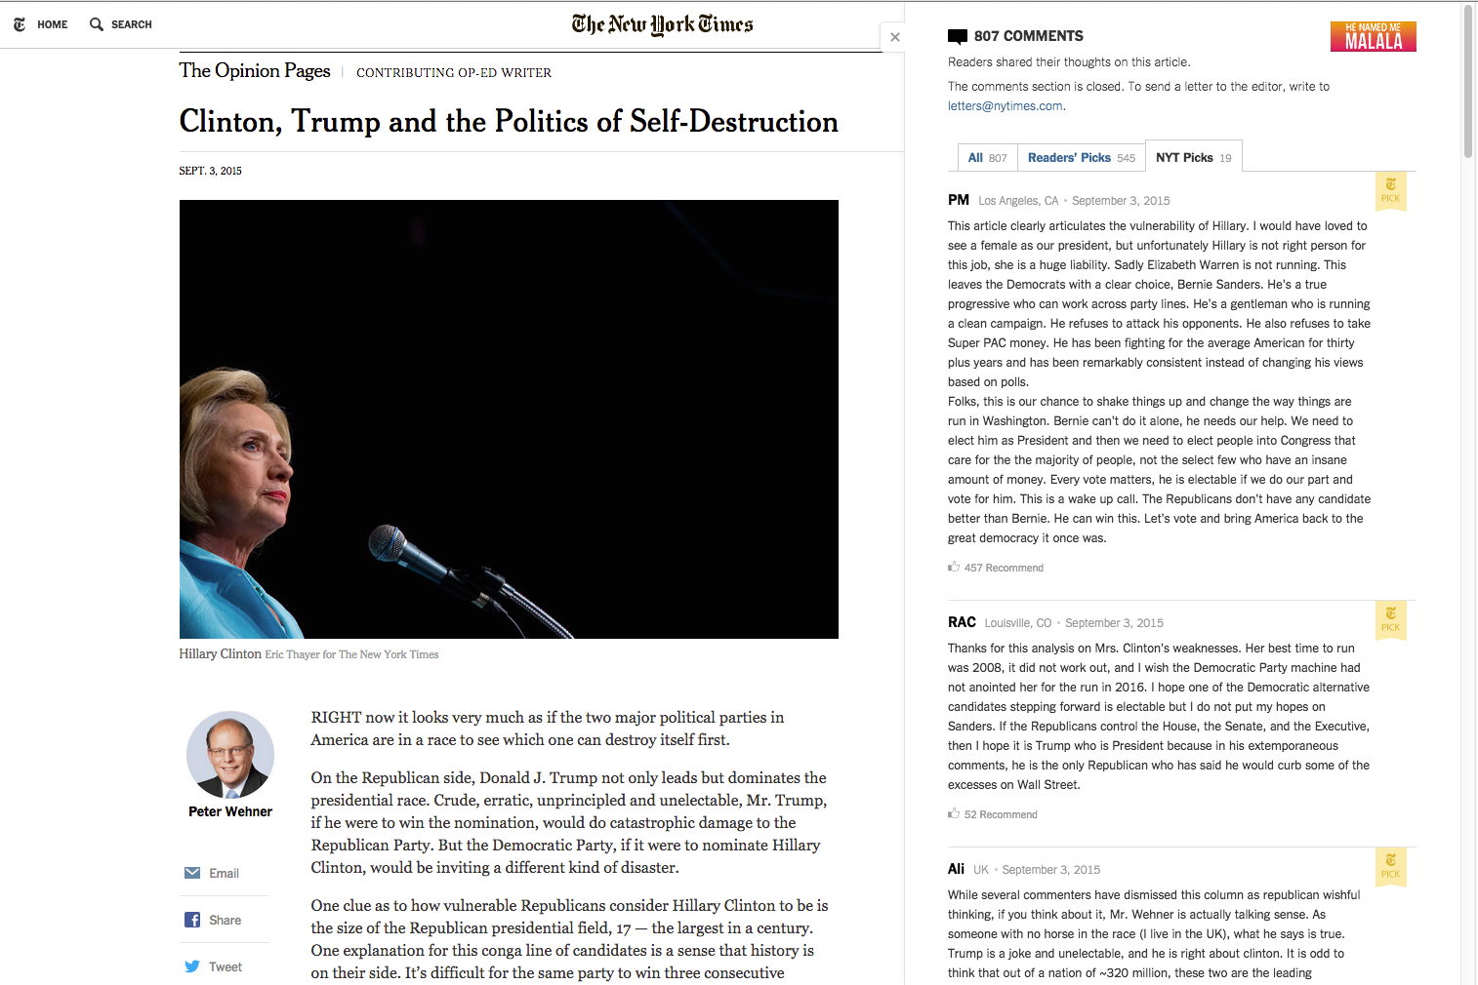

Slide 4
Objective
Build visualization that find out what are being discussed about candidates and how users feel about them.

Slide 5
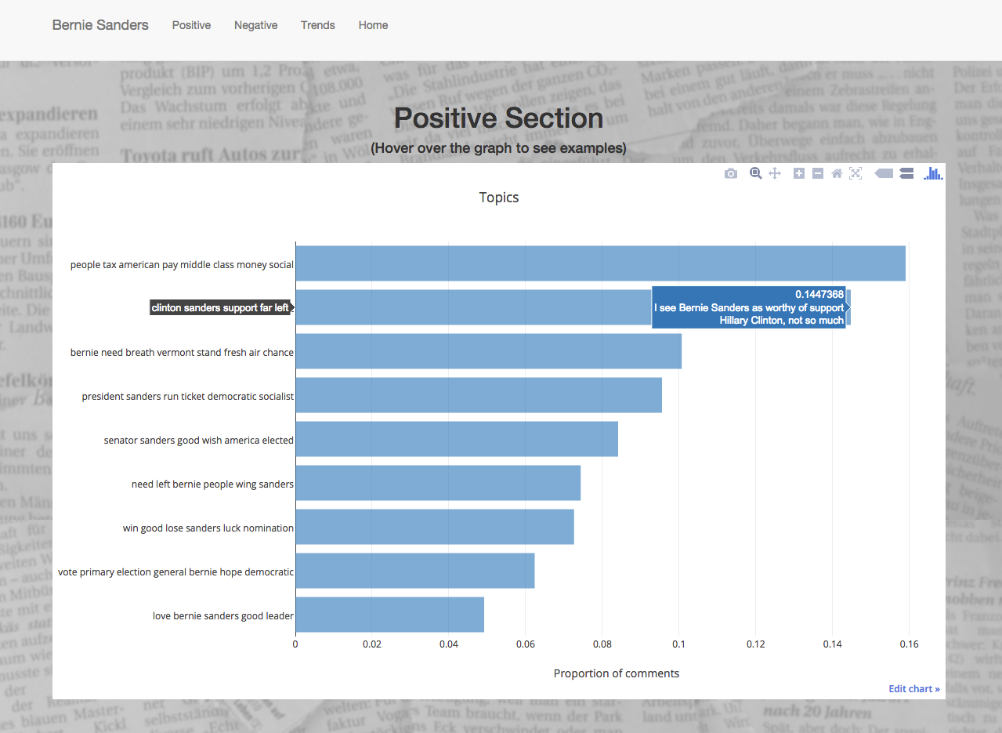
Postive Sentiment

Slide 6
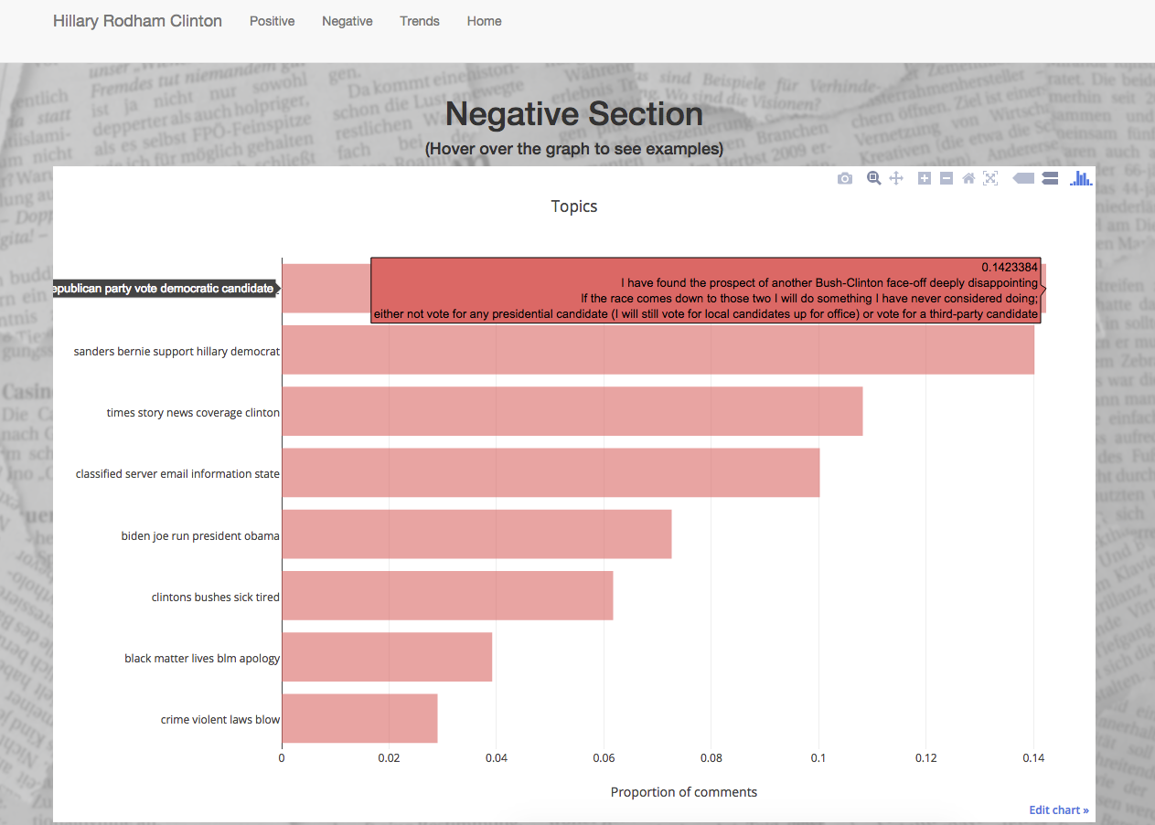
Negative sentiment

Slide 7
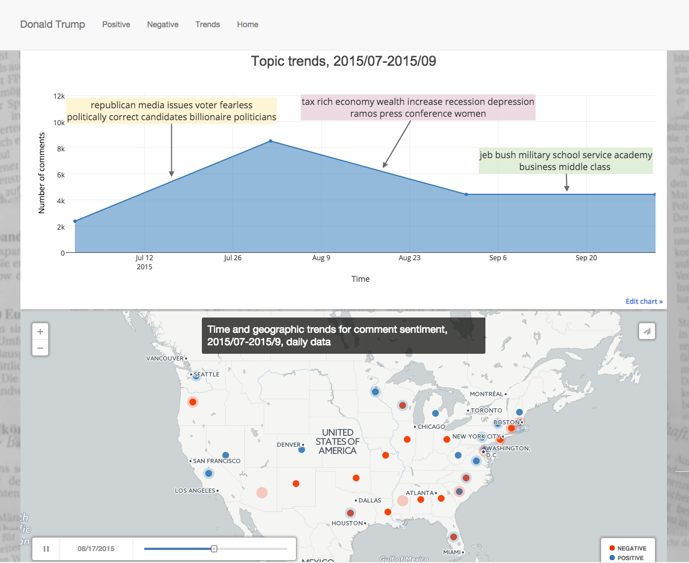
Trends

Slide 8
Data pipeline

