Slide 1

NEW YORK TIMES COMMENTS SUMMARIZER
http://nytsummarizer.us
A Data Visualization Project using Topic Modeling on New York Times comments on presidential candidates

Slide 2


Slide 3
Motivation
Discover topics and key examples from a large corpus
Monitor discussions with topic detection
Objective
Build visualization that captures sentiments and content in the discussions of the candidates

Slide 4
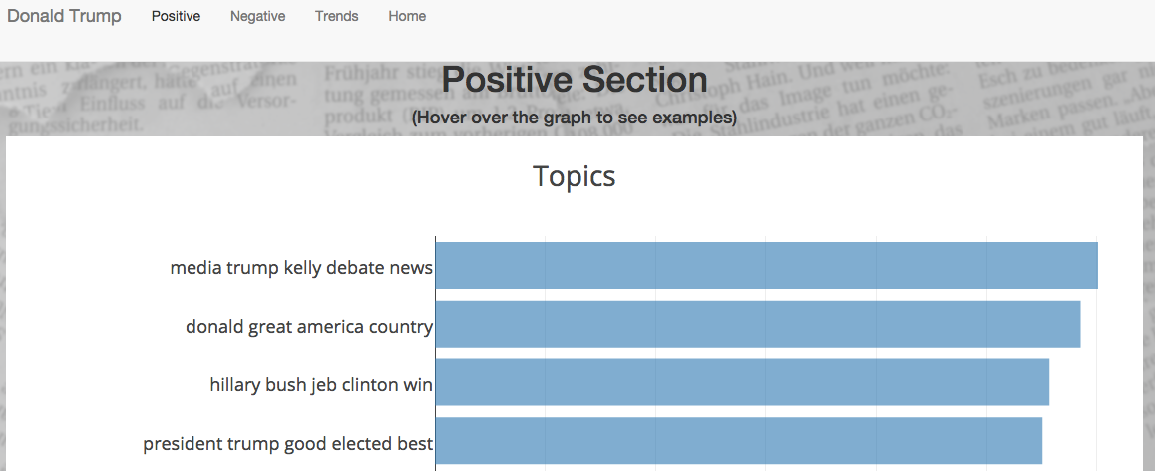
Sentiment

Slide 5
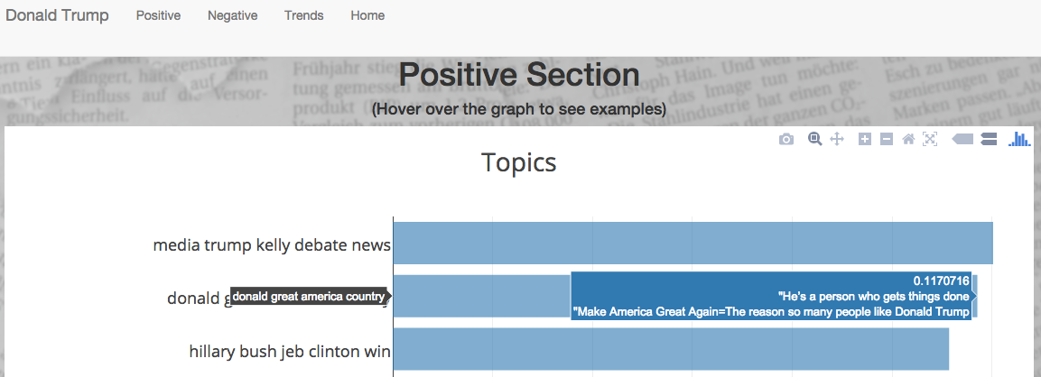
Sentiment
“He’s a person who gets things done …”

Slide 6
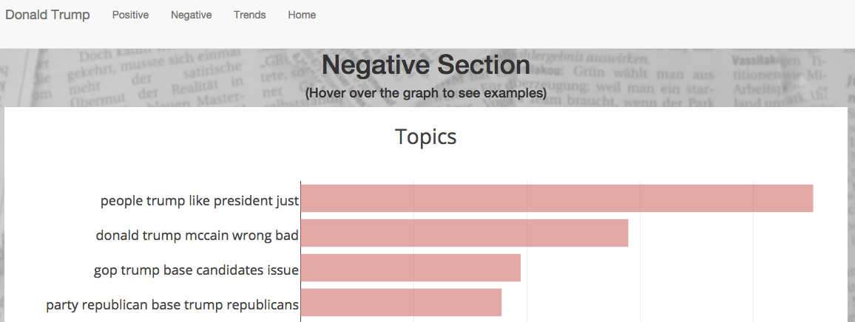
Sentiment

Slide 7
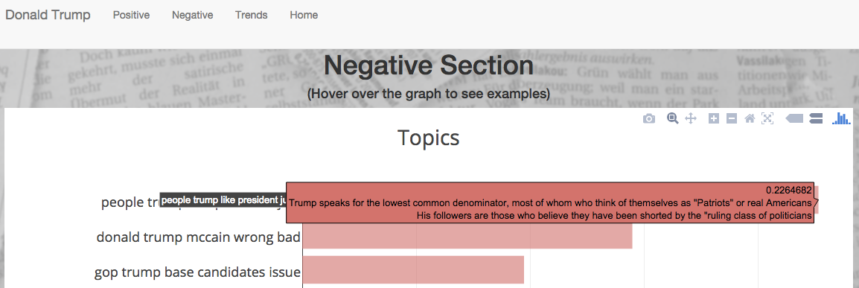
Sentiment
“Trump speaks for the lowest common
denominator…”

Slide 8
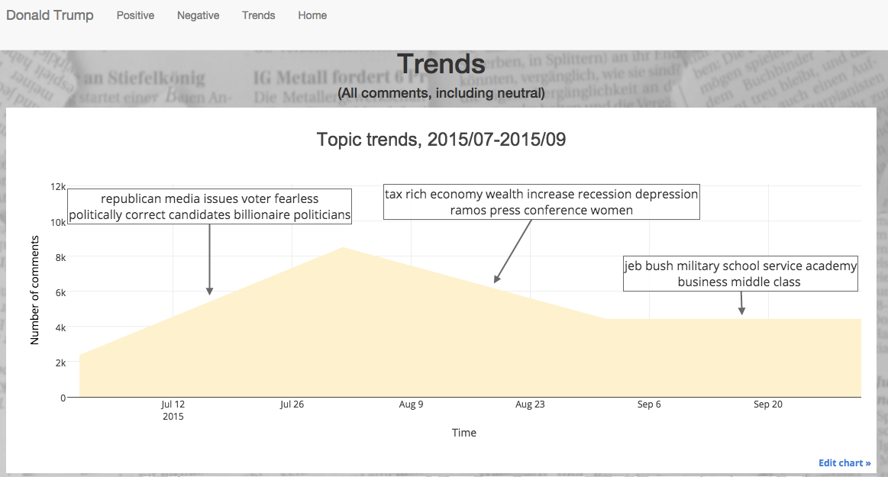

Slide 9
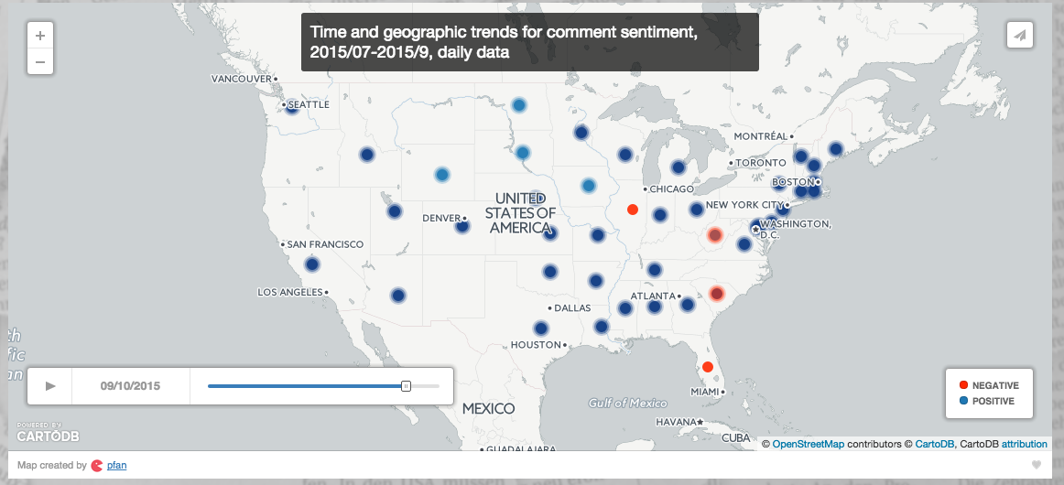

Slide 10

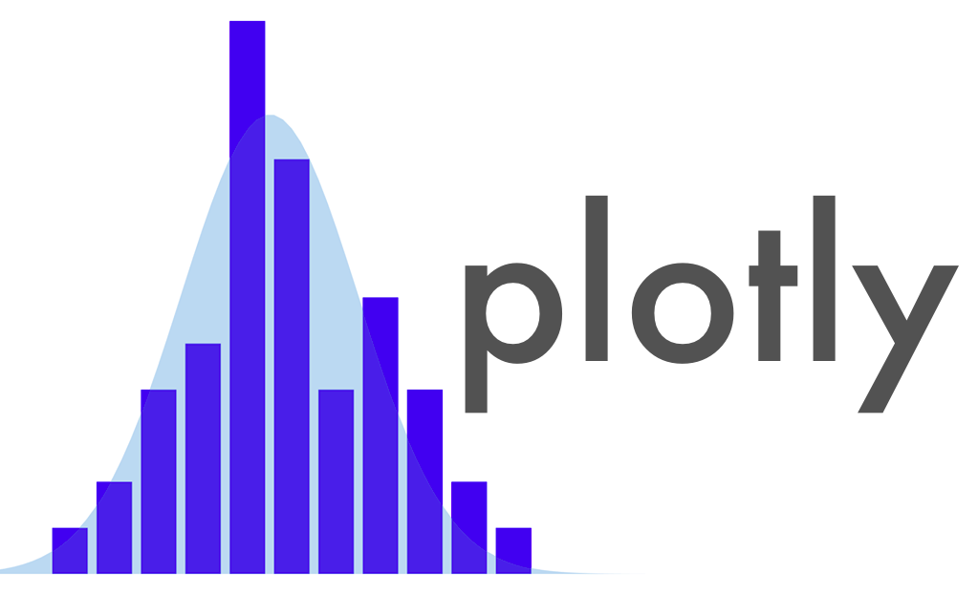


Data pipeline
New York Times Articles API
New York Times Community API
Exploratory analyses
Topic modeling (NMF)
Trends
Topics

Slide 11
Results
Topics in recent news detected.
Identify representative comment that captures each topic’s idea.
Notes:
Not a good dataset for (comment-to-candidate) classification problem: signals (sentiment, relevancy) are muted, many comments covers multiple candidates

Slide 12
Future steps
Classify comments by candidates. Use features such as distinct topics or other semantic measures
Utilize both the comments and news cycles to predict popular topics
Notes:
More precise clustering that can be used for targeting. plotting the the comments on two axises representing two topics

Slide 13


Thank you!
nytsummarizer.us
www.linkedin/in/fanpeggy
www.github.com/PeggyFan

Slide 14
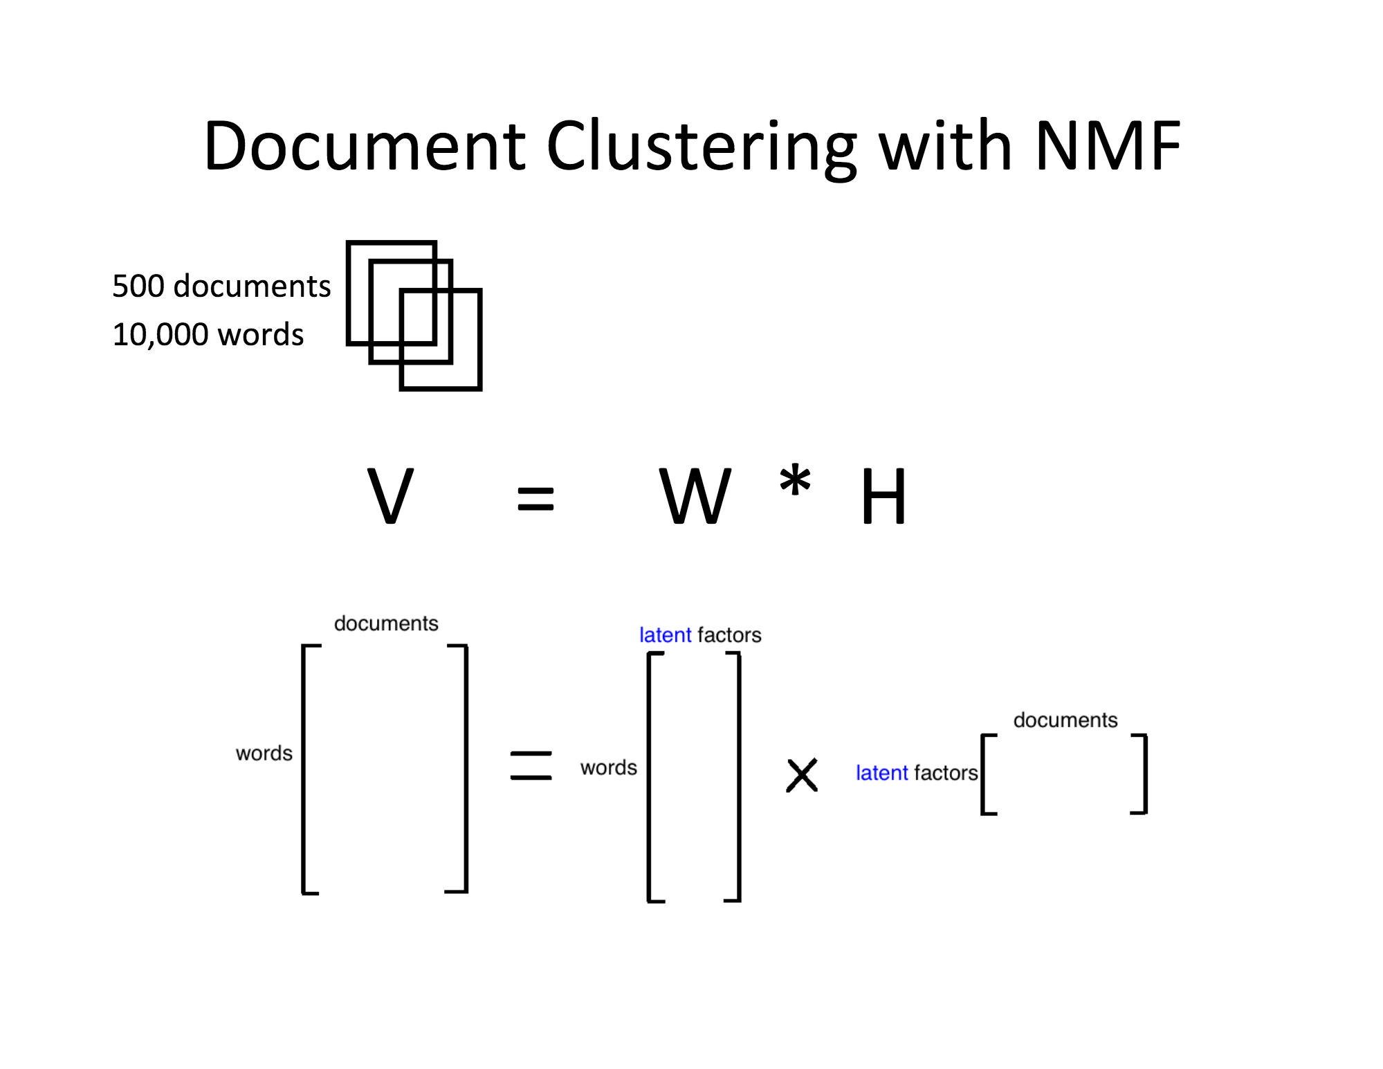
Appendices
Matrix factorization:
Dimensionality reduction
Latent properties
Linear combination of features

Slide 15
Appendices
How I picked number of topics
Using LDA:
Kullback-Leibler (KL) divergence is the difference between 2 distributions: actual distribution of P for the data and distribution Q for which compression scheme optimizes. A kind of entropy measure.
Perplexity: the log-likelihood of a held-out test set. The lower perplexity the better. Measure how well the word counts of the test documents are represented by the word distributions represented by the topics.
Using matrix factorization:
PCA - elbow at the scree plot to eyeball the optimal number of principal components

