Slide 1

NEW YORK TIMES COMMENTS SUMMARIZER
A Data Visualization Project using Topic Modeling on New York Times comments on presidential candidates
Peggy Fan

Slide 2
Motivation
Analyzing large number of texts
Discover topics and associate text with a topic
Potential tool for monitoring discussions: topic detection and tracking

Slide 3


Slide 4
Objective
Build visualization that find out what are being discussed about candidates and how users feel about them.

Slide 5
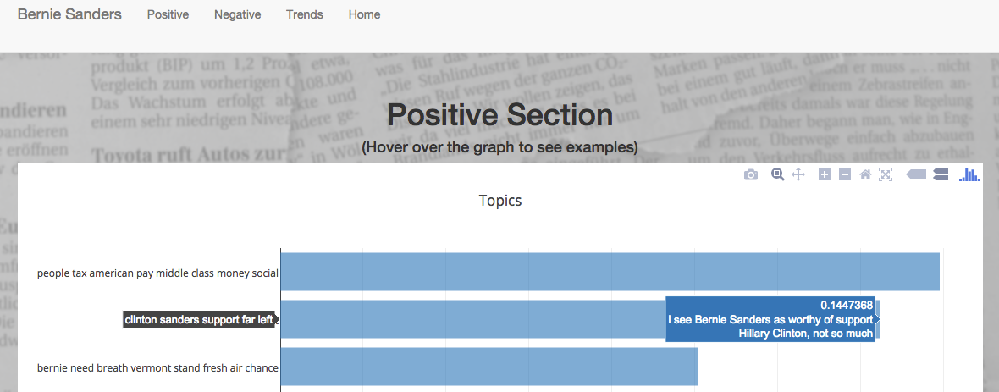
Postive Sentiment

Slide 6
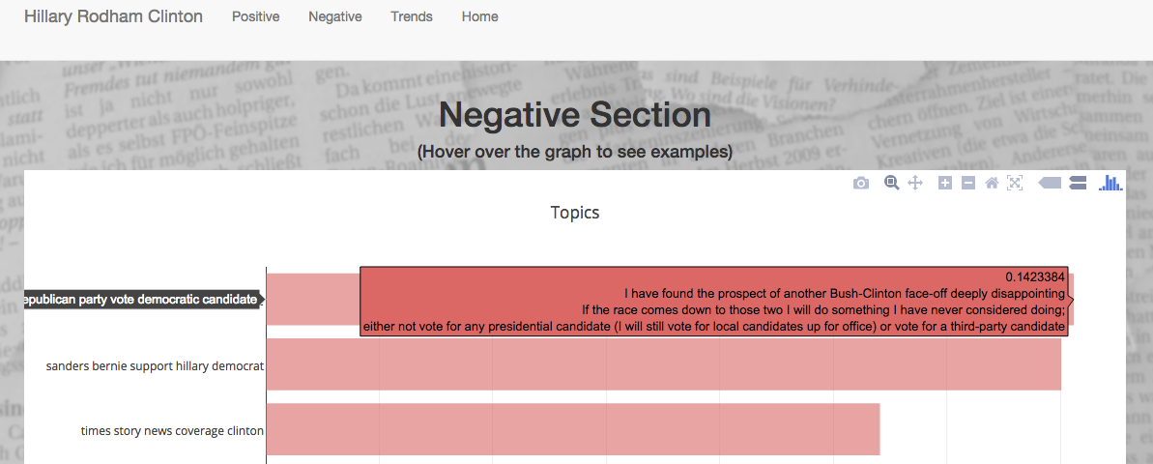
Negative sentiment

Slide 7
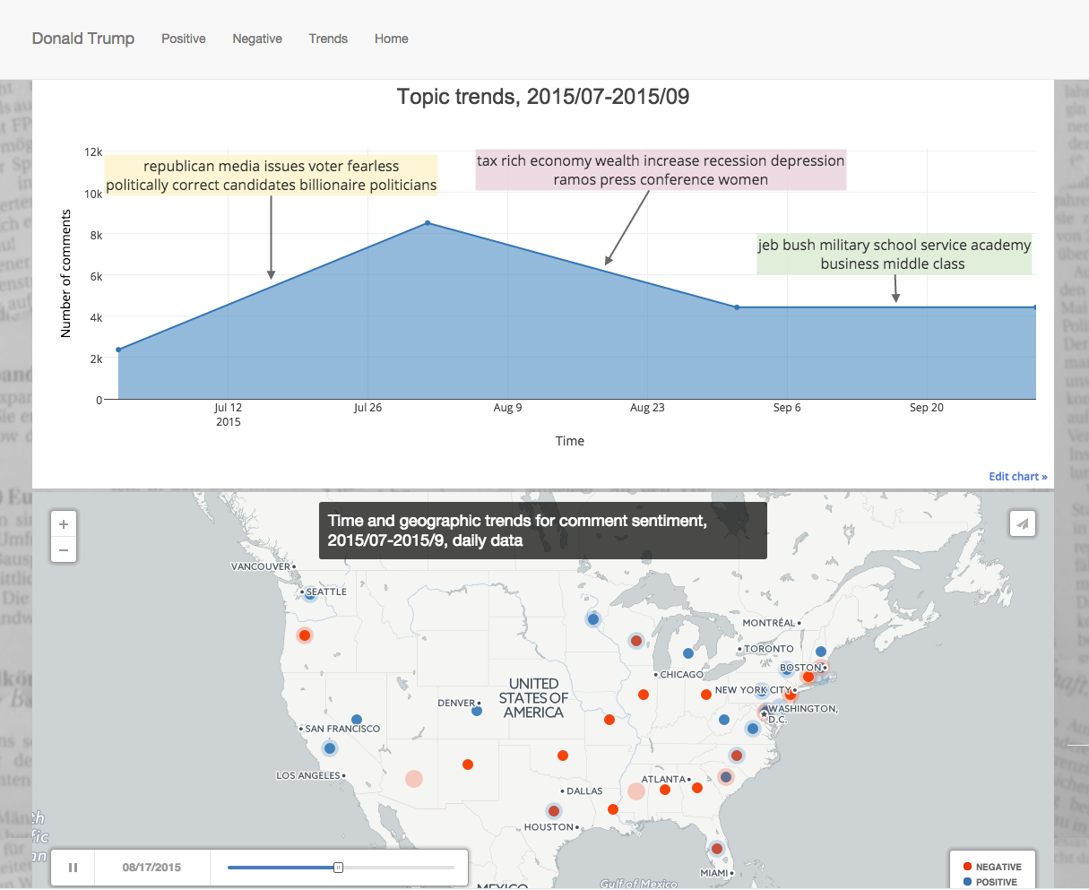
Trends

Slide 8


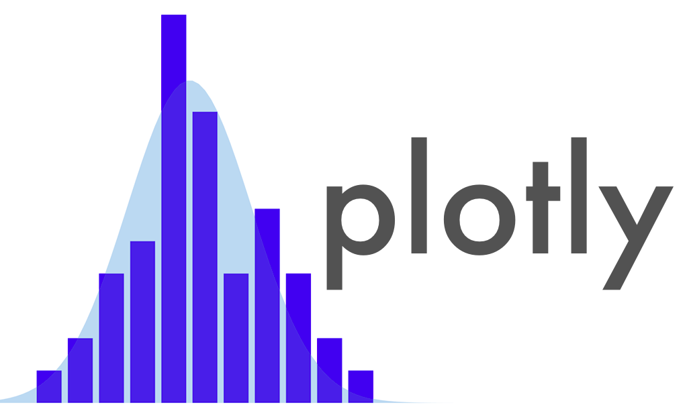

Data pipeline
New York Times Articles API
New York Times Community API
Exploratory analyses
Topic modeling
Similarity
TF-IDF
NMF
Trends
Topics

Slide 9
Insights
Topics in recent news detected. Topics also overlap.
While comments vary, typical comment capture the topic’s idea.
The comments on the New York Times are highly curated and balanced
Notes:
Not a good dataset for (comment-to-candidate) classification problem: signals (sentiment, relevancy) are muted, many comments covers multiple candidates

Slide 10
Future steps
Use distinct topics associated with each candidate or other measures (subjectivity) as feature in classification
Examine on what topics are the comments overlapping for candidates for more precise clustering
Utilize both the comments and news cycles to predict new topics
Notes:
More precise clustering that can be used for targeting. plotting the the comments on two axises representing two topics

Slide 11
Thank you!

Slide 12
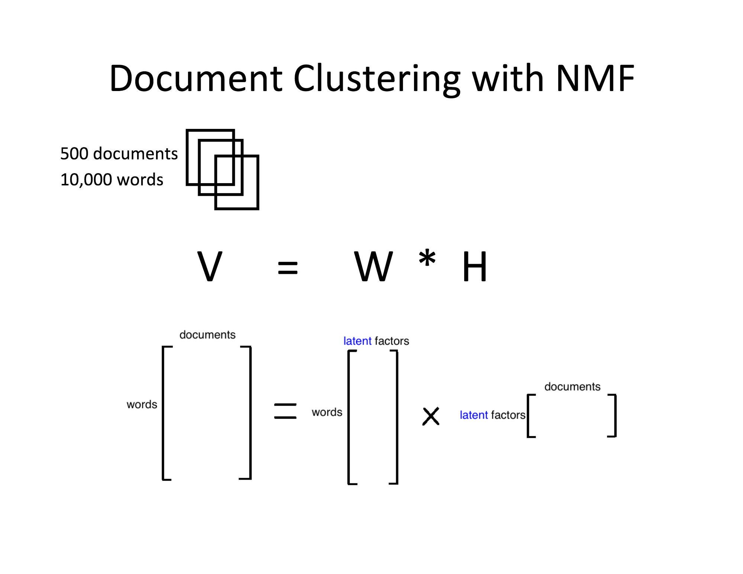
Appendices
Matrix factorization:
Dimensionality reduction
Latent properties
Linear combination of features

Slide 13
Appendices
How I picked number of topics
Using LDA:
Kullback-Leibler (KL) divergence is the difference between 2 distributions: actual distribution of P for the data and distribution Q for which compression scheme optimizes. A kind of entropy measure.
Perplexity: the log-likelihood of a held-out test set. The lower perplexity the better. Measure how well the word counts of the test documents are represented by the word distributions represented by the topics.
Using matrix factorization:
PCA - elbow at the scree plot to eyeball the optimal number of principal components

